Slide 1
Community Mental Health Transformation in City & Hackney, Newham and Tower Hamlets

Slide 2
Key features of our bid
Five key design principles have guided our model’s development:
Service users and citizens will be active, equal partners: leading the design, implementation, governance, and delivery of our new model
We will integrate mental and physical health, wellbeing and social care: our services will feel fully integrated to service users and carers
The right support in the right place and the right time: services will be delivered in the PCN footprint, and service users will not be “bounced around” services
A focus on what matters to service users: care planning will look beyond health goals to life goals and wider determinants of health; and we will work to connect people to each other and their communities
Evidence-based interventions: Service users will be confident that our services provide the latest evidence-based care, treatment and support.
Key enablers:
Our biopsychosocial assessment and care planning processes, structured around Dialog Plus, will address social care as well as health needs, ensuring residents will not require a separate assessment under the Care Act 2014
Multidisciplinary (multi-agency) MH teams organised around PCNs, including: psychiatrists, psychologists, nurses, social workers, peer support workers and community connectors working in partnership with primary care clinicians, social prescribers, clinical pharmacists and community health services
We will use our RCPsych accredited Peer Support Worker Training to increase our faculty of PSWs
A workforce strategy that utilises apprenticeships; blends clinical and non-clinical roles; and provides job opportunities for local citizens

Slide 3
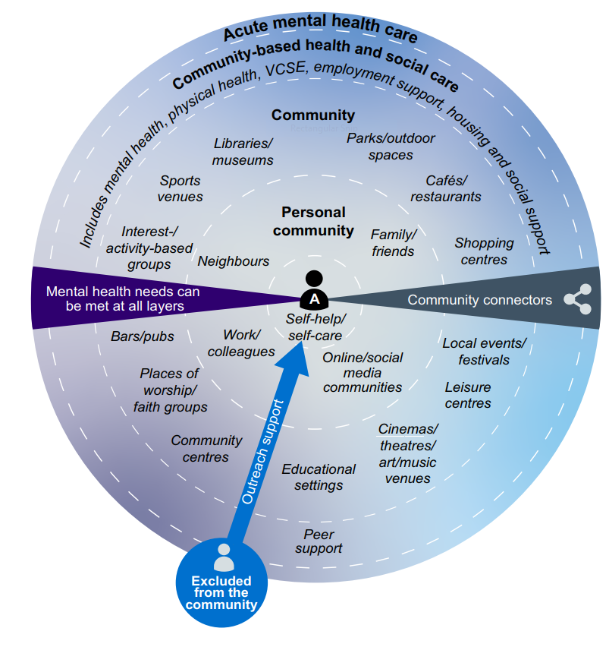
Developing neighbourhood models for mental health

Slide 4
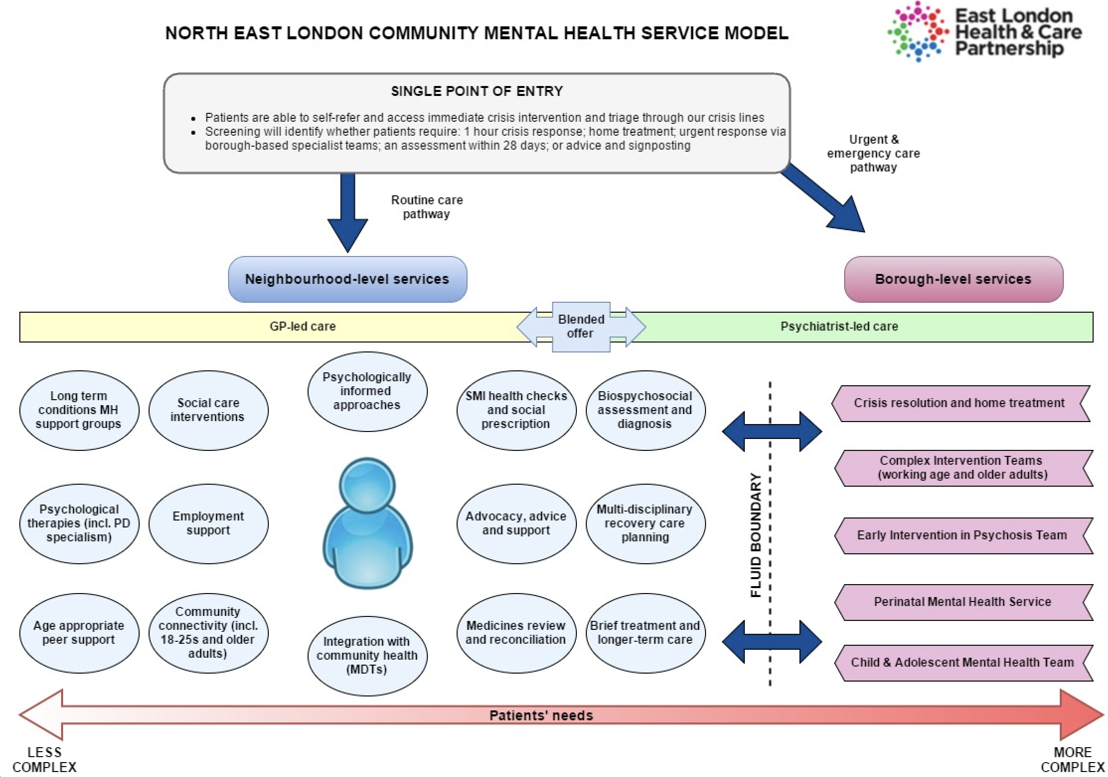
Our proposed model on a page

Slide 5
Areas of increased focus
Adults with a diagnosis of personality disorder
Adults at risk of developing an eating disorder
Older adults
Young adults (18-25)
Working age adults
Much clearer PD / complex trauma pathway, with significant additional clinical and non-clinical staff working as part of a PD specific offer to PCN populations
Our pathway will include locally delivered support networks led and delivered by people with PD – service user networks will provide peer support, increase participation, connection to community, and thereby reduce social isolation
We will develop a pre-diagnostic service (focused on pre-ICD 10 Eating Disorder diagnostic threshold patients and the mild end of the spectrum) to complement the existing services in our patch
We will build on the good practice in existing transitions planning between CAMHS and adult MH services (particularly EIP Teams) by developing young adult (YA) or transition specialists within the specialist community teams at place-level
The service will be co-developed with experts by experience, and we anticipate their input into the delivery of the service through opportunities such as being group co-facilitators
PCN teams will contain YA specialist posts to lead on assessment, support planning and peer support for 18-25s; and support will be offered at locations that are most meaningful to the service user e.g. university campuses, youth hubs
We will actively promote opportunities for YAs to pursue careers in MH; establishing a pathway for Peer Support Workers to take up paid Community Connector or other non-qualified roles within our staffing structures
Our Community Connectors, Support Workers and Peer Support Workers will flex between those whose needs are reducing; and those whose needs are increasing. This approach will particularly benefit people who struggle to navigate VCS and universal services on their own
We will co-design intuitive pathways to employment from both within the PCN teams and our place-based specialist teams. These pathways will incorporate third sector, council and DWP funded support for adult training and education
Where there is a care home within the PCN, the PCN MH Team will provide MH consultancy support to the home, as part of the more general PCN MDT offer
There will be Community Connectors with a specific brief to support older adults to connect with opportunities available in local community settings
Our PCN teams as part of the broader PCN MDT will proactively engage with paid and unpaid carers, and will be trained on how to manage expectations, and hold difficult conversations

Slide 6
Programme aims - what have we said we want to achieve?

Slide 7
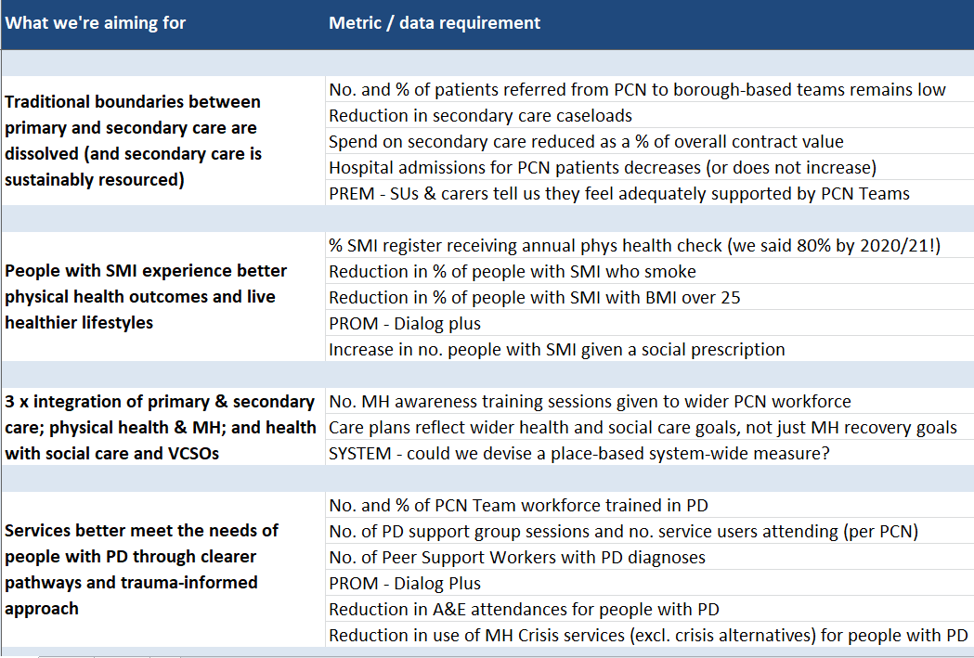
Programme aims - what have we said we want to achieve?

Slide 8
Programme methodology
AIM
MEASURES OF SUCCESS
MUST-DOs
EVIDENCE BASE (e.g. NICE)
EVALUATION CRITERIA
Centrally determined
CITY & HACKNEY
TOWER HAMLETS
NEWHAM
PCN
PCN
PCN
PCN
PCN
PCN
PCN
PCN
PCN
PCN
PCN
PCN
PCN
Locally determined
Innovation in design & delivery
Innovation in design & delivery
Innovation in design & delivery
PCN
PCN
PCN
PCN
PCN
PCN
PCN
PCN
PCN
PCN
PCN
PCN
PCN
LEARNING NETWORK & COMMUNITY OF PRACTICE

Slide 9
Programme methodology
Define the population
3 part data review:
Statement of purpose (aim)
Why are we doing this?
What are we hoping to achieve?
Measures of success
How will we know if we’ve achieved our aim?
How will we measure impact?
Programme plan / tasks
People with lived experience
People / services in touch with population
Quantitative data
Implementation plan for each place-based system
Overarching ‘must-dos’ vs. local change theory

