Slide 1
Bringing people together and books to life
Liz Ison, The Reader, London Regional Manager
Pan Provider Forum, Tower Hamlets - Wednesday 12 February 2020

Slide 2
Next Time by Mary Oliver
Next time what I'd do is look at the earth before saying anything. I'd stop just before going into a house and be an emperor for a minute and listen better to the wind or to the air being still. When anyone talked to me, whether blame or praise or just passing time, I'd watch the face, how the mouth has to work, and see any strain, any sign of what lifted the voice.
And for all, I'd know more -- the earth bracing itself and soaring, the air finding every leaf and feather over forest and water, and for every person the body glowing inside the clothes like a light.

Slide 3
Shared Reading
“The reading groups are a different kind of medicine and it’s through them that I’ve found a way back to life.”
Shared Reading group member, Birkenhead
Since 2008, over 5000 volunteers have been trained to deliver Shared Reading, running groups where and when they are needed most.
A story or poem is read aloud. Group members participate how they wish – sharing their thoughts, reading aloud or simply listening.
People are brought together, in small groups, on a weekly basis, run by a trained Reader Leader.
The Reader Leader facilitates discussion, creating a safe, creative space where members feel valued, encouraged and listen to.

Slide 4
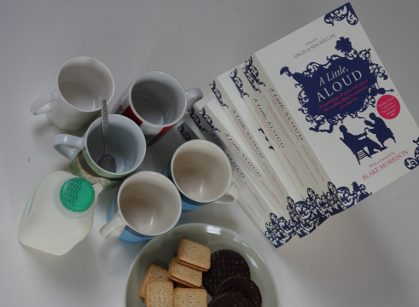

Slide 5
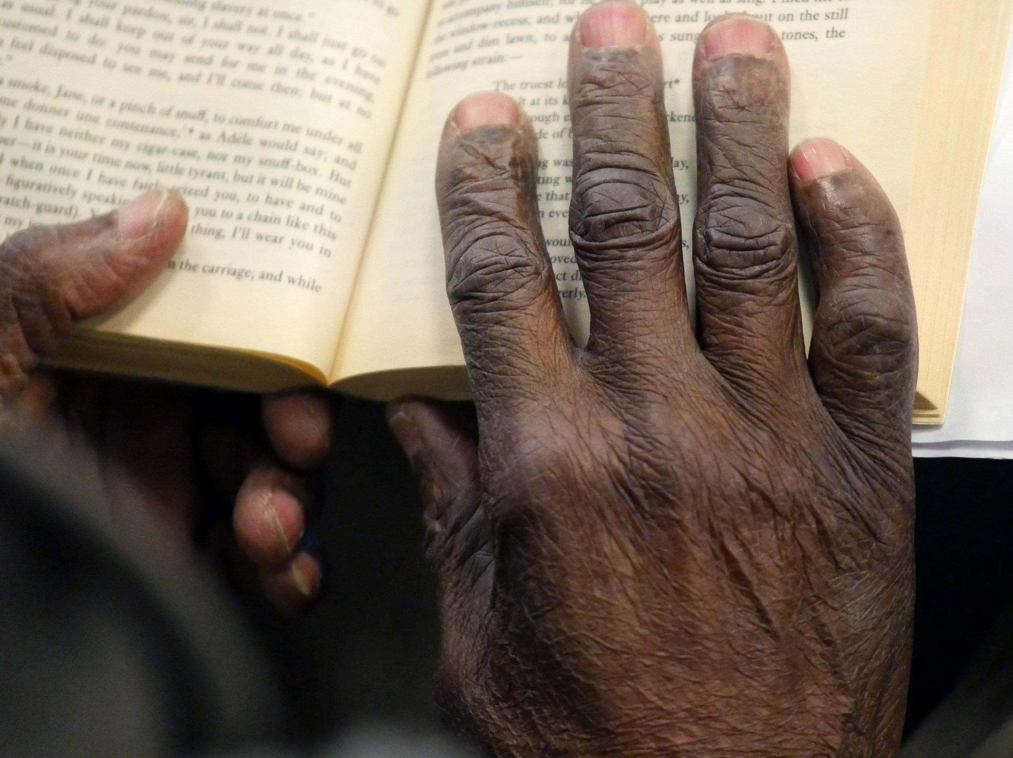
“The Reader’s approach has the power to transform the lives of the people that we see day after day at our surgery – those that are stuck, perhaps with low mood or who are socially isolated – these are the people for whom another tablet is not going to make a difference.”
GP, North Shropshire

Slide 6
amelia’s Story

Slide 7
“Shared Reading is my anchor during the week.”
“Working with the Reader has been one of the most life affirming experiences I have had.”
“I have learned how to enjoy reading without judgement and analysis and how to be more open with my own experiences.”
"When I first went to the group, I got short term enjoyment from it but the longer I have attended, I have felt it be a cumulative pleasure."
"I’ve felt really happy since the session with you – bought myself some flowers the next day, ate a falafel sandwich and went for a long walk while listening to music— all in one day
"It makes you think about things in a different way and helps you relate that to other things going on during the rest of the day, or even the rest of the week."

Slide 8
THE READER IMPACT: GROUP MEMBERS*
94%
look forward to the group as an important event in their week
91%
say Shared Reading sessions make them feel better
81%
say the group helps them to relate to others in a deeper way
83%
have made new friends within the group
*FY17/18 DATA

Slide 9
THE READER IMPACT: VOLUNTEERS*
88%
say volunteering “helps me feel more connected to other people”
84%
say volunteering has “improved my wellbeing”
94%
say Shared Reading sessions “make me feel better”
92%
say they would recommend volunteering to other people
*FY17/18 DATA

Slide 10
OUR REACH
General & Community
Wellbeing
Social Care
Older People’s Care
Dementia Care
Children in Care
Schools
Families
Workplace
Physical Medicine
Criminal Justice
Mental Health

Slide 11
The Reader in Tower Hamlets
Three year project
8 weekly shared reading groups
Focus on over 50s
Reader Leader volunteers
Group members
New local partners
Notes:
THIS SLIDE NEEDS WORK

Slide 12
Thank you
www.thereader.org.uk
@thereaderorg
#SharedReading
lizison@thereader.org.uk
The Reader is supported by

