Slide 1
Ageing Well in Tower Hamlets
Update on the Ageing Well Strategy 2017 - 2020
Ageing Well Team
Pan Provider Forum 27 November 2019

Slide 2
Aim of the strategy is:
“enhancing the health, wellbeing and quality of life of people growing older in Tower Hamlets – ensuring that Tower Hamlets is a borough where growing older is about retaining your independence and dignity with the assistance of family, friends and the community where necessary but knowing that the right care and support is there if that independence becomes significantly reduced or your changing circumstances mean increased isolation and loneliness.”

Slide 3
Key Theme 1: Ensuring that people with longer term health and social care needs experience care and support that is truly personalised to their individual circumstances, strengths and needs, and that optimises independence
Tower Hamlets Together – Promoting Independence workstream; focus on care co-ordination and personalisation
Adult Social Care Practices - The Care Act 2014 changed the approach from the concept of ‘meeting needs’ to developing resilience and promoting individual strength. Social care assessments consider an individual’s needs in the context of their skills, ambitions and priorities, taking into account their reasonable preferences. Assessments will also consider and include support networks around the adult such as family or friends. A guiding principle of the Care Act is to support people to live as independently as possible, for as long as possible. It is important to note that the authority will not only consider services as a way of meeting needs and outcomes.

Slide 4
Key Theme 2: Keeping me informed in accessible ways.
Update:
Improved access to IT and digital technology through e.g. intergenerational programmes, more bespoke training and support, exploring funding opportunities for more ipad based digital activities (Linkage Plus)
Ensuring information is available in a number of formats including leaflets that are up to date and clearly displayed, community languages,
Development of a digital portal and phone line as a single point of contact for information and advice
More WiFi and computers in public areas, e.g. Council buildings, community buildings

Slide 5
Key Theme 3: Ensuring that the right housing and accommodation options are available to people as they age
Introduced a new service model within sheltered housing provision, with a focus on intensive housing management and tenant activity’s.
Reviewed the criteria to access Extra Care Housing to ensure that a broader group of people can access the service based on care need as opposed to age.
Working with key partners exploring options to increase the availability of extra care and nursing care in borough.

Slide 6
Key Theme 4: Optimising independence and wellbeing: employment, welfare benefit take-up and reducing poverty
Update:
Linking in with the Council’s Workpath service including a programme for people aged 50+ (first cohort started in January 2018 with 18 residents aged 51 to 72, this year the Council’s Integrated Commissioning Team employed two residents over 50 on work placements)
More awareness raising among employers regarding the employment of older people and grater flexibility for particular health conditions through the Central London Forward Employment and Health contract
Workpath programme for women including older women into health and care employment
Particular support at Idea Stores for residents of BME/migrants with ESOL classes and support with volunteering/employment

Slide 7
Key Theme 5: Optimising independence and wellbeing: Supporting people, as they age, to continue making a positive contribution in our communities
Update:
Make it easier and more accessible for older people to volunteer e.g. IT support for online applications,
Linking in with TH Work Path to support volunteering and pathways into work where desired
Including volunteering as a community benefit into commissioned Adult Social Care contracts

Slide 8
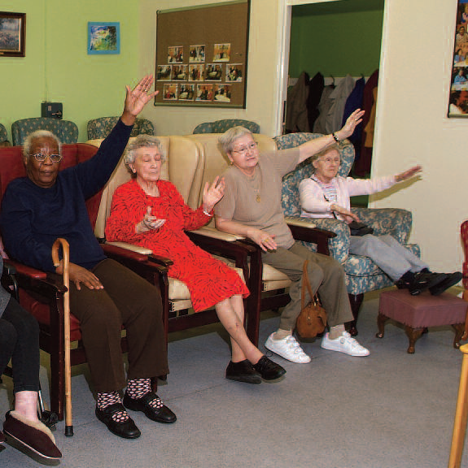
Key Theme 6: Optimising independence and wellbeing: staying healthy and active.
Update:
Ensuring that older people are aware of the range of Council strategies and can make their voices heard on e.g. Parks and Open Places strategy, Green Grid strategy, Cycling and Indoor Sports strategies, Livable Streets Programme, TfL Accessibility Strategy,
Involvement in priority areas for physical improvements in the borough
Working with leisure centers contracted by the Council to make them more attractive and accessible to older people, e.g. dementia friendly activities

Slide 9
Key theme 7: Living well with dementia
Update:
First Dementia Awareness Conference on 19 September 2018 with close to 100 people attending with the launch of a dementia friendly Tower Hamlets.
Dementia Friendly Tower Hamlets Steering Group in place to oversee and ensure the delivery of its action plan
In process are:
dementia friends training for Council staff, especially front line staff, providers and partner agencies, working with TfL on issues raised such as longer time for pedestrians crossing at traffic lights, promotion of use of ‘This is Me’ booklet with social workers, care homes etc., implementing dementia friendly designs for regeneration projects in high streets, dementia friendly design in public spaces of the new town hall etc.

Slide 10
Key Theme 8: Optimising independence and wellbeing: Reducing isolation and loneliness
Update:
This theme is being taken forward by the Council’s Loneliness Task Force (including development of an identification tool to be used by front line staff, partners and providers, currently trialled; development of a communications campaign raising awareness and signposting to what is available in the borough; understanding what works; looking at a potential funding stream to support initiatives)

Slide 11
Key Theme 9: Optimising independence and wellbeing: Getting the help and support I need as close to home as possible.
Update:
Review of day centre services for residents aged 65 plus
Vision of a service that is not solely focused on a building but offers activities from a range of community settings
A wide range of activities, less group focused and meeting the aspirations and desired outcomes of the people using it

Slide 12
Key Theme 10: Optimising independence and wellbeing: Last years of life
A new Palliative Care Pathway developed and agreed with relevant professionals in 2018.
A bereavement pack and survey has been designed and implemented.
Training offer ‘What's Best For Lily’ made available to residential and nursing care providers.
GP’s have recently started using ‘Co-ordinate My Care’ a tool for Advanced Care Planning. Work is ongoing with CCH colleagues to enable to providers to access the information going forward.

Slide 13
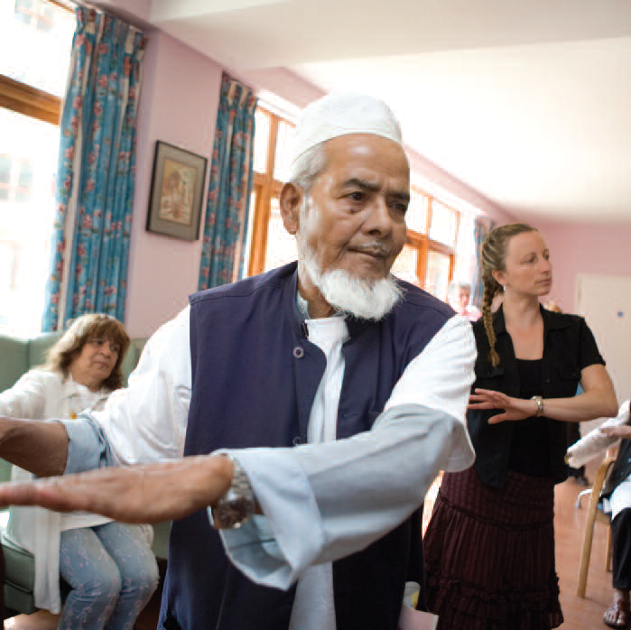
Any questions?

