Slide 1
DoLS and LPS (Case Study)
Sarah Murphy
Joint Strategic Safeguarding Lead
Central Adult Safeguarding/ DoLS Team

Slide 2
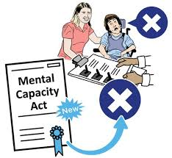
Why is DoLS changing?
It’s an amendment of the Mental Capacity Act 2005 in relation to procedures of DoLS.
Notes:
The DOLS has been criticised since they were introduced for being overly complex and excessively bureaucratic. So the House of Lords published a report concluding that DoLS were “ not fit for purpose and recommended they be replaced. March 2014
In July 2018, the Government published a Mental Capacity (Amendment) Bill, which if passed into law will reform the Deprivation of Liberty Safeguards (DoLS), and replace them with a scheme known as the Liberty Protection Safeguards (although the term is not used in the Bill itself).
The Bill draws heavily on the Law Commission’s proposals for reforming DoLS, but generally does not address some of the wider MCA reforms that the Law Commission suggested. So proposed reforms around supported decision-making and best interests are not included, although the omissions have proved controversial, and may be challenged as the Bill goes through Parliament.

Slide 3
What is changing?
DoLS
Professional Assessors (BIA &MH)
Cheshire West definition
Age 18+
Care homes & Hospital only
LPS
No Professional Assessors required
Likely to mirror Cheshire West
16 +
Anywhere
Notes:
Key features of the Liberty Protection Safeguards (LPS) include:
Like DoLS (but contrary to the Law Commission’s suggestion) they start at 18. There is no statutory definition of a deprivation of liberty beyond that in the Cheshire West and Surrey Supreme Court judgement of March 2014 – the acid test^{link 1}.
Deprivations of liberty have to be authorised in advance by the ‘responsible body’
For hospitals, be they NHS or private, the responsible body will be the ‘hospital manager’.
For arrangements under Continuing Health Care outside a hospital, the responsible body will be the local CCG (or Health Board in Wales).
In all other cases – such as in care homes, supported living schemes (including for self-funders), the responsible body will be the local authority.
Authorisers will be able to apply LPS to any setting and community cases would not need to go to Court of Protection. This will be huge numbers for authoriser.

Slide 4
What is Changing
Notes:
Everyone is responsible
For the responsible body to authorise any deprivation of liberty, it needs to be clear that:
The person lacks the capacity to consent to the care arrangements
The person is of unsound mind
The arrangements are necessary and proportionate
Urgent and standard DolS: The new Bill also broadens the scope to treat people, and deprive them of their liberty, in a medical emergency, without gaining prior authorisation.
Length of time
As under DoLS, a deprivation can be for a maximum of one year initially. Under LPS, this can be renewed initially for one year, but subsequent to that for up to three years.

Slide 5
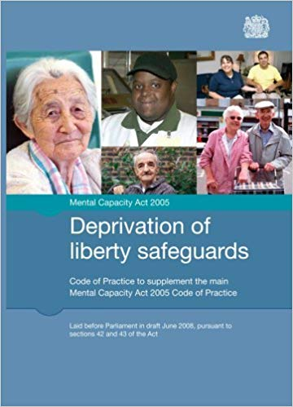
What is Changing
No explicit power to convey a person
Power to convey between places.
BIA required for all cases
BIA becomes Approved Mental capacity Professionals (AMCP)
Mental Health Assessor
Removed – it could be a GP
Code of Practice for LPS will be released.
Notes:
LPS is designed to provide a much less bureaucratic system?

Slide 6
DoLS and LPS Case Study
Mr B is a 48 year old man who moved into Orchid Rehab Centre in October 2019. Orchid Rehab Centre is a Neurological Rehabilitation Specialist Home. Prior to this Mr B had been residing in the community with his family, however his family were not able to manage some of his behaviours which they found challenging.
Mr B sustained a traumatic brain injury when he was ten years old when he ran out in front of a vehicle. Mr B underwent treatment in a specialist hospital and then went on to live in two different placements by the coast, both of which broke down.
In 1991 Mr B was placed in Sunny Vale, but staff were not able to manage his challenging behaviour. Mr B was then moved to Castle Court House (placement) and from there to Orchid Rehab Centre. Mr B behaviours include physical and verbal aggression including punching, kicking out, grabbing and displaying sexualised behaviour towards staff and other residents.
Consider the same situation and what should happen in Oct 2020

Slide 7
DoLS and LPS Case Study
Mr B has good days and bad days, and sometimes presents with capacity to make decisions on his few good days.
However, on his bad days he requires covert medication and even physical restraint.
The care team are thinking of requesting for a DOLS/ LPS assessment.

Slide 8
DoLS and LPS Case Study
CURRENT DOLS PROCCESS:
Orchid Rehab Centre to request a DoLS authorisation (Form 1/2)
Best Interests Assessor (Form 3)
Mental Health Assessor (Form 4)
Signatory Scrutiny and Agreed Authorisation (Form 5)
Authorisation sent to the Managing Authority (and/or CoP)

Slide 9
DoLS and LPS Case Study
(Provisional) LPS PROCCESS:
Care Home/ Placement to assess aspects of LPS in partnership with the social work team
Conflict and objections to proceed to Approved Mental Capacity Practitioner (AMCP)
Pre Authorisation (by Responsible Body – Social Work Team)
The Responsible Body Signatory Authorisation and/or CoP
Notes:
Responsible body takes necessary steps to secure determination of conditions, consultation, advocacy/appropriate person support and pre-authorisation review (by AMCP where relevant)
Responsible body can outsource steps, except for pre-authorisation review, to care home managers where arrangements (for 18 plus) are in care homes

Slide 10
DoLS and LPS Case Study
Adult Safeguarding, DOLS and MCA Team
John Onslow House | 2nd floor
1 Ewart Place
London
E3 5EQ
Tel: 0207 364 3346
Out of hours: 020 7464 4079
Email: dols@towerhamlets.gov.uk

