Slide 1
Borough Profile 2020
Chapter 9: Education

Slide 2
Summary
There are an estimated 78,000 children and young people aged 0-19 resident in Tower Hamlets, a quarter of all residents.
There are 45,000 pupils in primary and secondary schools in the borough.
There are 163 languages spoken by pupils in our schools. 70 per cent of pupils do not speak English as a first language. Predominantly these students are Bengali speakers, reflecting the 61per cent of all students who are of Bangladeshi ethnicity.
Across Tower Hamlets, attainment at all stages of school is relatively similar to the national average. Girls have higher attainment than boys at all stages. Non White British pupils have higher attainment than White British pupils at all stages.
Children and young people whose first language is not English have higher attainment than pupils whose first language is English at all stages. Children and young people who are entitled to and receiving Free School Meals have lower attainment at all stages than children who do not
Most pupils want to attend university/higher education.
The most common career aspiration amongst school pupils is a professional career (47per cent).
2.6 per cent of 16 and 17 year olds were not in education, employment or training in 2019 but this figure rises to 6.8per cent when taking into account those whose post school outcome is not known.

Slide 3
School and Child Population
There are 78,000 children a young people aged 0-19 resident in Tower Hamlets, a quarter of all residents.
There are 45,000 pupils in the borough's primary and secondary schools.
There are 163 languages spoken in Tower Hamlets schools with the top 3 being Bengali (52per cent ), English (30per cent ) and Somali (3 per cent ). More than 28,400 pupils (61per cent ) are Bangladeshi, with the next largest groups being White British (4000, 9per cent ) and Mixed Ethnic Background (3,000, 7per cent )

Slide 4
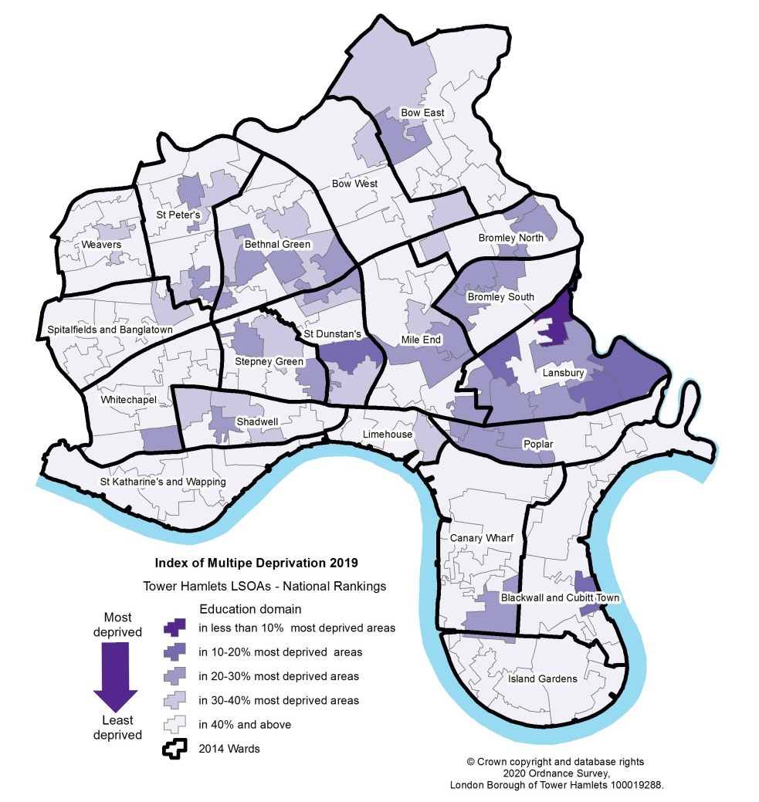
Indices of Deprivation – Education Domain
2015
2019

Slide 5
School characteristics
There are 6 nursery schools, 71 primary schools, 17 Secondary Schools, 1 all through school, 8 special schools, 1 post 16 school, 1 further education provider, and 7 higher education providers.
Ofsted rates 39 schools ‘outstanding’, 57 are ‘good’, 3 ‘requires improvement’, 1 ‘inadequate’. 99 per cent of primaries rated ‘outstanding’ or ‘good’; and 89 per cent secondaries rated ‘outstanding’ or ‘good’.
32 per cent of children in Primary Schools and 37 per cent of children in Secondary schools are eligible for and claiming Free School meals – above London and England average.

Slide 6
Pupil attainment – Early Years
The proportion of early years pupils achieving a good level of development has increased from 46 per cent in 2013 to 69 per cent in 2019, a 24 per cent increase compared with London (21 per cent ) and England (20 per cent ).
Girls were more likely than Boys to achieve a good level development (78per cent v 62 per cent ).
Non White British children were more likely than White British Children to achieve a good level of development (71 per cent vs 66 per cent).

Slide 7
Pupil Attainment – Key Stage 1
In 2019, compared with the national average, Key Stage 1 pupils’ attainment in Tower Hamlets was higher with the exception of reading, which was the same as the national average, and science, where the borough average (81 per cent) was one percentage points below the national average.
Girls and Non White British pupils more likely to achieve expected standard in reading

Slide 8
Pupil Attainment – Key Stage 2
Key Stage Attainment was higher than England across all subjects in 2019
Girls perform better than boys.
Non White British pupils perform better than White British pupils.
Children and young whose first language is NOT English perform better White British pupils.

Slide 9
Pupil Attainment – Key Stage 4
Key Stage 4 pupils in Tower Hamlets have higher attainment outcomes than their national peers with similar prior attainment. They are:
Above than the national average for strong pass (grades 9_5) in English and Maths (45 per cent in Tower Hamlets vs. 44 per cent in England);
Above the national average for standard pass (grades 9_4) in English and Maths (68 per cent in Tower Hamlets vs. 66 per cent in England), and
Above the national average for Average Attainment 8 scores (48 points in Tower Hamlets vs. 47 points in England).
There is a 5 per cent gap between girls and boys, 16 per cent gap between White British and Non White British, 13per cent gap between child who do and do not receive free school meals for pupils achieving a strong pass in English and Maths.

Slide 10
Attitudes to school

Slide 11
Ambitions to go into higher education
When asked whether they thought they would go to university or higher education, 69 per cent of primary aged pupils said yes and 60per cent of secondary aged pupils said ‘yes’.
Only 4 per cent of primary school and 5per cent of secondary school pupils said ‘no’ to the same question , with a quarter of primary school pupils and more than a third of secondary school pupils answering ‘don’t know’.

Slide 12
Reasons for wanting to go to University/Higher Education
Around a quarter of pupils said that cost was the reason for not wanting to go to university. The main reason, particularly for secondary aged pupils, was that they were ‘not interested’.

Slide 13
Career Aspirations
Just under half (47 per cent ) of pupils at both primary and secondary school age aspire to a professional career. Running their own business, working in sport, ICT and the arts/entertainment industry were other popular aspirations.

Slide 14
Absence and NEET
Primary School absence rate was 4 per cent in 2018/19, the same as the national average.
Secondary School absence rate was 4 per cent in 2018/19, below the national average.
The proportion of 16 and 17 year olds who were not in education, employment or training (NEET), or where their post school outcome was not known, was 6.8 per cent - above the London and England average.
16 and 17 year olds NEET in Tower Hamlets, 2019 (Source: Source: Department for Education, Participation in education, training and employment: 2018)
 | Tower Hamlets | London | England
per cent NEET (including not known) | 6.8per cent | 4.8per cent | 5.5per cent
per cent of which known to be NEET | 2.6per cent | 1.7per cent | 2.6per cent
per cent of which activity not known | 4.2per cent | 3.0per cent | 2.9per cent
per cent change since 2017 | -0.5 | -0.3 | 0

