Slide 1
Borough Profile 2020
Chapter 2: Employment

Slide 2
Summary
During 2016-19, around two thirds of Tower Hamlets working age population were in employment (67%).
86% of residents with a higher level qualifications are in employment compared to just one third of those with no qualifications in the borough. Those with no qualification have a lower employment rate in Tower Hamlets compared to London and Great Britain.
Residents whose main language is English are almost three times more likely to work compared with those who have a poor proficiency in spoken English.
Residents in the borough working full time earn higher than those in London. Over half of the jobs based in Tower Hamlets are in the financial, professional and technical sectors, while just one third of resident are employed in these sectors (34%).
The ethnic (White and BME) gap in employment rate in Tower Hamlets is twice as wide as the gap observed in London (ethnic gap in the borough- 27%, ethnic gap in London- 12.5%). The ethnic employment gap amongst women is twice as wide in the borough (36%) than in London (15%).
Over three quarters of adults aged 25-49 are in work. Employment is generally low for the 16-24 age group.
According to the 2011 Census, two thirds of all Bangladeshi households (68%) and just over half of all Somali households (53%) had dependent children.
Less than half (42%) of all disabled people aged 16-64 were in employment compared with nearly three quarters (72%) of the non-disabled population.
The number of Claimant count (out of work benefits) is higher in Tower Hamlets than London or Great Britain.

Slide 3
Employment
During 2016-19, around two thirds of Tower Hamlets working age population were in employment- 67% that is around 7% below the employment rate in London and 8% below the employment rate in Great Britain.
One third of the working age population were not in employment, this comprised of:
Unemployed and actively seeking work (7%)
Economically inactive (26%)
Caring for family
Too sick to work
Full time education
Would like to work (15%)

Slide 4
Overall borough population (2)
Tower Hamlets has a lower employment rate than London or Great Britain, the rate has fallen slightly since a peak in 2013-16, however London and Great Britain have shown a small but gradual rise over the same period.

Slide 5
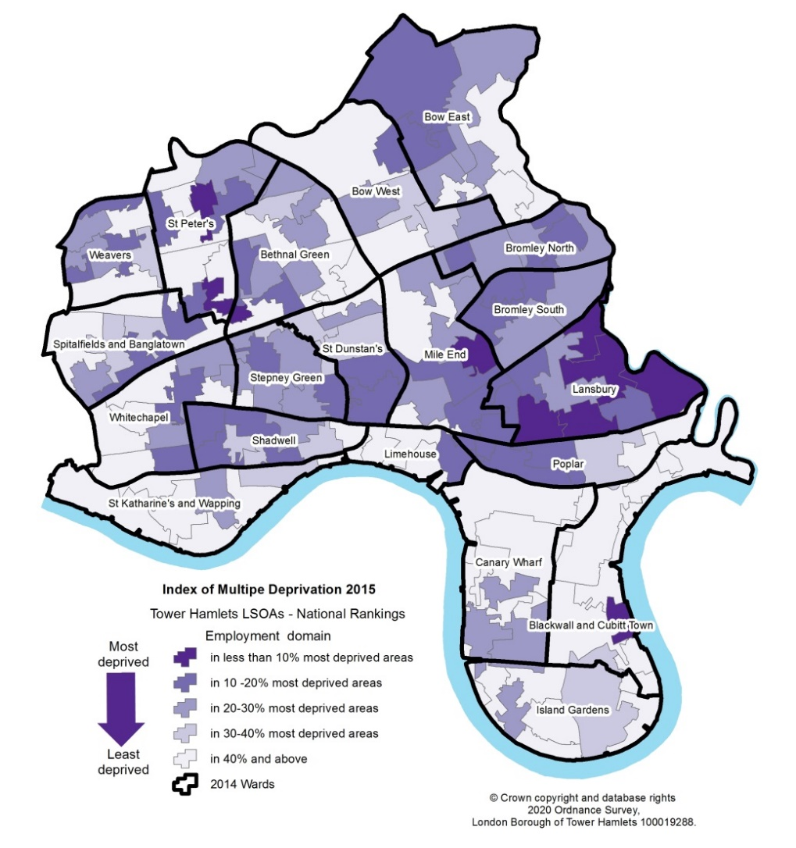
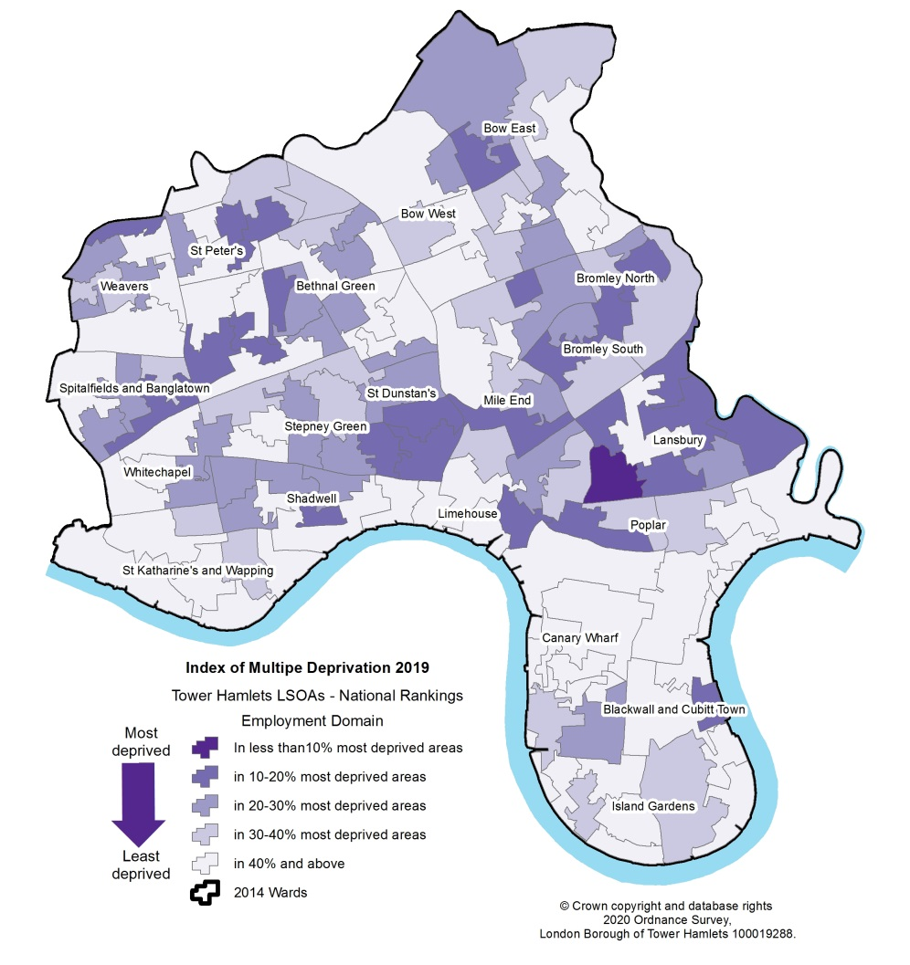
Employment Deprivation
Tower Hamlets was the 114th most deprived local authority area in England (of 317) on the Indices of Multiple Deprivation employment domain in 2019, having been 76th most deprived in 2015.
2015
2015
2019
2019

Slide 6
Employment and Qualifications
Qualification levels are strongly associated with whether people are in work or not.
86% of those who held a higher level qualification are in employment compared to just one third of those with no qualifications in the borough.
Those with no qualifications have a lower employment rate in Tower Hamlets compared with their counterparts in London or Great Britain.

Slide 7
Language Proficiency and Employment
2011 Census data highlighted the strong association between language proficiency and labour market outcomes. Our analysis shows residents whose first language was English were almost three times more likely to be in work compared with those who had poor proficiency in spoken English (71% - main language English vs 25% cannot speak English well/ at all).
Those whose first language was other than English, but were fluent in English have an employment rate of 61%, this is twice as high as the rate for those with poor proficiency in English.
Source: 2011 Census

Slide 8
Hours of Work and Earnings
Wage rates among full time working residents are 9% higher in Tower Hamlets than in London (£19.33 per hour in Tower Hamlets vs £17.58 per hour in London), while the opposite is true for part time workers, who earn 9% less in Tower Hamlets (£9.63 per hour) compared with London generally (£10.17 per hour).
Hourly paid rates for women are lower than those of men in London (£14.85 for women in London vs £16.96 for men in London).

Slide 9
Employment Patterns – Types of Jobs
Over half of the jobs based in Tower Hamlets are in the financial, professional and technical sectors but just one third of resident workers are employed in these sectors (34% of residents in Banking, Finance and Insurance).
Residents are more likely to work in the distribution, hotels and restaurants sector than workers based in the borough (19% of residents in the distribution, hotel and restaurant sector vs 11% of workers in the sector). Residents are also more likely to be employed in the public administration, education and health sectors (23% of residents compared to 19% of workers).

Slide 10
Employment Rate by Gender and Ethnicity
At 85% the employment rate for males is 24 percentage points higher than the female employment rate.
Employment rate for BME women in Tower Hamlets is much lower than the employment rate of BME women in London (38%- BME women in Tower Hamlets, while 59% BME women in London), leaving a gap of 21% points.
The gender gap amongst the White population in the borough is far narrower - 74%-White women vs 88% White men.

Slide 11
Employment by Age
In Tower Hamlets employment rates are highest for people in the 25-49 age group . Over three quarters of adults in this age group were in work (76%).
Around 54% of Tower Hamlets residents aged 50-64 were in work during 2016-19 - considerably lower than the proportion in London of 71%. Around 9% of residents aged 65 and over are still in employment compared with 14% in London.
Employment rate is generally low for 16-24 year age group. In Tower Hamlets, less than half of those aged 16-24 were in work during 2016-19 (43%). The 2011 Census found that over one third (36%) of residents aged 16-24 were not in work because they were in full-time education.

Slide 12
Unemployment by Age
According to the 2011 Census, 14% of young people (aged 16-24) said they were unemployed compared with 7% of those aged 25-64.
Recent statistics, based on ONS Claimant Count, identify 1,395 young people aged 16-24 claiming an out of work benefit. This figure excludes virtually all 16 and 17 year olds.

Slide 13
Employment Rate by Disability
Disabled people face a higher risk of worklessness compared with the non-disabled population. Less than half of all disabled people aged 16-64 were in work compared with nearly three quarters of the non-disabled population (42%- Disabled residents in Tower Hamlets vs 72%- Non-Disabled residents in Tower Hamlets). With an employment gap of 30% points.
The employment gap in London and Great Britain is slightly smaller.
National research has found that disabled people with learning difficulties and those suffering from mental health problems have the lowest employment rates across all groups in the UK*.
*Labour Force Survey, April to June 2016- DWP (Work, health and disability green paper: data pack)

Slide 14
Caring/Parenting Responsibilities
Parenthood is strongly related to ethnicity: BME households, particularly Bangladeshi and Somali households, are far more likely than other groups to have children.
2011 Census data revealed that just over two thirds of all Bangladeshi households (68%), and just over half of all Somali households (53%), had dependent children compared with just 13% of White British households. Somali and Bangladeshi households were also more likely than other groups to live in extended families.
% of households with children by ethnicity, Tower Hamlets, 2011
Source: 2011 Census

Slide 15
Worklessness
The claimant count measures the number of working age residents who are claiming an out of work benefit for being unemployed- out of work, able to work and actively seeking work. In Tower Hamlets the claimant count rate has consistently been higher than London and Great Britain. The borough has followed the national and regional trend.
Claimant numbers rose to well over 19,000 in May 2020 following a sharp rise as a result of the Covid 19 pandemic. There had, however, been a gradual rising trend in the claimant count from 2017 onwards.

