Slide 1
Borough Profile 2020
Chapter 10: Environment

Slide 2
Summary
The borough has a rich and historical environment, with more than 200 parks and open spaces
In 2019, the borough was the 36th most deprived area in England on the Living Environment Domain of the Indices of Multiple Deprivation
The borough’s high level of economic output contributes to it producing the 3rd highest level of CO2 emissions in London
CO2 emissions have fallen but not sufficiently quickly, so Tower Hamlets declared a climate emergency in March 2019
In 2010, it was estimated that there were 85 adult deaths as a result of poor air quality, which was relatively low compared to other parts of London.
The recycling rate in Tower Hamlets in 2018/19 was 23.2% which was below both the national and London average
Tower Hamlets residents have a high level of concern about environmental issues with dirt, air pollution, traffic congestion and lack of parks among those concerns

Slide 3
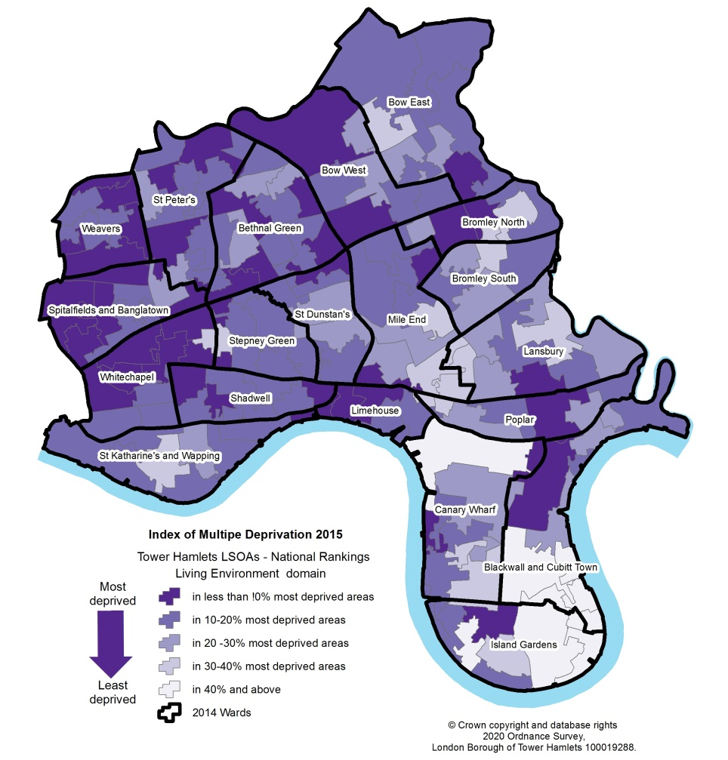
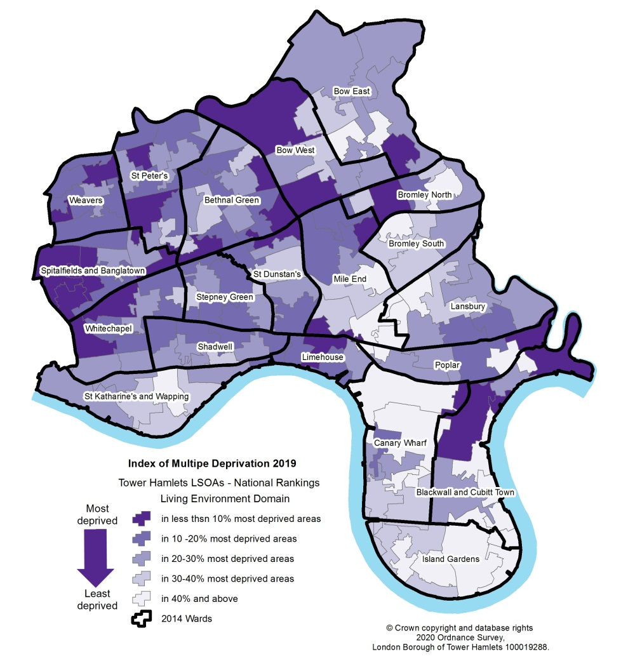
Deprivation – Living Environment
The Living Environment Domain of the Indices of Multiple Deprivation measures deprivation inside and outside and includes deprivation relating to air quality
On this measure, Tower Hamlets was the 36th most deprived local authority area in England in 2019, having been the 16th mot deprived in 2015
2015
2019

Slide 4
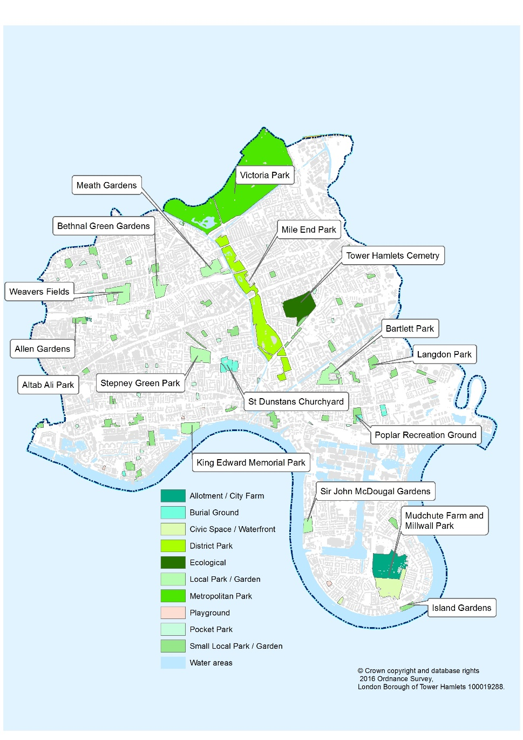
Parks and Open Spaces
Tower Hamlets has more than 200 parks and open spaces of which more than 170 are publicly accessible
Five registered historic parks
In 2019, 12 parks and open spaces had green flag awards
Victoria Park is the borough’s oldest and largest park covering over 80 hectares

Slide 5
Sustainability – CO2 Emissions
Total CO2 emissions within the scope of influence of the local authority in Tower Hamlets were 1237 (kt C02).
This was the 3rd highest amount of CO2 emissions in London after Westminster and Hillingdon.
Tower Hamlets accounted for 4.2% of all emissions in London and 0.43% of all emissions in England.
Source: Department for Business, Energy and Industrial Strategy, UK local authority and regional carbon dioxide emissions

Slide 6
Sustainability – CO2 Emissions (2)
CO2 emissions have fallen in recent years, both in absolute and per capita terms.
Tower Hamlets produced 4.0 tonnes of CO2 per capita in 2017 – more than Greater London (3.4 tonnes) but less than England (5.1 tonnes)
A large proportion of the boroughs emissions come from industry and commercial activity (717.9 kt CO2) – this is the 2nd highest amount in London after Westminster. .

Slide 7
Air Quality and the impact on health
Tower Hamlets operate 4 monitoring stations in the borough. These are located at Mile End, Blackwall Tunnel Approach, Victoria Park and Millwall Park
Public Health England estimated that there were 85 deaths in 2010 among adults aged over 25 in Tower Hamlets as a result of particulate air pollution. This was the 25th highest number among the 32 London boroughs and equated to 1121 years of life lost.
Source: Public Health England, Estimating Local Mortality Burdens associated with particulate air pollution, 2014

Slide 8
Waste Management and Recycling
In 2018/19, Tower Hamlets collected 441.2kg per household
The recycling rate was 23.2%
This compared with a recycling rate of 43.5% in England and 33.4% in London.
Across London, the recycling rate is typically lower in inner London and in the more deprived boroughs, with Newham having the lowest recycling rate at 17%
Source: Department of Environment, Food and Rural Affairs, local authority collected waste from households

Slide 9
Residents Views on the Environment
In the 2019 Tower Hamlets residents survey, residents identified a number of environmental issues among their top three personal concerns:
28% were concerned about litter/dirt in the street
16% were concerned about the level of air pollution
11% were concerned about traffic congestion
9% were concerned about lack of recreational facilities
40% of Tower Hamlets residents identified ‘going to a park’ as a hobby or interest, with the vast majority of those using Tower Hamlets parks, either exclusively or alongside parks elsewhere
6% of Tower Hamlets identified ‘seeing wildlife (zoos and farms)’ as a hobby or interest with around half of those undertaking this activity wholly or partially in Tower Hamlets.

