Slide 1
Borough Profile 2020
Chapter 7: Health

Slide 2
Summary
In 2016-18, life expectancy for men in Tower Hamlets was the same as in the UK, while for women it was slightly higher than the UK average.
However, healthy life expectancy was below the national average, with a particularly large gap for women.
Preventable mortality for under 75s was higher than in London as a whole.
Babies in Tower Hamlets were more likely to be born with a low birth weight than in England or London, but mothers were less likely to be smokers.
The infant mortality rate was higher than the national or regional average.
MMR vaccination coverage was good by London standards but below average for England.
Children in Tower Hamlets were more likely to be overweight or obese at year 6 than in London or England.
COPD mortality was higher than in London or England and was particularly high for males
Dementia prevalence among older people was higher than the national or regional average.
Prevalence of TB has reduced but remains more than twice the England average

Slide 3
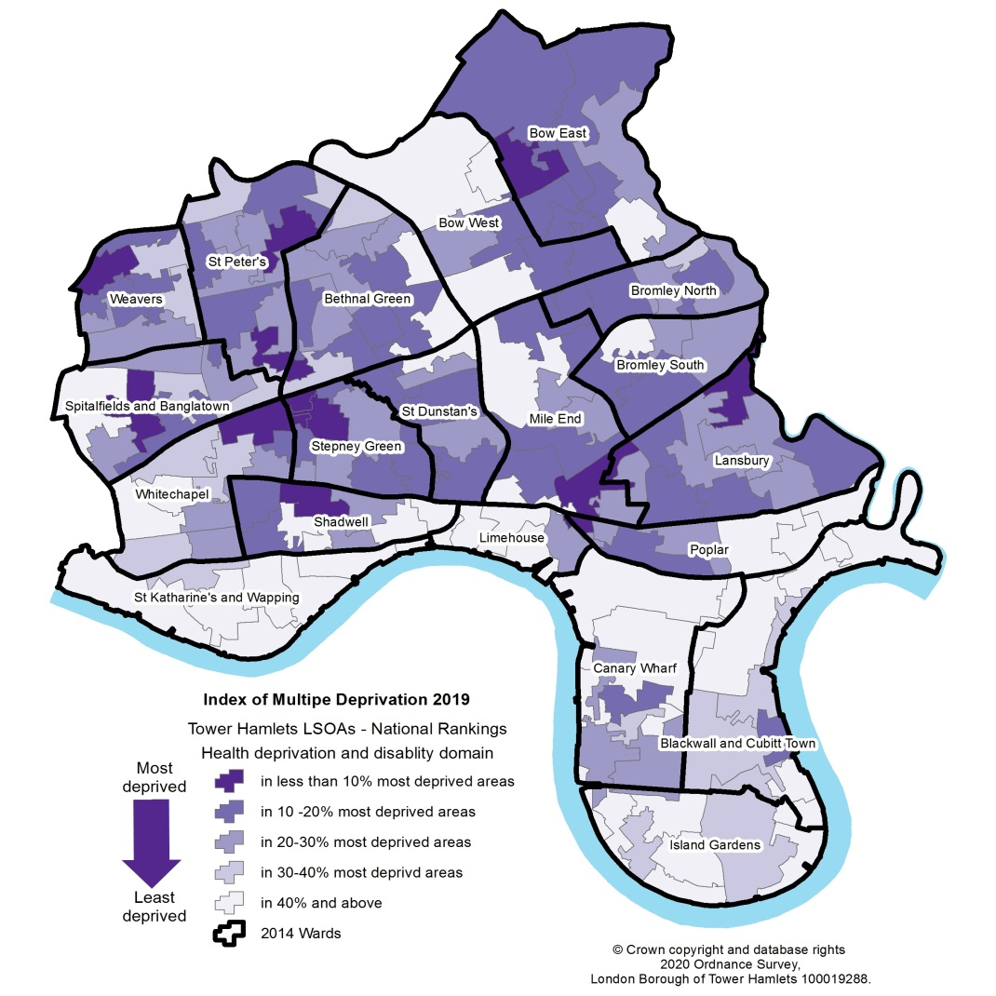
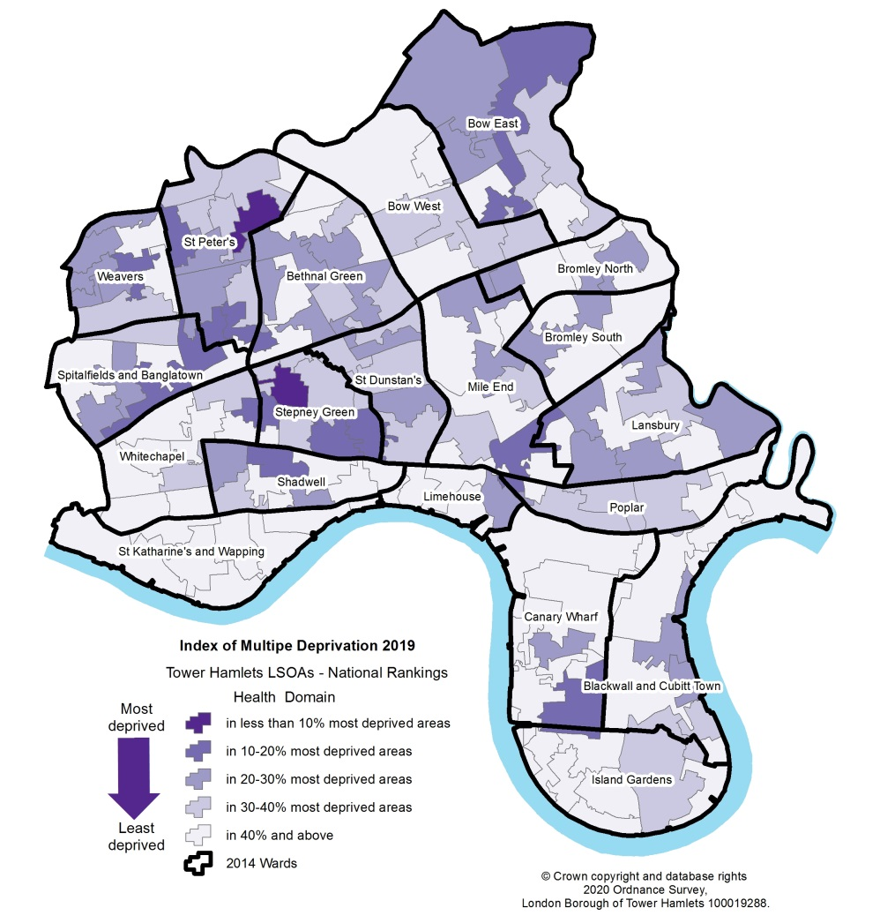
Health Deprivation
Tower Hamlets was the 98th most deprived local authority area in England (out of 317) in 2019 on the Indices of Multiple deprivation Health domain, having been the 56th most deprived in 2015.
2015
2019

Slide 4
Life expectancy at birth (males)
In 2016-18 male life expectancy in Tower Hamlets was 79.3 years.
The gap in male life expectancy between the UK and Tower Hamlets has been closing for several years and finally converged in 2016-18.
At 80.7 years, male life expectancy in London remains higher than Tower Hamlets.
Source: Life expectancy at birth and at 65 years by local areas, Office for National Statistics

Slide 5
Life expectancy at birth (females)
In 2016-18 female life expectancy at birth in Tower Hamlets was 83.2 years. Female life expectancy has been rising steadily and is now above the average for the UK.
Female life expectancy in the borough is above the average for the UK but below the average for London.

Slide 6
Life expectancy at birth – male and female
The gap between male and female life expectancy at birth in Tower Hamlets was 3.9 years in 2016-18, slightly larger than either London (3.8 years) or the UK (3.6 years).
Source: Life expectancy at birth and at 65 years by local areas, ONS

Slide 7
Life Expectancy at Birth – Male and Female (2)
Healthy life expectancy is defined as the number of remaining years that an individual can expect to live in “very good” or “good” general health. Healthy life expectancy at birth for males in Tower Hamlets is 60.5 years and for females it is 56.6 years.
Healthy life expectancies for both males and females are well below the average for the London and the UK.
Female healthy life expectancy is particularly low and is by far the lowest of any London borough and the 8th lowest of any area in the UK. Male life expectancy is the 4th lowest among 32 London Boroughs.
Source: Health state life expectancy at birth and at age 65 years by local areas, Office for National Statistics

Slide 8
Disability Free Life Expectancy
Disability-free life expectancy is defined as the number of remaining years that an individual can expect to live without an activity restriction in carrying out normal day-to-day activities associated with a long-standing physical or mental health condition or illness.
Disability free life expectancy for males in Tower Hamlets in 2016-2018 was 63.0 years and for females it was 60.0 years.
Female disability free life expectancy was below both the London and UK average and was the 3rd lowest among 32 London Boroughs
Male disability free life expectancy was below the London average but slightly above the national average.
Source: Health state life expectancy at birth and at age 65 years by local areas, ONS

Slide 9
Mortality – Deaths per 100,000
In 2018, males had a higher mortality rate per 100,000 than both London and the UK. Females had a higher mortality rate than London but a lower mortality rate than the UK
Source: Deaths registered by usual area of residence, 2018, Office for National Statistics

Slide 10
Low Birth Weight
Tower Hamlets has consistently had a higher proportion of babies born with low birth weight than London or England. In 2017 4.3 per cent of babies born Tower Hamlets were born with low birth weigh. However, the proportion of babies born with low birth weight reduced between 2007 and 2017, bringing it closer to the London and England averages.

Slide 11
Smoking during pregnancy
In 2018-19 3.6 per cent of mothers smoked at the time of delivery in 2018-19, considerably lower than the rate in England or London. This equated to 150 mothers who smoked at the time of delivery. This has declined since 2010 when the proportion of mothers who smoked at the time of delivery was 4.3 per cent. It has also declined in London and England.

Slide 12
Infant Mortality
In 2016-18 the infant mortality rate in Tower Hamlets was 4.3 per 1,000 births. This was higher than the rate in London or England. This was somewhat lower than it had been in the previous two years but higher than it had been in 2013-15.
Source: Public Health England, Public Health Profile, Infant Mortality rate per 1000 births 2016-2018 (data from Office from National Statistics)

Slide 13
A&E Attendance for Young Children
In 2017/18, there were 684.8 A&E attendances by children under 5 years of age per 1,000 children aged 0-4 and a total of 15,181 visits. This was above the average for England but some way below the average for London. A&E visits by children in this age group increased year on year between 2014/15 and 2017/18.

Slide 14
Children’s health – Overweight and Obese
In 2018-19, 21.8per cent of reception year children were overweight or obese . This was the same as the average across London and slightly below the average across England.
However, 41.4 per cent of year 6 children were overweight or obese – well above the rates in London (37.9 per cent) or England (34.3per cent). Of these, 25.3per cent of year 6 children were obese, including 4.9per cent who were severely obese.

Slide 15
Diabetes Prevalence
In 2018-19 6.7 per cent of Tower Hamlets residents aged 17+ recorded having diabetes.
This was slightly higher than the proportion in London (6.6 per cent) and slightly lower than the proportion of 6.9 per cent for England.
There was little variance in the rate between 2014/15 and 2018/19 with a negligible fall of 0.1per cent. This compares with a 0.5 per cent increase in the rate of diabetes in both London and England in the same period.
Within the Tower Hamlets Clinical Commissioning Group area, 78.4 per cent of people with type 2 diabetes were of minority ethnic origin while 21.4 per cent were white. The ethnic profile of type 1 diabetes was very different – 59.0 per cent of people with type 1 diabetes were white and 37.8 per cent were of minority ethnic origin. 96 per cent of people with type 2 diabetes were aged over 40.
Males were more likely than women to have type 2 diabetes (making up 52 per cent of all cases compared with 48 per cent for females ) but the proportion of type 2 diabetes cases that were female was above the England average of 44.1 per cent .

Slide 16
Coronary Heart Disease (CHD)
In 2018-19, 1.5 per cent of Tower Hamlets residents had CHD. This was below the proportion in London and well below proportion in England. The age profile in Tower Hamlets almost certainly contributes to this low rate.

Slide 17
Cancer Mortality
In 2018-19, the under 75 mortality rate for cancer was 123.7 per 100,000 persons. This was some way below the rate in England (132.3) but above the rate in London (120.1). Males aged under 75 had a mortality rate of 135.0 whereas females had a mortality rate of 113.0.
There was also a gap between males and females aged under 75 in the rate of mortality from cancer considered preventable, which was 82.5 for males and 69.4 for females

Slide 18
COPD (Chronic Obstructive Pulmonary Disease)
In 2016-18 the mortality rate for COPD in Tower Hamlets was 80.7 per 100,000, well above the England and London average. Mortality rates from COPD in Tower Hamlets were significantly higher for males than for females, as they were in London and England.
Mortality rates had declined year on year between 2008-10 and 2015-17, but then rose from 72.8 in 2015-17 to 80.7 in 2016-18
Source: Public Health England, Public Health Profiles, Mortality rate from COPD

Slide 19
Mental Health
In 2018-19, 22.8 per cent of 16+ year olds were estimated to have a common mental health disorder, well above the England average of 16.9 per cent.
7.7per cent of adults aged 18+ were recorded as having depression in 2018/19, similar to the average for London (7.6per cent) and below the average for England (10.7 per cent).
The prevalence of depression rose year on year 2012/13 and 2018/19, as it did across England as a whole.
In December 2018, dementia prevalence among over 65s was 4.93 per cent , above average for England (4.33 per cent) and London (4.5 per cent).
Amongst under 65 year olds, the dementia rate was 1.46 per 10,000 persons in 2018, which was well below the rate for England (3.41) and also below the rate for London (2.28)

Slide 20
Infectious Diseases – Tuberculosis
The incidence of tuberculosis (TB) was 23.4 per 100,000 persons in 2016-18. This was more than double the average for England of 9.2 per 100,000 and was slightly above the average across London of 21.9 per 100,000.
However, the incidence had reduced markedly since its 21st century peak of 62.9 per 100,000 in 2005-07, at which time is was more than four times the England average
It was also less than half the rate in neighbouring Newham (49.3 per 100,000 in 2016-18)

Slide 21
New HIV Diagnoses
There were 28.9 new diagnoses of HIV per 100,000 people aged 15+ in 2018. This compared with a rate of 8.7 in England and 20.9 in London. The rate has reduced significantly (by more than halved) since 2015.

