Slide 1
Borough Profile 2020
Chapter 4: Poverty

Slide 2
Summary
Tower Hamlets became significantly less deprived between the 2015 and the 2019 Indices of Multiple Deprivation, moving from 10th to 50th on the rank nationally but 60% of the borough still within the 30% most deprived parts of England.
Deprivation among children and older people is much higher than deprivation as a whole.
Other data, such as children in low income families continues to show a very high extent of poverty in the local population.
As with other parts of the country, in-work poverty appears to be an increasing issue with a high proportion of means tested financial support now going to people in work
29,000 employees earn less than the London Living Wage.
Although it is difficult to assess the impact of welfare reform overall, it is clear that some reforms such as the benefit cap and the freeze in the local housing allowance has impacted on thousands of residents. Larger families who received more means tested support and who require larger properties are the most affected.
The Covid 19 pandemic has had a significant impact on worklessness which may have long term impacts on the extent and nature of poverty and deprivation within the borough.

Slide 3
Indices of Multiple Deprivation
Tower Hamlets IMD Rankings, local authority summary measures
1= most deprived, 317 = least deprived | 2015 Ranking | 2019 Ranking | Change
Rank of Average Score | 10 | 50 | +40
Rank of Average Rank | 6 | 27 | +21
Extent | 3 | 57 | +54
Local Concentration | 80 | 134 | +54
Proportion in most deprived 10% | 24 | 175 | +151
Source: MHCLG, English Indices of Deprivation 2019
Lessening Deprivation on almost all measures relative to other parts of England
Virtually all of the borough has become relatively less deprived (142 of 144 areas).
Only 1.4% of the borough is now in 10% most deprived areas in England (Had been 40% in 2010).

Slide 4
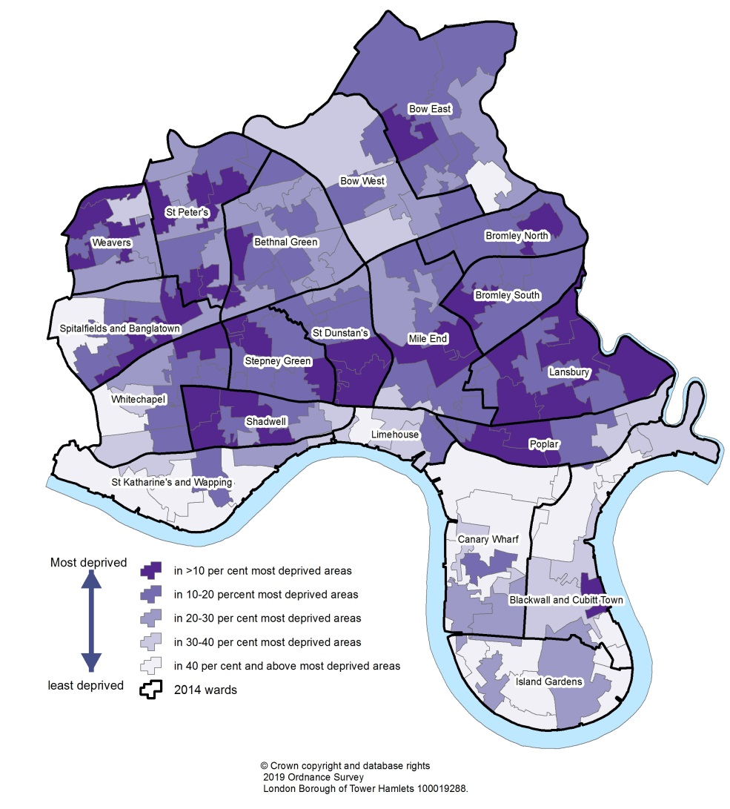
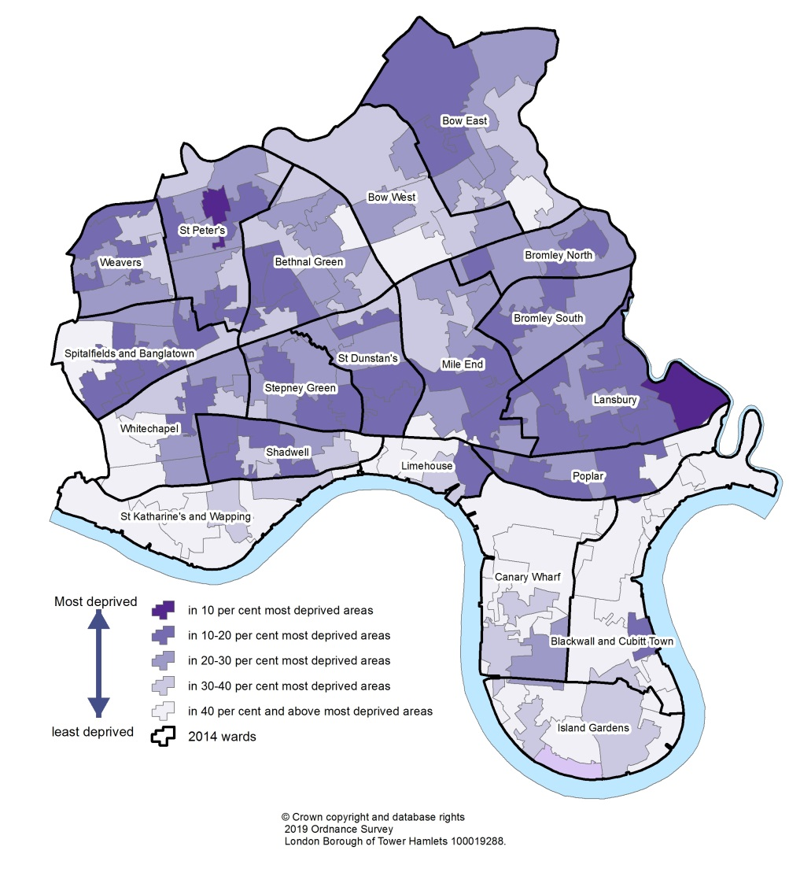
Indices of Multiple Deprivation Map
Tower Hamlets was the 50th most deprived local authority area in England (of 317) on the Indices of Multiple Deprivation employment domain in 2019, having been 10th most deprived in 2015.
2015
2019

Slide 5
Child Poverty
27.3% of children in Tower Hamlets were in relative low income families in 2018/19 which was the highest rate in London and well above the average for Great Britain. 21.4% of children were in absolute low income families – also the highest rate in London.
IDACI (Income Deprivation Affecting Children) Rank fell from 1st to 14th on Rank of Score, but remained 1st on Rank of Rank – meaning less areas with the very highest deprivation but consistently high deprivation across the borough.
72% of all children are in a family that receives either child tax credit or working tax credit.

Slide 6
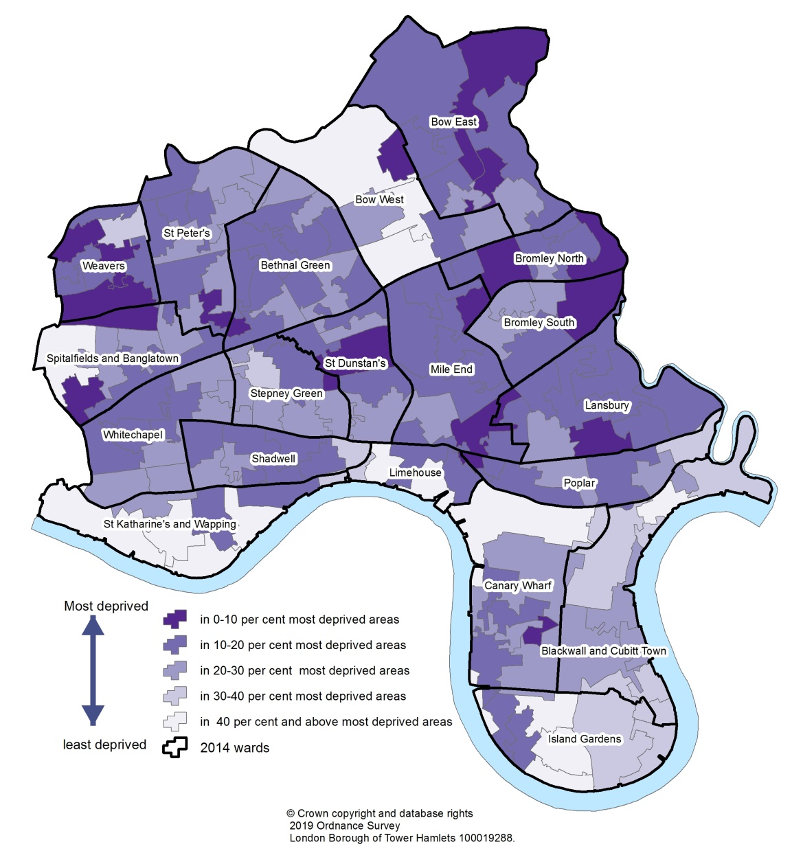
Child Poverty – Income Deprivation Affecting Children

Slide 7
Older People Poverty
44% of older people live in income deprived households, the highest proportion in England and more than double the average.
This is the only area of the IMD with no change in relative level of deprivation.
Older people are particularly sensitive to fuel poverty – overall 11.2% of Tower Hamlets households are in fuel Poverty but for households of older people this is almost certainly higher.
Source: MHCLG, Indices of Multiple Deprivation, Income Deprivation Affecting Older People Measure (Average Score)

Slide 8
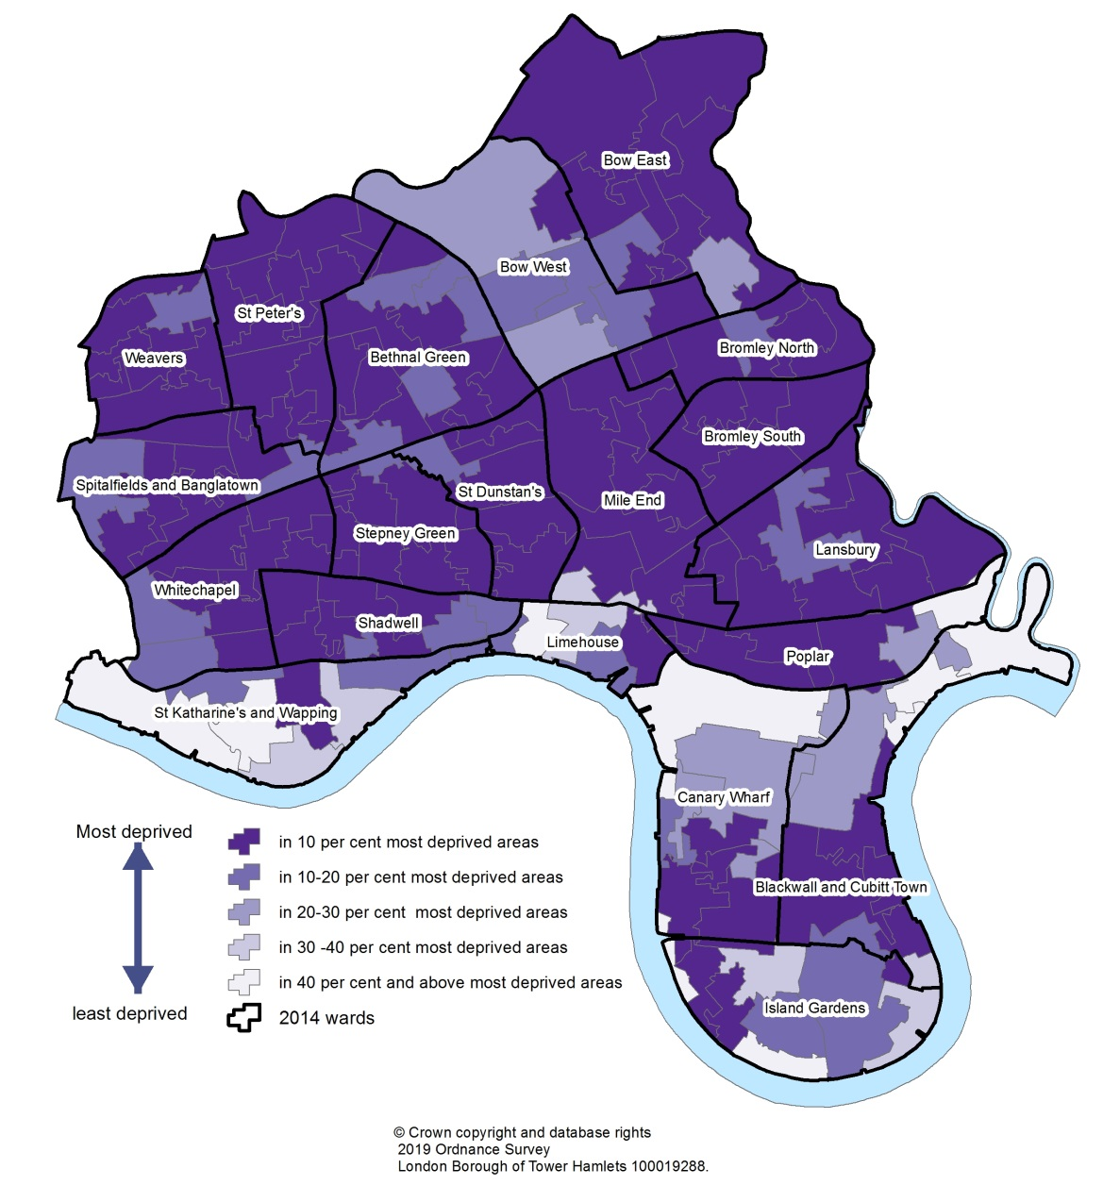
Older People Poverty – Income Deprivation Affecting Older People

Slide 9
In Work Poverty
63% of families receiving tax credits are in work.
29,000 (11.8%) of employee jobs in Tower Hamlets were below the London Living Wage of £10.20 in 2018.
Almost half (47%) of housing benefit claimants were in work
Source: HMRC Child Benefit Statistics August 2018 and Child and Working Tax Credit Statistics 2017-18
HOUSING BENEFIT CLAIMANTS
£ London Living Wage
29,000 jobs
47%
In Work
53%
Not In work

