Slide 1
Protect your business
Business Continuity Awareness Presentation
London Borough of Tower Hamlets – Civil Protection Unit
Emergency.planning@towerhamlets.gov.uk

Slide 2
Why should I protect my business?
What would you do if your shop was on fire or flooded?
How long could you survive for?
What about your staff?

Slide 3
Aim and Objectives
Aim:
Highlight to Small to Medium Enterprises some key actions that can be taken to better protect and prepare their business.
Objectives:
Identify Risks
Plan and Prepare
Document key contacts
Insurance Cover
Further Information

Slide 4
1. Identify Potential Risks
Think about the potential risks to your business that may stop you operating (e.g. the loss of premises, staff or equipment).
Why?
To protect your business.
How?
Speak to businesses around you.
Think about what has happened previously in your area (e.g. flooding, power cuts, protests).
You can use online guides and questionnaires to help you.

Slide 5
2. Plan and Prepare
Plan and prepare for the risks that are most likely to impact you.
Why?
Planning and preparation is an important factor in ensuring your business either remains unaffected, or is able to get back to operating as quickly as possible after a disruption.
It makes sure that people (yourself, staff or others) know what to do, and can do so quickly, even if you’re not available.
How?
Through a simple list with key actions per risk (e.g. if we are at risk of flooding then follow steps A, B and C…)
Then make sure these are explained to staff.

Slide 6
3. Document Key Contacts
Keep all important contacts written down in a safe location.
Why?
Making sure you can notify and get assistance as quickly as possible can make the difference between avoiding an issue and it stopping you operating.
If you’re not around, do staff know who to call and the best number? Do they know important information like account or policy numbers?
How?
Simple list kept somewhere accessible by all staff.

Slide 7
4. Insurance Cover
Insurance is essential for all businesses.
Why?
Insurance allows a business to ensure it’s not impacted by unmanageable financial costs when issues occur.
How?
Check that you’re fully insured and that all documentation is stored safely.
Make sure that your insurance is renewed and covers all the risks you may face. Are there limits to your cover/do you need further cover for specific risks? The Association of British Insurers offers downloadable guidance for smaller businesses.

Slide 8
5. Further Information
Your business networks can provide information and guidance on how to better prepare and protect your businesses.
Your Local Authority has a team dedicated to emergency planning for your borough. This team can help provide guidance on where additional information can be sought.
Being connected to your Local Authority and business networks in your area is an important part of protecting your business.
Local Authorities may be able to assist by:
Providing information and suggesting appropriate networks or Business Continuity groups; Offering presentations to staff and management on how to protect your business; and Supporting with the development of plans and exercises where appropriate.

Slide 9
5. Further Information Continued
Cross-sector Safety & Security Communications (CSSC)
Send notifications and updates pertaining to regional incidents
Sign up at: http://www.vocal.co.uk/cssc/
NACTSO – National Counter Terrorism Security Office
www.NACTSO.gov.uk
London Prepared
Visit www.london.gov.uk or Google ‘London Prepared’
Downloadable guides available, specific for SME’s
Business Resilience Planning Considerations
Insert Local Authority Website/Contact Details

Slide 10
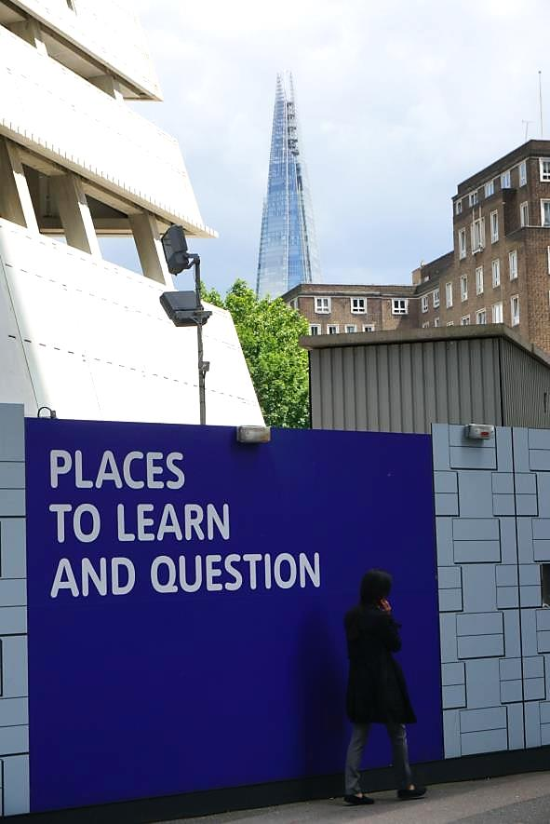
Any Questions?
LOCAL AUTHORITY CONTACTS:
Jason.Thomas@towerhamlets.gov.uk
Andrea.Stone@towerhamlets.gov.uk
Alex.Hurrell@towerhamlets.gov.uk

