Slide 1
Tower Hamlets Housing Forum Annual Overview
14th October 2015

Slide 2
THHF Executive
THHF Executive received presentations on:
Community Plan (consultation at draft stage)
The Care Act and the implications for Housing Associations
LBTH Digital Inclusion Strategy and new initiatives
Charity Works (providing graduates who specifically want to work for the not for profit sector)
The Whitechapel Vision
Results of the Strategic Housing Market Assessment
Gateway’s Winter Warmers Project
An overview of PREVENT
Allpay products and services
Community Plan
Voluntary and Community Sector Strategy Refresh
The Fairness Commission

Slide 3
Children and Families Partnership Board Represented by Fiona Humphries – Providence Row HA
REDUCING CHILD POVERTY IN THE BOROUGH - Strategy developed and championed by the CFP. Reduction from 60.3 % (2006) to 35.5% (2014).
PROMOTING AND STRENGTHENING SAFEGUARDING - Implementation of the Multi Agency Safeguarding Hub and the promotion of Safeguarding month (November 2014) which launched over 30 events across the borough. The Local Safeguarding Children’s Board reports into the CFP. The Family Wellbeing model was reviewed.
DEVELOPING THE TACKLING GROUPS, GANGS AND SERIOUS YOUTH VIOLENCE (GGSYV) STRATEGY - Developed to reduce the harm caused by groups, gangs and serious youth violence and its associated forms of abuse.

Slide 4
Community Plan Delivery Groups and Sub-Groups

Slide 5
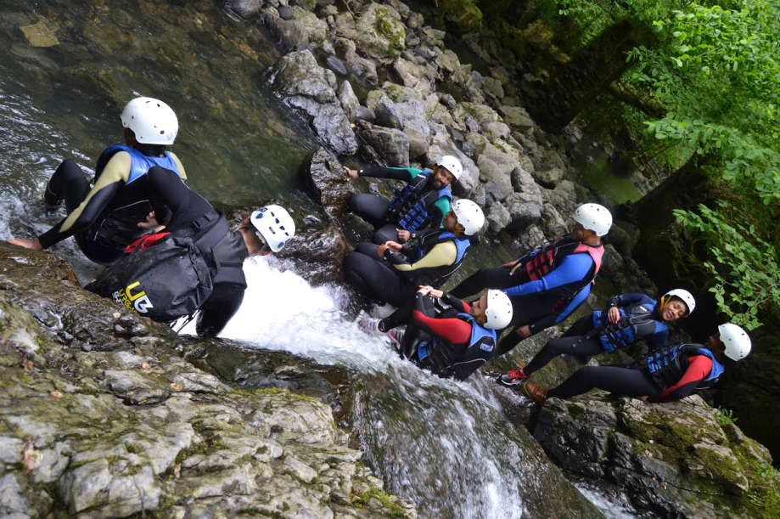
Children and Families Partnership Board Represented by Fiona Humphries – Providence Row HA
EMBEDDING THE CHILDS RIGHTS BASED APPROACH (CRBA) - The CRBA is embedded within the commissioning process and the profile of the whole Child Rights Agenda has increased. A group of young commissioners were trained by UNICEF to take part in the commissioning of substance misuse services. The Council adopted the charter of child rights developed by local young people.
STARTED TO DEVELOP THE NEW CHILDREN AND FAMILIES PLAN 2016-19 - The Children and Families Plan is a partnership wide framework for how we work together to add value to the work we do to improve outcomes for children and families in Tower Hamlets.

Slide 6
Health and Wellbeing Board Represented by Steve Stride – Poplar HARCA
The Local Authority developed a joint Health and Housing action plan
A borough wide compact for dealing with tenants with mental health problems Good Practice Guidance for Resident Referrals launched during the year
Training to increase professionals’ awareness of a safe home
Mapped what Tower Hamlets providers are already doing to promote healthy lifestyles
Pilot project to identify vulnerable tenants
Partnership approach to making older people aware of assisted technology
Tackling isolation with a borough wide needs assessment
New THHF sub group starting November 2015.

Slide 7
Safeguarding Adults Board Represented by Mike Tyrrell – Tower Hamlets Community Housing
Provision of awareness training for front line housing staff by LBTH Social Services
Contribution to the Annual Report of the Safeguarding Adults Board
Clarifying the housing aspects of the Safeguarding Adults Board Business Plan for 2015/16

Slide 8
Safeguarding Adults Board Represented by Mike Tyrrell – Tower Hamlets Community Housing
Improving definitions:
when someone is vulnerable and needs an assessment in relation to their health, social care or support services in the community to assist them to live as independently as possible and to feel as well as they are able, both physically and emotionally. This is not safeguarding.
when someone is especially vulnerable and for whatever reason needs a more urgent and careful assessment because there is a risk that they are (or may be) being abused or taken advantage of in some way. They may be living in their own home, someone else’s home, a residential or nursing care home, hospital, hostel or be homeless. This is safeguarding.

Slide 9
Welfare Reform Task Group Represented by Andrea Baker – Poplar HARCA
Partnership: LBTH teams & support agencies
Strategic response across the Borough
This year:
Consistent information for residents
Funding for employment & benefits solicitors
Implementation of crisis & support grant processes
Research briefings on key changes
Responding to early implications of UC
Statistical analysis & intelligence
Training for staff
Trialling Integrated Employment Service

Slide 10
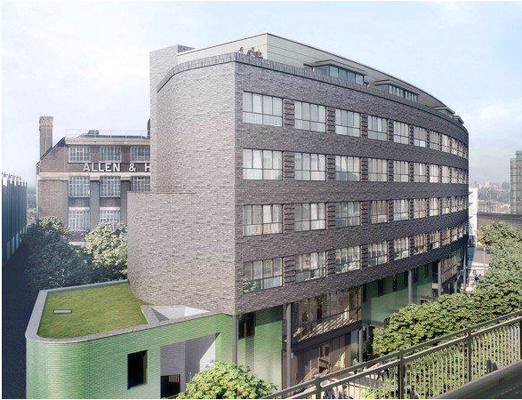
Development Sub-Group Led by Neal Hunt – Poplar HARCA
New Homes Delivered: 610 affordable ; 463 for rent 147 Intermediate; 107 wheelchair.
Project 120 : Project Team developed ; 105 cases on the list; almost 50% have properties identified.
Green Grid Projects: 15 identified and developed on vacant land for resident led food growing projects.
Successful Housing Zone Bid : £52m secured in phase 1; £26 m in phase 2; 6,000 new homes.

Slide 11
ASB Sub-Group Led by Jamie Carswell - THH
ASBPAG - set up of the group. Key support from mental health and support now being provided to vulnerable members of the community.
RPs & Police working together - improvements in partnership working reaping rewards from reduced ASB.
Summer Night Lights - 18 events, significant attendance and community satisfaction
Joint working with Council over noise service: low hanging fruit, more to come!
ASB sub-group: regular attendance and action planning now more relevant to overarching issues

Slide 12
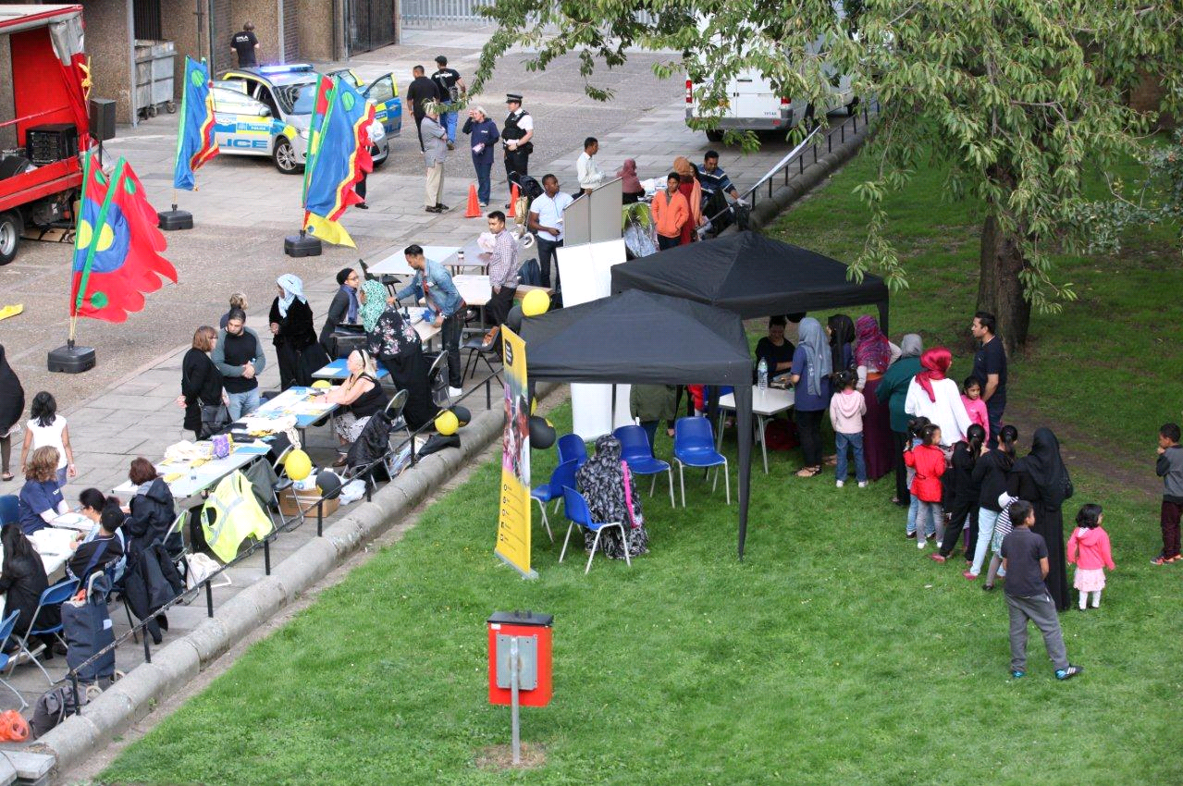
ASB Sub-Group Led by Jamie Carswell - THH

Slide 13
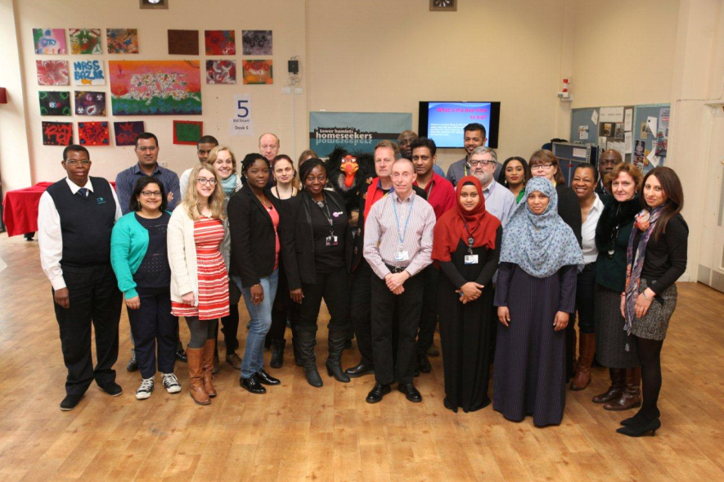
Common Housing Register Forum Led by Sandra Fawcett – Swan HA
Strong Partnership with good attendance
Lettings Open Day - 21 March 2015
Refreshed Common Housing Register Agreement
Overcrowding Strategy implemented
Under occupation targets achieved
Successful decant process for regeneration projects
Project 120 - successful joint working delivers results
New Mutual Exchange Charter for all RPs
Focus on Value for Money in advertising

Slide 14
Common Housing Register Forum Led by Sandra Fawcett – Swan HA
The numbers for 2014/15
Demand - 19,783
Total Lets - 1,872
By size
1 bed/ bedsits | 800
2 beds | 662
3 beds | 313
4 beds | 97
By banding
Community Group 1 | 744
Community Group 2 | 965
Community Group 3 | 163
Community Group 4 | 0

Slide 15
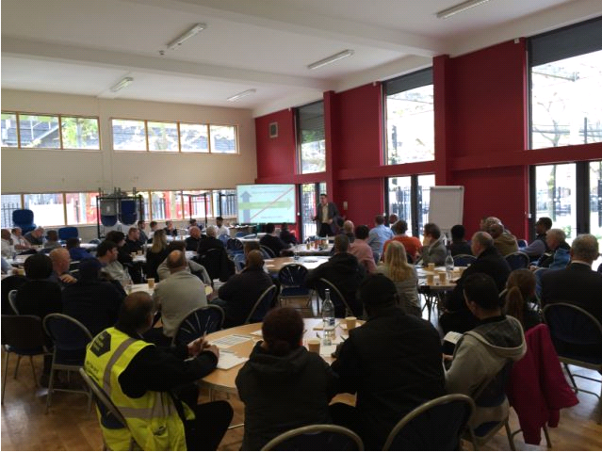
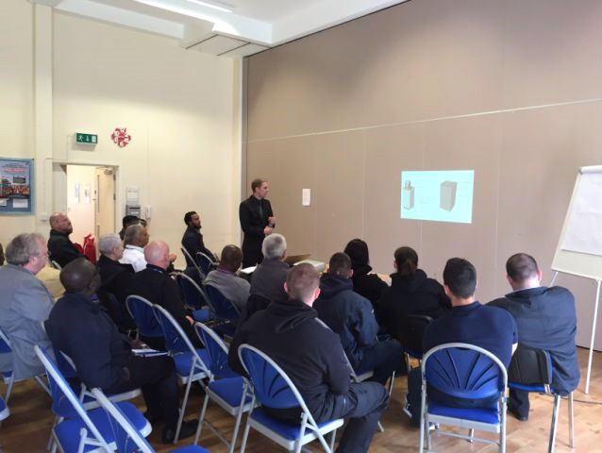
Public Realm Sub-Group Led by Joe Joseph – Peabody Trust
Successful Caretakers’
Conference held

Slide 16
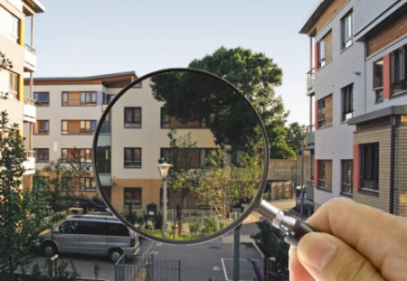
Public Realm Sub-Group Led by Joe Joseph – Peabody Trust
Positive feedback and good attendance
Excellent feedback from Caretakers conference on 1st May
Group work on waste management – focus on bulky refuse and recycling services
Working on trialling new cleaning products
Reviewed good practice in estate inspections
Presentation on options for pest control services

Slide 17
Benchmarking Sub Group Led by Paul Bloss – Eastend Homes
Key Performance Management Framework (PMF) KPI data collected/assessed. 11 PMF reviews held.
Service strength/best practice presentations– ASB, repairs, customer satisfaction
LBTH Benchmark data collected and analyzed
Comparative service charge data collected and analyzed
Agreement to set up a service charges good practice project
Work to support RPs in addressing requirements of the HCAs Regulatory Framework Value For Money Standard

Slide 18
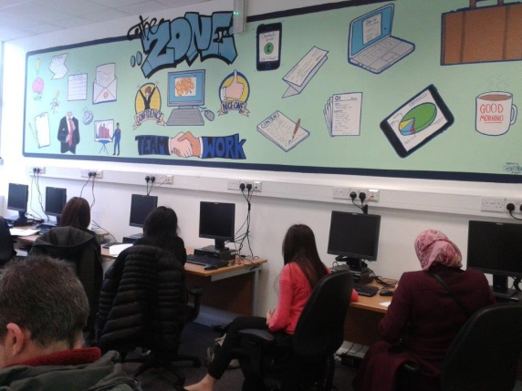
Housing Management Sub-Group Led by Jane Ball – Gateway HA
Consolidated partnership with LBTH
Good attendance at meetings, free debate and sharing of information and good practice
Hold the portfolio for digital inclusion
Welfare reform - modelling impact on impoverishment of residents and business plans
Mutual Exchanges - support for a protocol to facilitate better matching of residents and properties

Slide 19
Housing Management Sub-Group Led by Jane Ball – Gateway HA
Winter Warmers Initiative
Prevent workshop against radicalisation of young people
Closer working with health – set up of new Health and Housing Sub-group
Tenancy Fraud
Mental Health Protocol

Slide 20
Community Involvement Network
Led by Catherine Kyne – One Housing Group
Resident capacity building
7 RPs developed a joint residents training programme
Partnership working achieved VFM objectives on training costs
Health & Wellbeing
Promoted healthy eating and food growing initiatives
Mapped health & wellbeing services in the borough and promoted activities
Youth Work
Mapped and delivered borough wide sport programmes in partnership with third sector agencies
Employment & Training
Delivered employment workshops
Supported residents into training and employment

Slide 21
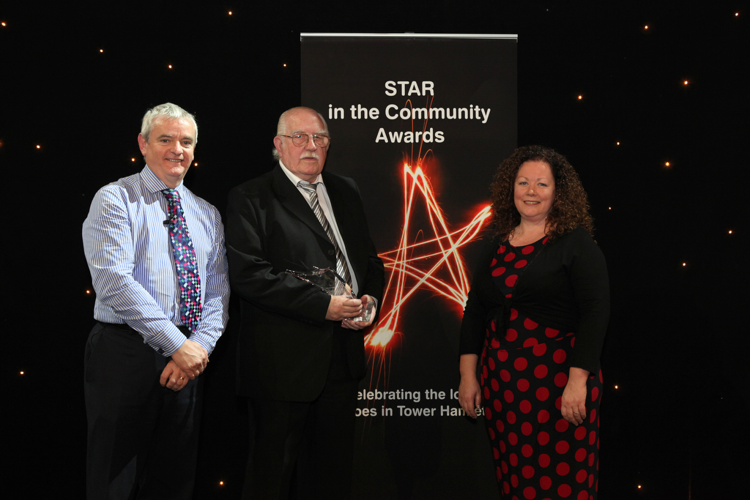
Community Involvement Network Led by Catherine Kyne – One Housing Group
STAR in the Community - Resident awards
Led and delivered STAR awards
Showcased community projects
Recognised resident champions from across the Borough

Slide 22
Asset Management Sub-Group Led by Tony Hughes – Southern Housing Group
New Heat Network Regulations 2014 – Active from December 2015
Reviewed good practice, understood regulation requirements and mapped risk
Overheating and Employers requirements
Explored issue of overheating and inefficiencies linked to heat loss in buildings between communal heat plants and end consumer. Organisational approaches shared and measures to improve the position developed.
Tackling condensation
Explored best practice approaches taken by RP’s to inform and educate residents on the issue of identifying and managing the effects of condensation.
Supply contracts and Local employment
Completed an audit on training and employment opportunities in service contracts. RP’s invested in resident employment initiatives with evidence of positive, innovative and targeted approaches .

Slide 23
Asset Management Sub-Group Led by Tony Hughes – Southern Housing Group
Environmental Health and Protection protocol
Joint working with Environmental Protection and Health Service through new protocol
Fire Strategy – Strathclyde Plates update
Supported the pilot project for the use of premises information (Strathclyde) plates to assist the Borough Fire Services when responding to incidents in high risk/ high rise schemes.
Electronic images of plates to be provided to crews via appliance mobile data terminals (MDTs).
Living roofs/ walls
Explored the issue of maintenance requirements for living roofs and walls. Members were provided with guidance, information and opportunity to work with Biodiversity team.

