Slide 1
MENTAL HEALTH
FEBRUARY 2019
The term ‘mental health’ encompasses the spectrum of positive and negative mental health states, and so this JSNA relates to both the needs of people with mental health problems and population wellbeing. Mental health problems are more common in Tower Hamlets than in London as a whole, and may be a result of some of the wider determinants of mental health such as deprivation, living and working conditions and social cohesion. These determinants can also impact on wellbeing. Public mental health attempts to prevent mental health problems and improve the lives of people living with these problems, as well as reduce mental health inequalities and promote mental health wellbeing in the population.
10.8% of people aged 5-16 years old in Tower Hamlets were estimated to have mental health disorders in 2015. This is higher than in London as a whole.
Self reported depression and anxiety levels are the highest in London (16.1%). 1.4% of residents have a severe/ long term mental health disorder, which is higher than London.
Poor mental health can affect residents of all ages. Life events can precipitate problems, e.g. the perinatal period, onset of physical health problems, or bereavement.
Those at particular risk include people who have had adverse childhood experiences, are deprived, have poor living and working conditions, or are experiencing loneliness.
The council, CCG and community and voluntary sector provide a number of services to improve population mental wellbeing as well as treat mental health problems
These services are currently tiered from Level 0 (whole population actions) to Level 4 (acute and crisis care)
CAMHS will be moving from tiers to the iTHRIVE model
Solidifying the public mental health approach in the borough is key to reducing illness burden and improving wellbeing
Tower Hamlets should continue to improve particular service areas such as transition from CAMHS to adulthood, physical health for severe mental illness, equity of access for ethnic groups and accessibility of services for low-level problems.

Slide 2
mental health? health?
The World Health Organisation (WHO), defines mental health as “a state of well-being in which the individual realises his or her own abilities, can cope with the normal stresses of life, can work productively and fruitfully, and is able to make a contribution to his or her community.”(1)
Using the definition above, mental health does not only refer to mental health problems or ‘illnesses’, though a lot of the focus in mental health is on these problems because of their significant burden and impact on people’s lives. Wellbeing is also an important concept and describes a state of both ‘feeling good’ and ‘functioning well’.(2)
Everyone has a sense of wellbeing. This includes people with persistent mental health problems, who can benefit from an improved sense of wellbeing, regardless of their diagnosis. This is sometimes referred to as the dual continuum model, i.e. mental health problems and wellbeing are not opposite ends of the same spectrum.
Personal circumstances and events, or living and working conditions can trigger changes in wellbeing. In some people, such factors can also increase the risk of developing and sustaining mental health problems.
It is therefore useful to take a ‘public mental health approach’, which considers the population factors that influence mental health, and aims to shift the population towards experiencing better wellbeing and fewer mental health problems.(2)
One of the frameworks for personal wellbeing is the Foundations of Wellbeing, which suggests that the 3 fundamental needs for personal wellbeing are safety, satisfaction and connection.(3)
The ONS has collated data on the 10 areas of UK life that impact wellbeing: Personal Wellbeing, Our relationships, Health, What we do, Where we live, Personal Finance, Economy, Education and skills, Governance and Environment. This goes beyond personal wellbeing to think about community wellbeing.(4)

Slide 3
mental health?
Mental health problems involve significant changes in thinking, emotion and/or behaviour, as well as distress and/or problems functioning in social, work or family activities. These conditions can be diagnosed and managed by mental health services.(5)(2)
The most common mental health problems are depression and anxiety disorders (which include generalised anxiety disorder, social anxiety, phobias and usually PTSD). The ‘severe mental illness’ register is for people with schizophrenia, bipolar disorder and other non-organic psychotic conditions. Other mental health problems include personality disorders, and ADHD.(6)
Severity of conditions are not intrinsically linked to diagnoses, and severity of e.g. depression can also be classified as mild, moderate or severe depending on the number of symptoms and how these interfere with functioning:
Mild depression: a small number of symptoms that have a limited effect on their daily life.
Moderate depression: more symptoms that can make their daily life much more difficult than usual.
Severe depression: many symptoms that can make their daily life extremely difficult.(7)
Note that the causes of mental health problems are often multi-factorial. Whilst some conditions, such as adjustment disorders, develop as a reactive response to life circumstances, most conditions follow an accumulation, in varying degrees, of biological, psychological and social risk factors.
The figure overleaf, taken from the Prevention concordat, demonstrates the complexity of mental health and the number of factors that can support or challenge a person’s mental health – for both problems and wellbeing.(8)

Slide 4
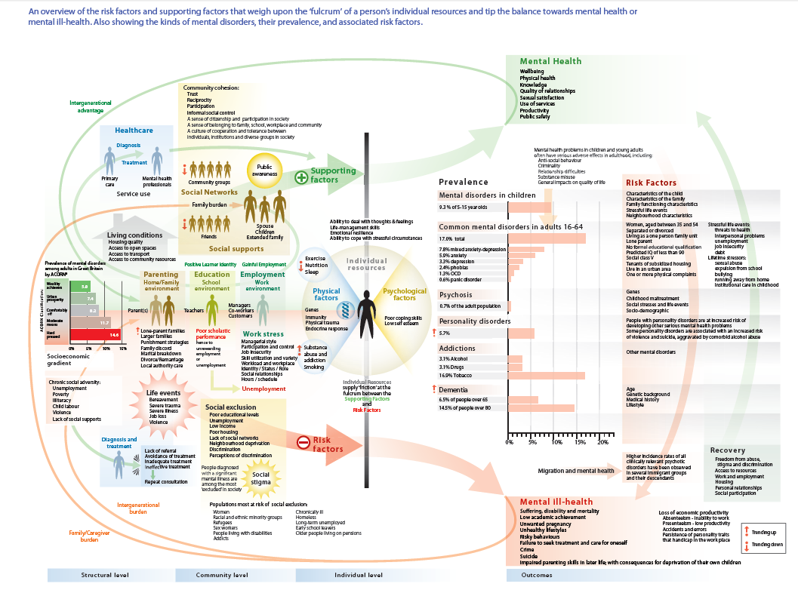

Slide 5
NATIONAL CONTEXT
The NHS Long Term Plan 2019 clearly identifies mental health as a priority, and follows a series of strategies that have emphasised the importance of mental health achieving parity of esteem with physical health.(9)
Key plans include:
improving access to perinatal mental health services up to 24 months after birth
expanding access to CAMHS services; improving mental health support in schools
improving mental health support during transition from childhood to adulthood through an integrated, comprehensive offer using e.g. iTHRIVE model: a person-centred and needs-based framework for services
increasing investment in adult mental health at a rate higher than overall NHS investment for the next 5 years
expanding access to Improving Access to Psychological Therapies
an integrated, community-based offer for people with severe mental illness
expanding and improving crisis response inside and outside hospital, including mental health transport services
ending of out-of-area placements in acute care by 2021
continuing action on suicide prevention
Prevention of mental health problems is also highlighted in the Long Term Plan, and builds on previous strategies highlighting the importance of communities, reducing stigma and improving mental health awareness. Time to Change and the PHE Mental Health campaign ‘Every Mind Matters’ (being piloted in the West Midlands) are examples of national action on this(10). PHE published a Prevention Concordat highlighting how local areas can take effective action to improve public mental health, using a framework to aid planning(8).
The Crisis Care Concordat is a national agreement that sets out how services will work together to help people experiencing a mental health crisis.(11)
Other relevant guidance: ‘The 5 Year Forward View for Mental Health’ and ‘Better Mental Health for All’ (12)(2)

Slide 6
LONDON CONTEXT
The Mayor’s Health Inequalities Strategy highlighted ‘Healthy Minds’ as one its 5 key aims(13). Mental health in schools and workplaces, Homelessness and mental health, and offenders and mental health have been some of the key areas of work from the London Mayor. Thrive LDN is a London-wide movement working across organisations to prevent mental health.
NORTH EAST LONDON STP CONTEXT
The ‘East London Health & Care Partnership’ has 3 key aims around mental health: to develop new models of care that address mental and physical health and social care needs as one; to provide good service user education to reduce stigma and promote resilience; and to help people with more serious mental health problems to find and remain in employment – a key factor in their recovery(14).
TOWER HAMLETS CONTEXT
The Mental Health Strategies for both Adults and Children in Tower Hamlets are being refreshed in 2019. The previous strategy was structured around 3 themes of building resilience, high quality treatment and support, and living well with mental health problems.
The Tower Hamlets Mental Health Crisis Care Concordat was created in 2015 in response to the national Concordat. The Tower Hamlets Suicide Prevention Strategy 2018-2021 sets out the borough’s action plan for preventing suicides and is a key part of delivering the existing Mental Health Strategy.
Integrated care has been a key priority through the creation of the Tower Hamlets Together (THT) partnership and mental health is commissioned jointly by the CCG and local authority. Tower Hamlets Together works through 3 workstreams: Born well, Growing well; Living Well; and Promoting Independence.
The Mental Health Partnership Board brings together stakeholders, including service users, on a quarterly basis.

Slide 7
The Prevention Concordat is a PHE report that sets out how local areas can take effective action, using NICE guidance, to improve public mental health(8). It divides interventions into 3 different approaches:
1. Whole population approaches: ‘Considering how to support good mental health across a whole population by strengthening individuals and communities, creating healthy places and addressing wider determinants‘
Examples: Tackling stigma by encouraging contact with people with mental health problems
Mental health literacy training to frontline workers
‘Whole school’ approaches to improving mental and social wellbeing
2. Targeted prevention approaches: ‘Consider how to target support to groups facing higher risk, Individuals with signs and symptoms and people living with mental health problems’
Examples: Supporting ex-offenders to receive mental health care and action on health inequalities
Supporting people with mental health problems with housing and employment
Providing psychological support to people with long term health conditions
3. Life-stage specific approaches: ‘Considering how to support good mental health across the life course, from family formation and pregnancy through adulthood and later life’
Examples: Parenting programmes for families at risk
Embedding wellbeing interventions and training into workplaces
Identifying older people at risk of social isolation and signposting them to assets
The ‘What Works for Wellbeing’ centre also suggests frameworks and resources for ensuring that wellbeing interventions are evidence-based and measured(15). https://whatworkswellbeing.org/evidence-into-action/

Slide 8
NICE GUIDANCE
NICE has set a range of recommended pathways, guidance and quality standards pertaining to Mental health. These help set the expectations for how services are run nationally and provide a standard to measure against.
There are ‘Mental health and Wellbeing’ guidelines, relating to broader population interventions across the lifecourse and in risk groups, and ‘Mental health and behavioural conditions’ guidelines, relating to how specific mental health conditions should be tackled. There are some pieces of guidance that are shared by both.
Mental health & wellbeing(16)
The guidance includes recommendations about antenatal and postnatal mental health, attachment and emotional difficulties in children, promoting social and emotional wellbeing, promoting wellbeing at work, workplace health, mental wellbeing and independence in older people, and transitions between community and inpatient mental health settings. There is also a guideline for adults in contact with the criminal justice system.
The quality standards add further recommendations relating to patient safety, patient experience and clinical effectiveness relating to the above areas but also groups such as mental health service users, looked after children, people with learning disabilities and people from BAME.
Mental health and behavioural conditions(17)
This section is subdivided into 15 condition-based topics, such as addiction, bipolar disorder and self harm. In turn, each topic contains various pieces of guidance; from broader recommendations about identification and management, to more specific recommendations relating to technologies and therapeutic options.
‘Common mental health problems: identification and pathways to care’ and ‘Psychosis and schizophrenia: prevention and management’ are two of the key clinical guidelines.

Slide 9
MENTAL HEALTH IN TOWER HAMLETS – AN OVERVIEW
Mental health need in Tower Hamlets is higher than elsewhere: in children, adults and older people
Children and young people in Tower Hamlets are estimated as having a higher prevalence of mental health problems (10.8%) than in London or England (2015).(18)
The proportion of primary school children with social, emotional and mental health needs (2.92%) in Tower Hamlets puts the borough in the highest quartile of need in England (2017/18).(18)
Adults in Tower Hamlets have reported having the highest levels of depression and anxiety (16.1%) in London and the 4th highest levels of long term mental health problems (9.8%) (2017/18).(18)
GP registers show that the adult population in Tower Hamlets has higher levels of severe mental illness (1.34%, 4334 patients) than London or England.(18)
Older people in Tower Hamlets are predicted to be the loneliest in London and England.(19)
About 50,000 adults in Tower Hamlets are managed in primary care with Depression, Anxiety or Serious Mental Illness based on 2018 GP registers.(20)
The mental health need in Tower Hamlets will be discussed in greater detail by life-course stages later in the JSNA. The numbers above, however, give an indication of the higher level of need in the general population, which is likely linked to the levels of deprivation in the borough and risk groups present in the population.
Notes:
Mental Health JSNA Feb 20219

Slide 10
TOWER HAMLETS CONTEXT
Tower Hamlets is an inner London borough with an ethnically diverse, mobile and young population. There are large differences in deprivation across the borough.
Tower Hamlets is an inner city borough in the North East of London.
The population of Tower Hamlets is estimated to be 323,696 in 2019 and it is projected to increase to 353,945 by 2025 due to population growth, and national and international migration.(21)
Deprivation levels are high but also vary greatly between the different wards of the borough. In 2015, Tower Hamlets was ranked 24th in the country for the proportion of LSOAs which were the in the 10% most deprived in England. However, in terms of ‘extent’ of deprivation, which looks at the proportion of a population living in the most deprived LSOAs, Tower Hamlets is still ranked the 3rd most deprived local authority in the country.(22)
The largest minority ethnic group is the Bangladeshi population - 32.0% of residents in the 2011 census.(23)
Population density is high, with GLA estimates from 2017 suggesting that 153.7 people are resident per hectare of land – higher than the inner London estimate of 110.7 and general London of 56.2 per hectare.(24)
The proportion of the population estimated to be of working age (16-64) was 73.5% in 2017, which is higher than the percentage (67.7%) in London as a whole and the percentage (62.9%) in the UK. The proportion of young people and working adults in the borough is expected to increase.(25)
Population turnover in the borough is 12th highest in the UK; an estimated 230 per 1000 people move into or out of the borough each year(26).

Slide 11
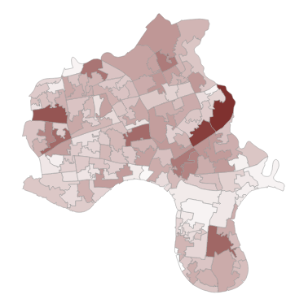
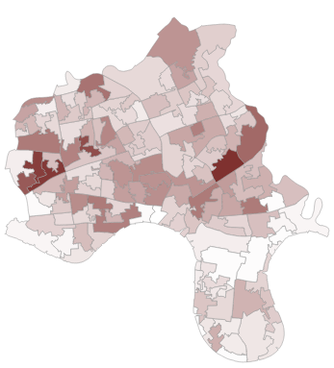
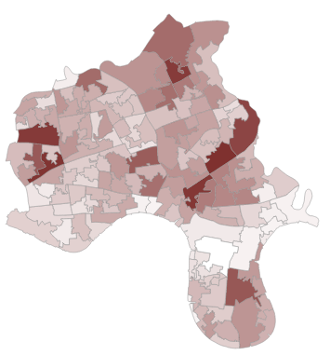
There is significant variation in diagnosed mental health conditions across the borough – below are borough maps showing the percentage of the population with each of these diagnoses according to GP records (2017/18) (27)
Anxiety
Serious mental illness
Depression

Slide 12
Self-rated levels of wellbeing in Tower Hamlets are similar to London and UK levels
The Annual Population survey asks people about their wellbeing across 4 domains. The graphs below show the trends of how Tower Hamlets residents rated themselves on these domains, compared to London and the UK. Ratings of ‘feeling worthwhile’ are consistently lower in Tower Hamlets than in the UK. (28)

Slide 13
Green space is limited in Tower Hamlets: in 2016 there was half the national average of green space per 1,000 people. Over 15% of the population are exposed to high noise levels from transport during the daytime. This is above the average for London but has decreased slightly over the past decade(29). Nonetheless, 79% of people responding to the Annual residents survey 2018 said that they were satisfied with their local area as a place to live(30).
Wider determinants of mental health
Deprivation
Employment
Housing
Education
Crime
Social cohesion
Environment
Tower Hamlets has high levels of unemployment, particularly amongst women and amongst Bangladeshi and Somali residents(20).
The percentage of workless households in 2017 was 20.9% in Tower Hamlets; which is high compared to 12.9% in London. 44% of claimants in Tower Hamlets cited mental health related issues as the reason for their incapacity in 2011 (25).
19% of adults living in poor quality housing in England have poor mental health outcomes. For example, adolescents living in cold housing are at a significantly greater risk of developing multiple mental health conditions. A cold home also contributes to social isolation(31). In 2016/17, only 2% of adults aged 18 - 69 on Care Programme Approach in Tower Hamlets were living independently in stable and appropriate accommodation- the worst in London, with the London average being 55%(18).
In the Annual residents survey 2018, 86% felt that people from different backgrounds get on well and 22% had undertaken volunteering in the past year(30). However, 44.4% of adult social care users (2017/18) and 35.1% of adult carers (2016/17) feel that they have as much social contact as they would like(18).
Being a victim of crime, or exposure to violent or unsafe environments can increase the risk of developing a mental health problem. Crime was the top concern for people in the borough in the Annual Residents survey 2018 – 41% rated it in one of their top 3 concerns (30). The crime deprivation score (which aggregates indices of crime in the borough) for Tower Hamlets is 0.76, which is much higher than the England average of 0.01(25).
Those not in education, employment or training (NEET) after the age of 16 are at increased risk of depression and suicide and the damaging effect of unemployment at this stage of life lasts into later life. Levels of 16 – 17 year olds not in education, employment or training (NEET) in Tower Hamlets are similar to nationally: 5.7% in 2016(18).

Slide 14
LGBTQ people in the UK are known experience higher levels of mental health problems than in the general population, particularly those aged 18-24, from BAME background, living in low income households & victims of hate crime(32).
People in contact with the criminal justice system have substantially more risk factors for suicide(31). In 2017 there were 225 per 100,000 people from Tower Hamlets that were first time offenders, which was higher than the London rate of 215.3 per 100,000 and the England rate of 166.4 per 100,000. Rates of re-offending in Tower Hamlets is similar to the rest of London(18).
Personal risk factors for poorer mental health
Offenders
People misusing substances
Carers
People in contact with social care
Homeless people
People of BAME
People who identify as LGBTQ+
There appear to be differences in mental health service utilisation between different ethnicities in Tower Hamlets, which may be due to stigma and difference in mental health characterisation between different ethnic and cultural groups.
People from black African and Caribbean backgrounds are disproportionately seen in the ‘hard end’ of services and are more likely to receive harsher or more coercive treatments(31).
People who have recently arrived from abroad to live in an area may face barriers to accessing mental health services., including language. Refugees are more likely to have experienced trauma(31).
People with co-occurring mental health and alcohol/drug use conditions often have multiple needs, with poor physical health alongside social issues such as debt, unemployment or housing problems. They are also more likely to be admitted to hospital, to self-harm and die by suicide(31). The estimated prevalence of opiate and/or crack cocaine use was 13.2 per 1000 population in Tower Hamlets, which was higher than London (8.0) and England (8.4). The alcohol related hospital admission DSR (broad definition) per 100,000 population was higher in Tower Hamlets (1480) compared to London (1252) and England (1258)(2014/15)(18)
Homeless people are twice as likely to have a common mental health condition, and psychosis is up to 15 times more prevalent. They are also over 9 times more likely to complete suicide. People experiencing homelessness find it difficult to access health services, including mental health care(31). 17.1 per 1000 households in Tower Hamlets were in temporary accommodation in 2017/18, which is the 11th highest rate in London (18).
Carers and people in contact with social care have a higher risk of mental health problems(31). 19356 people in Tower Hamlets provide some form of unpaid care, of which 3326 are under 25. 44.4% of adult social care users (2017/18) and 35.1% of adult carers (2016/17) feel that they have as much social contact as they would like(18).

Slide 15
THE LIFE COURSE APPROACH
While problems with mental health and wellbeing can affect people of all ages, every life-course stage presents different conditions that affect mental health and also the opportunities for action.
The next few slides will set out what we know about the local picture by life-course stages, including some of the risk factors that might affect mental health at each of those stages.
Early years & Perinatal mental health
Child & Adolescent mental health
Working age mental health
Older age mental health

Slide 16
PERINATAL & EARLY YEARS
Mothers in Tower Hamlets access perinatal mental health services at a higher rate than elsewhere
4,604 babies were born in Tower Hamlets in 2017(33).
Parenting, nurturing relationships and family functioning can impact the degree of security, stimulation and attachment experienced by a child, which in turn can affect their mental and emotional development(31).
Adverse Childhood Experiences cumulatively impact on mental and physical health in later life(31).
Children living in poverty are at higher risk of experiencing poorer social and emotional wellbeing, and Tower Hamlets has the highest rate in UK of children living below the poverty line (31% in 2015)(18).
We do not have local prevalence data for perinatal mental health conditions in mothers, but nationally up to 20% of mothers experience perinatal mental health problems of varying type and severity.
Risk factors for perinatal mental health conditions include history of mental health problems, childhood abuse and neglect, domestic violence, interpersonal conflict, inadequate social support, alcohol or drug abuse, unplanned or unwanted pregnancy and migration status(31).
Mothers in Tower Hamlets access more perinatal services (acute and in the community) than average in London. The rate of admissions of Tower Hamlets mothers to mother and baby units in 2016/17 were the third highest of London boroughs (2.4 admissions per 100,000 weighted population) and the rate of Tower Hamlets mothers accessing perinatal community services in 2016/17, was the 7th highest rate for London (71.5 women per 100,000 weighted population)(18).
This is likely to reflect higher prevalence of perinatal mental health conditions in Tower Hamlets mothers.

Slide 17
CHILDREN & ADOLESCENTS
Children in Tower Hamlets have higher levels of mental health problems compared to England
There are 47,000 children and young people of school age, 63% of which are of Bangladeshi origin, 9% white British and the rest are BAME. Over the next ten years, the school population will increase by about 10% to 50,000(34).
2.92% of primary school age children and 2.7% of secondary school children are known to have social, emotional and mental health needs in Tower Hamlets. These figures are in the highest quartile and second quartile in England respectively (2018) and are higher than the proportion in London overall(18).
10.8% of people aged 5-16 years old (4325) in Tower Hamlets were estimated to have mental health disorders in 2015, which was higher than the estimated prevalence of 9.3% in London and 9.2% in London(18).
By 2019, it is estimated that around 4438 children and young people aged 5-17 would have a diagnosable mental health condition and prevalence will increase by about 3% each year (estimation made in 2015)(35). The gap between estimated prevalence and the known level of need may indicate the degree of underdiagnosis.
Rates of hospital admission for self-harm in 10-24 year olds were lower in Tower Hamlets (154.8 per 100,000) than in London (197.2) and England (407.1) and were in the lowest quartile for England (2016/17)(18).

Slide 18
CHILDREN & ADOLESCENTS
Risk factors for mental health problems are more prevalent in children living in Tower Hamlets
Risk factors for mental health problems in children include the experience of Adverse childhood experiences (ACE), childhood poverty, being looked after by social services, having behavioural, emotional and social support needs or learning disability, being a youth offender or being 16-18 years old and not in education, employment or training(31).
ACEs include experiencing physical, sexual or emotional abuse, neglect, domestic abuse, parental separation, and having a parent who is an offender, has mental health problems, or has substance misuse problems(31).
31% of children in the borough are living below the poverty line, which is the highest % in the country(18).
There is a higher rate (16.9%) of under 25s in the borough with special educational needs compared to the England average of 14.4%(18).
333 children in the borough are looked after, which is similar to national levels(18).
There are higher numbers of children aged 10-16 who are in the youth justice system in Tower Hamlets. 9.3 per 1000 10-16 year olds were in the youth justice system (2016/17) compared to in London (6.2 per 1000) and England (4.8 per 1000)(18).
Levels of 16 – 17 year olds not in education, employment or training (NEET) in Tower Hamlets are similar to nationally: 5.7% in 2016(18).

Slide 19
ADULTS
Common and severe mental health problems are more common among adults in Tower Hamlets than in the rest of London
50,000 residents in Tower Hamlets are known to their GP as having Depression, Anxiety or Serious Mental Illness(20).
Self reported depression and anxiety is highest of London boroughs: 16.1% of residents aged over 18 reported suffering from depression and anxiety (2016/17). In London, this was 12.4% and in England it was 13.7%(18).
7.3% of 18+ adults were recorded as having depression in Tower Hamlets, corresponding to 18836 patients (2017/18, QOF register). This is similar to the prevalence of 7.1% in London and 9.9% in England(18), but such similar prevalence may be due to the lack of age-weighting of this statistic and the relatively young population of Tower Hamlets.
9.8% of 18+ residents reported having long term mental health conditions (2017/18, GP Patient Survey). This prevalence was the 4th highest of the London boroughs(18).
62.2% of social care users reported feeling depressed and/or anxious (2017/18, Adult Social Care Survey). This was the second highest percentage in all London boroughs(18).
Severe mental illness prevalence in 18+ adults was 1.34% in Tower Hamlets; 4336 patients (2017/18). This was the 7th highest for London boroughs and significantly higher than the London-wide prevalence of 1.11%(18).
The death rate from suicides of people aged over 10 between 2015-2017 in Tower Hamlets was 7.7 per 100,000 population and was not significantly different from the London rate (8.6) and England rate (9.6)(18).

Slide 20
ADULTS - SERVICES
Patterns of Use of services in Tower Hamlets is largely similar to that seen in London and nationally
941 per 100,000 people aged over 18 were referred into IAPT (2018/19 Q1). This is relatively high for London and significantly higher than that of England (841) (18). ↓
46.8% of referrals to IAPT were for BME patients, which is average for London (2018/19 Q1) – and lower than might be expected for the population. This was a drop from the previous year’s proportions, which were more in line with expected proportions at between 61.3 and 62.5%, and so may be a temporary reduction(18).
142 per 100,000 people completed IAPT treatment (2018/19 Q1) - lower than in London and England (18).↔
GP antidepressant prescribing is lower locally (1.0 per STAR-PU) than nationally (1.5 per STAR-PU)(2017/18)(18).
GP prescribing of drugs for psychoses and related disorders is the highest in London - 100.6 items prescribed per 1000 population compared to London (53.9 per 1000) and England (62.4 per 1000) (2017/18 Q4) (18) ↑.
17.3% of mental health services users in Tower Hamlets were on Care Programme Approach (CPA) at the end of Q2 2018/19, which is similar to the London and UK proportions(18). ↓
2225 per 100,000 people were in contact with adult specialist mental health services in Tower Hamlets, which was similar to London and England levels (2018/19 Q2) (18). ↓
There were 400.7 mental health admissions per 100,000 weighted population in Tower Hamlets, which was higher than London and England (2018/19 Q2) (18). ↔
In quarter 2 of 2018/19, 2.4% of mental health service users from Tower Hamlets were in hospital, compared to the London proportion of 3.0% and England proportion of 2.2% (2018/19 Q2)(18). ↔
518 per 100,000 population were detained under the Mental Health Act at the end of quarter 2, 2018/19. This was similar to the levels in London (475 per 100,000), but higher than the England at 375 per 100,000 (18). ↔

Slide 21
OLDER ADULTS
Older adults in Tower Hamlets low levels of wellbeing, a high recorded prevalence of dementia and high levels of loneliness. We do not have much local data on their mental health problems.
Tower Hamlets has the lowest proportion in London of residents aged over 65. Only 6.2% of the population was aged over 65 in 2017 according to ONS Population estimates(18).
Mental health problems in older people are common and often undiagnosed. At a national level, depression affects one in 5 older people living in the community and 2 in 5 living in care homes. Around one in 10 nursing home residents have psychotic symptoms such as delusions and hallucinations and a third of people using specialist mental health services are older adults(18).
Older residents report a low health-related quality of life in the borough; in the lowest quartile for England and is the second worst scoring borough in London (2016/17 – GP Patient Survey)(18).
Dementia prevalence, as a proportion of 65 year olds in Tower Hamlets, is the second highest in London at 5.25% and is significantly higher than the London prevalence of 4.49% (Sept 2017). This may partly be due to the high dementia diagnosis rate seen in Tower Hamlets(18).
Older people who are lonely or do not have access to social relationships are at greater risk of mental health problems and dementia; loneliness can also be a symptom of mental health problems. A model by Age UK, which estimates subjective loneliness, ranks Tower Hamlets as having the highest levels of loneliness in London and England(19). Age UK have also produced a heat map showing the significant variation in the risk of loneliness in different LSOAs of Tower Hamlets.
49.7% of those over 60 living in the borough are classified as having income deprivation; worst in London(18).

Slide 22
PHYSICAL HEALTH AND MENTAL HEALTH
There are 2 key challenges with respect to the crossing over between mental health and physical health:
People with long term physical health conditions are 2-3 times more likely to experience mental health problems than the general population(31).
People with mental health problems, particularly those that are severe, are more likely to have physical health problems. Those with severe mental illness have a lower life expectancy than the general population: on average, women die 15 years earlier and men die 20 years earlier than the general population(31).
46% of people with mental health problems have a long term physical health problem.
GP data from Tower Hamlets shows that the most common comorbid conditions for people with mental health problems were asthma, diabetes and hypertension (36).
Health behaviours and lifestyle also impact upon mental health. Negative health behaviours can worsen psychological well-being and reduce recovery from mental health problems. Smoking and obesity, particularly in children, are more prevalent in Tower Hamlets than in the rest of London and England(31).
Alcohol or substance misuse and mental health problems often are entwined in a vicious cycle, where greater addiction increase mental health problems, which in turn can lead to more intake as a form of self medication(31).
The estimated prevalence of opiate and/or crack cocaine use per 1000 population was 13.2, which was higher than the broader prevalence of 8.9 in London and 8.4 in England (2014/15)(18).
The alcohol related hospital admission (broad definition) directly standardised rate per 100,000 population was higher in Tower Hamlets (1480) compared to London (1252) and England (1258) (2014/15)(18).

Slide 23
MENTAL HEALTH SERVICES IN TOWER HAMLETS
There are a number of actions being taken on mental health across Tower Hamlets through services commissioned and provided by the local authority, CCG, and community and voluntary sector.
Mental health services outside of usual primary care are jointly commissioned by the CCG and local authority.
The Mental Health Commissioning Consortium (made up of Tower Hamlets, Hackney and Newham CCGs) manages the contract with East London Foundation Trust, which is the key provider of mental health services.
The Tower Hamlets Mental health Partnership Board brings together clinicians, providers, community and voluntary sector partners, service users and commissioners on a quarterly basis, and is also a platform for ensuring coproduction of services.
As part of the Tower Hamlets Together ‘Born Well Growing Well’ workstream, a Children and Young People Mental Health and Emotional Wellbeing Working Group was set up to steer, plan and oversee the delivery of services and initiatives to improve mental and emotional wellbeing outcomes.
As well as the services delivered by the CCG and local authority, there are a large number of services and assets in the community and voluntary sector for supporting people with their mental health and wellbeing. Some of these are mentioned later in this document but there are many outside of this.
Together these services provide support at different levels of the population. Some focus on a particular life-course stage, some target particular risk groups and others work on the whole population.
A new Integrated Accessible Information resource is being developed in the council as a single place for residents to access information about what services are available. The Ideas Store also has an online Mental Health & Wellbeing Directory called ‘In the Know’ which contains a catalogue of community assets that support wellbeing in Tower Hamlets, and is updated regularly.

Slide 24
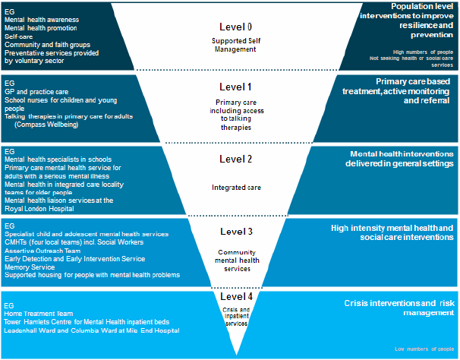
MENTAL HEALTH SERVICES IN TOWER HAMLETS
In the previous strategy, mental health services was structured in tiers, as is shown on the below diagram(37):

Slide 25
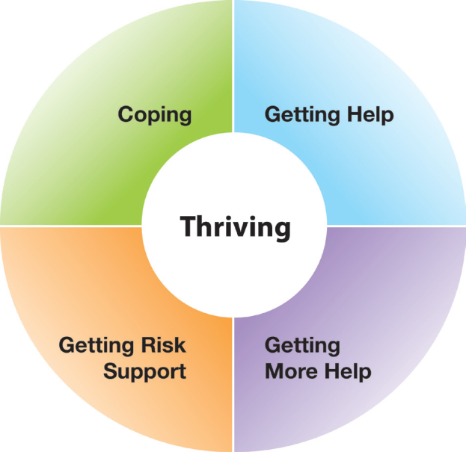
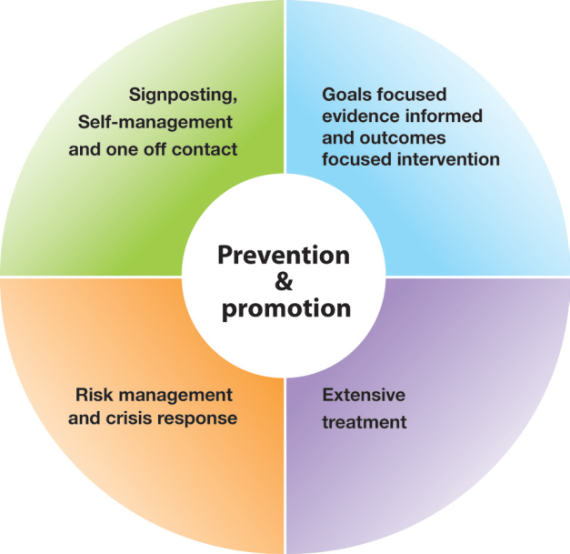
MENTAL HEALTH SERVICES IN TOWER HAMLETS
Child & Adolescent mental health services will move from a tiered model to the iTHRIVE model
The NHS Long Term plan has recommended the iTHRIVE framework (below) as a model for CAMHS that distinguishes between support and treatment, and groups people by type of input they require.
The central group of ‘thriving’ focusses on broader population need that gets supported by public health interventions. The four outer groups distinguish between the need of individuals, the skill mix needed to meet these needs, the main terminology used to describe this need (e.g. wellbeing, ill health, or support), and resources needed to met those needs. They do not distinguish between severity or type of problem(38).
This model will therefore be used to move CAMHS away from a tiered model. It will also be expanded to 0-25 year olds, which will affect current transition arrangements between children and adult services.
State of being
Type of input needed

Slide 26
PERINATAL & EARLY YEARS SERVICES
Wellbeing of children in their early years, and of mothers, is tackled through parenting programmes, supportive early years environments, and more intense support for mental health problems
Universal:
All mothers are eligible to receive Health visiting. In Tower Hamlets health visitors conduct an additional visit at the 3-4 month mark predominantly for maternal mood assessment, though such assessment is part of all visits.
Several parenting programmes are available in the borough, and through Early Years Integration hubs
Early years settings are encouraged to become ‘Healthy Early Years’ accredited
Regular training is provided to frontline workers about early years emotional health and wellbeing
Targeted:
The Gateway midwifery team, Family Nurse Partnership, Perinatal outpatient service and community services such as Maternity Mates and CAMHS Under 5 support vulnerable and struggling women, with intensive support during and after pregnancy.
The Perinatal Mental Health team offers pregnancy and post natal support to women who have pre-existing or newly onset mental illnesses. Under the current model, Tower Hamlets has 1 full time Psychiatrist, 1 Clinical psychologist, 0.8 Administrator, and 2 specialist nurses. Following a successful bid for perinatal services across North East London, this team will be expanded and more mothers will be able to access services.
Several targeted parenting programmes exist in the borough to support early years emotional development, such as the Community Parent Project and Raising Happy Babies.

Slide 27
CHILD & ADOLESCENT MENTAL HEALTH
Thriving:
The Healthy Lives team work with most schools within the borough to promote health and wellbeing ensuring a whole school approach to emotional and mental health is taken. Currently 93% of schools have registered(35).
Healthy School awards – the Healthy Lives team has supported schools to gain 81 Silver awards and 35 Gold awards, which are the highest figures in London. About half of the schools use ‘Jigsaw: A Mindful Approach to PSHE’, a curriculum which ensures an emotional and mental health and wellbeing approach is applied to PSHE.
LBTH also funds Attachment Friendly Schools, Emotional Learning Support Assistants, mindfulness in schools and Video Interaction Guidance(35).
Training about mental health has been delivered in different ways. Youth Mental Health First Aid Training is being arranged for teachers and assistants from schools across the borough in early 2019, in collaboration with Thrive and Time to Change. The CAMHS Schools Training Programme for staff and school governors was delivered in 12 schools across the borough. The Building Resilience Project, co-developed and delivered by young people to CYP, parents/carers & school staff has reached 429 students in primary and secondary schools and 54 parents. 22 young people have been trained as Peer Trainers and 11 have delivered workshops(35).
Coping:
School based services are available across the borough, though there is considerable variation in what is delivered. The Healthy Lives team is instrumental in ensuring whole school approaches are taken.
There is a CHAMP team is for children with parental mental health problems, an Emotional hub service for children who have experienced sexual abuse, the CAMHS neurodevelopment team, and other teams working with high-risk children and adolescents such as those who have offended, or are entering social care services(35). Safe East supports 10-19 year olds with making healthier choices related to sexual health and substance misuse.

Slide 28
CHILD & ADOLESCENT MENTAL HEALTH
Getting Help:
The Tower Hamlets CAMHS Community Mental health team is based across two sites in Whitechapel and Limehouse. Demand for specialist CAMHS has been increasing steadily. GP, Schools, Social Services & other agencies can refer into CAMHS, who then make an assessment of how best to help through the linked services.
Step Forward provides Tier 1 and 2 mental health services for young people aged 14-21 and up 25 if identified as having special educational need and/or disability (SEND). More than 400 used the service in 2017/18 (35).
The Children & Young Persons Improving Access to Psychological Therapies (IAPT) Partnership delivers psychological therapies and ensures service users are given assessment choice including time and place where they can be seen. They currently offer CBT, Counselling and Parent training.
Children wellbeing practitioners (CWP) service is for children who don’t meet CAMHS thresholds. It links with primary and secondary schools to provide early help interventions, and saw 223 children in 2017/18. It recently provided translated psycho-education written and audio material for use by the local Bengali community(35).
Tower Hamlets is a trailblazer site for the new national ‘Mental Health Support teams in schools’ project. 2 new teams will respond to the needs of children and young people with mild to moderate mental health issues and provide a link to specialist NHS services when needed. The teams will be led by CAMHS and cover a mixed group of schools across the borough. Up to 1000 additional children &young people per year will receive support(35).
Tower Hamlets Early Detection Service is for people aged 16-25 experiencing changes in their mental health
Tower Hamlets Early Intervention in Psychosis team is a multidisciplinary team working with young people presenting with psychosis.

Slide 29
CHILD & ADOLESCENT MENTAL HEALTH
Getting More Help:
The East London Community Eating Disorders Service for Children and Young People (CEDS-CYP) is a multi-disciplinary team providing specialist interventions
CAMHS groups for: children awaiting assessment for autism, children with challenging behaviour, children on the neurodevelopment pathway transitioning to between primary and secondary school or to adult services
Training in Dialectical Behaviour Therapy for staff will help expand the range of therapy options for children with maladaptive coping strategies.
Getting Risk Support:
For acute care, Tower Hamlets CAMHS have access to the Tier 4 Coborn Centre for Adolescent Mental Health in case admission for inpatient or day hospital treatment is required.
A Crisis service led by nurses will be based at the Royal London Hospital, Homerton Hospital and Newham University Hospital, operating between 11 am and 11pm during weekdays and 10 am to 16 pm on week-ends.
A new community nurse-led rapid response and assertive outreach service is being set up to respond to crisis presentations in the community, such as in schools, preventing young people to go to emergency services.
Step Forward has been awarded a ‘Beyond Places of Safety’ grant from the DHSC which will help develop infrastructure to give more access to psychological and psychosocial support
There are actions within the Suicide prevention strategy for children and adolescents.

Slide 30
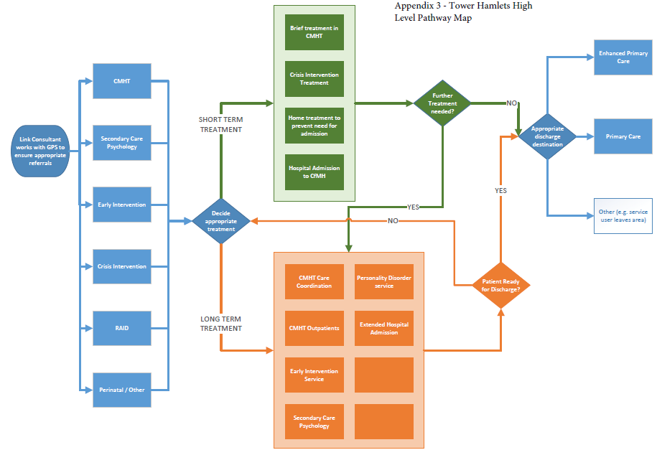
ADULT MENTAL HEALTH – SERVICES
Service map (39)

Slide 31
ADULT MENTAL HEALTH – SERVICES
Tiered services are provided for different levels of acuity, severity and chronicity
Level 0 (Supported self-management)– covered later
Level 1 (Primary care including access to talking therapies):
Primary care: most people with mental health problems see their GP. 50,005 residents in Tower Hamlets are known to their GP as having Depression, Anxiety or Serious Mental Illness(20).
Mind and ELFT together provide Tower Hamlets Talking therapies, which offers 1-1 counselling, as well as groups and workshops following an assessment of need. People can be referred by their GP or self-refer.
Level 2 (Integrated care):
The Enhanced primary care service manages a caseload of around 600-700 people in primary care with some secondary care support from a consultant psychiatrist, EPC mental health nurses and support workers(39).
The Rapid Assessment, Interface, and Discharge service is the ELFT provided psychiatric liaison service for Newham, Tower Hamlets and City and Hackney.
Tower Hamlets Early Detection Service is for people aged 16-25 experiencing changes in their mental health
Level 3 (Community mental health services):
There are four separate Community Mental Health Teams (CMHT) and one Older People CMHT for different clusters of GP practices. Each ‘Single Point of Entry’ within the CMHTs provides a pathway to a range of specialist mental health services. The CMHTs are an integrated mental health and social care team run in collaboration between ELFT and LBTH(39).

Slide 32
ADULT MENTAL HEALTH – SERVICES
A range of services are provided for different levels of acuity, severity and chronicity
Level 3 (Community mental health services) - cont:
There were 3617 adult referrals to Tower Hamlets CMHT in 2018, which was a 3% rise from 2017.
There were 2299 people on the CMHT caseload as of July 2018, of whom 673 were on CPA.
35% of the CMHT caseload has non-psychotic disorder, 50% has a psychotic disorder(39).
Tower Hamlets Early Intervention in Psychosis team is a multidisciplinary team working with people presenting for the first time with psychosis.
A new Improving Access to Psychological Therapies (IAPT) service is being rolled out between October 2018 – January 2019. Rather than using the linear model of waiting for one service, the redesigned service will use a group-based approach with signposting to reduce waiting times and ensure people are assessed more quickly.
The Recovery and Wellbeing service is made up of community support components which focus on delivering statutory duties, supporting mental health recovery, maintaining good mental health and keeping people out of hospital where possible. A key role is of support people with employment and access to services(20).
Level 4 (Crisis & inpatient services):
The Tower Hamlets Centre for Mental health is an acute unit based in Mile End Hospital.
The Tower Hamlets Crisis line is open 24 hours a day and is a ‘first port of call’ for those experiencing a mental health crisis. The Crisis intervention team offers support for those in psychosocial crisis. The Home Treatment Service assesses and treats people in the community, who are at risk of crisis and admission to hospital.

Slide 33
OLDER PEOPLE
The council, NHS and CVS organisations are working together to promote older people’s wellbeing
Universal services:
The ‘Ageing Well’ strategy 2017-2020 highlights the key priorities for meeting older people’s health and wellbeing needs. Access to information and services, safety, housing, loneliness, and maintaining and promoting independence were some key areas that the team will try to tackle(40).
The council is promoting wellbeing provision by working on welfare benefits uptake, volunteering opportunities and staying physically active.
The Linkage Plus service is open to anyone aged over 50 and aims to improve quality of life, physical and mental wellbeing and overcome social isolation
Many projects, such as luncheon clubs, are run by various voluntary sector organisations. There are daycentres, befriending projects and a number of health and wellbeing projects, some which are specifically focussed on particular resident groups, e.g. Bangladeshi.
A key theme in the council’s Ageing Well strategy is ‘Living Well with Dementia’
The council & NHS are also working together with voluntary and community sector partners to take steps towards achieving ‘Dementia Friendly Borough’ (a framework by the Alzheimer’s society) status by 2020
Care home providers talk to service users about mental health and wellbeing and signpost as appropriate to the three main agencies in LBTH: The Carer’s Hub (a supportive service for carers), Local Link (information & advice), and LinkAge Plus.

Slide 34
OLDER PEOPLE
Older people need specialist services for mental health problems as well as dementia
Mental health & Dementia services
The MHCOP (Older people services) CMHT for Older people based in Robinson Centre, in Mile End Hospital is an integrated mental health and social services team which provides psychiatric and social needs assessment, intervention and treatment. The service is multi-disciplinary, staffed by community mental health nurses, social workers, occupational therapists, psychologists, psychiatrists and support workers(39).
There were 1018 referrals to Tower Hamlets older people services in 2018 - a 3% rise from 2017.
There were 497 people on the MHCOP CMHT as of July 2018, of whom 115 were on CPA.
20% of the MHCOP CMHT caseload have non-psychotic disorder, 22% have a psychotic disorder and 53% have an organic disorder.(39)
The dementia diagnosis rate compares the number of people over 65 estimated to have dementia with the number diagnosed. In August 2018, Tower Hamlets dementia diagnosis rates were 3rd highest in London, with a rate of 83.5% and has remained relatively high compared to London and North East London in the last 2 years(18)
The Robinson Centre is located next to the Alzheimer’s Society base in Tower Hamlets.
2 occupational therapists based at the Robinson centre are Dementia specialists who work closely with care homes and deliver a training course for frontline workers in these care homes that leads to a qualification in Dementia awareness. The focus is on converting theory to practice and help carers overcome challenges.
‘Significant 7 - Signs of Deterioration for Care Homes’ training is being delivered to frontline staff to help notice and identify signs of deterioration.

Slide 35
WHOLE POPULATION ACTIONS
Improving awareness, challenging stigma and training frontline workers is key
Mental health first aid trainer programme is a course to increase local staff, carers and the Tower Hamlets community’s knowledge, understanding and confidence of talking about mental health, reduce stigma, integrate mental health within local employers and improve experiences of people with mental health illness. Until December 2018, 730+ people have been trained in MHFA and 280 in MHFA LITE.
Making Every Contact Count (MECC) training encourages frontline workers to utilise all opportunities to have a conversation about health, including mental health, and to offer signposting information to facilitate behaviour change. By April 2018, 1,064 people have been trained in MECC in Tower Hamlets, across 105 organisations.
Wellbeing Hubs are being set up in each of the Ideas Stores, each with a community navigator who will be able to help signpost people to the services they need. They will also be able to people engage with the Tower Hamlets Wellbeing Wheel (an online resource) and build a wellbeing plan based upon their wider determinants. Data will be collected about the usage and users of this service to help direct assets going forward.
‘Good Thinking UK’ is an NHS approved online wellbeing programme that can be used by any Tower Hamlets resident for free. It is an accessible resource for those with early or low-level mental health problems.
Thrive London is working to make London a ‘zero suicide’ city, and taking action on reducing stigma, training Mental Health Champions, youth and frontline workers, workplace mental health and raising awareness.
Social prescribing is practised throughout the borough, with the situating of link workers in GP practices, who can support patients with accessing support and services that are outside of direct healthcare but may be impacting their health and wellbeing, e.g. support for employment, housing, physical activity and loneliness.

Slide 36
WHOLE POPULATION ACTIONS
Employment:
Individual Placement & Support and Work retention is provided by the Working Well Trust for people with mental health problems. There was 100% success rate of employment retention in 2018/19 Q1 (27).
Workpath is a universal service that helps residents with getting into employment.
Rework connect offers practical support to help people hold onto their job when experiencing mental health difficulties, or to help people get into work and training if they already have existing problems
The Department for Work & Pensions provides an access and retention fund for anyone who needs reasonable adjustments to continue in the workplace.
WharfAbility is a network of businesses in Canary Wharf and wider London that allows employers to share ideas and experiences about mental health, disability and carers. An Employers Forum is being restarted in Tower Hamlets to help employers of businesses work towards Healthy Workplace Charter accreditation, with mental health being one of the key areas of discussion.
Housing:
A Resettlement Team provides specific support for adults living in a supported housing or residential care placement with mental health problems.
The Health E1 GP Practice for homeless people in the borough has psychology and mental health nurse input.
Homelessness teams, the Housing Advice service, Homeless Options & Support team are some of the borough’s teams working on homelessness alongside national and local charities.
There are 7 hostels across the borough offering 452 spaces at any given time. Generic hostels report multiple needs, including physical health, substance misuse and mental health, among service users.

Slide 37
WHOLE POPULATION ACTIONS
Suicide:
Suicide prevention training - ‘Train the trainer’ safeTALK training and ASIST suicide prevention training has been delivered to frontline staff working in Tower Hamlets across sectors.
The Suicide Prevention Strategy and Action plan works across the lifecourse to reduce suicide
Loneliness
Several projects on loneliness in Tower Hamlets have been undertaken to identify burden, create intergenerational projects and connect stakeholders. Loneliness is a priority in the Ageing well strategy.
LinkAge+ does outreach work to isolated and lonely older people in the borough.
A ‘Loneliness Taskforce’ has been identified as a Mayoral priority and is being set up in 2019.
Education:
The Ideas Store offers ‘Lifelong learning’ courses on Health and Wellbeing, and books in the ‘Health Zone’
The Recovery College offers courses that improve mental health literacy taking cultural context into account
Community participation and coproduction:
The Communities Driving Change (CDC) Programme is supporting co-production around themes important to residents. Themes being explored include community safety and mental health.
Work is underway to set up a Time to Change/ Thrive Hub in Tower Hamlets
Violence & Crime: A Violence JSNA is currently being conducted to help inform priorities for action for a strategy
Deprivation: Many actions are being taken to improve poverty in the borough, notably the Tackling Poverty Programme, Child Poverty Strategy and Food Poverty Strategy. A JSNA on Poverty and Health is also being developed.

Slide 38
TARGETED POPULATION ACTION
Targeted services in Tower Hamlets help ensure that those most at risk are not left behind
BAME: Community groups such as the Bangladeshi Mental Health Forum work to reduce the stigma around mental health in communities and encourage them to access services. They have produced leaflets in multiple languages. An event was held on World Mental Health Awareness Day to spread this message and knowledge of services
LGBT: Step Forward has groups for LGBTQ youth. Tower Hamlets LGBT Community Forum bring together LGBTQ people and acts as a support group. APANJON is a Bangladeshi LGBTQ support group
People misusing substances: 4 Dual Diagnosis nurses based in the Reset substance misuse treatment service and are fully integrated into the service. These nurses have their own caseload with between 40%-50% of Reset clients having some form of mental health need.
Carers: Almost all Young Carers in the borough are caring for an adult with a mental health condition. These Young people get referred to CHAMPS who can support them with their own mental health. There are a number of organisations providing support for carers, for example Rethink, which is specifically for carers of those with mental illness. Rethink offers individual support, groups, respite, and advice about local services for mental health. It also provides access to a mental health carers forum, where people can share suggestions.
Offenders: The Tower Hamlets Integrated Offender Management team and Reducing Reoffending work-stream of the Community Safety Partnership ensure that mental health support is included within plans. For young offenders, there is a Targeted Youth support team, Youth Justice team, Liaison & Diversion service and Integrated Gangs team.
Adolescents & Students: A Health needs assessment of young adults, including student population of Tower Hamlets, has been conducted, which includes assessment of mental health needs of this group. There is a Student Wellbeing service at Queen Marys University London.

Slide 39
TRENDS IN MENTAL HEALTH PREVALENCE & SERVICE USE
There have been increases in prevalence of mental health problems in adults over the past 4 years. GP prescribing of antipsychotics and proportion of service users in hospital has been rising.
Depression recorded prevalence has been steadily rising since 2013/14 in line with the trend nationally. This is likely to be due to improved diagnosis over this time(18).
Severe mental illness prevalence has not changed much since 2014/15 following an initial increase from 1.23% in 2013/14 to 1.32% in 2014/15(18).
Anxiety and depression self-reported prevalence rose from 14.4 in 2013/14 to 16.1 in 2016/17.(18)
There has been a small but significant increase in self-reported long term mental health problems on the GP Patient Survey from 5.5% in 2015/16 to 6.4% in 2016/17(18).
Depression and anxiety amongst social care users has also risen in 2017/18 to 62.2% from 56.5% in 2016/17.
Antidepressant prescribing in primary care has remained stable since 2013/14(18).
Rates of IAPT completion have remained stable since 2014/15(18).
Mental health admissions to hospital have remained stable over the past year(18).
GP prescribing of antipsychotics has been rising steadily since 2013/14, but jumped by 20 items per 100,000 in quarter 1 of 2017/18. there was a corresponding rise in London and England rates at the same time, but not as high. It has always remained higher than the London and England rates(18).
The rate of the population on CPA has slowly reduced from 2013/14 until 2016/17 but has since been stable(18).
The percentage of mental health service users in hospital has been gradually rising since 2016/17 quarter 1(18).

Slide 40
QUALITY & IMPACT OF SERVICES
GP services:
In 2017/18 only 41.2% of people aged 18+ with a new diagnosis of depression received a review within 10-56 days after the diagnosis, which was the lowest % in London. Levels were in line with London and national levels in 2016/17 and previously but have dropped significantly in 2017/18(18). ↓
54.6% of people with long term conditions visiting their GP felt that they have had enough support from local services in the last 12 months (GP Patient survey 2017/18), which is similar to London levels. This too has dramatically dropped since 2016/17 but in line with a London-wide fall (18). ↓
Primary care prescribing of '1st choice' antidepressants was 61.1% in Tower Hamlets, which is lower than the London average of 69.0% and England average of 68.7% (18).
Improving Access to Psychological Therapies:
95% of referrals who have completed IAPT treatment in June 2018 waited less than 6 weeks for their first treatment. This is in the middle range for London(18). ↔
42% of the people who finished IAPT treatment in June 2018 were ‘moving into recovery’. This is lower than the proportion moving to recovery in London (48.2%) and England (52.3%) (18). ↓
69.4% of people completing IAPT in quarter 1 of 2018/19 achieved ‘reliable improvement’, which is slightly but not significantly lower than London (71.4) and England values (72.1) (18).
The IAPT service has just been recommissioned and restructured to help improve waiting times and outcomes.
Loneliness in social care users:
74% of social care users report having good levels of social contact, up two percentage points on the year before (41).

Slide 41
QUALITY & IMPACT OF SERVICES
Psychosis:
100% of the people on the Early Intervention caseload began treatment within the first two weeks of being on the caseload throughout most of 2018, which is higher than the London and national average(18). ↔
76.5% of patients with schizophrenia, bipolar affective disorder or psychoses have a comprehensive care plan in place, which is the second lowest of London boroughs and is significantly lower than London (83.4%) (18). ↓
CPA: reviews
As of August 2018, 64% of people on CPA had a review recorded in the past 12 months, which is average for London and has remained consistent (42). ↔
88% of those on CPA in August 2018 had had their HONOS score recorded in the previous 12 months, which indicates regularity of clinical review. Tower Hamlets falls in the middle range for London boroughs (42). ↔
92.9% of patients on CPA were followed up within a week of discharge from hospital in quarter 2 of 2018/19, which was below the London (95.6%) and national (95.9%) (42).
CPA: employment & accommodation:
In August 2018, 39% of people aged 18-69 with a CPA in Tower Hamlets were in settled accommodation. This is the 6th lowest of the London boroughs and was lower than the London average of 61.6% (18). ↔
In August 2018, 4% of people aged 18-69 with a CPA in Tower Hamlets were in employment. This is the 5th lowest of the London boroughs and was lower than the London average of 6.7% (18). ↔
Recovery & Wellbeing services:
In 2017/18, 85% of people said their wellbeing had improved since using the RWS and 85% of people using the RWS said the support they received helped them to achieve their goals(20).

Slide 42
PHYSICAL HEALTH & SUBSTANCE MISUSE
Physical health recording of people with serious mental illness could be improved. About 30% of those with substance misuse problems are being seen by mental health services.
Recording of physical health in patients with severe mental illness:
82.2 % of patients have their alcohol consumption recorded by their GP in the last 12 months, which is lower than the London average of 85.29% (42).
83.3% of patients have their blood pressure recorded by their GP in the last 12 months, which is similar to the London average of 84.14% (42).
71.9% of patients have had their smoking status recorded within the last 12 months (43).
30.0% of patients on the mental health register are recorded as current smokers (43).
14% of the 1392 people who are recorded as current smokers were referred to the Stop Smoking Service (43).
30.7% of patients had a QRISK recorded in the past 12 months, and 20% had their Blood pressure and QRISK recorded at the same visit in the last 12 months (43).
Contact of people in substance/alcohol misuse services with mental health services:
29.6% of people aged over 18 in drug misuse treatment were in contact with mental health services in 2016/17. This is similar to London levels but higher than national levels (18).
33.9% of people aged over 18 in alcohol misuse treatment were also in mental health services. This was significantly higher than the London percentage (28.1%) and national percentage (22.7%) (18).

Slide 43
COMMUNITY INSIGHTS
The Community Insights team has held general sessions asking members of the public in Tower Hamlets 3 questions:
‘What helps you feel well and stay healthy?’
‘What prevents you from feeling well and staying healthy?
‘Do you have any ideas that can help make things better?’
Two of the sessions took place at London Muslim Centre- Bangladeshi Mental Health Forum’s (BMHF) World Mental Health Awareness day event and Whitechapel Idea Store. Some of the themes that arose:
People felt that what makes them feel healthy is closely linked to their environment, safety, financial situation, social cohesion and access to healthy food and exercise that is affordable
Residents also recognised factors such as diet and health behaviours: they discussed the importance of self care, sleeping, eating well, resting, exercise and managing time.
People at the Ideas Stores discussed the benefits of hobbies, such as poetry, spots and reading for their health. They also talked more about the benefits of green space.
At the BMHF event, faith and religion were identified as helping some people feel healthy
At the BMHF event, some mental health barriers were identified: ‘Not getting access to mental health services quickly’, ‘being sectioned under Mental Health Act stigma’, and ‘Self doubt prevents me from feeling healthy’
‘More accessible counselling’ was identified as a need at the Ideas Store session.
A theme picked up at sessions held with parents at Arnhem Wharf and Woolmore primary schools has been the close link between parental and child wellbeing. One mother described how her state of mind directly influenced how her children feel and relate to the world around them, and another reported “it’s not about the children, it’s about me - how do I look after myself to be able to look after them”.

Slide 44
MENTAL HEALTH SERVICE USER FEEDBACK
At various coproduction sessions, mental health service users are invited to give their thoughts on mental health services and how these can be improved.
The feedback included the following needs of service users:
They want to be able to access continuous support long-term without needing to re-apply each time anew
They want shorter waiting times for therapy appointments
They would like to have some continuous support whilst between different services
Crisis support in the community is needed so that crisis care is not focussed on A&E
Clinicians should have a more empathetic approach to understanding how physical health conditions can impact upon mental health conditions
Greater training about how to approach people with mental health problems with empathy is needed for healthcare professionals and universal service providers Improving physical health through changing behaviours requires ongoing support, and it can be difficult to do through one off interventions. Supportive environments and ‘safe spaces’ such as gyms where service users don’t feel stigmatised are important
Feedback on what has been taken into consideration from coproduction events is needed to give service users faith that it is being listened to

Slide 45
Quantitative:
Prevalence rates of perinatal mental health conditions, children’s mental health conditions
Data showing the impact of services on mental health outcomes
Numbers accessing the wellbeing and public mental health interventions in the general population
Local estimated costs of mental disorder, mental health expenditure or information about potential local economic savings from effective public mental health interventions
More data about the needs of at risk groups: people with dual diagnoses (including children misusing substances), offenders, BAME groups, migrants and refugees
Breakdown by ethnicity and other characteristics of access to mental health services
Qualitative:
What is needed at the transition points between CAMHS and adult services?
Better understanding of the population who feel that they have mental health problems but are not being seen by services; the gap between felt need and expressed need, and why there is this gap.
What do people in the general population do when they have problems but before they access services?
What impact do digital platforms and social media have on resident mental health needs; positive and negative?
Clearer narratives at a local, more granular level about what affects wellbeing, relationships and social cohesion in the borough, and what assets are most valued. Community asset mapping is recommended as a key action of needs assessment in the Prevention Concordat, which would need greater time than was available for this JSNA.

Slide 46
PHE’S 5 SECTION FRAMEWORK FOR LOCAL ACTION
The following 5 priority areas to support local action are recommended in PHE’s Prevention Concordat, and this framework been used to help set the priorities emerging from this JSNA(8).
Needs and assets assessment - effective use of data and intelligence: Having a clear understanding of the key mental health issues affecting local communities, and which specific interventions should be prioritised to best meet local needs.
Partnership and alignment: Local organisations and populations working together across sectors to align plans and undertake joint or complementary programmes of work.
Translating need into deliverable commitments: Ensuring that high-level strategic aims to promote better mental health are translated into actions and integrated into operational plans across a range of organisations.
Defining success outcomes: Having a clear understanding of how to measure outcomes in preventing mental health problems and promoting good mental health, and which would be most relevant to the local community.
Leadership and accountability: Ensuring that the wide range of organisations are involved in better mental health and are held to account for jointly agreed actions, with clear leadership and direction.

Slide 47
Local services:
Audit how services are being accessed by ethnic minority groups, and work to improve uptake as necessary.
Consider how best to provide mental health support for people with long term physical health conditions.
Review GP prescribing of antipsychotics and why this might be high the in borough.
Improve physical health checks and recording of people with severe mental illness.
Consider and plan for the national move towards greater digitisation of primary care and secondary care services, and how this might impact mental health provision in the borough.
Increase the number of people on CPA who are in employment and settled accommodation
Ensure that transitions between CAMHS and adult mental health services are smooth and carefully managed, taking into account the national plans to expand the iTHRIVE model to 0-25 year olds.
Create closer links between services for people who are vulnerable, such as welfare, social care and employment services, and wellbeing services may help (a) frontline workers more actively recognise the mental health implications, and (b) signpost people who are vulnerable to the services more quickly and easily.
Expand provision for people self identifying as depressed and anxious, who are not necessarily diagnosed by their doctor as such, in ways that are inclusive and accessible – e.g. ensuring digital offer is not exclusive.
Ensure that the mental health and wellbeing approach taken in schools is more consistent across the borough.
Improve engagement with pan-London activities around stigma and mental health awareness through Thrive.
Lack of information about services available is a concern for residents and service users. A central directory with information on wellbeing and mental health services in the borough that is regularly updated is important. This is being planned through the ‘Information, Advice & Guidance’ but should remain a priority until delivered.

Slide 48
Outcomes:
Mental health outcomes are difficult to measure so extra effort is needed to monitor progress.
Where possible, quantify the impact on wellbeing that services across the council and CCG commission have. This will help frame wellbeing as an outcome that is worth measuring and working on, across departments.
Mental health service outcomes could be linked to the Tower Hamlets Together ‘I statements’ to ensure that services are working towards standards set by residents as well as those set nationally.
Leadership, partnership, accountability and alignment
The current Mental Health Partnership Board is predominantly focussed on services for people with mental health problems, which leaves a gap around where broader public mental health is discussed.
Leadership of the public mental health approach is needed
Establishing accountability structures that centralise oversight of public mental health action in the borough can ensure that the range of necessary services are being covered, reaching enough people, and achieving the intended outcomes.
Such a group could be responsible for setting and adjusting public mental health commissioning according to need, across departments and organisaitons.
Establishing how mental health sits across the Tower Hamlets Together workstreams is necessary. While there is currently a working group for mental health and wellbeing set up in the ‘Born Well Growing Well’ workstream (for children), the way that adult mental health is shared by the ‘Living Well’ or ‘Promoting Independence’ workstreams needs to be clarified.
Signing the Prevention Concordat could be a first step towards this

Slide 49
This publication was produced by Dr Ahimza Thirunavukarasu, Public Health Registrar and approved by [name, job title] in [month, year]
This publication was signed off by [name, job title] in [month, year]
Any queries regarding this publication should be sent to [email address]
Stakeholders who contributed to this publication include: [name, organisation], [name, organisation], [name, organisation]
About the JSNA process
[insert info from current homepage for JSNA]

Slide 50
References
WHO Factfile (2014). Mental health: a state of well-being. https://www.who.int/features/factfiles/mental_health/en/
London: Faculty of Public Health and Mental Health Foundation (2016). Better Mental Health for All: A Public Health Approach to Mental Health Improvement. https://www.fph.org.uk/media/1644/better-mental-health-for-all-final-low-res.pdf
Foundations of Wellbeing (2019). The science. https://www.thefoundationsofwellbeing.com/science
ONS (2019). Measures of National Well-being Dashboard. https://www.ons.gov.uk/peoplepopulationandcommunity/wellbeing/articles/measuresofnationalwellbeingdashboard/2018-04-25
WHO Factsheet (2017). Mental disorders. https://www.who.int/en/news-room/fact-sheets/detail/mental-disorders
Public Health England (2018). Severe mental illness (SMI) and physical health inequalities: briefing https://www.gov.uk/government/publications/severe-mental-illness-smi-physical-health-inequalities/severe-mental-illness-and-physical-health-inequalities-briefing
NICE (2011). Common mental health problems: identification and pathways to care. https://www.nice.org.uk/guidance/cg123/ifp/chapter/common-mental-health-problems
Public Health England (2017). Prevention Concordat for Better Mental Health: Prevention planning resource for local areas. https://assets.publishing.service.gov.uk/government/uploads/system/uploads/attachment_data/file/740587/Prevention_Concordat_for_Better_Mental_Health_Prevention_planning.pdf
NHS (2019). The NHS Long Term Plan. https://www.longtermplan.nhs.uk/wp-content/uploads/2019/01/nhs-long-term-plan.pdf
Press release (2018). New mental health campaign launched across the Midlands. https://www.gov.uk/government/news/new-mental-health-campaign-launched-across-the-midlands
DHSC (2014). Mental Health Crisis Care Agreement. https://www.gov.uk/government/publications/mental-health-crisis-care-agreement
Mental Health Taskforce (2016). The Five Year Forward View for Mental Health. https://www.england.nhs.uk/wp-content/uploads/2016/02/Mental-Health-Taskforce-FYFV-final.pdf

Slide 51
References
(13) GLA (2018). The London Health Inequalities Strategy. https://www.london.gov.uk/what-we-do/health/health-inequalities-strategy
(14) East London Health & Care Partnership. Mental Health. http://eastlondonhcp.nhs.uk/our-work/mental-health/
(15) What Works Wellbeing. Evidence into Action. https://whatworkswellbeing.org/evidence-into-action/
(16) NICE. (2019). Mental health and wellbeing. https://www.nice.org.uk/guidance/lifestyle-and-wellbeing/mental-health-and-wellbeing
(17) NICE. (2019). Mental health and behavioural conditions: general and other. https://www.nice.org.uk/guidance/Conditions-and-diseases/Mental-health-and-behavioural-conditions/Mental-health-and-behavioural-conditions--general-and-other
(18) Public Health England (2019). PHE Fingertips tool. https://fingertips.phe.org.uk/
(19) London Datastore (2016) Probability of loneliness for those aged 65 and over. https://data.london.gov.uk/dataset/probability-of-loneliness-for-those-aged-65-and-over
(20) Tower Hamlets CCG (2018). Mental Health Wellbeing, Recovery and Employment Service Review – CLT paper
(21) London Datastore (2016) 2016-based Housing Led Projections. https://data.london.gov.uk/dataset/projections/
(22) London Datastore (2019). Indices of Multiple Deprivation 2015. https://data.london.gov.uk/dataset/indices-of-deprivation-2015
(23) London Datastore (2011). Ethnic Groups by Borough. https://data.london.gov.uk/dataset/ethnic-groups-borough
(24) GLA (2018). Land Area and Population Density, Ward and Borough. https://data.london.gov.uk/dataset/land-area-and-population-density-ward-and-borough
(25) NOMIS (2018). Tower Hamlets Local Area Profile. https://www.nomisweb.co.uk/reports/localarea?compare=1946157257
(26) London Borough of Tower Hamlets. Population estimates Mid-2017 for Tower Hamlets. https://www.towerhamlets.gov.uk/Documents/Borough_statistics/Population/MYE_2017_Factsheet.pdf
(27) Tower Hamlets CCG (2018). Mental Health Wellbeing, Recovery and Employment Service Review – Powerpoint Presentation
(28) ONS (2018). Personal well-being in the UK: July 2017 to June 2018 https://www.ons.gov.uk/peoplepopulationandcommunity/wellbeing/bulletins/measuringnationalwellbeing/july2017tojune2018
(29) London Borough of Tower Hamlets. Spatial Planning And Health. https://www.towerhamlets.gov.uk/Documents/Public-Health/JSNA/JSNA_Spatial_Planning_and_Health.pdf

Slide 52
References
(30) London Borough of Tower Hamlets. Annual Residents Survey 2018. https://www.towerhamlets.gov.uk/Documents/Borough_statistics/Annual_Residents_Survey_results_2018.pdf
(31) Public Health England (2018). Better Mental Health JSNA Toolkit. https://www.gov.uk/government/publications/better-mental-health-jsna-toolkit
(32) Stonewall (2018). LGBT in Britain: Health Report. https://www.stonewall.org.uk/sites/default/files/lgbt_in_britain_health.pdf
(33) ONS(2017). Births in England and Wales. https://www.ons.gov.uk/peoplepopulationandcommunity/birthsdeathsandmarriages/livebirths/bulletins/birthsummarytablesenglandandwales/2017
(34) London Borough of Tower Hamlets (2018). Spring 2017 School Census for Tower Hamlets
(35) Tower Hamlets CCG (2019). Tower Hamlets Local Transformation Plan for Children and Young People Mental Health and Emotional Wellbeing 2018/19
(36) Tower Hamlets CCG (2018). TH Mental Health Patients Population Analysis – Powerpoint presentation
(37) Tower Hamlets Health & Wellbeing Board (2014), Tower Hamlets Mental Health Strategy 2014 – 2019
(38) Anna Freud Centre & The Tavistock & Portman NHS Foundation Trust (2015). THRIVE. The AFC-Tavistock model for CAMHS. http://www.implementingthrive.org/wp-content/uploads/2016/03/Thrive.pdf
(39) East London NHS Foundation Trust (2018). SPR Themed Report – Adult and Older Adult CMHTs. October 2018
(40) London Borough of Tower Hamlets (2018). Ageing Well Strategy. https://www.towerhamlets.gov.uk/Documents/Adult-care-services/Supporting-adults/Ageing_Well_Strategy.pdf
(41) London Borough of Tower Hamlets (2018). The “Local Account” – Adult Social Care in Tower Hamlets. https://www.towerhamlets.gov.uk/Documents/Adult-care-services/Quality-of-services/LocalAccountSept2018.pdf
(42) Healthy London Partnership(2010). London Mental Health Dashboard. http://lmh.nhsbenchmarking.nhs.uk/toolkit
(43) Barts & The London Clinical Effectiveness Group (2018). Tower Hamlets – LDP report.

