Slide 1
Tower Hamlets Together Digital Platform
Dunya Dervis Integrated Commissioning
Connect to support video

Slide 2
What is the Digital Portal?
The Digital Portal will bring all online
social care
health
and benefits
information into one place to make it easier to find what people need and access services.

Slide 3
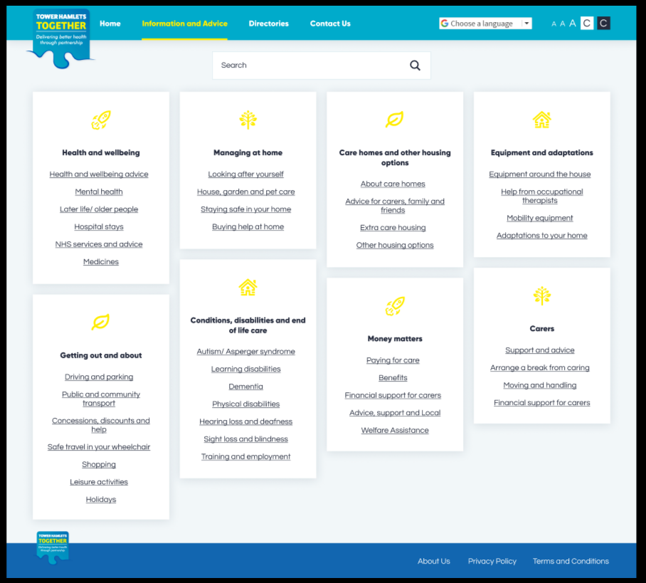
What is the Digital Portal?
The Digital Portal is a website where you will find:
information and advice on health, social care and benefits

Slide 4
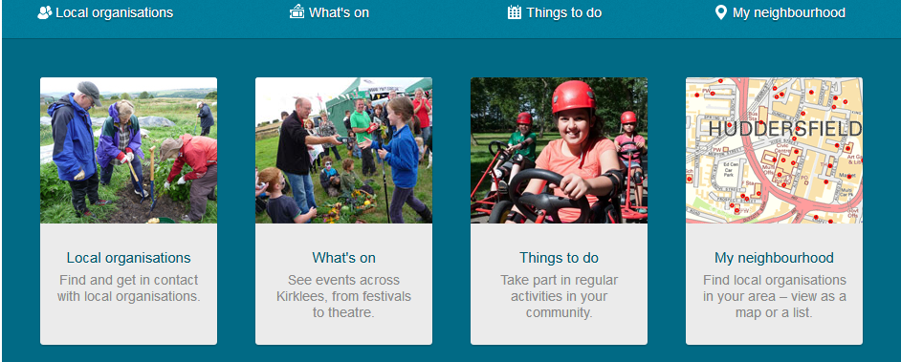
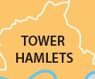
What is the Digital Portal?
The Digital Portal is a website where you will find:
information about local services, activities and events

Slide 5
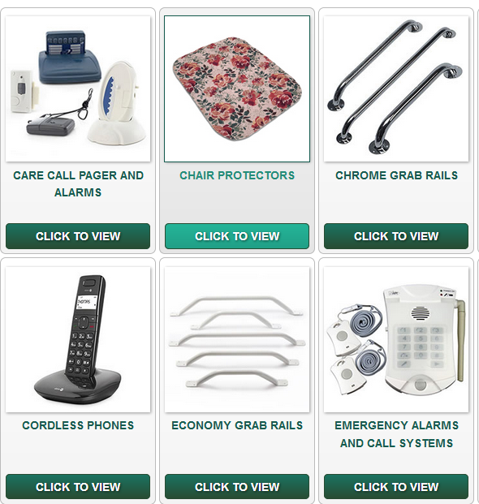
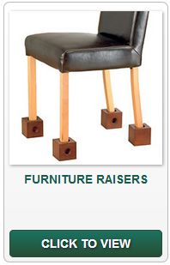
What is the Digital Portal?
The Digital Portal is a website where you will find:
Shop online for products and services like transport or equipment
Pay using a credit, debit, pre-paid cards and PayPal

Slide 6
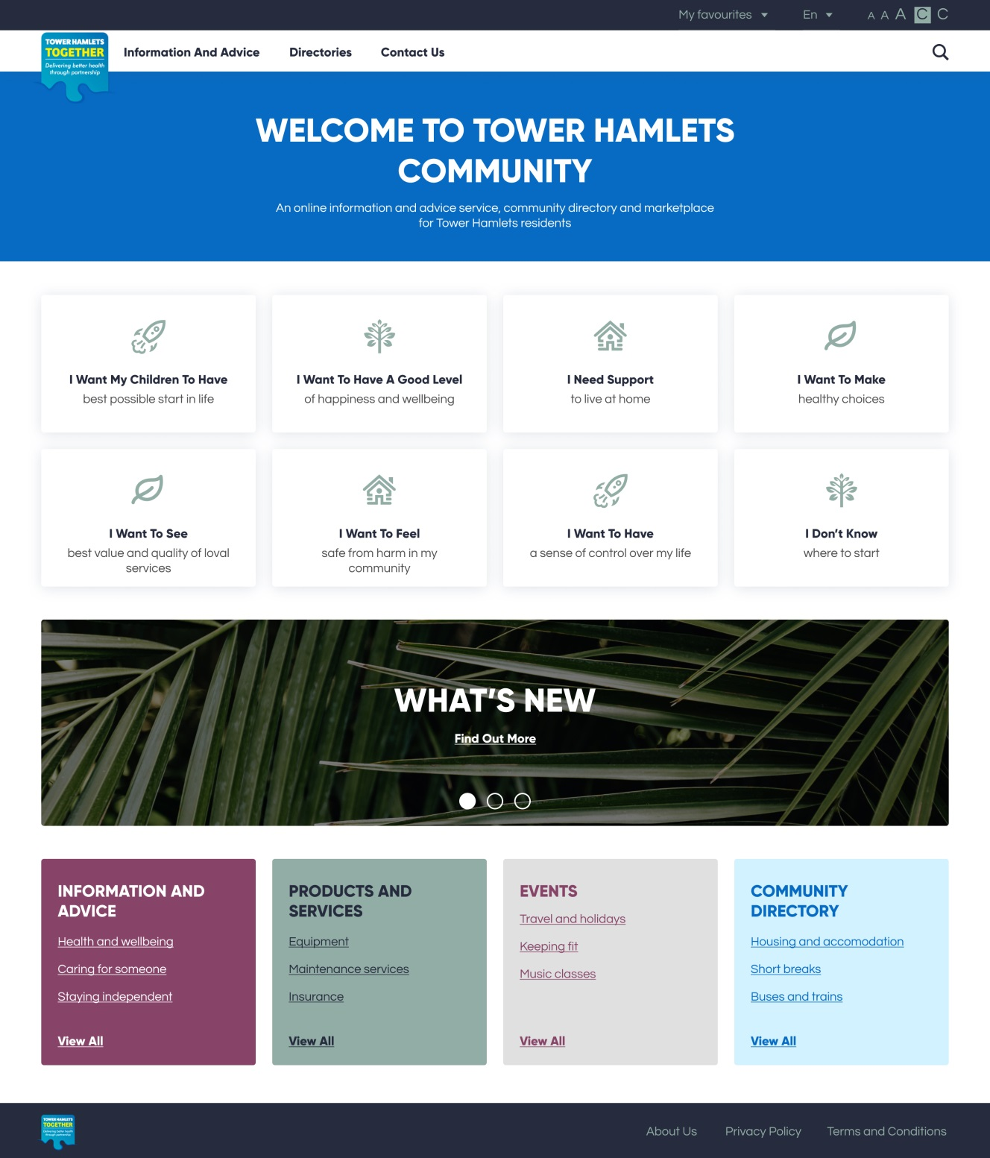
What will it look like?
Homepage design:
Coproduced with health and social care staff from across the borough, providers and Tower Hamlets residents.

Slide 7
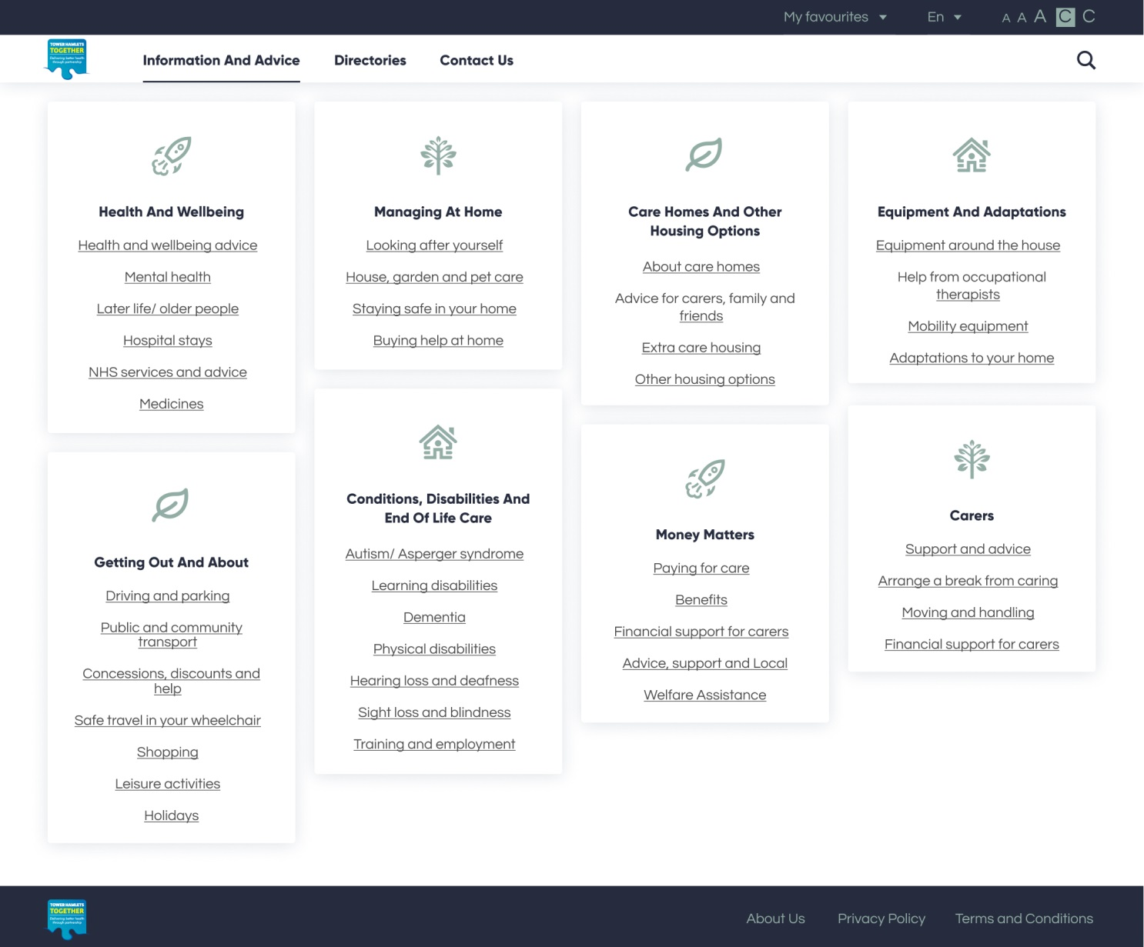
What will it look like?
Landing page design:
Coproduced with health and social care staff from across the borough, providers and Tower Hamlets residents.

Slide 8
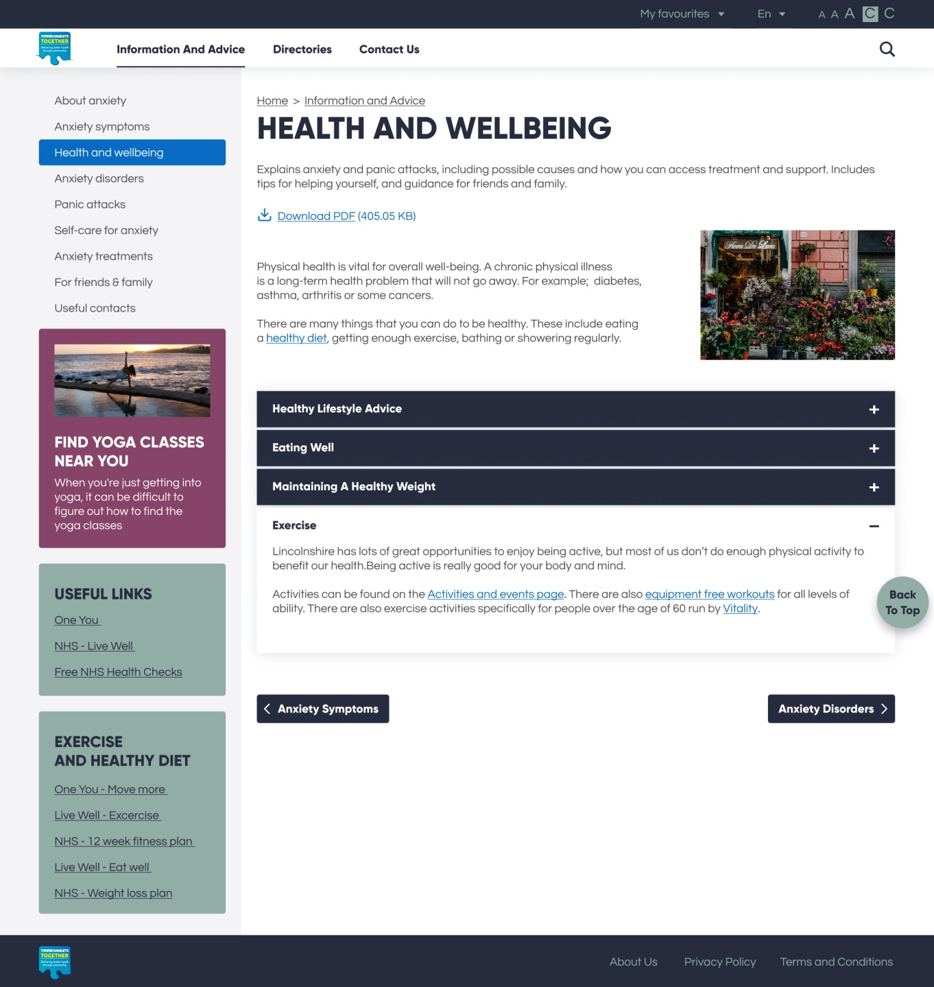
What will it look like?
Content page design:
Coproduced with health and social care staff from across the borough, providers and Tower Hamlets residents.

Slide 9
Digital Platform
What else will it include?
Self service options like self-assessments
To help health and social care professionals identify what people think they need, what is important to them and what they want to be able to achieve.

Slide 10
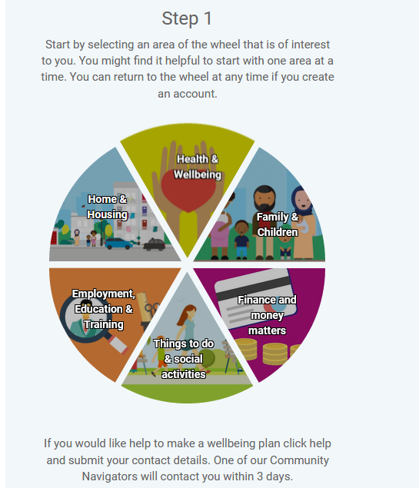
Digital Platform
What else will it include?
Create a Wellbeing plan
The Wellbeing Wheel has been designed to help set clear goals, find support to improve wellbeing and provide with useful information to help you achieve them.

Slide 11
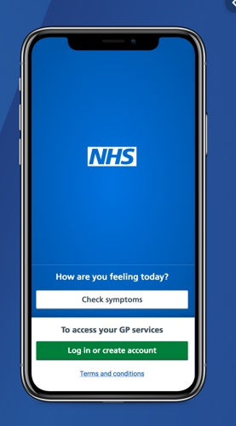
Digital Platform
What else will it include?
Links to the NHS App
The NHS App lets you book GP appointments, order repeat prescriptions and access a range of other healthcare services.

Slide 12
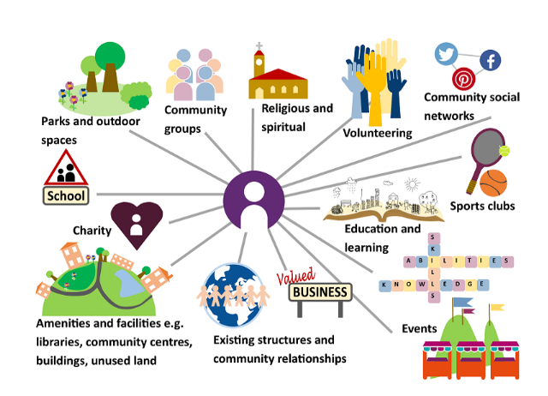
Digital Platform
What else will it include?
Social Prescribing
Sometimes referred to as community referral, is a way for GPs, nurses and other primary care professionals to refer people to a range of local, non-clinical services.

Slide 13
Digital Platform
What else will it include?
Virtual Wallet
Will let users pay providers directly online for a range of services from direct payment budgets, for personal assistants or equipment to increase independent living.

Slide 14
Digital Platform
When will it be ready?
The areas that will be ready later this year are:
information and advice pages
Emarketplace
Directory of services/events and activities
Other areas will be developed over the next year.

Slide 15
Digital Platform
What features do providers want on the directory of services?

Slide 16
Digital Platform
What features do providers want on the eMarketplace?

Slide 17
Dunya Dervis dunya.dervis@towerhamlets.gov.uk

