Slide 1


Moving to a more joined-up
(health, welfare and social care) information and advice
provision in Tower Hamlets

Slide 2
Welcome
Akbal Ahmed,
Strategic commissioning manager, Integrated Commissioning

Slide 3



Integrated Information and Advice
Why integration?
To put it simply, a more co-ordinated and integrated service across health, welfare and social care will improve the overall experience and outcomes for residents who access information and advice services.

Slide 4
An Integrated Information and Advice
Vision
Mission
To co-design and co-produce a more coordinated approach to information and advice, reducing duplication and improving the overall experience and outcomes for residents so that they are provided with the most appropriate forms of support
Outcomes
We want residents to have better access to excellent information and advice at the right time and in the right way to support them to live independent, healthy and fulfilling lives.
Outcome 3: Residents have access to joined-up information and advice services when they need it to remain independent longer.
Outcome 1:Better information available to residents so that they can make better choices about their health and wellbeing.
Outcome 2: Reduce demand and costs on health, social care and welfare services by providing information and advice as early as possible.
Outcome 4: A dynamic, outcomes based council using digital innovation and partnership working to respond to the changing needs of our borough.

Slide 5
Integrated Information and Advice
Research findings and workshops

Slide 6
Digital portal
Professional zone to share resources, training materials, discuss topics, ask questions and peer-to-peer support
Good navigation and jargon free language is key to allow residents (and advisors/professionals) to easily find information /resources.
Online resource, forms, letters, templates that can download and use.
Essential to keep online directory and resources updated.
Online assessment for advisors and residents to be simple and build on best practice from other sectors, with ongoing testing to ensure it’s
fit-for-purpose.
Online chat would require one or more dedicated advisors to reply. Ensure that advisors have suitable training/qualifications.
Being able to leave feedback/comments on the quality of information or satisfaction level on the portal.
Being able to track individual outcomes.
Residents said an online chat function would be useful.

Slide 7
Centralised helpline
Advisors staffing the helpline should have relevant training and qualified to give advice.
Centralised helpline offered in addition to and not instead of existing routes into services.
Would be useful for residents who do not know where to start or where to go initially for help.
There are other single phone numbers (national services and helplines). This needs to be taken into account so as not to confuse residents.
Booking appointments could be challenging to manage but useful for residents.
Follow up calls would be valuable in a timely manner and at an agreed time.
Important to be able to speak with a person rather than accessing a voicemail service or automated options.
Operational challenges (passing calls around, queues and waiting times).
Having time to listen to callers, being patient and asking the right questions to understand the callers situation and needs.
Challenges around data protection and data sharing and the need to obtain consent in light of GDPR.
Potential risk of building up crisis if people are not appropriately referred or dealt with.

Slide 8
Hub and outreach
Pooling and sharing of interpretation and opportunity to make better use of volunteers to support residents.
Opportunity to share locations/spaces across the borough and to better use community assets (delivering information and advice outside of advice centres).
Service should be accessible for different groups with different needs (mental health, physical disability, sensory, learning disability, etc.)
Language and communication barriers can affect residents ability to receive the support they need.
Improve partnership working across health, welfare and social care.
The council could make better use of the data and ensure that data is collected in a consistent way away across contracts and services.
Standardising data systems would be valuable however it would be challenging process as some organisations have different data demands from other funders and their national parent organisations
Being able to follow clients’ journeys through the system to understand what services they have visited previously, whether they got the support/answers they needed, etc.
Face-to-face interaction is the preferred option for Information and advice services.

Slide 9
Proposed model will include:
1. Digital portal
To work with partners to ensure the directory and information and advice pages are kept up-to-date and work with Tower Hamlets Together and the information/advice sector to develop the digital portal for residents to reduce demand for telephone support.
2. Centralised helpline
A triage based service providing information and advice and referring in to adults social care and/or other local services.
3. Hub and outreach
Provide face-to-face information and advice that compliments existing services (LCF funded info/advice, community navigators/mental health navigators/social prescribing and others).
4. Network
Engage with health, social care and welfare services to create a network to share information, best practice and develop opportunities for partnership working, and develop a volunteer network.

Slide 10
Proposed model
The service will act as a gateway for residents to access info/advice about health, welfare and social care.
The service will effectively act as a single access point to adult social care. The helpline is in addition to the council’s customer contact centre and existing routes into info/advice sector. The service will:
reduce demand on health and social care services whose main function is to not give information
reduce demand on the council’s customer contact centre where the only reason is to gain access to (health, social care and/or welfare) information/advice.
potentially reduce information/advice demand on LCF funded organisations.
The service will help people contact with the right information, advice and help through the portal, helpline, and hub and outreach.

Slide 11
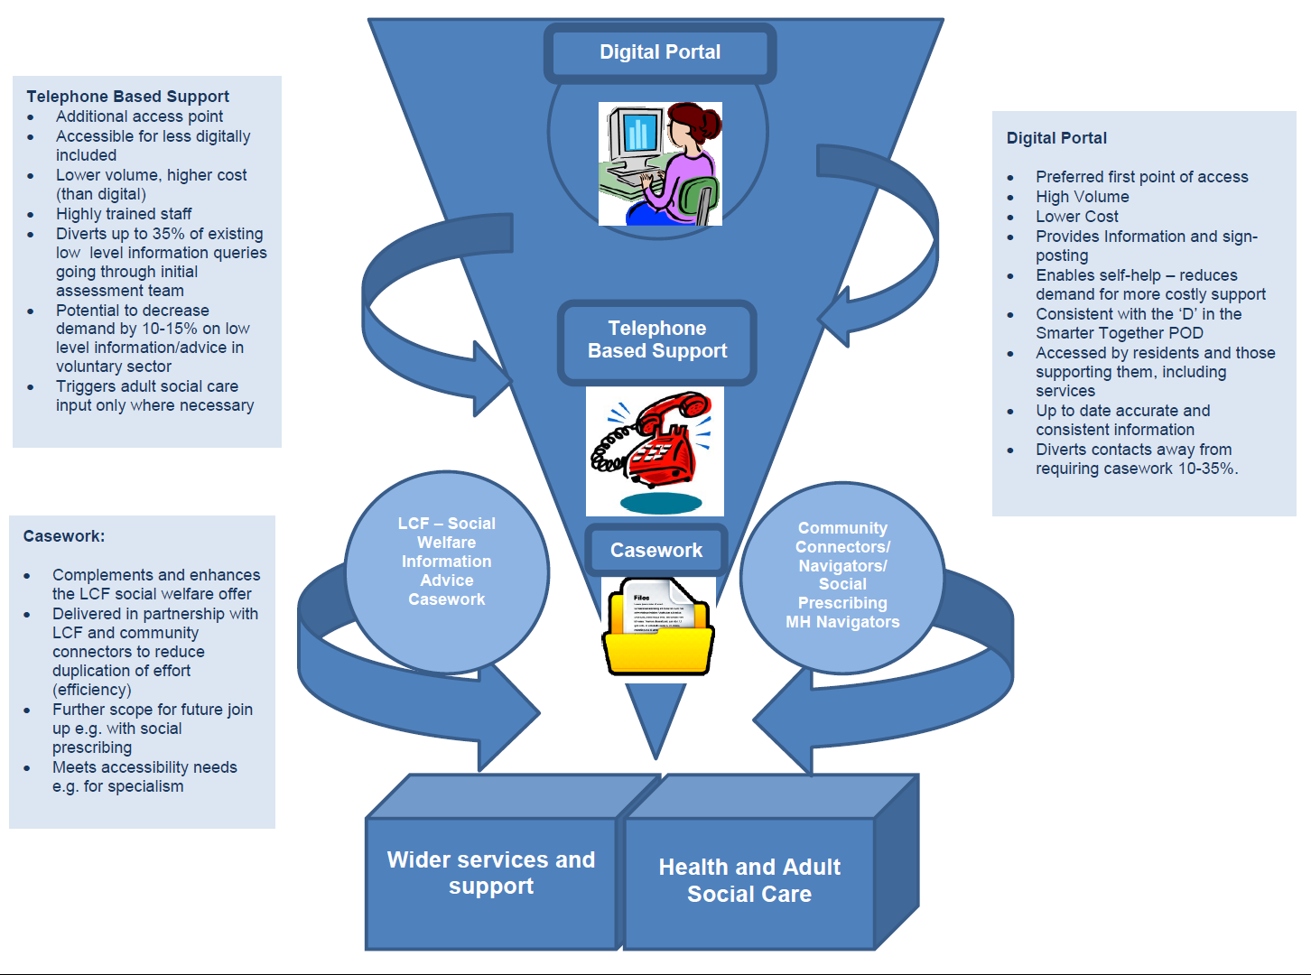
Proposed model

Slide 12
Proposed model
1. Centralised helpline
Helpline staff will be expected to spend time talking to, relating with, and understanding the lives of users and providing appropriate support through information and advice in an enabling way.
Staff will carry out regular case management ‘call-back’ appointments to check whether information and advice was provided correctly and outcomes met. Complete an online assessment through the portal on consent of user and forward to providers for a call back
2. Digital portal (next slide)
3. Hub and outreach
Will compliment the helpline and digital portal by providing face-to-face information and advice at locations throughout the borough, and will link in with LCF funded info/advice, community navigators/mental health navigators/social prescribing and others.
4. Network
The network will be critical in the success of delivering a coordinated information and advice provision across the borough. The provider will engage with health, social care and welfare services to create a network to share information, best practice and develop opportunities for partnership working, and develop a volunteer network.

Slide 13
Proposed model
3. Digital portal
The digital portal is being developed in three phases. Once Phase 1 is complete and launched later this year, the service provider will have responsibility for updating the directory of services and information and advice pages from April 2020.
The provider will work with Tower Hamlets Together and health, social care and welfare services to develop Phase 2 and Phase 3.
Phase 1: June - Ongoing
Assist v3.0 Upgrade
Infrastructure (information and advice pages)
E-market place
Directory of services
Online assessment
Phase 2: April 2020 onwards
Micro commissioning
Professional zone
Link into the council's new CRM
Link into the NHS app
Phase 3: Sep 2020 onwards
Social prescribing
Virtual wallet
Single sign-on
Appointments booking system (tbc)
Beds management booking system (tbc)

Slide 14
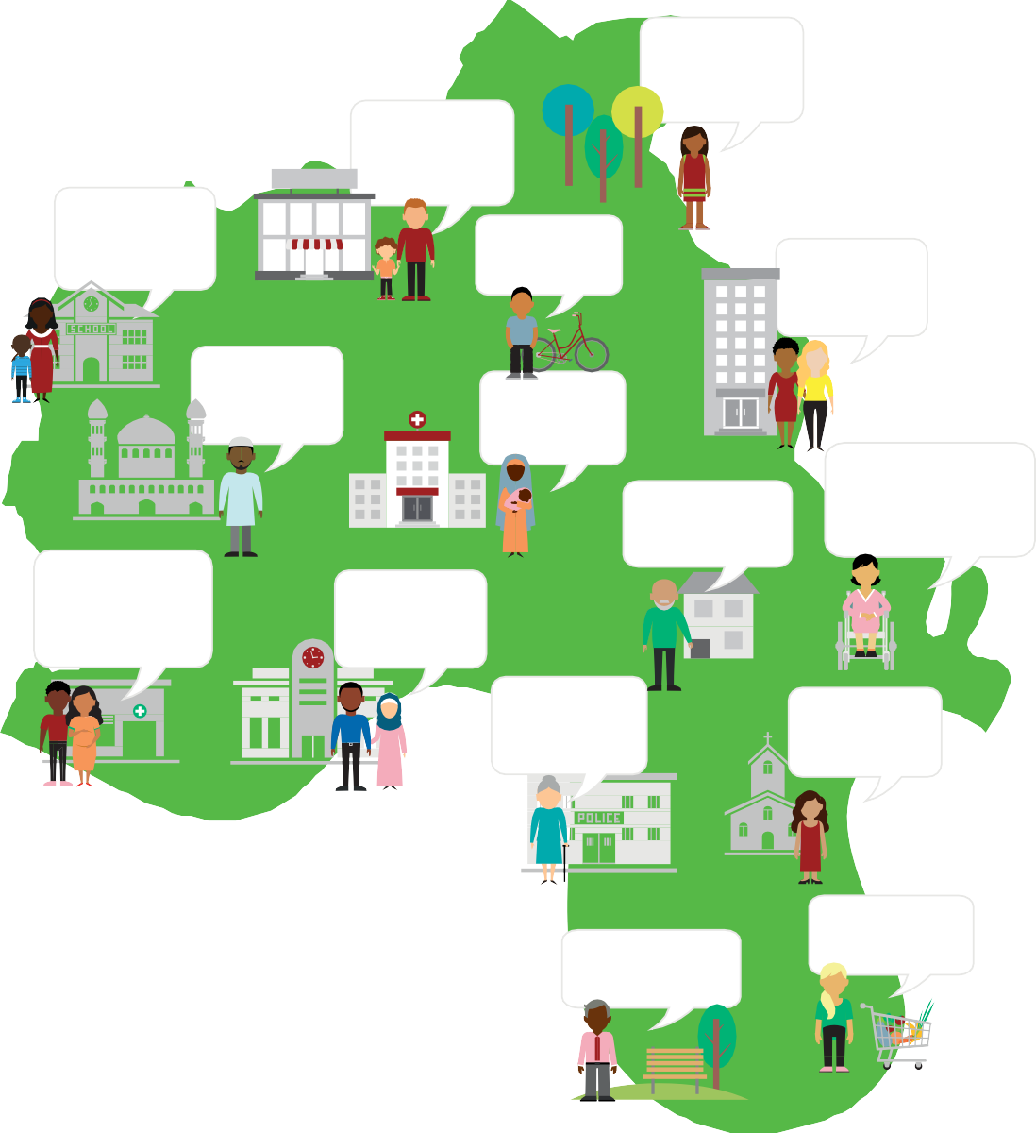
Tower Hamlets Together
Outcomes Framework
I am able to breathe cleaner air in the place where I live
I am able to support myself and my family financially
My children get the best possible start in life
It is likely I will live a long life
I am satisfied with my home and where I live
I play an active part in my community
I feel my care is provided safely
I am confident that those providing
I have a positive my care are skilled
experience of the services I use
and motivated in their work
I am able to access the services I need, to a safe and high quality
I want to see best value and quality of local services
I feel safe from harm in my community
I have a sense of control over my life
I am supported to make healthy choices
I have a good level of happiness and wellbeing

Slide 15



