Slide 1
Liberty Protection Safeguards Code of Practice
Hilary Paxton

Slide 2
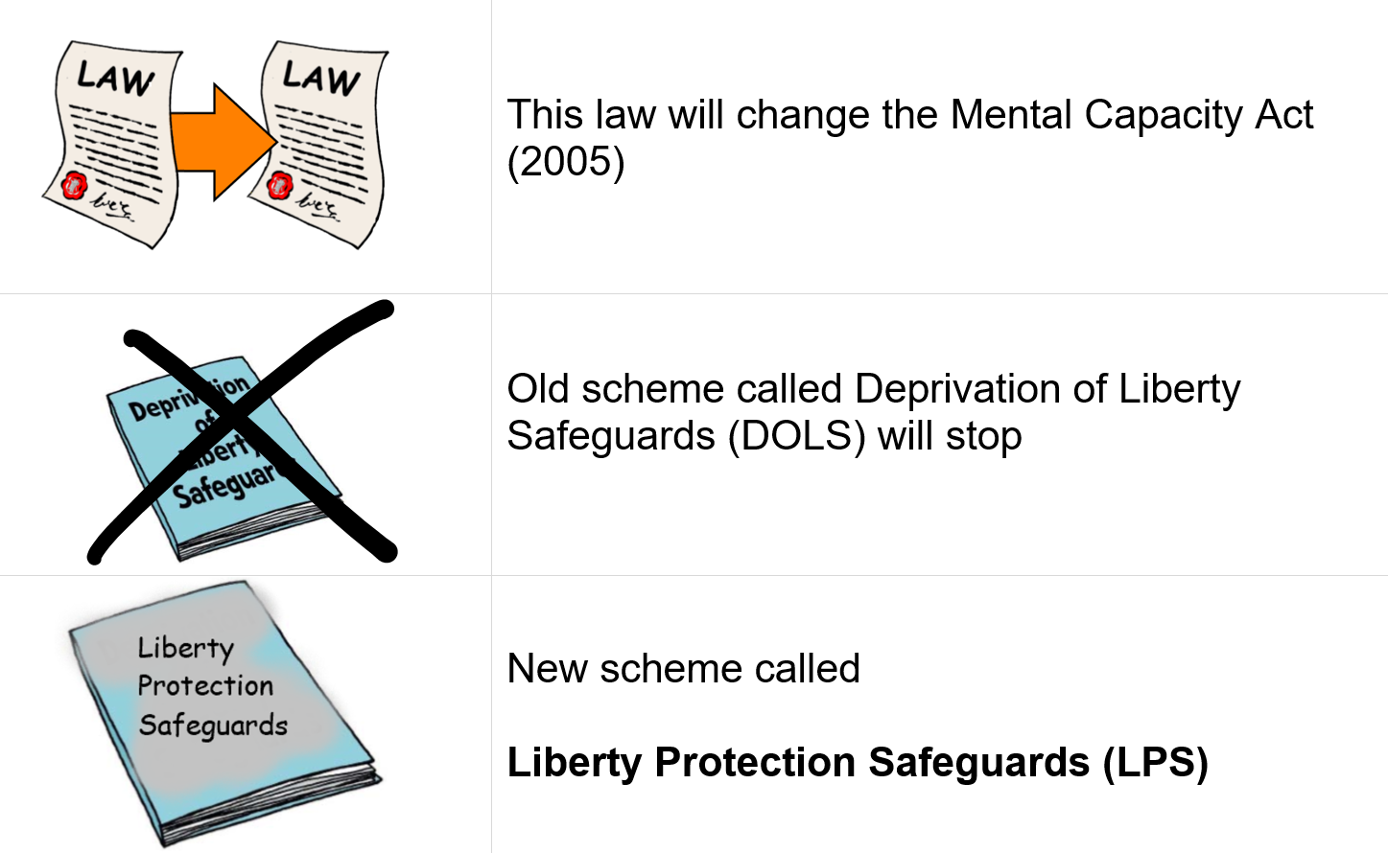
Mental Capacity (Amendment) Bill

Slide 3
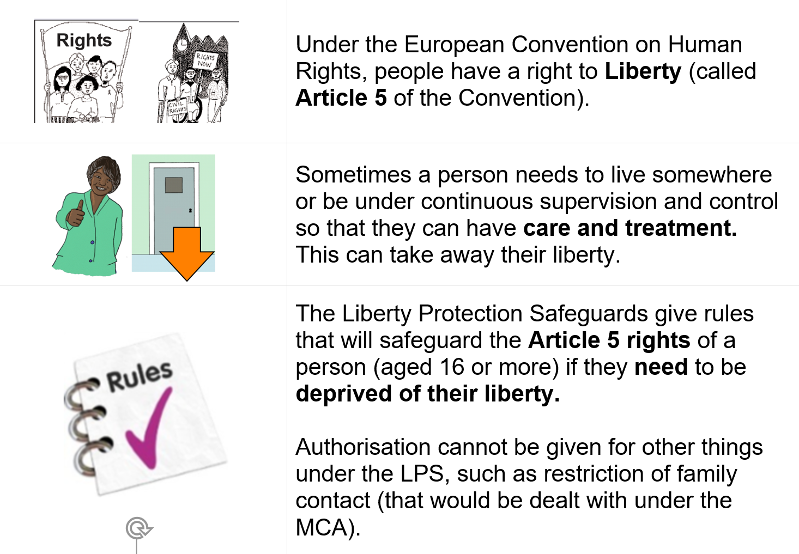
Safeguarding the rights of people aged 16 and above

Slide 4
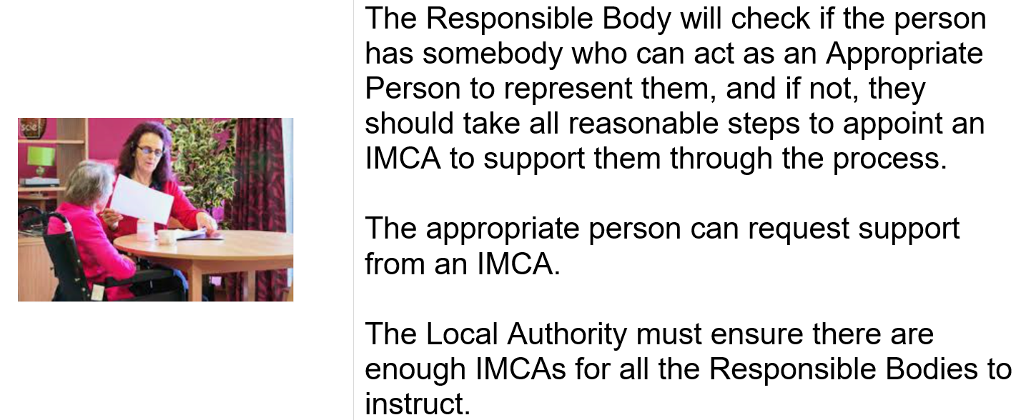
Right to representation by Appropriate Person or IMCA
.

Slide 5
Responsible Body
Arrangements mainly in an NHS Hospital: “Hospital Manager”
Arrangements mainly CHC: CCG
Everything else – Local Authority (including independent hospitals)
.
Care Homes

Slide 6
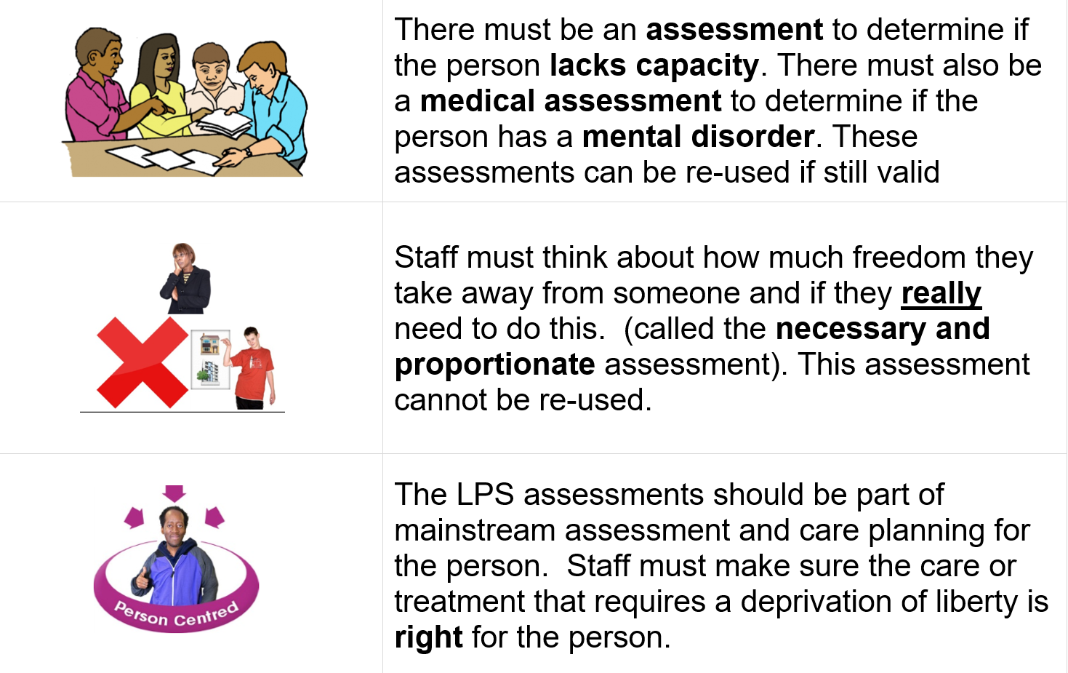
Assessments (and Determinations)

Slide 7
Consultation
.

Slide 8
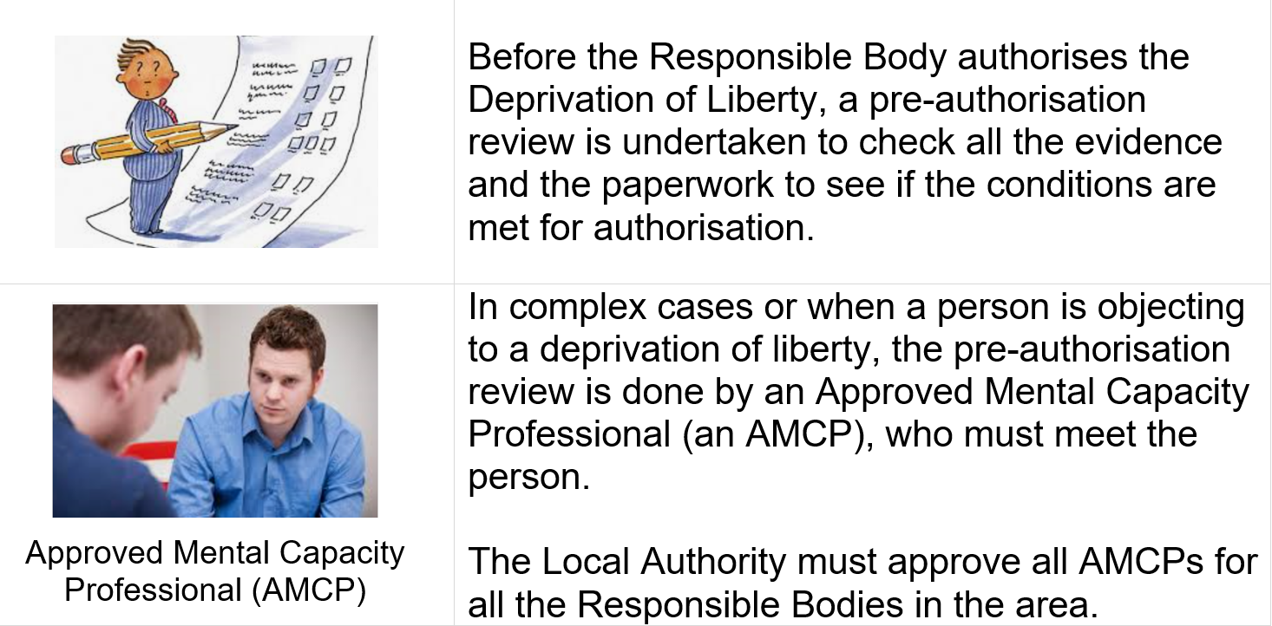
Pre-Authorisation Review

Slide 9
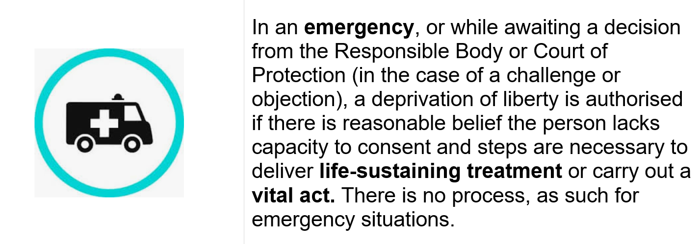
Life-sustaining Treatment or Vital Act
.

Slide 10
Code of Practice
.

Slide 11
First three parts

Slide 12
Last three parts

Slide 13
Next Steps for the Code of Practice
The content is being worked on in 6 Workstreams
There is an overarching group overseeing the work.
Regulations are still required before some of the detail can be completed
Legal advisers will need to check it thoroughly
The code will be subject to a public consultation (a commitment from ministers)
It must be laid before Parliament for 40 days
Expected publication by end of 2019.

Slide 14
Wider Next Steps
Publishing the Regulations
Revising the Impact Assessment to take account of changes to the Bill since December 2018 and concerns raised about earlier Impact Assessments
Agreeing the data required to support the changeover, including data about the people who are currently awaiting authorisation under DOLS or from the Court of Protection.
Agreeing the data required to monitor the new scheme and evaluate its success, together with the systems development required to enable the recording of the right information
Agreeing other information and supporting materials that will be needed: leaflets, website content, videos, online training courses, etc
Agreeing template forms
Workforce planning, both the number of staff and the knowledge, skills and qualifications they will need
Training for health and social services assessment and care planning staff and managers, AMCPs, staff who deliver care and registered care home managers.

Slide 15
Latest Impact Assessment (11/02/19)
Includes:
Transitional Costs
Training costs (health and social care, BIA to AMCP conversion, IMCA, etc)
Recruitment costs (a lead AMCP estimated to be required in 10% of LAs)
Familiarisation costs (following initial training – for care home managers)
Ongoing Costs
Cost of authorisations (care homes – estimated no net change)
Cost of administration (desktop pre-authorisation reviews)
Cost of reviews (only 6% of cases)
Cost of new ‘necessary and proportionate’ assessments in care homes
Total cost of advocacy (IMCA)
Cost of approval (pre-authorisation reviews) by AMCPs
Legal costs – Court of Protection, legal aid
Regulation

Slide 16
Points for Discussion:
Impact Assessment
Strategic Planning with other Responsible Bodies
Implementation Planning
Reducing the Backlog
Training
Understanding the demand for IMCA services
Understanding the demand for AMCPs

