Slide 1
Hoarding: A Safeguarding Approach
Hoarding is the persistent accumulation of and lack of
ability to relinquish large numbers of objects or living
animals.
It results in extreme clutter in and around premises,
compromising the intended use of premises and
threatens the health and safety of people concerned,
animals and neighbours. Hoarding is a progressive and
chronic condition associated with age.

Slide 2
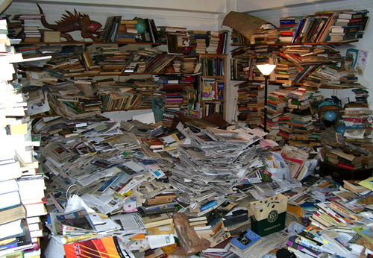
Hoarding is Extreme Behaviour

Slide 3
Hoarding Risks
Fire
Disease
Falls
Building Collapse
Isolation

Slide 4
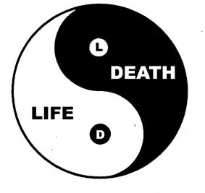
Can Serious Harm Result?
Real Life Cases
A ceiling collapsed due to clutter, killing 62 year old man
50 year old woman fell over clutter on her porch and lay
without help for two days as she was not visible from the street due
to clutter in her yard. Took 3 hours to clear a path to her
A fireman died attempting to save an 80 year old male hoarder
A 50 year old male hoarder died from smoke inhalation after being
rescued by fire crew. Delay due to obstacles led to death

Slide 5
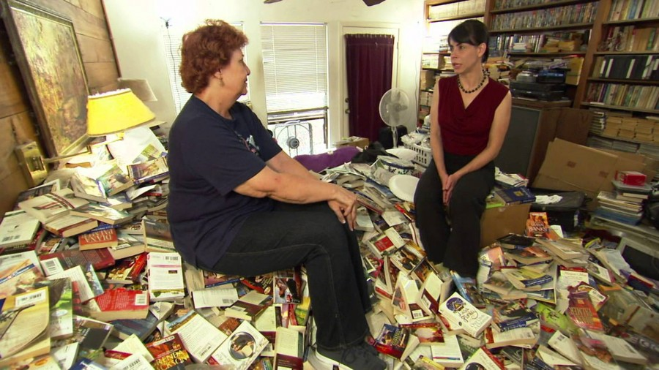
Hoarding- The Varied Causes
Around 40% of people with Obsessive Compulsive
Disorder feel compulsion to hoard.
Practical inability to remove clutter due to disability
Symptomatic of cognitive impairment or mental disorder –
dementia, depression, schizophrenia
Can be triggered by bereavement
Behavioural- family history of hoarding

Slide 6
Hoarding- The Associated Behaviours
Keeping items that may have little or no value, such as
junk mail and carrier bags
Finding it hard to categorise or organise items
Having difficulties making decisions
Struggling to manage everyday tasks
Refusing to let anyone touch or borrow items
Having poor relationships with family or friends
May have mental capacity to
weigh risks

Slide 7

Hearing Voices of People Who Hoard
•If I discard this, I will lose the memory.
•This may come in handy later.
•This may gain in value.
• I am rescuing something which will not be loved otherwise
This object is a part of me.
• These things are family ties.
• Safety (feeling of safety as a result of clutter)
• Everything is useful and I don’t want to lose anything
Talking to the person and understanding their chosen outcomes is essential
Source: Hoarding UK (charity)

Slide 8

Why Commercial Cleaning Alone is Ineffective
Deep-seated psychological & emotional states are not solved by practical solutions alone
Recidivism after commercial clean 96% & can worsen the behaviour
Person likely to experience commercial clean as trauma which takes all they have/their identity
The term ‘Blitz clean’ should never be used due to connotations of destruction
Staged interventions with emotional & psychological support involving small steps towards progress are more effective

Slide 9

Best Practice: Weighing Treatment of Hoarding Disorder & Harm Minimisation
Address Hoarding Disorder
Harm Minimisation
Cognitive behavioural therapy
Serotonin reuptake anti-depressants
Fire retardant materials
Falls Prevention
Mentoring/ monitoring

Slide 10
Developing a Safety Plan
Balance intervention
& empowerment for person
Housing & residential
options/small changes?/
new accommodation?
Fire prevention–use clutter
scale to assess risks
Isolation brings risk of
“cuckoo”abuse
Client
Care Package
Housing
Health

Slide 11
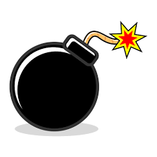
Preventing A Severe Incident- Prevent Different Risks Coming Together
Environmental
Incident e.g Fire/Fall/Disease
Individual

Slide 12
Assessment Issues: Individual
Cognitive impairment –dementia or delirium
Behaviour patterns
Continence problems
Injury from earlier falls
Fear of falling
Unsuitable footwear
Medication
Postural instability, mobility problems and/or balance problems
Syncope syndrome (fainting)
Visual impairment.
Cardiovascular health
Support mental health
Improve habits/behaviour
Support physical health

Slide 13
Assessment Issues: Environmental
Lighting
Flooring strength & space
Furniture
Walking routes
Signs eg exit route in fire
Building–based SADLs e.g handholds
Individual based SADLs and CADLs
Telecare e.g alarms & sensors
Visual falls prevention plan
Access to toilet facilities
Access to carers
Reduce Hazards
Add Protectors
Add Alarms

Slide 14
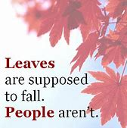
Assessing Hoarding Risks Includes Risk of Falls & Trips
Crisis is an opportunity- promptly address the patient's identified individual risk factors for falling in hospital and manage them [NICE ]
Do not offer universal falls prevention interventions. It must be person-centred [NICE ]
Include strength and balance training/ build responsibility
Include vision assessment and referral
Include medication review

Slide 15
The Key Change Factor: Interpersonal Professionalism
The person and their history
Professional knowledge
Knowing
Being
Doing
Relationship
Respect, empathy, reliability, honesty and care; being present, keeping company, being human
Hands-off and hands-on balance, building consensus over small steps while negotiating larger ones, deciding when intervention is essential

