Slide 1

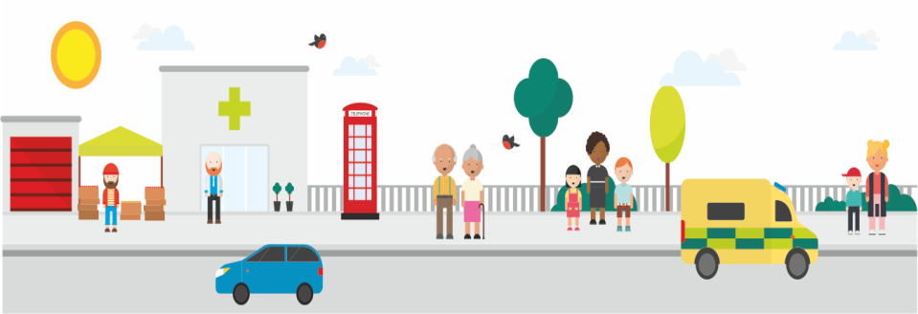
Tower Hamlets Loneliness Taskforce
27th November, 2019 Pan Provider Forum
Dr Somen Banerjee, Director of Public Health
London Borough of Tower Hamlets
www.towerhamletstogether.com #TH2GETHER

Slide 2
What is Loneliness?
‘a subjective, unwelcome feeling of lack or loss of companionship. It happens when we have a mismatch between the quantity and quality of social relationships that we have, and those that we want.’
Notes:
Loneliness definition (suggested by Perlman and Peplau and issued by Campaign to End Loneliness and Jo Cox Commission):

Slide 3
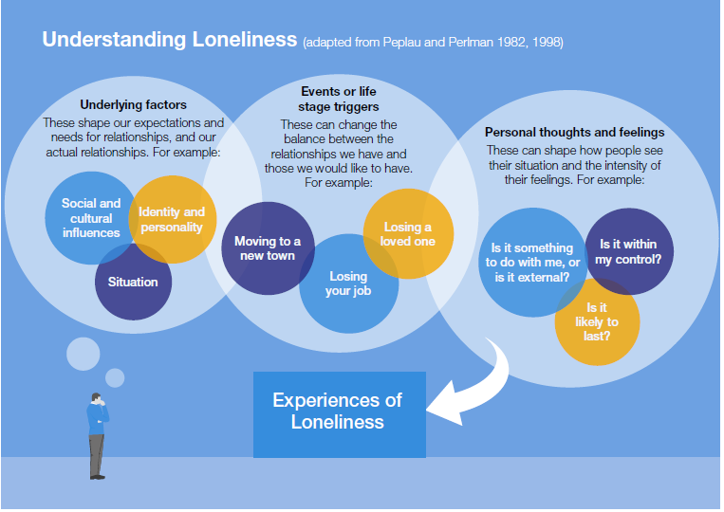

Slide 4
A Strategic Priority for Tower Hamlets
“Loneliness affects many residents here, especially the elderly. We support the work of the Loneliness Commission set up by Tower Hamlets resident Jo Cox MP and will lead a taskforce to identify how we can best address loneliness and isolation here.”

Slide 5
Loneliness Taskforce - membership
Chair: Cllr Denise Jones, Older People`s Champion
Wide representation
  Social Care, Public Realm, Social Prescribing, Public Health, Voluntary Sector, Ageing Well, Tackling Poverty, Transport, Equalities and Partnership, Youth service, Employment, Housing, Interfaith forum

Slide 6
What is our vision?
The vision of the ‘loneliness taskforce’ is for Tower Hamlets to be a place that is welcoming and friendly where people of all ages and backgrounds have opportunities to connect with each other in ways that are enjoyable, fun and life enhancing.

Slide 7
What are our aims?
Tower Hamlets is a friendly and welcoming place
Services in Tower Hamlets identify and support people for whom loneliness is an issue in their lives
Tower Hamlets is a place that is rich in opportunities for people to enjoy each other’s company and where residents can be part of creating these opportunities

Slide 8
Why does this matter?
Feeling connected is a foundation of wellbeing in our lives
In our borough we have assets that bring people together but also vulnerabilities that mean people experience loneliness and social isolation
Working together we can strengthen the assets and reduce the vulnerabilities

Slide 9
Where are we now and what is the opportunity?
Feeling connected is a foundation of wellbeing in our lives (hence part of Communities Driving Change priority of Health and Wellbeing Strategy)
In our borough we have assets that bring people together but also vulnerabilities that mean people experience loneliness and social isolation
Working together we can strengthen the assets and reduce the vulnerabilities

Slide 10
What is the plan?
1. We will have a shared action plan that strengthens assets to prevent and address loneliness in the borough – it builds on existing strategies, plans and initiatives but also includes specific initiative and programmes led by the taskforce
2. We will have a small steering group working but a large, dynamic network of stakeholders
3. We will actively gather insight into where there is need and opportunity to find ways to help people be more socially connected where this is an issue for them
4. We will continually trying out new ideas and evaluating them as well as learning from what is good elsewhere
5. We will actively seek and coordinate funding opportunities
6. We will have a small number of meaningful measures that track how much we are going, how well we are doing and what difference we are making.

Slide 11
Ideas and areas of focus
Friendly and welcoming
Link with existing plans
Work with staff in unofficial day centres
Service identifying loneliness
Training for frontline staff
Loneliness and social prescribing
Rich in opporunities to connect
‘Can Do’ on social isolation
Volunteering to promote connection
Welcome pack for new residents
Build on Communities Drive Change programme
Communication and engagement

Slide 12
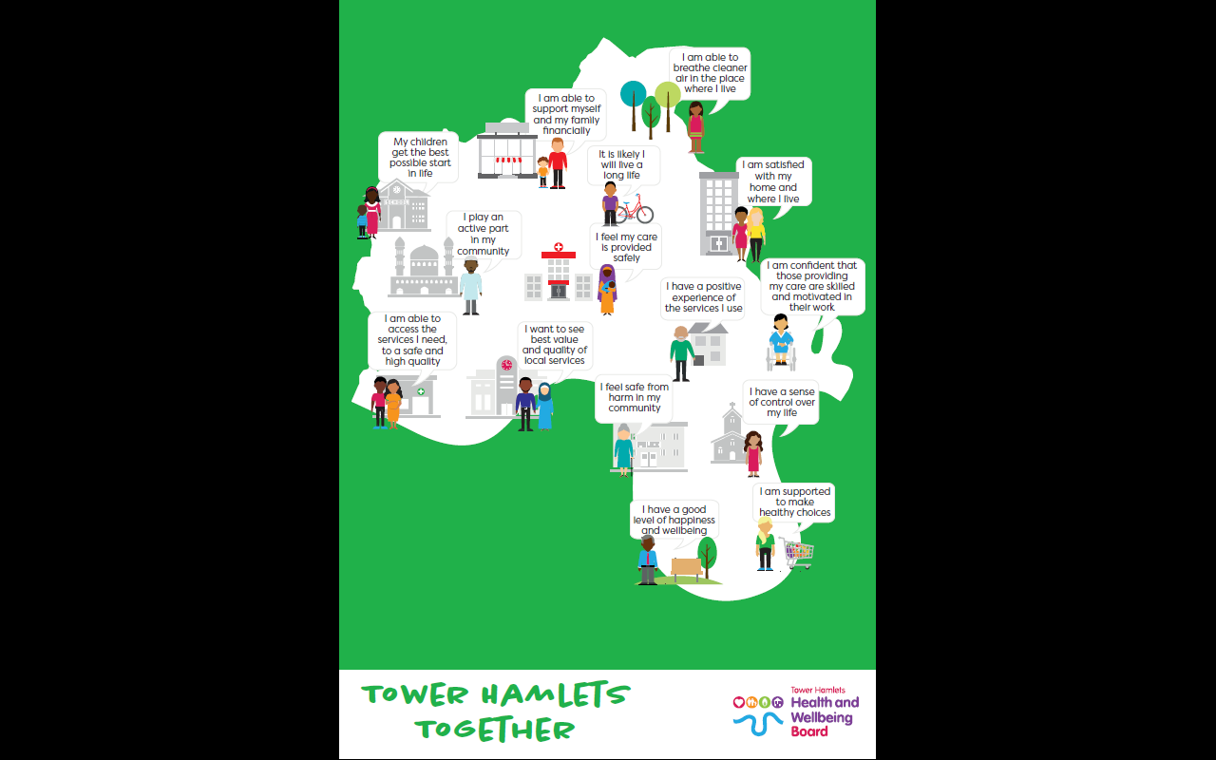
Feeling connected is a foundation of the TH Shared outcomes framework

