Slide 1


Safe Space Community
Presentation by Mind in Tower Hamlets and Newham
Joanna Boldeau and Lisa Grogan

Slide 2
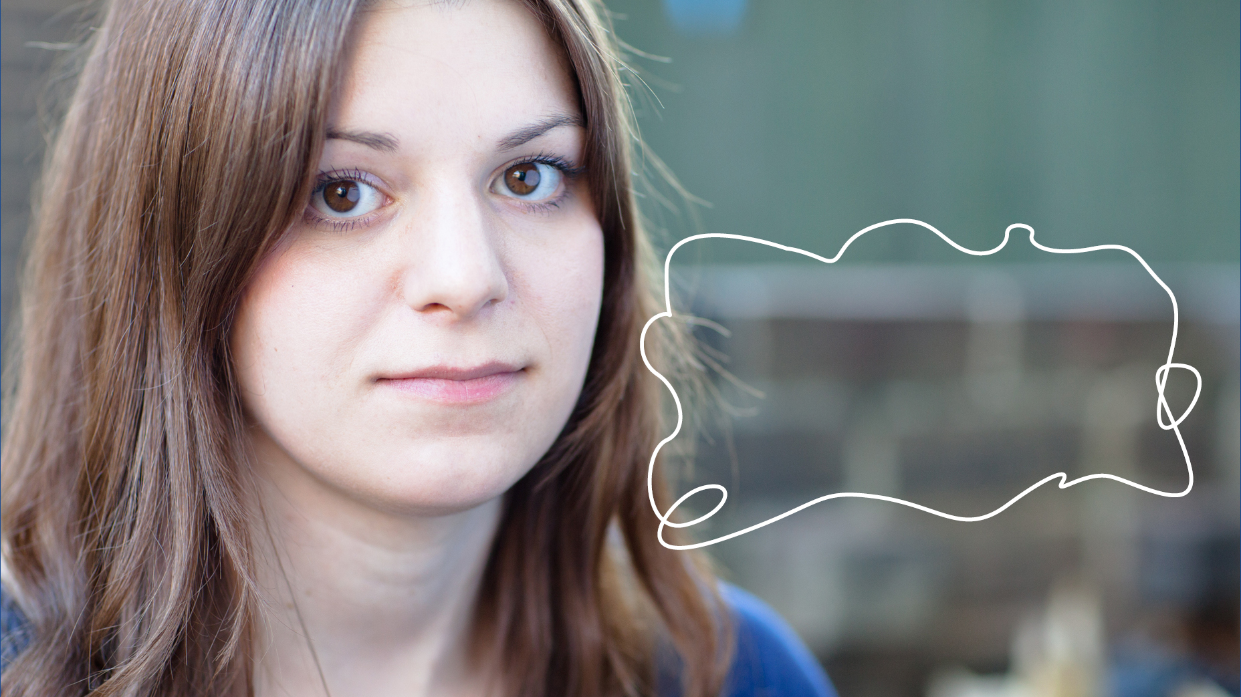
The Safe Space Community was developed through our client forum, where people with lived experience said they sometimes do not know where they will be welcomed

Slide 3
Introduction
Approximately 1 in 4 people will experience a mental health issue in their lifetime and this can also affect family and friends – Mind in Tower Hamlets and Newham are on a mission to make sure no one feels alone and are able to access support when they need it the most
Mind in Tower Hamlets and Newham are committed to our community and we are constantly working to improve the lives of those affected by mental health.
Notes:
Mind in Tower Hamlets and Newham are a community charity based in Bow.

Slide 4

We are working in Tower Hamlets to lead the way and create a borough where mental health is accepted and local businesses, organisations, community hubs, coffee shops, libraries join the Safe Space Community Movement

Slide 5

What is Safe Space Community?
We are pioneering a community response to improve mental health and wellbeing in Tower Hamlets.
Our vision is a society where people living with mental health can live free from discrimination and stigma
We are creating a wonderful network of ‘safe spaces’ where members of the community will be welcomed, safe from stigma and judgment, allowed the time and sanctuary when they need it and can connect with others in their community.

Slide 6
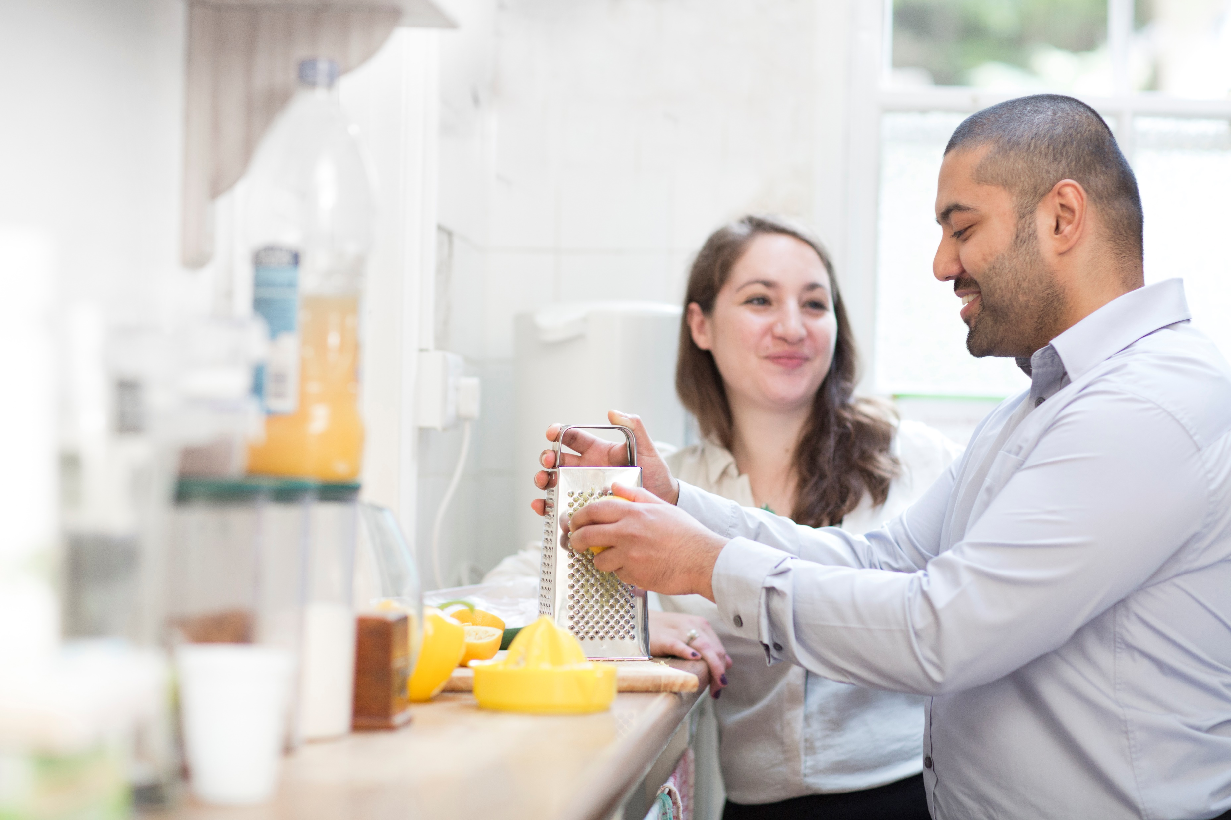
We are at the sign-up phase of launching the Safe Space Community and it forms an integral part of our transformational Connecting Communities service within the Tower Hamlets Recovery and Wellbeing contract.

Slide 7

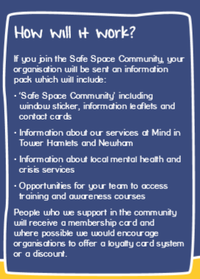
https://www.mithn.org.uk/get-involved/safe-space-community/
https://www.safespacecommunity.org.uk/

Slide 8

If you would like to know more about Safe Space Community contact us:
Email - safe.space@mithn.org.uk
Phone - 0207 510 1081
Website - https://www.mithn.org.uk/get-involved/safe-space-community/

