Slide 1


Tenants’ Activity Pot (TAP)

Slide 2
What is it?
In 2016, a review of the sheltered housing model led to all sheltered housing adopting an intensive housing management model.
During consultations, sheltered residents stated that more could be done around activities or that they didn’t reflect their interests.
Funds freed through the remodelling of services have been re-invested back into the sheltered schemes.

Slide 3
Focus on residents and activities
The Tenants’ Activity Pot (TAP) has been made available to help sheltered residents, with the help of their landlord, design a programme of activities that they, their friends and neighbours want to do.
TAP is Resident-focussed

Slide 4
Aims
Tackling loneliness and isolation for our older population is a key priority for the council and the TAP is one of the many programmes the council is investing in to help improve social connections.
The three areas where we want to see the TAP being used are in activities that:
support and maintain existing relationships;
foster and enable new connections: and
improve the health and wellbeing of tenants

Slide 5
One year findings
TAP programme started on 1st October 2018
Since then, 2944 sheltered residents and 744 friends, family, carers and neighbours from the locality attended over 336 activities across 20 schemes.
Because one person can attend more than one activity, analysis shows that 370 unique residents or 71% of the sheltered population attended one or more activity.

Slide 6
Types of activities
Gardening clubs
Sewing clubs
Fish and chip nights
BBQs
Trips to local theatres
Trips to the seaside
Madame Tussauds
Valentines Karaoke
Yoga, Tai Chi and Chair based exercises

Slide 7
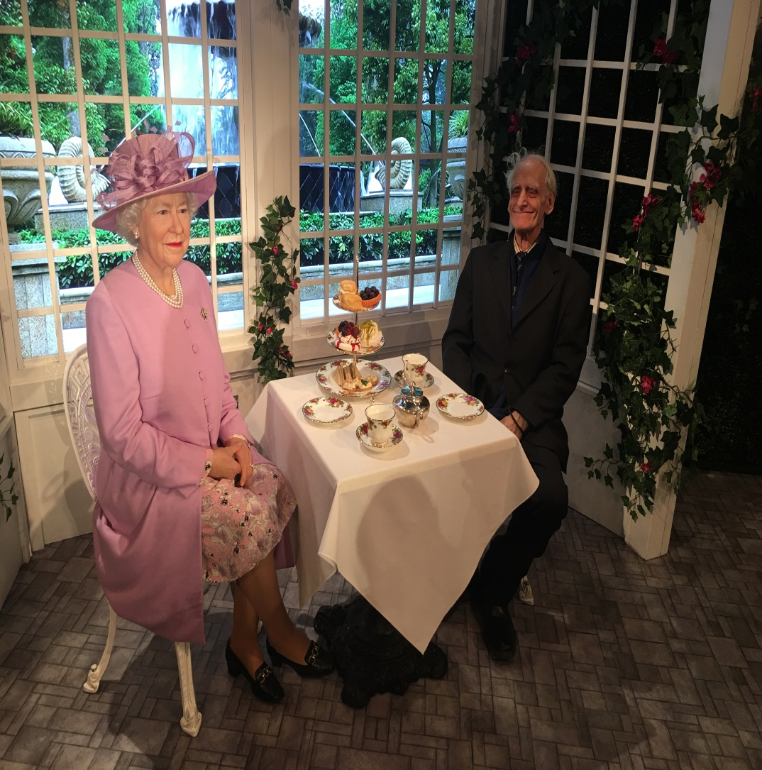
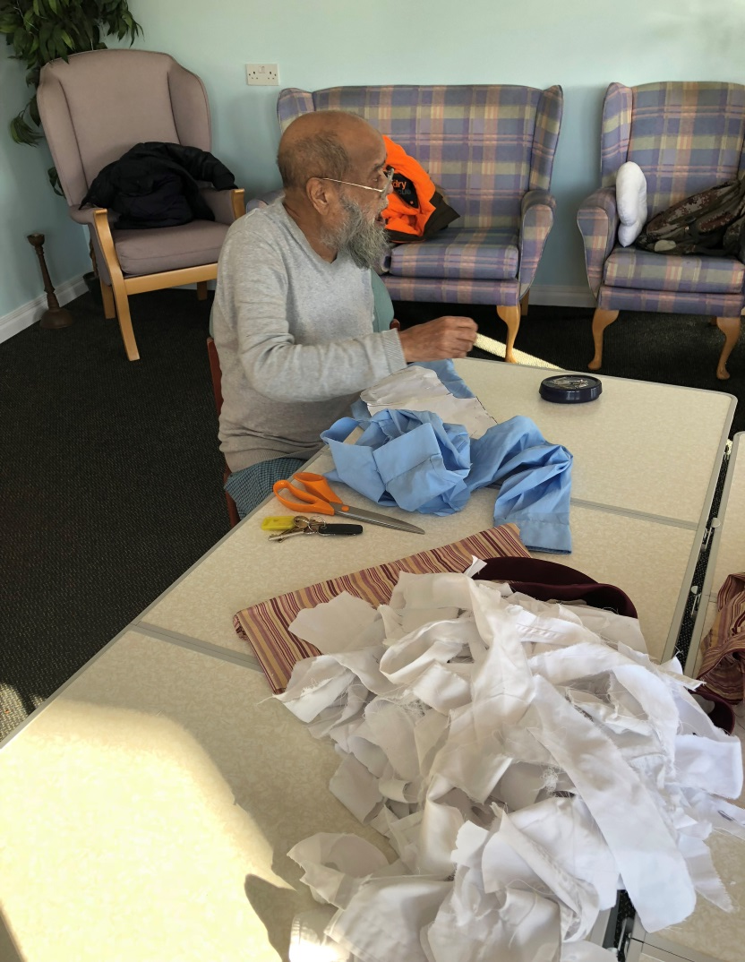
Activities

Slide 8
Feedback
“I was in hospital and I prayed that they’d let me out the next day as I didn’t want to miss the Tina Turner concert” – Gawthorne Court
“Gives us the opportunity to meet new residents and neighbours” – Pebble Centre
“Its broken our routine” – Cavell Street
“Makes a change and gets me out. Gives us plenty to look forward to” – Rochester Court

