Slide 1
2021 Census – Findings
March 2023
Corporate Strategy and Improvement Team
Find out more: Census - Office for National Statistics (ons.gov.uk)

Slide 2
Contents
Key Points
Demography
Country of Birth and Migration
Ethnic Origin, Religion and Language
Sexual Orientation and Gender Identity
Labour Force
Housing
Health
Education

Slide 3
Key points
The census was carried out on 21 March 2021. All residents are required to complete the census so it provides the most complete picture of the borough’s population available. This census was carried out during the Covid 19 pandemic. At the time England was in its third national lockdown. Restrictions were in place on gatherings and travel while non essential retail and hospitality venues were not able to open,
Tower Hamlets has the fastest growing population of any local authority area across England and Wales. Between 2011 and 2021 the local population has grown by 56,200 (22.1%) to 310,300. In 2011 the population was 254,096.
Tower Hamlets is the most densely populated borough in England with 15,695 residents per square kilometre compared to an average of 424 people per square kilometre in England – that is over 37 times higher than the mean average population density for England.
The median age in Tower Hamlets was 30 – the youngest of any area in England and Wales. The borough had the smallest proportion of older people aged 65+ in England and Wales.
The most common countries of birth other than the UK were Bangladesh, Italy, India, China and France. 14% of residents were born in a current European Union country.
Population turnover is high compared to elsewhere with more than a fifth (20.8%) of residents having lived somewhere else a year prior to the census.

Slide 4
Key points (2)
At 34.6%, Tower Hamlets has the largest Bangladeshi population in England and Wales and the largest Muslim population (39.9%) in England and Wales. It had the fourth smallest White British population and the smallest Christian population in England and Wales.
7.2% of adult residents were Lesbian, Gay, Bisexual or Other and 1% had a gender identity different to their sex registered at birth.
62.7% of all residents in employment were in managerial, professional or associate professional occupations but 46,000 adults have never worked.
Tower Hamlets has a high proportion of households who rent, both from social landlords and from private landlords whereas the proportion of owner occupiers is the lowest in England and Wales.
15.8% of households were overcrowded (had too few bedrooms for their needs).
Two thirds of households do not have access to a car or van, one of the lowest levels of car ownership in England and Wales.
12.9% of residents had a disability and 25.7% of households had at least one disabled person living within them.

Slide 5
Demography

Slide 6
Overall borough population
As of census day on 21 March 2021, the population of Tower Hamlets was 310,300.
This was an increase of 56,200 or 22% since 2011 – the largest increase of any area in England and Wales.
This equates to 15.4 additional persons every day over the ten year period.
The census day population is 21,700 below the mid year 2020 estimate – 7% lower.
*(rounded to nearest 100 persons).

Slide 7
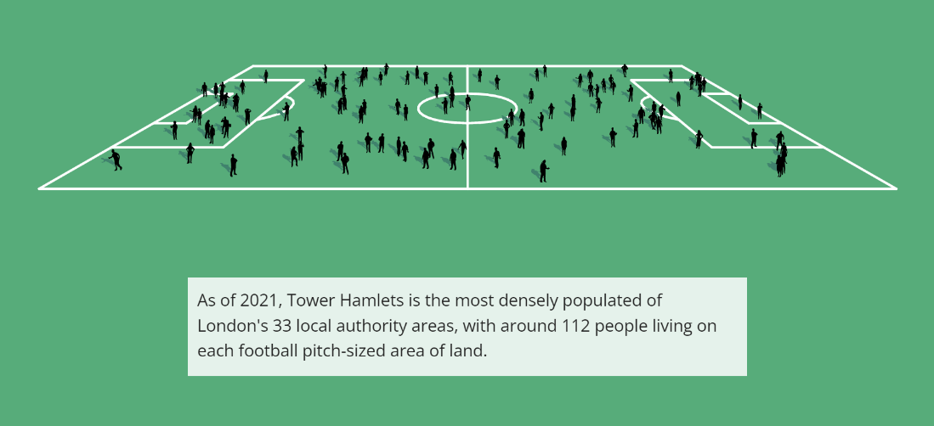
Population density
With a population density of 15,695 persons per km², Tower Hamlets is by far the most densely populated area in England and Wales.
The next most densely populated areas were Islington (14,578 per km²) and Hackney (13,611 per km²)
Population density in England was 434 persons per km² and in London it was 5,598 per km².
For England that is three people for every football pitch sized area of land. Contrast that to the chart on the right.
*(rounded to nearest 100 persons).

Slide 8
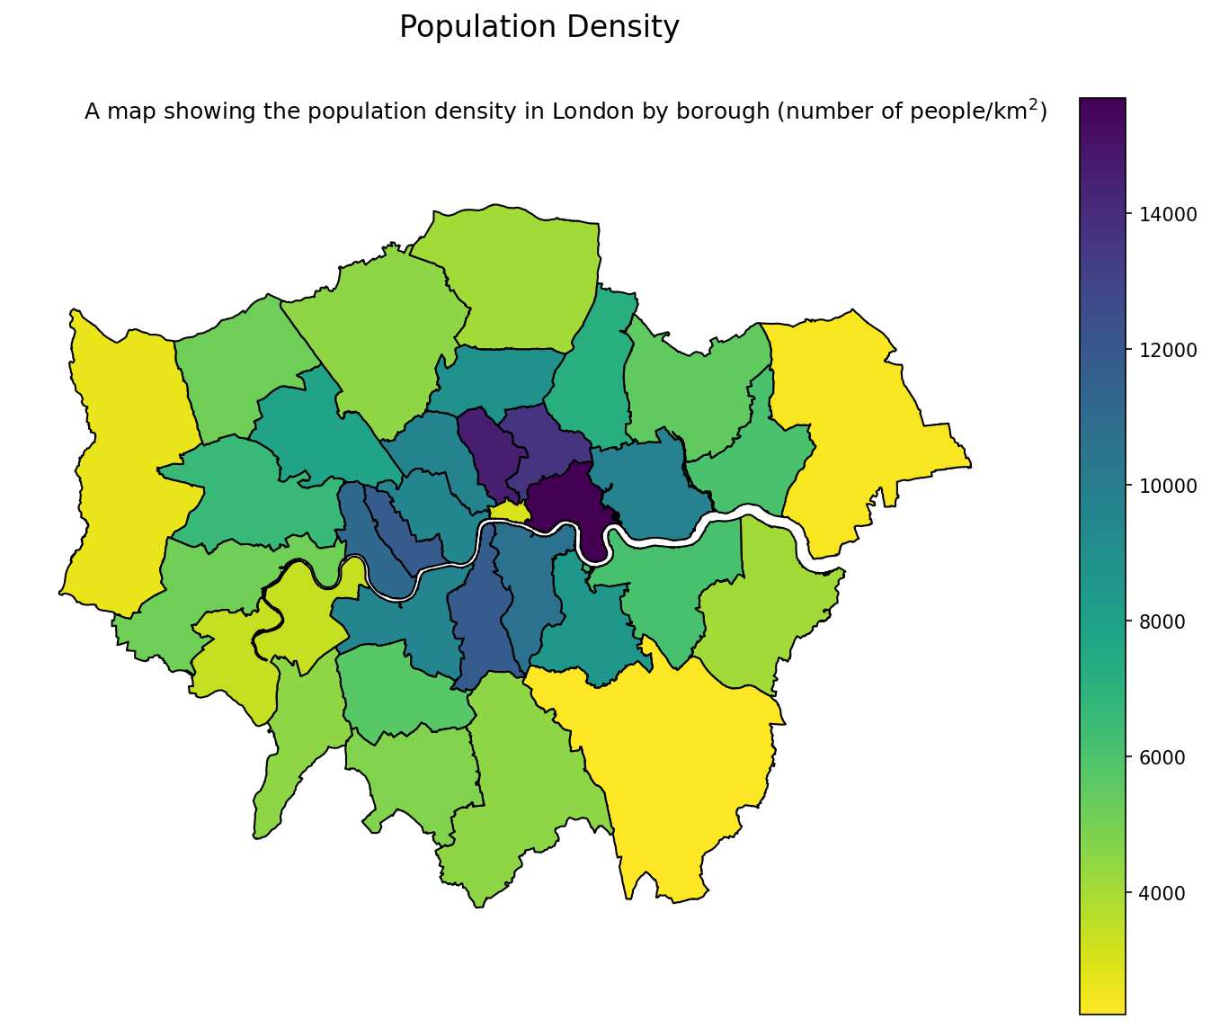
Population density – London
Population density is very high throughout inner north and inner north east London, with Islington and Hackney respectively having the 2nd and 3rd highest levels of population density in England and Newham the 8th.
The top 20 most densely populated areas in England and Wales are all London boroughs.
*(rounded to nearest 100 persons).

Slide 9
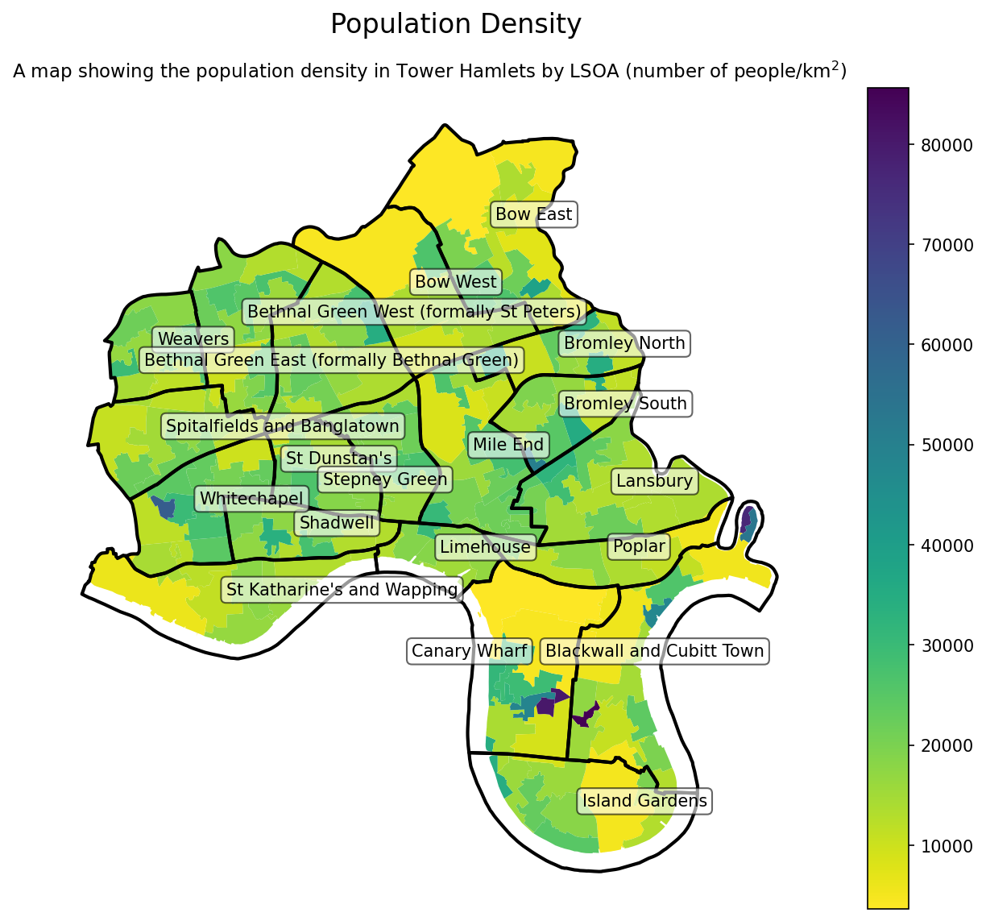
Population density across Tower Hamlets
Population density across the borough varies somewhat, dependent on land use and availability of green spaces.
The impact of concentrated pockets of residential high rise can be seen in parts of the south of the borough such as the Leamouth peninsular (London City Island) and the Isle of Dogs.
In other parts of the borough such as the north west, density levels are consistently high.
*(rounded to nearest 100 persons).

Slide 10
Age
Between 2011 and 2021, Tower Hamlets experienced an increase in the numbers of children, working aged people and older people, although some groups grew more quickly than others
The largest proportionate rise is in the working age population (25% increase).
Children and young people represent a slightly smaller proportion of all residents than in 2011, despite a numerical increase of 10,500..
Overall, locally there has been a decline in the proportion of people aged 65+ compared to 2011. Tower Hamlets is the only local authority area in the country to have less than 6% of the population aged 65+ (5.6%).

Slide 11
Age – five year breakdown
Every five year age group increased in size between 2011 and 2021 except 75-79 year olds and 80-84 year olds.
Conversely, the number of persons in their 60s has grown by 45% in this ten year period.
The number of people aged 45-49 has increased by 49% since 2011.
In comparison to the 2020 mid year estimate, every age group except 15-19 years, 20-24 years and 25-29 years was smaller with particularly large differences in the number of young children and those aged 35-44 years old.

Slide 12
Child population
The population of younger children aged 0-2 years old declined slightly between 2011 and 2021.
By contrast, the number of older children grew significantly since the last census, with almost 6000 more children aged 11-17 in 2021 than in 2011.

Slide 13
Older population
Although the older population was slightly larger in 2021 than in 2011, it had reduced as a proportion of the overall population.
This was most apparent among 80+ year olds where the population grew by just 2% compared to the 22% rise in the population as a whole. Conversely the 65-69 year old age group grew substantially (46% increase).

Slide 14
Older population by area (66+)
Older people (of normal retirement age) are concentrated in the north and central areas of the borough.
Canary Wharf, the western part of Poplar and Blackwall and Cubitt Town wards appear to have notably fewer older people than other parts of the borough.

Slide 15
Sex
Tower Hamlets had the 4th highest proportion of males in England and Wales and was one of only 11 local authority areas where males formed the majority of residents.
In 2021, the proportion of residents who were male was 50.2%, slightly more than those who were female (49.8%). This represented a narrowing gap between males and females when compared with 2011 and a considerably smaller gap than the 2020 mid year estimate had forecast.

Slide 16
Sex by age
There are generally more males than females across all of the five year age groups with the exception of 20-24 year olds, 25-29 year olds, 35 – 39 year olds and over 65’s where there are more females than males.

Slide 17
Households
Tower Hamlets added an additional 19,200 households between 2011 and 2021 with the total number of households increasing from 101,257 to 120,500.
This represented a 19% increase, the largest increase in households in the country.
There were slightly more persons per household than in 2011 with the average household size moving from 2.51 in 2011 to 2.58 in 2021.

Slide 18
Household size – larger households
Tower Hamlets has a great proportion of larger households than both London and England and Wales.
12.2% of households had at least 5 persons compared with 10.1% in London and 6.9% in England and Wales.
2.7% of households had at least seven persons – three times the proportion in England and Wales (0.9%).

Slide 19
Household composition – single person households
There were 38,530 one person households in Tower Hamlets which represented 32% of all households.
A greater proportion of residents in Tower Hamlets are living alone than in London (29.3%) or England and Wales (32.0%). The large majority of these are working age adults.
By contrast the proportion of households made up of older people (66+) living alone was much smaller than other areas. At 4.8%, it was just over half the rate in London and considerably lower than the rate in England and Wales of 12.9%.

Slide 20
Household composition – households with dependent children
32,666 households had dependent children. This was 27.1% of all households. This was a lower proportion than both England and Wales (28.3%) and London (31.3%)
As 6.6%, Tower Hamlets had a lower proportion of lone parent households than England and Wales (6.9%) or London (7.8%).
This represented a total of 7,961 lone parent households in Tower Hamlets.

Slide 21
Living arrangements
Living arrangements : adults in Tower Hamlets | number | %
Total | 246,800 | 100.0
Living in a couple: Married or in a civil partnership | 71,188 | 28.8
Living in a couple: Married or in a civil partnership: Opposite-sex couple | 69,479 | 28.2
Living in a couple: Married or in a civil partnership: Same-sex couple | 1,709 | 0.7
Living in a couple: Separated, but still married or in a civil partnership | 201 | 0.1
Living in a couple: Cohabiting | 36,908 | 15.0
Living in a couple: Cohabiting: Opposite-sex couple | 33,184 | 13.4
Living in a couple: Cohabiting: Same-sex couple | 3,724 | 1.5
Not living in a couple: Single (never married and never registered a same-sex civil partnership) | 109,704 | 44.5
Not living in a couple: Married or in a registered civil partnership | 7,331 | 3.0
Not living in a couple: Separated (including those who are married and those who are in civil partnerships) | 4,439 | 1.8
Not living in a couple: Divorced or formerly in a civil partnership which is now legally dissolved | 10,462 | 4.2
Not living in a couple: Widowed or surviving partner from civil partnership | 6,567 | 2.7
44% of adults in Tower Hamlets were living as a cohabiting couple while 56% were not living in a couple.
The proportion of adult residents living in a couple was well below the proportion in England and Wales (58%) and below the proportion living in London (49%).
Same sex couples - In total, 2.2% of adults were either married, in a civil partnership or cohabiting. This was above the rate in England and Wales (1%) and London (1.4%).
The proportion of adults who were divorced (4.2%) was some way below that in England and Wales (6.6%) or London (6%)
Likewise the proportion of adults who were widowed (2.7%) was some way below the rate in England and Wales (5.6%) or London (4%)

Slide 22
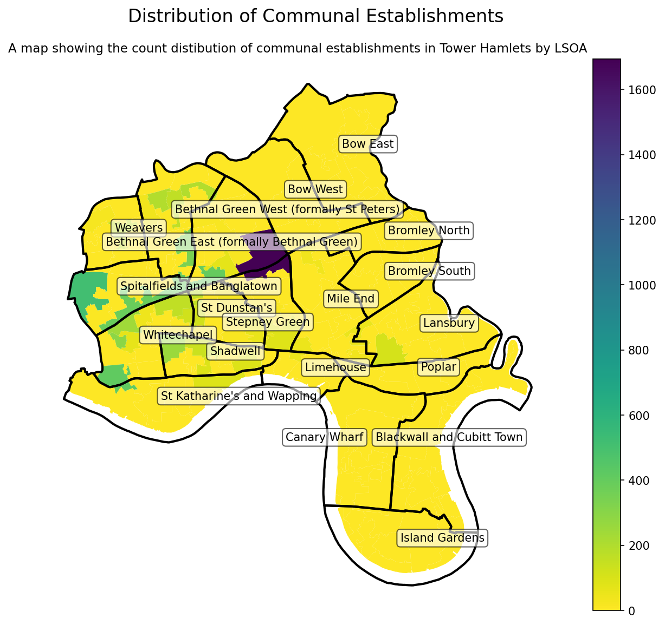
Communal establishments
Communal establishments are a type of residence that provide accommodation for multiple households but often have shared facilities and a shared entrance to the property.
The most common type of communal establishment in Tower Hamlets is dedicated student accommodation but such establishments also include some long stay health facilities and care homes.
In 2021, there were 6,627 residents of communal establishments. This a significant increase from 2011 when there were 3,753.

Slide 23
Country of Birth and Migration

Slide 24
Country of birth of Tower Hamlets residents (top 10)
In 2021 the most common country of birth was United Kingdom, followed by Bangladesh with 43,561 residents having been born in that country.
Although the total number increased, the proportion of residents born in Bangladesh was slightly smaller than in 2011.
Other than the UK, the largest increase in country of birth since 2011 came from Italy. This is probably at least in part reflective of the large Italian community of Bangladeshi ethnic origin.
The largest proportionate increase came from Romanian born residents which was more than half times larger than in 2011.
India was the 4th most common country of birth and the number if India born residents also grew quite significantly
Country of Birth | 2011 | 2011 % | 2021 | 2021 % | 2011-2021 Increase | 2011-2021 % Increase
United Kingdom | 144,662 | 56.9% | 165,079 | 53.2% | 20,417 | 14%
Bangladesh | 38,877 | 15.3% | 43,561 | 14.0% | 4,684 | 12%
Italy | 3,047 | 1.2% | 10,553 | 3.4% | 7,506 | 246%
India | 3,889 | 1.5% | 6,317 | 2.0% | 2,428 | 62%
China | 3,552 | 1.4% | 4,818 | 1.6% | 1,296 | 37%
France | 3,014 | 1.2% | 4,562 | 1.5% | 1,548 | 51%
Spain | 2,025 | 0.8% | 3,791 | 1.2% | 1,766 | 87%
Somalia | 2,925 | 1.2% | 3,107 | 1.0% | 182 | 6%
Poland | 2,674 | 1.1% | 3,077 | 1.0% | 403 | 15%
Romania | 587 | 0.2% | 2,765 | 0.9% | 2,178 | 371%

Slide 25
Country of birth compared with elsewhere
In 2021 Tower Hamlet had one of the smallest proportions of UK born residents in England and Wales (323rd of 331)
The Bangladeshi born population was by some distance the largest in England and Wales, both in absolute numbers and as a proportion of the population. Neighbouring Newham had the second highest number and proportion.
16% of all Bangladeshi born people in England and Wales were residing in Tower Hamlets.
Tower Hamlets had the largest number of Italian born residents and the second largest proportion of Italian born residents behind Kensington and Chelsea.
The borough also has among the highest numbers of Chinese, French, Spanish and Somalian born residents in England and Wales.
Country of Birth | 2021 | 2021 % of resident population in area | Ranking in England and Wales (absolute number) | Ranking in England and Wales (% of resident population in area)
United Kingdom | 165,079 | 53.2% | # | 323 (of 331)
Bangladesh | 43,561 | 14.0% | 1 | 1
Italy | 10,553 | 3.4% | 1 | 2
India | 6,317 | 2.0% | 33 | 49
China | 4,818 | 1.6% | 4 | 4
France | 4,562 | 1.5% | 6 | 7
Spain | 3,791 | 1.2% | 5 | 11
Somalia | 3,107 | 1.0% | 10 | 10
Poland | 3,077 | 1.0% | 72 | 151
Romania | 2,765 | 0.9% | 48 | 88

Slide 26
Country of birth – European Union and Africa
13.9% of Tower Hamlets residents were born in a current European Union country. This equates to 43,000 residents.
This was similar to the number of residents holding a passport of any current EU country (46,000)
The proportion of people born in the EU was higher than London (12.8%) and more than double the proportion in England and Wales (6.1%). It was the 19th highest proportion out of 331 local authority areas with Boston in Lincolnshire being the highest at 20%.
The proportion of residents born in any African country was 4.2% (13,000 residents). This was above the England and Wales average but below the London average.

Slide 27
Migration – length of residence in UK
46.8% of residents of Tower Hamlets were born outside the UK
7.8% of residents had been in the UK for less than 2 years at the time of the census.
Nearly a quarter of all residents (24.2%) had lived in the UK for less than ten years. This was 75,000 residents.
A further 22.6% were non UK born long standing residents of the UK (ten years+)

Slide 28
Migration – year of arrival in UK
Tower Hamlets residents from outside the UK have mostly arrived in the UK in the last twenty years.
106,000 Tower Hamlets residents (34.3% or over a third of all residents) had arrived in the UK in the 20 years since 2001, compared with less than 39,000 who had arrived prior to 2001.
Almost 43,000 residents have arrived in the UK since 2017 (13.9%, or about one in seven residents of the borough)

Slide 29
Migration – age at time of arrival in UK
Year of arrival in UK, Tower Hamlets | Number of residents
Arrived in the UK: Aged 0 to 4 years | 10,954
Arrived in the UK: Aged 5 to 7 years | 5,236
Arrived in the UK: Aged 8 to 9 years | 3,458
Arrived in the UK: Aged 10 to 14 years | 8,335
Arrived in the UK: Aged 15 years | 1,966
Arrived in the UK: Aged 16 to 17 years | 6,308
Arrived in the UK: Aged 18 to 19 years | 12,375
Arrived in the UK: Aged 20 to 24 years | 33,419
Arrived in the UK: Aged 25 to 29 years | 30,160
Arrived in the UK: Aged 30 to 44 years | 26,987
Arrived in the UK: Aged 45 to 59 years | 4,698
Arrived in the UK: Aged 60 to 64 years | 577
Arrived in the UK: Aged 65 to 74 years | 566
Arrived in the UK: Aged 75 to 84 years | 160
Arrived in the UK: Aged 85 to 89 years | 17
Arrived in the UK: Aged 90 years and over | 9
As might be expected, the large majority of migrants to the UK were of younger working age.
102,941 were aged between 18 and 44 when arriving in the UK, which was 71% of all migrants and 33% of all residents including those born in the UK.
Very few (752) were older people aged 65+ although a significant number were children with 36,257 being 0-17 at the time of arrival.

Slide 30
Migration - short term residents from outside the UK
Short-term residents were identified in the census as people who were born and usually live outside the UK, who are intending to stay in the UK for between 3 and 12 months, and who were in England or Wales at the time of the census.
There were 2,692 such residents in Tower Hamlets of whom the majority were female.
This was consistent with both London and England, where the majority of short term residents were also female.
Short Term Residents by Sex | Number | Percentage
All persons | 2,692 | 100.0%
Female | 1,485 | 55.2%
Male | 1,207 | 44.8%

Slide 31
Population turnover – living at same address as one year previously
20.8% (63,745) of residents were not living at the same address as one year previously.
Most of those who were living somewhere else had been living somewhere within the UK (50,084, 16.3%)
Around 3.4% (10,536) had been living somewhere else outside the UK
A further 1% (3,125) had been living at a student term time or boarding school address in the UK and were no longer doing so.
By comparison, in London 13% were living at a different address to one year previously and in England and Wales the figure was 11%
Population turnover – Tower Hamlets compared with England and Wales and London
 | Tower Hamlets | Tower Hamlets % | England & Wales | England & Wales % | London | London %
Total: All usual residents | 306,333 |  | 58,990,218 |  | 8,695,497
Address 1 year ago is same as address of enumeration | 242,588 | 79.2% | 52,496,530 | 89% | 7,547,990 | 87%
Migrant from within UK: address 1 year ago was in UK | 50,084 | 16.3% | 5,599,520 | 9.5% | 954,144 | 11%
Migrant from outside UK: Address 1 year ago was outside UK | 10,536 | 3.4% | 545,096 | 0.9% | 149,532 | 2%
Address 1 year ago is student term-time or boarding school address in UK | 3,125 | 1.0% | 349,072 | 0.6% | 43,831 | 0.5%

Slide 32
Ethnic Origin, Religion and Language

Slide 33
Ethnic Origin – 2011 and 2021
Significant decrease in White British population numerically and proportionately between 2011 and 2021
Significant rise in the Bangladeshi population in numerical terms and a smaller proportionate increase.
Significant increase in White Other population, with it totalling 45,187 in 2021 (14.6% of all residents)
Significant rise in ‘Other Ethnic Group’ population, to 8494 residents and twice as large as a proportion of residents than in 2011.
Increase in the Black African population in both numerical and proportionate terms between 2011 and 2021. Smaller increases in Indian, Chinese and Pakistani and Asian Other populations.
Increases in all Mixed ethnic groups, now comprising 5% of all residents
Decrease in Black Caribbean and Black Other groups – latter possibly related to new method of recording specific Black ethnic group and/or rise in Other ethnic group category.
Ethnic Group | 2021 | 2021% | 2011 | 2011%
White British | 71177 | 22.9% | 79231 | 31.2%
White Irish | 3567 | 1.1% | 3863 | 1.5%
White Gypsy Traveller | 110 | 0.04% | 175 | 0.07%
White Roma | 2225 | 0.7% | N/A | N/A
White Other | 45187 | 14.6% | 31550 | 12.4%
Asian Bangladeshi | 107333 | 34.6% | 81377 | 32.0%
Asian Chinese | 10279 | 3.3% | 8109 | 3.2%
Asian Indian | 10135 | 3.3% | 6,787 | 2.7%
Asian Pakistani | 3341 | 1.1% | 2,442 | 1.0%
Asian Other | 6768 | 2.2% | 5786 | 2.3%
Black African | 15373 | 5.0% | 9495 | 3.7%
Black Caribbean | 4930 | 1.6% | 5341 | 2.1%
Black Other | 2390 | 0.8% | 3793 | 1.5%
Mixed White and Asian | 4374 | 1.4% | 2961 | 1.1%
Mixed White and Black African | 2236 | 0.7% | 1509 | 0.6%
Mixed White and Black Caribbean | 3593 | 1.2% | 2837 | 1.1%
Mixed Other | 5206 | 1.7% | 3053 | 1.2%
Other Arab | 3588 | 1.2% | 2573 | 1.0%
Other ethnic group | 8494 | 2.7% | 3214 | 1.3%

Slide 34
Ethnic origin – Tower Hamlets and other areas
Ethnic Group | Tower Hamlets | England & Wales | London
White British | 22.9% | 74.4% | 36.8%
White Irish | 1.1% | 0.9% | 1.8%
White Gypsy Traveller | 0.0% | 0.1% | 0.1%
White Roma | 0.7% | 0.2% | 0.4%
White Other | 14.6% | 6.2% | 14.7%
Asian Bangladeshi | 34.6% | 1.1% | 3.7%
Asian Chinese | 3.3% | 0.7% | 1.7%
Asian Indian | 3.3% | 3.1% | 7.5%
Asian Pakistani | 1.1% | 2.7% | 3.3%
Asian Other | 2.2% | 1.6% | 4.6%
Black African | 5.0% | 2.5% | 7.9%
Black Caribbean | 1.6% | 1.0% | 3.9%
Black Other | 0.8% | 0.5% | 1.7%
Mixed White and Asian | 1.4% | 0.8% | 1.4%
Mixed White and Black African | 0.7% | 0.4% | 0.9%
Mised White and Black Caribbean | 1.2% | 0.9% | 1.5%
Mixed Other | 1.7% | 0.8% | 1.9%
Other Arab | 1.2% | 0.6% | 1.6%
Other ethnic group | 2.7% | 1.6% | 4.7%
At 22.9% the White British population is the fourth smallest in England and Wales behind Newham, Brent and Harrow and less than a third of the proportion in England and Wales.
The Bangladeshi population remains by far the largest in the country in both proportionate (34.6%) and numerical (107,333) terms and is almost twice the size of the next largest area Newham (55,677). One in six Bangladeshis in England and Wales live in Tower Hamlets.
The proportion of residents from a White Other ethnic background is similar to London and more than twice the proportion in England and Wales.
The proportion of Black African residents (5%) is double that of England and Wales (2.5%) although it is below the rate in London (7.9%).
As a proportion, the Chinese population is the third highest in England and Wales behind the City of London and Cambridge.
At 2,225, Tower Hamlets had the fourth largest Roma population in England and Wales after Brent, Sheffield and Newham.

Slide 35
Ethnic origin – White ethnic group (detailed)
The large White Italian ethnic group corresponds with large number of Italian born residents identified in the census but accounts for less than half of them, suggesting other Italian born residents are likely to be from other ethnic groups such as Bangladeshi.
Similarly the increase in people born in Romania would appear to be represented in both the Romanian and Roma ethnic groups and potentially other ethnic groups.
Ethnic Group | 2021 | 2021%
White: European Mixed | 8288 | 2.7%
White: Italian | 4939 | 1.6%
White: Irish | 3567 | 1.1%
White: French | 2369 | 0.8%
White: Polish | 2239 | 0.7%
White: Roma | 2225 | 0.7%
White: Spanish | 2060 | 0.7%
White: Greek | 1827 | 0.6%
White: Romanian | 1702 | 0.5%
White: Other Eastern European | 1676 | 0.5%
White: German | 1452 | 0.5%

Slide 36
Ethnic Origin – Black Ethnic Group (Detailed)
Ethnic Group | 2021 | 2021 %
Black, Black British, Black Welsh or Caribbean background: Caribbean | 4920 | 1.6%
Black, Black British, Black Welsh of African background: African unspecified | 4439 | 1.4%
Black, Black British, Black Welsh of African background: Somali | 3350 | 1.1%
Black, Black British, Black Welsh of African background: Somalilander | 2031 | 0.7%
Black, Black British, Black Welsh of African background: Nigerian | 1801 | 0.6%
Black, Black British, Black Welsh or Caribbean background: Black British | 1307 | 0.4%
Black, Black British, Black Welsh of African background: Ghanaian | 835 | 0.3%
Black, Black British, Black Welsh of African background: Democratic Republic of the Congo | 407 | 0.1%
Black, Black British, Black Welsh of African background: Black British | 367 | 0.1%
Residents from Black ethnic backgrounds identified into a variety of ethnic groupings.
The largest single Black ethnic group was Caribbean, but there were around three times as many residents from Black African backgrounds of any kind.
The largest of these Black African ethnic backgrounds was unspecified Black African ethnic origin. (Respondents were required to identify a broad ethnic group but specific backgrounds was determined by a write-in response under that broad background)
The largest identifiable Black African group was Somali, followed by Somalilander, Nigerian, Black British and Ghanaian.

Slide 37
Ethnic Origin – Somali and Somalilander
Not all people identifying as Somali or Somalilander identified their ethnicity as Black.
As a combined group anyone identifying their ethnicity as Somali or Somalilander comprised of 6180 residents (2.0% of all residents).
The census did not require respondents to identify a specific ethnic group so it is possible that this does not capture all Somali and Somalilander residents.
Ethnic Group | 2021 | 2021 %
Black, Black British, Black Welsh of African background: Somali | 3350 | 1.1%
Black, Black British, Black Welsh of African background: Somalilander | 2031 | 0.7%
Other ethnic group: Somali | 422 | 0.1%
Black, Black British, Black Welsh or Caribbean background: Somali | 195 | 0.1%
Other ethnic group: Somalilander | 182 | 0.1%

Slide 38
Religion
The most common religion for residents in Tower Hamlets was Muslim with 39.9% (123,912) of residents identifying it as their religion. This was the largest proportion of residents identifying Muslim as their religion in the country ahead of Blackburn with Darwen (35%) and Newham (34.8%).
26.6% of residents said they had No Religion. 22.3% identified as Christian which was the lowest proportion in England and Wales.
The proportion of residents identifying Muslim as their religion was higher than in 2011 (39.9% vs 34.5%). The proportion of residents identifying Christian was lower than in 2011 (22.3% vs 27.1%) but numerically the number of residents who were Christian was almost the same as a decade previously (a slight increase from 68,808 to 69,223).
Religion 2021 | Tower Hamlets | Tower Hamlets % | England and Wales | England and Wales % | London | London %
 | number | % | number | % | number | %
Total: All usual residents | 310,306 | 100.0 | 59,597,540 | 100.0 | 8,799,728 | 100.0
No religion | 82,635 | 26.6 | 22,162,062 | 37.2 | 2,380,404 | 27.1
Christian | 69,223 | 22.3 | 27,522,672 | 46.2 | 3,577,681 | 40.7
Buddhist | 2,961 | 1.0 | 272,508 | 0.5 | 77,425 | 0.9
Hindu | 6,298 | 2.0 | 1,032,775 | 1.7 | 453,034 | 5.1
Jewish | 1,341 | 0.4 | 271,327 | 0.5 | 145,466 | 1.7
Muslim | 123,912 | 39.9 | 3,868,133 | 6.5 | 1,318,754 | 15.0
Sikh | 966 | 0.3 | 524,140 | 0.9 | 144,543 | 1.6
Other religion | 1,652 | 0.5 | 348,334 | 0.6 | 86,759 | 1.0
Not answered | 21,318 | 6.9 | 3,595,589 | 6.0 | 615,662 | 7.0

Slide 39
Language and Proficiency in English
The most commonly spoken main languages other than English were Bengali (with Sylheti and Chatgaya) (11%) Italian (2.2%), Spanish (1.7%), French (1.2%) and Portuguese (1%)
There was a significant reduction in the number of people reporting Bengali as their main language in 2021 (32,772) compared with 2011 (43,525) suggesting that many more people in the Bangladeshi community now regard English as their main language.
There were increases in the number of people who spoke Italian as their main language between 2011 and 2021 (2,684 vs 6,643) and similarly with Romanian (411 vs 1818).
Among residents aged 3 and over, 73% spoke English as their main language and 27% did not. 5.2% said that they could not speak English well and 1% said that they could not speak English at all, totalling 6.2% with limited proficiency in English.
This was the 8th highest proportion of residents reporting that they could not speak English well or at all among 331 local authority areas, with the highest being Leicester (9%)
By comparison in 2011, 6.4% of residents over 3 reported not being able to speak English well and 1.6% reported not being able to speak English at all (totalling 8%), so English proficiency improved between 2011 and 2021.
Main language Spoken (1000+ residents) | 2021 number | 2021 %
English (English or Welsh in Wales) | 218,131 | 73.0
South Asian language: Bengali (with Sylheti and Chatgaya) | 32,772 | 11.0
Other European language (EU) | 17,773 | 5.9
Italian | 6,643 | 2.2
Spanish | 5,022 | 1.7
French | 3,663 | 1.2
Portuguese | 3,031 | 1.0
East Asian language: All other Chinese | 2,748 | 0.9
African language | 2,599 | 0.9
Polish | 1,740 | 0.6
Romanian | 1,818 | 0.6
Greek | 1,750 | 0.6
Russian | 1,906 | 0.6
Arabic | 1,575 | 0.5
African language: Somali | 1,578 | 0.5
German | 1,255 | 0.4
Turkish | 1,169 | 0.4

Slide 40
Sexual Orientation and Gender Identity

Slide 41
Sexual Orientation
Sexual Orientation | Tower Hamlets % | England and Wales % | London %
Straight or Heterosexual | 83.1 | 89.4 | 86.2
Gay or Lesbian | 4.0 | 1.5 | 2.2
Bisexual | 2.5 | 1.3 | 1.5
All other sexual orientations | 0.7 | 0.3 | 0.5
Not answered | 9.8 | 7.5 | 9.5
83.1% of Tower Hamlets residents aged 16+ identified as straight or heterosexual
4.0% of Tower Hamlets residents aged 16+ identified as gay or lesbian
2.5% identified as bisexual
0.7% identified as having another sexual orientation
Taken together this means that 7.2% of residents were of Lesbian, Gay, Bisexual or Other sexual orientations. This is significantly higher than the proportions of 4.2% in London and 3.1% in England and Wales.
9.8% of residents chose not to answer this voluntary census question. This was a relatively high proportion compared with England and Wales and was slightly higher than London.
This question was asked for the first time in 2021 so historical comparison data is not available.

Slide 42
Gender Identity
90.7% residents identified their gender identity as being the same as their sex registered at birth.
0.6% of residents aged 16+ had a gender identity different from their sex registered at birth with no specific identity given.
0.1% identified as a Trans woman
0.1% identified as a Trans man
0.1% identified as Non-binary
0.06% identified as having another gender identity
Collectively, 1% (2,643) of Tower Hamlets residents had a gender identity that was different to their sex registered at birth. This was the same proportion as London but twice the proportion in England and Wales (0.5%)
8.3% chose not to answer this voluntary question, which was higher than the proportion in England and Wales and in London.
This question was asked for the first time in 2021 so historical comparison data is not available.

Slide 43
Labour Force

Slide 44
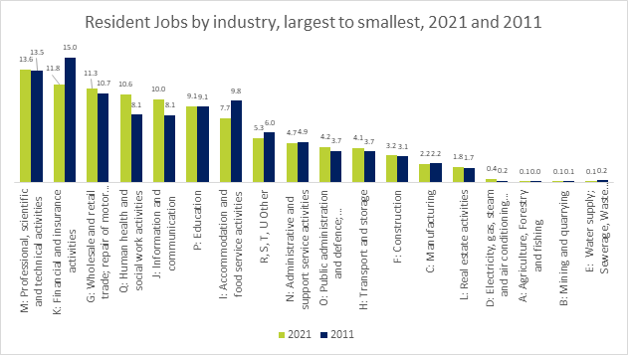
Labour force - industry
Of the 155,389 jobs held by Tower Hamlets residents, the largest sector was professional, scientific and technical studies (13.6%) followed by financial and insurance activities (11.8%). These were respectively the 12th and 5th highest proportions of residents employed in those industries in England and Wales.
At 2.2% the proportion of residents employed in manufacturing was the 4th lowest in England and Wales.

Slide 45
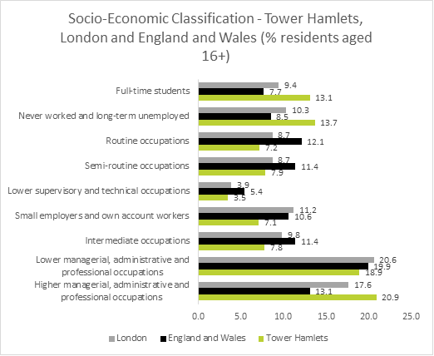
Labour force – socio economic classification
The Census identifies a socio-economic classification for each adult resident based on the level of occupation that they work or worked in. Socio-economic classification includes those who are retired and is based on the occupation that they held when they were in work.
At 20.9% Tower Hamlets had a higher proportion of adult residents classified as being or having been in higher managerial, administrative and professional occupations than either London (17.6%) or England and Wales (13.1%).
Tower Hamlets also had a higher proportion of adult residents classified as never worked and long term unemployed (13.7% in Tower Hamlets compared with 10.3% in London and 8.5% in England and Wales).

Slide 46
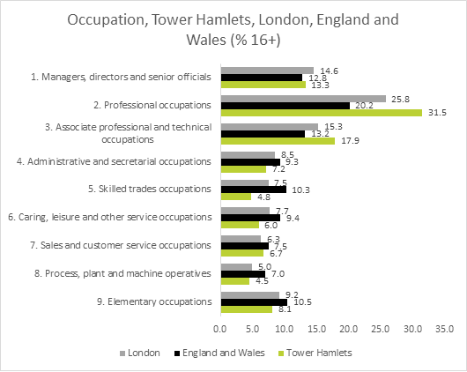
Labour force – occupation
Tower Hamlets had a particularly large proportion of adult residents working in professional occupations (31.5%) and associate professional occupations (17.9%) when compared to London and England and Wales. 62.7% of all residents in employment were in managerial, professional or associate professional occupations.
The borough had smaller than average numbers of residents working in administrative and secretarial occupations (7.2%), skilled trades (4.8%), caring, leisure and other service occupations (6.0%), process, plant and machine occupations (4.5%) and elementary occupations (8.1%).
Between 2011 and 2021 the proportion of residents in professional occupations grew from 25.7% to 31.5%. By contrast the proportion of residents in elementary occupations reduced from 9.5% to 8.1%, the proportion in skilled trades reduced from 6.0% to 4.8% and the proportion in administrative and secretarial occupations reduced from 9.9% to 7.2%.

Slide 47
Labour force – economic activity
Just under two thirds (63.4%) of adults (aged 16+) identified themselves as economically active with 58.7% of adults being in employment. This was above the proportion in England and Wales (55.7%) but below the proportion in London (59.4%).
The proportion of adults who were unemployed (excluding full time students) was 4.7% or 11,891 residents.
The total number of students, including students who were economically active, and students who were economically inactive, was 37,547.
Unsurprisingly given Tower Hamlets demographic profile, a much smaller proportion of adults were retired (5.8%) than London (12.9%) or England and Wales (21.6%).
There were 21,324 residents who were looking after the home, which was 8.4% of adult residents. This was higher than both London (6.0%) and England and Wales (4.8%).
The census found that 10,159 residents were economically inactive due to being long term sick or disabled.
Almost 100,000 residents (97,491) aged 16 and over were not in work at the time of the census. Of these, 18% had worked in the previous 12 months, 34.6% had not worked in the last 12 months and 47.4% (46,215) had never worked. This was the 2nd highest proportion of workless people that had never worked in England and Wales behind Newham. This indicates that Tower Hamlets has significant entrenched worklessness.

Slide 48
Labour force – travel to work
At the time of the census, 50.3% of all Tower Hamlets residents in employment were working mainly from home. This was well above the proportion in London (42.1%) and England and Wales (31.2%) and was the 12th highest proportion among local authority areas in England and Wales.
The most common method of travel to work for those that did not mainly work from home was underground/light rail/tram with 13.8% using this method.
The impact of the pandemic and the move to working from home can be clearly seen in the number of people travelling to work by underground/light rail/tram. In 2011, 47,191 (39%) travelled to work by this method which more than halved in 2021 to 21,452. Most other methods of travel also fell as a result of the huge rise in working mainly from home (from 3.7% in 2011 to 50.3% in 2021).
The number of people travelling to work by car increased slightly between 2011 and 2021 from 13,517 to 14,106 but this represented a smaller proportion of residents in employment.
Method of Travel to Work | %
Work mainly at or from home | 50.3%
Underground, metro, light rail, tram | 13.8%
Train | 4.6%
Bus, minibus or coach | 5.8%
Taxi | 0.6%
Motorcycle, scooter or moped | 0.5%
Driving a car or van | 9.1%
Passenger in a car or van | 0.6%
Bicycle | 4.6%
On foot | 8.9%
Other method of travel to work | 1.1%

Slide 49
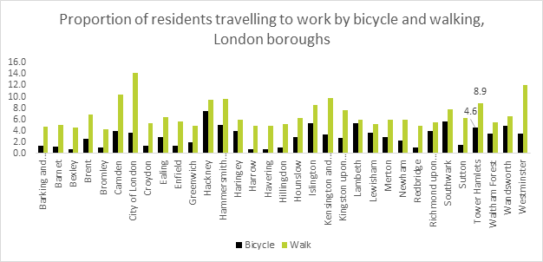
Labour force – travel to work (walking and cycling)
7th highest proportion of residents travelling to work by bicycle (4.6%) in London, 19th in England and Wales
7th highest proportion of residents travelling to work by foot (8.9%)

Slide 50
Housing

Slide 51
Housing – Accommodation
In 2021, 81% of households lived in purpose built flats. This was the second highest proportion in England and Wales after the City of London and was twice the proportion in the London region.
12% of households lived in a house while only 0.9% lived in a detached house. This was far smaller than England and Wales where 77.9% lived in a house and 23.2% lived in a detached house.
Compared with other parts of London, only a small proportion lived in a property that is part of a converted or shared house (2.3% in Tower Hamlets compared with 11.1% in London).
191 households (0.2%) were in a caravan or other mobile structure. Within Tower Hamlets this is likely to be primarily houseboat residents.
Accommodation type | Tower Hamlets % | England and Wales % | London %
Detached | 0.9% | 23.2% | 6.1%
Semi-detached | 2.3% | 31.5% | 18.6%
Terraced | 8.8% | 23.2% | 21.3%
Purpose-built block of flats | 80.7% | 16.7% | 40.3%
Part of a converted or shared house | 2.3% | 3.4% | 11.1%
Part of another converted building | 3.5% | 0.8% | 1.2%
Commercial building | 1.3% | 0.8% | 1.4%
Caravan or other mobile structure | 0.2% | 0.4% | 0.1%

Slide 52
Housing – tenure (1)
Between 2011 and 2021 there was a slight fall in the number of owner occupiers from 24.2% (of households) in 2011 to 23.1% in 2021
There was a decline in the proportion of social renting households from 39.6% in 2011 to 35.9% in 2021. Of these, 16,697 (13.9%) of households reported that they rent from the local authority. Note that there is a known issue with this census question where many social renters are unaware (or do not distinguish between) whether their landlord is the local authority or an RSL and therefore the question is often answered incorrectly. The latest dwelling stock data suggests that there are only around 11,500 local authority owned dwellings in the borough.
There was a rise in the proportion of private renting households from 32.6% in 2011 to 38.2% in 2021.

Slide 53
Housing – tenure (2)
In 2021 Tower Hamlets had the lowest proportion of owner occupiers of any area in England and Wales at 23.1%. The ten areas with the smallest proportions of owner occupiers were all inner London boroughs.
The total proportion of social renting households was 35.9% - significantly higher than London (23.1%) and more than twice the proportion in England and Wales (17.0%)
At 38.2%, Tower Hamlets had the 5th highest proportion of households renting privately in England and Wales in 2021.
At 2.6% the proportion of shared ownership households were also higher than London or England and Wales

Slide 54
Housing – property size
Of the 120,539 households,
- 37,943 (31.5%) had one bedroom,
- 48,055 (39.9%) had two bedrooms,
24,119 (20.0%) had three bedrooms
10,422 (8.6%) had four or more bedrooms.
Since 2011 the largest increase in households came in 4+ bedroom households (28% increase) and 1 bedroom households (26% increase) with slightly smaller increases in 2 bedroom households (15%) and three bedroom households (17%).

Slide 55
Housing – overcrowding
Based on the measure of having too few bedrooms, 15.8% of households were overcrowded (19,130 households).
This was slightly lower than in 2011 when it was 16.4% but it was the 4th highest rate of any area in England and Wales after Newham, Barking & Dagenham and Brent.
In terms of underoccupancy, 24.2% had one more bedroom room than they needed and 7.5% had two more bedrooms than they needed.

Slide 56
Car or van availability
Two thirds of Tower Hamlets households (66.4%) had no car or van in their household.
This was the third lowest level of car ownership in England and Wales after the City of London and Islington.
Historically this measure has been regarded as a proxy for income deprivation based on the affordability of running a car, but increasingly it illustrates areas where large numbers of residents choose not to keep a vehicle.
Since the 2001 census, the proportion of car owning households has reduced in each census from 43% in 2001 to 34% in 2021. However the increase in the number of households means that this reduction does not equate to fewer cars. In 2001, 34,000 households had access to a car but by 2021 this was 40,500.

Slide 57
Health

Slide 58
Health – general health
85.1% of Tower Hamlets residents described themselves as being in good or very good health, whereas 10% were in fair health, 3.6% in bad health and 1.3% in very bad health.
The proportion of residents in fair, bad and very bad health (14.9%) (46,250 residents) was below that of England and Wales (17.9%) but slightly higher than London (14.5%).
The proportion of residents in fair, bad or very bad health was lower in 2021 (14.9%) than in was in 2011 (16.7%).

Slide 59
Health – disability
12.9% (40,125) of residents reported having a disability
This is slightly lower than in 2011 when 13.5% had a disability
Of these, 5.7% (17,599) reported that their activities were limited a lot and 7.3% (22,526) reported that their activities were limited a little.
A further 4.5% had a long term physical or mental health condition that did not limit their day to day activities.
25.7% of all households had at least one person with a disability

Slide 60
Health – carers
18,551 residents were providing unpaid care which was 6.4% of residents aged 5 and over.
The proportion of residents providing care (6.4%) was lower than England and Wales (8.8%) and London (7.3%)
The 2011 Census recorded carers as a proportion of all age residents. Based on a proportion of all age residents as opposed to residents aged 5 and over, there were a smaller proportion of residents providing unpaid care in 2021 (6.0%) than in 2011 (7.6%).
This fall in the number of carers was consistent with the picture in England and Wales where carers fell from 10.3% of residents in 2011 to 8.8% in 2021 and in London where carers fell from 8.4% in 2011 to 7.3% in 2021.

Slide 61
Education

Slide 62
Education - highest level of qualification
50.3% of Tower Hamlets residents aged over 16 had a level 4 qualification. This was higher than London (46.7%) and substantially higher than England and Wales (33.8%).
Between 2011 and 2021 there was a significant increase in the proportion of residents with level 4 qualifications, rising from 40.0% to 50.3%.
16.2% of residents aged 16+ had no qualifications in 2021. This was lower than England and Wales (18.2%).
The proportion of residents with no qualifications has fallen since 2011 when it was 20.0%.
Between 2011 and 2021 the number of people whose highest qualification was an apprenticeship rose from 1,821 (0.9%) to 5,441 (2.2%)

