Slide 1

Borough Profile 2020
Chapter 8: Crime

Slide 2
Summary
Crime in Tower Hamlets has risen in recent years but less rapidly than in London as a whole. In December 2019 there were 35,118 notifiable offences, a 4.2 per cent increase since 2016, compared to the 16. per cent increase in the London as a whole.
Tower Hamlets has the 6th highest rate of crime overall in London (total notifiable offences) and the 2nd highest rate of Anti Social Behaviour calls in London.
86 per cent of residents say they feel safe in the area during the day and 58 per cent feel safe at night.
Recorded youth crime in the borough has fallen, as it has elsewhere. BME boys are more likely than other young people to have committed a proven offence.
Tower Hamlets has the 5th highest rate of domestic violence offences in London, with the majority of victims being female and the majority of perpetrators being male.
Between December 2015 and December 2019 there was a 39 per cent rise in sexual offences.
In 2019 the proportion of residents who cited drug using or dealing as a concern was 67 per cent, an increase of 7 per cent points since 2018.
In the context of other London boroughs, the number of race hate crimes, sexual orientation hate crimes, faith hate crimes and Islamophobic hate crimes are all above average. Conversely, fewer local residents consider hate crime to be a problem than in the majority of other London boroughs.
Our residents remain positive about cohesion. 78 per cent think people from different backgrounds get on well together. However there has been a shift between 2018 and 2019, with a fall of 8 per centage points from 86 per cent. Nevertheless, this compares well to the London average of 75 per cent.

Slide 3
Recorded Crime By Crime Type

Slide 4
Overall Crime
35,118 notifiable offences as at December 2019.
14.3per cent increase since December 2016.
Compares to an increase of 19.6per cent across London as a whole.
Rate of 117.9 crimes per 1000 population.
6th highest rate of 32 London Boroughs.
17,109 Anti Social Behaviour Calls in the year to December 2019.
57.45 ASB calls per 1000 population.
2nd highest number and rate of ASB calls in London (after Westminster).

Slide 5
Under Reporting of Crime
It is known that crime is significantly under-reported and some types of crime are particularly likely to go unreported
The Crime Survey for England and Wales (CSEW) estimates that there were 6.4 million crimes (excluding fraud and computer misuse) in the year to March 2019 but police recorded crime data in the year to March 2019 amounted to 5.2 million offences.
Domestic violence is particularly likely to go unreported - Nationally, the CSEW estimates that 2.4 million adults experienced domestic abuse in the year to March 2019 while the police recorded 746k crimes in the same period.
Police made 32 arrests per 100 recorded domestic abuse crimes nationally, meaning that fewer than one in ten of the adults who experienced domestic abuse will have seen that lead to an arrest.
It is clear from other sources such as A&E admissions and presentations in acute settings that unreported crime is impacting on other services such as healthcare provision

Slide 6
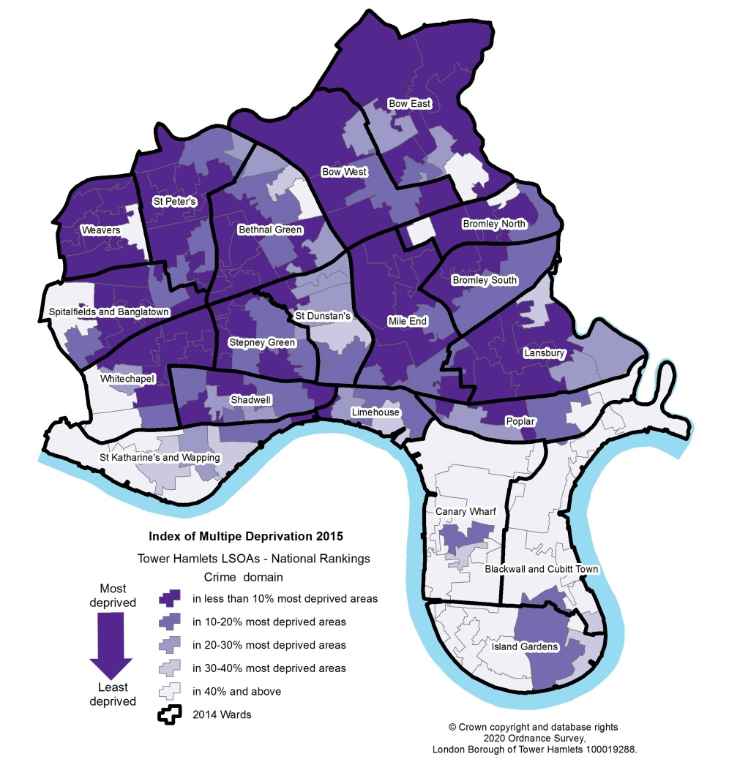
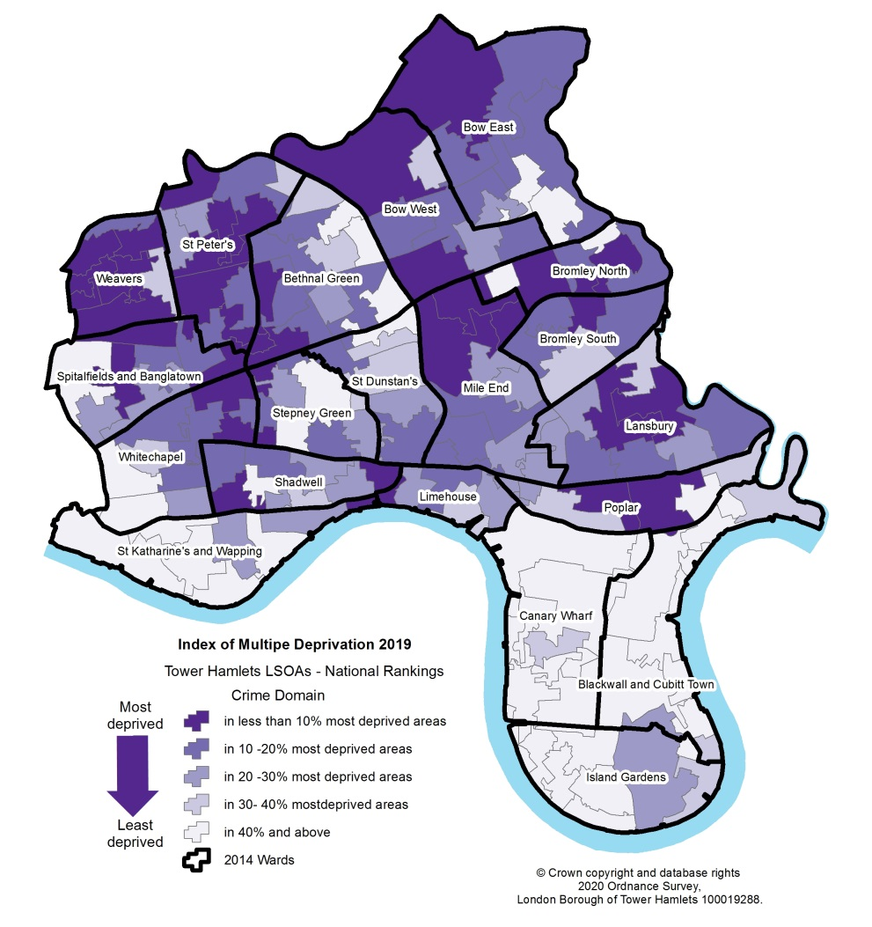
Indices of Multiple Deprivation - Crime Domain
2015
2019

Slide 7
Crime as a determinant of deprivation
The Crime Domain is one of seven domains in the English Indices of Multiple Deprivation (IMD). As such, it contributes to the overall deprivation score for the local area and recognises the link between poverty, disadvantage and crime.
Tower Hamlets is ranked 33rd out of 317 local authority districts in England on the IMD Crime Domain (based on the rank of score measure
This compares with an ‘overall’ ranking of 50th (Rank of Score measure) meaning that Tower Hamlets is more deprived on this measure than it is overall.
Tower Hamlets was the sixth most deprived London Borough (of 33) based on its rank of score for the Crime domain
Crime deprivation in Tower Hamlets decreased relative to other areas between 2015 and 2019, with Tower Hamlets moving from the 13th most deprived area to the 33rd most deprived area.

Slide 8
Youth Crime – Children Cautioned or Sentenced
182 children were cautioned or sentenced in Tower Hamlets and the City of London in 2018/19, which equates to 0.64% of all children aged 10-17 estimated to be living in the two areas in mid 2018.
By comparison, 4023 children were cautioned or sentenced in London which equates to 0.50% of all children aged 0-17 in mid 2018.

Slide 9
Youth Crime – Offences Committed
Youth offences have fallen in each of the last two years and totalled 407 in 2018/19.
However, drugs offences in 2018/19 were the highest they had been since 2013/14

Slide 10
Youth Crime – Ethnic Group and Sex
75.3 per cent of offenders in 2018/19 were from a BAME ethnic group, 21.4 per cent were from a white ethnic group, 3.3per cent were from an unknown ethnic group.
92% of offenders in 2018/19 were male and 8% were female

Slide 11
Domestic Violence
There were 3,613 domestic abuse offences in the year to February 2020, a rate of 12.1 offences per 1,000 population.
Tower Hamlets had the 5th highest rate among the 32 London Boroughs.

Slide 12
Domestic Violence (2)
Rate of recorded Domestic Violence incidents much higher – 6,098 or 20.5 per 1000 population (3rd highest in London).
74 per cent of victims of domestic Violence victims were female and 26 per cent were male in 2018/19. This compares to the Crime Survey for England and Wales where 67% of victims nationally were women and 33% were men.
41 per cent of victims were Asian, 35per cent White, 10per cent Black, 12per cent unknown ethnicity .
77 per cent aged 18-44, with 25-34 year olds making up the largest group. 4per cent under 18.
92per cent of domestic violence perpetrators were male while 8 per cent were female.
47per cent of perpetrators were Asian, 37per cent White, 14per cent Black. 87per cent aged 18-44

Slide 13
Sexual Violence
There were 817 Sexual offences in Tower Hamlets in the year to February 2020, a rate of 2.7 offences per 1000 population.
There has been a 26 per cent rise in sexual offences in the borough between March 2016 and February 2020.

Slide 14
Sexual Violence – Victims and Perpetrators
Victims - 88per cent of sexual violence victims were female in 2018/19 and 39 per cent of victims were White, 27per cent Asian, 12per cent Black, 12per cent unknown ethnicity. 69per cent of victims were aged 18-44 while 22 per cent were under 18.
Perpetrators - 98per cent of sexual violence perpetrators in 2018/19 were male. In terms of ethnic group, 47 per cent of perpetrators were Asian, 37per cent white, 14per cent black. In terms of age. 70 per cent of perpetrators were aged 18-44 with 19per cent being aged 18-24. 5 per cent were under 18 and 25per cent were aged 45 and over.

Slide 15
Drugs and Alcohol
The Annual Residents Survey (ARS) captures residents perception about local services and includes a suite of questions about residents concerns about anti-social behaviour. In 2019, 67 per cent of residents cited drug using or dealing as a concern.
There were 551 arrests made for intent to supply drugs in 2018/19, with 64per cent of arrests relating to possession of class A drugs involved the possession of cocaine or crack cocaine.
Tower Hamlets has the highest estimated rate of opiate and crack cocaine users in London - 3,244 or 14.4 per 100,000 adults.
According to the 2017 Pupil Attitude Survey of children and young people in Tower Hamlets schools, 6per cent of school children have tried drugs
The Annual Residents Survey also found that 45per cent of residents said people being drunk and rowdy was a concern, but 48per cent of adult residents say that they have never drunk alcohol
There were 3,400 dependent drinkers in Tower Hamlets.

Slide 16
Hate Crime
In the year to February 2020 there were 13 anti-Semitic hate crime offences; 13 disability hate crime offences; 119 Faith hate crime offences (5th highest in London); 162 sexual orientation hate crime offences (6th highest in London); 81 Islamophobic hate crime offences (2nd highest in London); 718 race hate crime offences (7th highest in London); 10 transgender hate crime offences.
There is a rising trend in some hate crimes, particularly sexual orientation hate crimes which almost doubled between March 2016 and February 2020. Race hate and Islamophobic hate crimes were also higher in February 2020 than in March 2016 (respectively rising from 548 to 718 and from 54 to 81).

Slide 17
Hate Crime (2)
Males were more likely than females to be the victim of every type of hate crime in 2018/19 and were particularly more likely to be the victim of sexual orientation hate crimes, accounting for 85 per cent of these crimes. They were also particularly more likely to be the victim of anti-Semitic hate crimes, accounting for 78 per cent of these crimes.
33per cent of victims of race hate crimes in 2018/19 were Asian, 23 per cent were black, 22per cent were white and 19 per cent were of unknown ethnicity.
More than a quarter (27 per cent) of victims of disability hate crimes in 2018/19 were children under 18 and 22per cent of victims of anti-Semitic hate crimes were children under 18 (although this only related to a small number of reported crimes).
Adults aged 18-44 were the victims of 78 per cent of race hate crimes, 84 per cent of sexual orientation hate crimes and 84per cent of Islamophobic hate crimes.
Males were much more likely than females to be the perpetrators of hate crime in 2018/19, accounting for at least 80 per cent of every hate crime type for which information was available.
12 per cent of residents say that Hate Crime is a major or minor problem in their area – a smaller proportion than in 18 other London boroughs

Slide 18
Perceptions of the Borough
The Annual Residents Survey captures residents perceptions about the council, local services and the area. In 2019:-
  78 per cent of local residents agreed that the local area is a place where people from different backgrounds get on well together. This was 8 per centage points lower than in 2018 but was still above the London average of 75 per cent.
  70 per cent of residents said they were satisfied with the area as a place to live, down from 79 per cent the previous year.
  86 per cent of residents said that they feel safe in the borough during the day and 58 per cent feel safe after dark.
  35 per cent of residents said noisy neighbours were a problem.
  45 per cent of residents said vandalism and graffiti were a problem.

