Slide 1



Cover Page
THSCP
Annual Report
2022-2023

Slide 2

Executive Summary from the Statutory Partners
“We want to start by thanking all partners and their frontline staff who have worked hard to ensure that children in Tower Hamlets grow up healthy, stimulated and safe so that they can fulfil their potential. In particular we thank everyone, both professionals and family members, who have acted to protect children from abuse, neglect and exploitation, and who have engaged in the work of the partnership. We have worked hard as a partnership to drive continual improvement in our local child safeguarding system through 2022/23, with a particular focus in the past year upon more direct engagement of children in the way that we work.
The context for many children growing up in Tower Hamlets remains challenging, with the highest rates of child poverty and population density in the country, and the new Cost of Living crisis following on the lasting impact of the pandemic. But our context is also one where we know that public services can make a real difference to the lives of babies, children and young people. Professionals, whether in our schools which are so consistently effective in setting children up with the opportunity to do well in life, our health services which ensure that children get the best start in life through prevention and health promotion, our police who protect so many young people from the risks of serious youth violence, or our children’s social care service which delivers such effective relationship based practice so that only very low rates of children need to come into care or become subject to Protection Plans.
Our development and employment of three Young Scrutineers has been both significant and successful. These children have not only added value to the specific areas of work that they have taken up, but have also helped the partnership to strengthen the voice of children in everything that we do. In addition, they have ensured that we do not just see children as passive recipients of protection, rather as actors themselves able to take steps to secure their own safety as well as sometimes being the most effective agents of change for their peers.
We are determined to deepen our culture of learning across our partnership, and the past year has seen many ways in which we have sought to do this. We have worked hard to improve our Rapid Review process, so that the focus is more upon rapid analysis and learning for both individual agencies and the partnership. This in turn is helping us to realise our ambition for Child Safeguarding Practice Reviews that are more thematic in focus and more concentrated upon system learning, whilst still typically being triggered by questions in respect of an individual child. We have carried out further Multi-Agency audits and we are now more confident that we have embedded a culture and practice of escalation when partners have a concern that they do not feel has being adequately addressed. We continue to develop our partnership data dashboard and use the information that it sets out to pose test questions for where partners or partnership working should be more effective.
In considering our strengths as a partnership, we start by looking at the day to day practice of frontline staff across a complex partnership network, and we are proud of the effective joint working that takes place in the local system conditions that we work hard to maintain. An example would be the support and challenge provided by the partnership executive to the GP Care Group as it overcame significant challenges in frontline staffing capacity. There have been achievements across all three of the priorities that we have had in focus for the past three years, whether in the strengthened partnership approach in respect of child exploitation and harm outside the home, the child-designed tools to help children understand the impact of Domestic Abuse and where to go for help, or in the improved understanding and awareness across the partnership of the nature of online risk.
We know that there is much still to do, and we have still to regain the full level of partner engagement in both training and the work of the partnership that we had before the pandemic. Whilst we are still completing the process of setting priorities for the next two years at the time of writing this report, it is clear that implementing and seeing the impact of the learning we have found in respect of Infant Safety is going to be a particular focus for us – helped by the approaching conclusion of our current Child Safeguarding Practice Review. We need to develop a deeper focus upon Early Help and the measures of its impact in preventing risk. We seek to balance the needs of victims alongside maintaining a child-centre approach. And despite the ongoing constraints of funding across the public sector including savings agendas for the ICB and the Council, we need to find a way to ensure that the partnership has the resources and capacity to fulfil all of our ambitions.
Finally, to recognise some significant changes and milestones in the past year. In July 2022 the new Integrated Care Board (ICB) was formed for North East London picking up the statutory responsibilities from the legacy CCG. Members of the Tower Hamlets Safeguarding Partnership Executive are Korkor Ceasar ( ICB), James Thomas (Local Authority), and the new BCU Commander in James Conway, picking up the baton from Marcus Barnett. A new Mayor, Lead Member for Children’s Services and a new Council were elected in May 2022 and have reaffirmed their commitment to supporting effective safeguarding in the borough. Our new Independent Scrutineer, Laurelle Brown, has taken up her role and has quickly demonstrated rigour and insight in providing high support and high challenge to the Partnership .”

Slide 3
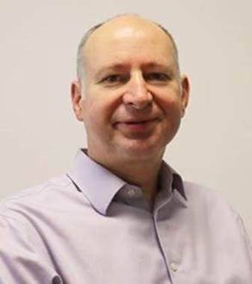
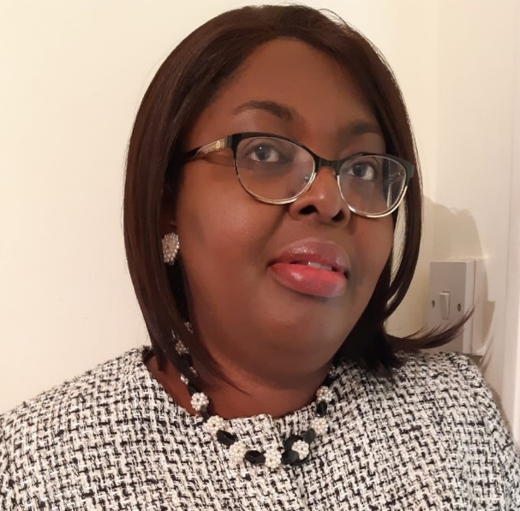
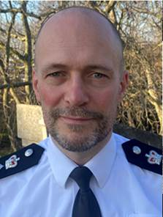
Introduction
James Thomas Children’s Services | Korkor Ceasar Integrated Care Board | James Conway Metropolitan Police
James is the statutory Director of Children’s Services for Tower Hamlets, and the Corporate Director for Children and Culture, with lead responsibility for children’s safeguarding as well as for the delivery of a range of social care, education, early help and commissioned services. He is also chair of a number of children’s partnership boards and sits on the Health & Wellbeing Board and the Community Safety Partnership. He is also the national and London lead for ADCS on multi-agency safeguarding and sits on the cross-governmental Safeguarding Reform Delivery Board and the London Safeguarding Children's Partnership. | Korkor is the Associate Director for Safeguarding Children, NHS North East London Health and Care Partnership. She leads on the implementation of all safeguarding statutory duties for children safeguarding and Looked after Children, ensuring all risks are escalated thorough the appropriate governance. She is responsible for providing expert advice and guidance to the Partnership Boards via Chief Nurse and other colleagues on all safeguarding functions, aspects and responsibilities; with a particular focus on ensuring the strategic needs are met. Korkor is also responsible for ensuring that safeguarding is effectively managed across the health system, engaging local providers in a robust partnership approach to commissioning and provision of health services. | Detective Chief Superintendent Conway is the senior police officer responsible for the strategic and operational oversight for the London Boroughs of Tower Hamlets and Hackney. James Conway works closely with both internal and external partners in order to safeguard the vulnerable, tackle crime and continue to build on trust and confidence in policing amongst the community it serves.
The Tower Hamlets Safeguarding Children Partnership (THSCP) is fully established under the Working Together to Safeguarding Children 2018 Arrangements and has developed over the last year into a responsive and agile system.
The Working Together Arrangements state that:
A safeguarding partner in relation to a local authority area in England is defined under the Children Act 2004 (as amended by the Children and Social Work Act, 2017) as:
(a) the local authority
(b) a clinical commissioning group for an area any part of which falls within the local authority area
(c) the chief officer of police for an area any part of which falls within the local authority area
Within Tower Hamlets James, Korkor and James make up the leadership and core partners and rotate chairing THSCP Executive.

Slide 4
Governance and Structure
THSCP Executive
Rotational Chairs: James Thomas (CSC), James Conway (Police), Korkor Ceasar (ICB)
Quality Assurance and Performance Sub-Group
Chair: Director, Supporting Families (TH Local Authority)
Priority 1: Vulnerable Young People and Exploitation Subgroup.
Chair: Head of Service,
Exploitation Service
(TH Local Authority)
Priority 2: Domestic Abuse and the Impact on C/YP Domestic Abuse Task and Finish Group
Chair: AD for safeguarding children (North East London ICB)
Priority 3: Staying Safe Online Task and Finish Group
Chair: Det. Supt Public Protection (Central East BCU Metropolitan Police Service)
Rapid Review Panel
Chair: Designated Nurse Safeguarding Children (North East London ICB)
Education Safeguarding Forum
Chair: Headteacher, TH Primary School
Rapid Review Working Group
Chair: Head of Service, Safeguarding and Quality Assurance (TH Local Authority)
The Groups Explained:
The Executive Group oversees the THSCP, which aims to continue to promote and support multi-agency working across all areas of Safeguarding. The local Police, Clinical Commissioning Group and Local Authority are equally responsible for the Partnership and its outcomes. The group meets up to eight times a year with at least quarterly meetings.
The Quality Assurance and Performance Group oversees the business part of the partnership which includes (but is not limited to), reviewing multi-agency data, audits and action plans that arise from statutory reviews. The group meets quarterly.
The three priority groups are set up to focus a lens on an area that has arisen as a challenge within the borough. Each group meets every other month.
The Rapid Review Panel has been established to respond quickly to serious incidents when a child has been significantly harmed or died from abuse or neglect. The group reviews the cases, draws out any immediate learning and makes recommendations to the Executive on what level of Statutory Review is required.
The Rapid Review Working Group has the responsibility of implementing the learning from statutory reviews. Meeting every other month.
The Education Safeguarding Forum is a space for Education Providers to raise thematic and strategic safeguarding concerns. Meets once per term.
Each member of the Executive Group sponsors a sub-group, attends and offers support.

Slide 5

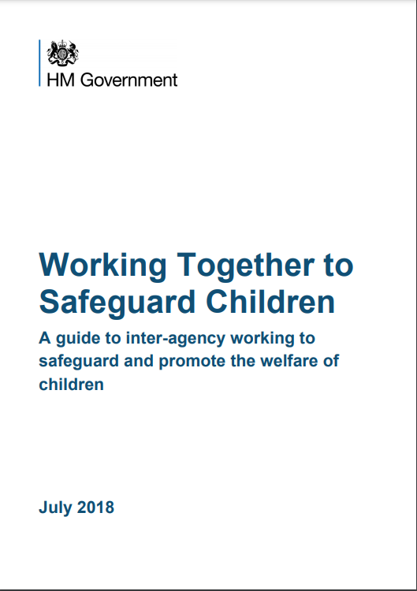

Membership
“Strong, effective multi-agency arrangements are ones that are
responsive to local circumstances and engage the right people. For local arrangements to be effective, they should engage organisations and agencies that can work in a collaborative way to provide targeted support to children and families as appropriate. This approach requires flexibility to enable joint identification of, and response to, existing and emerging needs, and to agree priorities to improve outcomes for children.” – Working together to Safeguard Children 2018
The partnership has been made stronger this year through key agencies taking the lead in many areas including shaping and leading the work in our priority areas. The infographic shows a snapshot of members, but the membership is made up of over 200 professionals from various agencies and teams across Tower Hamlets.
Working Together to Safeguarding Children:
“Local organisations and agencies that work with children and families play a significant role when it comes to safeguarding children.
To achieve the best possible outcomes, children and families should receive targeted services that meet their needs in a co-ordinated way. Fragmented provision of services creates inefficiencies and risks disengagement by children and their families from services such as GPs, education and wider voluntary and community specialist support.
There is a shared responsibility between organisations and agencies to safeguard and promote the welfare of all children in a local area.” – Working Together to Safeguard Children 2018

Slide 6
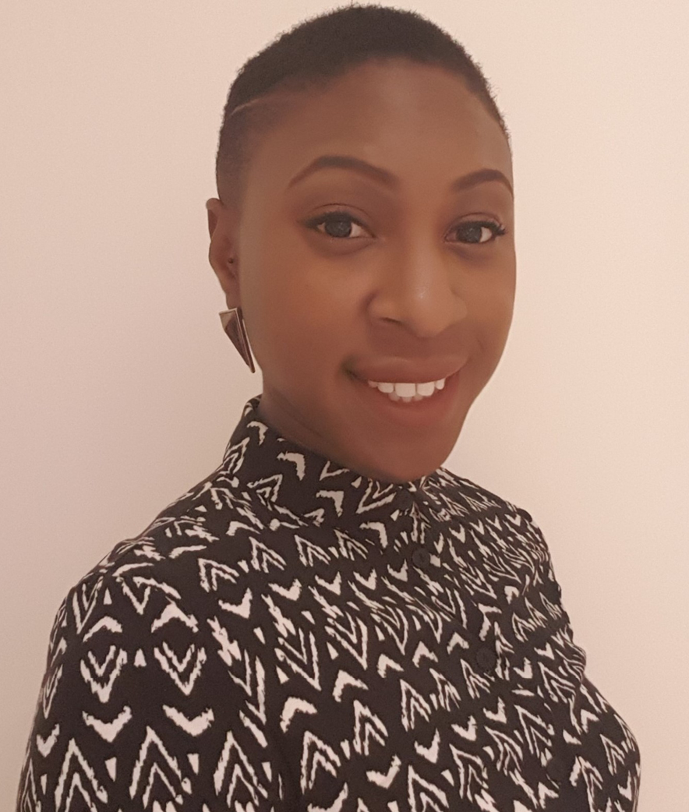
Independent Scrutiny
Independent Scrutineers Reflections over the Last Year
This annual report acknowledges the progress made by the THSCP throughout the year and the challenges that remain, which the Partnership is committed to addressing in the coming year. In collaboration with the Young Scrutineers, I began an in-depth review of the safeguarding arrangements towards the end of 2022/23, which immediately highlighted commendable strengths and practices.
Significant efforts have been made to enhance the Partnership's response to children and young people experiencing harm outside the home, informed by Pan-London research, locally commissioned reviews, and national research. THSCP is also developing its approach to data and performance to provide a strong evidence base for demonstrating the Partnership's impact on children and young people.
The Covid-19 pandemic had a profound impact on children, young people, and safeguarding systems. Partners have shown resilience and adaptability in embedding hybrid models to remain responsive. While online working has its benefits, there is value in face-to-face collaboration to tackle issues effectively and foster strong relationships across the safeguarding system. Partners have also expressed this, and changes have been made to reestablish face-to-face subgroup meetings.
There is a genuine commitment to improving multi-agency collaboration and engagement, with all statutory partners fully committed to the safeguarding ambitions of the Partnership. The need to strengthen THSCP’s arrangements in the year ahead is recognised, and significant efforts are already underway. The findings of my review intend to support these efforts.
Looking forward, strong change management, systems leadership, and systematic processes will be crucial for future developments. Communication within and between partner bodies will need to be a focus for continuous improvement to drive efficiency, challenge, equity, and inclusion while ensuring all safeguarding priorities are addressed.
As the Independent Scrutineer, I am committed to hearing directly from children, young people, families, and frontline practitioners to understand what is working well and how multi-agency working can be improved. While challenges lie ahead, I have confidence in the THSCP's ability to build upon its strengths and notable progress to date, and I will continue to scrutinise and support the Partnership in navigating risks and challenges.
Together, the Partnership will strive tirelessly to safeguard children, and I look forward to working alongside them in this important endeavour.
‘The role of independent scrutiny is to provide assurance in judging the effectiveness of multi-agency arrangements to safeguard and promote the welfare of all children in a local area, including arrangements to identify and review serious child safeguarding cases” and “The independent scrutineer should consider how effectively the arrangements are working for children and families as well as for practitioners, and how well the safeguarding partners are providing strong leadership and agree with the safeguarding partners how this will be reported.” – Working Together to Safeguard Children 2018
Laurelle is a JNC qualified Youth and Community Worker with experience in a range of cross-sector frontline, research, strategy and leadership roles. Her background includes work in further education, violence reduction, children's social care, youth offending, and children's charities. Laurelle’s work focuses on tackling complex inequalities challenges across systems for children. She is a Lay Member on a local SCP, Co-Founder of a community for Black safeguarding professionals and a primary school Governor, helping her keep attuned to safeguarding from different perspectives. She is deeply invested in improving the lives of children.
As the Independent Scrutineer joining THSCP in October 2022, my observations primarily focus on the last six months. In this time, the THSCP Executive and Partners have welcomed constructive challenge and support. With changes in key personnel, the Executive Leadership Group is still in its early stages but acknowledges the need for growth to facilitate change and improvement beyond system, institutional and interpersonal constraints. The ambitious commitment of THSCP to enhance the outcomes of children and families in Tower Hamlets is impressive, and I have confidence in their shared determination to accelerate positive change.

Slide 7

Young Scrutineers
The THSCP are proud to have introduced ‘Young Scrutineers’ into the Tower Hamlets Safeguarding Children Partnership which was the result of an innovative bid to the Department for Education and means we can involve young people in the work of the Partnership. As a result of the successful bid, we have three Young Scrutineers, who are paid at an adult living wage hourly rate, and who work up to 4 hours a week. The contract is flexible to work around their educational needs, so they can work less hours when school is more demanding. The Scrutineers are aged 16 and 17 and they work alongside our Adult Scrutineer. Their role is to give their views, share theirs and peers' experiences and review policies and projects to ensure we have the voice of the child at the centre of the work. We have three priority areas (Impact of Domestic Abuse, Staying Safe Online and Exploitation), so each Scrutineer is aligned to a priority project. The Young Scrutineers are currently working on a Six Steps of Scrutiny project with the Adult Scrutineer, a project which is based on the University of Bedfordshire model. They are also working on awareness raising tools for children and young people in their priority areas and a young person’s guide to certain protocols and procedures. They have been in post since June 2022 and the current Scrutineers will be with us for a year. The project is funded for a year by a grant from the DfE and we are looking at how we mainstream this for future years.
Over the last year the Young Scrutineers have completed the following activities:
1:1 meetings with over 15 senior managers and directors
Gave initial feedback on priority areas and action plans
Benchmarked the THSCP website and gave feedback on how parts of the website should be accessible for children and young people when they wish to seek information on safeguarding.
Completed a jargon busting exercise which breaks down common used terminology into a young person friendly guide
Helped facilitate a scrutiny workshop when the THSCP had a change over in Independent Scrutineer
Are working alongside the Independent Scrutineer on the Six Steps of Scrutiny project to highlight improvements to the THSCP
Presented feedback to priority task and finish groups
Helped analyse and feedback on a survey regarding online safety which was sent out to schools.
Gave feedback on how to make the Thresholds document more accessible for children and young people and are now working on a guide for young people and children to navigate a thresholds document.
Engaged other groups of children and young people to help shape the THSCP new priorities.
Are currently working on a survey to capture more views of children and young people.
In June 2023 they will be attending a THSCP Executive group to be a part of scrutiny discussions.
Impact
Having young people work directly in the THSCP ensures that policies and projects are created with the voice of the child at the centre of the work. A few examples of impact are:
The Young Scrutineer allocated to the ‘Domestic Abuse and Impact on Children’ Group highlighted that the action plan was missing any activity around Domestic Abuse in adolescent relationships. This was fed back to the group and amendments were made to ensure this was covered.
Whilst procuring a website, the aim was solely looking at a website for professionals, the Young Scrutineers explained they would want a place where young people can go for advice, so this has been added to the website plans.
When meeting with children and young people they have explained that it is much easier to meet with the Young Scrutineers than adults to give their feedback.
The scrutiny of the THSCP is strengthened by having the three independent young people.

Slide 8
Young Scrutineers – In their own words…
Imtiyaaz | Imaana | Mia-Ly
“I am a first year A level student studying Mathematics, Economics, Philosophy and Government and Politics. I enjoy keeping up with current affairs and being involved in local charity projects within the community. I have been assigned to online safety. Having been a young scrutineer for almost one year now, I have been involved in many areas of work that the safeguarding childrens partnership carry out and have met a great team of people who offer many amazing services for the young people within the Borough. I have worked on several tasks and projects which includes being part of updating the new THSCP upcoming website, and interesting detailed research tasks with my most recent being with Laurelle, the Independent Scrutineer where we are analysing the THSCPs work through the 6 steps of scrutiny, presenting to professional individuals regarding our work and what services I think can be improved from a young person’s perspective and being able to meet a diverse group of young people. The best part about being a young scrutineer was learning about protocols when keeping young people safe and this was explored in detail when I reviewed the multi-agency safeguarding threshold where we are looking to introducea version for young people like me. Staying on next year, I would look forward to working with young people and having opportunities to try to improve services.” | “I am 17 years old. I started as a Young Scrutineer during 2022 with Domestic Abuse as my priority area. My goal is to make sure Domestic Abuse is less common in Tower Hamlets, improve the help that victims receive and ensure the voice of children are taken into account. Additionally, I want to ensure that victims feel safe and comfortable enough to seek help. At the start of this role me and the other two Young Scrutineers were meeting with all of the senior people that work within the Partnership to discuss our ideas and share what changes we wanted to make to Tower Hamlets. We have communicated some of this through joint presentations. My favourite part of this role has been meeting with other young people to get their views on what they like and what they would change about the borough. It was very interesting to hear everyone’s side about their experience in Tower Hamlets. The part I found most challenging was gaining the confidence to talk to so many new people but I was quickly able to do this after receiving all the help from the adults that work with me. If I stay in this role next year, I’m looking forward to having new priority areas to help improve. The new priority areas will be ideas coming from young people and practitioners in the borough about what they want improved, so I am very excited to work on these.” | “I am currently a sixth form student, and I am hoping to go to University. After being assigned exploitation, my priority area, we went to meetings where we were introduced to a range of people. We are working together to focus on scrutiny and improvements within the partnership. I worked with the head of the exploitation team, to address the areas that we agreed could be developed more to capture the voice of the child. Some of the work we completed included producing a presentation to introduce ourselves to a variety of professionals at the Every Chance for Every Child Board and meeting with Young Carers. These experiences allowed us to share some of the ideas for improvement, gain feedback and understand which areas of our work could have the most impact. Pieces of work I produced included a compilation of articles regarding exploitation and other related topics and developing a toolkit that will be distributed amongst young people. (I presented this to professionals at the Exploitation group). My favourite part of working in the THSCP has been gaining insight into an area that I knew very little about. I have been able to meet a wide variety of people from different backgrounds. I enjoyed engaging with youth groups, including the Young Carers and Young People’s Participation Group for CAMHS. The challenging part of this role was getting to grips with all of the mechanisms and terminology that are used within the partnership – a year in, I have found that I have a better understanding and I am able to talk to my colleagues about things that I don’t understand . I hope that in the next year, the toolkits for each priority area are distributed amongst young people, the new partnership website is introduced and that we continue to engage with children and young people.”

Slide 9

Funding the Tower Hamlets Safeguarding Children Partnership
“Working in partnership means organisations and agencies should collaborate on how they will fund their arrangements. The three safeguarding partners and relevant agencies for the local authority area should make payments towards expenditure incurred in conjunction with local multi-agency arrangements for safeguarding and promoting welfare of children. The safeguarding partners should agree the level of funding secured from each partner, which should be equitable and proportionate, and any contributions from each relevant agency, to support the local arrangements. The funding should be transparent to children and families in the area, and sufficient to cover all elements of the arrangements, including the cost of local child safeguarding practice review” – Working Together to Safeguard Children 2018
Income |  | Expenditure
Local Authority | £98416 | Salaries & Oncosts Manager Co-ordinator Apprentice Young Scrutineers | £169934
ICB | £50000 | Independent Scrutineer (Including overlap period) | £15000
Police | £5000 | Website hosting cost | £3600
DfE Innovation Bid | £35000 | Training (NSPCC Safeguarding Training) | £0 (£8400 to be paid in yr 23-24)
 |  | Venues | £800
Total | £188,416 | Total | £189,334
 |  | Overspend | £918
Funding is agreed at the beginning of the year with the partners and is used to fulfil the function of the partnership. It is noted that many organisations face financial challenges each year. The partners will often give their time and resources in kind to support the functioning of the partnership. This includes, chairing and participating in sub/task and finish groups, conducting reviews, audits, leading and attending workshops and analysing and submitting data.

Slide 10












About Tower Hamlets
 | Tower Hamlets continues to have one of the fastest growing populations nationally and now has an estimated population of 324,745. The latest population estimates published by ONS show that Tower Hamlets continues to have one of the youngest populations in the country with a median age of 31.6. |  | The council has the 7th highest housing waiting list nationally. There are 18,808 households on the council’s housing waiting list. BME households account for 78% of all households on the housing register. In March 2019, there were 2,529 households in temporary accommodation, of which half are placed in accommodation outside of the borough.
 | Tower Hamlets has a similar proportion of young people aged 0-19 to England and London. There are an estimated 78,000 children and young people aged 0-19 resident in Tower Hamlets, a quarter of all residents. |  | Tower Hamlets has a high proportion of children in need when compared with England and London. The number of children identified as being in need has risen considerably since 2017. Neglect is the most common form of abuse for children in receipt of a child protection plan.
 | There are 45,000 pupils in primary and secondary schools in the borough. Most pupils want to attend university/higher education. |  | In 2016-18, life expectancy for men in Tower Hamlets was the same as in the UK, while for women it was slightly higher than the UK average. Babies in Tower Hamlets were more likely to be born with a low birth weight than in England or London, but mothers were less likely to be smokers. The infant mortality rate was higher than the national or regional average.
 | Tower Hamlets economic output in 2017 was £29.7bn – more than Birmingham or the City of Manchester. The economy grew by 49% between 2008 and 2017. |  | Crime in Tower Hamlets has risen in recent years but less rapidly than in London as a whole. In December 2019 there were 35,118 notifiable offences, a 4.2 per cent increase since 2016, compared to the 16. per cent increase in the London as a whole. Recorded youth crime in the borough has fallen, as it has elsewhere.
 | During 2016-19, around two thirds of Tower Hamlets working age population were in employment (67%). |  | The borough has a rich and historical environment, with more than 200 parks and open spaces. CO2 emissions have fallen but not sufficiently quickly, so Tower Hamlets declared a climate emergency in March 2019
 | Tower Hamlets became significantly less deprived between the 2015 and the 2019 Indices of Multiple Deprivation, moving from 10th to 50th on the rank nationally, but 60% of the borough are still within the 30% most deprived parts of England. Deprivation among children and older people is much higher than deprivation as a whole. |  | Tower Hamlets has an extensive transport network with 7 Overground stations and 9 underground stations, the busiest of which is Canary Wharf station. The borough is also served by 17 DLR stations and 26 daytime bus routes.

Slide 11
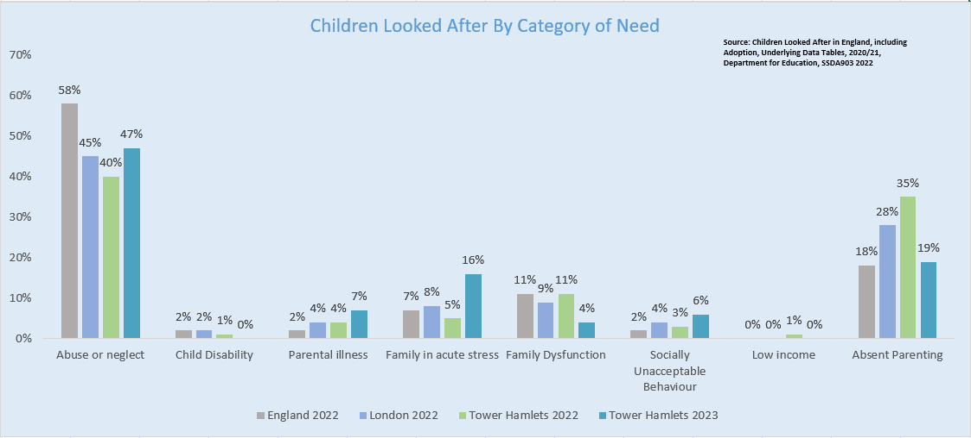
Data regarding Children and Young People
Narrative: In 2023, the primary reason for children entering care was Abuse or Neglect, an increase to 47% (from 40% in 2022) of the overall figure, lower than the 2022 England average of 58%. There has also been an increase on children placed due to Family in Acute Stress, rising from 5% in 2022 to 16% in 2023. Conversely, there has been a notable decrease in the proportion of children recorded under the category of Absent Parenting, a reduction from 35% in 2022 to 19% in 2023.

Slide 12
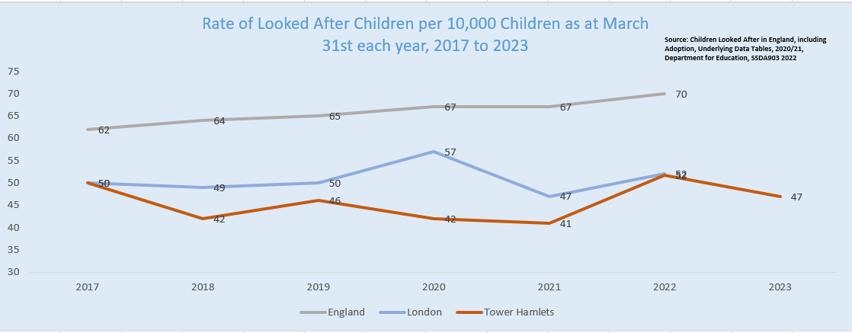
Data Looked After Children
Narrative: As at March 2023, Tower Hamlets was responsible for the care of 301 children, a 9% decrease on the 2022 figure of 332 and the lowest level since 2018 (286). This represents a rate of 47 children per 10000 population. Significantly lower than the 2022 averages of 70 for England and 52 in London.

Slide 13
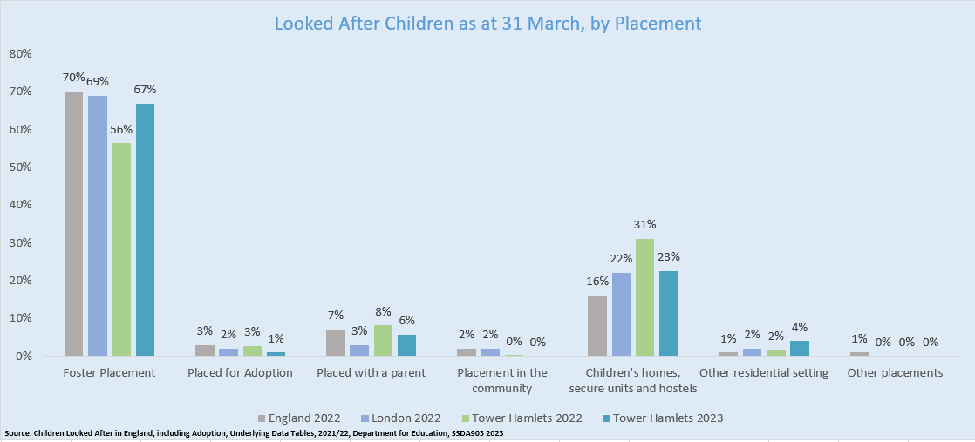
Data Looked After Children, by Placement
Narrative: The percentage of children in Foster Placements in the borough was 67% in 2023, an increase of 11 percentage points compared to 2022 (56%). This is also below the 2022 average rates for both England (70%) and London(69%). The borough had a decrease in 2023 on those children either placed for adoption, placed with parents, or in children’s homes, secure units and hostels when compared to 2022.

Slide 14
Key Achievements and The Impact – Snapshot
6 Steps of Scrutiny | The 6 steps of scrutiny is a model created by the University of Bedfordshire and has been rolled out in the THSCP by the Independent Scrutineer to complete a full review of the strengths and improvements required. This has included reviewing all documentation, focus groups, interviews, and surveys, all with leaders, managers, practitioners and young people. This aims to strengthen the THSCP and therefore strengthen the response to safeguarding children.
Training & Awareness Program & increased bulletin activity | Additional focus was put into training and awareness, some of the training sessions included, introduction to safeguarding, designated lead safeguarding, gaming and gambling awareness, child sexual exploitation awareness and an array of awareness events. Alongside increasing activity of THSCP bulletins. Training improves the confidence and ability of partners to react to safeguarding situations and gives partners opportunities to work alongside their counterparts from different agencies.
Delivered Safeguarding Month | During November 2022 Safeguarding month was delivered where partners came together to host and attend awareness sessions. The topics included, an Infant Neglect conference, Domestic Abuse, Exploitation, Online Safety, Learning from CSPRs and the Rapid Review process. This gave the opportunity for multi-agency partners to come together to ensure they all received consistent information on the topics.
Completed a Thematic Review into Serious Youth Violence | A thematic review named ‘Troubled Lives, Tragic Consequences’ took place in 2014-2015 which reviewed older children who had committed serious offences or were victims of serious harm. The aim was to understand common themes in the lives of these older children, relating to system practice and academic research. The reviewer was re-commissioned to return to this subject of work which allows Tower Hamlets to see what change has taken place and what change needs to happen to protect children and young people from serious youth violence.
Improvements to Rapid Review Processes, including a new decision sheet. | A full protocol and guidance on reviews was finalised this year which ensures all partners have a full understanding of the review process. Within this protocol, the process was tightened up, ensuring everyone refers cases in the same way and we trialed 3-Way decision making for Serious Incident Notifications.
Improved embedding learning from Child Safeguarding Practice Reviews | A themes sheet was produced so that partners have a snapshot of the key themes of concern at all Rapid Reviews. THSCP business unit representatives also attended supervision groups, management meetings, and practitioner events to highlight the key themes of reviews. Events took place 1 year post CSPR publication with partners to review what changes have been made and continue to raise awareness into the key areas. This ensures partners have a full understanding of what issues are seen at review level and can help prevent such cases repeating.
Young Scrutineers embedded into the THSCP | Three young scrutineers have been working in the THSCP business unit, this ensures that the voice of the child is always at the centre of the THSCP work and gives paid development opportunities to young people.
Closed task and finish groups after 2 years of activity. | Three priority groups were set 2 years ago, this saw multi-agency improvements into the areas of online safety, exploitation and domestic abuse. This was also a key opportunity for partners to work together in project groups to jointly produce outcomes.

Slide 15
Key Achievements and The Impact – Snapshot
Introduced a group to solely work on implementing actions from Rapid Reviews and CSPRs & received positive feedback from an internal audit into the CSPR learning process | A statutory review action plan was introduced which combines all actions from all Rapid Reviews and CSPRs, to reduce duplication and review themes more easily. A small group of professionals who usually attend the Rapid Review Panels now meet every 6 weeks to implement the actions from reviews. This ensures that each agency is fully aware of their responsibilities and enables the actions to be completed at a faster pace. Evidence that the actions are completed is collated by the THSCP business unit. This process received good feedback from the local authority auditing service.
Introduced an Administration Apprentice into the THSCP business unit | An apprentice was introduced, which aided capacity and meant more time could be spent on training and awareness programmes this year. The extra support also ensured actions could be followed up between meetings thus saving time of partners and ensure time is used efficiently.
Produced new polices, including a Non-Recent Abuse protocol, tool kits, Multi-Agency Escalation Policy, updated Rapid Review Protocol | Ensuring our policies are up to date is vital for all partners. Consistent messaging around protocols ensures that children are more protected. Alongside the aforementioned policies, a non- accidental injury pathway, refreshed multi-agency domestic abuse guidance, refreshed multi-agency neglect tool and guidance for use of translators are currently being worked on and will be finalised in the summer/ autumn of 2023.
Improved the multi-agency data set | We now collect data from over 11 teams and agencies, this year exploitation data and children missing data was added. Having a full data set from all agencies ensures the THSCP are aware of any trends or safeguarding issues that are occurring and can respond to recurring themes.
Reviewed and introduced new Thresholds | Consultation was held with partners on the current Thresholds document. The main feedback was to change this to a ‘levels of needs’ documents. Therefore, we have adopted the New Pan London Levels of Need. Many of the safeguarding partners work across a wider area than just Tower Hamlets and so this will help to ensure there is a consistent approach across Boroughs. We will also introduce a young person's guides and a local guide to more specific pathways.
Completed a multi-agency audit into Exploitation | Multi-agency audits ensure that all partners can reflect on cases and how partners collaborated to ensure the safeguarding of children. This period introduced multi-agency audits to the THSCP, where partners are responsible for presenting cases from their agency and taking part in the audit activity. This ensures there is a 360 degree, joined up review of systemic issues. The audits review areas for improvement and best practice. The majority of the activity take places in a workshop style meeting where partners can have open and honest discussion about the cases.
Made improvements to meetings including introducing an Escalation Tracker | With additional support in the business unit, minutes are supplied for more meetings which helps ensure actions are carried out, an escalation tracker was introduced so within any meeting partners can make strategic escalations to the THSCP Executive. Action plans and trackers have also been adopted as the remit of the safeguarding children partnerships grows.

Slide 16
Key Challenges and The Impact – Snapshot
Commissioning of Independent Reviewer | Although there has been a lot of progression in regard to CSPRs, there was difficultly with the local authority procurement process of an author. The procurement system is not set up to be able to quickly acquire an author. This meant that the report was delayed. The THSCP are working with the Pan-London safeguarding partnership on a pool of authors and with local authority legal and procurement teams to ensure that processes are created to enable the quick appointment of authors for future reviews. The THSCP are considering training for a pool of internal authors alongside this.
Attendance at Training and Awareness Events | The THSCP are happy to say more training and awareness courses were delivered this year, however, there have been issues with no-shows and low attendance. The THSCP are looking at an ambassador programme; a senior manager from each agency will be responsible for ensuring their agency is represented at such events.
Partners reporting they feel a disconnect from the THSCP | The THSCP arrangements have now been in place for three years, partners have voiced that they feel a disconnect from the THSCP Executive Group and decision making. The Independent Scrutineer, has conducted a full review (including partner consultation) which contains recommendations for structural change, which will be considered in June 2023.
Priority Group Delivery | Three priority areas were introduced in 2021, the groups spent a significant amount of time on scoping and building the action plans and struggled with direction. The THSCP Executive have committed to giving clearer outcomes to the new priority areas and an agile project management methodology will be implemented.
Capacity and Funding | There is still a significant way to go to a Safeguarding Partnership of equal funding and the Local Authority contribution decreased substantially. Local Authority restructures meant the role responsible for the multi-agency training was deleted. Partners have had a very difficult couple of year and are now working in a post pandemic arena and have expressed issues with capacity to carry out some work within the THSCP. A key aim from last years report was to introduce a new website but due to pressures on capacity this has not been possible.
Multi-agency Data | Last year the THSCP developed a multi-agency data dashboard, which requested data from partners that was ‘readily available’, due to this, the data is not always aligned with the most recent quarter. The THSCP has identified that data should focus thematically on the priorities, as well as a compliance return and to include comparative data from the previous quarter or year.
Infant Safety | Child Safeguarding Practice Reviews often highlight a number of safeguarding themes. For Tower Hamlets, Infant Safety concerns (including unsuitable sleeping arrangements, infant neglect, infant abuse) have been at the centre of all Rapid Review and CSPRs in the last 18 months. Recommendations from reviews are implemented with partners and a conference was held on Infant Safety, in the year ahead this will be considered as a key priority area for improvement.

Slide 17



THSCP Priorities
Priorities:
In 2021 three priorities were set by the THSCP Executive. The following activities took place to contribute to the decision making:
Consultation: Events held with practitioners, managers and 1:1 meetings.
Young People: 11 Young Peoples engagement groups were consulted.
Data: Data from SCRs (at the time), Rapid Reviews, Audits and the Multi-Agency data dashboard.
The Groups have been live for 2 years and are closing down over summer 2023, and new priorities set through a similar methodology.
Exploitation – Local Authority led | Domestic Abuse and the Impact on Children and Young People – Health led | Staying Safe Online – Police led
The group was initially chaired by the Divisional Director for Supporting Families, the group was taken over by the Head of Exploitation. This group was already a sub-group under the THSCP due to the Independent Enquiry for Child Sexual Abuse response. The group took on the task and finish function to improve services around Exploitation on a multi-agency level. A year into the Task and Finish Group, the Young Scrutineer joined. She met with the Chair(s) on 3 occasions and attended 1 group. | The group had three chairs over the duration and ended under the chairing of the Associate Director for Safeguarding Children . An action plan was established where the key focus was on scoping and opportunities for better join up, spreading awareness and creating a toolkit for children and young people to use. The group chose to focus on a toolkit for children and young people following feedback from Young People’s participation groups that they wanted resources to support them in knowing what happens if a disclosure is made about Domestic Abuse and what to do if they are worried about a friend who they think may be in a household where there is domestic abuse. The group was also linked in with the VAWG team and it was felt that there was already good support in this area for practitioners. A year into the Task and Finish Group, the Young Scrutineer joined. She met with the Chair(s) on 2 occasions and attended 1 group. | The group was chaired by Det. Supt Public Protection – Central East BCU. Online safety was a key theme raised by young people and partners and following a CSPR where practitioners said they did not feel confident in supporting children regarding online safety. An action plan was established where the key focus was on scoping to find out more about this topic, spreading awareness and creating a supporting document for practitioners to use. The group reviewed looking at support for parents and linked with the parental engagement team who already supply training for parents and carers, therefore the group focused on improving practice for practitioners. A year into the Task and Finish Group, the Young Scrutineer joined. He met with the Chair on 3 occasions and attended 1 group.

Slide 18
Overview of the Priority Groups – Exploitation
Achievements
THSCP Improvements Commitment to engaging in the development of the Exploitation screening tool. Support to develop the multi-agency action plan. Exploitation Multi-Agency Audit. Improvements implemented by the service (Exploitation Supporting Families and the Met Police) Development alongside the Met Police of joined up disruption plans for children. A multi-agency training plan has been embedded. The Multi-Agency Exploitation Partnership (MACE) has been reviewed and improved. The MACE had a re-launch to include oversight of missing children. Quarterly data performance reports are now produced for the exploitation service and MACE. A development of a Problem Profile has been produced which shows data by the MET Police and narrative by the Exploitation Service. Quality reports on exploitation risk and harm assessments have been embedded. An Exploitation Coordinator is now based in the Multi-Agency Safeguarding Hub (MASH). An Exploitation Coordinator in now based in the Community Safety team. The exploitation service has a co-location with Community Safety (part-time) There has been a development of safer places for children and young people and safer spaces meeting which is a part of neighbourhood tasking. Harm outside the Home Framework was launched for the Supporting Families division in the Local Authority
Lessons Learnt
The THSCP Executive and Safeguarding Adults Board agreed that this group would be co-chaired and would focus on both children and adults. Unfortunately, it was not clear at the time what the focus for adults would be as there was still a substantial improvement plan for children. Community Safety had just joined as co-chairs to develop the Harm outside the Home (HoH) agenda and it was thought three chairs may be over complicated. Adults therefore became part of the membership of the group and were involved through this. As the Local Authority Exploitation Service were delivering an improvement plan, partners attended the group in the capacity of gaining information and updates from the service. A sub-group was already in place to focus on vulnerable young people and exploitation, when the priorities came in the THSCP in 2021 the group turned into a Task and Finish Group to focus only on Exploitation. In hindsight the sub-group should have been shut down and new Task and Finish Group set up to avoid confusion of outcomes.
Impact
The multi-agency approach to developing the strategic action plan helped embed the more operational work delivered by the Exploitation Service. All agencies gained an oversight of what was happening on the ground which helped ensure there is a consistent approach to exploitation. Partners also took part in an audit, which helped all involved to understand the underlying issues of young people who may be vulnerable to exploitation, which in turns helps partners to know what signs to spot and therefore, overall reduce risk.

Slide 19
Overview of the Priority Groups – Domestic Abuse and The Impact on Children
Achievements
Vlog on use of language - The Designated Nurse for Safeguarding recorded a vlog about use of language by professionals when discussing and writing case recordings in cases where there is domestic abuse. This arose from a CSPR where there was inappropriate victim blaming language used in case recordings and during meetings. There are unfortunately technological difficulties with sharing the vlog which are being looked at. Toolkit for children and young people (in final stages) – The toolkit contains information on the signs of domestic abuse, what happens when a referral is made and a list of websites and resources which the Young Scrutineers feel are young people friendly and they would sign post friends to. Peer to peer advice (in final stages) – This is being developed by the Young Scrutineer in conjunction with other young people, it is a slide show of peer-to-peer advice around recognising coercive and controlling behaviour and the effects and signs of unhealthy relationships. Refresh of Multi Agency Domestic Abuse guidance (in final stages) – The guidance will be shared widely once signed off and Supporting Families have committed to twice yearly refresher/new starter training
Lessons Learnt
The group had a lack of consistent membership and Chairing, leading to confusion over actions. It was agreed by the group that where representation for a group changes, there needs to be a clear system of handover within each agency. A record of the discussion rather than just an action log for future groups will also improve this. The group agreed that too long was spent on scoping and drawing up the action plan. A clear steer from the Executive on outcomes for future groups would improve this. During scoping, the group were clear in their belief that healthy relationships are taught about in schools, but this was at odds with what children and young people were saying when they were consulted with, in that PSHE education does not always include this topic and is delivered too late; they would like more information on this topic at a younger age. On hearing directly from the Young Scrutineer there was a shift in the group to supporting the need for a toolkit and peer to peer advice.
Impact
The group focused on primarily what domestic abuse means to young people and children and how this affects their lives. Once the finalised versions of tool kits are in place this ensures that practitioners have a consistent approach to DA and have further tools to aid their understanding of how DA can affect a child. Young people have said they want to feel empowered by understanding the processes behind DA referrals and what that means for them.

Slide 20
Overview of the Priority Groups – Online Safety
Achievements
YGAM Training – The group linked with YGAM who ran local training at no cost. This was a total of three rounds of training and within each round there was agency specific training. Pan London also took up the training and offered further spaces to Tower Hamlets partners. Awareness Sessions – The police hosted 3 online Safety Specific Awareness Sessions where all partners were invited. Police representatives also presented at Every Chance for Every Child, Local Authority DLT, Education Safeguarding Forum and a CSPR Asif Initial Learning Event. The presentations included updates on key apps and websites the police found to be of concern and practical advice around setting restriction on devices, as well as explaining when online safety becomes a policing issue. The police will be presenting again at the Asif Reflection Learning session in April 2023, which is a session held a year after publication of a CSPR where online safety was a feature of the review. School Survey –17 Primary Schools, 2 Secondary Schools and 1 Alternative Provision took part; 1576 children aged 6-11 and 542 aged 11-18 took part. The survey had 79 questions about online safety The main themes were: Digital Access, Screen Time, Gaming and social media, Online Harms via Contact, Online Harms via Conduct (Nudes/Semi-Nudes and Cyberbullying), Online Harms via Content & Commerce, Impact on well-being: positive and negatives, Parental oversight and supervision, Digital resilience: E-safety lessons, levels of empowerment Some key statistics were: 90% of primary aged children and 96% of secondary aged children use social media. 18% of primary aged children and 30% of secondary aged children say they often play online games with people they have never met in real life. 3% (37) of primary school aged children and 4% (20) of secondary pupils said that they would meet a person who they have only interacted with online through gaming or social media. Online Safety Tool Kit (in final stages) – The tool kit contains all information from the police on key apps and websites of concern as well as practical advice for setting up parental controls. The police have committed to updating this every 6 month. The kit offers advice around professional curiosity and clear guidelines of the laws regarding children and online safety. Attached to the tool kit is a comprehensive list of websites and links for additional support. Peer to peer advice (in final stages) – This is being developed by the Young Scrutineer in conjunction with other young people.
Lessons Learnt
The group spent a substantial amount of time setting up the action plan, this took half the life span of the group. Action plan was too broad, it was difficult for the group to choose a focus, initially the group looked at support for primary aged children, but this led to all aged children. Some actions were not completed which included: A community learning session led by the police – which would have included police cadets and young scrutineers. Linking up with local tech groups for advice. Having an expert in the field (outside of the police) to come to a meeting of the group. Links with faith groups for awareness raising. A review of training and awareness raising that takes place in schools. This was mainly due to the capacity of partners & actions not having clear deliverables. The group asked for the next priorities to have a steer from the THSCP Executive on outcomes. Some YGAM training sessions had to be cancelled by the provider due to lack of take up. Business Support: The group trialled not having minutes and updates directly into the action plan, this caused some confusion and partners asked for more context around actions. For future groups actions notes with context will be provided.
Impact
Online Safety was an area practitioners said they felt the least comfortable with and an area where children and young people had most of their concerns. Through this group and the awareness events it has added online safety to the wider agenda. Practitioners and strategic managers now have an understanding of how children view the online world; it is not a separate world and it is embedded into everything we do. Alongside the achievements of the group, the THSCP has committed to keeping an ‘online theme’ running throughout all of the work. For example, if a priority were to be set on Infant Safety an element of that action plan will be reviewing how online safety is interlinked. The police raised awareness on a number of occasions around key apps and websites of concern which has helped practitioners identify what to look out for and what to speak to children and young people about.

Slide 21
Partner Commitment to the THSCP & Priority Areas
“Domestic Abuse – we have ensured that parents have had access to face to face sessions with key organisations for example the Women's Health and Family Services. They have run sessions on Domestic Violence, Violence against Women and Girls and FGM. Some of our parents have become ambassadors and worked with the trainers in other settings. Post covid it has been very important to move to face to face meetings with parents who don’t always access information through online meetings. Online Safety- staff have attended training on the risks of online gambling through the E1 Partnership of schools.” – Primary School & Chair of Education Safeguarding Sub Group
“NEL ICB has chaired one of the three priority areas, Domestic Abuse and has participated within the other priority areas. This has ensured that the views of health are captured within the partnership. The Designated Nurse has been proactive to encourage the representation of health at partnership meetings. This has included increasing the health participation at the Rapid Review Working Group, to ensure timeliness of completing actions following local CSPRs. The Designated Nurse for Safeguarding has delivered training with partners during THSCP Safeguarding Month. The training supported staff with learning from local and national CSPRs and how to raise a rapid review referral locally and how they can be supported to do so. There has been attendance and partnership during Safeguarding Month. Facilitation at the Refreshing Thresholds Event and joint leadership on the writing of the Non-Recent Abuse Policy.” – Integrated Care Board
“THGPCG actively contribute to Partnership work via the case reviews, audits and subgroups, including those relating to the priority areas. We are also an active contributor to the development of new /updated guidance documents (non-recent abuse, neglect, unexplained bruising etc). We ensure that our service delivery is reviewed and where necessary, amended to incorporate learning / best practice guidance from any case reviews or priority area workstreams. Feedback of Partnership work / developments are fed back to staff via internal governance groups, practice forums, team meetings etc. Any learning is incorporated into our in-house mandatory safeguarding children and domestic abuse training courses and is reinforced via supervision.” – GP Care Group
“The VSCYF Coordinator advertises training, resources and information on areas of safeguarding priority for children, young people and families in Tower Hamlets in emails, and quarterly ebulletins. The VSCYF Coordinator also delivers a mini workshop annually on how organisations can plan for online safety in their organisation, and a training workshop on Developing Safeguarding Policy and Procedures for VCS organisations. The VSCYF Coordinator also supports individual organisations in developing their safeguarding procedures, and with safeguarding queries. The VSCYF Coordinator has attended and supported the work of all three priority tasks and finish groups.” - Voluntary Sector Children and Youth Forum
“We attend all THSCP meetings and contribute on various aspects throughout work with the most vulnerable children in the Local Authority. We work intensely on domestic abuse, exploitation and online safety as all our students are victims as well as perpetrators of the above. We have a consistent and thorough PSHE programme, as well as workshops, 1-2-1 sessions with external agencies and much more to support our young people and their families.”-LEAP
“The police have delivered the highest performance for domestic abuse in the MPS in Tower Hamlets. This is due to the excellent partnership work and risk management in the MARAC. The Exploitation partnership work has resulted in several notable successes in safeguarding children and bringing perpetrators to account through the criminal justice system. The merging of the police missing and exploitation teams under Project SHIELD has led to a more effective response in dealing with children that are missing and exploited. Seeking early evidence whilst children are missing allows for the criminal investigation into modern slavery offences to be initiated earlier than waiting for children to be found and then de-briefed. This is a pioneering piece of work and a first in the MPS. The MPS chaired and led on the Online Safety Priority and presented several times on online safety - delivering to the LBTH Directorate Leadership Team session about Focus on online Safety, Education Safeguarding Forum, THSCP workshop.” – Met Police
“The Head of Exploitation chaired the exploitation sub-group. In addition we have: provided single agency and multi-agency training in the area of exploitation and harm outside the home, supported children and families being harmed through exploitation, chaired MACE, developed a weekly partnership briefing, developed a children and young people section of neighbourhood tasking to support making places and spaces safe and developed mapping provision to understand risk.” – Exploitation Service

Slide 22
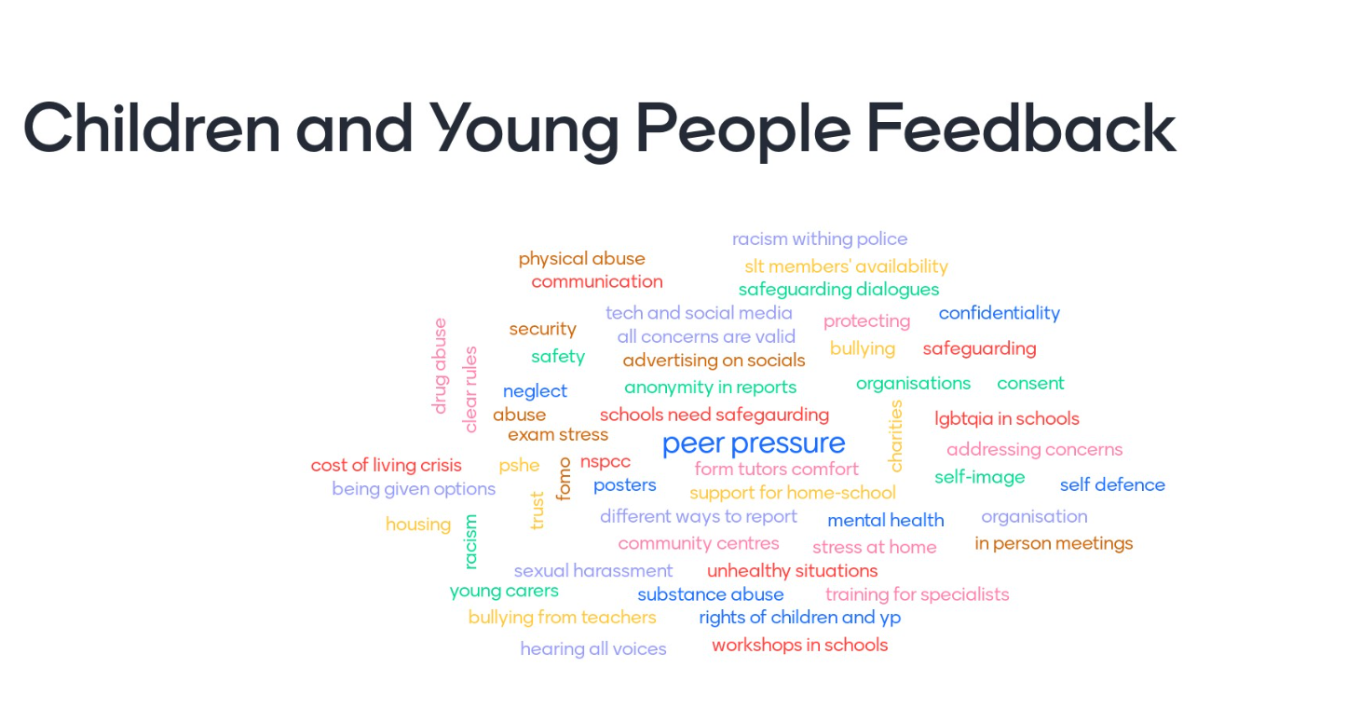
Voice of the Child and Young Person at the Centre of What We Do
A few highlights of what the youth groups have fed back about their biggest concerns and areas of improvement they would like to see:
Over the last year we have tried to ensure the voice of the Child and Young Person is at the centre of all THSCP work. The Young Scrutineers have developed this, and in addition to their own views they have linked with other existing children and Young People’s Groups. So far they have linked with:
Youth Empowerment Squad (Barts Health NHS Trust)
Young Carers (Hailey Bury Youth Centre)
Young People’s Participation Group (CAHMS)
They will be meeting with additional Youth Groups over the summer.
They have also devised a questionnaire which will be sent out to all youth groups and schools to gain feedback on safeguarding areas of concern and how linked in children and young people feel with safeguarding activity.
Note: Collation of feedback and infographic were created by the Young Scrutineers

Slide 23
Voice of the Child and Young Person at the Centre of What We Do Continued
The Young Scrutineers provided more detail of areas that Children and Young People in Tower Hamlets said were areas of concern. This will be added into the 6 steps of scrutiny review and feed into the recommendations as well as be used to consider the new priority areas for 2023-2025.
“Sexual harassment:
Young people had stated that they feel that sexual harassment is not discussed enough, it is said to be somewhat ignored within schools. Young people feel that some concerns raised to school are disregarded and this leaves the young person less inclined and engaged with their education as normal (especially if the perpetrator of the harassment is in the school – another peer) They also spoke about sexual harassment on public transport to and from school.
Bullying in schools:
More discipline and consequences were expressed for perpetrators of bullying, young people had felt that they were being bullied by not only peers but by teachers and that teachers were taking their power and authority to an advantage by ‘picking’ on certain students – this makes young people less likely to report any concerns (safeguarding or other) to teachers, due to the possibility of not feeling supported.
Police and young people:
The young people had expressed that some feel the police often behave in a racist manner towards young people from BAME. They also expressed the lack of trust they have within the police and would like to see more diversity and representation of people of colour working within the work force.”

Slide 24
Children and Young People at the Centre of THSCP
The THSCP makes it a principle to consult with children and young people when implementing decisions, such as setting the priorities. Throughout the year we ensure our partners keep the voice of the child/ young person at the centre of their care, some examples of this are below:
“In addition to school pupil voice systems (an open door approach, circle time, pupil voice, mentoring and therapists) we have developed a new universal system which offers all KS2 children a key adult who they can talk to.
We have introduced a Personal Development Record 1-1 meeting for each KS2 child. Children identify an adult in the school that they trust. They meet with their trusted adult formally twice in the year to discuss key questions and prompts about school and home learning. The aim is for each child to develop a trusted relationship with a key adult who is accessible to them during the school day.” – Primary School & Chair of Education Safeguarding Sub-Group
“The North East London ICB liaise with delivery partners in establishing the voice of the child to influence the delivery of our work. We regularly quality assure Looked after Children review health assessments in which it is established that assessing practitioners are capturing the voice of the children who we care for. These voices are acted upon and have had influence on the care that is provided. The Designated Nurse for Looked after Children has liaised with Children Living in Care council to gather their views on health related issues. The award winning Health Spot has celebrated the success of 3 years of service. Health Spot is a specialist extended GP hub specifically for young people in Tower Hamlets, which can be accessed at Spotlight. Due to the success the model has now been extended to a 2nd location. The Young scrutineers have met with the Designated Nurse for Safeguarding Children and Associate Director of Safeguarding Children to discuss priority work areas in which their feedback has enabled further discussion within the priority areas.” – Integrated Care Board
“The voice of the child is central to the Healthy Child Programme delivered by 0-19 services. It is also a key focus of the Maternal Early Childhood Sustained Home-Visiting and Family Nurse Partnership programme offered to all families who meet the criteria. 0-19 Practitioners capture the voice of the child during their routine assessments through promotion and observation of attachment, responses to parental interaction and through assessment of children’s health and development at home and in play environments, including at Children’s Centre. Once children develop verbal communication, this will also include direct conversations with them in child friendly language. 0-19 Practitioners are also advocates for children, supporting parents to have developmentally appropriate expectations and to be able to see things from the child’s perspective. They also work with parents to support them in understanding how bonding and attachment, ensuring environments are safe and nurturing with the appropriate level of stimulation and how their lifestyle behaviours will impact on their children. The voice of the child is also considered and documented within all safeguarding children supervision. Staff receive training on the voice of the child within assessment training which is mandatory for 0-19 staff. Skill mix staff have specific training to observe a child and escalate any concerns. The Tower Hamlets GP Care Group (THGPCG) Safeguarding Children Team have met with the Young Scrutineers to explain the remit of our team, THGPCG Services and the wider health services in the borough. “ – GP Care Group
“All the VSCYF Coordinator’s work is based on current issues for children, young people and families. VCS organizations base their work on the needs of the child, often in coproduction with them. The VSCYF Coordinator met the Young Scrutineers when they started and discussed the work of the VCS with them. They were also at some of the task and finish groups I attend.” – Voluntary Sector Children and Youth Forum
“All our students have their own key worker who meets with some of them on a daily basis, depending on need. We regularly meet with students and parents to hear their views or complete restorative justice processes, which allows them to communicate with us. We have a student council that meets regularly to hear our students’ views and wishes.” – LEAP
“Obtaining the voice of the child has been central to MPS policy in working with children both as victims and suspects. This is monitored through compliance checks carried out internally and also by external inspections carried out by the HMIC. The Detective Superintendent has met the young scrutineers and was really impressed with their passion and drive to improve outcomes for children in the borough. This is an excellent contribution to the richness of the safeguarding partnership” – Met Police
“Children who are open to support workers within the service work with their workers to develop the direct work we undertake. Plans are co-produced with children. We have worked with Mia-Ly the Young Scrutineer. Mia-Ly has attended the sub-group and met with staff within the service.” – Exploitation Service

Slide 25
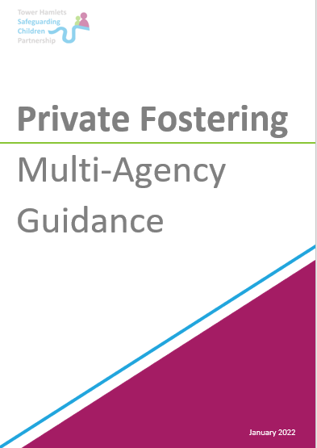
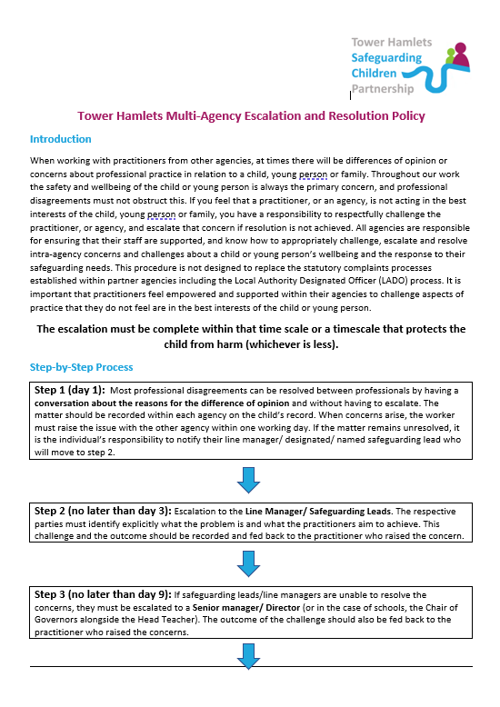
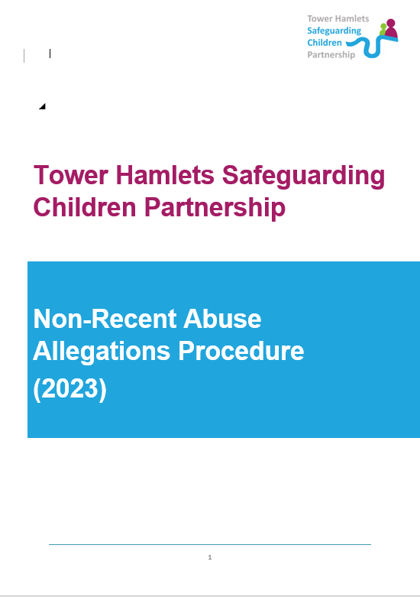
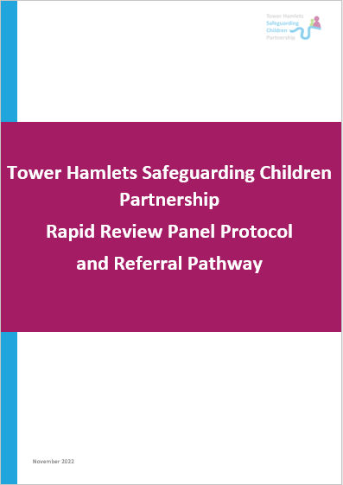
Quality Assurance
Over the last year Quality Assurance of Safeguarding Across Tower Hamlets has improved.
A board meets quarterly which reviews multi-agency data, single and multi-agency audits, training compliance, updates on key agencies (such as the LADO annual report and updates of the front door in Children’ Services) and areas of concern to the partnership.
It was highlighted that some protocols and policies were out of date and required refreshing. Small task groups were formed to refresh the following multi-agency policies:
Multi-Agency Escalation Policy (Complete)
Rapid-Review Protocol & Guidance (Complete)
Non-Recent Abuse Protocol (Complete)
Private Fostering Guidence (Complete in previous year Jan 2022)
Non-Accidental Injury Pathway (In final stages)
Neglect Tool Kit (In final Stages)
Translator Guidance (Initial Stages)
These sit alongside the tools and protocols produced by the Priority Task and Finish Groups.
In addition to the operational guidance, some strategic elements to the running of the THSCP have been improved by:
Introduction of action logs for Quality Assurance and Performance and the THSCP Executive alongside minutes.
Introduction of an Escalation Log which each group under the THSCP Executive can use to escalate strategic concerns to the Executive and therefore see the response and action by the Executive.
Detailed forward plans for both the Executive and QA&P have been strengthened, currently at one year ahead but this will be changed to 3 years ahead in the coming months.
Impact:
Quality Assurance Activity is a core function of the Partnership, to monitor the quality of the work undertaken to safeguard children; and to understand the impact of this work in terms of its effectiveness in improving outcomes and keeping children safe from harm. Keeping protocols and policies up to date ensures all agencies receive the same guidance and give a consistent approach. They also promote agencies working together.

Slide 26
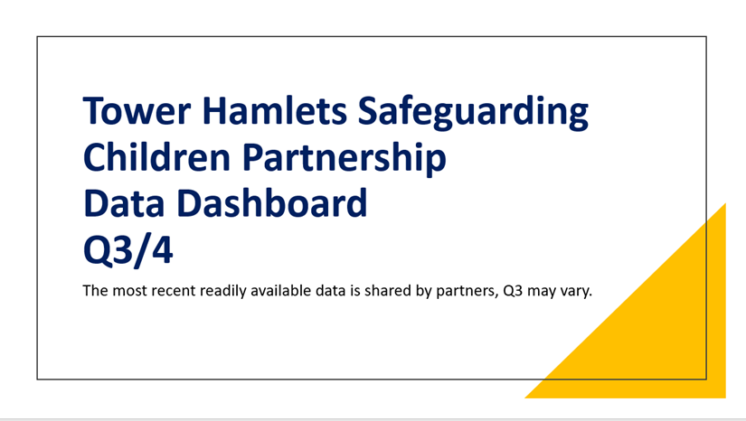
Using Data to Inform Practice
Partners submit data and narrative to the THSCP to form the multi-agency dataset. Within the Quality Assurance and Performance Group each partner discusses their data. Key trends and issues are then picked up and escalated to the Executive Group for action. Within this year the THSCP has tightened up the processes, ensuring it is available every quarter from all partners and allocating more time for data scrutiny. This year exploitation and children missing has been added to the dataset. All data is completely anonymised.
A few things we learnt from our data this year:
The percentage of section 47’s which move to Initial Child Protection Conference was low in Q3, so therefore it was queried whether this means that there are too many s47’s taking place. The THSCP will consider whether a future multi-agency audit should be on referrals in and threshold.
A recent challenge for health visiting has been supporting the significant number of refugee and asylum-seeking families who have arrived in the Borough. After interegating the data, the agency confirmed that there is a specialist Health Visitor for asylum seekers.
East London Foundation Trust data showed Key safeguarding themes have remained largely the same; Parental incapacity, parental mental ill health. There has been a rise in non-recent abuse cases. Therefore, a multi-agency approach to developing a non-recent abuse protocol was implemented.
Referrals to Childrens Social Care in Q2 were largely driven by referrals from the police which differs from last year where the largest referrals came from schools post lockdowns.
Children’s Social Care
Police
Early Help
Youth Services
GP Care Group
Child Death Reviews
Barts Health
East London Foundation Trust
Integrated Care Board
Exploitation Service
Impact:
The report details a small section of data that has been reviewed and discussed over the past year. Bringing the data together into one dataset allows the group to highlight cross cutting themes. Areas were highlighted via the dataset but also through discussion, allowing the Quality Assurance and Performance group to action tasks to improve the areas of practice.

Slide 27
Child Safeguarding Practice Reviews (CSPR) and The Learning Cycle
Rapid Reviews and New Process:
The purpose of reviews of serious child safeguarding cases, at both local and national level, is to identify improvements to be made to safeguard and promote the
welfare of children. Learning is relevant locally, but it has a wider importance for all practitioners working with children and families and for the government and policymakers. Understanding whether there are systemic issues, and whether and how policy and practice need to change, is critical to the system being dynamic and self-improving. – Working Together to Safeguard Children 2018
One CSPR is taking place, an Independent Reviewer has been commissioned and is working alongside the Associate Director of Public Health to author the report. The report will be published in summer 2023.
The boxes to the right show the process from referral to Child Safeguarding Practice Review.
A referral comes in from any partner.
Strategy Manager consults Children's Social Care.
Children’s Social Care consults the Police and Health then submit a Serious Incident Notification – A 15 day window of activity begins.
A Rapid Review Panel is set up and partners are invited.
Partners submit all their relevant information on the case and the information is reviewed.
A Panel is held, the case is discussed and any immediate learning is pulled out and actioned. A recommendation on level of review is made.
Decision sheet with recommendation is shared with the THSCP Executive. Signed off and submitted to National Panel. 15 day window closes.
THSCP meet to decide how the review will take place.
Review takes place within 6 months.
Recording the findings, and implementing the learning:
The initial Rapid Review Panel is a key part of the reviews, the panel itself is a workshop that takes on any immediate action required.
Previously each case was allocated its own action plan, actions that come out of Rapid Review Panels and Child Safeguarding Practice Reviews are now collated into one action plan. This ensures that there is no duplication and additional themes can be picked up from reviewing actions side by side. This action plan is held by the Rapid Review Working Group and the Quality Assurance and Performance subgroup has oversight, which ensures the recommendations are implemented.

Slide 28
Child Safeguarding Practice Reviews (CSPR) and The Learning Cycle
Once a recommendation has been made the Executive Group decide how the review will be carried out from the following options:
Single Agency Audit and Assurance
Multi Agency Audit
Partner led Workshop
Commissioned Independent Reviewer led Workshop
Partner Authored Report
Commissioned Independent Reviewer Report
Strategy Manager Report
Family and/or Child Engagement
Children and Young People Workshop
Children and Young People Outreach Activities
More than one option is chosen to ensure a thorough review. The individuals within the THSCP who are chosen to carry out the tasks are of senior management level with no direct involvement in the case. The options are chosen based on what is best suited for each individual case and the main themes of the case.
After the publication of each review a partnership wide workshop is held. A workshop is also held a year after publication to review changes in the system since publication and the next steps, this year a partnership wide workshop was held on the case of Asif (mentioned in last year’s annual report) which was the case of an adolescent who was severely underweight. The workshop included speakers who came to raise awareness of services (including police on online safety, CAMHS on accessing services and gaming addiction, Local Authority on Domestic Abuse and Parental Conflict) and a workshop activity to forward plan.
Dissemination of Learning
Workshops with all agencies involved in the review
Follow up workshops to check progress and explore challenges
Newsletter and partnership communications
Embedded into Training
Engagement events with the wider partnership
Within Sub-Groups and Task and Finish Groups
Impact:
When a case comes to Rapid Review level there has been a significant incident that has happened to a child. We ensure the review is bespoke to every case to draw out the learning to prevent future incidents from happening. The dissemination of learning is critical to this, hence why follow up workshops are held a year later, in addition to initial workshops after reviews are published.
A recent audit has described the CSPR and Learning Cycle as “a generally sound system of governance, risk management and control in place.” Auditors received ‘reasonable assurance over the governance, risk management and controls in operation”

Slide 29
Rapid Review and Child Safeguarding Practice Reviews
During this year Five THSCP Rapid Reviews were held (one of which reached the threshold for CSPR). A Theme sheet has been created to capture the key themes of all Rapid Reviews, this is shared with all partners, at team meetings and awareness events. Key themes have been:
Infant Safety – Every Rapid Review and CSPR in the last 2 years has featured Infant Safety concerns including unsafe sleeping.
Neglect
Domestic Abuse
Overcrowding and housing
Physical Abuse
Premature stepdown and threshold decisions
Missing from education
Multiple physical health concerns
Vulnerable mothers including care leavers and survivors of exploitation.
Cultural competence.
Professional Curiosity.
Improvements to the Rapid Review Process:
The THSCP has reviewed and improved the process of reviews over the last year by:
Introducing a new guidance with step by step instructions for practitioners who have been involved in a case which is subject to review.
Renewed the Decision Sheet which is used to inform the National Panel of learning from the Rapid Reviews and whether or not the decision is to proceed to a CSPR. The new sheets now capture themes, reasoning for agency recommendations, more background of the family and looks at the case more holistically.
Renewed the agenda for Rapid Reviews, which is now based on the SCIE (Social Care Institute for Excellence) learning together framework. This includes adding initial research questions to the agenda and helping the meeting remain strategic and keeping the multi-agency learning the primary focus. The meetings are now 3 hours long rather than 90 minutes. This allows the group to workshop the case and carefully consider immediate recommendations for improvement.
Impact: For a Rapid Review to be held, a Serious Incident Notification must have been made. This is the highest level of Safeguarding concern. The THSCP records the themes and ensures they are disseminated and acted on, as well as the specific recommendations that come out of the reviews. These themes have influenced the safeguarding practice week and work of the task and finish groups and subgroups. The more the THSCP understands about the cases the more prioritisation and focus can be aimed at prevention.
It is equally important to continuously review the effectiveness of Rapid Reviews and ensure the group is kept up to date with the latest learning methodologies.

Slide 30
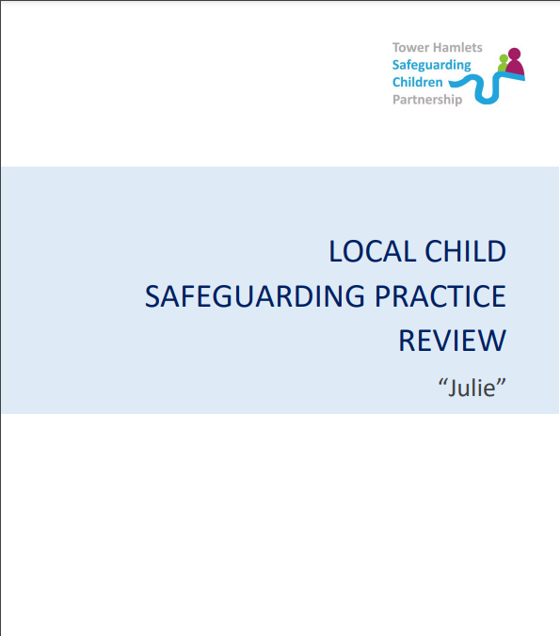
Published Child Safeguarding Practice Reviews
CSPR ‘Julie’
The report is in relation to the case of ‘Julie’, an infant who suffered two serious head injuries on two separate occasions due to falling off a bed, both of which required hospitalisation. Julie is not the real name of the child involved and the report contains no identifiable information in order that it can be published, to aid learning, without further trauma to the family.
The methodology for the review itself included:
• A large-scale, system wide workshop, chaired by the Head of Quality Assurance (LBTH) in which all professionals involved in the case were invited to attend and review the case from each perspective and review the systems used within the case.
• A children’s services focused workshop chaired by Head of Quality Assurance (LBTH) to review systems.
• A series of individual interviews conducted with each professional involved in the case and/or the management of the agency.
• A multi- agency audit was conducted into seven cases regarding Infant Neglect this activity was chaired by Keith Makin, Independent Scrutineer.
• Tower Hamlets Children’s Social Care also facilitated an interview with Julie’s mother to secure her contributions, contact was attempted with Julie’s father but he was unable to engage.
• Local and national research on key areas identified.
• During this report period a second infant with a head injury came to the attention of the THSCP, a review workshop was held and the learning is woven through this report, the infant’s name is changed in this report to ‘Daniel’.
The key themes of the review were:
Live CSPR
There is currently a CSPR being undertaken by an External Independent Author.
The case features infant safety and overcrowding. The review is due to be published in July 2023.
All practitioners involved in the case have taken part in a workshop to review the case and consider the learning. Below is some of their feedback:
“Thank you for inviting our Service to the meeting. It was an extremely useful and reflective experience”
“Agreed (with above quote) -Thank you, I really took a lot away from this meeting”
“I just wanted to say thank you very much for inviting me to attend the meeting. It was informative and a good learning experience”
“Thank you. It was very informative and reflective”
“Thank you for this and chairing it in a way that was helpful”
It has been important to the THSCP to ensure that reviews are reflective and focus on the learning rather than blame.
Theme 1
Appropriate sleeping arrangements of the baby, infant supervision, and appropriate accommodation
Theme 2
Identifying and addressing infant neglect
Theme 3
Thresholds, decision making meetings and record keeping
Theme 4
Impact of covid 19, including the impact of delivering face to face services and the effect that has had on families.
Theme 5
Consistent use of interpreters and advocates
Theme 6
Assessment of vulnerabilities in mothers including potential exploitation
Theme 7
Domestic abuse (DA), the use of DASH and awareness of historical DA within agencies

Slide 31
Partner Commitment to the Implementation of Learning
“The learning from the reviews has raised our awareness of the risks of non-engagement of parents and carers with Safeguarding professionals. As Chair of the THSCP Education Safeguarding Group I have escalated concerns about Safeguarding systems such as Early Help and the management of Health Care Plans which can rely on active parental and carer engagement. Schools can provide a context of more trusting relationships which may offer an effective starting point for engaging parents and carers in need. “ – Primary School & Chair of the Education Safeguarding Sub Group
“THGPC completed Internal Management Reviews for both CSPR cases and contributed to both multi-agency reviews. We have implemented the learning from our internal reviews and that of the wider partnership:
Julie: We have improved our use of interpreters and standardised the way we record, should parents require an interpreter to ensure visibility for all staff. Where required, interpreters are utilised to book all appointments and support at all contacts. 0-19 practitioners were also reminded that should any part of an assessment not be completed due to language issues, that the need to repeat these is clearly action planned. Where families do not engage, practitioners were reminded to follow our Standard Operating Procedure (SOP). The 0-19 Service has additionally introduced diary management processes to enable recording and outcoming of appointments of contacts. A Child and Family Health Needs Assessment SOP was introduced in March 2022 to strengthen assessment. A caseload weighting tool has been introduced in January 2023 to weight the level of need and stratify this in line with the clinical model offer, against practice time to manage this, and clearly identifies vulnerabilities aligned to the child/family to enable prioritisation for assessment and follow up based on risk. The requirement for head to toe assessment has also been detailed in the new Birth Visit. Training has also been provided for skill-mix staff including the need to escalate any abnormalities to the duty health visitor. The expected method of contact with each family including minimum timescales for review has also been included. The School Health Service have reviewed their health assessment, introduced trigger questions for exploitation and linked the Tower Hamlets Exploitation Screening Tool to the assessment template. Assessment training has additionally been introduced to support the rollout of the SOP which also includes professional curiosity, voice of the child and record keeping. Service delivery has been strengthened to ensure that families continue to be reviewed when practitioners are on leave and any safeguarding meetings attended by another member of the team. We have also strengthened line management and supervision arrangements to ensure sufficient case oversight and support for staff. We have updated our Record Keeping to ensure practitioners record email communication and we have also strengthened our recording of safeguarding meetings. We have improved communication channels with multi-agency partners and strengthened our involvement at, and introduced a standardised agenda within General Practice Multi-Disciplinary Team Meetings to ensure that discussions are held regarding families where there is concern.
Asif : THGPCG continue to review and strengthen where needed, handover pathways/procedures between the 0-19 Service and the Gateway Midwifery Team via locality psychosocial meetings. We reviewed geographical working process to ensure timely continuity of care and internal information sharing and are currently introducing caseload modelling which will further strengthen this. We have improved our use of interpreters and standardised the way we record should parents require an interpreter to ensure visibility for all staff. Where required, interpreters are utilised to book all appointments and support at all contacts. In respect of support for maternal mental health, perinatal mental health training has been delivered to all health visitors and community nursey nurses. Maternal mood pathways continue to be developed and we plan to introduce a specialist mental health post, subject to funding.
We have updated our Record Keeping to ensure practitioners record email communication. We have introduced caseload weighting to ensure that vulnerable children are stratified according to their level of need as described in the Tower Hamlets Threshold Guidance. Guidance has been introduced for staff on the use of vulnerability coding, this is supported by continual training and is reinforced within supervision. We have introduced mandatory face to face domestic abuse training for 0-19 staff. This training specifically includes routine inquiry and how to overcome the challenges of asking should family members be present, the use of risk assessments tools (DASH) and onward referral to MARAC. “ – GP Care Group

Slide 32

Partner responses on the Implementation of Learning
“Asif: Front line officers and MASH teams are required to display professional curiosity around a variety of factors. This LCSPR highlighted that weight loss (or gain) is a potential safeguarding risk. This is a review by police MASH when BRAG’ing police Merlin reports for onwards safeguarding assessments. Julie: This has raised awareness of non accidental injury (NAI) in young babies that may not have mobility. All CAIT supervisors are aware that when dealing with cases that involve injury to non-mobile children to base decision making at the highest level of suspicion. Then work with partners to fully understand the risks and medical evidence before agreeing that it constitutes NAI as opposed to intentional.” – Met Police
“The Julie CSPR was not so related to our service as we work solely with adolescents being harmed outside the home. We looked at the Asif one and discussed this in team meeting. This has also led to the service commissioning SCIE to support a learning framework for Harm outside Home and learning reviews.” – Exploitation Service
“We have asked the Local Authority to audit our safeguarding procedures at LEAP and are constantly working on improving our safeguarding processes and procedures. We have a DSL, 4 Deputy DSLs, a CP Coordinator, a CP worker, and a social worker on site to support with child protection and safeguarding.” – LEAP
“The VSCYF Coordinator has advertised the reviews, and the learning events, to VCS organisations that are members of VSCYF. Where appropriate, the VSCYF Coordinator has advertised specific CSPR related resources in the VSCYF quarterly ebulletin” - Voluntary Sector Children and Youth Forum
“As chair of the Rapid Review Action Plan we have ensured that there was partnership and equal contribution to the learning and identified actions from the reviews. Both CSPRs are acknowledged when identifying any similar incidents which has contributed to additional review of cases and referral to the rapid review panel for discussion of cases to ensure that learning is being embedded. The CSPRs have also been shared across the North East London ICB to ensure that learning is shared at a wider level.” – Integrated Care Board

Slide 33
Multi-Agency Training
The THSCP uses a mix of commissioned training and linking in with other local and national partners to open training and share with partners. A full training calendar is provided through the E-Bulletin and at Quality Assurance and Performance Meetings. Below is a snapshot of the formal training provided. The following slide contains information on the awareness events delivered by the THSCP. For the training courses provided by the London Safeguarding Children Partnership, Tower Hamlets had the 4th highest number of attendees across London.
23 E-Bulletins have been circulated in 22-23 to a distribution list with over 200 partners.
These contain information on:
  Training courses
  Updates on priority areas
  CSPR Recommendations
  Request for feedback such as workshops and surveys.
  National updates on Safeguarding
DATE | COURSE TITLE
29.04.22 | Early Help Assessment Skills Training
16.06.22 | AIM Foundation: Harmful Sexual Abuse Training
08.11.22 | AIM Foundation: Harmful Sexual Abuse Training
22.11.22 & 23.11.22 | Gaming and in-gaming gambling harms
29.11.22 | London Safeguarding Children Partnership: Talking to young people about mental health & wellbeing
30.11.22 | London Safeguarding Children Partnership: Fabricated illness
31.01.23 | London Safeguarding Children Partnership: Working with Children and Young People Who Self-Harm: Responding to Risk
2.02.23 | Gaming and in-gaming gambling harms
8.02.23 | London Safeguarding Children Partnership: Fabricated illness
9.02.23 | London Safeguarding Children Partnership: Infant Mental Health
20.02.23 | Introduction to Safeguarding
22.02.23 | London Safeguarding Children Partnership: Understanding Adolescent Mental Health: Implications for practice and improving emotional well being
27.02.23-28.02.23 | Designated Safeguarding Officer Training
2.03.23 | London Safeguarding Children Partnership: Understanding personality disorders and Impact on child development & parenting
7.03.23 | Intra-Familial Child Sexual Abuse
15.03.23 | London Safeguarding Children Partnership: DBS – Playing a part in safer recruitment
20.03.23 | AIM Foundation: Harmful Sexual Abuse Training
23.03.23 | London Safeguarding Children Partnership: Working with Parental Substance Misuse; Impact on adults, children and young people
19.04.23 | Introduction to Safeguarding
19.04.23 | London Safeguarding Children Partnership: Mental Health and Parenting
26.04.23-27.04.23 | Designated Safeguarding Officer Training
Impact: Feedback from partners who attended the training and awareness events is positive in relation to how useful and applicable to practice the sessions are and that they leave with knowledge which they can apply to their roles to better safeguard children.
The THSCP always ensure that basic Safeguarding Training is commissioned and delivered so all partners have a consistent and shared understanding of Safeguarding.
By bringing together London and Tower Hamlets training into one offer it ensures partners have even more opportunities to learn and equally ensures consistency across boroughs.

Slide 34
Engagement Activity and Events
During 22-23, engagement activity such as workshops on updating Threshold Guidance and a conference on Infant Neglect were held in person to ensure partners can come together in the same space. Training Courses such as Introduction to Safeguarding and Intrafamilial Abuse have been delivered online.
November 2022 was Safeguarding Month and the THSCP presented awareness sessions for partners. The sessions were also led by various agencies the sessions included:
Safeguarding Week | Other Awareness and Engagement Events
Infant Safety Conference Speakers joined from the Midwifery Service, Early Help, Health Visiting and Childrens Social Care to share awareness on keeping infants safe including advice on safe sleeping, keeping homes safe and how to refer concerns. | Two Child Safeguarding Practice Review Learning Events and Attendance at Childrens Social Care Senior Leadership Team, Managers Forum, Team Meetings and Group Supervision to Raise Awareness on themes and learning from Rapid Reviews and Child Safeguarding Practice Reviews.
Thresholds Event: The thresholds event shared information about the current thresholds guide and how this is used and gained feedback from workshop activities on what new thresholds should look like. | THSCP Bulletins which were sent out with key decisions, feedback from the Executive and training dates (including training held by partners open for any agency to join).
Online Safety Awareness Event was held by the police and informed practitioners which applications, browsers and sites to watch out for and be wary off. Information was distributed after the event with the list of current apps on the police radar and how they impact the safety of children and young people. | Priority Setting Event, all partners were invited to an event to give feedback on what the next set of priorities should be for the THSCP
Rapid Reviews: the Process Event was led by the chair of the Rapid Review Group, to disseminate information on how the process works around Rapid Reviews and CSPRs, the session also included the learning from a published CSPR ‘Asif’. | THCSP Executive Q&A Event, partners were invited to join the Executive to hear key updates and ask questions. One focus of this event was the Met Response to the Hackney CSPR Child Q.
Exploitation Awareness was chaired by the Exploitation Team, this session showed how to spot the signs of exploitation and discussed the implementation of the Violence, Vulnerability and Exploitation Strategy. | Additional Online Safety Presentations delivered by the Met Police to Every Chance for Every Child Forum, Education Safeguarding Forum, Local Authority Corporate Leadership Team.
Impact: Awareness events give the partners opportunities to learn about key safeguarding concerns but also come together in spaces and learn from other agencies. They also give the space to feedback on the work of the partnership and feed into key changes such as the Thresholds Document.

Slide 35
Strategic Boards and Partnerships linked to the THSCP
Safeguarding Adults Board: The Tower Hamlets Safeguarding Adults Board is a statutory multi-agency board that is committed to protecting an adult’s right to live in safety, free from abuse and neglect. It has overall responsibility for co-coordinating safeguarding adult matters and ensuring that partner agencies carry out safeguarding adults work.
Children's and Families Executive: The Children and Families Executive has delegated responsibility to lead on the partnership decision making in relation to children, young people and families in Tower Hamlets. It sets the strategic partnership direction for children and families’ services through the Children and Families Strategy, advocates for the voice and needs of local children, young people and families in strategic decision-making, and agrees key policies and approaches that cut across services for children, young people and families.
The Health and Wellbeing Board :Having a Health and Wellbeing Board is a statutory requirement for local authorities. The board brings together the NHS, the local authority and Health Watch to jointly plan how best to meet local health and care needs, to improve the health and wellbeing of the local population, reduce health inequalities and commission services accordingly.
Community Safety Partnership Board: The Community Safety Partnership Board is required by law to conduct and consult on an annual strategic assessment of crime, disorder, anti-social behaviour, substance misuse and re-offending within the borough and the findings are then used to produce the partnership’s Community Safety Plan.

Slide 36
Strategic Plan for the Year Ahead
The THSCP will continue to deliver and will develop the following areas over the next year…
Embedding learning of reviews and develop a pool of internal and external authors
Partner engagement, which will include reviewing the structure to ensure our partners feel engaged and a part of the work.
Independent Scrutiny, a report on the six steps of scrutiny will be discussed in the summer of 2023, which will contain recommendations to improve the THSCP.
Further Improvements to the Multi-Agency Training Offer.
Developing the strategic function with a formal Improvement Plan and Project Delivery and Support.
Improving the digital presence of the THSCP.
Setting and Delivering new priority areas for the next two years.

