Slide 1
Tower Hamlets Plan (2018-2023) Annual Review, 2021-2022
September 2022

Slide 2
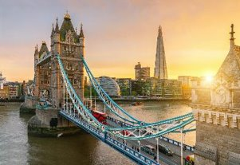
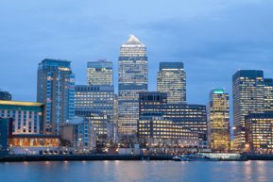
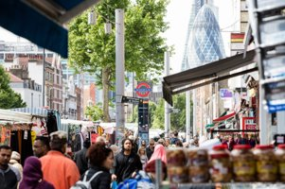
Tower Hamlets Plan – Annual Review April 2021 – March 2022
Contents
Introduction 3-4
Partnership Executive Group 5
A better deal for children and young people 6
Good jobs and employment 7
Strong, resilient and safe communities 8-11
Better Health and Wellbeing 12-13
Tower Hamlets Plan Data 14-17
Find out more 18

Slide 3
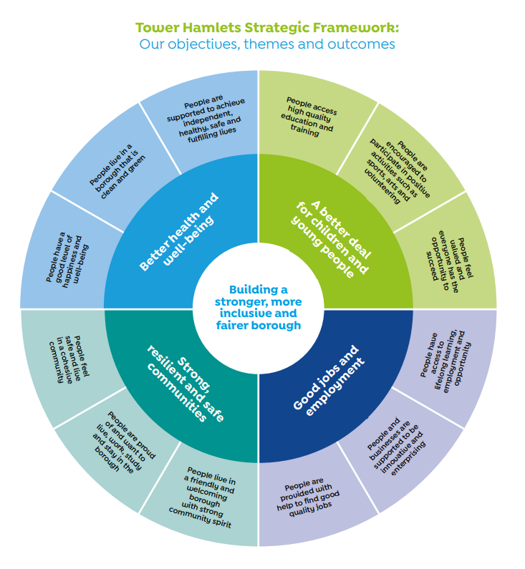
Tower Hamlets Plan Annual Review April 2021 – March 2022
Introduction
The Tower Hamlets Plan 2018-2023 sets out the Tower Hamlets Partnership’s vision for the borough: to tackle inequality by building a strong, inclusive and fair borough.
The Partnership Plan is underpinned by four priorities:
a better deal for children and young people
good jobs and employment
strong, resilient and safe communities
better health and wellbeing
This report is prepared for partners and reviews partnership activities in 2021-22.
It illustrates with case studies the impact of partnership to address priorities including:
The Covid-19 pandemic
Race inequality
Digital inclusion
Climate change
Poverty and economic development
Community safety
Children’s development
Looking forward, the report outlines cross-cutting priorities partners have identified for the year ahead including:
Recovery from Covid and moving forward
Tackling poverty and the cost-of-living crisis
Inclusive growth and levelling up
Tackling race inequality
Climate change
Health and wellbeing (including mental health)
Children’s development. education, aspiration, and opportunities
Communities – cohesive, empowered, safe and resilient
Promoting Tower Hamlets through the Place campaign
2022 – 23 is the final year of the current Tower Hamlets Plan. The TH Partnership will work to develop a new Tower Hamlets Plan 2023-2028. This work will be coordinated by the Partnership Executive Group, under the Executive Mayor’s leadership.

Slide 4
Tower Hamlets Partnership: overview
Partnership Executive Group
Under review: Race Equality Partnership Network
Children and Families Executive
Health and Wellbeing Board
Community Safety Partnership
Cooperate
(VCS and Public Sector)
Growth and Economic Development Partnership
Tower Hamlets Partnership Board
Climate Partnership
Tower Hamlets Housing Forum
Strategic Discussion
Strategic Co-ordination
Thematic Partnerships (many chaired by Cabinet Members)
Wider Partners and Stakeholders – including statutory partnerships for safeguarding adults and children
Our Community

Slide 5
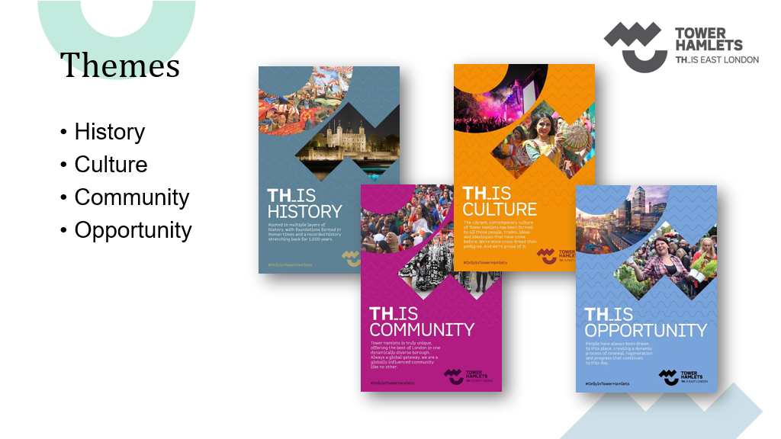
Our strategy and Partnership Boards
Partnership Executive Group
Introduction:
The Tower Hamlets Partnership’s Partnership Executive Group (PEG) brings senior partner representatives together to deliver on the Tower Hamlets Plan. It also provides governance for the partnership boards.
Current Priorities, Activities and Impact (2021-22) including:
Tackling race inequality: agreed action plan, a £1.5million funding package and the Tower Hamlets anti-racist pledge.
Covid-19 pandemic: coordinated the partnership response, vaccination programme, and recovery programme.
Digital inclusion: agreed a digital inclusion strategy and action plan to ensure all residents are online by 2024.
Tackling the climate emergency: agreed a climate action plan and partnership and a pledge to be a net zero borough by 2045.
Place campaign: launched place campaign to celebrate and promote the borough.
Poverty Review: contributed to review findings and recommendations.
Bouncing back to learning: promoted collaboration to support children and young people’s education and well-being.
Spotlights, challenge and forward planning: community safety and violent crime, Covid-19 and the environment.
Priorities for 2022-23:
Economy, cost of living and levelling up
Integrated care systems
Equality and community engagement
Climate emergency and air pollution
Community Safety and safeguarding
Supporting children and young People
Developing new Tower Hamlets Plan 2023-2028
Case Study: Museum of London Docklands and Place campaign
The Museum has used the place campaign to help increase visits, promote the West India Quay area, and improve awareness of what Poplar and Docklands area has to offer.
Visits to the Museum were down 76% in 2020 due to Covid-19, significantly impacting revenue, and it was particularly urgent for the Museum to increase its visits. The campaign formed part of the Museum’s recovery strategy.
The Museum is using the campaign on their website, banners, marketing and social media. It tells the story of Tower Hamlets and promotes events including the Quay-side event in the summer which brings together local organisations.

Slide 6
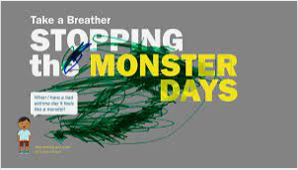
Our strategy continued 1 - The Children and Families Executive
A better deal for children and young people
The Children and Families Executive
The Children and Families Executive brings together local agencies to support children’s health, wellbeing and development. It focuses on implementing the Tower Hamlets Children and Families Strategy (2019 – 24), Born Well Growing Well workplan, and supports a smooth transition from childhood to adult services.
Current Priorities, Activities and Impact (2021-22) including:
Children's Mental Health & Emotional Wellbeing: identified support needs after Covid-19 and agreed an action plan to 2024.
Children's pathway development: developed GP Education and Pathways to improve quality in primary care; launched a Community Ear Nose and Throat service which has reduced outpatient waiting lists; secured funding for Hospital at Home and delivered integrated health service improvements for young people; launched the asthma and allergy-friendly schools programme in over 20 schools since January 2022.
Special Education Needs and Disabilities (SEND): updated the Family Services Directory on the Local Offer website and co-produced a new Young Person’s Zone, and set up a transition board to support young people with Education Health Care Plans (EHCPs) as they move to adult services.
Healthy Weight for Children and Young People: developed a programme focused on increasing activity and healthy eating.
Children who are looked after: ensured improved access to health services. 98.5% children who are looked after are now registered with a GP; 97% have had their health assessments on time; and 81% have had a dental check.
Education and opportunities: ensured tailor-made support for care leavers, including one day a week work placement, Personal Education Plans for all Year 12 and 13 students, and additional engagement for care leavers and young people who are looked after and who have been in contact with the Youth Justice Service.
Priorities for 2022-23:
Children's mental health and emotional wellbeing
Special Education Needs and Disabilities
Childhood Obesity
Ways of working – including pathways for long term conditions, a shared practice framework, a shared model of locality and Multi-Disciplinary Team working
Poverty & economic hardship
Case Study: Asthma and Wheeze project
This partnership project reduced unplanned child asthma hospital admissions by 22 per cent in a year. More than three hundred people from across the partnership were actively involved in improving services, including council and NHS leaders, researchers and professionals, as well as children and young people affected by asthma and their parents. The project won the Local Government Chronicle award in 2020 and a Health Service Journal Value award in 2021 and has had a wider impact on services across North East London.
www.towerhamletstogether.com/hsj-value-awards-2021-paediatric-care-initiative-of-the-year

Slide 7
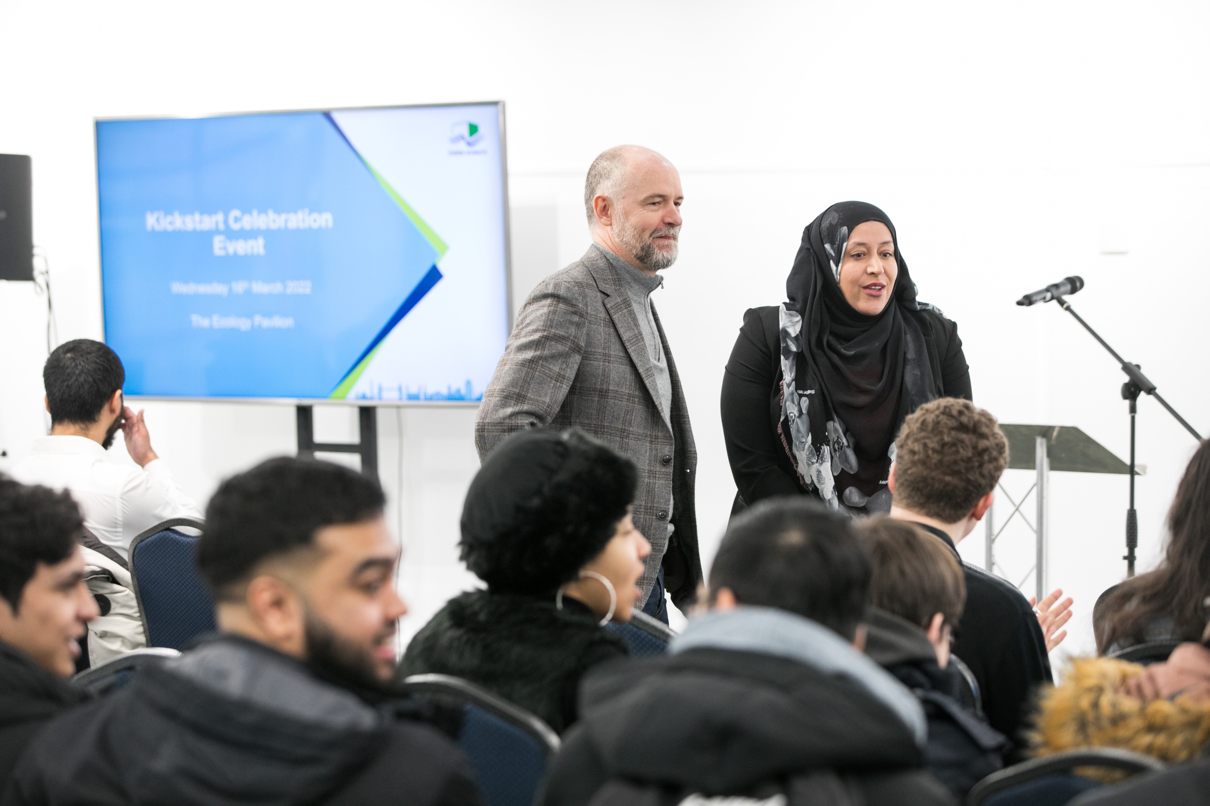
Our strategy continued 2 - The Growth and Economic Development Partnership Board
Good jobs and employment
The Growth and Economic Development Partnership Board
The Growth and Economic Development Partnership Board (its Local Economy Silver Group) and other networks work closely to achieve a more inclusive Tower Hamlets by creating pathways that will allow residents to succeed in their job aspirations. A strategic partnership, its work is multi-faceted seeking to bring about a lasting improvement in the economic, physical, social and environmental condition of the borough. It is supported by the brough’s Regeneration Strategy which is key to ensuring everyone has access to the opportunities derived through growth.
2021-22 has been marked by a desire to look forward towards a post-pandemic economic landscape – both in terms of challenges and opportunities for Tower Hamlets.
Current Priorities, Activities and Impact (2021-22) including:
Supporting aspiration, tackling poverty
Attracting and securing inward investment, maximising social value and promoting entrepreneurship
Economic support and post-pandemic recovery, including a focus on flexible working, green jobs and skills, and the life sciences. The council’s support to small businesses during the pandemic won an award from the Federation of Small Businesses and London Councils.
Implementation of actions to tackle race inequalities in access to jobs and economic opportunities
Jobs fairs, including at Canary Wharf, showcasing over 1000 vacancies and attended by over 500 job-seekers.
University summer schools and other opportunities for young residents
Employment support – including the Kickstart programme
Priorities for 2022-23:
Re-establish itself as a strategic body focused on the jobs and growth.
Host an inward investment focus group, contributing to the council’s emerging inward investment strategy for growth.
Refresh of the local economic growth strategy.
Case Study: Kickstart
1,838 young people aged under 25 have been supported into employment via kickstart programme. The East London Job Centre Plus District worked closely with partners to coordinate placements and provide training, and the local programme was ranked number one nationally in terms of delivering on Kickstart.
Oluwaseyi Prince, a Kickstart recruit and Social Media Consultant for Carrington Blake said: “I have increased my skills in leadership during my time in Carrington Blake. I have realised my true ambition and I am very grateful for that. I am looking forward to see how I can grow as a person and professional.”

Slide 8
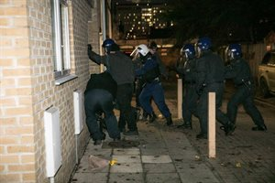
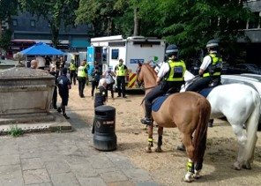
Our strategy continued 3 - The Community Safety Partnership
Strong, resilient and safe communities
The Community Safety Partnership
The Community Safety Partnership is a statutory requirement of the Crime and Disorder Act 1998. It is a strategic group that works in partnership to address local issues including crime, disorder, antisocial behaviour, substance misuse, and re-offending. It directs the work of its partnership boards in order to create a safer borough for people to live in, work in, and visit.
Current Priorities, Activities and Impact (2021-22) including:
Tackling Neighbourhood Crime and ASB: achieved c.40 per cent reduction in anti-social behaviour. Following the introduction of a borough-wide Public Space Protection Order in May 2021, 78 seizures of psychoactive drugs were made in the ten months to the end of March 2022.
Tackling drugs and violence: the Addiction, Diversion, Disruption, Enforcement and Recover (ADDER) programme began in June 2021, with multiple interventions to address drug-related harm. Operation Continuum and charges for drug supply and large-scale drug seizures led to 118 warrants, 112 arrests and 102 people charged with drug trafficking.
Tackling Hate Crime Community Tensions and Extremism, Violence Reduction: Safeguarding Those at Risk of Violence and Exploitation: work has included a team of navigators to support young people away from exploitation and criminality.
Reduce Re-offending and Tackling the Drivers of Crime: two Case Officers recruited to case manage prolific and violent offenders
Improving Public Confidence and Trust.
Priorities for 2022-23 including:
Current priorities plus
Keeping young people safe.
A focus on addressing ‘hidden harm’ crimes such as domestic violence, child sexual exploitation, and serious organised crime.
Case Study: Anti Social Behaviour Awareness Week (July 19 to 25)
The CSP joined a national campaign that brought together people and organisations from across the borough to take a stand and work together to make communities safer.
During the awareness week, multi-agency staff patrolled known hotspots and offered advice to residents.
To mark the launch of the UK’s first official ASB Awareness Week, council officers highlighted the work they do to tackle Anti-Social Behaviour. Other partners completed weapon sweeps, street briefings, high visibility patrols, carried out multiple stop and searches, issued multiple ASB warnings and community protection notice warnings. Several arrests were made, and knives and drugs were taken off the streets.

Slide 9
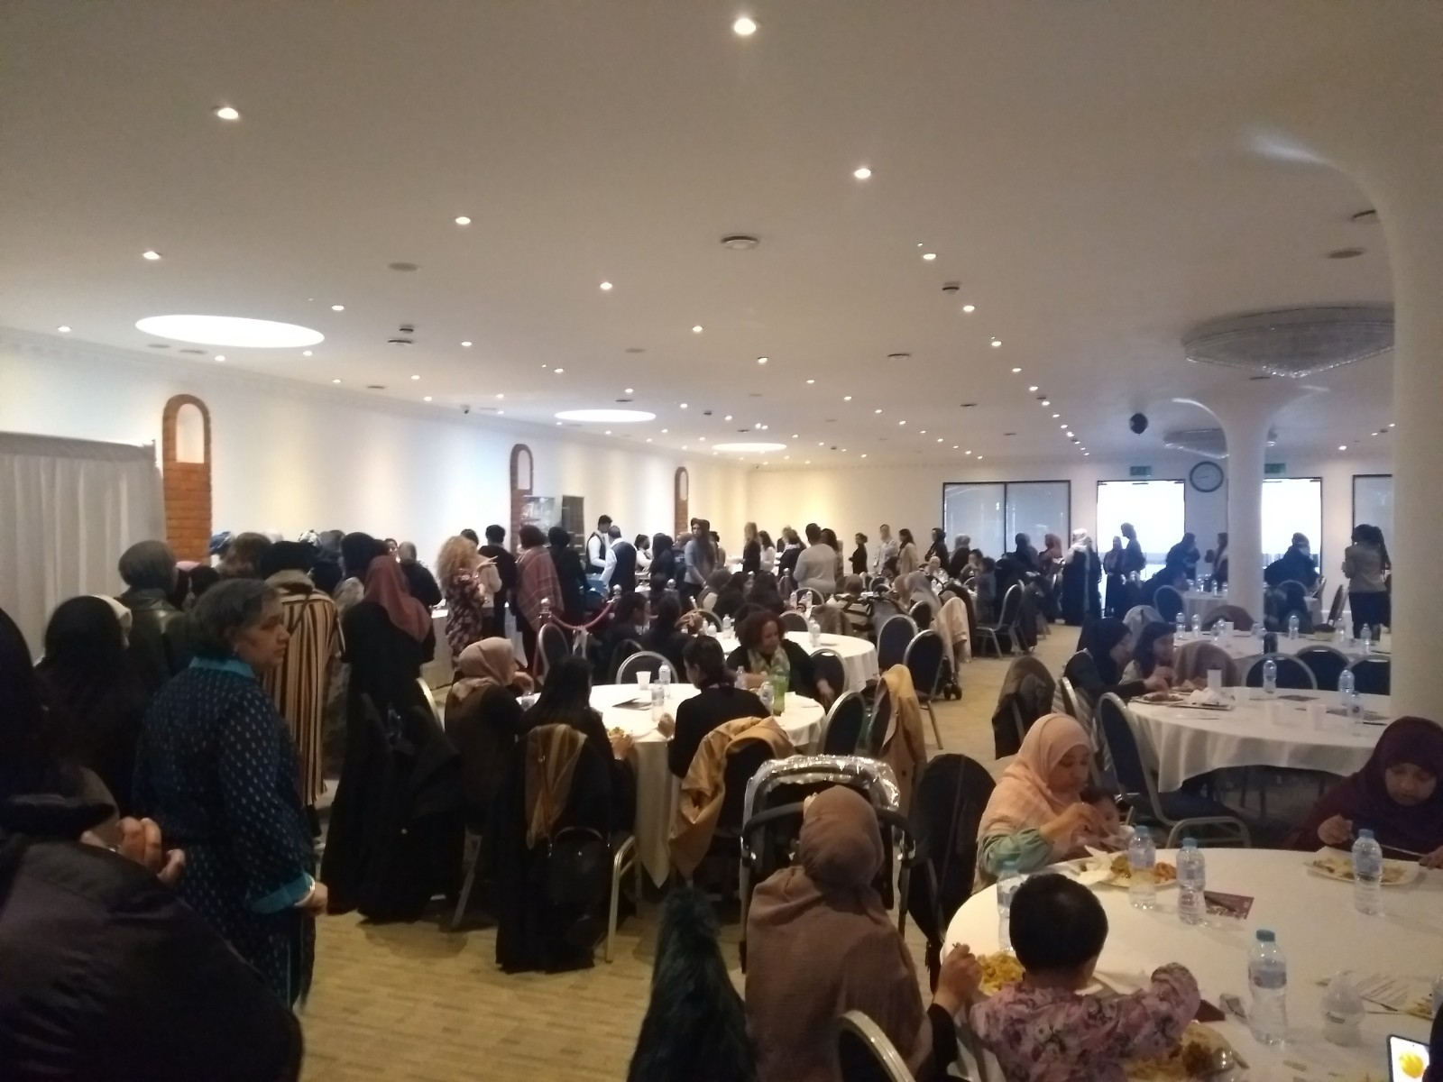
Our strategy continued 4 – Race Equality Partnership Network
Strong, resilient and safe communities
The Race Equality Partnership Network
Race Equality Partnership Network provides strategic leadership, vision and coordination to ensure partner organisations effectively tackle the issues and challenges of race inequality to improve outcomes for Black, Asian and Multi-Ethnic communities and residents. The Network works across the Tower Hamlets Partnership to help set, deliver and monitor targeted action plans which respond to the challenges and opportunities highlighted by Inequalities Commission.
Current Priorities, Activities and Impact (2021-22) including:
Developed partnership action plan and secured £1.5 million in council funding for implementation.
Delivered Black Asian and Multi Ethnic women in leadership event providing access to opportunities for mentoring, work experience, and further training and support to engage in civic life and career progression.
www.towerhamlets.gov.uk/News_events/2022/March-2022/Inspiring-and-supporting-Tower-Hamlets-women-into-leadership.aspx
Launched Tower Hamlets anti-racist pledge.
Case Study:
Tower Hamlets is a place that has for generations welcomed people from all over the world, and at times has come together in solidarity to stand up to racist attacks from those who wish to divide local people.
Ian Parkes, Chief Executive of East London Business Alliance said: “We need to really step up the drive for diversity and inclusion in education, in the pathways into higher earning careers and into positions of decision making and seniority for people from Black, Asian and Ethnic Minority backgrounds. Signing the anti-racist pledge is a symbol of our intention to do more - both in our external work with all our partners, and for our own people.“
Sheila Gupta, Vice-Principal (People, Culture, and Inclusion) at Queen Mary University of London said: “We are proud to be signatories to the Tower Hamlets anti-racist pledge. The only way to promote race equality is through hard work, commitment, and honest conversations.”
Priorities for 2022-23:
Race Equality Partnership Network
Support, shape and improve outcomes for BAME residents and hold council services and partners to account on action plans and Anti-Racist Pledges and commitments.
Development of a community leadership programme and launch of a local recognition scheme.

Slide 10
Our strategy continued 5 - cooperate
Strong, resilient and safe communities
Cooperate
Cooperate is the voluntary, community and public sector partnership. It is a strategic body that engages its partners to deliver the Tower Hamlets Voluntary and Community Sector (VCS) Strategy. Co-operate provides an opportunity to come together to consider recovery and renewal, bringing in new thinking and new ways of working.
Current Priorities, Activities and Impact (2021-22) including:
Developing volunteering resources
Continuation of COVID-19 Volunteering Hub, linking volunteers to employment, education and training and recruiting more volunteers from Black, Asian and Multi-Ethnic backgrounds
Training and matching programme for VCS trustees from BAME backgrounds
Enhancing access to external funding
Establishment of Tower Hamlets Funders’ Forum and co-ordinated funding briefing enabling Tower Hamlets to be 8th most successful in London for VCS securing funding relating to pandemic (£44 million)
Improving the digital capabilities of organisations
VCS contribution to Digital Inclusion Strategy and continued development of Tower Hamlets Council for Voluntary Service digital offer
Improving Consultation and engagement with the VCS
New Cooperate established, with new structure and membership
Equalities Hub and Networks established
Secured Cornerstone funding bid to support partnership working
Priorities for 2022-23:
VCS contribution to health and social care Integrated Care Systems
Co-ordinating input into the development and implementation of borough Climate Change Action Plan
Development of a VCS Forum in the borough, providing leadership and linking the Forum to Queen Mary University of London's Civic Agreement programme.
Case Study:
A partnership led by the Tower Hamlets Council for Voluntary Service has secured £300,000 from the Cornerstone Fund. The two-year funding will support civil society organisations to take a community-driven approach to their work. The ultimate aim is to tackle inequality and bring about change in people’s lives.

Slide 11
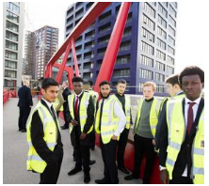
Our strategy continued 6 – Tower Hamlets Housing Forum
Strong, resilient and safe communities
Tower Hamlets Housing Forum
Tower Hamlets Housing Forum (THHF) brings together the council and local housing associations, so residents benefit from effectively developed, managed and safe homes and estates; and a vibrant cohesive community.
Current Priorities, Activities and Impact (2021-22) including:
Community greening and quality open spaces: good practice guide to support health benefits, and inspecting and maintaining play areas.
Tower Hamlets Common Housing Register (CHR): approved local lettings plan for new homes.
Fire & Building Safety: landlords have been reviewing the fire and building safety of homes, and partners have shared best practice and lessons from recent tower block fires. Partners, residents and the council are promoting fire safety through films.
Antisocial Behaviour: conducted joint Police, Housing Associations and Tower Hamlets Enforcement Officer (THEO) patrols, weapon sweeps, and conversations with residents as part of ASB Awareness week and publicised the Community Trigger - a tool that offers those experiencing ASB a means to bring their landlord and statutory agencies together to review the effectiveness of ASB interventions.
Covid-19: celebrated community heroes and continue practical, financial and emotional support to those most affected.
Training and Employment: worked with the council to bring more accredited training and employment opportunities to residents. This has included Kickstart, Workpath, and very successful job fairs.
Case Study: Joint Resident Training Programme
This partnership programme running now for five years, has been delivered through housing providers across Tower Hamlets. It upskills residents through a mix of accredited and non-accredited courses including First Aid and Mental Health First Aid, Level 2 Food Safety, personal leadership and effectiveness and safeguarding.
Ms B. Completed the Personal Leadership Training: “I took part in this course because I work in a school, and I wanted to further my career. I was told that I would need to demonstrate leadership skills to do this. This made me really nervous because I didn’t know what they wanted from me and how I could show this. Luckily, I saw this course was available, so I signed up and the trainer was fantastic. He really has the confidence and knowledge on how to be a good leader. I’ve now received a certificate of completion which I showed my employers, and they were really impressed that I went out of my way to gain this experience.”
Priorities for 2022-23:
under development

Slide 12
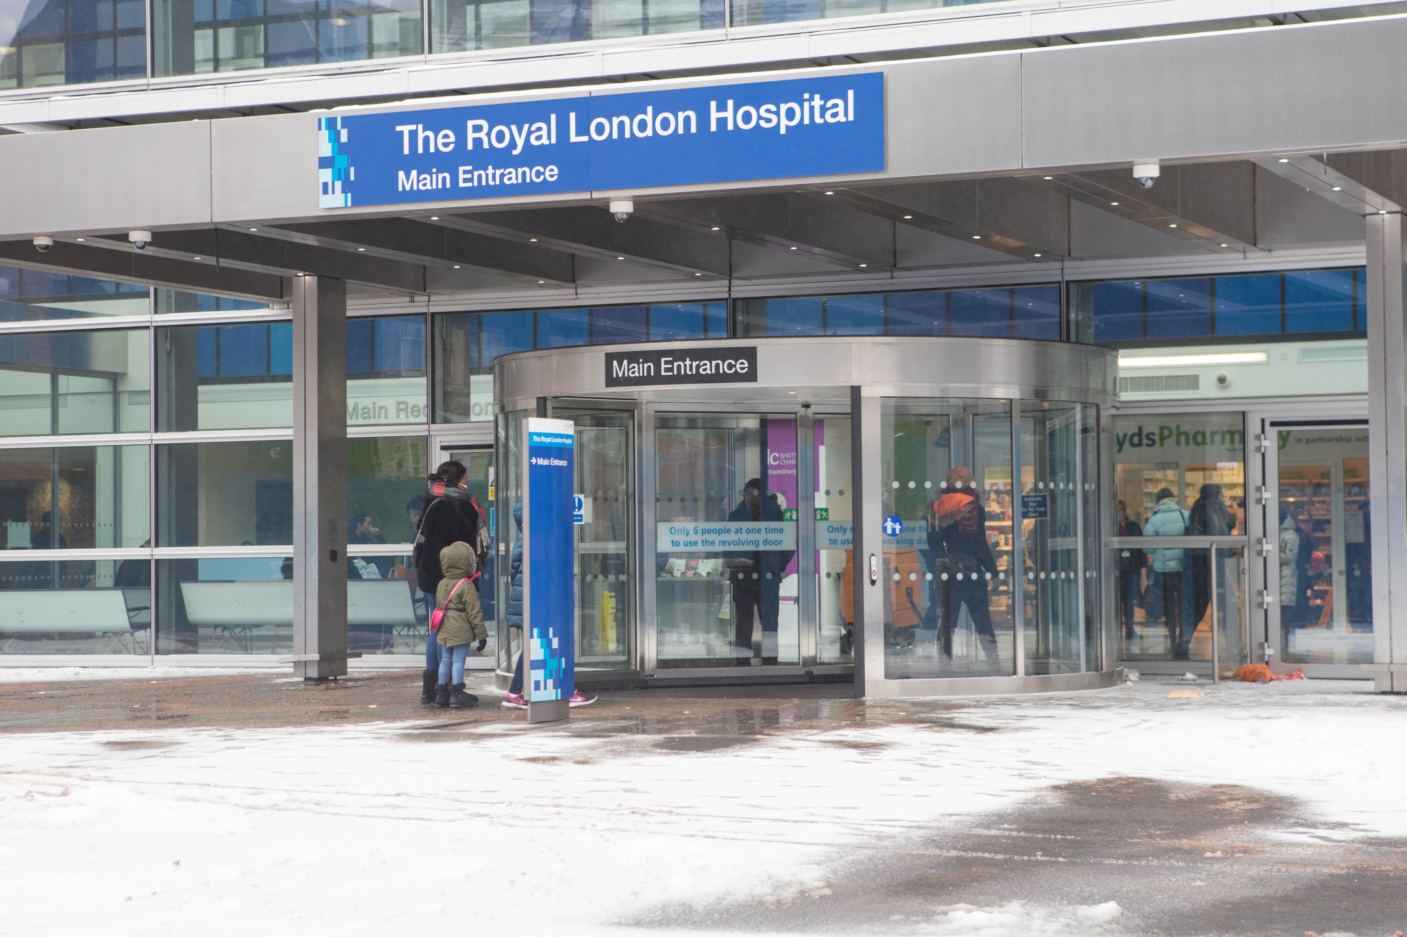
Our strategy continued 7 - Health and Wellbeing Board and Tower Hamlets Together
Better health and wellbeing
Health and Wellbeing Board and Tower Hamlets Together
The Health and Wellbeing Board and the Tower Hamlets Together work to improve the health and well-being of people, reduce health inequalities and improve the quality and management of health and care services. The HWBB has a statutory duty to prepare the Joint Strategic Needs Assessment, Joint Health and Wellbeing Strategy (JHWS) and is responsible for encouraging integrated working and overseeing deployment of the Better Care Fund. On 1st July 2022, the North East London Health and Care Partnership was established as an Integrated Care System. Tower Hamlets is part of seven Place-based Partnerships of the ICS and continues as THT working with provider collaboratives to transform people’s health and lives by reorganising services to match people’s needs.
Current Priorities, Activities and Impact (2021-22) including:
Launched the new Joint Health and Wellbeing Strategy 2021-25 with a focus on safety, happiness, healthy lives and good support.
Responded to the Covid-19 pandemic and vaccination rollout.
Launched an integrated information and advice offer across health and social care, with a digital portal, a telephone-based triage and information service, supported by community outreach.
Worked to increase the integration between the council’s reablement and NHS rehabilitation services.
Integrated rapid response offer including therapies, nursing, step-down & step-up provision.
Expansion of Rough Sleeping and Mental Health services, and improved support at Royal London for homeless patients.
Introduced new primary care network mental health teams, including support for people with longer-term and complex needs.
Priorities 2022-23 including:
Implementing JHWS and development of a locality plan across health and social care
Healthy adults: Living Well
Trauma-informed approach to care
Integrating pharmacies into the local system
Coproduction to address health inequalities
Improving health service access for disabled residents
Complex adults: Promoting Independence
New model of homecare
Long-term management for people with diabetes
Local care coordination for people who are frail
Smooth transitions for young people with complex needs
CASE STUDY: Covid-19 Vaccine Helpline
The first borough in London to set up a joint vaccine helpline with multi-agency staff who could speak community languages.
The helpline focused on making sure that every eligible resident, including those who were vulnerable or did not have access to the internet, received their vaccination appointments. In its first two weeks, 4000 outgoing calls were made to residents in priority groups to offer appointments, and the helpline received 1000 calls.
Encouraged residents to get vaccinated and helped to reassure those who were hesitant.
Other boroughs across London showed interest in replicating the model.
One resident commented: ‘Outstanding service and professionalism shown by the Covid helpline when I called the service for assistance. They patiently and thoroughly dealt with all of my queries and went above and beyond what I presume are the scope of a call handler’s duties and subsequently completing my booking for a vaccination.’

Slide 13
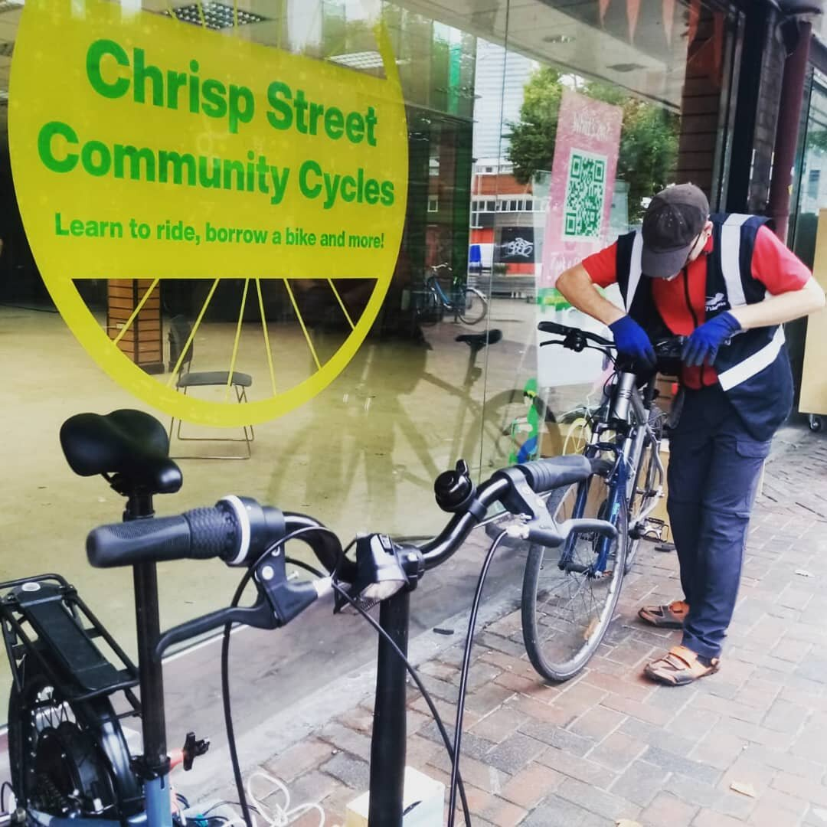
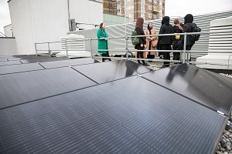
Our strategy continued 8 – climate partnership
Better Health and Wellbeing
Climate Partnership
The council declared a climate emergency in 2019 and set two ambitious targets, net zero council by 2025 and borough by 2045. In May 2021, the PEG established a partnership climate task force. Representatives worked together to develop a Climate Action Plan which was agreed by PEG in November 2021. The task force has become the Climate Partnership and is overseeing the implementation of the action plan. This strategic partnership will act at the Mayor’s Climate Advisory Board, with changes incorporated.
Current Priorities, Activities and Impact (2021-22) including:
Mobilised partners to work collaboratively to tackle the climate emergency through a climate engagement event, the partnership climate action plan, and development of the Climate Partnership.
Engaged with 344 Idea Store learners during Green Week February 2022, to promote recycling, plastic reduction, composting, sustainable travel, reducing emissions and energy saving approaches. The council, Stepney City Farm, Bromley by Bow Centre, Bikeworks, Women’s Environment Network, Sunny Jar Eco Hub, and Chrisp Street community cycles participated.
Delivered the third year of a retrofit grants programme supporting energy efficiency in schools and small and medium enterprises. To date, the council has awarded 166 grants totalling £1,432m, reducing carbon dioxide emissions by c.758 tonnes.
Case Study: Carbon reductions
The Schools Energy Retrofit Programme supports schools and pupils in their ambitions to reduce their energy consumption, carbon emissions and energy costs. 24 schools have received 100 per cent grant funding from the council c.£673,000 through this programme funded by the Carbon Fund, saving 348 tonnes of carbon. 5 more schools are in the pipeline, having put forward successful bids, developed with their students. Solar panels installed at Morpeth School in Bethnal Green is providing 20 percent of its electricity, reducing its carbon output by 19 per cent and saving the school around £20,000 per year.
Headteacher of Morpeth School, Jemima Reilly, said:
“I’m really pleased that the project of installing the solar panels at Morpeth was one that was largely driven by the pupils. It was their commitment to finding ways that we could become more sustainable as a school that challenged us to do better, led by the Eco Council. This is just one part of the work that they’ve been doing to help us address the climate emergency.”
Priorities for 2022-23:
Launch the Climate Partnership sub-groups
Launch Climate Pledge for organisations to sign up
Launch carbon footprint tool to help organisations calculate and reduce their carbon footprint
Establish and launch the borough Climate Alliance

Slide 14
Tower Hamlets data: a better deal for children and young people
Measure | Polarity | Baseline: 2017/18 | 2018/2019 | 2019/2020 | 2020/21 | 2021/22 | Overall Trend from 2017 | London
Pupil progress score in reading for KS2 | Higher is better | 1.1 | 1.3 |  |  |  |  | 0.8
Pupil progress score in writing for KS2 | Higher is better | 1.5 | 1.2 |  |  |  |  | 0.8
Pupil progress score in maths for KS2 | Higher is better | 1.9 | 1.9 |  |  |  |  | 1.2
Percentage of pupils have participated in positive activities in the past four weeks | Higher is better |  |  |  |  | 98%
Percentage of secondary school pupils who have enough information and support to help plan their future | Higher is better |  |  |  |  | 37.8%
Progress 8 score at the end of KS4 | Higher is better | 0.15 | 0.24 |  |  |  |  | 0.22
 | Improved |  | The same |  | Worsened
 | Data Unavailable
Notes:
Performance across many TH plan indicators as expected has been affected by factors including the Covid-19 pandemic where data is either unavailable or performance has dipped against the baseline position of 2017.
There is still work to be done to support children with writing at KS2, and careers support for secondary school pupils.

Slide 15
Tower Hamlets data: good jobs and employment
Measure | Polarity | Baseline: 2017/18 | 2018/2019 | 2019/2020 | 2020/21 | 2021/22 | Overall Trend from 2017 | London
Employment Rate | Higher is better | 64.7% | 73% | 71.8% | 72.6% | 72.9% |  | 74.9%
Business survival rate (in one year) | Higher is better | 88.1% | 86.5% |  | 81.8% |  |  | 84.1%
Number of residents supported into sustainable employment through support from the WorkPath partnership | Higher is better | 994 | 1113 | 1180 | 692 | 891
Residents with a Level 1 qualification (% with NVQ1 only - aged 16-64) | Higher is better | 5.3% | 6.9% | 2.2% | 5.1% | 6.1% |  | 5.8%
Job growth | Higher is better | 2.8% | 2.3% | -4.9% |  |  |  | -2.5%
 | Improved |  | The same |  | Worsened
 | Data Unavailable
Notes:
Economic indicators show a mixed picture, business survival rates, and job growth are down (brexit and covid-19 pandemic) so there is more work to be done here, however, more residents are employed which is a positive reflection of the increase in the WAP, and more young people also have an NVQ at level 1, so that’s also good news.
NVQ: 9/20 London average 6.5 other borough’s – slight dip, but not as significantly. Newham 9.3 to 8.1. Hackney 6.9 to 6.2. London Data Store.

Slide 16
Tower Hamlets data: strong, resilient and safe communities
Measure | Polarity | Baseline: 2017/18 | 2018/2019 | 2019/2020 | 2020/21 | 2021/22 | Overall Trend from 2017 | London
Percentage of residents who feel safe during the day | Higher is better |  | 86% |  | 89%* |  |  | 94%
Percentage of residents who feel that partners are dealing effectively with crime and anti-social behaviour | Higher is better | 57% | 52% |  | 42%*
Percentage of residents satisfied with their area as a place to live | Higher is better | 79% | 70% |  | 74%* |  |  | 83%
Percentage of residents who feel that people from different backgrounds get on well together | Higher is better | 86% | 78% |  | 79%*
Population turnover rate (per 1,000 population) |  | 235 | 248 | 227 |  |  |  | 95
*N.B: Telephone survey, so not comparable to previous years Annual Residents Survey results (ARS)
 | Improved |  | The same |  | Worsened
 | Data Unavailable
Notes:
Due to Covid-19 restrictions, the face-to-face annual resident’s survey was postponed. However, results from the most recent telephone survey suggest that there is more work to be done on strengthening community cohesion and building trust. Your take on how the partnership might do this is welcomed.

Slide 17
Tower Hamlets data: better health and wellbeing
Measure | Polarity | 2017/18 | 2018/2019 | 2019/2020 | 2020/21 | 2021/22 | Overall Trend from 2017 | London
Healthy life expectancy years for men (at birth) | Higher is better | 61.9 | 60.5 |  | 65.3 |  |  | 63.8
Healthy life expectancy years for women (at birth) | Higher is better | 57.2 | 56.6 |  | 57.8 |  |  | 65.0
Year 6 prevalence of overweight or obese | Lower is better | 42% | 41.4% | 41.7% |  |  |  | 38.2%
Percentage residents exposed to N02 levels that exceed the EU limit | Lower is better | 77% |  | 7.5% |  |  |  | Inner: 2.9% Outer: 0.1% Greater London: 1.9%
Residents’ happiness rating compared to London and England (score 0 to 10) | Higher is better | 7.3 | 7.7 | 7.6 | 7.1 |  |  | 7.2
Children and young people accessing timely mental health support | Higher is better |  |  | 45.5% | 27.1%
Hospital admissions for asthma for young people aged 19 and under (per 100.000 population) | Lower is better | 192.9 | 263 | 224.6 | 51.6 |  |  | 72.9
 | Improved |  | The same |  | Worsened
 | Data Unavailable
Notes:
There are positive trends in health improvement indicators. However, the data does suggest that ongoing improvements are needed in the timely access to mental health services by children and young people.
Air quality improvements in the borough, NOX emissions reductions, possibly from Covid and lockdowns, and remote working/learning.
Before we move on to our discussion on partnership and our SWOT analysis, are there any reflections or comments on the cross-cutting priorities and performance areas?

Slide 18
If you have any questions about the annual review or would like to find out more, please do not hesitate to contact us:
Frances Winter: LBTH Strategy and Improvement Lead
Abidah Kamali: LBTH Senior Strategy and Policy Officer
TowerHamletsPartnership@towerhamlets.gov.uk
https://www.towerhamlets.gov.uk/lgnl/community_and_living/community_plan/tower_hamlets_partnership.aspx
Tower Hamlets Full headteacher consultative

