Slide 1
Mayor’s Community Grants
Application workshop

Slide 2
Today’s session
Welcome and introduction to MCGP
Welcome from Cabinet Member
Themes and priorities
Eligibility
Your application
Creating and using your on line account
Organisation information form
Project form
Timetable
Help and support
Questions

Slide 3
Mayor’s Community Grants Programme
Vision - a thriving and diverse VCS that improves outcomes for residents
Period - 3½ years from 1st November 2023 to 31st March 2027
Budget - £12.25 million (£3.5m each year for 3½ years)
Application deadline – noon on Monday 5 June 2023

Slide 4
Cllr Saied Ahmed, Cabinet Member for Resources and Voluntary & Community Sector

Slide 5
Themes and Priorities

Slide 6
What projects will we fund?
The new grants programme will support the delivery of the council’s Strategic Plan 2022-2026 and consists of five themes:
Tackling the cost of living
Accelerating education
Culture, jobs, business and skills
Invest in public services
Empower communities and fight crime
£900,000 available
£700,000 available
£650,000 available
£800,000 available
£450,000 available

Slide 7
Tackling the Cost of Living Crisis
Schemes | Priorities
1A Advice and Information and crisis support | Information, advice and representation concerning individuals' legal rights, particularly for vulnerable, marginalised and hard to reach groups
 | Immigration/asylum advice and casework
 | Debt advice and support with budgeting and financial stability, particularly for vulnerable, marginalised and hard to reach groups
 | Support with universal credit
 | Housing/homelessness advice and casework
 | Support for residents in crisis needing immediate support

Slide 8
Accelerate Education
Schemes | Priorities
2A – Education attainment and development of children and young people | Access to community-based study support
 | Access to community language development
 | Developing community-based provision for children with Special Educational Needs
 | Wider access to extracurricular activities and after school provision
2B – Lifelong Learning | Skills for life and lifelong learning
 | English for Speakers of other Languages (ESOL)
 | Digital Inclusion

Slide 9
Culture, Business, Jobs and Skills
Schemes | Priorities
3A - Employment and skills opportunities for socially excluded residents | Supporting people not in education, employment or training (NEET)
 | Targeted youth outreach
 | Access to Youth Provision
 | Promoting enterprise and innovation, particularly the greening of the borough
 | Job brokerage by supporting people into work
3B Sports and local culture and heritage | Promoting local culture and heritage
 | Promoting sports activity

Slide 10
Invest in Public Services
Schemes | Priorities
4A – Physical and mental wellbeing of older people | Supporting older and vulnerable people, including luncheon clubs, meals on wheels and pensioner projects
 | Developing community activities aimed at tackling loneliness and active lifestyle
4B - Physical and mental health of residents | Promoting health and wellbeing through tackling inequality

Slide 11
Empower Communities and Fight Crime
Schemes | Priorities
5A – Inequalities experienced by people and communities reflecting different equality groups and social economic backgrounds | Addressing inequality for Black, Asian & Multi-Ethnic communities and women
 | Creating opportunities for people from different backgrounds to come together
5B – Community safety | Tackling drug and alcohol issues
 | Promoting safer communities
 | Supporting ex-offenders
 | Gang intervention and prevention
 | Victim support
 | Violence against women and girls

Slide 12
Eligibility

Slide 13
Which organisations are eligible?
The Mayor’s Community Grant Programme is for projects and initiatives that will benefit Tower Hamlets residents. Funding is available to:
Voluntary and community sector organisations
Registered charities, including charitable incorporated organisations
Not for profit companies
Community interest companies
Faith based groups, where the funding is for inclusive activity open to all
Organisations who have a registered office in Tower Hamlets, have a base within Tower Hamlets, or have delivered here for at least two years

Slide 14
Your application

Slide 15
What is the application process?
The new grants programme closes at noon on 5 June 2023
Applications can only be submitted via the council’s online portal, Blackbaud Grant Making (BBGM)
You will need to complete the following forms:
Organisation information form
Project form
Your organisation only needs to submit one Organisation information form and a separate Project form for each project you are applying for

Slide 16
How much can you apply for?
Organisations can apply for funding for up to five projects
There is a maximum funding of £40,000 per annum for each project
For the theme ‘Tackling the Cost of Living Crisis’, we welcome consortium bids. There is no funding limit for consortium bids in this theme.

Slide 17
Proportionate assessment
Assessment is proportionate to the size of your organisation.
For some of the assessment criteria the Council expects larger organisations to meet higher standards than small ones.
We define your organisation’s size by annual income
Small - up to £150,000
Medium - size between £150,001 to £250,000
Large - over £250,000.
Your application will be judged on the information you provide. Don’t assume assessors know anything about your organisation

Slide 18
Before you start to fill in the forms
Read the prospectus and all the guidance on the Mayor's Community Grants Programme web page
Consider which theme and scheme(s) are most appropriate for your project(s)
Plan your project and work out what outcomes you can deliver, what the work will be, and how you will measure impact
Read the forms and the assessment guidance in the MCGP Prospectus
Find and check all your attachments for the organisation information form and your project form(s)

Slide 19
Creating and using your on line account

Slide 20
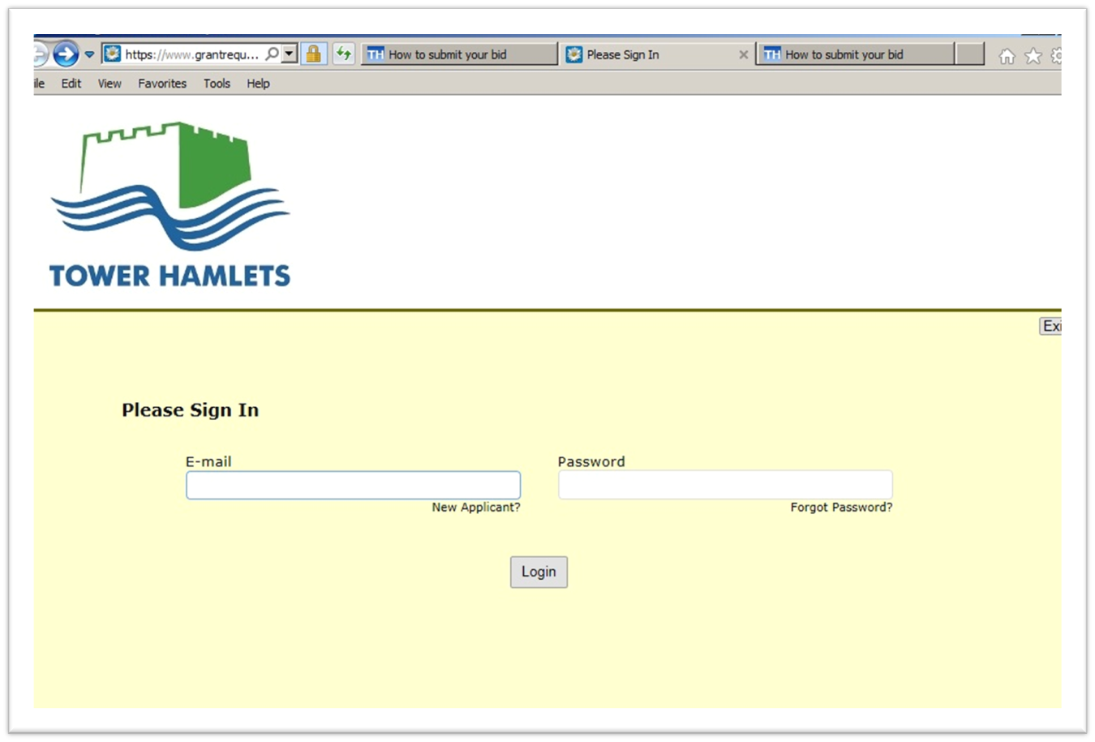
Sign in screen
The links to the applications forms will take you to the sign in screen to log in

Slide 21
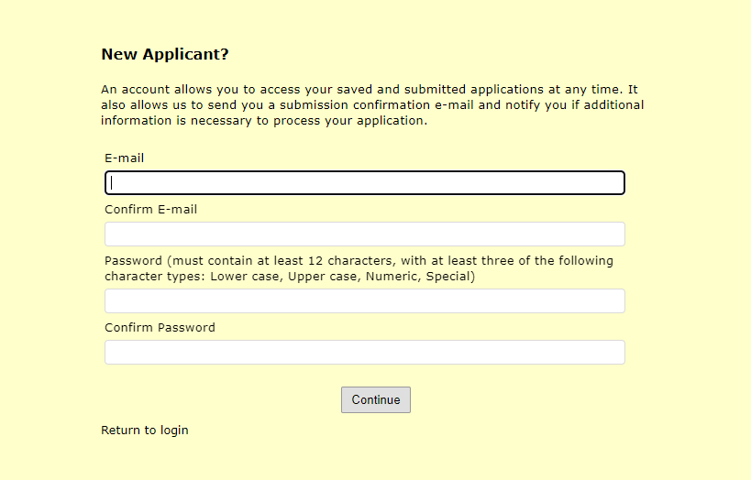
Creating an account
If your organisation does not already have a funding account, you will need to create one.

Slide 22
Logging in
Use the link you get in your email to return to the login screen

Slide 23
Tips
Read the MCGP Online Form Guidance
The website links create a new form each time
System emails you each time you save
When returning to your application use the link sent to you in your email
BEWARE TIMEOUTS! Save regularly, click from page to page to let system know you are there
Compile in Word and paste in – watch your word count
Fields and documents with an asterisk are mandatory.

Slide 24
Organisation information form

Slide 25
Eligibility quiz

Slide 26
Page 1 General information
On this page we give general guidance, information on GDPR and FoI. We also ask you to complete the declaration that the application is authorised by your governing body.

Slide 27
Page 2 Organisation information
On this page we ask you for basic information about your organisation,
Organisation name
Contact details
Which ward you are based in
Legal status
Charity/company number
If you already have an account from previous funding applications, some of the details may be pre-populated.

Slide 28
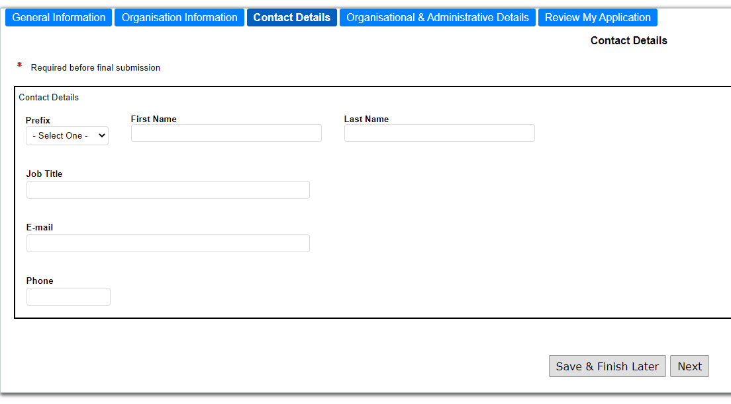
Page 3 Contact details
On this page we ask you for your details. You will then be the principal contact for your organisation.

Slide 29
Page 4 Organisation details
On this page we ask you for the information that will show whether you meet the standards we expect of organisations the council supports.
The form includes questions relevant to each of the criteria set out in the assessment guidance in the MCGP Prospectus
We also ask you to upload a number of documents. The guidance on how to do this is in the MCGP Online Form Guidance

Slide 30
Page 4 Organisation details (2)
1. Constitution
Upload governing document (not just a certificate of registration)
Answer questions,
Date you were established
List of board/committee members
Last AGM date
Sub-committee information
2. Borough connections
Provide a verifiable registered address in the borough, or
Upload a copy of your lease or rental agreement, or
Provide other evidence that you have worked with a partner organisation or have had other arrangements to provide services in Tower Hamlets for two years

Slide 31
Page 4 Organisation details (3)
3. Business planning
Upload your business plan. Additional documents may be uploaded using the ‘additional documents’ uploads at the end of the page.
Key points we are looking for in the business plan are set out in the guidance
4. Quality assurance
Upload your QA accreditation (additional uploads are provided if you have more than one QA accreditation), or
In the box provided, explain how your organisation actively tries to improve both the quality of your management and the services your organisation provides.

Slide 32
Page 4 Organisation details (4)
5. Managing People
If you employ staff and/or use volunteers, we expect you to meet the standards set out in the assessment guidance. To assess this we ask you to,
Upload your HR/staff policy and procedures document, if available, or, if you don't have one, upload the four staff related documents listed using the additional uploads provided
Upload your volunteer policy and procedures document, or, if you don't have one, upload the four volunteer related documents listed using the additional uploads provided
Answer questions,
How many paid (FTE) members of staff are employed by your organisation?
How many (FTE) of the organisation's paid employees are Borough residents?

Slide 33
Page 4 Organisation details (5)
6. Managing money
Competent financial management is a key requirement. The points we are assessing are set out in the guidance. We ask you to,
Answer a question on other funding from the council, and
Upload your most recent accounts
Upload your organisation’s budget for the year.
Upload confirmation of your bank details
Upload your financial procedures (medium and large organisations only)

Slide 34
Page 4 Organisation details (6)
7. Equality and diversity
Upload your equal opportunities or equality and diversity policy (which should include recruitment, planning and provision of services and the management of your organisation)
8. Safeguarding children and adults at risk of abuse
Upload your policy relating to safeguarding children and adults at risk of abuse
If your organisation does not work with children or vulnerable adults you should upload a document stating this.
9. Insurance
Upload certificates of insurance for public liability and, if appropriate, employers’ liability, property and equipment and professional indemnity

Slide 35
Page 5 Review and submit
Review any items highlighted in red
Print a paper copy of the completed form
Submit
Look for a confirmation email that the form has been received
Contact vcs@towerhamlets.gov.uk if you do not get a confirmation email

Slide 36
Project form

Slide 37
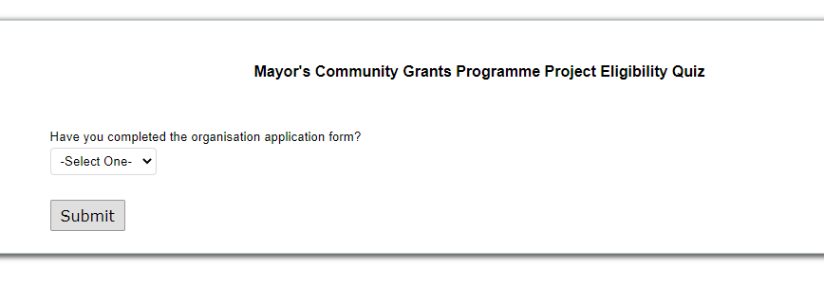
Eligibility Quiz (Submission page)

Slide 38
Page 1 General information
On this page we give general guidance, information on GDPR and FoI. We also ask you to complete the declaration that the application is authorised by your governing body.

Slide 39
Page 2 Contact details
On this page we ask you for your details. You will then be the principal contact for this project if the application is successful.

Slide 40
Page 3 Project proposal
Theme and scheme
Select from the drop down menu
If you think the project also covers other schemes, say which one(s) in the box provided
Project name
Short but descriptive - may be published in our grants register
Project summary
Concise and descriptive (50 word limit). May also be published in the grants register

Slide 41
Page 3 Project proposal (2)
Service delivery
Describe your project, including:
What the activities/ services are
Plans for delivery
Governance and measurement arrangements
How you will reach your target beneficiaries
Any specific group(s) that your project would support
Geographic area targeted.
Partnership arrangements.
Details of why you think your project is needed
How your proposal will achieve the priority set out in the prospectus
20 marks
1000 words

Slide 42
Page 3 Project proposal (3)
10 marks
Track record
Provide details of the experience your organisation has in the development and delivery of similar projects.
if your organisation is new provide details about your capacity and skills to deliver the project.
400 words

Slide 43
Page 3 Project proposal (4)
15 marks
Local connections
Provide details on your ability to reach residents and communities in Tower Hamlets.
Show that you have a good knowledge of the area, experience of delivering services to Tower Hamlets residents.
Tell us about your local base and existing working links and connections with other organisations in Tower Hamlets.
Do you have other potential partnership arrangements?
400 words

Slide 44
Page 3 Project Proposal (5)
5 marks
Service co-design
Provide details about how you’ll work with residents and other stakeholders towards improving the service over the period of funding
400 words

Slide 45
Page 3 Project Proposal (6)
10 marks
Quality assurance
Provide details of the relevant quality standards in place, including appropriate certification to deliver your proposed service/project.
You will need to provide evidence of how you will assess the quality of the project to ensure it is achieving its outcomes
400 words

Slide 46
Page 3 Project Proposal (7)
15 marks
Community cohesion, equality and diversity
Describe how your organisation promotes community cohesion and addresses inequalities impacting those with protected characteristics.
How will your project contribute towards community cohesion?
400 words

Slide 47
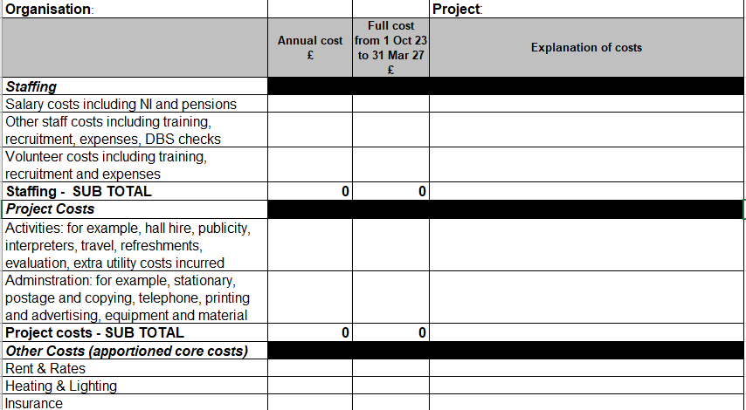
Page 3 Project Proposal (8)
Value for money
Tell us about how the service you are proposing offers good value for money and provide us with a budget using our template
10 marks
400 words

Slide 48
Page 4 - Outcomes
15 marks
Outcomes are the result of what a project does and the changes it makes over time to address the needs identified.
Outcomes should answer the following questions:
What is the change you intend to make?
Who will benefit?
How will residents benefit (what will they gain or have achieved by the end of your project)?

Slide 49
Outcomes
Page 4 - Outcomes (cont)

Slide 50
Timetable

Slide 51
Timeline
Timeframe | Milestone
24th April 2023 | Applications open
5th June 2023 | Closing date for applications
June-July | Assessment of applications
August 2023 | Chief executives decision on awards
September 2023 | Applicants receive notification of application outcomes
September 2023 | Development of grant funding agreements with successful applicants
November 2023 | New projects start

Slide 52
Help and Support

Slide 53
Support from THCVS
THCVS will be providing help and advice to applicants and will be delivering:
Preparing for organisation assessment training
Preparing for project assessment training
Finalising your bid training
Drop in sessions
1-1 support
All THCVS information is online here: https://thcvs.org.uk/news/mcgp/

Slide 54
Questions, comments, concerns
If you have a question or need support, then please get in touch with the council’s Voluntary & Community Sector Team by emailing vcs@towerhamlets.gov.uk

Slide 55
Questions

