Slide 1

Housing Strategy 2026 -2036
Evidence Pack

Slide 2
Local Trends

Slide 3
1) Census 2021 findings: Tower Hamlets experienced the largest population increase in London between 2011 and 2021 and has the highest population density. It is projected that this trend will continue between mid-2022 and mid-2032.
Census 2021 (Office for National Statistics)
According to the Census 2021, Tower Hamlets was the local authority with the largest population increase in London at 22.1%, from circa 254,100 in 2011 to 310,300 in 2021. This is higher than the overall increase for England at 6.6%, where the population grew by nearly 3.5 million to 56,489,800.
Tower Hamlets had a population density of 15,695 persons per km² at the time of the 2021 census - by far the most densely populated area in England and Wales.
In 2021, Tower Hamlets ranked 40th for total population out of 309 local authority areas in England, moving up 20 places in a decade.
ONS population projections (2022-based subnational population projections for England – June 2025)
Population Tower Hamlets is projected to grow by 20.4% between mid-2022 (projected population 323,854) and mid-2032 (389,845). This is the fastest growth in local authorities in England (City of London is omitted due to its small population size).
The population density of the borough would be 19,719 persons per km² in mid-2032, an increase of 4,024 persons per km² from 2021.
Notes:
Bibliography: Census 2021
Subnational population projections for England: 2022-based by ONS Subnational population projections for England - Office for National Statistics

Slide 4
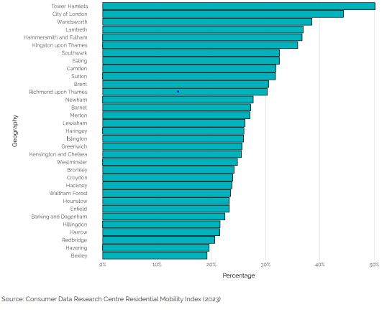
2) Tower Hamlets has the highest population churn of any local authority in London
According to information from the Consumer Data Research Centre Residential Mobility Index (2023)
Tower Hamlets has the highest population churn (population churn represents the proportion of households that have changed since any year prior to 2023) of any local authority in London.
In 2023, 40.5% of households had changed in the previous 3 years, rising to 50.1% in the previous 5 years. The dynamic nature of Tower Hamlets’ population implies service provisions need to be adaptable to the differing needs of high resident turnover
Notes:
Bibliography: Census 2021
Subnational population projections for England: 2022-based by ONS Subnational population projections for England - Office for National Statistics

Slide 5
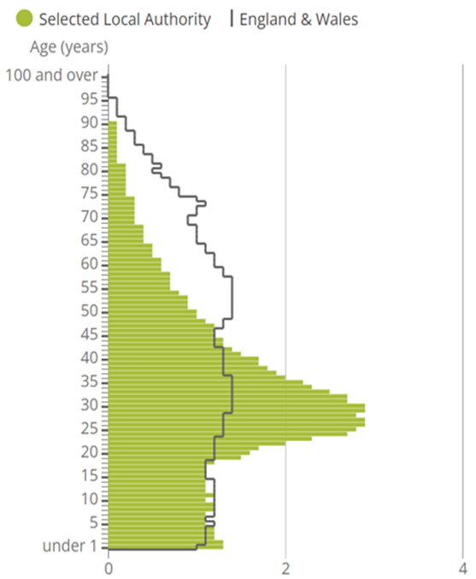
3) Census 2021 Findings: A young, working-age population
Tower Hamlets has an extremely young and diverse population, with a median age of 30. This was the lowest median age in England and Wales. This may partly be accounted for by a large university student population residing in the borough.
The borough had 17,300 people aged 65+. Tower Hamlets is the only local authority area in the country to have less than 6% of the population aged 65+ (5.6%)
The percentage of households including a couple with dependent children in Tower Hamlets increased from 14.8% to 16.4% between 2011 and 2021
The percentage of households including a couple without children increased from 14.7% in 2011 to 17.4% in 2021.
Notes:
Bibliography: Census 2021

Slide 6
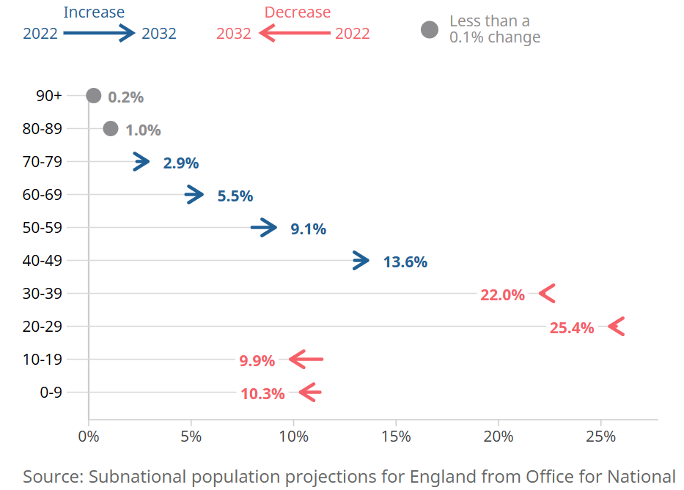
4) ONS Subnational Age Projections for Tower Hamlets by 2032
The median age in Tower Hamlets is projected to rise from 30 years in 2022 to 31 years in 2032.
In England, the median age is projected to be 41 years in 2032.
In 2032, 6% of the population in Tower Hamlets are projected to be aged 65 years or over, around the same as in 2022.
The 10 to 19 age group are set to see the largest change in Tower Hamlets between 2022 and 2032
Notes:
Bibliography: Census 2021

Slide 7
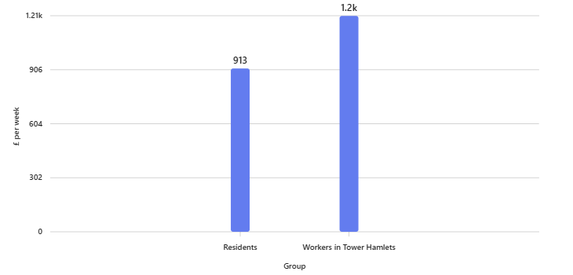
5) Residents earn significantly less than those working in Tower Hamlets - the largest gap between workers and residents in UK and below average incomes after housing cost deductions
The median annual gross pay for Tower Hamlets residents working full time from the latest available data in 2022 was £39,868.
Statistics highlight an income disparity between residents and those working in the borough. At £1,207 per week, the mean earnings for workers in Tower Hamlets are the second highest in the UK as of 2023 (after the City of London). Yet residents in the borough earn an average of £294 less per week in comparison to those working in Tower Hamlets – the largest gap between workers and residents in Great Britain.
Out of all the London boroughs, Tower Hamlets has the largest percentage of children growing up in poverty (48%), after housing costs have been deducted.
Source: Trust for London, collated by Loughborough University and commissioned by End Child Poverty coalition – November 2024.
Notes:
Bibliography: Census 2021
Source: ONS Annual Survey of Hours and Earnings, Resident Analysis and Workplace Analysis, 2023
Annual Survey of Hours and Earnings (ASHE) - Office for National Statistics (ons.gov.uk)
Poverty & Inequality Data For Tower Hamlets - Trust For London | Trust for London

Slide 8
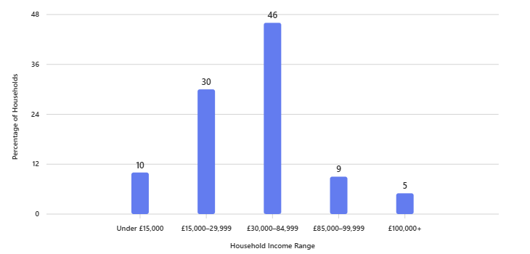
6) Almost 10% of households have an income under £15,000 per annum
Almost 10% of households have an income of under £15,000, a similar in proportion to the 9% with incomes above £85,000. 55,381 (40%) households have an income of less than £30,000 per year, 7,443 (5%) are paid £100,000 or more.
Source: ONS Annual Survey of Hours and Earnings, Resident Analysis and Workplace Analysis, 2023
Borough profiling undertaken by Trust for London found that in 2019/20, 39% of people in the borough lived in households with an income of less than 60% of the national average after housing costs have been subtracted. This was worse than the average London Borough.
Source: Trust for London Poverty
and Living Standards
Notes:
Bibliography: Census 2021
Source: ONS Annual Survey of Hours and Earnings, Resident Analysis and Workplace Analysis, 2023
Annual Survey of Hours and Earnings (ASHE) - Office for National Statistics (ons.gov.uk)
Poverty & Inequality Data For Tower Hamlets - Trust For London | Trust for London

Slide 9
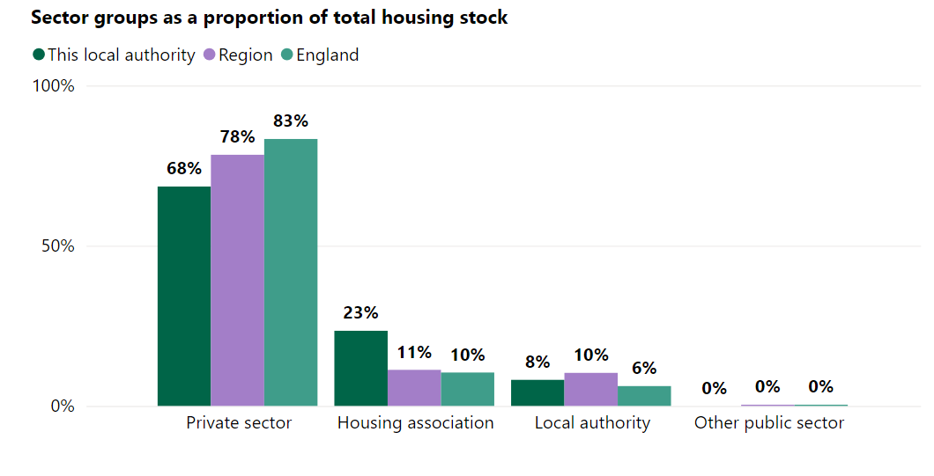
7) Housing Tenure: Tower Hamlets in top 2% of LAs by social rented share, but this fell between 2011 and 2021, while private renting has increased
Tower Hamlets was in the highest 2% of English local authority areas for the share of households in the social rented sector in 2021 but saw England’s third-largest percentage-point fall in the proportion of social sector households between 2011 (39.6%) and 2021 (35.9%).
Conversely, private renting rose from 32.6% in 2011 to 38.2% in 2021 (the 5th highest area for private renting in England and Wales in 2021
23.1% of homes were owner-occupied (down from 24.2% in 2011).
Source: Regulator of Social Housing, Housing by Local Authority 2024
 | 1 Bed | 2 Beds | 3 Beds | 4+ Beds
Percentage of all households, 2011 | 30.4% | 41.3% | 20.3% | 6%
Percentage of all households 2021 | 31.5% | 39.9% | 20.0% | 8.6%
% Increase in number of households between 2011 and 2021 | +26% | +15% | +17% | +28%
Source: Local authority data on housing supply. Houses of Parliament , 2023
Notes:
Bibliography: Census 2021

Slide 10
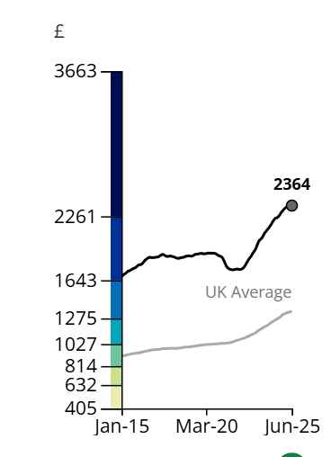
8) Continued demand for PRS accommodation in Tower Hamlets outstrips supply, and it remains increasing difficult for residents to source accommodation in this sector which is affordable
Aside from the wider national economic conditions driving the PRS, at a local level this has been driven by economic growth in Canary Wharf and the City of London and a continued boom in overseas investment, which has served to distort the local housing market for residents.
Private rents in the borough rose to an average of £2,363 in June 2025 (4.97% above the London average).Source: Price Index of Private Rents (PIPR) from the Office for National Statistics (July 2025)
Mortgage interest rates combined with impact of the proposals within the upcoming Renters Rights Bill (estimated 2025, formerly known as ‘Renters Reform Bill’, 2023), including the abolition of Section 21 (no fault evictions) have contributed to landlords removing themselves from the market which in turn is contracting the supply of accommodation within the Private Rent Sector.
Rising PRS rents as well as mortgage interest rate rises are already increasing the pressures on local authorities’ homelessness services who, (prior to the pandemic), had already been beset by austerity and reductions in public finance.
Notes:
Bibliography: Price index private rents from ONS Housing prices in Tower Hamlets
UK House Price Index - Office for National Statistics (ons.gov.uk)

Slide 11
9) Housing Prices in Tower Hamlets are on the rise following 2023 decrease
The housing market saw steady growth in the first half of 2022, until the impact of rising inflation, interest rates and affordability began to have an impact on house price growth.
In the first half of 2023, house prices dropped 4% from the peak of August 2022 , however between August 2023 and August 2024 house prices in England increased by 2.3%.The average house price in Tower Hamlets was £503,000 in January 2025 (provisional), up slightly 1.7% from January 2024. This was lower than the rise in London (2.3%) over the same period. Source: ONS- UK House Price Index
The average price paid by first-time buyers was £483,000 in January 2025 (provisional). This was up slightly (1.7%) from January 2024, but lower than the rise in London (2.3%) over the same period. Source: ONS- House prices in Tower Hamlets.
Only a small fraction of the population, those who earn incomes way above the national or London averages, can afford to own or privately rent a property. The continued downward pressure on real incomes as the price of food and fuel has risen, combined with welfare reforms, the benefit cap in particular, has also placed further pressure on existing households – larger families or those on very low incomes may not be able to afford to live in Tower Hamlets anymore or may choose to live in overcrowded accommodation. These twin factors could change the demographics of the borough.

Slide 12
Social Housing Supply and the council’s Housing Management Service

Slide 13
11) Common Housing Register: number of applicants has risen from 18,808 in 2018 to 29,109 in May 2025
While we continue to build new council homes alongside RPs and developers to increase the supply of social and affordable homes, the Right to Buy Scheme remains in place which reduces the supply of council stock in the borough.
1 November 2023: Housing Management Services (previously provided by Tower Hamlets Homes - THH) came back in-house. Repairs, maintenance, improvements, caretaking, gardening, rent and service charge collection for these homes are now delivered by the Council.
Out of a total of 21,833 homes in the Council’s property portfolio, all are directly managed except for 737 homes with shared management arrangements alongside tenant management organisations (TMOs) and 51 homes in leasehold enfranchisement blocks.
2,646 Council’s homes situated within conservation areas, 748 homes with listed building status
Council Property Portfolio
Leasehold | 9,964
Tenant | 11,516
Freehold | 353
Supported Housing Projects (by room) | 9
Total | 21,833
Source: Tower Hamlets Housing Management Service
Almost half of our leasehold homes are sub-let to occupants which poses a unique housing management challenge.
With the announcement in the October Budget that there would be a reduction in Right to Buy discounts, we received 1,396 Right to Buy applications between 30 October and 21 November 2024. This means there could be a potential reduction in tenanted stock and a reduction in income from rents.
Notes:
Bibliography: Sources?

Slide 14
12) Two in three council tenants in Tower Hamlets are from a minority ethnic background, one in five identify as having a disability
Over 66% council tenants identify as from a black or minority ethnic background, approximately 49% identify as Bangladeshi
The median age of our tenants is 52 years
25% of council tenants are over 65 years of age, much higher among our tenants than the borough as a whole which is 10%
One in five council tenants identify as having a disability
Forty national languages are spoken within the tenant population, Other than English, the most widely spoken languages among tenants are Bengali, Somali, Chines, Vietnamese, Polish and Arabic
5% of tenants require a language other than English to access services
Source: Tower Hamlets Housing Management Service
1st April 2024 –Regulator of Social Housing’s Consumer Standards were introduced.
Social landlords are required to comply with the Transparency, Influence and Accountability Standard. Requirement for landlords to be open with tenants, fair treatment, respect of rights.
Tenants are able to influence decision making, access services raise complaints and hold landlord accountable.

Slide 15
13) Tenant’s Voice, Residents Associations and TMOs
Tenant’s Voice (set up in Spring 2024):
8 Tenants, 3 Leaseholders, 1 Sub-tenant of Leaseholder
Facilitated and developed by the council’s Housing Management Service, this group provides strategic engagement with council tenants and leaseholders on the quality and accessibility of Housing Management Services. The group set recommendations and is connected to Housing & Regeneration Scrutiny Sub-Committee. The Tenant’s Voice are all also consulted with on proposals affecting provision of the council’s housing services.
LBTH also has 27 Tenant & Resident Associations and 3 Leaseholder Associations, supported by a dedicated team in the Housing Management Service, in terms of the governance, capacity building and access to wider council departments.
Tenant Management Organisations (TMOs):
The council employs a TMO Client Officer, provides bespoke overview and support to the 4 TMOs, covering 373 tenanted properties
Name of TMO | Location | Properties (of which tenanted)
Bancroft Tenant Management Co-operative | Bethnal Green | 558 (285)
Birchfield TMO | Poplar | 24 (6)
Dennis Central London Housing Co-operative | Poplar | 75 (32)
Withy House TMO | Bethnal Green | 80 (50)
TOTAL |  | 737 (373)

Slide 16
14) Right to Buy sales saw a post-pandemic increase, while the number of Empty Homes has also increased substantially
Right to Buy (RtB) sales declined during the pandemic: 97 (2018-19) 44 (2019-20) 40 (2020-21)
Post-pandemic resurgence: 54 (2021-22) 105 (2022-23)
Reform of RtB scheme announced in October 2024, early reporting of boom in applications this year.
Consultation on RtB ended 15 January 2025.
Empty Homes Statistics October 2024 (MHCLG) empty homes in total in borough
3,415 total in October 2024
375 Vacant dwellings owned by Council
605 General Needs long-term vacants owned by RPs
429 properties owned by RPs ‘unavailable’ (presumed major works/ decanted for regeneration)
Source: MHCLG Live Tables on dwelling stock (including vacants) Table 615 – June 2025)
Notes:
MHCLG (2024) Table 615 Live tables on dwelling stock (including vacants) - GOV.UK (www.gov.uk)

Slide 17
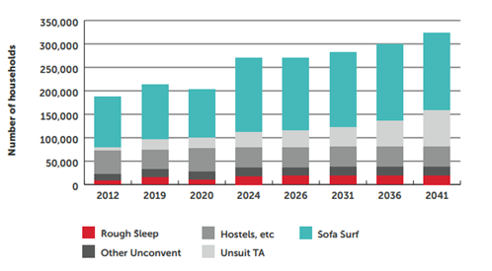
15) Homelessness forecast to surge in coming years despite additional financial support from government
In the last 5 years LBTH has seen a surge in homeless applications. This trend is forecast to continue for the rest of this financial year. The number of residents (both single and families) who approached the council as homeless increased from 2,044 in 2020/21 to 3,195 in 2023/24. Source: MHCLG Statutory Homeless Detailed LA Level data 2020/21 & 2023/24
Homelessness Reduction Act (2017) brought additional assistance for those at risk of homelessness and has increased the number of applicants qualifying for assistance.
New burdens funding was provided by government to assist LAs, but the rising costs for LAs has risen due to increased costs of providing assistance.
Financial Year | Q1 | Q2 | Q3 | Q4 | Average | Total for Financial Year
2020/21 | 520 | 479 | 447 | 468 | 479 | 1914
2021/22 | 536 | 548 | 427 | 438 | 487 | 1949
2022/23 | 509 | 560 | 559 | 674 | 576 | 2302
2023/24 | 651 | 696 | 735 | 783 | 716 | 2865
2024/25 | 700 | 619 | 800 | 880 | 750 | 2999
Homelessness Applications received (single and family households)
Source: Housing Options Service
Homeless Crisis Monitor data anticipates that homelessness will increase in England substantially over the course of the next two decades, particularly among those living in unsuitable Temporary Accommodation.
Source: Crisis Homelessness Monitor 2023
Notes:
Crisis: The Homelessness Monitor (2023) homelessness-monitor-england_report-2023_v11.pdfs

Slide 18
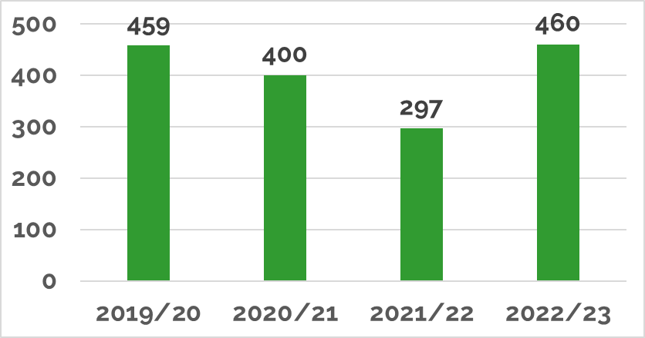
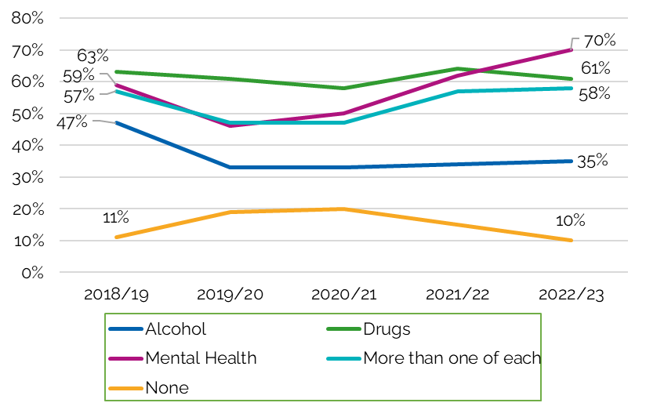
16) Tower Hamlets has the 7th largest Rough Sleeping cohort in London, with 59% of people are new rough sleepers
In Tower Hamlets during 2022/23, 460 individuals were sleeping rough, a 55% increase between 2021 and 2022 due to Covid protections and the ‘Everyone Initiative’ ending and increases in the cost of living.
This mirrors the trend in London over the past five years.
Tower Hamlets has the 7th largest rough sleeping figure in London: in 2022/23, 59% were new rough sleepers (Flow), 25% were individuals seen rough sleeping in the previous year (Stock) and 16% were individuals having a gap in rough sleeping (Returner). (Source: CHAIN Annual Bulletin for Greater Lonon 2022/23 - GLA)
Black ethnic groups (14%) and White Other (21%) groups see the biggest overrepresentation in the borough’s rough sleeping population. 49% of the rough sleeping population identified as UK nationals, slightly higher than the London average.
The right-hand chart demonstrates support needs recorded for rough-sleeping clients over time. Overall support remains consistently high over time.
Only alcohol needs have seen the largest decrees over time.
Mental health needs have risen the most from 59% to 70%.
Source: CHAIN
Source: CHAIN
Notes:
On a national basis rough sleeping had been decreasing in England since it’s peak in 2017 (4,751 people rough sleeping on a e e night). This decreased to 2,443 by 2021, but the latest data shows it has increased to 3,898 by Autumn 2023.

Slide 19
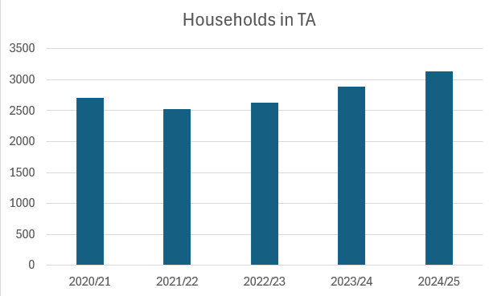
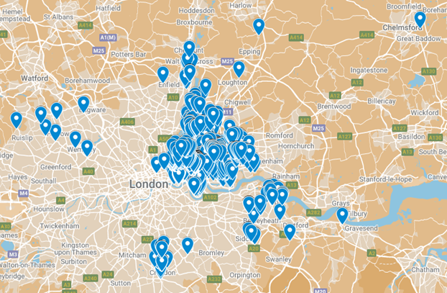
17) Households placed in TA is increasing with 3% of households placed outside of London
The left-hand graph shows the increase in the number of households placed by the council into TA over the last 5 years.
In Q2 2024/25 a total of 3,132 households were placed in TA: 36% in the borough, 61% outside borough, but in London, 3% outside of London.
The Housing Options Service uses its own benchmark limiting temporary accommodation to within 90 minutes commute of Whitechapel Town Hall to help maintain family connections and social networks in the borough (see map below).
Source: Tower Hamlets Housing Options Services
In an emergency or highly unusual set of circumstances (e.g. a block of flats needing to be decanted due to fire or other emergencies) households may be placed beyond London’s outskirts.
Similarly, the council may make placement where there are safety issues, including but not limited to when an individual needs relocating due to fear of violence, abuse, gang violence or for safeguarding reasons.
Source: Tower Hamlets Homelessness & Housing Options Services

Slide 20
Issues Affecting Housing Supply and Affordability in Tower Hamlets

Slide 21
19) PRS and buy-to-let market contraction has led to multiple challenges directly impacting our ability to provide suitable TA
Demand for TA has increased as a wider range of people are owed interim housing duties after the introduction of the Homelessness Reduction Act (2017).
Smaller buy-to-let landlords continue to exit the PRS market due to factors such as increases in tax and anticipated regulation changes (Renters’ Rights Bill (2025)), along with higher maintenance and borrowing costs.
PRS accommodation and buy-to-let markets have contracted as a result.
Portfolio holders often acquire properties, offering them to LAs as TA or PRS, but they require guaranteed rents.
The shortage of affordable and suitable TA across London and in the Borough has led to significant challenges to the council as we work in supporting residents placed in TA.
The gap between LHA rates and widening rents is presenting a difficult challenge to the council as an increasingly difficult cost implication to sustain.
The chronic shortage of affordable properties in the Borough is leading to more households in unsuitable B&B accommodation (mainly outside LBTH, but in neighbouring East London boroughs). The Borough is seeing a significant volume of statutory breaches and judicial review threats as families are placed in unsuitable accommodation and/or beyond the statutory 6-week time limit.
The council continues to pay a higher rate to secure whatever accommodation is available than the Pan-London rate set in other Boroughs. This has been necessary to ensure we are legally compliant in providing suitable accommodation and reducing and negating the challenges brought by judicial reviews.

Slide 22
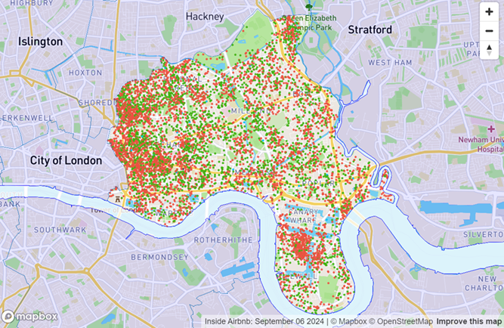
20) Airbnb-style short-term lets and second homes impact housing availability and affordability, and disproportionally present in the borough compared with others in inner London Boroughs.
The borough has seen considerable growth in short-term lets through companies such as Airbnb, resulting in fewer properties available for longer-term renting.
Data from Inside Airbnb (May 2025) showed that the number of Airbnb listings in Tower Hamlets was 7,377 (7.8%) out of 94,559 listings in London. Of the 7,377 Tower Hamlets Airbnb listings, 4,320 (58.6%) are entire homes/apartments, 3,044 (41.3%) are private rooms, 11 (0.1%) are shared rooms and 2 (0.0%) are hotel rooms.
On average each listing is booked on average for 46 nights a year.
Council Tax records from October 2022, 6,135 properties were classed as second homes, 4% of the overall dwellings. This ranks LBTH as being in the top three London Boroughs with the greatest percentage of second homes. Only RBKC and Camden have more.
In LBTH, the presence of second homes has more impact on housing availability than long-term empty properties.
This map illustrates Airbnb listings in the Borough (Source: Inside Airbnb (May 2025)

Slide 23
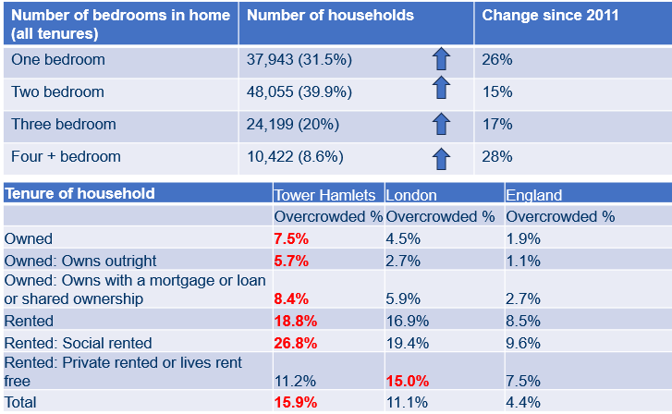
21) Building more family-sized homes as part of our housing target to tackle overcrowding?
Although overcrowding is a key housing issue nationally, the rate is higher across London and Tower Hamlets. We use the ‘bedroom standard’ definition of overcrowding- when two or more people of a different sex who are not a couple share a bedroom.
Data from the CHR (May 2025) indicates that 44% of all applications were from overcrowded households (12,797 households, out of which 2,595 households lack 2 or more bedrooms than they need), compared with the overall rate in England at 4.4%.
Local Housing Needs Assessment (October 2023) recognises the borough's notably high housing need, with unique age demographics and population density.
The assessment found justification to focus policy on seeking a greater proportion of family sized homes (3+ beds) as part of the housing target to bring more people out of need. For example, one 3-bedroom home might meet the need of 5-6 people, whereas a 1-bedroom property will likely affect a maximum of two people.
Source: ONS Census 2011
and 2021
Source: Tower Hamlets Housing Options CHR Dashboard (May 2025)

Slide 24
Housing Affordability

Slide 25
23) New Local Plan with Revised Affordable Housing Developer Requirements progressing to approval (40% of new developments to be affordable)
Delivery of affordable homes is a key mayoral manifesto priority (Priority 2: Homes for the Future). Progress against this is reported quarterly. This information is publicly available and monitored via the council’s Annual Delivery Plan.
New Local Plan is progressing to approval: Revised Affordable Housing policy - increasing affordable housing requirements of developers from 35% to 40% (of which 85% will be socially rented, and 15% will be intermediate rent homes).
Council is exploring opportunities to acquire s106 properties where there is a lack of interest from RPs.
The council are engaging with developers to improve market intelligence and track progress on delivery where permission to build has been granted, this builds a picture around delivery challenges and will help the council respond with appropriate action.
The council's Planning Service are identifying potential solutions, and policy levers the council can implement to help bring forward stalled sites and support Tower Hamlets development strategy.
Confirmation of GLA/MHCLG funding for 237 homes over a 2-year period (24-25) received, discussions on sites and buy back purchases are underway.
The council are working to secure development agreements to increase delivery are undergoing evaluation.
The council has a healthy housing capital programme with 415 homes on site or in procurement, and 269 submitted for planning or in design.
It is anticipated that the council’s strong housing pipeline, including its own affordable housing programme, increases prospects of greater delivery when market conditions improve in relation to build costs, borrowing and other development finance, planning stability to improve developer confidence and ability to deliver homes at volume.
Forecasting suggests new build sales volumes are likely to return 2023 levels in 2025.

Slide 26
24) Tower Hamlets reflects broader regional and national market trends given the wide financial and regulatory changes affecting all LAs
There are factors beyond the council’s control which adversely affect the delivery and the conversion of approvals to completions.
Both housing starts and completions are falling regionally and nationally due to the prevailing economic climate for housing delivery both in the private and affordable housing sectors. Tower Hamlets is therefore not an outlier and reflects these trends. Issues impacting on delivery include:
The cost of development investment (high interest rates and inflation).
Construction outputs contracting (labour availability and skills), regulatory changes (fire safety & damp/mould).
Complex brownfield site development and other macro-economic factors (post Brexit/Pandemic).

Slide 27
26) External Funding: £40m from GLA and £8.3m from MHCLG
External grant funding of £40m has been made available by the GLA from its Council Housing Acquisition Programme (CHAP) for the council to secure permanent homes.
The balance of the scheme costs will be met by council borrowing, which has been included in the council’s HRA Business Plan for acquisitions.
All homes will be permanent council homes and will be sourced in the borough in accordance with the funding conditions.
The council will mainly acquire new build homes from developers, enabling bulk purchases.
The balance of homes will be from existing council leaseholders selling to the council
Other local market-based opportunities to be taken advantage of should they arise.
Priority will be given to acquiring larger buy back homes within existing estates, as an aid to meeting overcrowding
The council can prioritise larger homes in its acquisition of market units, working with developers, if need be, to reconfigure blocks.
MHCLG has made £8.3m available from its Local Authority Housing Fund Round 3 (LAHF R3) programme for the purchase of 32 temporary accommodation (TA) homes as well as 5 permanent homes for the Afghan Citizen Resettlement Scheme. This programme is an expansion of the plans to meet the challenge to deliver much needed homes and contribute to the reduction in households in overcrowded homes and homeless families in temporary accommodation.

Slide 28
25)There are currently 10 stalled sites in Tower Hamlets (a total of 4,614 homes)
Q2 of 2024-25, there were 184 (net additional) homes completed across all tenures (72 private, 68 RP-owned, 44 council-owned including 1 acquisition)
For both Q1 and Q2 of this financial year, over half of each respective quarters’ net delivery was affordable within the 2024-25 monitoring period.
In Q2, 2,165 homes were approved (397 affordable), highlighting continued developer interest in the borough.
The average ‘build out’ rates for schemes in the borough is 4.5 years. Factors such as the complexity and phasing of schemes (market absorption) impact the rate in which schemes are delivered.
As of October 2024, there were circa 2,594 affordable homes under construction. Between April 2022 and May 2025, 1,492 affordable rental homes were completed including 288 built by the council, 1,140 by housing associations, and 64 through property acquisitions
There are currently 10 stalled sites currently identified compromising of 3,678 private homes and 936 affordable.
In order to increase the delivery of further additions to the Borough’s housing stock, the council are taking the following actions:
Holding developer engagements sessions to better support delivery and understand housing delivery issues.
Developing a ‘fast track’ dedicated planning service for council and major housing schemes which are committed to delivery, to bring more efficiency into the process and therefore speed up the delivery of net additional housing stock.
Proactively engaging with developers/landowners with permissions to track progress on delivery and to better understand challenges around housing delivery.
Securing developer agreements with partners for sites it cannot build out itself to increase housing delivery.
Working to increase the council’s legal capacity for planning, particularly for finalising Section 106 Agreements.

Slide 29
Stock Condition & TSMs

Slide 30
28) Retrofit and Energy Use
The council has secured a Warmer Homes London grant of £800,000 to undertake a retrofit of 122 houses that have EPC rating of D or E. Almost every council tenant’s home with a domestic gas boiler already has a SEDBUK A-rated boiler. The vast majority are 12 years or younger and have high efficiency.
The council offers home energy advice programme throughout the borough. Our visiting officer can offer residents advice at their door to reduce the burden of rising energy bills and reduce the impact that their home’s energy use has on the environment.

Slide 31
29) Condition of stock - Social Sector
In advance of the Social Housing (Regulation) Act (2023) coming into effect, the Regulator of Social Housing introduced tenant satisfaction measures (TSMs) in April 2023, to make social landlords’ performance more visible to tenants and help tenants hold their landlords to account.
These 22 TSMs cover repairs, safety, tenant engagement, complaints handling and neighbourhood management.
10 measures are based on information measured by social landlords, and 12 are measured through phone surveys with tenants conducted by an independent research agency.
Although Tower Hamlets receives more complaints per 1000 units of stock than the London average (103.65 and 73.48 respectively), the council had 31% less of their complaints upheld than in the previous financial year.

Slide 32
30) The council remains in the upper quartile for TSMs, but is below target for call handling reception and satisfaction
In 2023/24, 65.3% of council tenants were satisfied with the overall service provided by the council, compared with the London average of 59%. In terms of local context, Tower Hamlets is in the upper quartile for tenant satisfaction.
The council’s Housing Management Service also performs above average in terms of satisfaction with how the council engages with council tenants: 55.8% of tenants were satisfied that their views were considered (51.3% London-wide) and 72.7% were satisfied with being kept informed (66% London-wide).
The Council’s Housing report does, however, highlight that we were performing below target with call handling. 69% of 156,211 calls received by Tower Hamlets were answered (below the 92% target) and 81.8% of callers were satisfied with the way their call was handled (below the 90% target). The top complaint by a significant margin was repairs, with 77% of all calls being repairs calls, followed by tenancy management complaints at 6% of all calls.
Local Authority | Overall satisfaction 2023-24
LB of Hackney | 59%
LB of Haringey | 47%
LB of Newham | 59%
LB of Waltham Forest | 61%
LB of Tower Hamlets | 65%
*London Median | 59%
*London Upper Quartile | 65%
Source: HouseMark, 2023-24

Slide 33
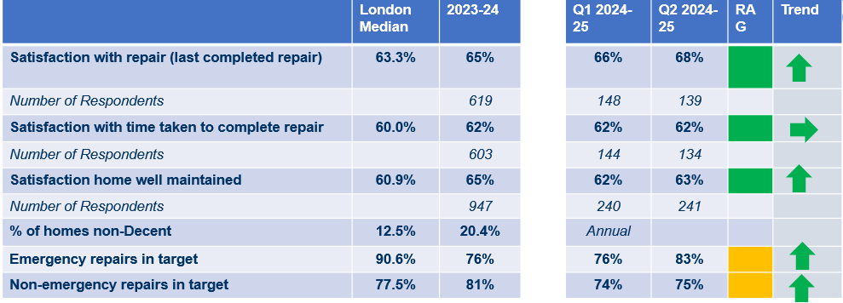
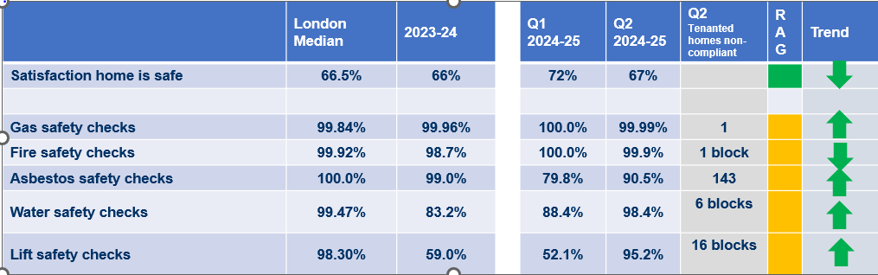
31) Maintenance: Tower Hamlets consistently performs above London average, but behind timeliness for emergency repairs (14.7% below London average)
Housing Management Service’s outsourcing of repair delivery of council stock
Contractor | Contract
ABCA | Door entry, TV aerials
K&T | Domestic gas
LES | Mobility lifts
Mears General Build | General Build
OCO | Communal M&E
Openview | Fire safety
PLS | Passenger lifts
During 2023-24, 91,377 responsive repairs were carried out on our stock. Of those repairs counting as emergency repairs, 75.9% were completed on time, compared with the 90.6% London average.
Tower Hamlets has performed above average in the on-time completion of non-emergency repairs, at 81.3% compared with the London average of 77.5%.
In all categories, the tenant satisfaction measures with the way repairs were dealt with, time taken to complete the repair and general maintenance remained above the London average.
Notes:
Source: LBTH Council Housing Annual Report 2023-24, p.5

Slide 34
32) Actions taken to improve performance
The actions that we are taking to improve performance include:
A new strengthened Governance structure to oversee the delivery of the compliance programmes.
Implementation of a new compliance system to improve reporting and monitoring of Asbestos and wider compliance programmes. We have a programme of domestic asbestos surveys underway and compliance for blocks has now improved to 100%
Drawing down on the £10m previously agreed funding to address fire and building safety issues

Slide 35
33) Tower Hamlets has the most high-rise buildings within its council stock of any local authority in the UK
The council manages the highest number of high-rise buildings in the UK, overseeing 78 buildings (18+ storeys) and 4,130 council homes, alongside 7,969 homes in medium-rise flats (11m-18m).This has significant implications in the post-Grenfell context, highlighting the council’s duty to keep residents safe in blocks that may pose higher safety risks due to their size.
In 2025, the council initiated the procurement of contracts to deliver £140m of capital investment over 5 years. The capital programme is focused on essential upgrades, including fire and building safety improvements. A new Housing Risk team is overseeing improvements in capital programme management. Importantly, an Asset Management Strategy is being developed to ensure capital funding is used effectively.

Slide 36
Private Rented Sector Profile

Slide 37
35) Affordability in the PRS
Only a small fraction of the population, those who earn incomes way above the national or London averages, can afford to own or privately rent a property in Tower Hamlets (with those earning just below the national average often sharing a tenancy with other people to reduce their housing costs).
Research from Trust for London (May 2025): Gentrification across London & how this is changing populations | Trust for London looked at how incomes have changed across neighbourhoods in London between 2012 and 2020, to identify parts of London where gentrification is likely to have taken place, and subsequently, their research identified 53 neighbourhoods in London that more than a decade ago housed those on the lowest incomes, classing those areas as now gentrified, which has resulted in those with higher incomes moving in and making those areas less affordable to those on average or below average incomes.
12 out of those 53 neighbourhoods were in Tower Hamlets. While average incomes in London’s neighbourhoods as a whole have barely nudged between 2012 and 2020, these neighbourhoods have seen their average incomes rise by 11% - to £32,100 between 2012 and 2020, after inflation has been accounted for
By contrast in the rest of London average incomes stayed almost the same at £37,300 in 2012 and £37,700 in 2020 (+1%) In some, the change has been even starker. For example, in Tower Hamlets both in Spitalfields (45%) and Aldgate (29%) had increases in average incomes.
These neighbourhoods have seen their populations change significantly – with a remarkable drop in their Black population and fewer families with children. Within these neighbourhoods, the proportion of residents living in social housing drop. Without London’s social housing stock increasing, this may push families and households into the expensive PRS market, or to leave the city

Slide 38
36) The council operates licensing schemes to improve conditions in the PRS
A selective licensing scheme has been in place since 1 April 2016 . This was renewed for another five years from the 1 October 2021, in the Spitalfields and Banglatown, Weavers and Whitechapel wards, it excludes all House in Multiple Occupation (HMO). The current selective licensing scheme will end on 30 September 2026 and the development and evidencing process of for renewing and extending the borough’s selective licencing scheme has begun.
Tower Hamlets previously operated a discretionary additional licensing scheme for smaller HMOs from April 2019, excluding Spitalfields and Banglatown, Weavers and Whitechapel wards. With effect from 1 April 2024, the whole borough was designated as an area for additional licensing (including those three wards) which is in place now until 31 March 2029.
The effect of the designation requires all smaller HMOs privately let properties, including flats which are occupied by three or more persons comprising of two or more households, irrespective of the number of storeys, to be licensed. There is also a mandatory HMO scheme which landlords need to comply with.
As of May 2025, there are 6483 properties licensed under the council’s Selective Licensing scheme and a further 6849 properties licensed under the HMO Licensing scheme. Over the course of the last five years, a total of 1228 hazards have been identified under the Housing Health and Rating System. As a result of officer intervention, or where hazards or issues are picked up on inspection, 2149 properties have been made compliant.
In 2024-25, c. £1.9m was raised from the council’s housing licensing services. Income raised from these schemes is ringfenced to administer and enforce non-compliance with both schemes.

Slide 39
Short-Term Lets From ‘Scale of the Short-Let market in central London: Savills Research draft report to Central London Forward’ January 2025

Slide 40
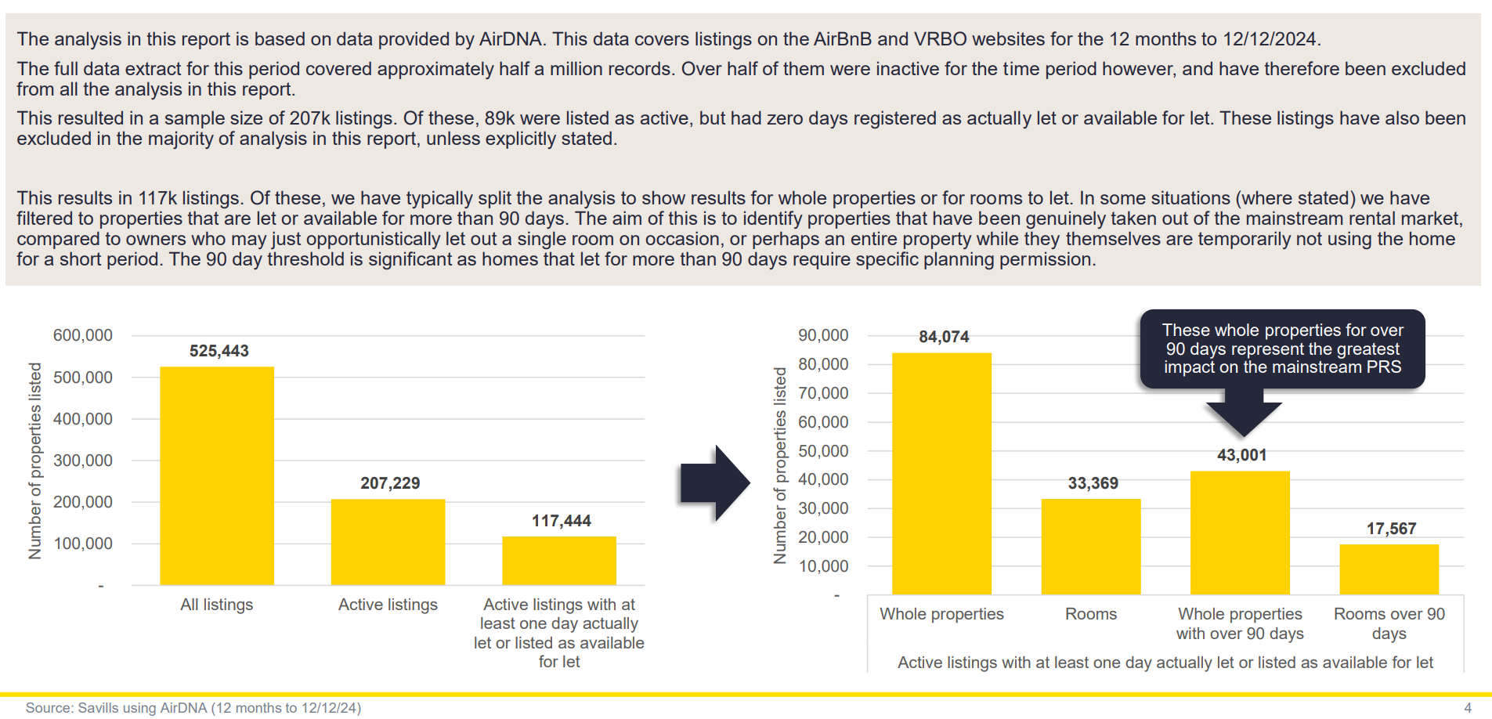
38) In London, 43k whole properties were let over 90 days between December 2023 and December 2024. They have the greatest impact on the mainstream PRS

Slide 41
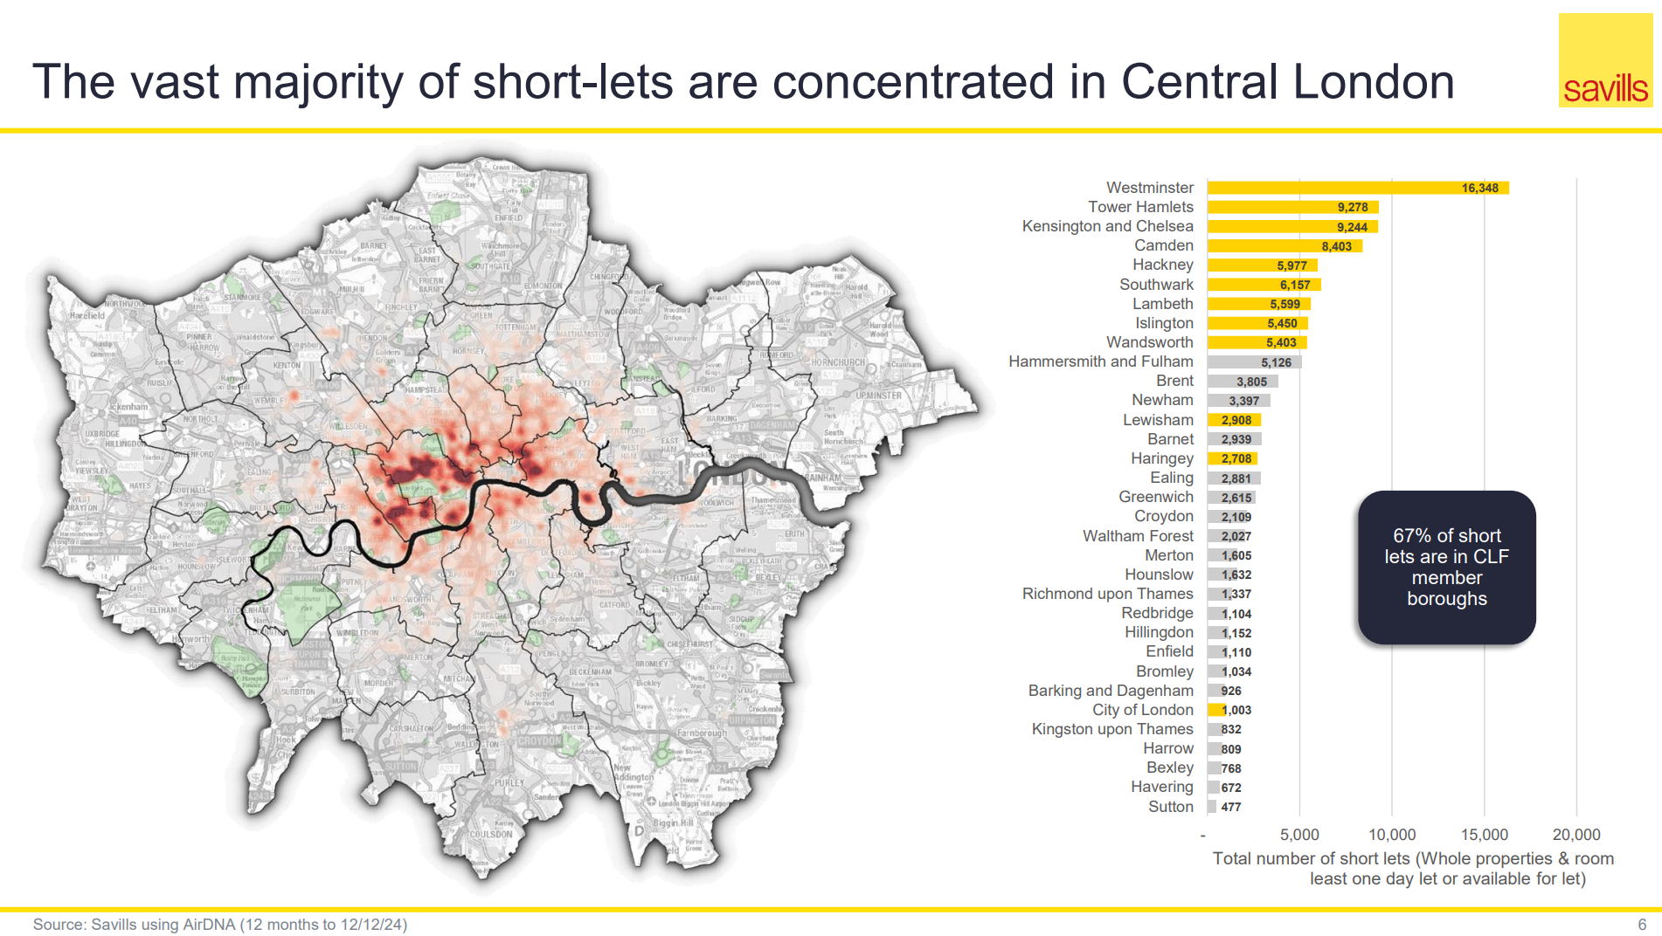
39) Tower Hamlets had over 9,000 short lets (whole properties and room) between December 2023 and December 2024, ranking the second highest across London boroughs

Slide 42
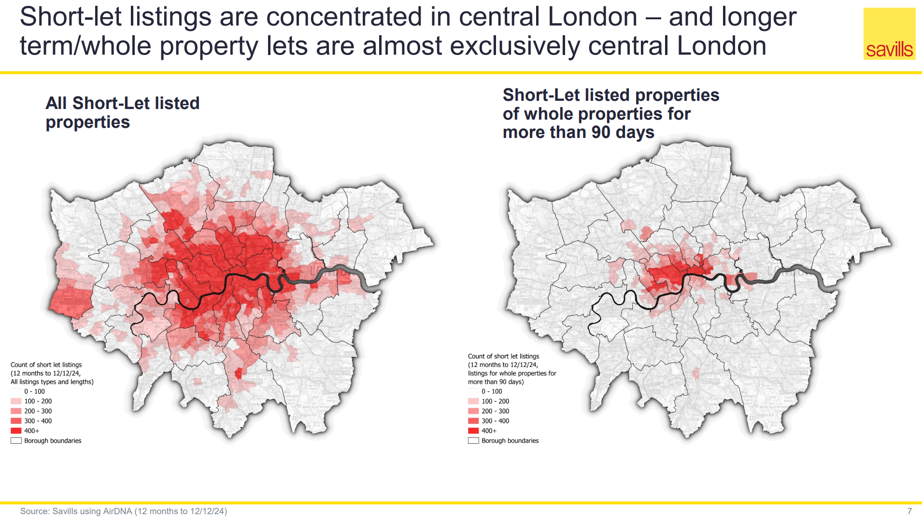
40) Short-let listed whole properties let for more than 90 days in are concentrated in the west of the borough and Canary Wharf

Slide 43
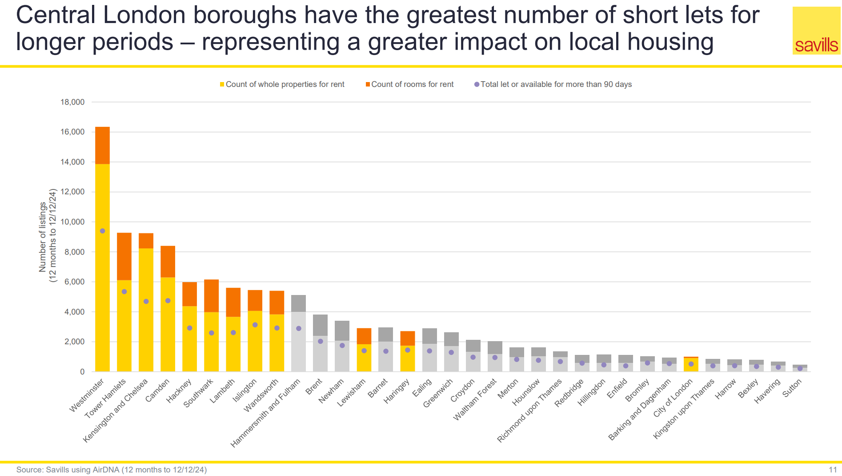
41 It is estimated that over 5k whole properties or rooms were made available for short-term let for more than 90 days in the borough

Slide 44
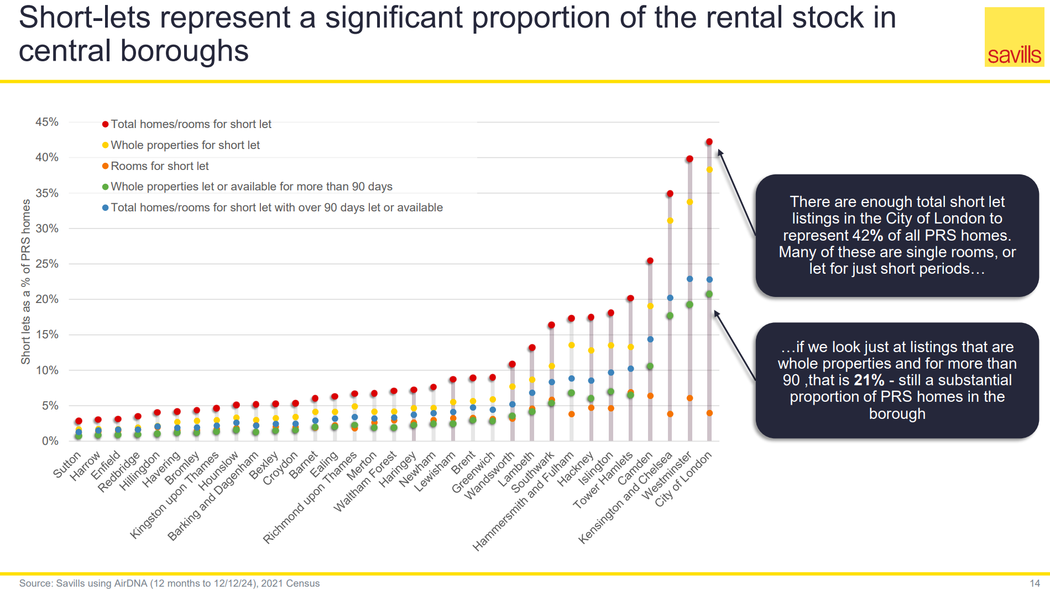
42) Over 5% of all PRS homes in Tower Hamlets fall into the category ‘whole properties let or available for more than 90 days’

Slide 45
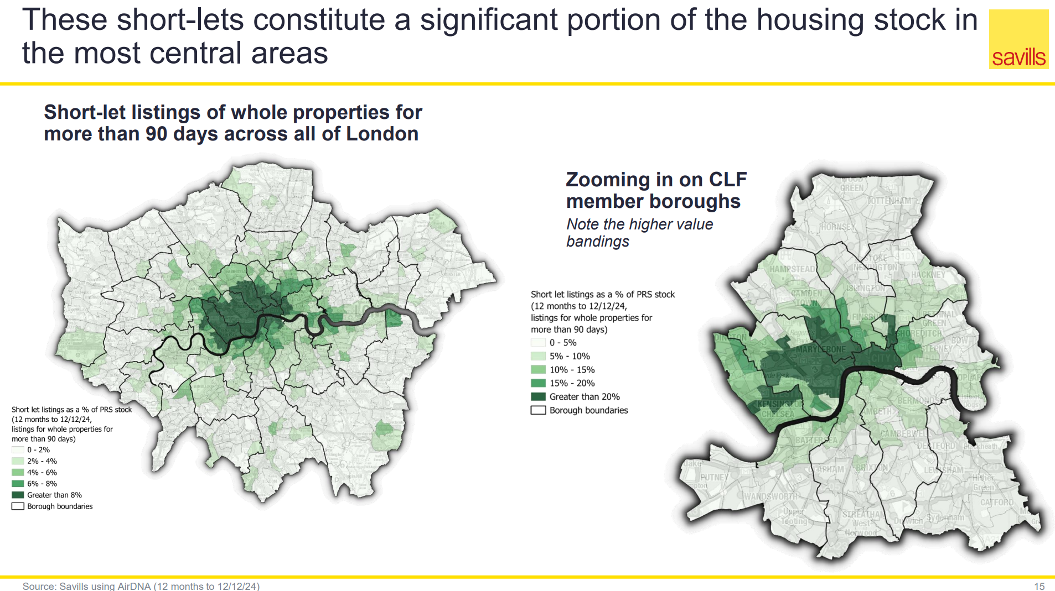
43) More than 10% of PRS stock in the City Fringe area were whole property short-lets for more than 90 days in 2023-24

Slide 46
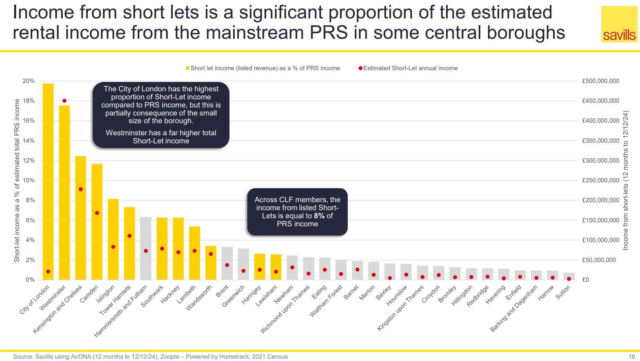
44) In Tower Hamlets, the income from listed short-lets was over 7% of PRS income.

Slide 47
Rough Sleeping and Commissioned Housing

Slide 48
46) Tower Hamlets commissions a Housing First service support for people with long term histories of rough sleeping
18 tenancies with intensive outreach support for people with long term histories of rough sleeping and multiple disadvantages
35-50 bedspaces of temporary accommodation with onsite support for people rough sleeping at Luke House
We are expanding our existing Housing First provision, by bringing on an additional 24 tenancies through another Housing First service due to launch in April this year. By accessing specialist government funding (SHAP) we seek to develop accommodation as identified through ongoing strategic commissioning analyses.
We are utilising short-term accommodation funding pots to meet need. This is split into 50% for women and 50% for those part of the T1000 cohort.
We have approximately 450 hostel bed spaces across 6 projects. Some of these spaces are emergency bed spaces in the hostel sector. They are accessible 24/7 to allow outreach teams that meet criteria can be places here 24/7 6 space.
We are working with the NE London sub-region- to address specific homelessness needs. This includes addressing women’s homelessness, with £200,000 in funding support from MHCLG.
Source :Housing Regulatory Compliance, & Management, Rough Sleeping Service

Slide 49
Rough Sleeping October – December 2024 London Data Store Chain quarterly report

Slide 50
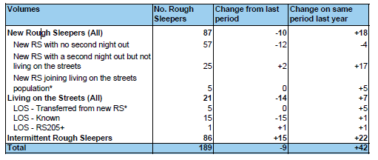
48) Tower Hamlets-People seen rough sleeping in 2024-25 quarter three, by new living on the street ang intermittent

Slide 51
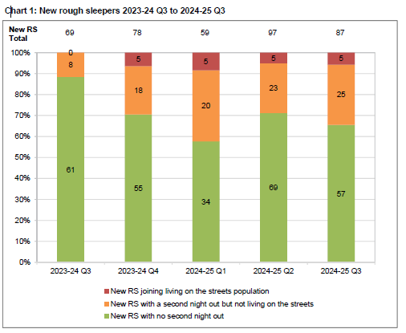
49) Tower Hamlets – achieving 'No second night out'

Slide 52
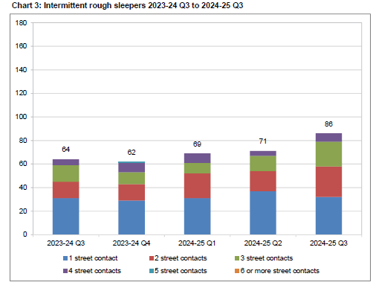
50) Tower Hamlets: Intermittent Rough Sleepers

Slide 53
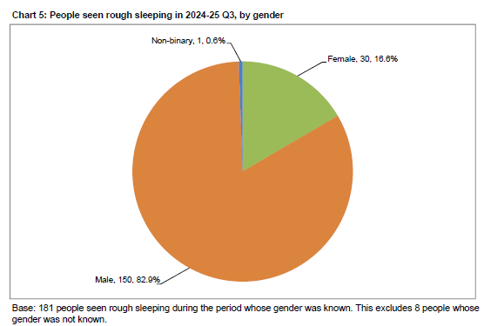
51) Tower Hamlets Rough Sleeper data by Gender (Q3:2024-2025)

Slide 54
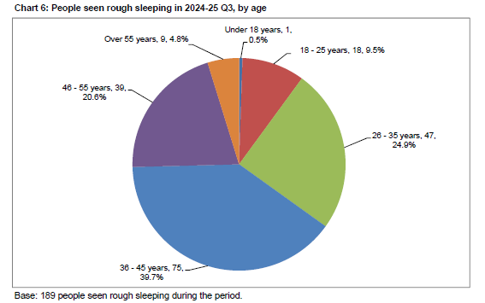
52) Tower Hamlets - Rough Sleeping by age (Q3:2024-2025)

Slide 55
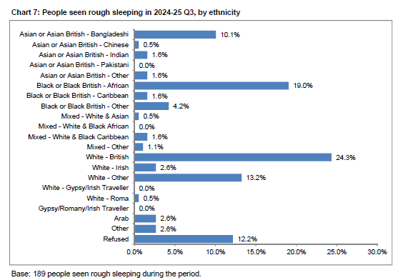
53) Tower Hamlets- Rough Sleeping by Ethnicity (Q3: 2024-2025)

Slide 56
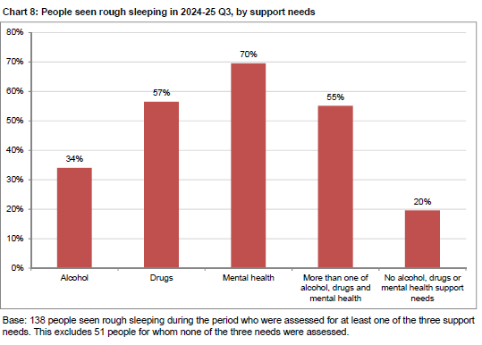
54) Tower Hamlets Rough sleeping by supported need (Q3: 2024-2024)

Slide 57
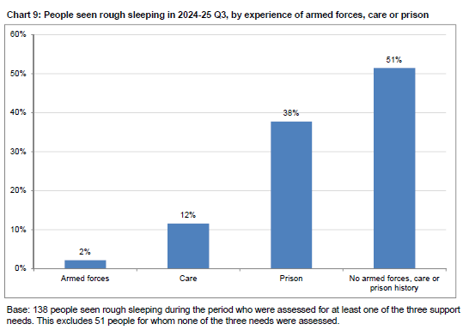
55) Tower Hamlets Rough sleeping – Institutional and armed forces history (Q3 2024/25)

Slide 58
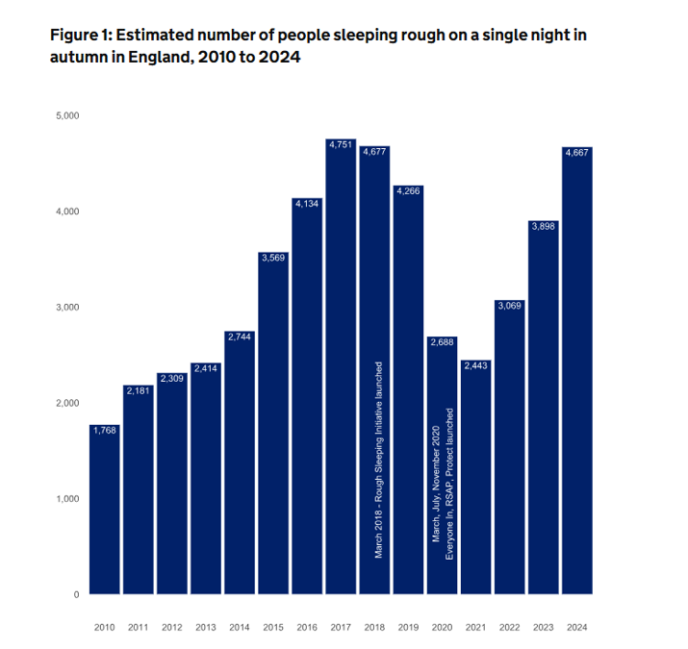
56) There was a 19.74% increase in the number of rough sleepers on a single night between 2023 and 2024

Slide 59
Single Housing Pathway

Slide 60
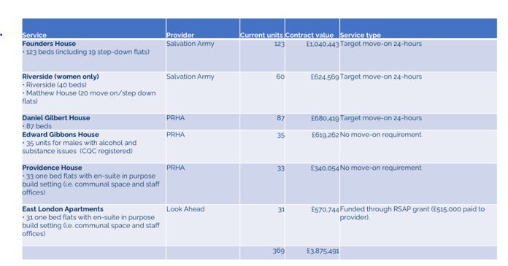
58) Single Housing Pathway (Q4 2024/2025)
Source: Tower Hamlets Integrated Commissioning Service

Slide 61
Building Safety- Compliance

Slide 62
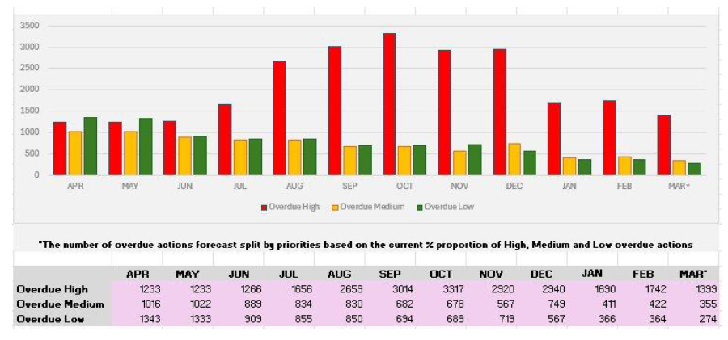
60) The chart shows our forecast overdue remedial actions up to March 2025
Source : Housing Management Compliance Dashboard January 2025

Slide 63
Housing Management Service - Complaints and Performance

Slide 64
62) Corporate Complaints received by Housing and Regeneration Directorate( Q3 Complaints Performance 2024/25)
The repairs service continues to be the primary driver of complaints. Further analysis of the “THH Repairs” Category shows underlying root causes of Roof Leaks, Damp and Mould and Communal Heating Repairs Recent increase in Mears complaints relates to carpentry jobs HSC has seen an increase in complaints in quarter- root causes include call handling, parking and administration process issues Actions to mitigate New Head of Contact Centre joins on 20 February and will be tasked with addressing performance issues across the service The root causes correlate with the findings of our Repairs Improvement Plan and we are addressing this with contractors

Slide 65
63) Housing and Regeneration Directorate Overdue Complaints (Q3 Complaints Performance 2024/25)
During Q3, 92 Stage 1s went overdue and 17 Stage 2s, as at the time of writing there are 0 overdue Stage 2 complaints The highest areas for overdue complaints were our Contractor OCO (Communal Heating) and the Housing Service Centre We have previously stated the actions we are taking to address performance in those areas At the time of writing this report there are 70 overdue Stage 1 complaints, all of which sit in the Repairs area. This has reduced from 112 at the start of February and we have a target to clear the backlog by the end of February and shows that the action plan implemented is working

Slide 66
63) Housing and Regeneration Directorate Ombudsman Cases (Q3 2024/25 Complaints Performance)
Housing Ombudsman Casework update | Open/Closed
Status | Closed | Open | Grand Total
Awaiting Determination |  | 38 | 38
Compliance ongoing | 5 |  | 5
Live Case |  | 2 | 2
Triage and Mediation Team |  | 6 | 6
Grand Total | 5 | 46 | 51
Overall Summary of Cases - Outcomes | Q1 | Q2 | Q3 | Total
Maladministration | 8 | 9 | 5 | 22
Service Failure | 4 | 1 | 1 | 6
Reasonable offer of redress | 3 |  |  | 3
Outside Services Jurisdiction |  | 2 |  | 2
No maladministration |  | 1 |  | 1
Total | 15 | 13 | 6 | 34
Wider Themes Poor Record Keeping Repairs Review has taken into consideration issues raised in process Communal heating contractor reviewing stock to address future issues Improve Resident Communication throughout the process Audits and quality checks implemented by Complaints Manager to performance manage this aspect of the process Inadequate Compensation We are assessing the levels offered in line with Ombudsman remedy guidance We have recently reviewed Compensation Policy
In Q3, we received 6 Determinations: 5 for repairs and 1 for neighbourhoods, all primarily related to responsive repairs and how we handled the decanting process.
There were 5 Maladministration and 1 service failure orders.
The common theme was the handling of leak and window repairs. These complaints were historical, from 2022 to 2023, and did not consider recent changes like awarding redress according to HOS remedy guidance and complaint handling failure. Notably, the Ombudsman has recently requested formal investigations into cases responded to in 2024.

Slide 67
Damp, Mould and Condensation Data

Slide 68
65) Number of Damp, Mould and Condensation orders completed April 2024- March 2025
2023-24 | Apr-24 | May-24 | Jun-24 | Jul-24 | Aug-24 | Sep-24 | Oct-24 | Nov-24 | Dec-24 | Jan-25 | Feb-25 | Mar-25 | YTD
1879 | 217 | 200 | 159 | 173 | 201 | 155 | 193 | 200 | 172 |  |  |  | 1670
 | Q1 |  |  | Q2 |  |  | Q3 |  |  | Q4
 | 576 |  |  | 529 |  |  | 565 |  |  | 0
1670 Damp , Mould and Condensation orders were completed against a total of 1879
Source : Housing and Regeneration- Damp, Mould and Condensation (DMC) dashboard 2024/25

Slide 69
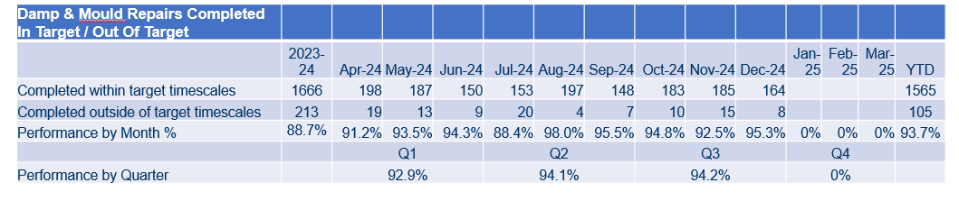
66) Damp and Mould Repairs- 95% of work orders completed in December 2024 within the target timescales
Source : Housing and Regeneration- Damp, Mould and Condensation (DMC) dashboard 2024/25

Slide 70
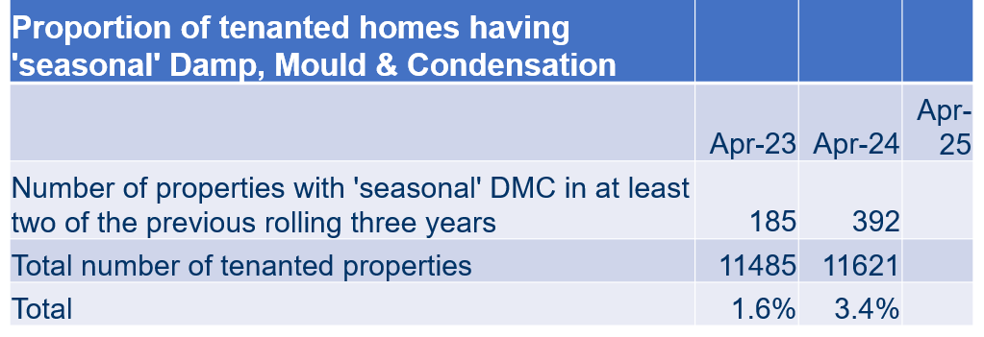
67) The number of reported cases of seasonal DMC has increased
Source : Housing and Regeneration- Damp, Mould and Condensation (DMC) dashboard 2024/25

Slide 71
Private Rented Housing

Slide 72
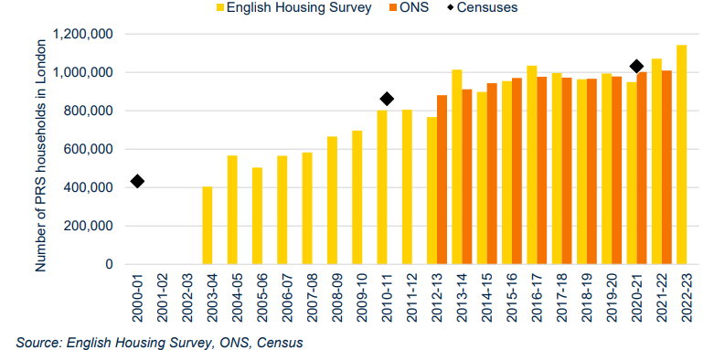
69) The size of the private rental sector in London has rapidly increased
Source :Savills Research Report Private Rented Housing Supply in London (Oct 2024)

Slide 73
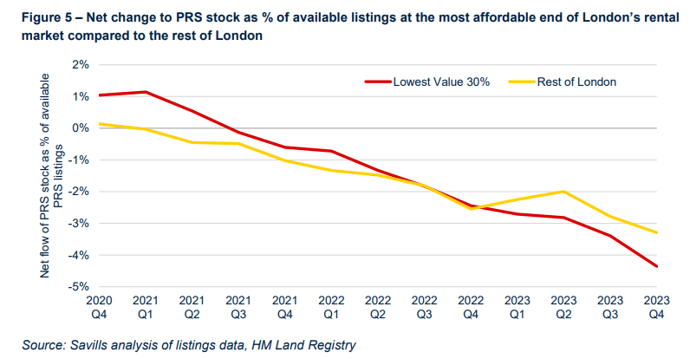
70) In London, properties are leaving the rental market at a faster rate in the lower value locations to rent
Source :Savills Research Report Private Rented Housing Supply in London (Oct 2024)

Slide 74
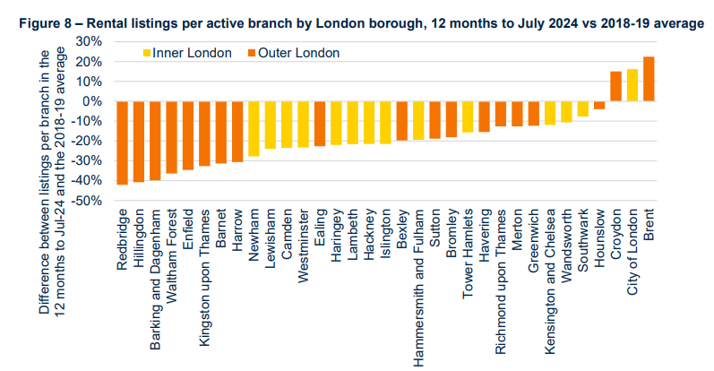
56) Rental listings have declined across both inner and outer London since 2018/19.
Source :Savills Research Report Private Rented Housing Supply in London (Oct 2024)

Slide 75
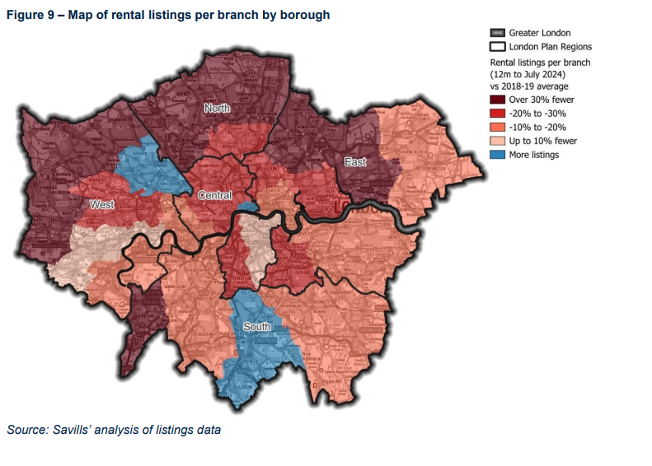
71) Rental listings across inner and outer London
Source :Savills Research Report Private Rented Housing Supply in London (Oct 2024)

Slide 76
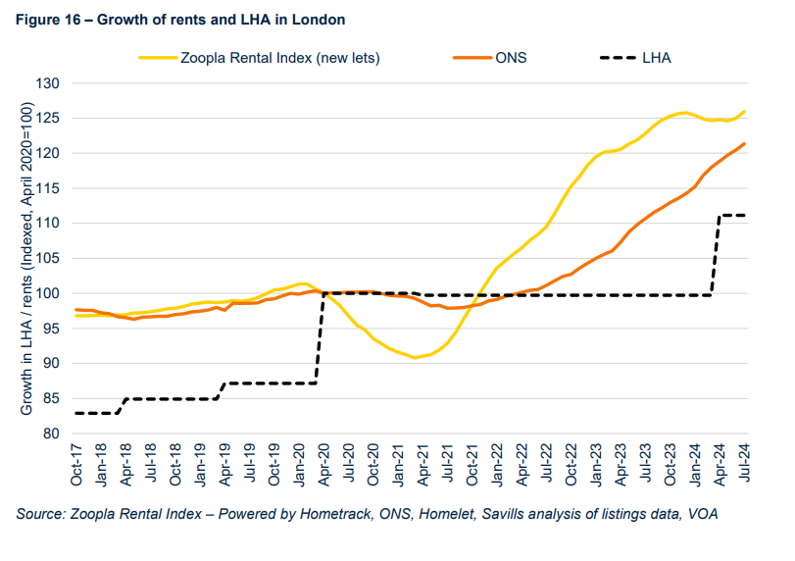
72) The average newly agreed rent had increased by 25% since April 2020, compared to the 11% increase in the average LHA rate.
Source :Savills Research Report Private Rented Housing Supply in London (Oct 2024)

Slide 77
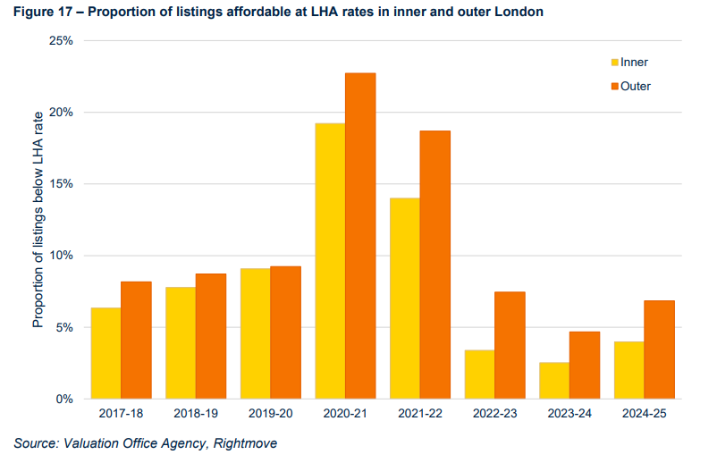
73) LHA now covers 4.0% of listings in Inner London, up from 2.5% in 2022-23, and covers 6.8% of listings in Outer London, up from 4.7%
Source :Savills Research Report Private Rented Housing Supply in London (October 2024)

Slide 78
Tower Hamlets Population Projection GLA city intelligence

Slide 79
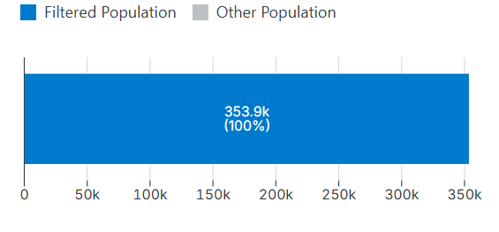
75) The Projected Population for Tower Hamlets - borough total, in 2030 is: 353.9k

Slide 80
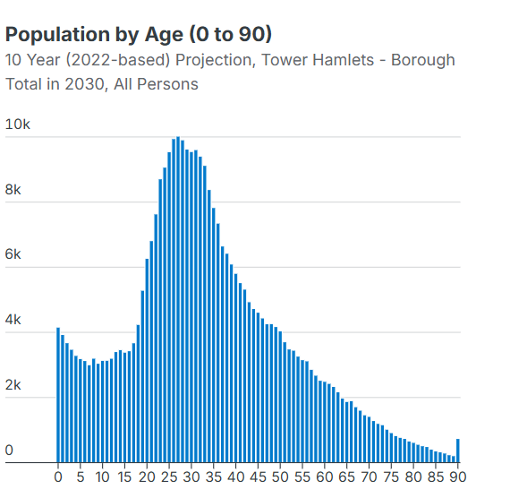
76) Projected growth in Tower Hamlets population by age (2030)

Slide 81
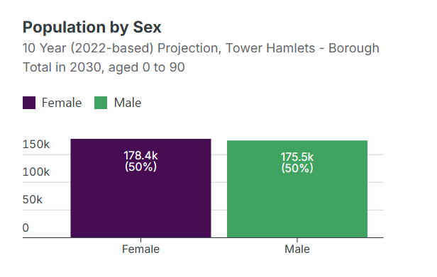
77) Projected growth in Tower Hamlets by sex (2030)

Slide 82
Housing Assets & Investment

Slide 83
79) Key evidence – Housing Assets & Investment
Decent Homes 2024/25 Tracker (data correct as of 1st March 2025)
Current HRA stock: 12,809
Projected number of Non-Decent Homes including TA at 1 April 2025: 2,809 (23.36%)
2024/25 Non-Decent Homes Target
Minimum: 2,773 (24.00%)
Stretch: 2,080 (18.00%)
Live B failures - Elements old and in need of replacing
Flats (not HRB) | No' | %
Internal Only | 789 | 6.56%
External Only | 567 | 4.72%
Internal/External | 157 | 1.31%
Total | 1,513 | 12.58%
Flats (HRB) | No' | %
Internal Only | 61 | 0.51%
External Only | 351 | 2.92%
Internal/External | 15 | 0.12%
Total | 427 | 3.55%
Houses | No' | %
Internal Only | 41 | 0.34%
External Only | 128 | 1.06%
Internal/External | 75 | 0.62%
Total | 244 | 2.03%
HHSRS Category 1 Hazards | No' | %
Total in year | 51 | 0.42%
Closed | 43 | 0.36%
Live cases | 8 | 0.07%

