Slide 1

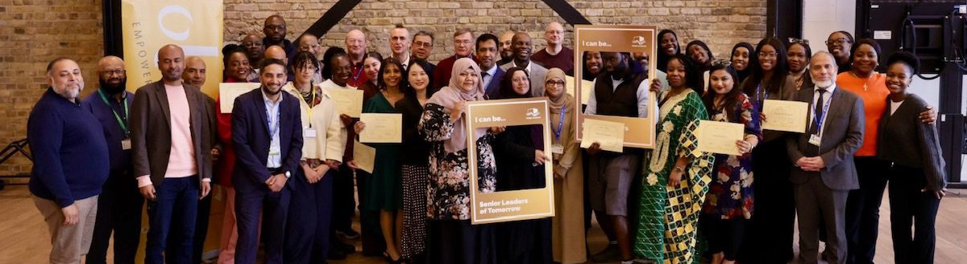

Tower Hamlets Community Leadership Black on Board Programme
Evaluation Report November 2025
Olmec Charity registration number 1100007 | Company registration number 04640278

Slide 2

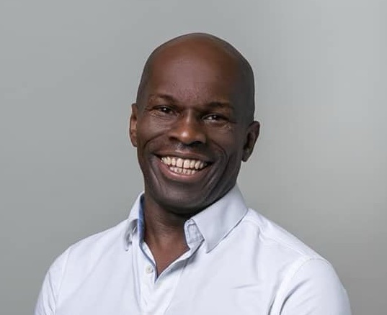
Preface from Olmec’s Chief Executive Officer
2025
Maurice Mcleod
It gives me great pleasure to introduce this report on the first two successful cohorts of our Black on Board programme in Tower Hamlets. At Olmec, we believe that leadership potential exists in every community — what’s often missing are the opportunities, networks, and confidence to step forward. In Tower Hamlets, those opportunities have found fertile ground.
The talent in this borough is exceptional. Across both cohorts, we have seen residents with deep roots in their communities and a powerful drive to make change — from emerging leaders stepping into governance roles to experienced professionals seeking to give back.

Slide 3
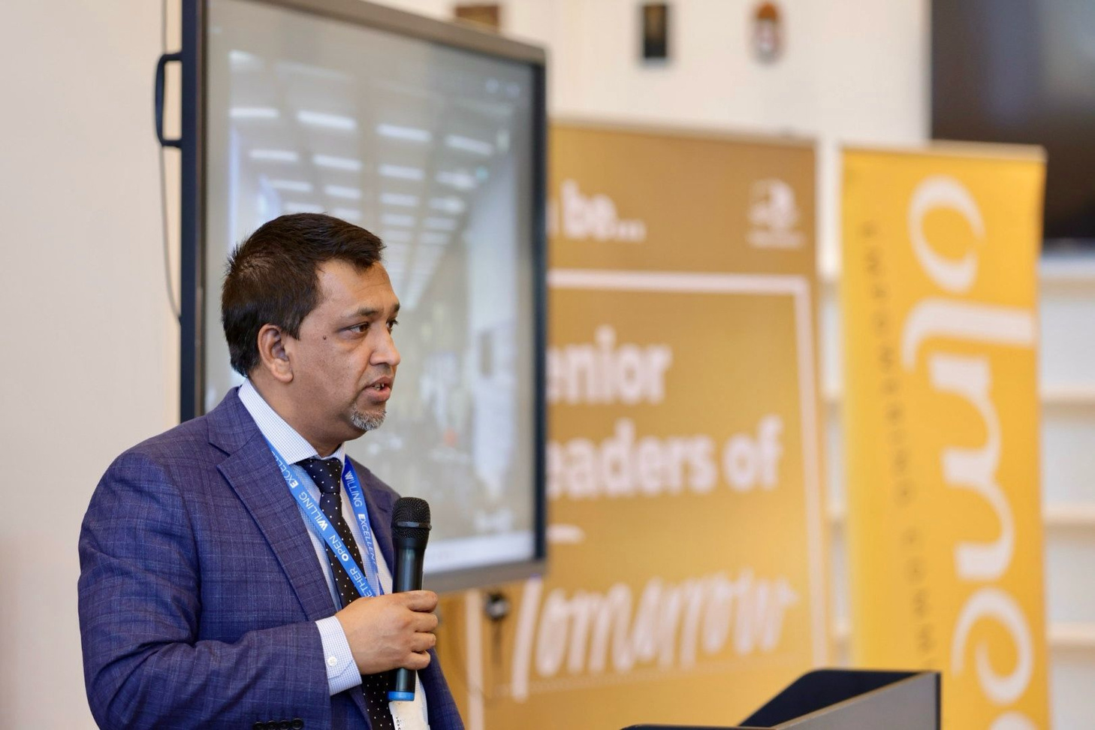
Foreword from Councillor Bodrul Chowdhury Cabinet Member for Equalities and Social Inclusion
2025
Councillor Bodrul Chowdhury
As Cabinet Member for Customer Service, Equality and Social Inclusion, I am pleased to support this community leadership programme and this evaluation report. This initiative reflects our borough’s commitment to equity, empowerment and inclusive growth. The programme had been developed to tackle the race inequality while ensuring that the community had an opportunity to shape the future of this great borough. Reducing racial inequalities, promoting and celebrating diversity at a leadership level across our borough is fundamental to the Council’s strategic commitments.

Slide 4
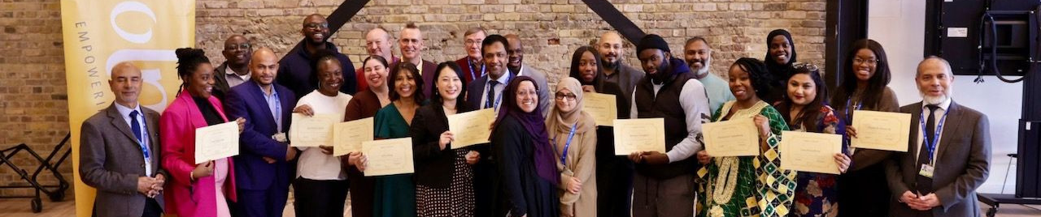
Executive Summary
The Black on Board Community Leadership pilot significantly exceeded expectations. Instead of the target 25 recruits and 16 leadership outcomes, the programme enrolled 38 delegates, with 25 graduates achieving 21 new leadership roles, rising to 42 when including those who joined with existing positions. All reported increased skills and effectiveness. Strong community connections have formed across the three cohorts, and a third cohort is now underway. Key learning includes improving recruitment by expanding eligibility to Tower Hamlets staff, Councillors, and graduates, and better linking the programme with wider council initiatives tackling structural inequalities in leadership.
The Black on Board Community Leadership pilot significantly exceeded expectations. Instead of the target 25 recruits and 16 leadership outcomes, the programme enrolled 38 delegates, with 25 graduates moving into 21 new leadership roles, rising to 42 when including those who joined with existing positions. All reported increased skills and effectiveness. Strong community connections have formed across the three cohorts, and a third cohort is now underway. Key learning includes improving recruitment by expanding eligibility to Tower Hamlets staff, Councillors, and graduates, and better linking the programme with wider council initiatives tackling structural inequalities in leadership.

Slide 5
Executive Summary (cont)
1
42 Community Leadership positions, promotions and jobs
All targets met or exceeded
6
3 Cohorts Recruited featuring 41 delegates
2
36 Community Leadership positions
7
£720,000 Social Return on Investment of £60,000 using the HACT SROI model
3
21 New community leadership positions and jobs or promotions
8
Community cohesion, confidence and new networks reported by 90% of delegates
4
15 New Community Leadership positions
9
Enhanced professional skills reported by 90% of delegates
5
6 New Promotions/Jobs

Slide 6
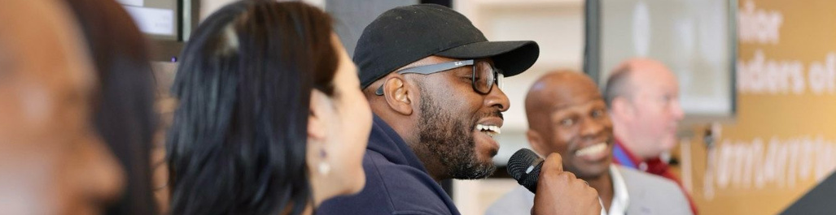
Underrepresentation in Leadership in Tower Hamlets
The Tower Hamlets Black, Asian & Multi Ethnic Inequalities Commission Report highlighted the lack of representation from the Black, Asian and Multi Ethnic people in leadership roles which leads which is critical barrier in accessing services, employment and ensuring services meet the needs of the community. According to the 2021 Census:
⅙
Bangladeshi residents across England and Wales live in Tower Hamlets
6,180
Residents identified as Somali or Somalilander
5%
of residents identified as Black African
The largest number of Italian born residents at
3.4%
Our local Chinese population at
3.3%
is the third highest alongside our Roma population which is the fourth highest
The borough has the highest proportion of Muslim residents in England and Wales, at just under
40%

Slide 7
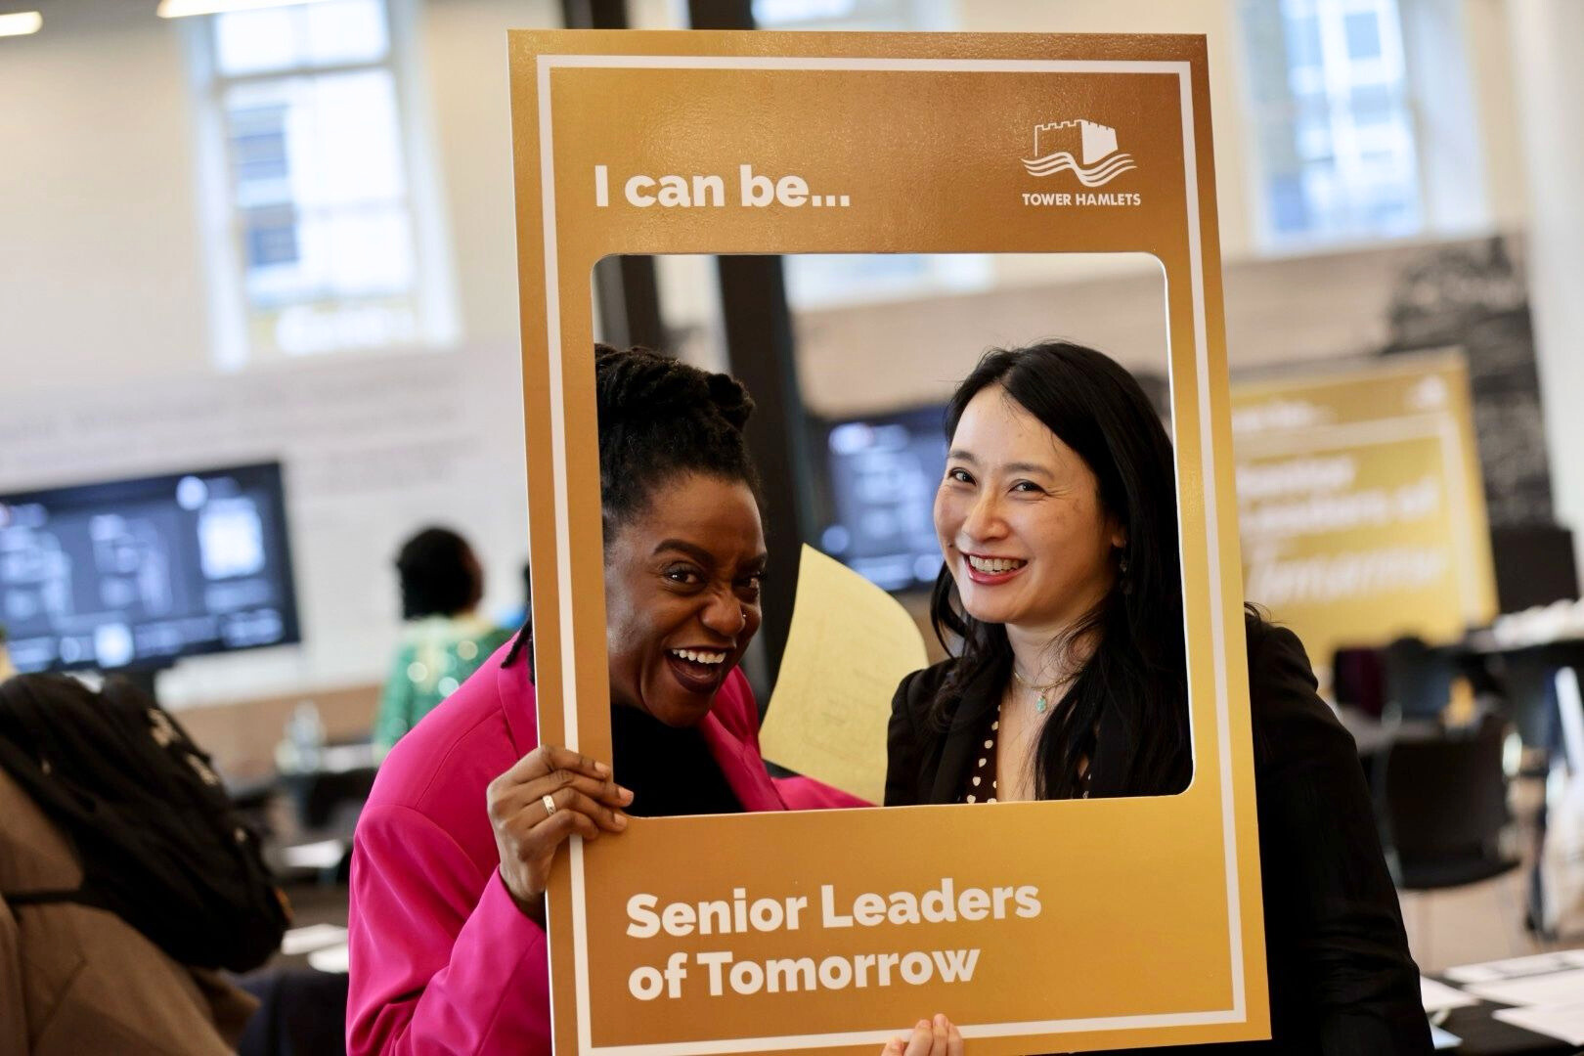
Black on Board
Community Leadership Aims:
Increase the resilience and capabilities of current and potential leaders, supporting them to lead social change efforts at a time of great volatility and uncertainty.
Creation of a talent pipeline of people with diverse backgrounds to move into formal leadership roles in the migration and refugee charitable sector.

Slide 8
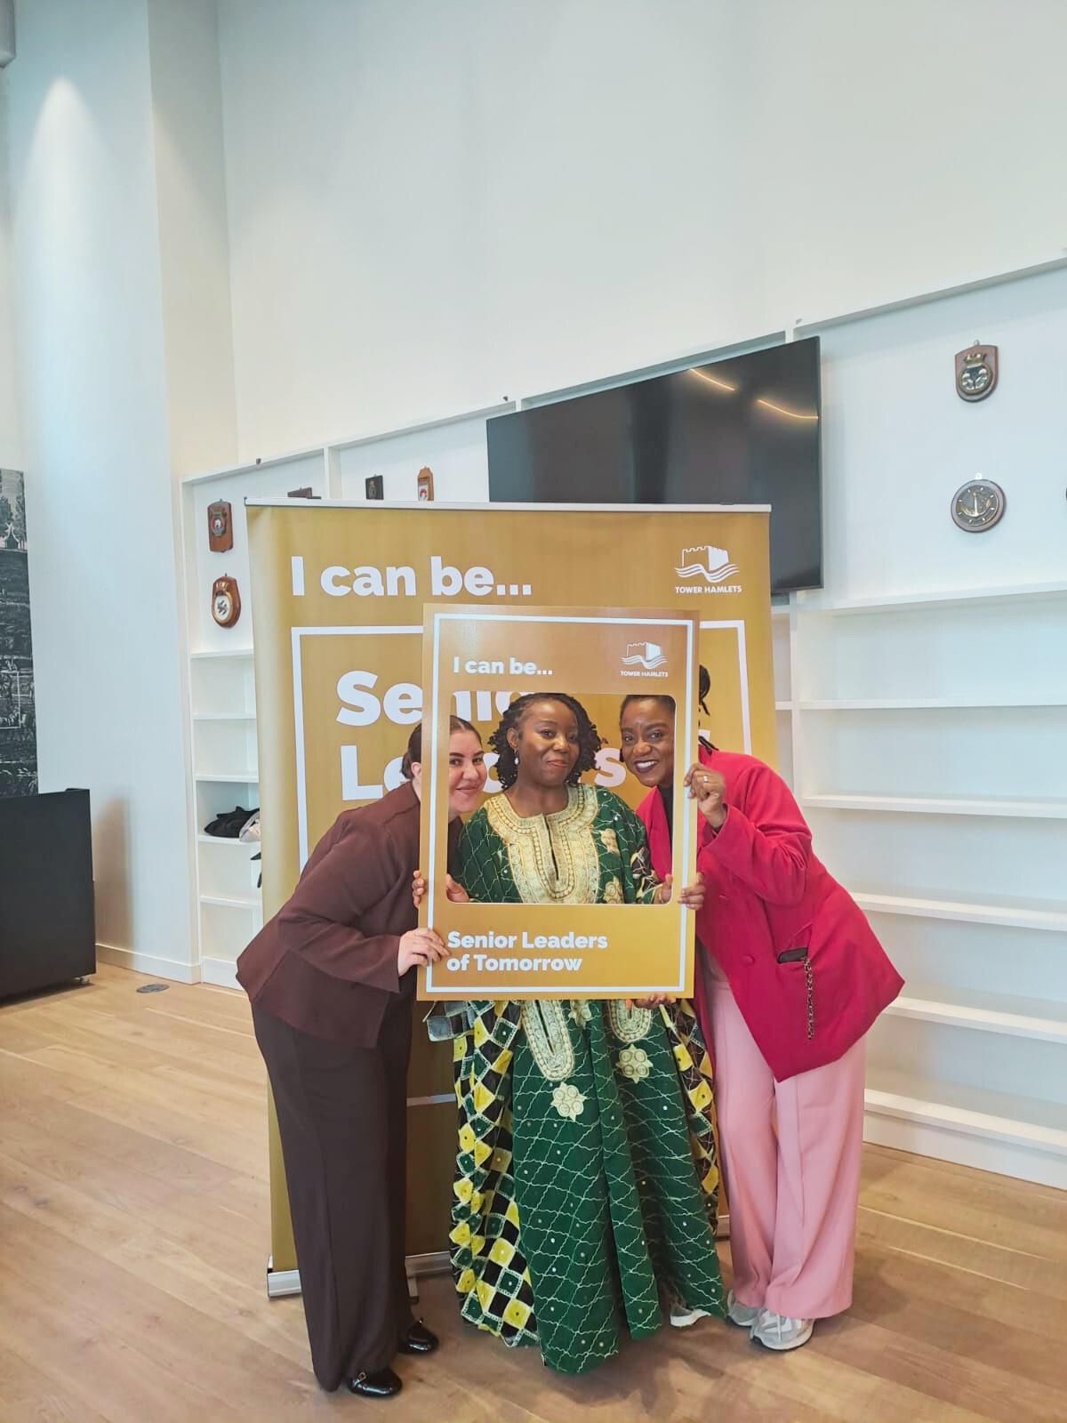
Olmec
Black on Board
Olmec is an award-winning social enterprise established in 2003 to champion race equality through economic and social justice. Olmec’s key programmes support minoritised and racialised communities onto boards, into social business and jobs as well as offering anti-racist training. Olmec’s board all hail from Black, Minoritised and racialised (BMC) Communities
The Black on Board programme was set up to address under-representation at Board level in the social housing sector. Olmec created the programme in response to research carried out by De Montfort University on behalf of Southwark Council. Published in 2001 the report found large disparity at board level in housing associations for Black Asian minortised and racialised people.

Slide 9

Olmec was awarded a tender to pilot its Black on Board Community Leadership Programme in Tower Hamlets across three cohorts
Olmec
Set up in 2003 to address under representation at board level
Since 2018 Olmec has
trained 650 people of colour, 450 people on boards or in community leadership positions
Our Tower Hamlets pilot
had a 73% take up by women across 3 cohorts
Outcomes
100% reported increased learning against every indicator in the programme, 75% of graduates consistently achieve community leadership

Slide 10
Olmec Design and Delivery
Historical and Geographical Contexts
Intersectionality
Unconscious biases
Engagement
Diverse Facilitators
Interactive
Structural Racism
Cultural humility and sensitivity
Empathy Building
Ongoing Learning
Privilege
Safe Space
Allyship
Microaggressions
Legal Frameworks
Accessibility
Follow-up and Resources
Evaluation

Slide 11
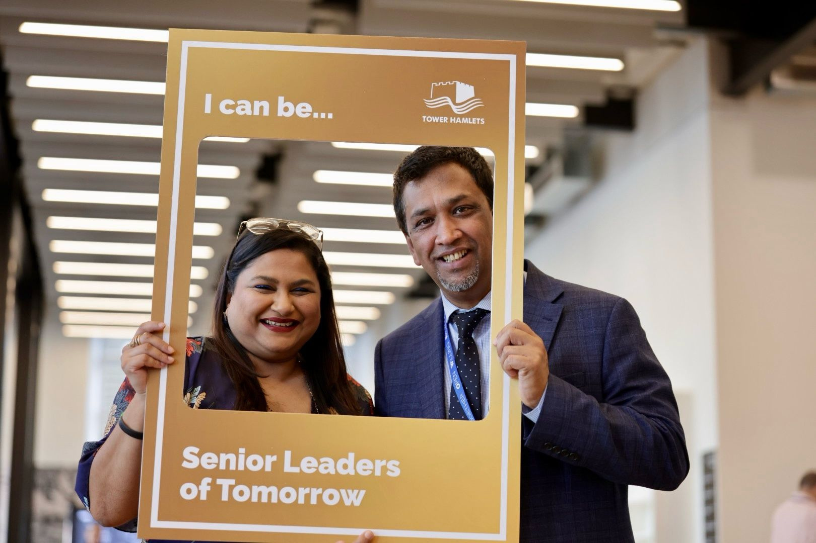
Our Applied Learning Approach
The programme uses applied learning with all subject areas. Collective rule setting, an “each one teach one” approach to peer learning, positive reinforcement and affirmation, acknowledgement of structural racism and associated intersectionality and microaggressions, and cultural models of individual and collective leadership, focus on confidence building and public speaking development define the ethos of the programme

Slide 12
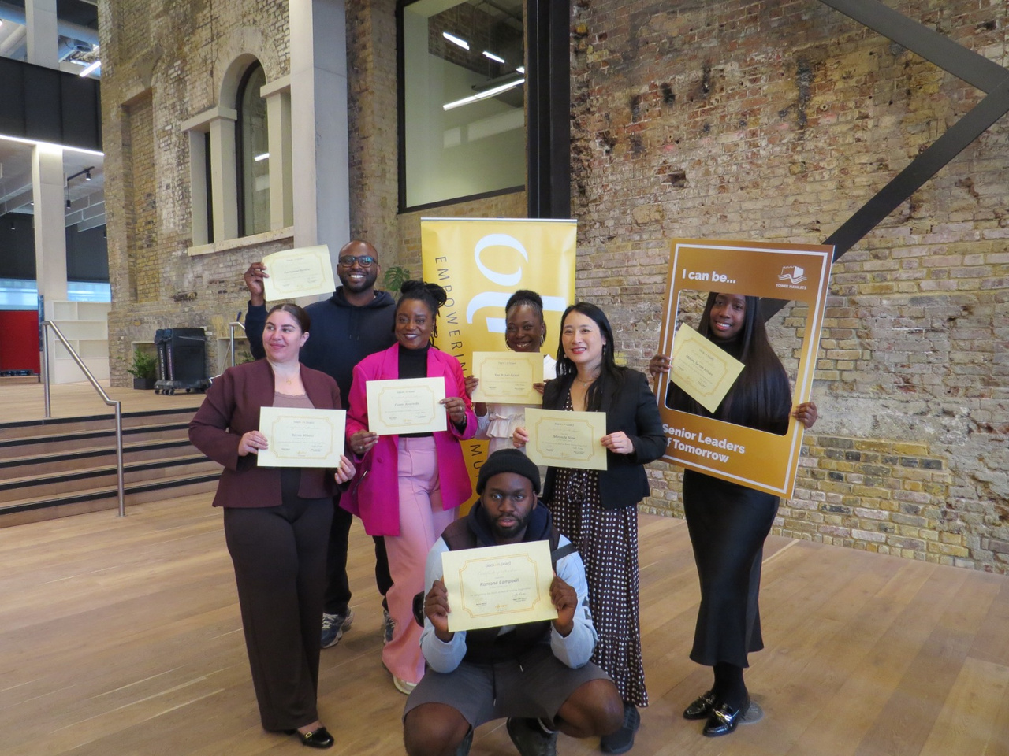
Core Modules
Legal structures, governance and UK sectors
01
Operational and strategic management
02
Business and financial modelling
03
Networking for success
04
Legal Obligations and governance
05
Employing people
06
Managing Risk
07
Managing Finances
08
Leadership
09
Your first board meeting
10
Public Speaking Getting The Message Across
11
Applying for roles and positions
12
Changemaking and influencing
13

Slide 13







Skills & Knowledge Gained
Board Responsibility, Legal duties, Decision Making
Leadership styles, Talent management, Effective recruitment
Governance
Leadership
Building confidence, BoB Community
Risk management, Strategic planning, Operational tools
Networking
Strategic
Using Linkedin, Public speaking
Budgeting, Cash-flow, managed accounts
Personal Branding
Financial

Slide 14
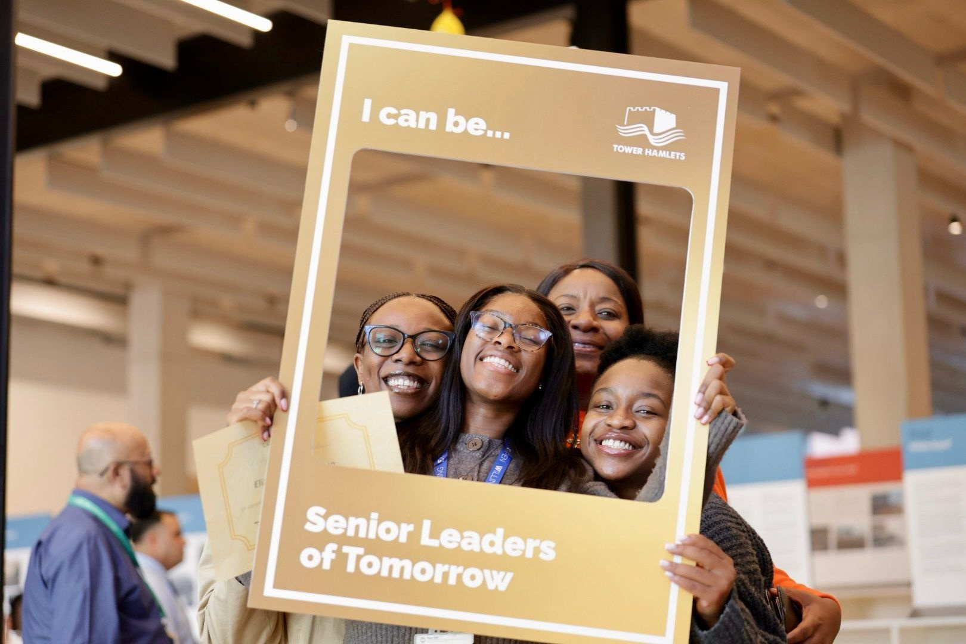
The Power of Community in Black on Board
A key objective of Black on Board is the creation of a safe space where participants feel safe to share and learn in a non-judgmental zone. Participants are encouraged to feel comfortable to share their journeys candidly with their fellow participants providing a support system to fall back on. The focus goes beyond facts and figures to motivating, encouraging, and supporting each participant. The consistent result is the creation of a genuine community as evidenced by the BoB Community and the bonds of each cohort.

Slide 15






Community Engagement
To deliver the Black on Board community leadership programme, Olmec partnered with a range of organisations to promote, support, and enhance its delivery. Relationships Olmec bought into the partnership in our 22nd year of operation including Poplar Harca, Account3, BME London, CORE, G15, Social Enterprise UK and more...
Poplar HARCA
Womens Inclusive Team
Council of Mosques – Tower Hamlets
Ministry of Justice
Account 3
A housing and regeneration organisation in East London; partnered to host several sessions in their venues, with delegates now working for Poplar HARCA, holding board positions, or running community initiatives for the organisation.
(WIT) A Tower Hamlets-based charity supporting Black and ethnic minority communities; partnered to host sessions in their venues, with plans to collaborate on future social justice projects.
A government body overseeing public appointments; partnered through a long-standing relationship, invited to speak at BoB sessions and fairs to promote public appointments to delegates.
A social mobility and employment support organisation; partnered by referring many resident delegates to the BoB programme.
A network of local mosques; partnered by attending Docklands community events to promote the programme and foster ongoing relationships with organisers.

Slide 16
Programme evaluation submitted
Olmec Tender Outputs
Key Performance Indicators
25 people Black, Asian and Multi Ethnic individuals that have enrolled and completed the programme
16 people to overcome barriers to roles
16 people accessing community leadership interventions
16 people tailored support through personal assessments, one on one coaching/mentoring
90 people attending programme launch

Slide 17
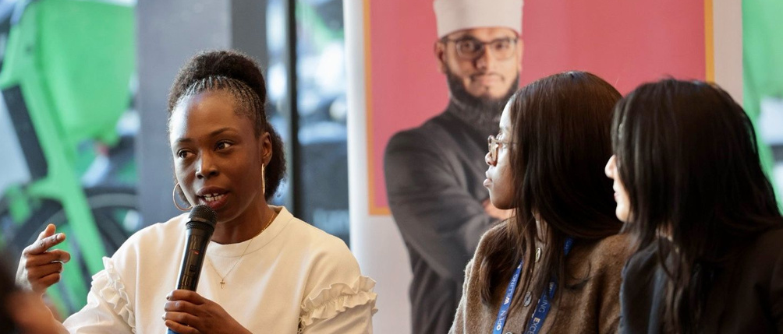
Programme
Outcomes
Achieved
21 Black, Asian and Multi Ethnic people into new Community Leadership positions and jobs
38 people accessing personal assessments, one on one coaching
38 Black, Asian and Multiethnic delegates enrolled
38 people accessing community leadership interventions
90 people attending programme launch

Slide 18
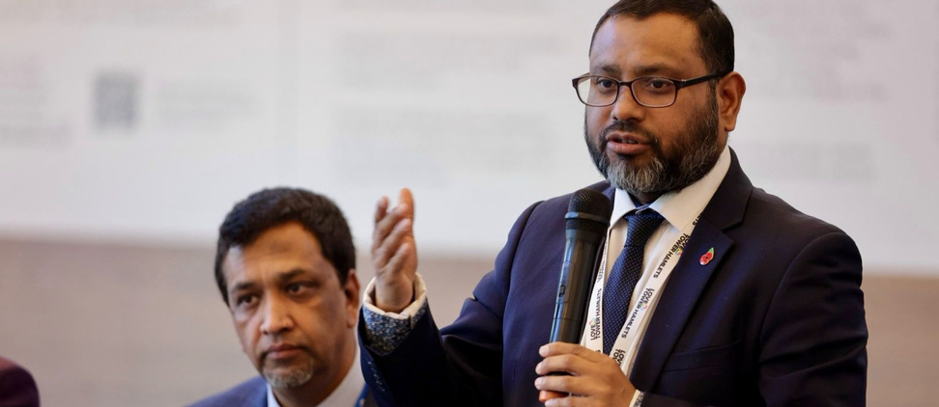
The remit of the Community Leadership Tender was set, following the Tower Hamlets Black, Asian & Multi Ethnic Inequalities Commission Report and the Borough Equality Assessment
Additional Outcomes
90% of participants gained confidence, skills, and resilience through the programme.
25 graduates joining the Black on Board Community
90% reporting Improved understanding of leadership development and approaches
20 graduates actively promoting Olmec and Black on Board
90% approval rating of the launch and graduation ceremony
90% reporting increased networks

Slide 19
New Jobs
New Community Leadership Positions
University Tutor
New Adventures Club
Oar and explore
novi Futures CIC
Space Studios
Youth Justice Panel Member
Collaboration Circle
Olmec Associate
Corporate Social Impact Lead
Tutor Tower Hamlets Recovery College
University research advisor
Financial Literacy in Tower Hamlets
Discover Children’s Centre
Local Government Association
Deputy People Operations Manager
Poplar Harca Housing Estate Board
Lift Off Global Network
Queen Mary University London
Assistant Director
100 Great Black Women Speak
School Governor

Slide 20




Graduate 5
Director of the Collaboration Circle, a grant-making body and subsidiary of London Funders
Graduate 1
Founder of a social enterprise advancing youth social mobility, non-executive advisor and Trustee, school governor, youth justice panel member, and applying for public appointments.
Case Studies
Graduates 2 and 3
Two delegates have established a Community Interest Company supporting Womens Financial Literacy
From Local Leadership to National Influence
Our Graduates are shaping communities, health systems and social enterprises
Graduate 4
Trustee of an East London arts charity, founder of a social media consultancy, promoted to a workshop facilitator, and writer partnering with Olmec associates

Slide 21
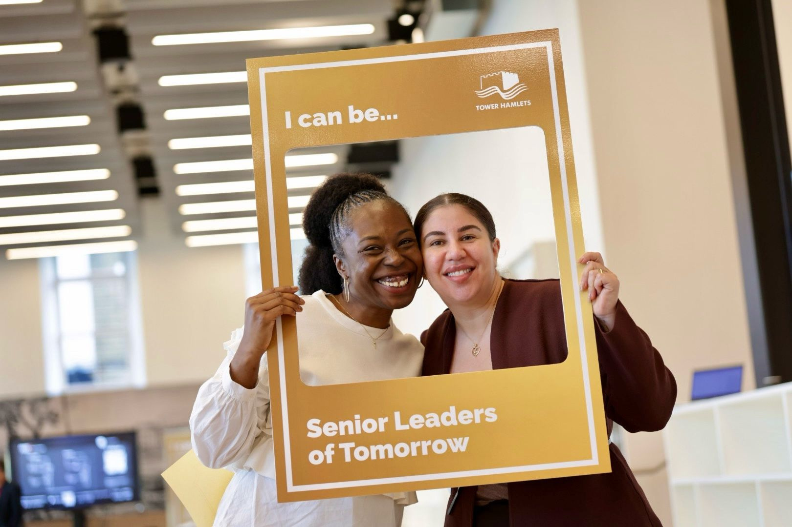

Community Leadership positions, promotions and jobs
Tower Hamlets Black on Board Community Leadership Delegate Outputs
Cohorts 1 and 2
25
Graduates
15
New Community Leadership positions
42
6
New jobs or promotions

Slide 22






Programme Journey Map
1
Recruitment
2
Application
3
Deadline
4
Interviews
Recruitment for Cohorts 1,2, and 3 began July 2024 - coinciding with “I Can Be” TH event
Applications open for individuals August 2024
Deadline for applications to Cohorts 1 and 2 October 2024
Rolling interviews from September - November 2024
5
Cohorts 1 and 2 Launch
6
Deadline 2
7
Cohort 3 Launch
Cohort 1 commenced in November 2024, and Cohort 2 commenced in January 2025
Cohort 3 application deadline September 2025. Rolling interviews
Cohort 3 commenced in October 2025

Slide 23
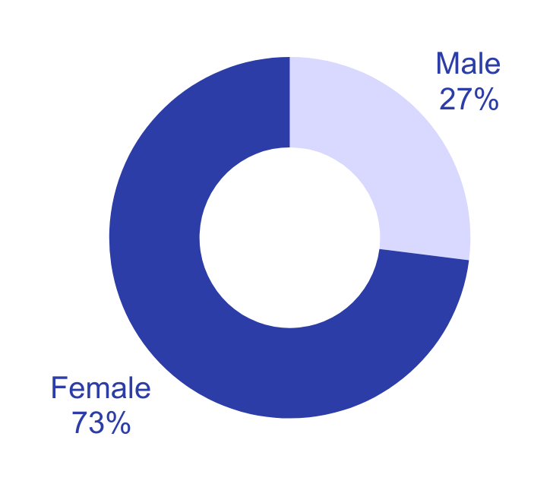
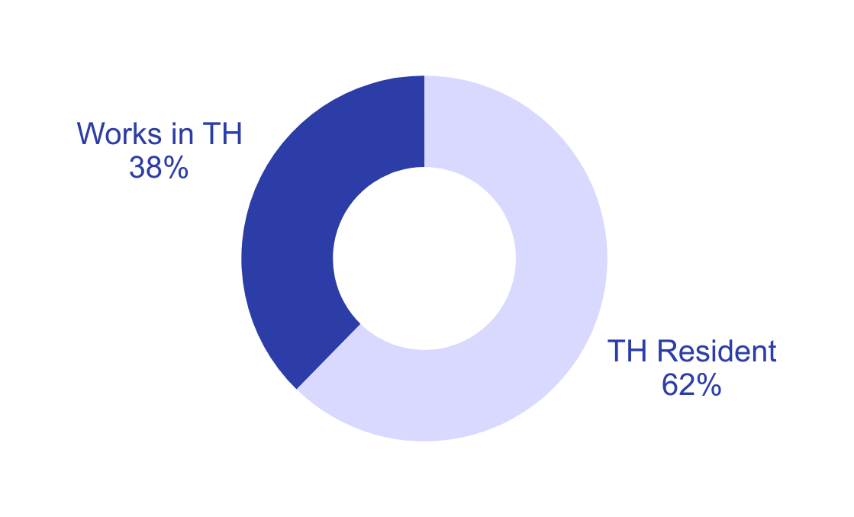
Delegate Demographics: Gender and Local Presence
Gender Breakdown across Cohort 1-3 attendees
Tower Hamlets Residents and Workers across Cohort 1-3 attendees

Slide 24
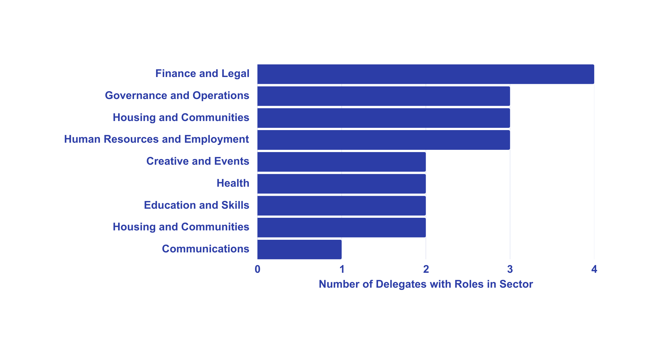
Employment Sector Distribution across Cohort 1-2 attendees

Slide 25
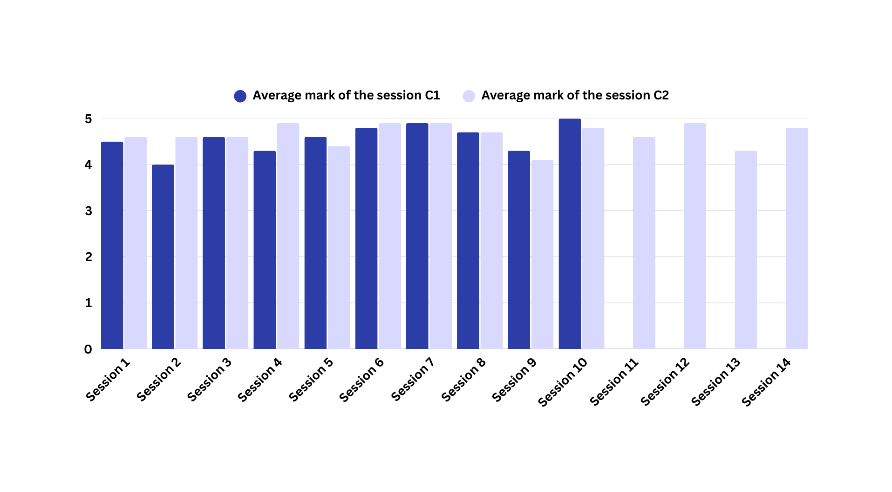
Total Average Mark of The Session*
*The data for Cohort 1 ends at Session 10, as they opted for the 10-session Black on Board Masterclass. Cohort 2 completed the full 14-session Black on Board Programme, so their data continues through to Session 14.

Slide 26


Delegate Testimonials
“The BOB programme is probably single handedly the most impactful professional but also personal training programme I have been on. Not only has it provided me with the tools to access the next level of my career and opportunity to affect real change, its restored confidence in myself personally and professionally. I will be forever changed by the programme.”
Lerato Marema, Black on Board Graduate
As a Bangladeshi Muslim woman from Tower Hamlets, it often feels like our wings are clipped to a certain agree, and we must work harder than others to make similar progress, both in our career and also in our personal lives. I would never have dreamed that I would ever be in a position where my lived experience, ideas and suggestions are not only heard but acted upon. Black on Board made that possible.” Liza Chowdury, Black on Board Graduate
We shared stories, lifted each other up, and continue to collaborate. These connections are rooted in shared purpose and lived experience. Black on Board opens doors, reminds us we belong in the room, and that we can be change makers.” Miranda Siow Black on Board Graduate

Slide 27
Delegate Testimonials (cont)
“The epitome of what inclusion, equity and diversity really looks like at play- I had that in one room, was so encouraging! If you want to have collective impact, through your individual story at any stage of your life or career, this is the first step!”
Christianah Agbabiaka, Black on Board Graduate.
“Since graduating, I secured a trustee role on the Estate board of Poplar HARCA. I have also elevated how I facilitate cross‑functional learning, using board‑style thinking – clarity of purpose, data‑informed decisions and measurable outcomes/impact. Black on has Board turned my commitment to community into board‑level confidence. It doesn’t just open doors, it prepares you to walk through them and lead.” Yaa Antwi-Nsiah, Black on Board Graduate
“Black on Board helps you realise that leadership is not about where you come from, but what you stand for. It gives you the confidence to use your voice, not just to take a seat at the table, but to help shape the future of it.”
Abu Chowdhury, Black on Board Graduate

Slide 28
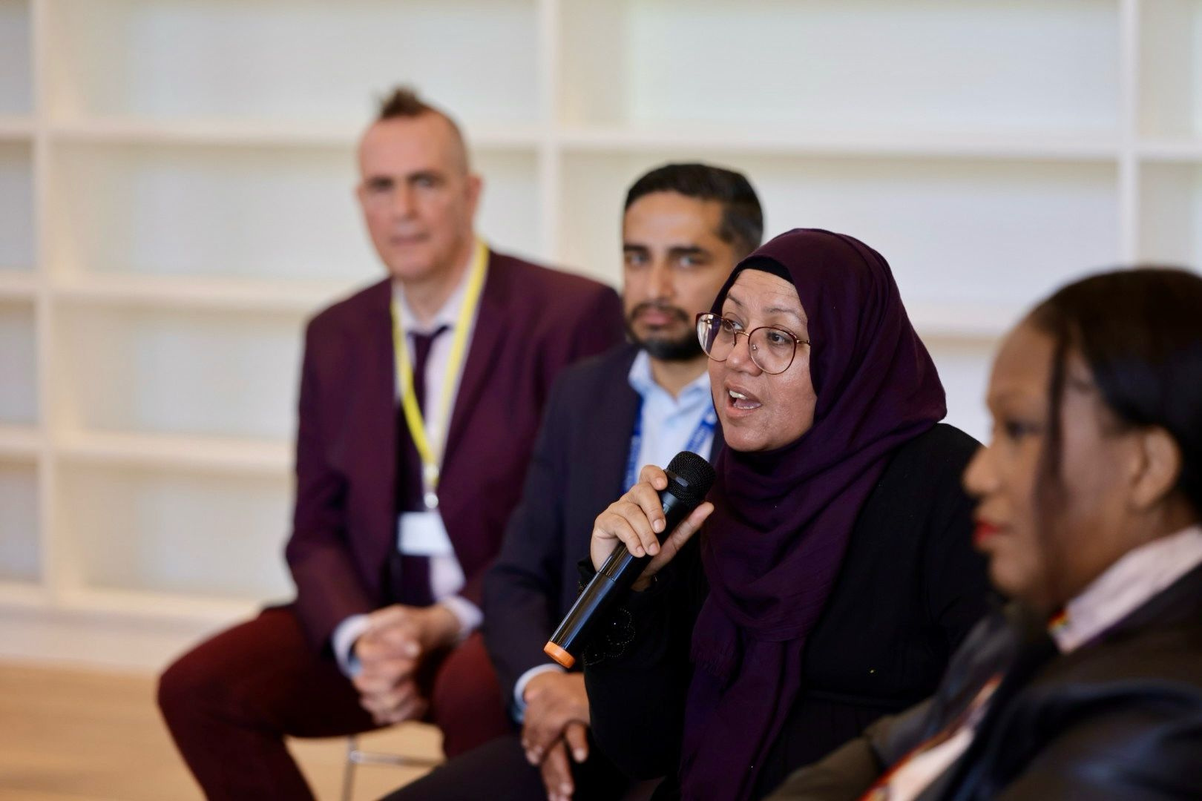
Wider Collaboration
Develop the connection with Tower Hamlets criminal justice, health and education initiatives
More guest speakers with board vacancies invited to sessions
Successes,
Challenges and Learning Opportunities
Steering Group and qualitative evaluation reflections
Improved recruitment
Recruitment for future cohorts can be improved by:
Expanding eligibility to include Tower Hamlets staff and Councillors.
Leveraging graduate referrals to boost future recruitment.
Increased Masterclass sessions
More in person session for the masterclass 10 session version
Graduate community
Tower Hamlets Council provides space for BoB Graduates to meet following their graduation
Supplementary Finance Training
3 delegates struggled with the finance session – this is a low percentage which has been noted with offer to repeat training on cohort 3 and future supplementary training

Slide 29
Recommendations - Part 1
Long-Term Roll-Out: Tower Hamlets Council should consider adopting the programme for 3–5 years to secure cost savings and build on strong cross-sector partnerships.
Strategic Alignment: The programme should be clearly aligned with key Council frameworks such as the Corporate Equalities Plan, Women’s Commission, and BAME Inequalities Commission.
Planned Integration with Governance Needs: Longer-term recruitment would allow Black on Board to meet governance needs across the community and voluntary sector, public appointments, social enterprises, and the Council.
Leveraging Social Capital: The Council and Olmec can utilise the social capital created through the pilot’s 41 delegates and 25 graduates who hold 36 leadership roles.
Long-Term
Roll-Out
Strategic Alignment
Planned Integration
Leveraging Social Capital

Slide 30
Recommendations - Part 2
5. Graduate Buddying System: Graduates from Cohorts 1 and 2 could buddy future cohorts to strengthen peer support and continuity.
6. Leadership Development Integration: Black on Board could be embedded within the Council’s leadership development framework to support succession planning and reflective practice.
7. Partnerships and Scaling: Olmec and the Council should explore partnerships with other London authorities and housing providers to scale the programme and share learning.
8. Targeted Recruitment: Recruitment should explicitly target Tower Hamlets staff and Councillors to build on the pilot’s focus on local residents and workers.
Graduate Buddying
Leadership Integration
Partnership Opportunities
Targeted Recruitment

Slide 31
Appendices and References
Tower Hamlets Corporate Equalities Plan 2024-26
The Tackling Race Inequality Action Plan
Tower Hamlets Black Asian and Multi Ethnic Inequality Commission report
Borough Equality Assessment
Tower Hamlets Women’s Commission
Race Disparity Audit
McGregor-Smith Review
Parker Review

