Slide 1
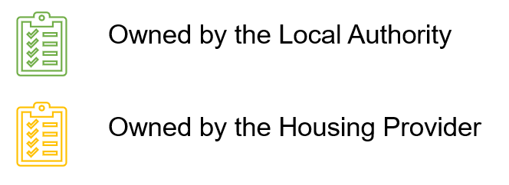
Stage 1: Pre-launch
Distributed to remind residents of the upcoming FRP service and what to expect. It will follow any guidance on the communications and use images over wording to depict what can and cannot go in the bin store recycling bins. The leaflet will also include details on where they can go for further help or information.
Communications materials are produced to share with landlords and managing agents. This will include posters to be put up in communal areas at estates informing of the upcoming changes. Further materials provided will include template emails and letters that can be sent out to residents by landlords providing further information.
Key:
Informs residents of the upcoming FRP, when to expect the service to start and how to use the upgraded bin stores. The press release will also link to the council channels where residents can find more information.
To ensure householders understand t#he planned changes to the existing residual service
Social Media Campaign
(external)
FAQs Developed
(external)
-1
(internal & external)
-3
-1
Launch
By month number
-4
-4
-3
Teaser Leaflet
(external)
Press Release 1
(external)
0
…to increase knowledge that the new service is coming and to engage residents. Residents who engage with the Council’s social media channels will be signposted to the Council’s waste and recycling pages to minimise calls to the contact centre. Both organic and paid for social media options should be considered to target information and messages about the service change. Engaging content is critical, the use of images, videos and quizzes can help make information sharing easy and fun. It can also encourage residents to actively engage in recycling.
Attendance by LBTH officers at resident meetings in estates with particularly poor recycling performance to inform them directly of the changes and encourage the proper use of the recycling and residual waste facilities.
…on areas such as how the collection service will work, the different bins and what can or cannot go in the recycling. This will also allow any queries from the social media campaign to be answered by the social media team.

Slide 2
Stage 2: Launch
Further attendance by LBTH officers at resident meetings for estates which are still showing poor recycling performance to resolve any queries.
Should food waste recycling be introduced, this would be communicated and “No Food Waste” stickers would be made to stick onto residents refuse bins to inform residents they should now be using the separate food waste collection service to dispose of their food waste.
…to inform residents on how to use the service and any benefits the service brings. Engaging content will be used and will include social norming messaging such as “Recycle here” and slogans such as “Protect your family’s future. Next Time Recycle”.
To ensure householders understand how to participate with the new service
Social Media Campaign
(external)
FRP Is In Place and New Bins Are Operational
1(external)
By month number
1
2
2
3
4
Key:
Review opportunities for further promotion e.g. council publications, information in public buildings and community areas (subject to budget).
Residents will receive an instructional leaflet explaining how and when to present them for collection and reinforcing what can be recycled. It will also state the benefits of sorting recycling such as the increase in capacity of their residual bins. This will help residents manage their waste effectively. Residents can start to use the bins immediately.
Press Release 2
(external)
Further Promotion (external)
The second press release will act as a reminder of the new services and what can and cannot go in the bins, as well as the success of the service and answering any questions that have come through social or council channels.

Slide 3
Stage 3: Post-launch
Key:
Waste and recycling web pages are a key means for householders to find information about their services. LBTH communications team will liaise with the web team over scheduling updates and amends to support introduction, implementation and post launch activities. We want to minimise calls to the call centre so will signpost residents to the website where possible. However, residents will be able to call the contact centre if they have queries or issues about the new service. Social media analytics will be reviewed and are essential to determine how well people respond to social media content. This information should then be used to develop future content.
To share successes with residents and thank them for their support
Social Media Campaign
(external)
End
By month number
4
4
Business as Usual Communications
(internal & external)
…this will include nudge communications and motivational messaging to further the uptake of the service and reminders on how to use it.
Regular leafleting yearly to ensure any new residents are informed of the services.

