Slide 1
Learning Disabilities Needs Assessment 2024

Slide 2
Contents
Background
Summary of Key Findings
Population of adults with a learning disability
Scope of Needs Assessment
Professionals’ skills and knowledge
Specialist Services​
Transition to adult services
Health and wellbeing and Adult Social Care
Mental Health and Wellbeing
Health Protection
Vaccinations
Employment and Volunteering
Social Inclusion and Community Safety​
Financial security
Housing

Slide 3
Background

Slide 4
Aim for this needs assessment of adults with a learning disability
The needs assessment in Tower Hamlets for adults with learning disabilities aims to inform decision-making and action planning to improve their well-being and inclusion by addressing identified challenges and fostering a more supportive environment.
The focus on Learning disabilities and autism in Tower Hamlets is to gain a further understanding of the challenges faced by adults with learning disabilities and autism locally. This needs assessment seeks to fill information gaps where possible (building on from the recently completed health needs assessment about adults with learning disabilities in Tower Hamlets, Newham and Hackney in 2023 by East London NHS Foundation Trust).
This needs assessment builds on existing knowledge from one previously conducted in 2016, the previous Learning Disabilities Strategy for Tower Hamlets (2017-2020) as well as a health needs assessment of Tower Hamlets, City & Hackney and Newham conducted in 2023.
To understand further data and information needs about the experiences of adults with Learning Disabilities & Autism in Tower Hamlets and establish the scope of a needs assessment.
Notes:
To summarise current needs that adults with learning disabilities have in Tower Hamlets
This slide pack includes existing service data and documents
Topics include population statistics, specialist services, social care, health, housing, employment, safety, and social inclusion.
To identify data and information gaps for further investigation to be included in the final document
To inform strategic planning re: addressing needs of adults with learning disabilities in Tower Hamlets from 2024

Slide 5
What we mean by adults with a learning disability
A significantly reduced ability to understand new or complex information, to learn new skills (impaired intelligence), with a reduced ability to cope independently (impaired every day functioning e.g. with managing tasks, money, or socialising), which started before adulthood.
Learning disabilities can have different causes, some which are not fully understood. However, the causes always affect brain development before/during birth or in childhood e.g.:
  Fragile X syndrome;
  Down’s syndrome,
  Turner syndrome,
  Exposure to environmental toxins or infections during pregnancy, complications during birth,
  Very premature birth,
  Injury or illness in early childhood such as meningitis or measles
For the purpose of this needs assessment, we have looked at local needs among adults aged 18 or older. There is a separate needs assessment focused on children with special education needs (SEND), although this document references information about transitioning from children’s services and looking at numbers of young people with a learning disability.
This needs assessment focuses on adults with at least one learning disability, including people who have both a learning disability and another diagnosis like autism. A learning disability is different from a learning difficulty (like dyslexia or ADHD, dyspraxia) as a learning difficulty does not affect general intellect.

Slide 6
Key definitions and terms from All Our Health (2023)
DHSC Definition
A learning disability is “a significantly reduced ability to understand new or complex information, to learn new skills (impaired intelligence), with a reduced ability to cope independently (impaired social functioning), which started before adulthood.”
Vs learning difficulty
A learning disability is different to a learning difficulty, which is a reduced intellectual ability for a specific form of learning
Learning difficulties include conditions such as dyslexia (reading), dyspraxia (affecting physical co-ordination) and attention deficit hyperactivity disorder (ADHD).
A person with a learning disability may also have one or more learning difficulties.
Overlapping conditions and disorders
Some conditions or disorders might involve LD or cause LD
Examples: Down’s syndrome, autism, meningitis, epilepsy or cerebral palsy
Causes
LD are caused by something which affects the brain before birth, during birth or early childhood – the cause is not always known
Examples can include inherited conditions, abnormal chromosomes, exposure to toxins/infections/illnesses during pregnancy; very premature birth or complications during birth; illness or injury in early childhood

Slide 7
Methodology and Approach
Investigated current strategies and policies in the UK and Tower Hamlets to identify gaps by reviewing government reports, analysing policy documents, and consulting with experts in the field
Professionals engagement
Resident engagement
Engaged with adults with learning disabilities to understand their needs and perspectives
Visited Create (CLDS) and a Learning Disability care centre (Antil Road) to discuss the area with adults with LD
Distributed a survey to professionals working with adults with learning disabilities to gather insights
The Survey was emailed to professionals working with adults with LD, the survey consisted of both qualitative and quantitative data
Visited the carers centre to talk to carers and find out their views
The questionnaires were adjusted to the audience communication needs (Please see Next slide)
Services data and information
Gathered routine data and information from various services across Tower Hamlets as well as utilising the recently conducted Health Needs Assessment by ELFT / PHAST in 2023 examining need in Tower Hamlets, City & Hackney and Newham
Inputs from service managers
Policy and evidence review

Slide 8
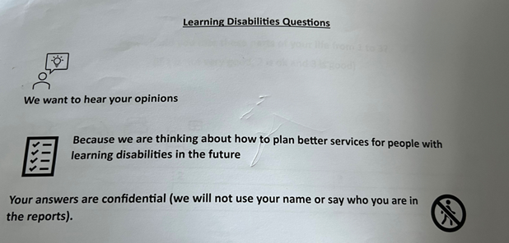
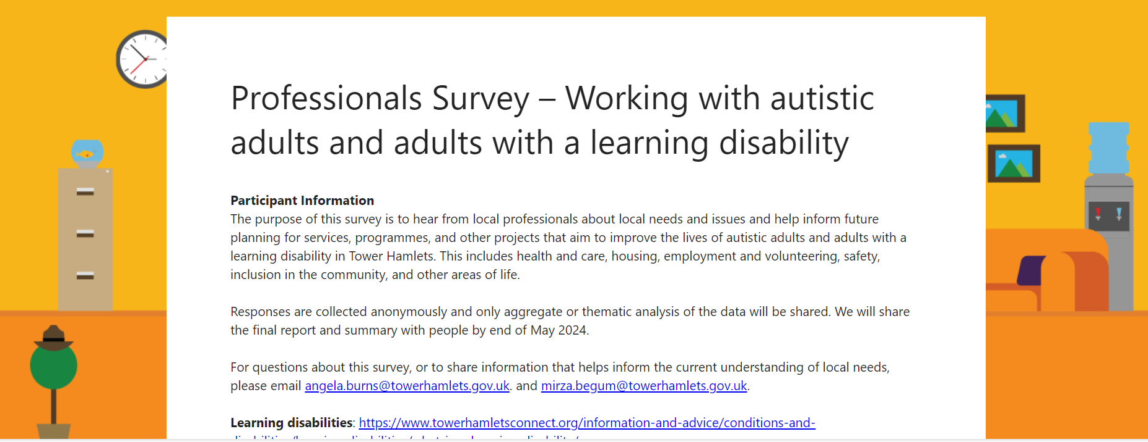
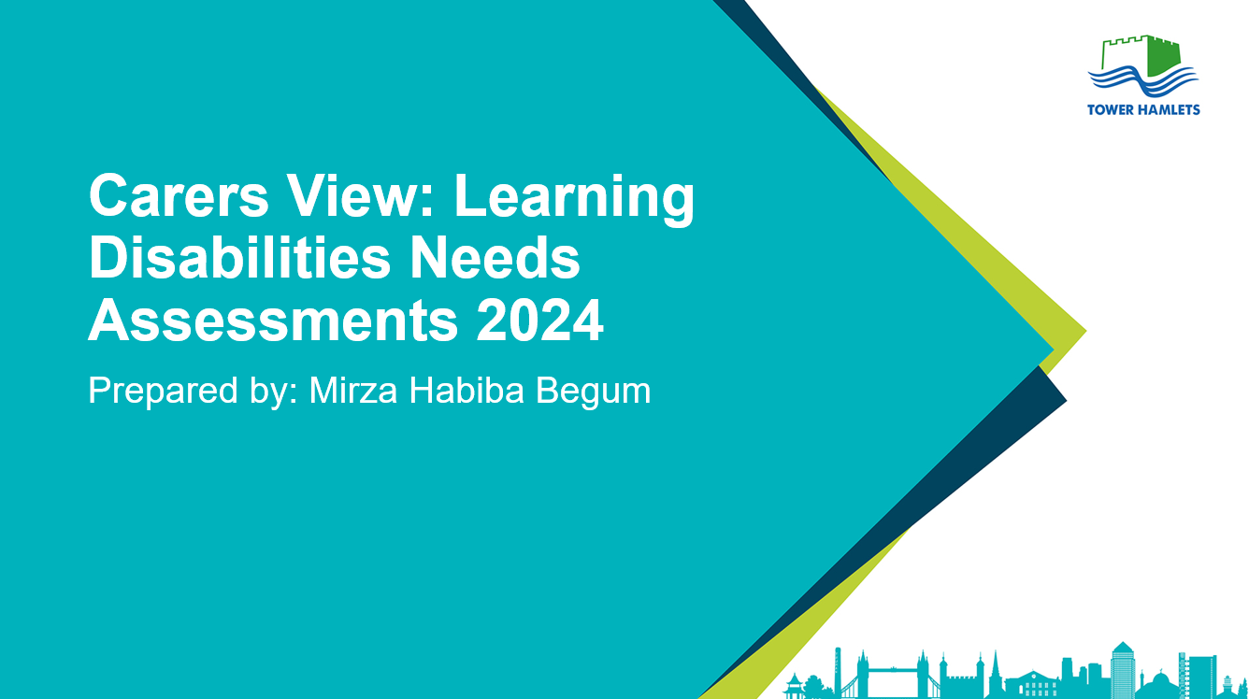
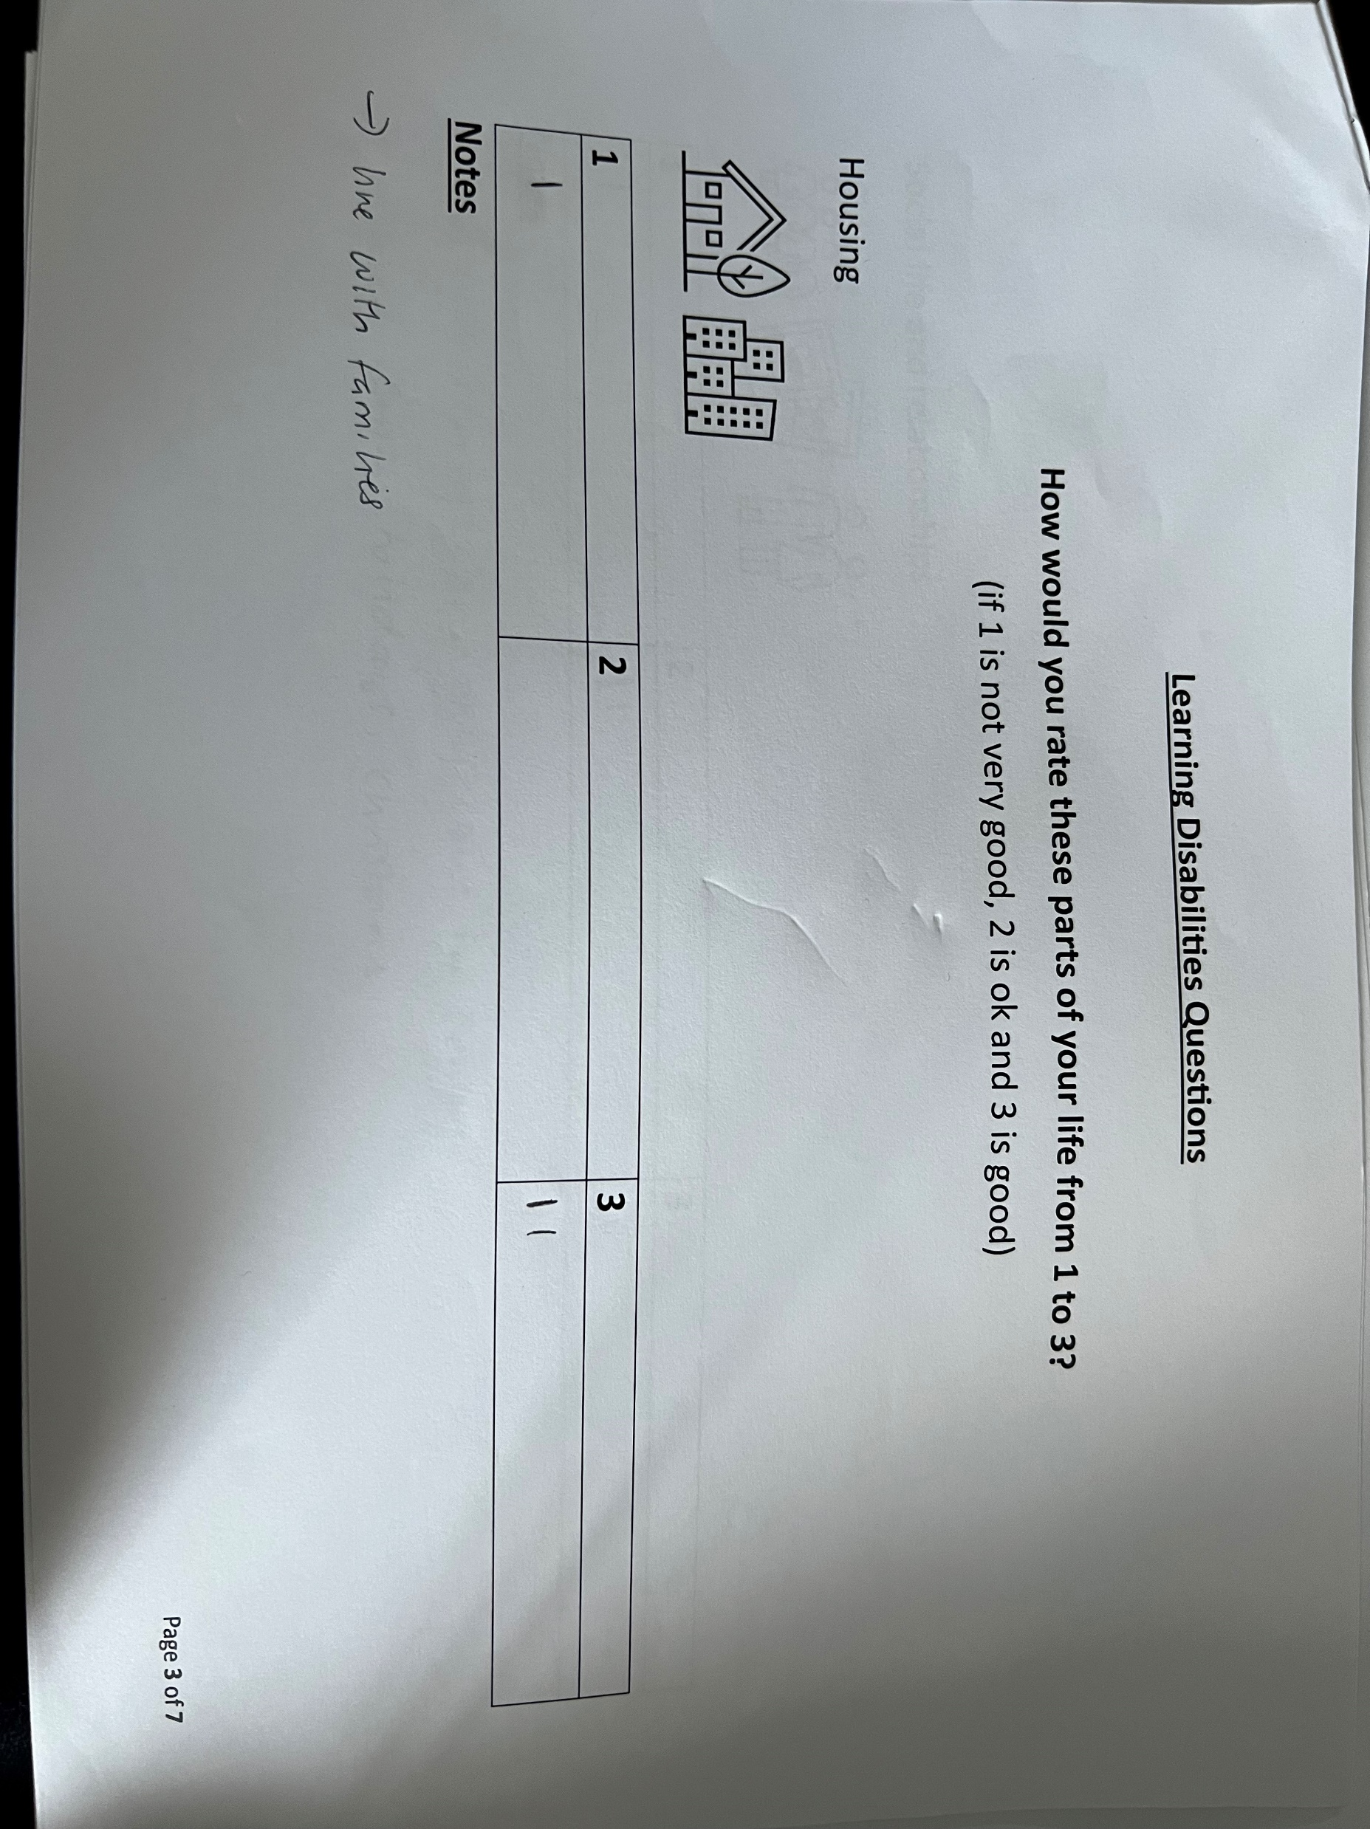
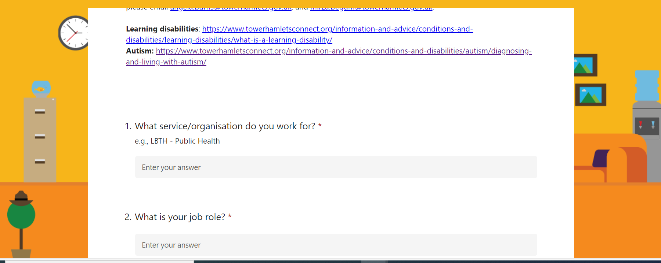
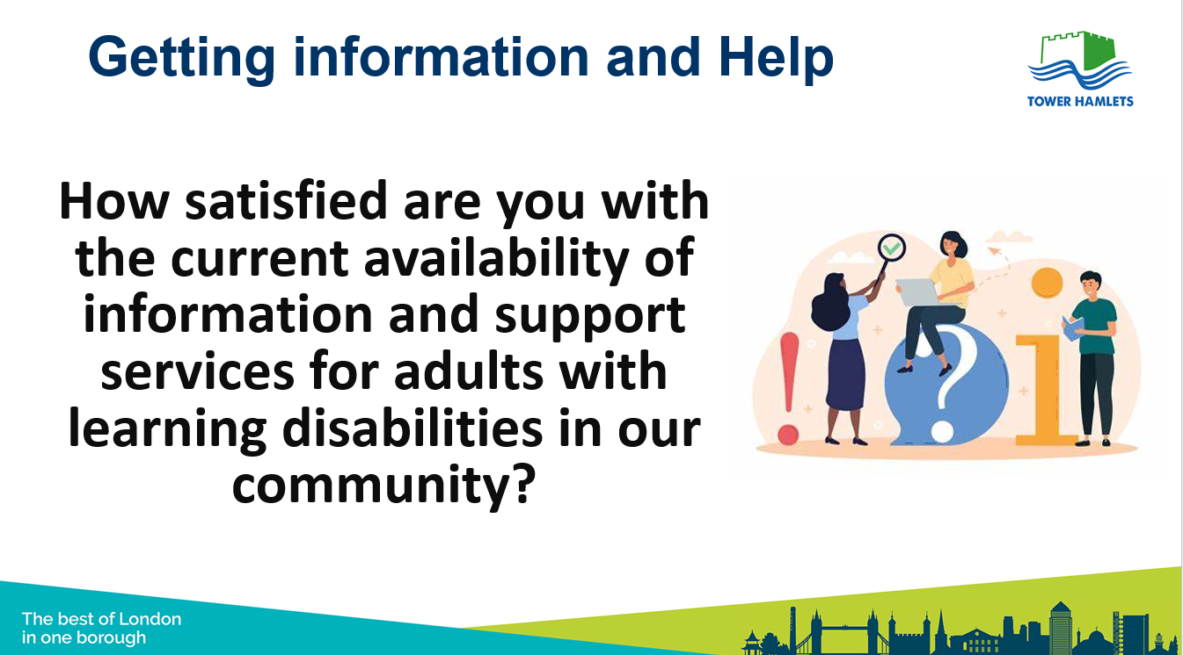
Engagement with professionals and residents
Professional Survey-
Via emails
Questionnaire with Adults with Learning Disabilities-
Face to Face
Carers Focus Group-
Face to Face

Slide 9
Key Findings

Slide 10
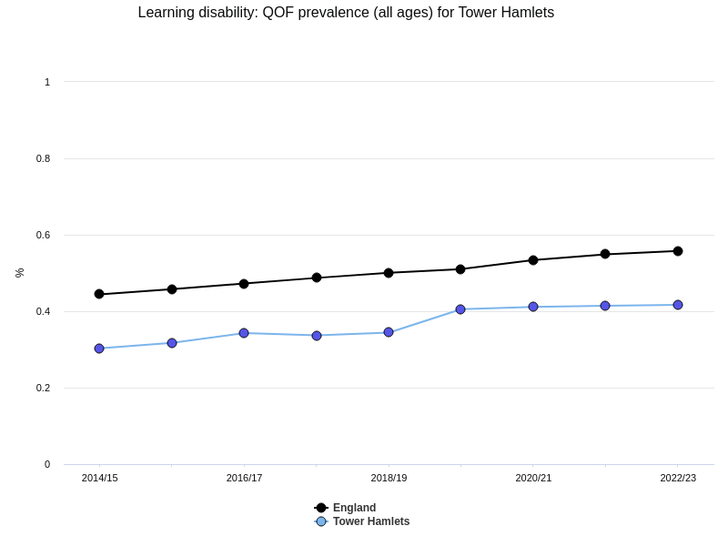
Tower Hamlets has a growing population of adults with learning disabilities
England:
Approximately 2% of adults in the UK are believed to have a learning disability (approx. 1.5 million people affected (Mencap, 2024); The proportion of people who self-identify as having a learning disability increased slightly from 1.5% in 2018 to 1.9% in 2023 (NHS England, 2023).
~0.5% of patients in primary care were identified by GPs as having a diagnosed learning disability (NHS England, 2023). This rate has also increased over the past 10 years, but is still lower than the rate that people self-identify (likely due to differences in access to services, understanding of learning disabilities as well as social stigma).
Tower Hamlets:
Diagnosis in primary care: The prevalence of diagnosed LD is about 0.4%; this has been increasing since 2014. Rates are similar to London and lower than England (Fingertips, 2023). Rates of LD diagnosis among adults in Tower Hamlets are highest among males, 18-24 year olds, Asian and Black ethnicities, and people living in more deprived neighbourhoods (East London Database, 2024).
Adults known to social care: There are increasing numbers of adults with LD as the primary support need in Adult Social Care (particularly across the 18-64 age group and among Bangladeshi and Black African residents). There was also a 135% increase gross spend for learning disability support in 2021/2022 compared with the previous year, higher than London (106%) and England (108%).

Slide 11


Summary of Key Findings (1)
Key demographics in Tower Hamlets – 2022/23
Ethnicity and Nationality
Learning Disability Prevalence in Tower Hamlets
Significant variations exist among ethnic groups, with the highest prevalence in Asian or Asian British, White, and Black or Black British populations (PHAST, 2023)
The prevalence is thought to be up to three times higher in South Asian populations (e.g. Bangladeshi) compared to the white British population.
The large Bangladeshi population in Tower Hamlets is believed to contribute to a relatively high number of people with learning disabilities, consistent with national estimates for moderate or severe learning disabilities (0.5% of the adult population.
Diagnosed Prevalence: Approximately 0.46% of the population has a diagnosed learning disability but estimates suggest the actual prevalence is between 2.14% and 2.27% (PHAST, 2023).
National trends show an increase in self-identification of learning disabilities from 1.5% in 2018 to 1.9% in 2023, Specific trend data for Tower Hamlets is not provided.
In terms of ethnicity, Tower Hamlets shows higher prevalence rates among Asian or Asian British, White, and Black or Black British populations, Comparable ethnic data for national prevalence is not specified.
Socioeconomically, Tower Hamlets experiences a higher prevalence of learning disabilities in the most deprived areas.
Age and gender
Gender Ratio: The male-to-female ratio is 60:40 (PHAST, 2023).
Notes:
https://www.towerhamlets.gov.uk/Documents/One-TH/How-can-we-look-out-for-each-other-Evidence-Pack.pdf

Slide 12
Summary of Key Findings (2)
Health and Wellbeing: Specialist services
CDLS and Primary Care is the leading specialist service for LD and Autism in Tower Hamlets
Helpful tools identified in the specialist survey have been signposts to local service involvement of carers and families, involvement of adults with LD, and collaboration between professionals.
The survey results indicate the need for improved referral pathways, enhanced community and respite services, more robust safety and police connections, better housing and welfare access, increased educational options, greater legal and social protection, more diversity and inclusion, specialised support for complex health needs, direct user feedback, and comprehensive training and support for professionals and communities.
Main Barriers professionals identified:
Lac, of inclusion/consideration of autism and LD in general programmes, services and policies
Not knowing what services/support are available and insufficient resources
Lack of awareness/skills among professionals
.
Health and Wellbeing: Annual Checks
In Tower Hamlets, people with learning disabilities aged 14 and older are eligible for annual health checks covering a wide range of needs; however, despite increased completion rates by GP practices, low uptake suggests potential community barriers, highlighting the need for targeted outreach and improved accessibility efforts.
Tower Hamlets Council and health partners address learning disability care through scrutiny sessions, focusing on health, accommodation, and employment. Initiatives include annual health checks, innovative service delivery pilots, and communication passports to engage hard-to-reach groups.

Slide 13
Summary of Key Findings (3)
Health and Wellbeing: Weight Management
Tower Hamlets' Shape Up Weight Management Service for adults with learning disabilities offers personalised, long-term support and collaborative care to promote healthier lifestyles. It addresses gaps in uptake, evaluation, long-term funding, and inclusion in various aspects of weight management.
Gaps in implementing the Shape Up Weight Management Service for adults with learning disabilities include limited uptake and evaluation of the service, uncertainty regarding long-term funding for weight management initiatives, and the need for greater inclusion of individuals with learning disabilities in various aspects of healthy weight management programs.
.
Health and Wellbeing: Access to medication
STOMP in Tower Hamlets aims to reduce inappropriate psychotropic medication use among individuals with learning disabilities or autism through comprehensive reviews, personalised care plans, staff training, and collaboration, aligning with national efforts to enhance person-centred care and quality of life.
The STOMP initiative in Tower Hamlets aligns with key policies and regulations, including the Mental Capacity Act 2005, Equality Act 2010, NICE Guidelines, and Care Quality Commission regulations, by promoting person-centred care, preventing discrimination, and ensuring safe and appropriate medication use for individuals with learning disabilities and autism. Additionally, STOMP aims to enhance co-production and accessibility, implement continuous improvement strategies, and foster collaboration and knowledge sharing to effectively reduce over-medication and improve the well-being of this vulnerable population.

Slide 14
Summary of Key Findings (4)
Health and Wellbeing: Mental Health
Tower Hamlets faces challenges in addressing mental health issues among individuals with learning disabilities, including higher prevalence rates of various conditions such as diabetes, asthma, stroke, depression, and Serious Mental Illness.
Despite stable employment and accommodation, there is reduced utilisation of secondary mental health services in the area.
Tower Hamlets records the highest percentage of long-term mental health issues among its residents, indicating a need for targeted interventions and support.
Elevated levels of deprivation contribute to increased demand for mental health services in Tower Hamlets.
Individuals with autism often experience multiple unrecognised physical or mental health problems, emphasising the need for comprehensive support and interventions.
.
Health and Wellbeing: Screening
In 2023-2024, cancer screening coverage among individuals with learning disabilities in Tower Hamlets was notably lower compared to the general eligible population, with only one-third participating in bowel cancer screening, one-fifth in breast cancer screening, and higher participation in cervical cancer screening for women with learning disabilities in Tower Hamlets.
Addressing the accessibility needs of individuals with learning disabilities in cancer screening programs involves providing easy-to-read materials, personalized communication, accessible facilities, training for healthcare professionals, supportive networks, reminder systems, accessible transportation, reasonable accommodations, and involving family and carers in the screening process to ensure inclusivity and support throughout.
Health and Wellbeing: Vaccination
During the first wave of Covid-19, people with learning disabilities faced a sixfold increased risk of death, and despite initially similar vaccination rates, recent booster coverage has declined; Tower Hamlets is developing a new pandemic plan to ensure their equal access to health protection.

Slide 15
Summary of Key Findings (5)
Transition between children and adult services
Tower Hamlets aims to facilitate smooth transitions for individuals with learning disabilities by implementing early planning, fostering interagency collaboration, providing personalised support, promoting community inclusion, and supporting the development of independence skills.
The CLDS has a dedicated Transition Team working with young people from age 14 to ensure a smooth handover to adult services. The Transition Board facilitates joint working between children’s and adult services and involves young people and families in future planning.
The Adult Learning Disability Strategy 2017-2020 offers flexible, personalised activities for diverse age groups and needs, promotes inclusion in community activities, supports the development of independent living skills, and aims to reach individuals slipping through service gaps during the transition.
Supported employment programs like internships and apprenticeships assist young adults with learning disabilities transition into employment.
Research highlights delayed and ineffective transition planning, poor understanding of transition needs, and information system challenges.
Improvement recommendations include advocating for a more integrated and data-driven approach and enhancing care coordination.
Survey findings underscore the need to address disjointed transitions, lack of support after individuals become adults, insufficient transition planning and partnership with Children's Health and Social Care Services, and problems transitioning into day centres from school due to educational deficiencies.
.

Slide 16
Summary of Key Findings (6)
Financial security
Tower Hamlets residents identify the cost-of-living crisis as a primary concern, prompting the government to allocate £5.9 million through the Household Support Fund.
Initiatives like the Community Cupboard and Residents’ Support schemes aim to alleviate financial strain for needy families.
Despite population growth, satisfaction with local services remains high.
The council provides various support schemes, including emergency financial aid, energy-saving tips, debt advice, and money management services to assist residents.
The Adult Learning Disability Strategy 2017-2020 aims to improve employment and volunteering opportunities for adults with learning disabilities.
While the borough's Financial Inclusion Strategy targets financial literacy and access to services, specific provisions for adults with learning disabilities are lacking.
Clear, targeted efforts to address financial insecurity for adults with learning disabilities are currently insufficient.
Findings from a questionnaire indicate a range of financial management challenges faced by adults with learning disabilities, including decision-making difficulties and reliance on family support.
.

Slide 17
Summary of Key Findings (7)
Training
Collaboration between various organisations has resulted in developing resources like the Health Equalities Framework e-learning tool and the BEST Practice Guide.
These resources aim to equip healthcare professionals with skills and awareness to address the access needs of individuals with learning disabilities.
Despite available training options such as the Oliver McGowan Mandatory Training and initiatives like Mencap's Treat Me Well campaign advocating for mandatory learning disability training, there remains a significant gap in training provision.
This gap impacts the quality of care received by individuals with learning disabilities.
Action is required to enhance training and support within the healthcare system, aligning with the goals outlined in The Adult Learning Disability Strategy (2017-2020).
.
Employment
Tower Hamlets is experiencing employment deprivation, particularly among individuals with learning disabilities, highlighting the need for targeted and inclusive employment support programs.
Despite facing the highest levels of deprivation affecting children and older individuals, limited data is available on employment rates, hindering comprehensive analysis and planning.
Data indicates a significant employment rate gap of 71% between the general population and those with learning disabilities, with frustration expressed over limited work experience opportunities.
While Tower Hamlets's employment rate was slightly lower than the national average, variations in employment rates emphasise the importance of considering geographical and temporal factors.
The Tower Project Jobs, Enterprise and Training team, Poetry in Wood, MAP Squad, and Disability Advocacy Network offer support and training for individuals with disabilities seeking employment, but there is a lack of publicly available data evaluating the outcomes and impact of these programs.

Slide 18
Summary of Key Findings (8)
Volunteering
Employment and volunteering are highly valued by adults with learning disabilities for involvement, contribution, and income, but job opportunities remain limited, with only 4.9% in paid employment in 2015-16.
Current initiatives provide skills development and employment support to about 60 people per year, with commitment from Health and Wellbeing Board members to employ people with learning disabilities.
Feedback from the community emphasizes the need to increase job opportunities, provide early advice and support to prevent stress and financial issues, and improve education tailored to individuals' levels.
Future actions include collaborating with local businesses to create flexible job opportunities, encouraging high aspirations from childhood, and developing accessible education, training, and work experience opportunities.
Measuring success involves supporting 110 people into employment per year over four years, aiming to reach 11% in paid employment within three years.
Volunteering offers people with learning disabilities friendships, skills, enjoyment, and confidence, challenging disability stereotypes, but barriers and limited opportunities hinder participation.
Key places offering volunteering opportunities in Tower Hamlets include Volunteer Centre Tower Hamlets, Tower Hamlets Community Learning Disabilities Service (CLDS), and Mencap, yet data on adults with learning disabilities volunteering in Tower Hamlets is lacking.
.

Slide 19
Summary of Key Findings (9)
Community Safety
Vulnerabilities such as deprivation, substance misuse, mental health issues, learning disabilities, homelessness, and age can increase the risk of criminal exploitation and grooming.
A significant proportion of service users accessing the IDVA service for domestic abuse reported having a learning or intellectual disability, with 18% of all clients having a disability.
Over half of disabled victims and survivors with sensory impairments or physical or learning disabilities expressed a desire to access specialist services.
Specialised support services like Respond, Stay Safe East, and SignHealth's Domestic Abuse Service offer advocacy and support for adults with learning disabilities who have experienced abuse, trauma, or violence.
The Tower Hamlets Adult Learning Disability Strategy 2017-2020 aims to promote community inclusion, independence, and equal opportunities for adults with learning disabilities, contributing to a safer and more inclusive community.

Slide 20
Summary of key findings and recommendations
Key findings
The population of adults with learning disability in Tower Hamlets has been increasing, along with the levels of need and levels of spend.
There are also significant gaps in health outcomes for adults with a learning disability and low uptake of preventative health interventions.
There is still a need for improved awareness of LD and co-occurring conditions, increased provision of reasonable accommodation (e.g. Makaton and easy read materials) and accessible communications in mainstream services and organisations (e.g. health services, housing, community activities, employers).
There is currently gaps in system coordination aimed at improving support for people with a learning disability beyond the Community Learning Disability Service, with staff noting they were not aware of what is available.
Support with transitioning to adulthood has improved but new processes and programmes still need to be more widely implemented and shared.
Recommendations
Re-instate the Learning Disability Partnership Group with representation from commissioned services, wider organisations, adults with a learning disability and carers.
Examine cross-organisational investment in line with increasing population and complexity of needs, including children and young people.
Improve data quality regarding disability across services (including mainstream ones) to generate better insight about improvements in access.
Build capacity among and resource for local non-specialist services and organisations to work with adults with a learning disability and their carers (including employers and commissioners) so that communication and co-production can be prioritised.

Slide 21
Population of adults with a learning disability

Slide 22
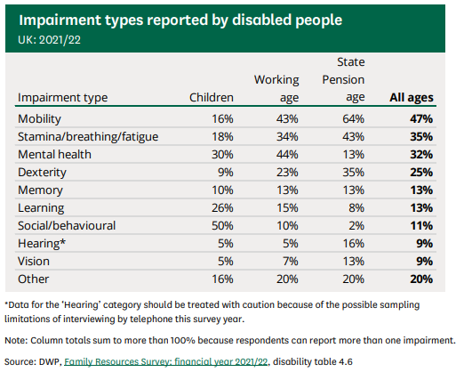
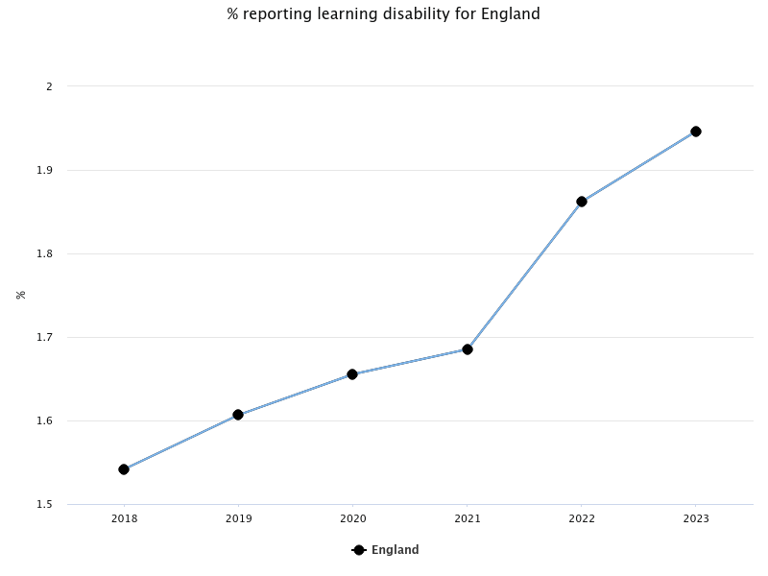
In the UK, the rate of self-reported learning disabilities has increased higher than recorded in primary care
Approximately 2% of adults in the UK are believed to have a learning disability (approx. 1.5 million people affected (Mencap, 2024); The proportion of people who self-identify as having a learning disability increased slightly from 1.5% in 2018 to 1.9% in 2023 (NHS England, 2023)
Only ~0.5% of patients in primary care were identified by GPs as having a learning disability (NHS England, 2023)
Learning disabilities are less frequently reported than some other kinds of disabilities, with higher rates among children and working age adults
Notes:
https://researchbriefings.files.parliament.uk/documents/CBP-9602/CBP-9602.pdf
Fingertips

Slide 23
Rates of diagnosed learning disabilities have increased in Tower Hamlets, similar to London but lower than England
Approximately 0.46% of the adult population has a diagnosed learning disability, equating to about 1,700 people (Quality and Outcomes Framework (QOF), NHS England 2023)
  However, the actual number is likely higher, as PANSI estimates an adult prevalence of 2.14%-2.27% (PHAST, 2023).
The prevalence of diagnosed learning disabilities in Tower Hamlets is lower compared to the rest of England; this may be due to a range of issues such as underreporting, lack of access or knowledge among parents/carers, stigma; diagnosis is crucial for accessing tailored/specific services
Notes:
OHID: https://fingertips.phe.org.uk/profile/learning-disabilities/data#page/4/gid/1938132702/ati/502/iid/93443/age/164/sex/4/cat/-1/ctp/-1/yrr/1/cid/4/tbm/1

Slide 24
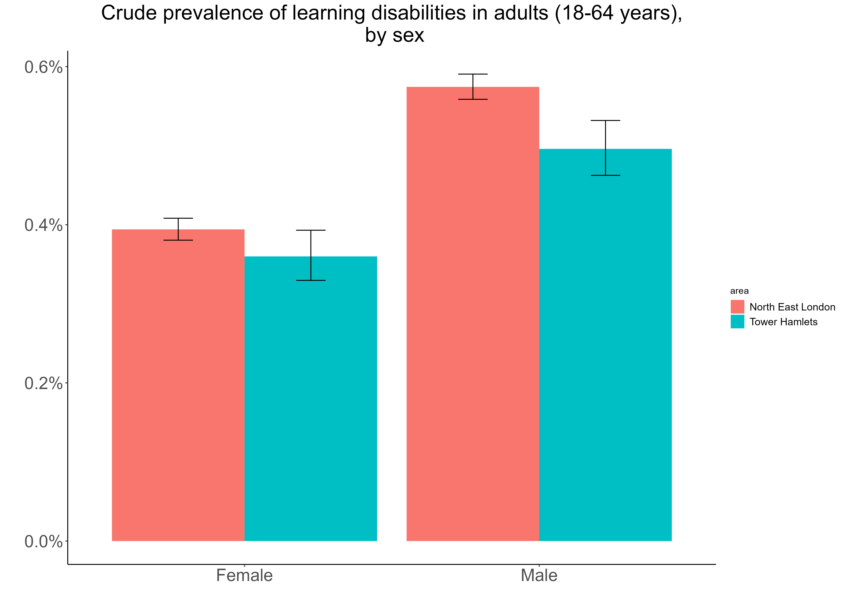
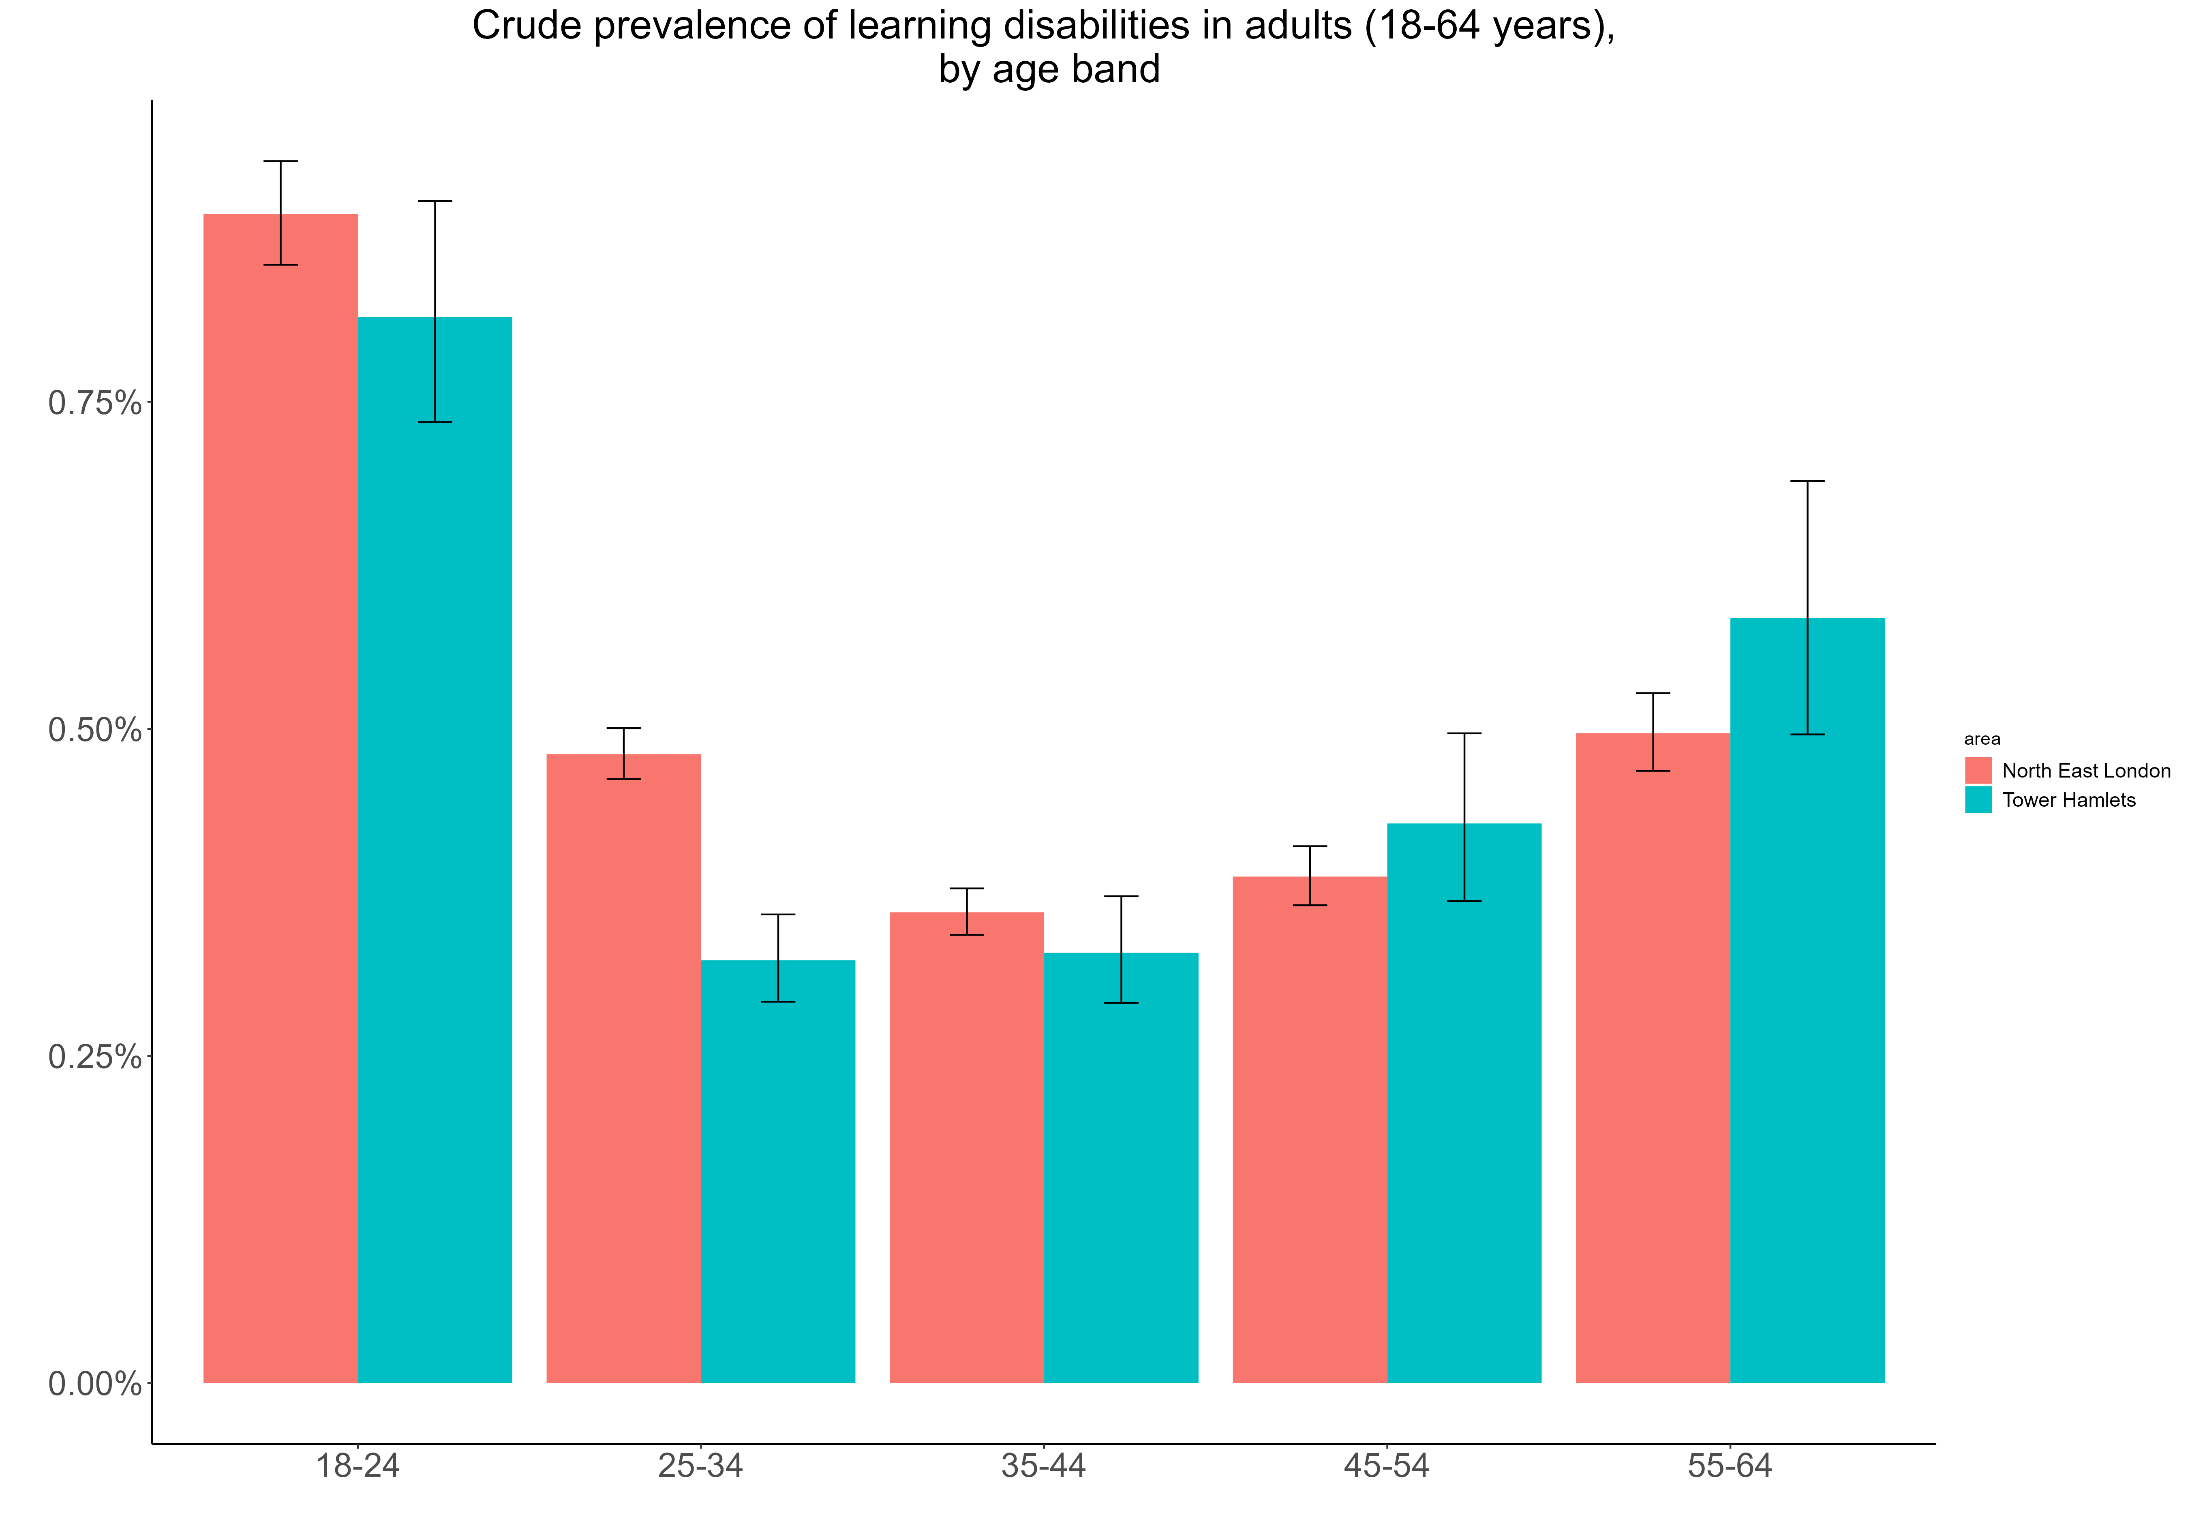
Prevalence of learning disabilities is highest among males and younger adults
Gender
The prevalence of learning disabilities is higher in males compared with females, with the population being 60% males and 40% females.
Age groups
The prevalence of learning disabilities is higher among adults aged 18-24 years old. However, the prevalence increases to over 0.50% among adults aged 55-64 years old. Data was not available for adults aged 65+
Crude prevalence of Learning Disabilities in Tower Hamlets (blue) and NEL (red) residents aged 18 to 64, by sex (East London Database 2022-23).
Crude prevalence of Learning Disabilities in Tower Hamlets (blue) and NEL (red) residents aged 18 to 64, by age band (East London Database 2022-23).

Slide 25
LDs are most prevalent among Asian and Black adults and people in the most deprived areas of Tower Hamlets
Ethnic groups
By ethnicity, prevalence of learning disabilities in Asian and Black ethnic groups are over two times higher than those in all other ethnic groups. The prevalence of learning disabilities in Asian ethnic groups in Tower Hamlets is notably higher than the NEL average.
Socioeconomic groups
In Tower Hamlets, the prevalence of learning disabilities in adults aged 18 to 64 living in the most deprived areas is over three times higher than for those living in the least deprived areas.
Note: the numbers in the least deprived category are very small

Slide 26
Considering the population of children and young people with a learning disability can support future planning
According to the Department for Education special educational needs statistics from 2013, there were 1,782 pupils
There are nearly 6,000 pupils in Tower Hamlets with SEND needs; of these, 1 in 8 have learning disability as a secondary need (~750 pupils)
There are also just over 100 young people with learning disabilities (aged 14-17 years old) recorded in primary care (CEG, 2024)
LD category​ | Tower Hamlets​ | England​
Moderate LD​ | 1.50%​ | 2.89%​
Profound and multiple LD​ | 0.39%​ | 0.126%​
Severe LD​ | 0.29%​ | 0.37%​

Slide 27
Levels of need are expected to increase, with higher projected numbers than neighbouring boroughs
PANSI (Projecting Adult Needs and Service Information) projects that the number of working age adults with severe or moderate learning disabilities will rise from 1300 in 2020 to 1600 in 2040 (State of the borough report, 2024). See chart on the right.
There is currently a SEND Needs Assessment being drafted, which will enable longer term planning in terms of population need. Some key population statistics from this NA include:
  Over 2% of pupils in Tower Hamlets had a LD according to the most recent school census (December 2023); most are moderate while smaller proportions are profound, multiple or severe.
  Of the nearly 6,000 pupils in Tower Hamlets with SEND needs; 1 in 8 have learning disability as a secondary need (~750 pupils).
  There are also just over 100 young people with learning disabilities aged 14-17 recorded in primary care, transitioning from children’s services (CEG, 2024). It is not clear how representative this is of the wider population of young people with LD SEND or if registration in primary care needs improvement.

Slide 28
Scope of Needs Assesment

Slide 29
National guidance to inform how to work with adults with a learning disability
Learning Disability-applying All our Health:
This guide, as part of All Our Health, is intended for health and care professionals, emergency services, and the wider public health workforce to promote well-being and prevent ill health in individuals with learning disabilities and their families.
NHS Long Term Plan:
Prioritises improving lives of individuals with learning disabilities and autism.
Focuses on community-based support, early checks, and tailored care for fulfilling lives at home.
Emphasizes quality healthcare, reducing health inequalities, and valuing lived experiences.
Aims to become a model employer through increased awareness and collaboration within the NHS
National plan – Building the right support:
Published in 2015 as part of the Transforming Care Programme, 'Building the Right Support' by NHS England, LGA, and ADASS supports commissioners in reducing reliance on mental health inpatient care for individuals with learning disabilities and autism, aiming to develop community alternatives.
Learning disabilities and behaviour that challenge: service design and delivery (NICE guideline):
This guideline covers services for children, young people, and adults with a learning disability (or autism and a learning disability) and behaviour that challenges.
It aims to promote a lifelong approach to supporting individuals and their families and carers, focusing on prevention, early intervention, and minimizing inpatient admissions
While undergoing a review in 2022/23, its core values remain pertinent, emphasising a commitment to personalized housing, care, and support for individuals to lead healthy lives in the community.
It highlights the importance of personalised activities and interventions, promotes awareness of local resources, and seeks to improve the overall well-being of individuals and families through a holistic approach.

Slide 30
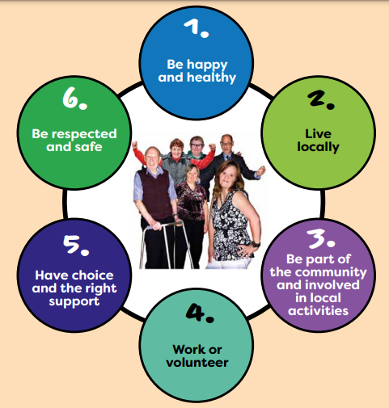
Tower Hamlets’ previous Adult Learning Disability Strategy 2017-2020 had objectives and actions across 6 topics
Vision: Adults with learning disability in Tower Hamlets live well
Objectives:
  Reduce health inequalities and the length of stay in hospital
  Increase the number living locally
  Increase the number involved in the community and local activities
  Increase the number who work or volunteer
  Increase the number reporting they have choice and the right support
  Increase the number reporting they feel respected and safe
Ways of working:
  Learning Disabilities Partnership Board: The Board works to improve health and wellbeing outcomes for people with learning disabilities and their families
  Values and principles from the Equality Act and UN Convention on the Rights of Persons with Disabilities
    Respect, dignity, independence, consent, advocacy
    Meaningful and effective participation
    Accessible communication
    Strengths-based
    Access to the full range of opportunities and support
For this needs assessment, we are assessing gaps in addressing these objectives and ways of working as well as the national guidance

Slide 31
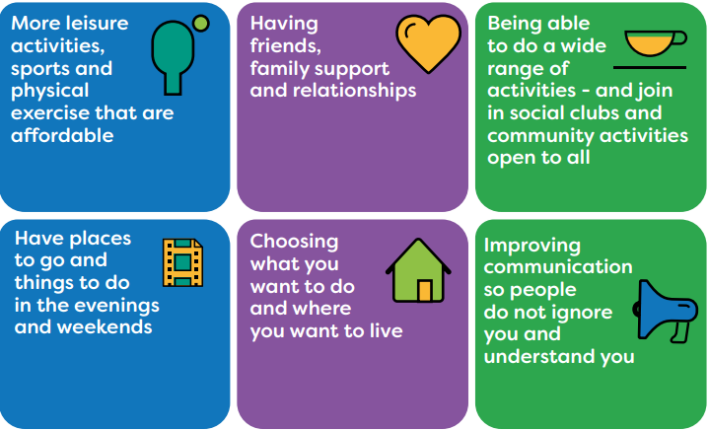
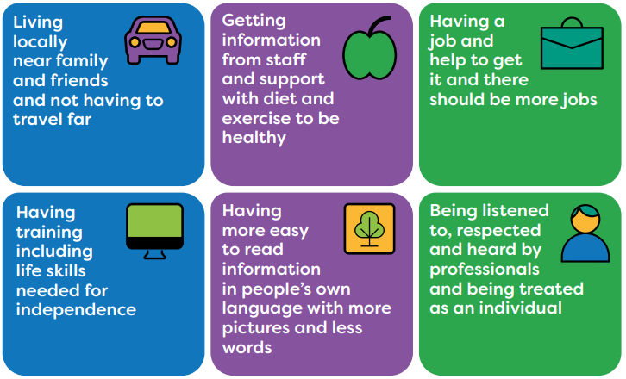
In the previous strategy consultation, people shared what was important to them

Slide 32
A similar range of topics were assessed in this project to inform upcoming strategic planning for 2024 onwards
Specialist services
Diagnosis coverage
Specialist services (CLDS)
Health and care
What is the coverage and quality of health services for this population
Findings from LeDeRs (Learning from Deaths reviews)
Housing
Access to long-term supported living options
Proportion of people with local accommodation
Work and volunteering
Coverage and outcomes of existing employment and volunteering support services
Accessibility of work and volunteering opportunities and settings
Community activities and involvement
How much do people with LD access different activities
How much involvement do people with LD have in shaping activities (e.g. Empowering Voices, Quality Checkers)
Respect and safety
Occurrence of violence and victimisation (DA, hate crime, exploitation etc)
Perceived levels and issues to address re: respect/inclusion/stigma
Access to benefits and money
Financial security
Costs of living

Slide 33
Professionals’ skills and knowledge

Slide 34
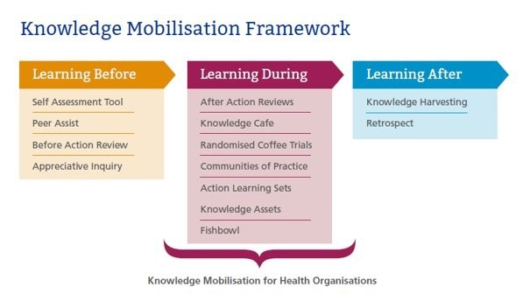
People require the right knowledge and skills to enable adults with a learning disability to live well
Implementation of the Knowledge Mobilisation Framework
The Knowledge Mobilisation Framework can significantly contribute to this process by facilitating continuous learning and the sharing of best practices.
Using the Knowledge Mobilisation Framework helps ensure that knowledge and skills are effectively shared, leading to improved practices that support adults with learning disabilities in leading fulfilling and healthy lives
The framework’s three stages—Learning Before, Learning During, and Learning After—support teams and individuals in effectively utilising knowledge:
Learning Before:
    Reflect on previous experiences and lessons learned from others to inform planning and decision-making.
Learning During:
    Foster ongoing reflection on progress, create opportunities for knowledge exchange, and assess current practices.
Learning After:
    Evaluate achievements, identify successes and challenges, and document insights for future use
•Knowledge plays a crucial role in helping individuals advocate for themselves and make informed decisions, which fosters independence.
•Knowledge of rights and available resources enables individuals to effectively navigate healthcare and social services.
•Being aware of health management strategies and support options leads to better health outcomes and encourages active participation in personal care.
•Knowledge helps individuals identify potential risks and understand how to mitigate them, enhancing personal safety.
•Staying informed about local services and activities promotes participation and helps build social networks.
•This framework provides a systematic approach to learning and sharing knowledge:
•The framework also assists in training caregivers by equipping them with the necessary tools to effectively support individuals.
Notes:
https://library.hee.nhs.uk/knowledge-mobilisation/nhs-knowledge-mobilisation-framework-postcards

Slide 35
Training is one step in building the skills and knowledge in the workforce
Staff working in both specialist and mainstream services for people with learning disabilities should possess the skills and knowledge necessary to provide positive support.
Training for All:
Comprehensive Content:
Person-Centered, Rights-Based Approach:
Inclusive Training Development:
Adequate Funding:
Support Networks:
Training should be offered to families, supporters, and staff from various local organisations to manage challenging behavior positively.
Training should include communication skills, meaningful engagement with individuals, understanding complex health needs, positive behaviour support, assistive technologies, planning, and the Mental Capacity Act.
Training on managing challenging behaviours should emphasize a person-centred, rights-based approach for both staff and families.
Local areas should facilitate support networks, mentoring, and knowledge-sharing platforms for staff, personal assistants, and families to continuously enhance their skills.
Sufficient funding must be allocated for personal budgets to hire skilled staff and provide ongoing training and professional development opportunities.
Local authorities, providers, and organizations should involve people with learning disabilities and their families in developing and delivering training programs.
Notes:
https://www.skillsforcare.org.uk/Developing-your-workforce/Care-topics/Learning-disability/Good-learning-disability-and-autism-training.aspx & https://www.mencap.org.uk/sites/default/files/2016-06/2012.340%20Raising%20our%20sights_Guide%20to%20workforce_V2.pdf & https://www.cqc.org.uk/guidance-providers/training-staff-support-autistic-people-and-people-learning-disability

Slide 36
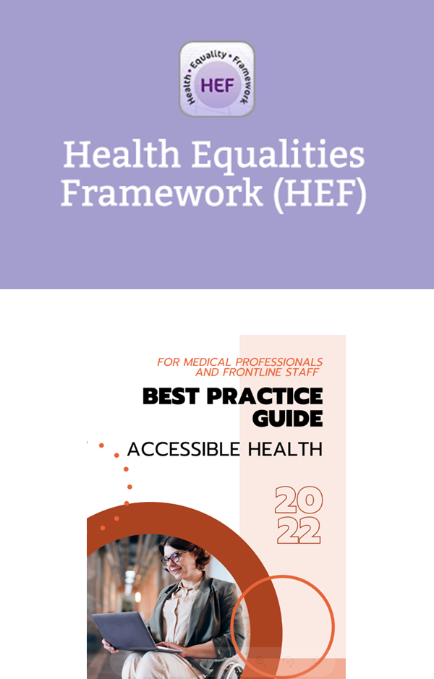
Current available training
Health equalities Framework
The Health Equalities Framework (HEF) e-learning resource, delivered through a partnership involving the Learning Disability Nurse Consultant Group, the National Development Team for Inclusion, and Health Education England e-learning for healthcare, offers practitioners a practical introduction to the Health Equalities Framework tool, fostering an understanding of health inequalities among individuals with learning disabilities and the determinants behind these disparities
BEST Practice Guide. 2022: For Medical professionals and Frontline Staff By Real, Deaf plus, and ICM Foundation
The purpose of the guide is to upskill health staff and build awareness for how they can make their services equal at the point of entry and adjust their behaviours, actions, and services to meet different people’s access needs.
The best practice guide was created after participants reported that frontline staff and medical professionals lacked training in meeting their access needs, making reasonable adjustments, and providing adequate support. Health services and information are often designed without consulting disabled people, resulting in inaccessible environments and ineffective communication by staff due to a lack of knowledge and skills. This guide is divided into different chapters. These chapter themes were determined by coproduction groups based on where they felt frontline staff and medical staff needed more training.
Notes:
https://www.hee.nhs.uk/our-work/learning-disability/current-projects/oliver-mcgowan-mandatory-training-learning-disability-autism
https://www.england.nhs.uk/long-read/clinical-guide-for-front-line-staff-to-support-the-management-of-patients-with-a-learning-disability-and-autistic-people-relevant-to-all-clinical-specialties/
https://www.autism.org.uk/what-we-do/autism-training-and-best-practice/training
https://www.hee.nhs.uk/our-work/learning-disability/current-projects/oliver-mcgowan-mandatory-training-learning-disability-autism/employer-resources
https://www.gov.uk/government/consultations/learning-disability-and-autism-training-for-health-and-care-staff

Slide 37
Mencap's Treat Me Well campaign calls for mandatory training on learning disabilities for healthcare professionals
Mencap's Treat Me Well campaign urges mandatory training on learning disabilities for healthcare professionals.
Research suggests a lack of such training could contribute to 1,200 avoidable deaths annually among people with learning disabilities.
The campaign emphasises the necessity of reasonable adjustments in healthcare under the Equality Act 2010 to ensure equal treatment.
Surveys indicate that a significant proportion of healthcare professionals have never received training on meeting the needs of patients with learning disabilities.
Hospitals and universities often lack adequate provisions for training on learning disabilities, impacting the quality of healthcare received by individuals with learning disabilities.
Immediate action is needed to improve training and support within the healthcare system for individuals with learning disabilities. (Mencap, 2024)
Notes:
https://www.mencap.org.uk/press-release/concerns-over-lack-clinical-training-causing-avoidable-learning-disability-deaths

Slide 38
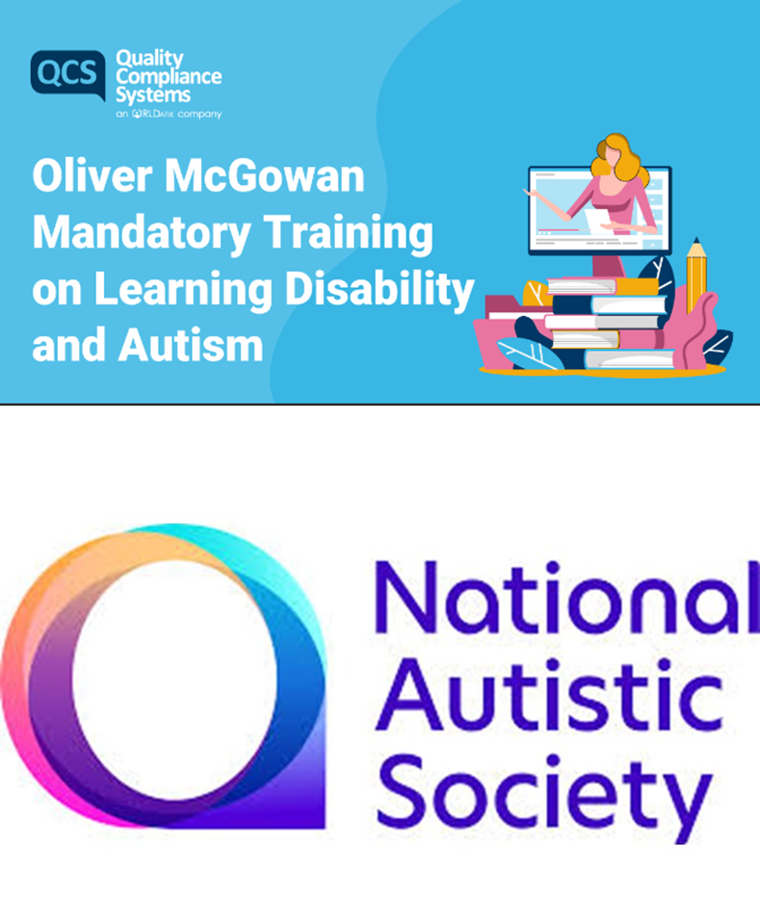
Current available training:
The Oliver McGowan:
The Oliver McGowan Mandatory Training is the government's preferred and recommended training for health and social care staff to undertake to enable providers to meet the requirements of this regulation.
The National Autistic Society
The National Autistic Society provides training courses to understand autism and supportive approaches
Employers guide to employing people with a learning disability
Core Capabilities Framework for supporting Autistic People
The collaborative project with Maudsley Learning assesses the alignment of current autism training in England with the Core Capabilities Framework. Through surveys and interviews, researchers aim to identify gaps in workforce training, increase Framework awareness, and enhance support for autistic individuals. Autistic facilitates community engagement and contributes to the research process.
Notes:
https://www.hee.nhs.uk/our-work/learning-disability/current-projects/oliver-mcgowan-mandatory-training-learning-disability-autism
https://www.england.nhs.uk/long-read/clinical-guide-for-front-line-staff-to-support-the-management-of-patients-with-a-learning-disability-and-autistic-people-relevant-to-all-clinical-specialties/
https://www.autism.org.uk/what-we-do/autism-training-and-best-practice/training
https://www.hee.nhs.uk/our-work/learning-disability/current-projects/oliver-mcgowan-mandatory-training-learning-disability-autism/employer-resources
https://www.gov.uk/government/consultations/learning-disability-and-autism-training-for-health-and-care-staff

Slide 39
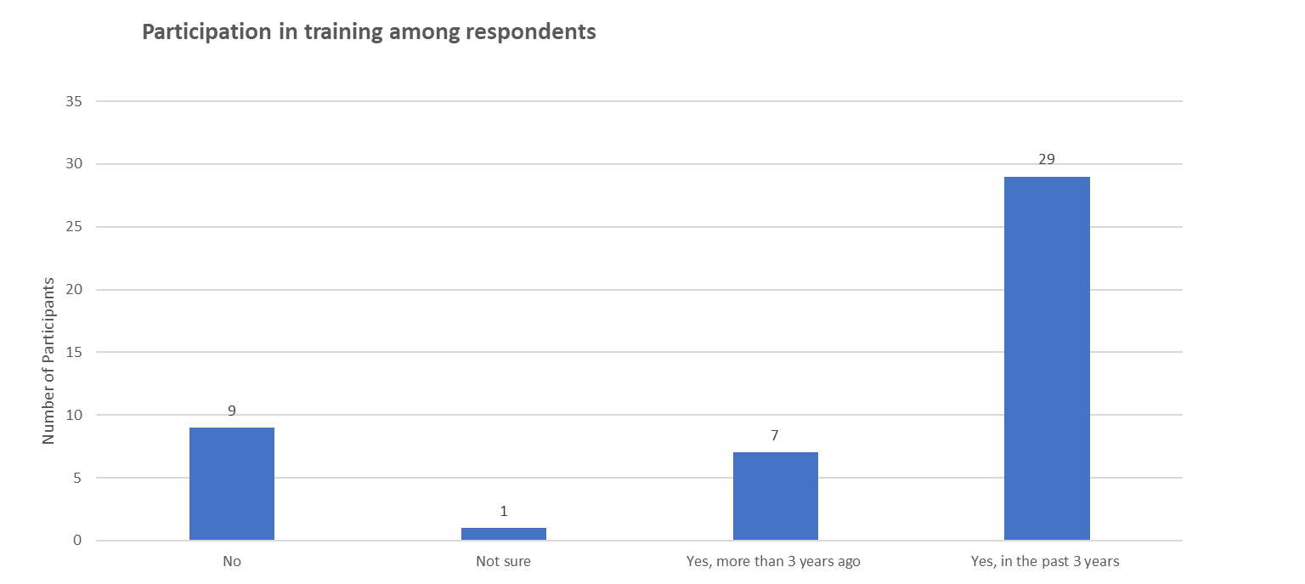
Training in Tower Hamlets
Findings
Our recent survey suggests that training has been offered to a large number of staff working with adults with special needs who completed the survey in the last three years.
A small percentage haven’t participated in any training, indicating room for improvement to increase skills and knowledge when working with adults with learning disabilities.
Professionals also identified areas they would like to improve in when working with adults with learning disabilities. Please see the next slide.
All staff in the CLDS had positive behavior support training so that they could better meet the needs of this group

Slide 40
Staff can be supported to implement training by building on these enablers and addressing these barriers

Slide 41
Professional identified they have learning needs in various areas when working with adults with LD
Refresher course on LD support
Advanced tools and methods for LD clients
Case studies for unique needs support
Mandatory LD awareness training
Autism awareness and sensory processing training
Sex and relationships education training
Creating social stories and easy-read documents training
Understanding autism diagnostic criteria
Oliver McGowan Training
Makaton training
Supporting LD or Autism in finding work/volunteering
Managing complex behavioural issues in a community hub
Assessment training for communication in autism
The survey results show that all staff need further training in services for people with learning disabilities and mainstream services. Enhanced training ensures better understanding, effective communication, personalised support, inclusive practices, legal compliance, crisis management, and improved collaboration.

Slide 42
Staff shared their views about gaps and issues in the local system of support for adults with a LD
Employment opportunities and inclusion in the community of adults with undiagnosed autism or learning disability who are presumed to be functionally able to manage their daily lives and do not meet the threshold of CLDS support
How do we know if someone who resides in [asylum seeker] accommodation has a learning difficulty or is autistic - they probably dont even know. The language barrier, PTSD, MH needs may mask the LD/Autistic.
Mainstream Adult Social Care isn't equipped to successfully work with adults with learning difficulties and/or autism.
CLDS eligibility criteria is too rigid and the threshold is very high, leaving adults with special needs unable to access their specialist services and preventing them from achieving the best possible outcomes.
Mainstream Adult Social Care needs more training and resources and/or CLDS eligibility criteria needs to be reviewed and reconsidered.
Some services get greater prominence within the borough at the expense of smaller, specialised services and support/ projects. There is a lot of under used resources out there.
If we had a proper mapping exercise of what is in the borough then people with learning disabilities will have greater choice. Also, we need an overview of the projects going in that are commissioned, it seems there is too much silo work going on without seeing how the different funded short-term projects can fit together better.
More education/training opportunities for those post 19. For those with complex needs, who leave Beatrice Tate or Phoenix Sixth Form at 19, it can be very difficult to find a suitable educational placement for them. A post 19 offer for those with complex needs is needed in Tower Hamlets, rather than these young people having to transition into Day Centres via Social Care.

Slide 43
Professionals’ knowledge and skills
Staff working in both specialist and mainstream services for people with learning disabilities should possess the skills and knowledge necessary to provide positive support that is accessible and appropriate.
Since 1 July 2022, all registered health and social care providers have been required to provide training for staff in LD and autism at a level appropriate to their role (e.g. Oliver McGowan training)
Most staff we surveyed had participated in some form of training related to LD (especially people working in specialist services). People who responded to the survey may have a greater interest in this population than the wider workforce.
Knowledge of working with adults with a LD varied but more staff saying they had decent or strong knowledge, especially people working in specialist services or teams.
0 = very poor, 4 = very strong

Slide 44
Partnership working needs further development to increase collaboration across the borough
Mencap reviewed the role and effectiveness of Learning Disability Partnership Boards, finding that these boards can provide a space for both strategic planning as well as for hearing the voices of service users and carers.
North East London has a Transformation Board focused on specific programmes of work in health and care like LeDeR, STOMP and personal health budgets.
In Tower Hamlets, there was previously a Learning Disability Partnership, but this is not currently active.
This includes adults with learning disability and carers
There is a need to re-establish this with strong leadership and governance including partners from across different areas of programme and policy (not limited to commissioned specialist services).
In 2015, ADASS and NHS England released a plan to improve community services and move away from inpatient facilities for people with a learning disability and/or autism, recommending partnership approaches to system improvement and commissioning.

Slide 45
Specialist Services

Slide 46
CDLS and Primary Care is the main specialist service for LD and Autism in Tower Hamlets
Tower Hamlets Community Learning Disabilities Service (CLDS):
The Tower Hamlet’s Community Learning Disability Service (CLDS) Specialising in providing support for adults with Learning Disabilities in Tower Hamlets, the service is primarily based at Beaumont House within Mile End Hospital. However, recognising the diverse needs of their clientele, CLDS extends its reach beyond the hospital premises.
Operates as a health and social care team, jointly administered by the London Borough of Tower Hamlets and the East London NHS Foundation Trust.
The team offers the flexibility to visit individuals at their homes, colleges, or day services, ensuring accessibility and tailored assistance to meet the community’s unique requirements (Tower Hamlets Connect, 2024, Learning disability Stratrgy 2017-2020)
Primary Care: ​
Primary Care in Tower Hamlets took proactive steps in 2009 by organising a 'Six Lives Panel' to address gaps in meeting the health needs of individuals with learning disabilities. The panel, comprising senior staff from various health and social care services, formed a steering group that commissioned a DVD showcasing firsthand experiences of health services by individuals with learning disabilities.
This initiative led to influential discussions and subsequent developments, including the recruitment of a Learning Disabilities Liaison Office by Barts and the London Trust.
Ongoing efforts include work to enhance access to annual GP health checks for people with learning disabilities, reflecting a commitment to improving healthcare outcomes for this community (Northeast London, 2024)

Slide 47
There are a range of specialist services for adults with learning disability in Tower Hamlets
The Tower Project Jobs, Enterprise and Training team (JET) provides support and training for people with disabilities in Tower Hamlets and the City of London seeking employment
Poetry in Wood is a social enterprise, training and employment scheme for people with learning disabilities.
People with disabilities in Tower Hamlets can access advocacy services through Disability Advocacy Network
Health promotion literature produced nationally in easy read is to be made available to GP practices and day services across the borough.
Tower Hamlets Community Learning Disabilities Service (CLDS) is an integrated health and social care service comprising social workers, occupational therapists, community nurses, psychologists, psychiatrists, and a Bangladeshi Parent and Carer Adviser team. CLDS works with just under 1,000 people aged 14 and over with various health and social needs.
Apasen: Information and advice service is free, independent, confidential and impartial, supporting disabled people living in Tower Hamlets. Providing information and advice on benefits, housing, travel, finance, social care and other issues for adults with disabilities and making referrals to other AQS-accredited organisations where relevant.
Real: Help disabled and non-disabled people in Tower Hamlets work together to share information, provide support and make change happen for over twenty years. They also have an independent advocacy service that can help you have your voice heard, uphold your rights and access services.
Tower Hamlets Mencap Society: Mencap Direct provides advice and information about individual budgets and self-directed support in relation to learning disability issues. They have advisers who offer further information to support people with a learning disability and parents.
Tower Hamlets SEND Information, Advice and Support Service: a self-referring service offering advice, information and support to parents or carers of children and young people with special educational needs and disabilities (SEND) from birth to 25 years old.

Slide 48
A professional survey in 2024 identified multiple areas where professionals are already working with adults with learning disabilities and/or autistic adults as part of their role.
 | Roles
Clinical and Therapeutic Interventions and Awareness | Conducting assessments under the Mental Health Act 1983. Carrying out Care Act assessments, mental capacity assessments, and safeguarding assessments Assessment for eligibility, health needs, and welfare benefits. Offering assessment advice and treatment for communication needs and swallowing difficulties. Completing diagnostic assessments and psychotherapeutic support.
Direct Support and Care | Providing direct support in the practice during consultations. Offering daily support for personal care, healthy lifestyle, and meaningful activities. Engaging in one-on-one work and group work. Offering psychological interventions and mental health support. Supporting individuals with managing cleaning, finances, and property maintenance
Assessment and Support Planning | Organising events to raise awareness. Providing inclusive cycling sessions for physical activity, well-being, and connectivity. Offering day activities to improve health and well-being, social inclusion, and life skills.
Management and Supervision | Line managing social workers. Managing integrated health and social care teams. Managing/supervising staff who provide front-line support. Managing a small clinical case load.
Training and Education | Attending workshops and training sessions, such as PBS workshops - Providing accessible information, communication methods, and support.
Advocacy and Benefits Support | Supporting individuals in crisis situations, such as homelessness or fleeing domestic violence Supporting with applications for disability benefits and appeals Assessing for medical awards and housing needs.
Not Currently | Do not currently work in this area, a few participants reported
Notes:
The most popular services among the professionals who took part in the presentation was Clinical and therapeutic interventions, assementent and planning and direct support and care

Slide 49
Further improvements to enhance the lives of adults with learning disabilities.
The strategy emphasises that the Community Learning Disability Service (CLDS) is an integrated health and social care service comprising professionals such as social workers, therapists, nurses, psychologists, and psychiatrists. CLDS supports around 850 adults aged 18 and over with diverse needs. It also has a dedicated transition team to assist young people transitioning from children to adult services starting at age 14. Additionally, part of CLDS's role is to help mainstream health services develop the awareness and skills needed to better support adults with learning disabilities.
The strategy identified a need for more mental health support for adults with learning disabilities, as well as the need for better integration and training of mainstream health services to improve access and support, particularly in the area of mental health.
Furthermore, despite the services available, Professionals, through their experiences and perspectives, have recognised the necessity to improve services for adults with autism and learning disabilities in their local communities. This acknowledgment underscores the importance of addressing specific needs to enhance the quality of life for this demographic
Survey results for professionals highlighted the need of:
Improve Pathways: Collaborate with CLDS to review rejected referrals and improve pathways for individuals with learning difficulties who do not meet the criteria for global LD.
Community Support and Respite Services: Establish more centres to accommodate autistic adults and their families and increase respite provision to better support the community.
Safety and Police Connections: Enhance safety support and connections with the police to protect vulnerable individuals from criminal targeting and mistreatment.
Housing and Access to Welfare Support: Address the need for safe and secure housing and improve access to welfare support and benefits.
Education Accessibility: Develop more appropriate and local educational options for adults aged 19 and above.
Legal and Social Protection: Raise awareness and provide education on forced marriage issues for individuals with LD who lack capacity to consent.
Diversity and Inclusion: Increase representation of local communities within LD services through recruitment practices and promote cultural sensitivity and awareness.
Complex Health Needs: Address key issues faced by autistic individuals with co-morbidities such as epilepsy and provide specialized support services.
User Feedback and Engagement: Gather feedback directly from service users to better understand their needs and experiences.
Training and Support: Increase awareness, education, and reasonable adjustments for professionals and communities to better support individuals with autism and learning disabilities.
This highlights further improvements can be created in enhancing mental health support for adults with learning disabilities, fostering better integration and training of mainstream health services to improve accessibility and quality of care, and addressing specific needs of individuals with autism and learning disabilities to enhance their overall well-being and quality of life within local communities.

Slide 50
There is a range of tools which help when working with adult with LD
The Tower Hamlets Learning Disability Strategy 2017-2020 outlines several key points for working with adults with learning disabilities:
Promoting User Involvement and Recognising Carers: Emphasises the importance of actively involving adults with learning disabilities and their careers in service planning and delivery to promote independence and meet their needs effectively.
Improving Communication and Staff Training: Recognises the need for better communication skills among staff, especially in non-verbal communication, through enhanced training to effectively support individuals with learning disabilities.
Integrated and Coordinated Services: This initiative addresses the issue of fragmented care by advocating for more integrated health and social care services, facilitated through the Community Learning Disability Service (CLDS), to provide seamless and coordinated support.
Person-Centered Planning: While not explicitly stated, the strategy's focus on promoting choice, independence, and community involvement suggests alignment with person-centred planning principles, prioritizing individual goals and preferences.

Slide 51
Adults with LD access info from employment, LBTH, support workers and healthcare workers
In a questionnaire/interview taken face-to-face with adults with learning disabilities, it was found
Support workers and family workers assist with form filling, prioritising personalised assistance over formal services
There were past difficulties encountered when renewing the freedom pass due to confusing errors with administrative processes
­Adults with LD recognised Healthcare workers helped when they were in the hospital.
One person who was employed at LBTH noted that this helps to facilitate access to information and resources

Slide 52
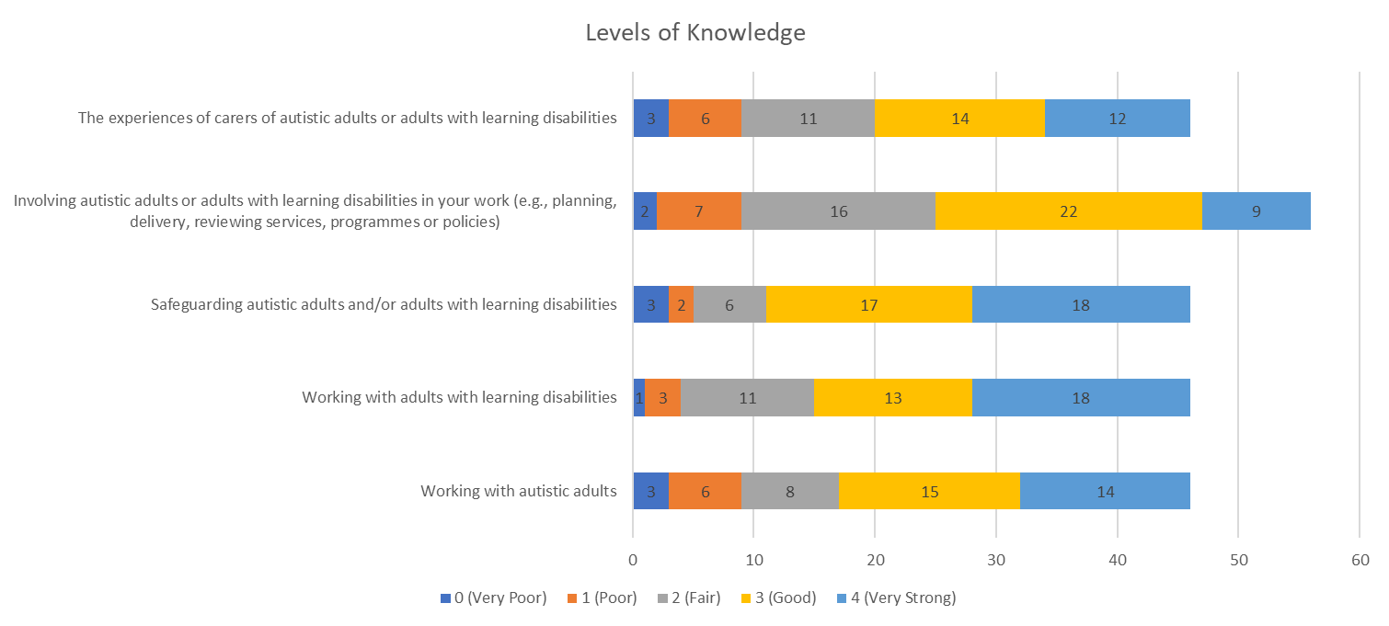
Professionals shared their views on enabling good practice and support for adults with LD and autism. They are confident in supporting these individuals but identify a gap in understanding carers' experiences.
Notes:
A range of tools was found helpful when working with adults with disabilities, the top four being:
Professionals working together
Involvement of the autistic adult or adult with learning disabilities
Involvement of autistic adults and adults with learning disabilities
Local services I can refer or signpost to

Slide 53
Responding professionals reported on gaps observed in Tower Hamlets including lack of inclusion, knowledge, resources as well as complexity of needs
The previous strategy prioritised user involvement and recognises carers' vital role in supporting adults with learning disabilities, emphasising the need to engage them in service planning and delivery actively. Despite this, professionals have noted ongoing challenges in this area, underscoring the imperative for continued efforts to enhance user involvement and carer support to ensure more responsive and inclusive services.
The previous strategy also identified the need for improving communication and staff training to facilitate engagement with adults with a learning disability, including people who communicate nonverbally. This is still an area of concern, as professionals perceived that there is still a lack of skills and services available in the wider community.
Other:
Lived experienced colleagues
Well-being practitioners
Policies and procedures
Systemic working
Trauma-informed care
Empowerment
Trustworthy relationships
Interpreters and cultural advisors
Funding
Positive attitude
Disconnect between services and commissioners
Notes:
The survey revealed that there are several barriers to accessing services, including a lack of knowledge, insufficient resources, and limited awareness of available services. This indicates hoe more support is required to

Slide 54
Professionals identifies Gaps Identified in Tower Hamlets to Improving Lives of Autistic Adults and Adults with Learning Disabilities through their views and experience
Some of the results highlighted:
Service Accessibility and Funding: Some referrals to the CLDS team are not accepted, and specific community centres lack support due to funding issues, making it difficult for patients to navigate and access necessary services.
Employment Disparities: Autistic adults often face challenges in employment opportunities, and psychiatric wards are often not suitable for them.
Professional Awareness and Training: Professionals in other departments lack knowledge and training in supporting individuals with learning disabilities (LD) or autism, leading to ineffective support and services.
Social Integration and Financial Insecurity: Many individuals face a lack of integration into society, leading to loneliness, and there is a shortage of finances, resulting in food insecurity.
Health Advocacy and Access to Services: There is a need for more advocacy to support individuals in accessing health appointments and services, as well as specialised support for complex behaviours and autism.
Early Diagnosis of LD: There is a need for earlier diagnosis of learning disabilities to ensure a smoother transition and access to appropriate support services.
Transitioning to Adult Care: Better handover and support from Children's Social Care to Adult Social Care are needed, along with consideration of CHC assessments for children under 18.
Resourcing of Community Support: There is poor resourcing for individuals to access the community safely, particularly for those with limited awareness of risks.
Individualised Support and Tailored Services: Services need to be more personalised to address the diverse needs of individuals with LD or autism rather than adopting a one-size-fits-all approach.
Lack of Awareness and Understanding: Professionals and mainstream services often lack awareness of autism and LD, leading to misinterpretations and inadequate support.
In the title, please indicate that these are the views of professionals that responded to the survey

Slide 55
Professionals shared suggestions for how to improve the skills and knowledge of the local services
The main themes which arose were:
Communication Accessibility: What Services are available locally? Utilisation of LD templates and signposting techniques. Training for effective communication with individuals with learning disabilities. Accessibility through transcription to audio for assessments, support plans, etc. | Understanding and Engagement: Case studies are available to comprehend barriers and enhance engagement strategies. Lived experience in case studies to foster understanding and best practices.
Support Tools: Provision and training for Makaton resources for enhanced communication. Safeguarding measures and training to ensure the well-being of all involved. | Community Engagement: Guidance on how to engage with carers, recognising their crucial role in the support network.

Slide 56
Transistion to adult services

Slide 57
Best practice Transition to adult service
The National Institute for Health and Care Excellence (NICE) has published comprehensive guidance on good practices for the transition from children’s to adult services. Here are the key recommendations:
Overarching Principles for Good Transition
Transition should be planned in advance with the young person and their carers and initiated a year before the transfer is due.
Transition should be person-centred, considering the young person’s needs and circumstances.
Transition should promote the young person’s autonomy and independence.
Planning Transition
A transition plan detailing the support needed before, during and after the transfer should be developed.
The transition plan should be reviewed regularly and updated as the young person's circumstances change.
Young people should be involved in service design and delivery related to transition.
Support Before and After Transfer
Young people should be empowered to make decisions about their care through advocacy and supported decision-making.
Information about the transition process and adult services should be provided to the young person and their family.
There should be joint meetings between children's and adult services before transfer.
Adult services should provide age-appropriate environments and facilities.
Supporting Infrastructure
There should be a formal transition policy and protocol covering all services involved.
A named transition worker should coordinate the transition process.
IT systems should allow effective sharing of information between services.
Additionally, NICE emphasises the importance of no gaps in service provision during transition, with children's services continuing until adult care is in place.
Early transition planning from age 14 is recommended for those with complex needs
Notes:
https://www.nice.org.uk/guidance/ng43

Slide 58

In Tower Hamlets, support for people transitioning from children’s to adult’s services is available
Previous assessment of need in 2016-2017 identified that more coordination and joint working between children and adult services at transition was needed. In the 2017-2020 strategy, aims were set to ensure multi-agency and joint planning so that staff worked together. Since this time, a review of transition between children and adult services was completed and
Transition Support Team
Transition Leaflet
The Care Group has launched a new leaflet titled "Transition: Moving from Children's Services to Adult Services". This leaflet was created in collaboration between Frances Dawson-Otoo, Children's Continuing Care Nurse Assessor, colleagues from Tower Hamlets' Children with Disabilities Team (CwDT), and Special Educational Need (SEN) services.
The leaflet aims to provide guidance to young individuals and their caregivers as they navigate the process of transitioning from children's services to adult services. It covers several key questions and signposts readers to the appropriate services.
During the time of the transition, the service is made of :
Disability Transition Team
Community Learning Disability Service (CLDS)
Tower Hamlets Youth and Connexions
Service
Educational Psychology
Disabilities Options Team (physical disabilities)
Special Educational Needs
Tower Hamlets NHS PCT
Job Enterprise and Training JET

Slide 59
Tower Hamlets Transition Support for Individuals with Learning Disabilities
The overall goals are to facilitate smooth transitions by implementing early planning, fostering interagency collaboration, providing personalised support, promoting community inclusion, and supporting the development of independence skills.
Dedicated Transition Team (CLDS)
  Works with young people from age 14
  Ensures smooth handover to adult services
Transition Board
  Facilitates joint working between children's and adult services
  Involves young people and families in future planning
  Emphasizes collaborative approach for successful transitions
Adult Learning Disability Strategy 2017-2020
  Offers a broader range of flexible, personalised activities for diverse age groups and needs
  Promotes inclusion in mainstream community activities with reasonable adjustments
  Supports the development of independent living skills like money management
  Aims to reach individuals slipping through service gaps during transition
Supported Employment Programs
  Supported internships and apprenticeships (e.g., Tower Project, DFN Project Search, council apprenticeships)
  Assists young adults with learning disabilities in transitioning into employment
Notes:
https://www.elft.nhs.uk/services/tower-hamlets-community-learning-disabilities-service
https://www.localoffertowerhamlets.co.uk/pages/local-offer/send/let-s-talk-send

Slide 60

Transition between children and adult services
A study of young people with autism and learning disabilities found that planned hospital admission rates decreased during the transition to adult care, while unplanned admission rates increased before and after the transition (Zylbersztein et al, 2023)
Research conducted by PHAST in 2023 indicated the following issues:
Delayed and Ineffective Transition Planning:
HNA findings highlight delays and ineffective collaboration in transition planning.
Poor understanding of the needs of individuals in transition.
Information System Challenges:
Information systems lack effective connectivity across different agencies.
Recommendations for Improvement:
Advocate for a more integrated and data-driven approach.
Enhance care coordination during transition periods.
Initiate statutory transition planning during the year 9 review when individuals are 13-14 years old
(PHAST, 2023)
Notes:
Zylbersztejn A, Stilwell PA, Zhu H, Ainsworth V, Allister J, Horridge K, et al. Trends in hospital admissions during transition from paediatric to adult services for young people with learning disabilities or autism: population-based cohort study. The Lancet Regional Health - Europe. 2023 Jan;24:100531.

Slide 61
Service users and carers identified areas for improvement in the support for transitions
Survey Findings
The survey results indicate a need to address several issues, and the transition isn't running smoothly. Below are some of the results identified in the professional survey, indicating the transition process stated in the strategy needs improving:
The disjointed and clunky transition between children and adult services.
Lack of support for individuals after they become adults.
Need for improved transition planning and partnership with Children's Health and Social Care Services.
Requirement for more seamless transitions spanning both children and adults.
Problems transitioning into day centres from school due to educational deficiencies in the borough.
Transitioning was identified as an area needed for improvement In a focus group with carers :
Lack of Information: There's insufficient guidance available for families and individuals during this transition assistance for challenging kids when they become adults
Poor Support for Challenging Cases: Adults with complex needs often receive less support than required.
Difficulty Accessing Services: Information about social and day centres is hard to obtain, making it difficult to find necessary services.
Poor Management of Care Transitions: Moving between care settings is poorly handled, leading to decreased support despite increased needs.
Inadequate Transition Processes: Changes in services during the transition often result in reduced support.
Outdated Health Data: Consultants frequently spend time catching up on health data rather than providing care.
Lack of Preventive Measures: No measures are in place to prevent worsening health conditions.
Communication Failures: Poor communication with carers leads to unnecessary deaths among adults with LD.

Slide 62
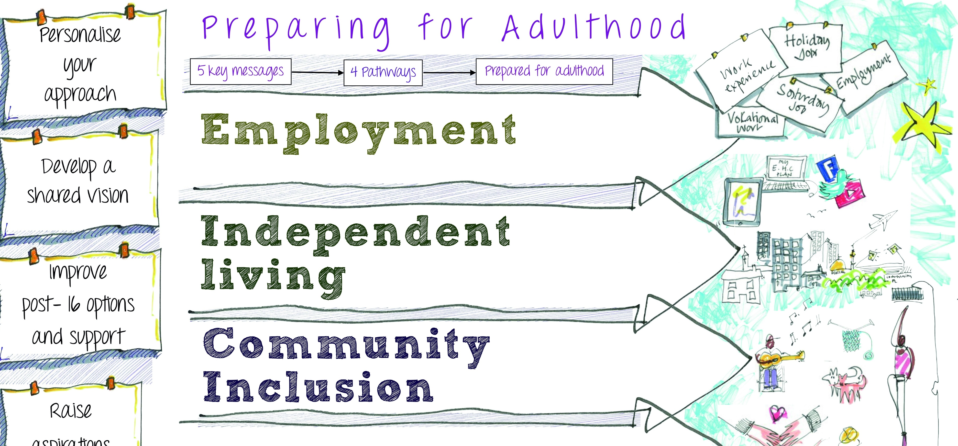
Improving transitions should remain a priority as challenges continue despite recent advancements
The National Institute for Health and Care Excellence (NICE) has published comprehensive guidance on good practices for the transition from children’s to adult services including advanced planning, person-centred care, autonomy and independence, and supporting infrastructure
The National Development Team for Inclusion (NDTi) has also published a set of tools and resources for planning, employment, independent living and relationships
In Tower Hamlets:
  The dedicated multi-agency transition team works with young people from age 14; there has been a review of the transition pathway, a new protocol developed between children’s and adults’ services, as well as a new leaflet
  The protocol describes options available for people whose learning disability does not meet the threshold for CLDS; some of these go through to the Adult Social Care Initial Assessment team for Care Act assessments.
  However, reported challenges remain for people with a learning disability transitioning to adult services (according to the ELFT needs assessment as well as feedback from service users, carers and staff)
    Delays and ineffective collaboration in transition planning and changes in provision leading to gaps in support in adulthood
    Challenges with support for people with more complex needs
    Inadequate information and communication for families, carers and individuals
    Information systems lacking integration between agencies and having outdated data
  There is an opportunity to build off the new local SEND strategy, currently being developed, which has a priority area around young adults’ education, training and employment opportunities.

Slide 63
Health and wellbeing and Adult Social Care

Slide 64
Adults with learning disability often experience a range of barriers to accessing health and care services
According to Mencap (2023), common barriers to health and care services experienced by adults with LD include:
Insufficiently accessible transport links
Undetected identification of patients with learning disabilities
Limited staff understanding of learning disabilities
Failure to recognise the health issues of individuals with learning disabilities
Incorrect diagnoses
Anxiety or a lack of confidence among people with learning disabilities
Inadequate collaboration among various care providers
Limited involvement allowed from caregivers
Inadequate aftercare or follow-up care
Notes:
Numerous obstacles hinder individuals with learning disabilities from accessing high-quality healthcare, including:
.
These barriers, as identified by Heslop et al. (2013), Tuffrey-Wijnes et al. (2013), and Allerton and Emerson (2012),
UK Government. Digital Lifeline Fund: Evaluation summary [Internet]. 2022 [cited 2023 Feb 27]. Available from: https://www.gov.uk/government/publications/digital-lifeline-a-qualitative-evaluation/digital-lifeline-fund-evaluation-summary
Tower Hamlets 2011https://www.local.gov.uk/our-support/safer-and-more-sustainable-communities/health-inequalities-hub/health-inequalities

Slide 65
Best practice
The "Supporting adults with a learning disability to have better lives" framework directly relates to and reinforces several best practices for supporting the employment of adults with learning disabilities:
Equal Access to Opportunities
One of the key vision elements is "Equal access - To opportunities and services e.g. contributing to community life, social and leisure opportunities, housing, banking, jobs, health, and transport." This aligns with the best practice of supported employment providing access to competitive integrated employment in the open labour market.
Person-Centered Planning
The framework emphasises “person-centred planning and support—Involve people, families, and carers in solutions that respond to the individual strengths and needs." This principle mirrors the supported employment principle of person-centered planning and customised job matching based on an individual's interests, strengths, and needs.
Transition Planning
Under "Understand demand and use prevention and early interventions effectively", the framework highlights the importance of effective transitions from children's to adult services. This aligns with the best practice recommendation for early transition planning from age 14 to prepare for employment.
Developing a Capable Workforce
One of the domains is "Develop the local workforce to have the capacity and capability needed to support adults with learning disability needs." This relates to having skilled job coaches and workplace support, which evidence shows is crucial for successful employment outcomes.
Efficient Systems and Partnerships
The framework calls for "Operate efficient and accessible business systems and processes that ensure value for money." Supportive policies, funding models, and cross-system partnerships are identified as enablers of effective supported employment services.
In summary, the "Better Lives" framework aligns with and reinforces many of the established best practices for increasing competitive integrated employment for adults with learning disabilities through its emphasis on equal access, person-centred approaches, transition support, capable workforce development, efficient systems and cross-sector collaboration
Notes:
https://www.local.gov.uk/our-support/partners-care-and-health/autistic-and-learning-disabilities/learning-disabilities/better-lives

Slide 66
The UK government and NHS have implemented several national strategies and policies aimed at improving the health and wellbeing of adults with learning disabilities
NHS Long Term Plan (2019)
Staff Training
LeDeR Programme
Improving Data and Evidence
Set a target to increase the uptake of annual health checks for people with learning disabilities to at least 75% (achieved in 2021).
Committed to introducing regular hearing, sight, and dental checks for children and young people with learning disabilities in special residential schools.
Expanded the STOMP-STAMP programmes to reduce overmedication of people with learning disabilities or autism.
The Learning Disabilities Mortality Review (LeDeR) programme reviews deaths of people with learning disabilities to identify areas for improvement in health and social care services.
In 2022, the programme was expanded to include autistic people without a learning disability to address health inequalities and premature mortality in this group.
Subject to evaluation, the Department of Health and Social Care (DHSC) will make training on autism and learning disabilities available for all 2.7 million health and adult social care staff to improve their experiences.
The National Disability Strategy outlines plans to improve the availability, quality, and use of disability data in health and social care datasets.
DHSC will establish a disability data working group and fund research to improve the quality of life for those with multiple long-term conditions.
By focusing on increasing access to healthcare, reducing health risks, improving staff training, and enhancing data collection, these national policies aim to address the health inequalities faced by adults with learning disabilities across the UK

Slide 67
Tower Hamlets’ previous strategy had a focus on enhancing health and well-being for adults with a LD
Enhancing physical and mental health outcomes through targeted interventions and support services.
Promoting independence through skills development, vocational training, and employment opportunities.
Implementing community-driven initiatives that empower individuals with learning disabilities and promote social inclusion.
Ensuring access to quality healthcare services by addressing barriers and providing appropriate accommodations.
Developing personalised support plans tailored to the unique needs and preferences of each individual.
Respecting individuals' rights and promoting autonomy in decision-making processes.
Improving integration between health and social care services to provide holistic support and care coordination.
Collaborating with stakeholders, including individuals with learning disabilities, families, caregivers, and service providers, to co-design and implement effective strategies.
Fostering a community culture of inclusion and acceptance to reduce stigma and discrimination.
Monitoring and evaluating the impact of the strategy to ensure continuous improvement and responsiveness to evolving needs

Slide 68
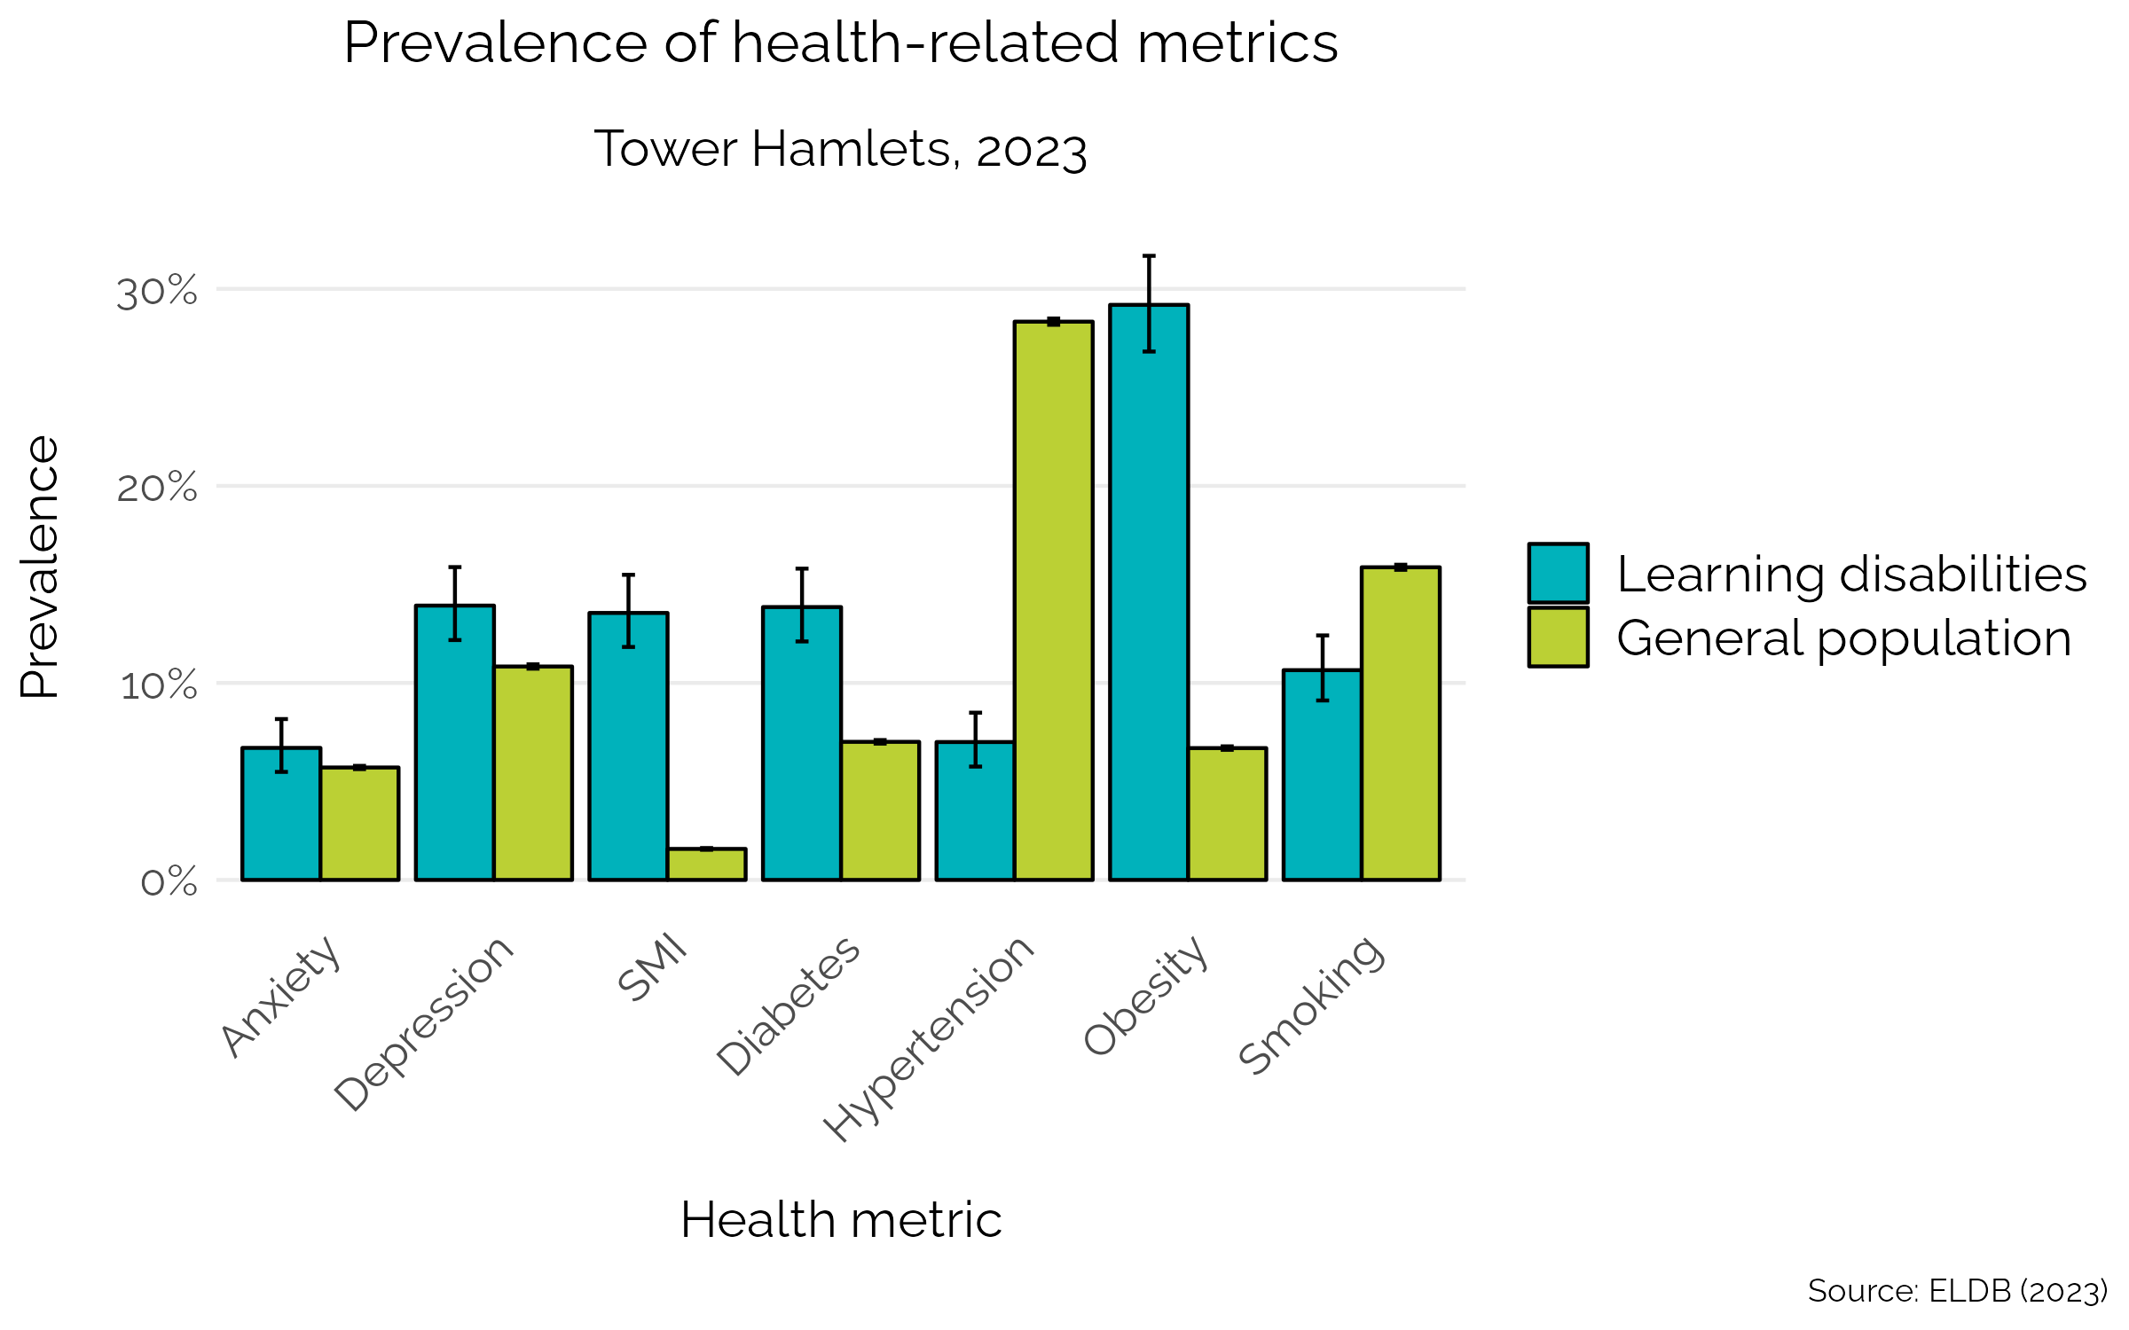
Health disparities and digital exclusion exist among individuals with learning disabilities
GP data in Tower Hamlets:
Individuals with learning disabilities face a relatively higher prevalence of health conditions, emphasising the need for targeted interventions and support (PHAST, 2023).
Analysis of GP-registered data reveals significant health condition disparities between individuals with learning disabilities and the general population in Tower Hamlets - Adults with an LD have higher rates of depression, severe mental illness, diabetes, and obesity compared with the general population (right)
Comorbidities and Health Implications:
Individuals with learning disabilities often experience multiple comorbidities. Common comorbidities include cardiovascular diseases, diabetes, epilepsy, mental health issues, and other functional impairments, contributing to poorer overall health (PHAST, 2023).
Digital Poverty:
An estimated 35% of individuals with learning disabilities lack essential digital skills, compared to 21% of the general population (GOV, 2024)
Stakeholder interviews for this health needs assessment have revealed that a significant amount of information related to health needs and GP appointments is available exclusively online, which can present challenges for individuals with learning disabilities who often face digital poverty and exclusion (PHAST, 2023)

Slide 69
High Health Disparities Among Adults with Learning Disabilities in Tower Hamlets
Prevalence of Coexisting Conditions in Tower Hamlets:
  45% of individuals (aged 14 and over) with learning disabilities in Tower Hamlets have a coexisting condition.
Cardiovascular Diseases in Tower Hamlets:
  The prevalence of CVD diagnoses among those with learning disabilities in Tower Hamlets is 45.2%.
Cancer Prevalence Among Learning Disability Patients:
  Learning disability patients exhibit more than twice the rate of cancer prevalence compared to the overall practice registered population.
Higher Prevalence Among Learning Disability Patients:
  Learning disability patients show a higher prevalence for various conditions, including diabetes, asthma, stroke, and all mental health issues such as depression and Serious Mental Illness.
Morbid Obesity Rates:
  Morbidly obese case rates are considerably higher among individuals with learning disabilities, highlighting significant health inequality in this aspect.
Severe Mental Illness Prevalence:
  Notably a higher prevalence of severe mental illness (9.3%) is observed among individuals with learning disabilities compared to the general population (0.9%).
                (Tower Hamlets annual Report, 2022)
Notes:
https://www.towerhamlets.gov.uk/Documents/Public-Health/TowerHamletsPublicHealthReport2022.pdf

Slide 70
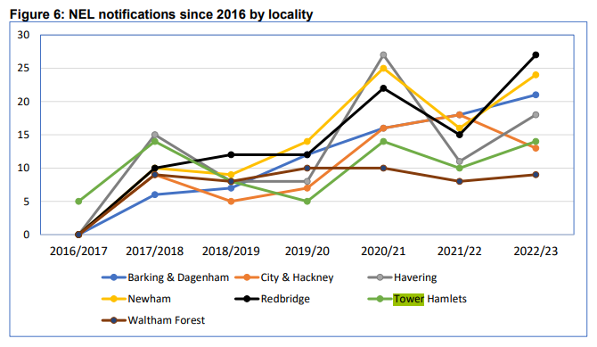
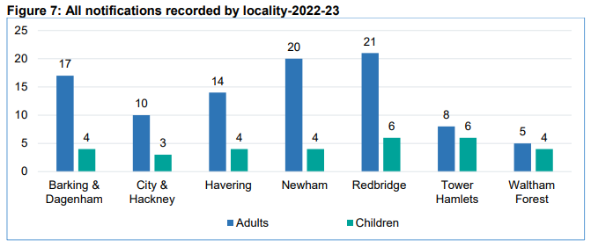
Tower Hamlets has had fewer deaths among adults with LD than other NEL boroughs, but still areas to improve
Tower Hamlets was one of the pilot sites of the Learning from Lives and deaths for people with a learning disability and autistic adults (LeDeR) programme in 2026-17, which is now delivered by the NEL ICB locally.
There may be gaps in information about deaths where LD was not diagnosed or recorded.
According to the 2022-2023 report from NEL ICB, further work is required re:
Links between key partners and care providers so that findings are shared and reflected in work streams
The development of local LeDeR forums and governance
Awareness of the LeDeR programme across partners so that deaths are notified and reviewed
Annual health checks among persons aged 14+ that are robust with an action plan
GP registrations being up to date
Care staff recognition of deterioration and end of life care so that hospitalisation is minimised and help is sought in good time
Compliance with the Mental Capacity Act (2005), Deprivation of Liberty Safeguard (DoLs) and application of best interest
Staff empowerment for holding end of life care conversations in hospital and community settings that enable early planning with individuals and people who care for them
Awareness of the importance of reasonable adjustments for people with a learning disability and autistic people to remove barriers to accessing services
Notes:
NELICB_LeDeR-Annual-Report-2022-23_-20230815_v03-final.pdf

Slide 71
The number of adults with LD using Adult Social Care has increased since 2018
The age band 25-34 uses adult social care services the most, followed by the 18-24 age group, among ASC service users with LD-listed PSR over time.
The majority of, ASC service users are Bangladeshi, followed by White British.

Slide 72
Navigating Healthcare: Challenges and Efforts of Adults with Learning Disabilities
Interviews with adults with LD identified
Healthy Lifestyle Efforts:
  Diet and Exercise: Adults with LD eat well and go for walks, which improves their health with the help of a support worker. They are also drinking lots of water and spending time outside.
  Challenges: Eating healthy isn't always easy, and walking more is needed.
Healthcare Experiences:
  Hospital Visit: A good experience was reported when getting checked for an issue at the hospital.
  District Nurse: Sometimes, the district nurse doesn't show up, which can be challenging for adults with LD.
Support and Appointments:
  Support Worker: There are instances where adults with LD lack support with healthy living activities like cooking.
  GP Visits: They can visit their GP, but booking appointments can be difficult.
  Online Challenges: Adults with LD face challenges with online services and interpreting, especially when involving their parents.
Healthcare System Improvements:
  Staffing: More NHS staff, like GPs, need to be hired to reduce their stress and improve services.
  GP Services: Delays in getting PRN (as-needed medication) requests from GPs have been experienced, indicating a need for faster GP services.
  Doctor's Assistance: Doctors have been helpful during hospital visits.

Slide 73
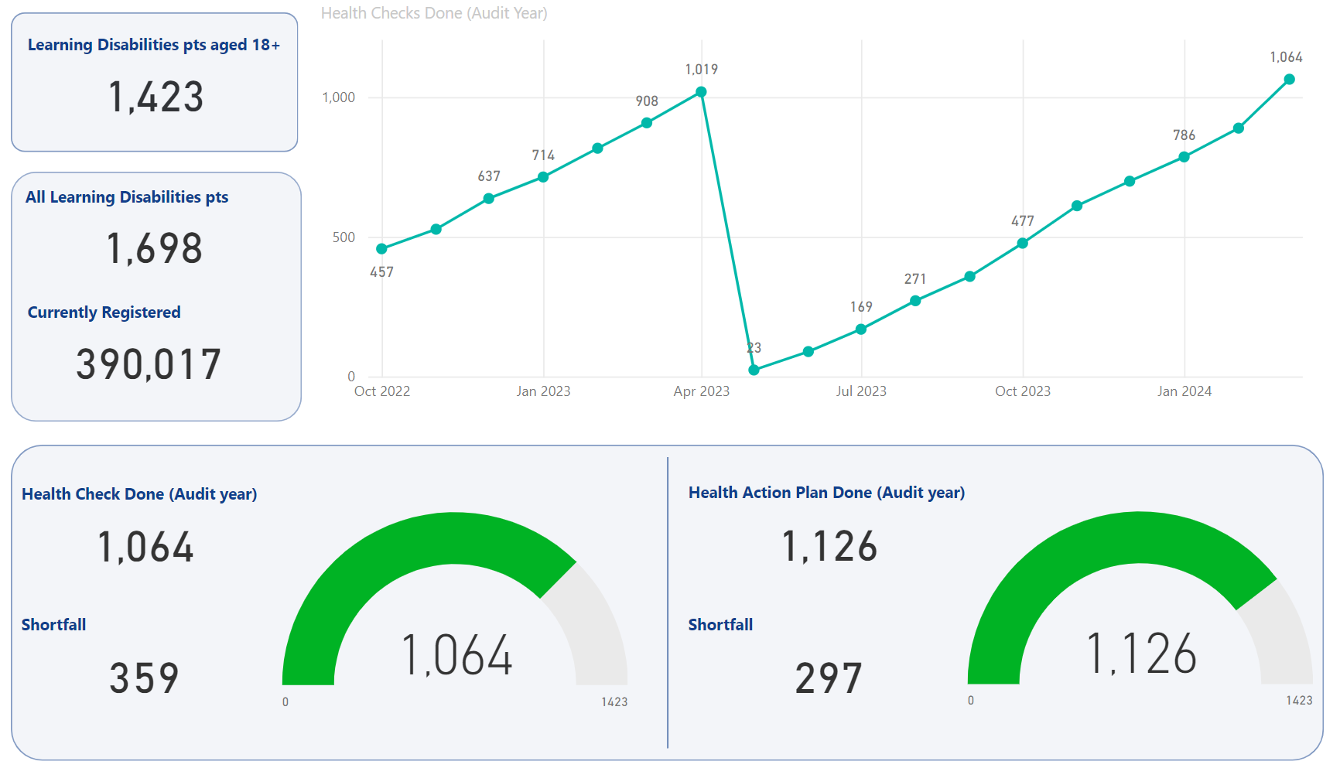
The uptake of annual health checks among adults with LD is slightly better than in 2022-2023
People with a learning disability aged 14 or older are eligible for an annual health check, a preventative check to pick up a wide range of unmet health needs (different from the NHS Health Check scheme) including physical health, weight and height, blood pressure, vision and hearing, oral health, mental health, medication review, immunisation status, nutritional assessment, screening for chronic conditions, review of health goals and concerns, referral for further assessment or support, assessment of communication and support needs, and health promotion and education (NHS,2024)
GP practices in Tower Hamlets completed a greater proportion of health checks in 2023-2024 (75%) compared with 2022-2023 (70%), although this completion rate varied between primary care networks (66% in Network 1 to 90% in Network 2) (See graph) -
Low uptake rates in these health interventions may signify challenges or barriers in the community related to awareness, accessibility, or willingness to participate in preventive health measures.
It could prompt a need for targeted outreach, education, and efforts to improve accessibility to these health services in the Tower Hamlets community with adults with learning disabilities.
Notes:
https://www.nhs.uk/conditions/learning-disabilities/annual-health-checks/

Slide 74
Initiatives for individuals not participating in the annual health checks
Health & Adults Scrutiny Sub-Committee:
  Tower Hamlets Council and health partners oversee care for people with learning disabilities.
  Scrutiny sessions in 2020 and 2021 addressed health, accommodation, and employment.
  An updated action plan incorporating recommendations was presented in December 2021 (Tower Hamlets, 2022)
Annual Health Checks (AHCs):
  AHCs are crucial for early detection of health needs.
  Only 37% of those with learning disabilities live beyond 65.
  NHS aims for at least 75% to receive AHCs by 2023/24 (NHS England, 2021)
Innovative Approaches:
  NHS encourages local pilots for creative service delivery.
  Specialist expertise can enhance existing services.
  Focus on engaging difficult-to-reach groups like young adults and BAME communities (NHS, 2021).
Communication Passports:
  Utilise communication passports for individuals with complex communication needs, offering key information and recommendations (Tower Hamlets, 2024)

Slide 75
Adults with learning disabilities generally rate health services as satisfactory but find it easy to access information or help.
Adults with learning disabilities find the healthcare services to be satisfactory (2).
Majority of the Adults with learning disabilities rated 3 for getting information or help

Slide 76
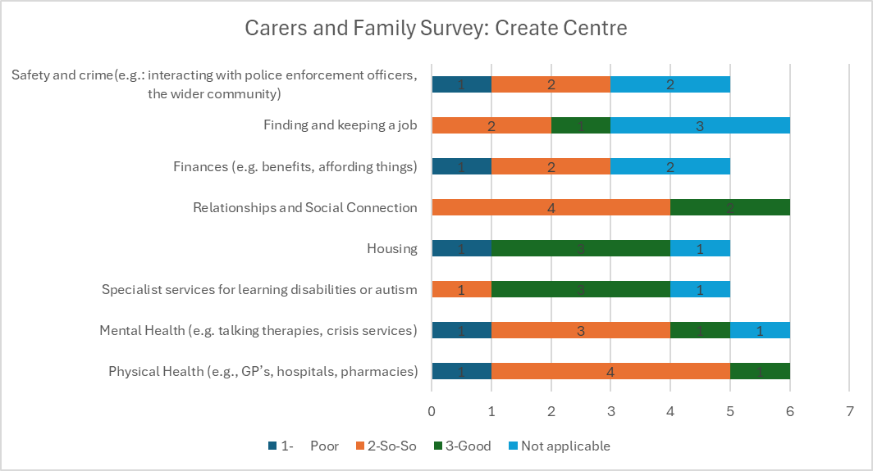
Carers and Family Survey from Create Centre
Participants
We conducted some surveys for carers and families, relating to adults with learning disabilities.
6 Surveys were completed and 4 of the adults they cared for were 50-59 years old and two were 20-29 years old
4 were adults with learning disabilities, one had a learning disability and autism, and one had autism
Additional Comments:
Cost of transportation is very high, a lot of money from the benefits is spent on transport which previously used to be free
Attended A&E on assessments and they made a GP appointment with another surgery
Safety and crime (e.g interacting with police etc.) Non-existent

Slide 77
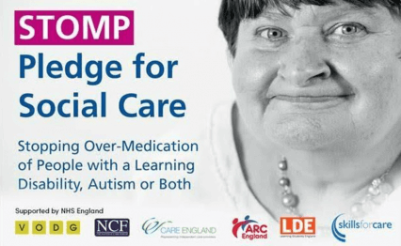
The STOMP initiative aligns with key policies and regulations
The acronym STOMP stands for "Stopping the Over-Medication of People with a Learning Disability, Autism, or Both with Psychotropic Medicines." It is a nationwide project that involves several organisations working together to prevent the excessive use of these medications, with an aim to assist people in maintaining good health and enjoying a high quality of life (NHS England, 2024) It aligns with policies and regulations such as the Mental Capacity Act 2005, Equality Act 2010, NICE Guidelines, and Care Quality Commission such as considering less restrictive alternatives, making reasonable adjustments, promoting regular medication reviews, and minimising use of psychotropic drugs.
Tower Hamlets
Tower Hamlets has 191 psychiatric patients. Initially, 64 were STOMP eligible, but only 30 were suitable for antipsychotic dose reductions. A learning disability pharmacist worked with the psychiatry and nursing teams to review medication. 8 patients had dose reductions, and 3 stopped taking antipsychotics. Overall, there was a 45.4% reduction in antipsychotic doses (PHAST, 2023)
A research study was conducted on 29 patients who were eligible for the Stopping Over-Medication of People with a Learning Disability (STOMP) program within TH CLDS. As a result of raising general awareness of STOMP through presentations to staff and reviews of GP letters to identify service users within the caseload who are likely to benefit and/or be receptive to dose reductions, we were able to reduce antipsychotics in 8 of the patients. So far, it has been a total reduction of 45.4%, and three patients have been completely taken off their medication (John et al, 2022)
Notes:
https://q.health.org.uk/idea/2023/improving-confidence-with-stomp-to-enable-better-care-at-home/
https://www.england.nhs.uk/atlas_case_study/use-of-positive-behaviour-support-in-conjunction-with-the-stomp-initiative-to-support-the-reduction-of-psychotropic-medication-use/
https://www.rcpsych.ac.uk/docs/default-source/improving-care/better-mh-policy/position-statements/position-statement-ps0521-stomp-stamp.pdf?sfvrsn=684d09b3_6
https://www.england.nhs.uk/learning-disabilities/improving-health/stomp/
https://www.england.nhs.uk/learning-disabilities/improving-health/stomp/
https://www.ncbi.nlm.nih.gov/pmc/articles/PMC9378033/

Slide 78
The STOMP initiative aligns with key policies and regulations:
Potential improvements that can be made to the STOMP initiative
Co-production and Accessibility
Actively involve service users, carers, and experts by experience in co-creating STOMP materials, training, and resources. This will help ensure the content is relevant and understandable and addresses real-world challenges faced by the target audience.
Translate STOMP information into multiple languages and formats to improve accessibility for individuals with diverse linguistic and cultural backgrounds.
Develop a dedicated website or app to centralize STOMP resources and make them easily accessible to all stakeholders.
Implementation and Continuous Improvement
Utilize implementation science frameworks like the Normalization Process Theory to develop structured implementation plans tailored to local contexts. This can help ensure successful adoption and normalisation of STOMP practices.
Continuously gather feedback and data from service users, carers, and healthcare professionals to identify areas for improvement and make necessary adjustments to STOMP interventions.
Establish robust data collection and monitoring systems to track progress, measure outcomes, and demonstrate the impact of STOMP on reducing inappropriate medication use and improving quality of life .
Collaboration and Knowledge Sharing
Foster multidisciplinary collaboration among psychiatrists, pharmacists, nurses, social workers, and other professionals involved in STOMP implementation. This can facilitate a holistic approach and ensure consistent messaging and practices.
Create platforms and networks for sharing best practices, success stories, and lessons learned from STOMP implementation across different regions and organizations . This can accelerate the adoption of effective strategies and promote continuous learning.
Engage with professional bodies, such as the Royal College of Psychiatrists, to disseminate STOMP principles and resources to a wider audience of healthcare professionals .
By incorporating these improvements, the STOMP initiative can become more inclusive, accessible, and effective in reducing the over-medication of people with learning disabilities, autism, or both, while promoting their well-being and quality of life.
Notes:
https://q.health.org.uk/idea/2023/improving-confidence-with-stomp-to-enable-better-care-at-home/
https://www.england.nhs.uk/atlas_case_study/use-of-positive-behaviour-support-in-conjunction-with-the-stomp-initiative-to-support-the-reduction-of-psychotropic-medication-use/
https://www.rcpsych.ac.uk/docs/default-source/improving-care/better-mh-policy/position-statements/position-statement-ps0521-stomp-stamp.pdf?sfvrsn=684d09b3_6
https://www.england.nhs.uk/learning-disabilities/improving-health/stomp/
https://www.england.nhs.uk/learning-disabilities/improving-health/stomp/
https://www.ncbi.nlm.nih.gov/pmc/articles/PMC9378033/

Slide 79
Personal health budgets (PHB’s)
Summary of Personal Health Budgets (PHB)
.
A Personal Health Budget (PHB) is a financial allocation given to eligible patients to support their health and recovery goals, allowing for greater choice, flexibility, and control over their care
Eligibility: PHBs are available to patients under specific conditions, such as adults in Continuing Health Care, children in Continuing Care, people under Section 117 (mental health), wheelchair users, and additional groups in Tower Hamlets (e.g., those with learning disabilities or COPD).
2. Control and Flexibility: Individuals can decide how to use their allocated budget, whether on traditional healthcare services or alternative methods, as long as it contributes to their overall health and well-being.
3. Collaboration: PHBs are developed through collaboration among individuals, their families or caregivers, and healthcare professionals, ensuring that the budget effectively addresses the patient’s specific needs.
Support Available for PHB Applicants
Professionals and individuals have access to a range of resources and training to support the PHB application process, including:
Key features of Personal health budgets
1. Personalisation: Personal Health Budgets (PHBs) allow patients to choose the services or products that best align with their health goals, providing flexibility in how they receive support.
Funding: PHBs offer up to £1,000 per person for 12 months, funded through the Better Care Fund.
Setting Up Activities: Professionals must consult with individuals to plan group activities, complete required forms, seek NHS approval, and ensure proper risk management and compliance.
Monitoring: Regular reviews (at 6, 12, and 10-12 months) assess progress toward health goals and adapt the plans as needed.
The toolkit offers guidance for healthcare professionals on applying for and managing PHBs effectively.
Pooled PHBs: Multiple individuals can combine their PHBs to fund shared activities or programs that align with their health goals.
Personalisation Officers: Local officers are available to guide individuals and health professionals through the process of setting up a PHB, including support with form completion and navigating the approval process.
Training Resources: Workshops, webinars, and the free online training from the Personalised Care Institute can help health professionals understand and apply PHBs effectively.

Slide 80
LIFT disability and carer data
The November 2023 LIFT update reveals key statistics about low-income households across all boroughs:
43% of all low income households are disabled and claiming ESA, DLA or both (13,934 households).
31% of all low income households are defined as claiming the highest level of disability or sickness benefit by claiming higher DLA, higher AA, enhanced PIP, or they are in the ESA Support group (10,035 households).
13% of all low income households are carer households (4,220 households).
The data highlights the significant financial challenges faced by disabled individuals and caregivers in low-income households. It emphasizes the urgent need for targeted support and resources. This underlines the necessity of tailored services for these households, which are disproportionately affected by health-related issues. Implementing policies and programs aimed at supporting disabled individuals and caregivers and improving access to resources like healthcare, financial assistance, and social services is crucial for addressing the needs of these vulnerable groups.

Slide 81


Hospital passports
Hospital passports describe individuals and their learning disability, health needs as well as any communication or reasonable adjustment considerations
The previous strategy set out an ambition to introduce cards with key information and redesign hospital passports so that hospital staff could access and use them; the North East London LeDeR strategy 2022-2025 also has a
There remains a continued need to promote the use and value of hospital / health passports with different kinds of staff so that they are comprehensive and up to date

Slide 82

Tower Hamlets recently implemented a weight management programme for adults with learning disabilities
Obesity and weight management for people with learning disabilities: guidance (Gov, 2020)
For adults with LD, actions to address healthy weight through diet and exercise are similar to other adults (with additional complexities in achieving this)
Tailored approach: Guidance emphasises personalised assessment and intervention plans considering the individual's cognitive abilities, communication needs, and health conditions.
Supportive environment: Creating environments that promote healthy choices, accessible information, and collaborative care between healthcare professionals, caregivers, and individuals with learning disabilities.
Long-term support: Highlighting the importance of ongoing support, positive reinforcement, and inclusive programs to address barriers and promote sustainable weight management for this population.
Healthy weight interventions
Shape Up: Time-limited funding for weight management enabled LBTH Public Health to commission a Tier 2 service for adults with learning disabilities. The Community Learning Disability Service, in collaboration with Create, implemented the weight management program in Tier 2 to assist adults with learning disabilities in Tower Hamlets to achieve a healthier and more active lifestyle by losing weight. Participants, along with their caregivers or support workers, were offered personalised schedules and weekly goals to work towards. The programme included weekly or bi-weekly fitness and information sessions over a minimum of 12 weeks, as well as one-on-one guidance from health and lifestyle professionals who work within the Community Learning Disability Service.
Ability Bow: Ability Bow is a charity providing specialist exercise support for people living with disabilities or complex health conditions
Bike works: All-inclusive cycling clubs in Victoria Park.
Healthy Weight Program: A 12-week program with one-on-one and small-group exercise and nutrition sessions for adults with learning disabilities. It encourages physical activity and healthy eating
Disability Sport Sessions: Centres. Swimming: Be Well runs sessions specifically for people with disabilities at Poplar Baths and Tiller Leisure Centres. Multi-Sport: Mile End Park Leisure Centre hosts sessions where participants can try different sports and activities each week. These sessions cater to various age groups
Gaps in information: What has the uptake and evaluation been of the service
Gaps in implementation: long-term funding for weight management? Inclusion of people with LD in different aspects of healthy weight
Notes:
https://www.england.nhs.uk/learning-disabilities/improving-health/stomp/
https://www.ncbi.nlm.nih.gov/pmc/articles/PMC9378033/
https://www.gov.uk/government/publications/obesity-weight-management-and-people-with-learning-disabilities/obesity-and-weight-management-for-people-with-learning-disabilities-guidance

Slide 83
Mental Health and Wellbeing

Slide 84

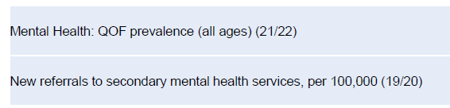
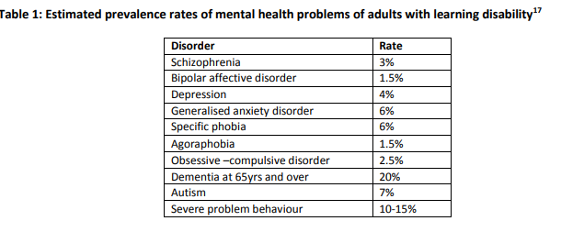
Adults with LD have multiple risk factors for poor mental health and wellbeing
Limited data available regarding mental health issues among individuals with learning disabilities Tower Hamlets, however it is found:
Higher prevalence of various conditions, including diabetes, asthma, stroke, depression, and Serious Mental Illness, noted among learning disability patients (NICE, 2023)
Tower Hamlets exhibit reduced secondary mental health services utilisation among individuals in stable employment and accommodation (PHAST, 2023 )
In Tower Hamlets, there are notable challenges related to a high prevalence of common mental health problems within the population. Specifically, Tower Hamlets record the highest percentage of long-term mental health issues among its residents, emphasising the need for targeted mental health interventions and support (PHAST,2023)
  In Tower Hamlets, there are elevated levels of deprivation, contributing to potentially increased demand for mental health services. Given the established connection between deprivation, poverty, and mental health issues, Tower Hamlets faces a heightened risk of experiencing greater demand for common mental health services.
There is a growing number of referrals in Tower Hamlets for secondary mental health services
In Tower Hamlets, there is a range of different mental health problems a person with learning disabilities may suffer from, with the most common being a severe problem behaviour.
Notes:
https://cks.nice.org.uk/topics/learning-disabilities/background-information/associated-conditions/

Slide 85
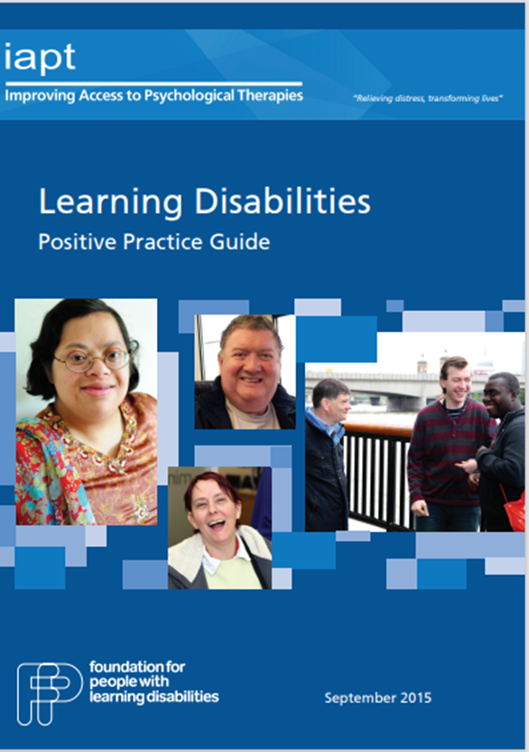
There is some guidance for making mental health services more accessible for adults with a LD
Currently, there is The Positive Practice Guide, authored by experts in learning disabilities. It outlines how the Improving Access to Psychological Therapies (IAPT) programme can effectively cater to individuals with learning disabilities.
It emphasises the importance of making reasonable adjustments in therapy delivery to ensure optimal benefits for this demographic. By addressing their specific needs and implementing appropriate modifications, individuals with learning disabilities can access and benefit from NICE-recommended psychological therapies offered by IAPT services.
Key adjustments include:
Using simple language and visual aids to aid communication.
Offering extended sessions or breaks to allow for cognitive processing.
Provide flexible scheduling and allow for support from a carer or advocate.
Adapting therapeutic techniques, maintaining consistent routines, and setting tailored goals.
Ensuring extra time for assessments to fully understand individual needs.

Slide 86
Mental Health Services in Tower Hamlets
Mental Health Services
The Community Learning Disability Service (CLDS) provides mental health support services like psychological therapists (psychologists, art therapists) and psychiatrists for adults with learning disabilities in Tower Hamlets.
Notes:
https://www.towerhamletsconnect.org/information-and-advice/wellbeing-and-mental-health/mental-health/mental-health-services/

Slide 87
Carers view: Taking care of physical Health and Mental Health
Health Care and Support General Care:
Strengths:
  Hospital care is generally effective.
  GPs are good.
Challenges:
  GPs in residential care are often not proactive, leaving most tasks to consultants.
  Carers are not valued or involved by healthcare professionals.
  Adults with learning disabilities (LD) cannot often answer for themselves.
  Services do not include carers' input.
  Adult service is horrible, communication is bad, no suitable equipment, no bed, service and staff not supportive, overall an awful experience
  No Empathy
  Training needs to be on-going
  1 learning disability coordinator throughout NHS (BARTS Trust)
  Hospital Passport: staff are not aware of it or do not use it appropriately, hospital passport not observed
  There needs to be more flexibility, better communication
  A more personal profiles needed in GP
  Hospitals need to cater for food for adults with LD

Slide 88
Carers view: Taking care of physical Health and Mental Health cont…
Suggestions
Improved Appointment System: Implement double appointment slots and train reception staff to be more aware and accommodating of the needs of individuals with LD.
Post-Appointment Reminders: Provide reminders of discussed topics after appointments for carers, GPs, and individuals with LD to enhance continuity of care.
Patient Profiles: Include profiles in GP patient records to highlight specific needs and preferences when making appointments.
Carers should be involved in planning campaigns and interventions related to LD care to ensure their perspectives are considered.
Limited LD Nurse Capacity: Address the limited capacity of LD nurses by recruiting more professionals to meet the demand within the trust.
Clear Advertisements: To promote awareness and participation, ensure clear and accessible advertisements for annual health checks for individuals with LD.
Multidisciplinary Team Involvement: Include carers in Multidisciplinary Teams (MDT) to facilitate holistic care planning and decision-making.
Hospital Passport Observance: Ensure consistent observance of hospital passports throughout the patient's journey and within patient folders to effectively communicate individual needs.
Utilise resources and expertise from the Tizard Centre to enhance support and services for individuals with LD.

Slide 89
Tower Hamlets has a range of health interventions in place aimed at addressing disparities, but gaps remain
Programmes | Current status
GP Register | A list of people with a LD for a GP surgery based on a SNOMED code – being on this register enables identification for targeted interventions (lack of diagnosis or access to / registration with a GP can therefore present barriers to wider service access)
Annual health checks | People with a LD aged 14+ are eligible for an annual health check. This is a preventative check to pick up a wide range of unmet health needs GP practices in Tower Hamlets completed a greater proportion of health checks in 2023-2024 (75%) compared with 2022-2023 (70%), meeting the national target. However, this completion rate varied between primary care networks (66% in Network 1 to 90% in Network 2). Limited information available about the follow-up actions.
LeDeR programme | Annual reviews have produced recommendations for system improvements at a NEL level e.g., local LeDeR forums, collaboration between partners, compliance with relevant legislation, holding end of life conversations, reasonable adjustments
Stopping overmedication | In line with the NHS England programme (STOMP), there is a LD pharmacist who has worked with psychiatry team and nursing team to conduct medication reviews and there have been small numbers of reductions with an overall reduction of 45% (PHAST, 2023).
Communication passports | These passports, which support communication and coordination, are not yet widely used or supported. There are templates available from CLDS and at the end of annual checks.
Personal health budgets | There is a toolkit available for Tower Hamlets providers to use but long-term funding is not yet available.
Accessibility guidance and support in health care (for disabled residents including adults with a LD) | In 2022-2023, Real DPO produced best practice guidance for health and care providers and Public health implemented a disability awareness pilot co-produced with disabled volunteers including people with a LD Training about disabled access to be delivered to Tower Hamlets Together partners Frontline health and care staff working in services need to be supported to adopt these, so similar learning should be directed towards commissioners and managers.
Annual health checks are meant to examine a wide range of health needs including:
physical health, weight and height, blood pressure, vision and hearing, oral health, immunisation status, nutritional assessment, screening for chronic conditions,
mental health,
medication review,
review of health goals and concerns,
referral for further assessment or support,
assessment of communication and support needs, and
health promotion and education.

Slide 90
Adults with LD are also using specific health services but uptake and accessibility could be better
Programmes | Current status
Healthy weight | Public Health commissioned a weight management programme for adults with LD, similar to a Tier 2 level programme but tailored to this cohort in community settings including accessible communication approaches. There have been challenges in achieving expected weight loss outcomes and Public Health will be conducting an evidence review in 2024 prior to re-commissioning in 2025. Other offers have included Ability Bow, Bike Works, and tailored sport sessions. The new LBTH leisure service is exploring how to provide an appropriate offer for adults with a LD, which could receive time-limited funding from NEL ICB. Staff, carers and service users noted a need for increased support around healthy eating.
Sexual and reproductive health | The CLDS health and wellbeing lead offers sex education and resources to service users. In 2022-2023, All East sexual health services provided services to 10 adults with a learning disability of a total 26,000 patients. There are national easy read resources but these are not currently used locally.
Seasonal vaccinations | Despite increased risk of morbidity due to flu, seasonal flu vaccination is low among people with LD (nearly 1 in 2 got vaccinated in the past year) especially younger people (closer to 1 in 4); covid booster uptake has been similarly low A pilot in one PCN using tailored outreach generated learning re: settings, consent, training, and comms approaches to apply to improve uptake and outcomes
Cancer screening | In 2023-2024, there was lower uptake of bowel and breast cancer screening among TH Adults with LD compared with NEL, but higher uptake of cervical cancer screening. There is an easy read pamphlet available on the North East London Cancer Alliance website.
Mental health and wellbeing | Risk factors for poor mental health incl. wider determinants and adverse childhood experiences. There is practice guidance for psychological therapies to enable working with adults with LD (e.g. through reasonable adjustments) however, implementation of this and participation in Talking Therapies has not been investigated yet. Public health are commissioning a project to address loneliness among people with LD.
Substance use | 1.8% of substance use treatment service users during 2023-2024 had a recorded learning disability. It is possible to request reasonable accommodation on self-referral but accessibility levels are not known.
There is a continued need for wider implementation of these to improve uptake of these preventative interventions
Materials for promoting uptake with easy read formats, clear illustrations
Personalised support
Training for health professionals
Appropriate reminder systems
Informed Consent
Reasonable accommodation e.g. extended appointments
Involving families and carers
Accessibility of facilities

Slide 91
Health Protection

Slide 92
Barriers to cancer screening can be overcome using reasonable adjustments
Participation in cancer screening programmes can be improved through education/training, support, and collaboration with learning disability services as well as people with a learning disability
These case studies aim to improve screening uptake and identify barriers faced by adults with learning disabilities in healthcare and screening. They are examples of successful interventions to make health care more accessible.
Torbay and South Devon NHS Foundation Trust have created videos aimed at Bowel Cancel screening. These videos are aimed at those with learning disabilities and carers but can be used by everyone to help them understand the cancer bowel screening process (torbayandsouthdevon, 2024)
Breast, Bowel and cervical Screening: Easy reads are available
Camden Council's Integrated Learning Disability Service (CLDS) collaborated with local hospitals to analyse data on admissions for people with learning disabilities, revealing a significant issue of repeat admissions, particularly from supported living settings. This data prompted internal and partner recognition of the problem's magnitude and spurred proactive action. By identifying common causes of repeat admissions and individuals at risk, health and social care partners can work together to prevent avoidable admissions. CLDS plans to use the High Impact Change Model for a detailed review of this data. Learning from Safeguarding Adult Reviews, CLDS piloted the Significant 7+ scheme, training social care staff to recognise and manage signs of health deterioration in residents, initially designed for dementia care homes, to prevent avoidable A&E visits and acute admissions (Local, 2021)
A local project in the North East and Cumbria has significantly increased bowel cancer screening uptake among people with learning disabilities by nearly 30%, providing them with specialised support and assistance in making informed decisions about participation. Led by the North East and Cumbria Learning Disability Network, in collaboration with local GPs, NHS screening hubs, and community-based learning disability teams, the initiative is part of broader efforts to enhance cancer services accessibility and outcomes for this population, addressing their heightened risk of gastrointestinal cancer and historically lower screening rates (NHS England, 2024)

Slide 93
National Resources Available to help increase Screening
There are available resources aimed at aiding people with learning disabilities in comprehending and accessing bowel cancer screening. The new materials include an easy guide to undergoing a colonoscopy, an easy guide to undergoing a CT colonography (CTC) scan, and guidance specifically tailored to support individuals with learning disabilities throughout the screening process. These resources seek to improve understanding and access to screening procedures, ultimately contributing to better health outcomes for this demographic (Gov, 2020)
Cancer Research UK: These resources, including leaflets, books, websites, and videos, are specifically designed to provide accessible information about cancer for people with learning disabilities. They cover a range of topics such as recognising signs of cancer, attending medical appointments, self-examination for cancers, and coping with bereavement.
The materials utilise colour pictures and simplified language to make the content more accessible for individuals with learning disabilities.
Additionally, some resources include guidelines for carers and health professionals to facilitate discussions with individuals with learning disabilities. These resources empower individuals with learning disabilities to explore their feelings, discuss complex topics, and engage more effectively with their healthcare providers.

Slide 94
Addressing Accessibility Needs of People with LD in Cancer Screening Programs: Interventions and Strategies
Easy-to-Read Materials: Providing information about cancer screening in easy-to-read formats with simplified language, clear illustrations, and graphics can make the information more accessible to individuals with LD.
    Easy read guides: https://assets.publishing.service.gov.uk/government/uploads/system/uploads/attachment_data/file/1158879/2023.04.17_nhs-bowel-screening_FIT_EasyRead-Leaflet-WebAcc.pdf
Personalised Communication: Tailoring communication methods to meet the needs of individuals with LD, such as using visual aids, simple language, and repetition when necessary. Personalised support from healthcare professionals or trained support workers can also be beneficial.
Accessible Facilities: Ensuring that screening facilities are physically accessible to individuals with disabilities, including those with mobility or sensory disabilities. This may involve providing wheelchair ramps, accessible parking, and sensory-friendly environments.
Training for Healthcare Professionals: Providing training for healthcare professionals on how to effectively communicate with and support individuals with LD during the screening process. This may include training on disability awareness, communication techniques, and strategies for accommodating diverse needs.
Supportive Networks: Establish support networks or peer support groups for individuals with LD undergoing cancer screening. These networks can provide emotional support, share experiences, and offer practical advice to help individuals navigate the screening process.
Reminder Systems: Implementing reminder systems, such as phone calls, text messages, or mailings, to remind individuals with LD about upcoming screening appointments and the importance of attending them.
Accessible Transportation: Providing accessible transportation options for individuals with LD who may have difficulty arranging or accessing transportation to screening appointments.
Reasonable Accommodations: Offering reasonable accommodations, such as extended appointment times, additional support during appointments, or alternative screening methods, to accommodate the specific needs of individuals with LD.
Family and Carer Involvement: Involving family members, caregivers, or support workers in the screening process to provide additional assistance and support to individuals with LD.

Slide 95
Cancer screening was lower than overall rates in Tower Hamlets and LD rates other geographic areas in 2023-24
In 2023-2024:
Bowel cancer screening
Eligible population: men and women aged 60-74 years old
Coverage: only one-third of people with LD in Tower Hamlets compared to the 45% of the overall eligible population in Tower Hamlets and 42% of the eligible population with LD in NEL
Breast cancer screening
Eligible population: women aged 50-71 years old
Coverage: only one-fifth of people with LD in Tower Hamlets compared with about one-third among the overall eligible population in Tower hamlets and the eligible population with LD in NEL
Cervical cancer screening
Eligible population: women and people with a cervix 25-49 year olds every 3 years and 50-64 year olds every 5 years
Coverage: higher among women with LD in Tower Hamlets compared with the overall eligible population in Tower Hamlets and the eligible population with LD in NEL
Implementing some of the recommended measures described on previous slides could foster improved coverage.
Notes:
NEL Clinical Effectiveness Group. Learning disabilities data. 2022.

Slide 96
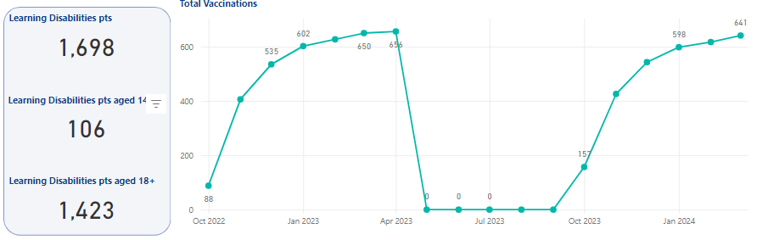
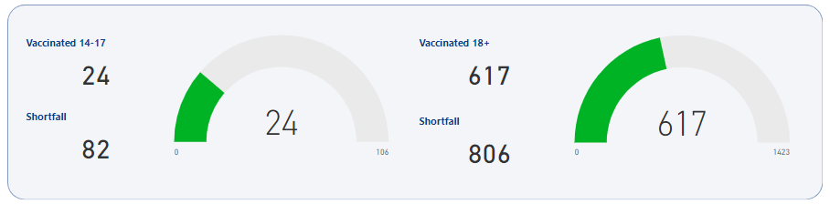
Seasonal flu vaccination uptake is low among people with learning disabilities, especially younger people
People with a learning disability are more likely than others to become seriously ill if they get the flu, especially if they have other risk factors such as obesity or diabetes
The seasonal flu vaccine is free for people with a learning disability as well as their family carers and paid supporters - there is a specific code for recording the need for the flu jab in primary care
Local data indicates that fewer than half of people aged 18+ get the vaccine, and about a quarter of people aged 14-17 years old did
The usual approach to contacting individuals for screenings, often through SMS reminders, may not effectively reach those with intellectual disabilities, highlighting the importance of alternative communication strategies tailored to their needs. Reasonable adjustments, such as providing information in easy-to-understand formats like easy-to-read materials and allocating longer appointment times for procedures like flu vaccinations, are crucial to ensure equitable access to healthcare services for individuals with intellectual disabilities.
Importance of consent in one-off / proactive outreach events
Notes:
https://www.gov.uk/government/publications/flu-vaccinations-for-people-with-learning-disabilities/flu-vaccinations-supporting-people-with-learning-disabilities

Slide 97
Pilot in primary care network 6 Identified challenges
Network 6 Pilot:
Funding was allocated for targeted outreach from December 2023 to 2024, focusing on Covid boosters and flu vaccinations.
Considered methods include phone calls with motivational interviewing (MI) training on vaccine hesitancy and texting campaigns.
CHALLENGES IDENTIFIED:
Consent Challenges:
  Identified challenge: Learning disability (LD) patients often have consent from family members or carers, necessitating obtaining consent in advance.
Outreach Considerations:
  Providers recognise that visiting supported accommodations may be akin to entering someone's home, rather than a formal care setting like a care home or hostel.
Risk Factors:
  Obesity, diabetes, and other health conditions are significant risk factors for poor outcomes, including mortality, during the Covid pandemic, emphasising the importance of addressing health needs.
Notes:
Gemma:
Network 6 pilot – funding for targeted outreach in December 2023-2024 for Covid booster and flu (phone call with MI training on vaccine hesitancy versus texting)
A challenge identified at event – LD patients said that consent is provided by family member / carer – need to get consent ahead of time
Providers going out to supported accommodation isn’t suitable as it is kind of like going to someone’s house (rather than something like a care home / hostel)
Risk factors for poor outcomes – obesity, diabetes etc – huge risk of poor covid outcomes (mortality during first wave) – are there health needs

Slide 98
Vaccinations

Slide 99
Learning from covid-19 can support an improved support for adults with LD in future pandemics
People with learning disabilities had a significantly increased risk of death during the first wave of the Covid-19 pandemic compared with the general population (about 6x)(Public Health Engalnd,2020)
Covid-19 vaccination rates were initially like the rest of NEL, but coverage has dropped off with more recent boosters (CEG, 2024)
In 2023, LBTH began developing a new pandemic plan, presenting an opportunity to ensure adults with learning disability are included and have equal access to health protection
LD (Aged 16+) | LD (Aged 16+) First Vaccine | % | LD (Aged 16+) Second Vaccine | % | LD (Aged 16+) Booster | % | LD Autumn Booster | %
1,442 | 1,176 | 82% | 1,103 | 76% | 768 | 53% | 232 | 21%
9,085 | 7,463 | 82% | 7,079 | 78% | 5,574 | 61% | 2,454 | 35%

Slide 100
Getting Information and Help
Strengths in TH
Carers found the following places helpful to find information as there are experienced staff, however too many changes to rules
  Carers centre
  Parent and advice centre
  Tower Project
  Create
  Poplar College- Adults with learning needs
Challenges
No facilities for older people
No care homes for adults with LD
Centres not in the appropriate place
Benefit advice from carers
Parent support group
No assistance for challenging kids when they become adults
Lack of information when transitioning
Looking for more social opportunities, lack of data

Slide 101
Employment and Volunteering

Slide 102
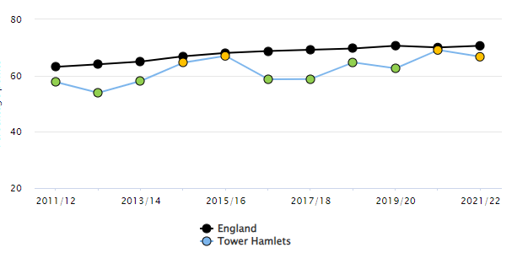
Further support needed for organisations to employ adults with a learning disability as a worker or volunteer
Adults with LD in Tower Hamlets have shared that employment and volunteering are valued as opportunities for involvement, contribution and income.
The percentage of the population with a learning disability in paid employment has remained around 5% in Tower Hamlets and England, but the gap in employment between this group and the overall rate has increased since 2012. Tower Hamlets does have a lower employment rate in general, particularly among women aged 18-64.
Support and training for Adults with a learning disability exists in Tower Hamlets through WorkPath, JET, day centres, and others. In 2019-2021, more than 240 individuals were supported into employment.
CLDS and East London NHS Foundation Trust have a strong ‘people participation’ offer for service users to get experience by being involved in service-related projects.
However, residents and carers perceived that suitable placement opportunities were limited in the borough – this could be addressed through further work to engage and support local businesses/organisations to have the capacity to appropriately host.
Gap in the employment rate between those who are in receipt of long-term support for a LD (aged 18-64) and the overall employment rate
PHE Fingertips, 2023

Slide 103
More best practice
Types of roles people with a learning disability can typically do
People with a learning disability are all individuals with different skills so that they can do many different kinds of jobs.
A learning disability can be mild, moderate, or severe, so some people can do more complex tasks while others need more basic responsibilities.
While we encourage you to keep an open mind about what individuals can offer.
Support available
Supported Employment Services
Supported Internships
Employ Me
Apprenticeships
Notes:
https://www.mencap.org.uk/resource/fact-sheet-5-what-support-available-employers-who-take-person-learning-disability

Slide 104
Best Practice
This guidance is intended to help employers involve people with learning disability and autistic people in co-delivering The Oliver McGowan Mandatory Training on Learning Disability and Autism.; it can also be used as a guidance when employing.
Employers must make reasonable adjustments under the Equality Act 2010.
People must be recognised and paid for their work and be paid at a rate that is appropriate to their role.
They should be paid the same rate that anyone who is not autistic or without a disability is paid for the same or equivalent work.
People should be given clear, accessible information to help them make informed choices about work. The employer is responsible for ensuring that this information meets the Accessible Information Standard.
Terms and conditions of employment should be discussed and agreed.
Organisations must overcome barriers to employment by meeting the needs of individuals. For example, by making buildings accessible, offering flexible working hours and providing accessible information.
There must be a fair and transparent recruitment process. Where appropriate, reasonable adjustments should be made to all employment processes and procedures. This includes development opportunities and processes to manage performance. It may be helpful to identify a person or co-ordinator responsible for this.
People must be supported with their role's practical, emotional and psychological elements.
Notes:
https://www.hee.nhs.uk/sites/default/files/documents/Involving%20people%20with%20a%20learning%20disability%20and%20autistic%20people%20FINAL%20.pdf

Slide 105
Employment- Adults with LD
Support Services
The Adult Learning Disability Strategy 2017-2020
  Develop a comprehensive plan to improve employment support tailored to the needs of people with learning disabilities, regardless of location.
  Provide support to employers to increase the hiring of people with learning disabilities.
  Promote positive attitudes among employers towards employing people with learning disabilities and valuing their work.
  Ensure the education system equips students with learning disabilities with skills for employment.
  Create more job opportunities, work experience placements, and apprenticeships for people with learning disabilities.
  Implement supported employment as the most effective method of systematically training individuals with learning disabilities for paid work. This method involves vocational profiling, employment planning, job matching, in-work support, and ongoing monitoring.
  Highlight the benefits for employers of hiring people with learning disabilities, including improved staff reliability, enhanced company reputation, access to a wider talent pool, and fostering inclusivity.
  Make reasonable adjustments to the recruitment process and workplace to enable people with learning disabilities to demonstrate their abilities, including using work trials, providing assistive technology, and offering flexible work arrangements.
  Treat employees with learning disabilities equally in performance management, with reasonable adjustments, and utilise Access to Work for practical and financial support in starting or maintaining employment
  The Adult Learning Disability Strategy 2017-2020 aimed to increase employment and volunteering opportunities for adults with learning disabilities, which could help improve their financial situation.
  The strategy recognised the importance of preventing financial difficulties and providing support and advice for those in work.
  The borough's Financial Inclusion Strategy aims to improve financial literacy, access to financial products/services, and free debt/money advice for residents. However, it is unclear if this has specific provisions for adults with learning disabilities.
  The Community Learning Disabilities Service (CLDS) provides health and social care support for adults with learning disabilities in Tower Hamlets.

Slide 106
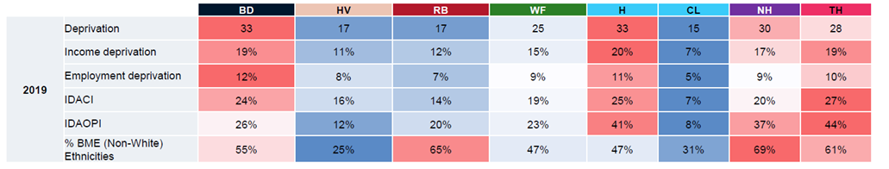
Tower Hamlets faces significant employment deprivation with Adults with LD
IDACI: Income Deprivation Affecting Children Index
IDAOPI:
The table above indicates that Tower Hamlets is experiencing a degree of employment deprivation, underscoring the urgent requirement for targeted and inclusive employment support programs to tackle the related socio-economic issues.
Additionally, Tower Hamlets faces the highest levels of deprivation affecting both children and older individuals. As these demographic groups continue to grow, service providers must consider broader challenges and outcomes associated with these populations. (PA consulting, 2023)
Limited data is available on the employment rates of individuals in the workforce.
There is a substantial employment rate gap of 71% between the general population and those with learning disabilities. The latter group expresses frustration over the limited availability of work experience opportunities (PHAST, 2023).
Data from the annual survey of adults with learning disabilities receiving long-term social care in England indicates a decline in the percentage of adults with learning disabilities in paid employment, dropping from 6.0% in 2015 to 5.0% in 2021 (Nuffield Trust, 2022).
Notes:
PHAST
Nuffield Trust. Supporting people in employment. 2022.

Slide 107
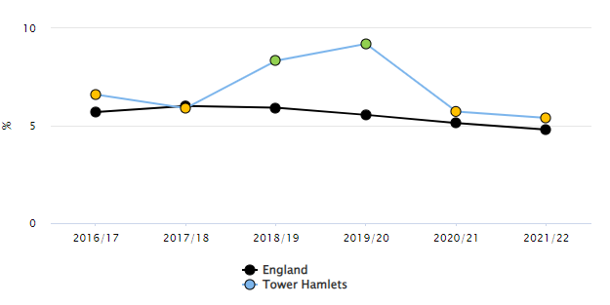
Tower Hamlets had a slightly lower employment rate than the national average Adults with LD
A slight disparity suggests Tower Hamlets had a slightly lower employment rate than the national average during this period.
The data highlights variations in employment rates, emphasising the significance of considering geographical and temporal factors.
The declining trend from 2018-2020 prompts further exploration into factors influencing changes in the employment landscape for individuals with learning disabilities in Tower Hamlets.
The data indicates that in the 2021/22 period, the employment rate in Tower Hamlets was 66.7%, while the overall employment rate for the entire UK was 70.6%. This suggests that there was a slightly lower employment rate in Tower Hamlets compared to the average rate across the United Kingdom during that specific time frame (Fingertips, 2024)
The data reveals that Tower Hamlets had a higher number of individuals with learning disabilities on long-term support in paid employment during 2018-2020. However, there was a decline to 5.4%, just slightly above the national average of 4.8%. No significant change was observed in 2020-2022 (Fingertips, 2024).

Slide 108
Employment Support services: There is lack of data on attendance
The Tower Project Jobs, Enterprise and Training team (JET) provides support and training for individuals with disabilities seeking employment in Tower Hamlets and the City of London.
Poetry in Wood is a social enterprise and employment scheme specifically designed for people with learning disabilities, offering training in woodwork, art, and design.
MAP Squad offers advocacy support and day opportunities for individuals with learning disabilities interested in working on community projects, either independently or in partnership.
Disability Advocacy Network provides advocacy services for people with disabilities in Tower Hamlets, offering support and assistance.
Tower Hamlets disability work scheme
There is a lack of publicly available data or performance metrics evaluating the actual outcomes and impact of these programs.

Slide 109
Tower Hamlets Adult Learning Disability Strategy aim to offer more opportunities
Feedback from Adults with Learning Disabilities:
Employment and volunteering are highly valued for involvement, contribution, and income.
Good local support and training exist, but job opportunities are lacking.
Only 4.9% were in paid employment (2015-16), below the London average (7.5%) and the national average (5.8%).
Current Initiatives:
Organisations provide skills development and employment support, aiding about 60 people per year.
Health and Wellbeing Board members are committed to employing people with learning disabilities.
Feedback from the Community:
Increase job opportunities and support employment through social enterprises.
Provide early advice and support to employed individuals to prevent stress and financial issues.
Improve education by focusing on reading and writing tailored to individuals' levels.
Ensure information on available resources is accessible.
Future Actions:
Collaborate with local businesses to create flexible job opportunities, internships, apprenticeships, and volunteering.
Employment support services to offer advice and support for job seekers.
Encourage high aspirations from childhood and support achieving employment goals.
Ensure accessible education, training, and work experience opportunities.
Support from centres, accommodation staff, and families/carers for high aspirations.
Develop peer support networks.
Clarify earnings impact on benefits.
Develop accessible local learning, including reading, writing, and numeracy.
Measuring Success:
Aim to support 110 people into employment per year over four years, reaching 11% in paid employment within three years.

Slide 110
There is a gap in data in Volunteering for Adults with LD in TH
People with learning disabilities often face social exclusion and are perceived as lacking value in society, primarily seen as recipients of help rather than active contributors. Only 6% currently volunteer due to barriers and limited opportunities. However, volunteering offers people friendships, skills, enjoyment, and confidence, challenging disability stereotypes (Volunteering England, )
Key places where people with learning disabilities can find volunteering opportunities include:
Job Centres: Individuals can inquire about volunteering opportunities with the disability officer or access paper/audio adverts if unable to use touch-screen facilities.
Day Centres: Managed by local authorities and private or voluntary organisations, these centres may offer work experience schemes or seek new opportunities for attendees.
Colleges: Further education colleges' learning support departments can inform students about available opportunities, and adverts can be placed in newsletters or college papers.
Local advocacy groups: Self-advocacy groups and advocacy organisations can inform individuals with learning disabilities about volunteering opportunities (Volunteering England, )
There are volunteering options in Tower Hamlets
Volunteer Centre Tower Hamlets (VCTH): This organisation helps people find inspiring volunteer roles in the borough. They offer various roles suitable for all ages (15+), backgrounds, interests, and abilities. Roles include mentoring, befriending, helping at food banks, supporting refugees, youth work, giving advice, environmental projects, health and social care, event stewarding, office administration, teaching, and charity trusteeships. They also run the Covid-19 Recovery Volunteering Hub in partnership with the council1.
Tower Hamlets Community Learning Disabilities Service (CLDS): CLDS works with adults with learning disabilities in Tower Hamlets. They operate from Beaumont House at Mile End Hospital and can also visit people at their homes, college, or day service
Mencap: Mencap is committed to recruiting more volunteers with a learning disability and to working with partners to help them make their volunteering accessible to people with a learning disability
There is a lack of data on adults with learning disabilities volunteering in Tower Hamlets.

Slide 111
Carers View: Employment
Carers identified most Adults with LD not suited for employment, won’t follow instructions
They suggested what is needed instead:
Opportunities for creative activities are needed.
Activities to learn new skills.
Easy-read adult books should be available.
Creative activities and work opportunities are beneficial.
Social clubs and cafes where individuals with LD can engage in activities.
Places like the Bubble Club: Social events held every six weeks.
Spot Light: Specific social activities or programs (details unspecified).
Taster courses: Short-term courses to try new activities.
More holiday time activities are needed for people with LD.
Utilise programs like Spot Light and Idea Stores, ensuring they are adapted for the needs of adults with LD.

Slide 112
Social Inclusion and Community Safety

Slide 113
Adults with LD have an increased risk of being a victim of different forms of crime or violence
National Context
People with a learning disability have an increased risk of being a victim of crime such as targeted exploitation (e.g. cuckooing), sexual violence, domestic violence and bullying. In the context of domestic abuse, organisations are recommended to:
Invest in more in-person services and support, including court interpreters, that are accessible for different abilities
Ensure institutional advocacy for disabled victims of domestic abuse
Involve disabled people in the prevention of domestic abuse
Promote greater understanding of the dynamics of disability and domestic abuse
Promote greater awareness of hidden impairments such as mental illness and learning disabilities.
There is also statutory guidance about forced marriage which reference people with learning disabilities being at risk due to particular reasons or risk factors such as the prefer to obtain a carer, financial security or status.
Wider disability inclusion efforts to address ableism in society and community must include and involve adults with a learning disability. Similarly, efforts to address other forms of discrimination including violence (e.g. gender and race based) should consider intersectional identities and the specific vulnerabilities experienced by adults with a learning disability. This includes collaboration with police and other enforcement officers.
Tower Hamlets
Domestic and sexual violence: In 2021-2023, about 5.6% of sexual offence victims identified as having a disability – learning disabilities were among the most reported. Recent data from the Independent Domestic Violence Advocate (IDVA) service showed that although most people accessing the service did not report having a disability, learning disabilities were among the most commonly recorded (57 out of 2029 service users).
Exploitation: There have been some known local cases of cuckooing or exploitation of residents with a learning disability, however, data quality in the national referring mechanism (NRM) tends to be poor.
Hate crime: There also are very small numbers of reported hate crime targeting any disabled people in Tower Hamlets compared with other forms of hate crime (e.g. racist or transphobic).
Community Safety: Service users shared their concerns about safety in public spaces such as being followed while walking, limiting being out at night time, feeling the need to rely on others for safety
Service providers and support networks have a role to play in safeguarding adults with learning disabilities. Some actions that have been implemented in Tower Hamlets include:
  There are multi-agency panels (e.g. High risk panel, community MARAC) where professionals can refer a person and discuss how to address vulnerabilities. This may also be a place where learning disability is first identified if it was not diagnosed early on.
  Tower Hamlets Hate Crime team offers hate crime prevention training including disability hate crime.
  VAWG Training references people with a learning disability when discussing intersectionality.

Slide 114
Beat practice: Community Safety Tips for Adults with disabilities
Safeguarding and Support
Service providers and support networks play a crucial role in safeguarding adults with learning disabilities in the community:
Staff should receive training on legal frameworks, risk assessment, safeguarding, and communicating with those who have cognitive impairments
Involving experts and those with lived experience in delivering training
Ensuring adequate support, advocacy, and access to community resources
By following these practices, adults with learning disabilities can be better equipped to navigate community environments safely while maintaining their independence and inclusion.
Notes:
https://riseservicesinc.org/news/community-safety-tips-for-adults-with-disabilities/

Slide 115
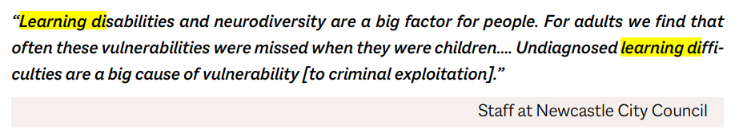
Adults with learning disabilities are likely to be at risk to risks include exploitation, sexual violence, domestic violence
  Criminals target people’s vulnerability to coerce them into criminal activity. Deprivation, substance misuse, mental health issues, learning disabilities, homelessness, and age can all put people at risk of criminal exploitation
  Other issues that can affect someone’s capacity to make decisions, such as mental health issues and learning disabilities, can also put them at risk of grooming that leads to exploitation. This can include the impact on decision-making caused by previous trauma, domestic abuse or violence (Centreforsocialjustice, 2024)
Notes:
https://www.centreforsocialjustice.org.uk/wp-content/uploads/2024/02/CSJ-JC_Criminal_exploitation.pdf
https://bills.parliament.uk/publications/51938/documents/3718

Slide 116
Police records of criminal exploitation through cuckooing have increased in London
Cuckooing: a process whereby criminals target the homes of vulnerable adults for any criminal purpose, resulting in them losing control of their property. They may use property for any criminal purpose, including drug dealing, sexual crimes and firearms. The vulnerable adult can be exploited and coerced to participate in criminal acts.
Being a victim of cuckooing can have a negative impact on a person’s safety, financial and housing security, and mental or physical health and wellbeing
There is limited recorded data in Tower Hamlets regarding cuckooing, however:
  There are various panels where professionals refer and discuss these issues (High risk panels, Community MARAC)
  The Exploitation team run by Children’s Services does not end provision after people turn 18

Slide 117
Different forms of violence against women and girls require specific approaches to address the needs of those with disabilities
National Guidance
Disabled women and girls have an increased risk of violence and abuse than those who are not disabled and typically experience abuse for a longer time before accessing support.
Statutory guidance about forced marriage has noted that prevention should form part of existing protection policies and procedures. There have been instances where people with learning disabilities were forced to marry and there are considerations regarding capacity to consent and particular risk factors and reasons (e.g., obtaining a carer, financial security or status).
To address these barriers in the context of domestic abuse, organisations are recommended to
  Invest in more in-person services and support, including court interpreters, that are accessible for different abilities
  Ensure institutional advocacy for disabled victims of domestic abuse
  Involve disabled people in the prevention of domestic abuse
  Promote greater understanding of the dynamics if disability and domestic abuse
  Promote greater awareness of hidden impairments such as mental illness and learning disabilities.

Slide 118
Recorded violence perpetrated against adults with learning disability
Hate crime
- To be added
Exploitation
- To be added
Domestic/Sexual Violence
According to MPS data about sexual offences in Tower Hamlets between 2021-2023, there were 2,273 sexual offences reported to police in Tower Hamlets. 5.6% of victims self-identified as having a disability – of these victims, one of the most frequently reported disabilities were 'learning difficulties' (17%).
The Independent Domestic Violence Advocate provision in Tower Hamlets is provided to address the safety of victims at high risk of harm due to domestic abuse. Recent service-level data has indicated that although most people accessing the service did not report having a disability, learning disabilities were among the most commonly recorded (57 out of 2029 service users accessing the IDVA service for domestic abuse reported having a learning or intellectual disability_
  It was found that 18% of Idva clients have a disability
  55% of the disabled victims and survivors with a sensory impairment or physical or learning disability wanted to access a specialist by and for the organisation

Slide 119
Adults with learning disabilities in Tower Hamlets have access to various community safety and support services to ensure their well-being and protection from abuse or neglect
  Services:
  The CLDS is a joint health and social care team run by the London Borough of Tower Hamlets and the East London NHS Foundation Trust. It provides specialised support to adults with learning disabilities in the community
  Adult Safeguarding Team: The Adult Safeguarding Team at Tower Hamlets Council can be contacted to report abuse of a vulnerable adult, seek information, or raise concerns about a vulnerable person's safety. They work to protect adults at risk from abuse or neglect and support their independence.
  Specialist Support Services
  Several organisations offer specialised support for adults with learning disabilities who have experienced abuse, trauma, or violence:
  Respond: Provides psychotherapy, advocacy, and support for children and adults with learning disabilities who have experienced abuse or trauma, as well as those who have abused others.
  Stay Safe East: A user-led organisation offering advocacy and support services to disabled people from diverse communities who are victims/survivors of domestic or sexual violence, hate crime, harassment, and other forms of abuse.
  Sign Health's Domestic Abuse Service: Specialised service for Deaf adults and children who have experienced or witnessed abuse, communicating directly using British Sign Language (BSL) and other methods.
  The Tower Hamlets Adult Learning Disability Strategy 2017-2020 also outlines plans to promote community inclusion, independence, and equal opportunities for adults with learning disabilities to build a safer and more inclusive community.

Slide 120
Adults with LD faces crime in community
In a questionnaire/interview taken face-to-face with adults with learning disabilities, residents shared that:
Experiences fear of being followed and robbed at cash machines
Concerns about safety exacerbated by encounters with intimidating gangs and aggressive dogs like bull terriers
Prefers feeling secure in a car with others, acknowledging vulnerability with walker
Limits night-time outings and prioritises safety while striving for independence
Seeks guidance on interactions with law enforcement for effective management of such situations
Lack of freedom, need to rely on support workers, not always reliable
Feel intimidated on the roads due to Older school kids (gangs) look, trying to cause trouble
In a focus group, it was revealed that the challenges faced was:
Adults with LD may engage in shoplifting or drug dealing, particularly in supported accommodations.
Individuals in temporary accommodation often struggle to trust caregivers, especially due to concerns about potential misuse of money. Care workers being distracted (e.g., on the phone) can exacerbate these trust issues.
There are significant concerns regarding care workers misusing the funds of vulnerable individuals, leading to a general difficulty in trusting caregivers.
It was also identified There is a critical need for training on managing challenging behaviours and preventing exploitation, emphasising the importance of building trust and ensuring the safety of individuals with LD.
The focus group also identified:
The Carers Centre offers advice and support for individuals with LD and their caregivers. Tower Hamlets provides training on hate crime prevention to enhance community safety.
The police in Tower Hamlets are recognised for their prompt and calm responses to incidents, contributing to positive community support.
The Vulnerable Person's Registry offers a safeguard for adults with LD, allowing them to be registered to ensure better protection.

Slide 121
Carers view: Community safety
A focus group was conducted with carers at a carers centre, and the findings revealed
Positives:
Tower Hamlets supports individuals with learning disabilities (LD) and their carers through the Carers Centre.
Additionally, the area offers hate crime prevention training, and the police are known for their practical and calm handling of situations.
The community in Tower Hamlets provides positive support for its residents.
Issues
Adults with LD in supported accommodation are prone to shoplifting and involvement in illegal activities.
Trust issues arise in temporary accommodation, particularly regarding misuse of money by care workers.
There's a need for a Vulnerable Person's Registry to safeguard individuals with LD, and more people should know about it
Training is required to handle challenging behaviours and prevent exploitation, especially concerning financial matters.

Slide 122
Social connection and positive relationships can be fostered through tailored opportunities
Best Practice
Having an active social life can lead to increased happiness, confidence, and a sense of inclusion and value for people with a learning disability (Mason et al., 2013; Chadwick et al., 2014; Wilson et al., 2017).
Friendships help reduce loneliness, which is associated with health risks such as depression, high blood pressure, and higher mortality risk (Holt-Lunstad et al., 2010; Gilmore and Cuskelly 2014; Valtorta et al., 2016).
Having more and better quality friendships is linked to better physical health and a lower risk of early mortality (Holt-Lunstad et al., 2010; Ho, 2016; Hojjat et al., 2017).
In a questionnaire/interview taken face-to-face with adults with learning disabilities, it was found
Cautious approach with strangers, prioritising safety in social interactions
Contrasting experiences between online and real-life relationships
Positive engagement in youth clubs, day centers, college, and school, fostering meaningful connections with peers and support networks
Mixed interactions with neighbors, ranging from friendly encounters to occasional misunderstandings
Unpleasant experience with a bus driver's reaction to a request for directions, highlighting challenges in public settings
Enjoyment of social outings, such as visiting a local café on Friday nights, contributing to a vibrant social life
Ease of access to community resources like Create and the Town Hall, simplifying engagement in social activities and services.
Notes:
https://www.mencap.org.uk/learning-disability-explained/research-and-statistics/friendships-research-and-statistics

Slide 123
Financial security

Slide 124
Adults with LD and their carers/families experience general and specific financial security issues in TH
Tower Hamlets has high levels of economic deprivation as well as high levels of inequality (in the general pop); this has been an ever increasing concern as costs of living (e.g. food and fuel) have increased across England and London, within the past 2 years. It was considered the greatest concern for residents in the Residents’ Survey conducted in 2023.
People with disabilities, including adults with LD, face unique barriers to financial security such as insufficient inclusive employment and training opportunities, limited and reducing benefits, costs of care, constraints on carers’ finances due to caring responsibilities.
The numbers of people with learning disability eligible for Disability Living Allowance or Attendance Allowance has decreased since 2015 while numbers eligible for Personal Independence Payment have increased during the same time (across England). Local data on benefits uptake by disability type was not available.
Mencap recommends the following for adults with a LD, which Tower Hamlets organisations should incorporate into planning given the increasing financial constraints residents are under:
  Right to financial self-determination alongside supported financial management
  Assessment of mental capacity should include financial management
  Appointee-ship and court-approved deputies should be pursued while maximising the individual’s autonomy in decision making
Income Deprivation Affecting Children Index
Income Deprivation Affecting Older People Index
Notes:
Table is from NEL Analysis
Mencap

Slide 125
Cost of living and support for people with a learning disability
Financial difficulties and adults with a learning disability
The Joseph Rowntree Foundation's report, "From Disability to Destitution," identifies several key barriers to financial access for disabled individuals, which contribute to their higher risk of poverty and destitution:
Inadequate Social Security: Benefits often fall short of covering basic living costs, leaving disabled individuals financially vulnerable
Debt and Deductions: Debt from benefit overpayments and advance payments reduces the income of disabled people, exacerbating financial hardship​
Rising Living Costs: The increasing prices of essentials like food and heating disproportionately impact disabled individuals, who already face additional expenses​
Employment Challenges: Discrimination and a lack of suitable job opportunities limit employment prospects, often resulting in low-paying, insecure jobs​
Health Impacts: Financial stress worsens physical and mental health, creating a cycle of increasing need and poverty​
Approaches
Comprehensive policy changes and community support are essential to address these issues and prevent destitution among disabled individuals (Justice Reform Foundation, 2024)​.
Notes:
From disability to destitution | Joseph Rowntree Foundation (jrf.org.uk)

Slide 126
Evidence/good practice Financial Security
Mencap: Consent and decision-making: Financial matters for people with a learning disability aged 18 or over
Right to Financial Self-Determination
Adults with learning disabilities aged 18 or over have the same legal rights and freedoms as any other adult regarding financial matters.
They have the right to open bank accounts, make contracts, manage money, and make financial decisions if they have the mental capacity to do so.
The principle of maximising choice and control over financial affairs should be followed, providing support as needed
Assessing Financial Capacity
An assessment of mental capacity is required to determine if an adult with a learning disability can make specific financial decisions like opening a bank account or making a will.
Clear information should be provided to facilitate their understanding of the decision.
If lacking capacity, other options like appointees or court-approved deputies may be pursued
Assessing Financial Capacity
An assessment of mental capacity is required to determine if an adult with a learning disability can make specific financial decisions like opening a bank account or making a will.
Clear information should be provided to facilitate their understanding of the decision.
If lacking capacity, other options like appointees or court-approved deputies may be pursued
Supported Financial Management
Many adults with learning disabilities can manage weekly benefits, personal spending, and budgeting with appropriate support.
Appointee-ship and Court-Approved Deputies
If an adult lacks the capacity for certain financial decisions, a responsible person can be approved as an appointee to manage their benefits.
The Court of Protection can appoint a deputy to manage finances if the person cannot do so even with support.
These options should be pursued while still maximising the individual's autonomy in decisions they can make
Notes:
https://www.choiceforum.org/docs/mcapconsent.pdf

Slide 127
Cost of living issues overall in TH
The cost of living crisis is the primary concern for 40% of Tower Hamlets residents.
The government allocated £5.9 million through the Household Support Fund to Tower Hamlets Council to address this issue until March 2024.
Initiatives launched with this funding include the Community Cupboard scheme, which provides essential items to needy families, the Residents' Support Scheme, which aids those at risk of crisis, and the LBTH Food Hub, which delivers groceries to local food banks.
Despite a 22.1% population increase since 2011, Tower Hamlets has maintained high satisfaction with local services.
Mayor Lutfur Rahman emphasised the council's dedication to supporting residents through the crisis, aiming to alleviate many families' dilemma of choosing between heating and eating.
Notes:
https://www.towerhamlets.gov.uk/News_events/2023/October/Cost-of-living-is-a-key-concern-for-residents.aspx
https://www.towerhamlets.gov.uk/News_events/2023/October/Cost-of-Living-package-worth-nearly-6million.aspx
https://www.towerhamlets.gov.uk/lgnl/advice_and_benefits/cost-of-living/household-support-fund.aspx
https://www.towerhamlets.gov.uk/lgnl/advice_and_benefits/cost-of-living/Cost-of-living.aspx

Slide 128
Support Services for Cost-of-Living Challenges in Tower Hamlets
Support Services
The Tower Hamlets council supports individuals and carers facing money and cost-of-living challenges.
The Adult Learning Disability Strategy 2017-2020
The Adult Learning Disability Strategy 2017-2020 aimed to increase employment and volunteering opportunities for adults with learning disabilities, which could help improve their financial situation.
Support Scheme: Provides emergency financial aid for short-term living costs.
Energy Saving Tips: Offers advice to reduce gas and electricity usage.
Debt Advice and money Management Services: This includes support from Island Advice Centre, Stifford Centre, Limehouse Project, and Bromley by Bow Centre.
Financial Health Centre: Free advice on debt, benefits, housing, and employment.
Citizens Advice Tower Hamlets: Face-to-face and telephone advice on various financial issues.
These services aim to help individuals and carers manage cost-of-living challenges in Tower Hamlets​
The strategy recognised the importance of preventing financial difficulties and providing support and advice for those in work.
The borough's Financial Inclusion Strategy aims to improve financial literacy, access to financial products/services, and free debt/money advice for residents. However, it is unclear if this has specific provisions for adults with learning disabilities.
The Community Learning Disabilities Service (CLDS) provides health and social care support for adults with learning disabilities in Tower Hamlets. However, no details are given on specifically addressing financial insecurity.

Slide 129
Tower Hamlets Lacks support with financial difficulties
What is Tower Hamlets doing for Financial difficulties and adults with a learning disability?
Recognition of Disability and Poverty Link:
Tower Hamlets acknowledges that disabled residents face higher risks of financial hardship.
Approximately 17% of the borough's population has a long-term illness or disability preventing them from working.
Employment and Volunteering:
The Adult Learning Disability Strategy 2017-2020 emphasises the importance of employment and volunteering for adults with learning disabilities.
Only 4.9% of adults with learning disabilities were in paid employment in 2015-16, below regional and national averages.
Plans to Increase Employment:
The strategy outlines plans to work with local businesses to create more jobs, internships, apprenticeships, and supported employment opportunities for people with learning disabilities.
The Adult Learning Disability Strategy (2017-2020) addresses cost of living issues by acknowledging the financial hardships faced by adults with learning disabilities. It emphasises the need for adequate financial support and access to resources that can alleviate economic stress. The strategy outlines support services such as tailored financial advice, benefits guidance, and financial assistance programs designed to help individuals manage living costs and avoid destitution​ (Tower Hamlets Council)​.
Employment support services like Workpath are tasked with providing advice and assistance.
Lack of Specific Financial Insecurity Initiatives:
No specific initiatives are mentioned that directly target financial insecurity or poverty among adults with learning disabilities in Tower Hamlets.
Broader Financial Inclusion Strategy:
Tower Hamlets has a Financial Inclusion Strategy to improve financial literacy, access to financial products/services, and provide residents free debt/money advice.
It is unclear if this strategy has specific provisions for adults with learning disabilities.
Summary:
Tower Hamlets acknowledges the employment challenges and poverty risks faced by disabled residents, including those with learning disabilities.
The borough focuses on broader strategies for financial inclusion and increasing employment opportunities.
There is a lack of clear, targeted efforts to address financial insecurity, specifically for adults with learning disabilities.
Notes:
file:///C:/Users/mirza.begum/Downloads/172ca-FINAL%20THT%20Borough%20Plan%20post%20C19%20May%202021%20v.7.0.pptx.pdf
https://www.towerhamlets.gov.uk/Documents/One-TH/Part-I-Poverty,-debt,-and-unemployment.pdf
https://democracy.towerhamlets.gov.uk/mgConvert2PDF.aspx?ID=112138

Slide 130
Services to support financial In TH
TH CAN (Tower Hamlets Community Advice Network)- Provides debt advice, benefits advice, housing advice, immigration advice, general advice, legal advice and information about Food banks
Tower Hamlets Connect - Connects Tower Hamlets residents with information and advice on health and social care, local events, and community services across the borough.

Slide 131
Adults with LD & Finance
In a questionnaire/interview taken face-to-face with adults with learning disabilities, it was found
  Financial Support:
    Adults with LD are receiving benefits, which are sufficient to cover your needs.
    Some adults with LD do not have access to money as their family manages it (they would need to ask family for money)
  Decision-Making Challenges: Some people question their choices and struggle with self-trust, particularly in financial matters.
  Support Worker Assistance: A support worker helps adults with LD balance saving and spending, preventing overspending.
  Budgeting Course: Adults with LD have attended a one-off budgeting course to improve their financial management skills.
  Family Support:
    Many adults with learning disabilities and their families handle their money.
    Adults with LD family help with financial matters occasionally, which provides enough support to keep you going.
  Employment: Adults with LD have three jobs, working at a gallery and town hall and one in training.

Slide 132
Adults with LD & Finance: Carer’s view
A focus group was conducted with carers at a carers centre, and the findings revealed:
Current Issues:
Vulnerability due to intermittent capacity.
Financial mismanagement by workers and family members.
Challenges in managing and separating funds.
Trust issues with carers handling money.
Incorrect allocation of funding for respite care.
Lengthy and generic PIP forms.
Lack of Tower Project respite funding.
Difficulty in transitioning medications and services.
Banking challenges and financial mismanagement, e.g: Bank made it difficult to open a current account.
Lack of awareness of danger among adults with LD.
Payment for prescriptions during transition is unclear.

Slide 133
Adults with LD & Finance: Carer’s view cont…
Suggestions:
Simplify and personalise PIP and support forms.
Create a personalised profile in GP records for individuals with LD.
Improve support and communication during the transition from child to adult services.
Provide clearer guidance and assistance for carers in filling out forms.
Address medication and prescription payment issues during the transition.
Ensure generic medication forms meet the needs of individuals with LD.
Facilitate easier access to banking services and financial management support.
Implement measures to enhance awareness of danger among adults with LD.
Provide Training to carers and Carers who need to keep records to monitor financial transactions.

Slide 134
Housing

Slide 135
Adults with LD and their families face a wide range of issues related to housing depending on their needs
Guidance from the Local Government Association recommendations that housing options for people with a learning disability should be:
  person-centred,
  support choice and independence,
  be inclusive and accessible,
  with an offer of support services.
  There should be collaboration with adults with LD and their families and sustained funding mechanisms including specialised supported housing for people with complex needs.
Tower Hamlets has a range of challenges related to housing affordability and availability for the general population. Overcrowding is a significant issue in the local authority, which is the most densely populated in England.
About one-third of housing stock in the borough was either Council housing or provided by a registered social landlord but there is still a scarcity of suitable providers and placements for people with a high level of need (PHAST, 2023).
Local service users and carers shared mixed feedback about their experiences:
Professionals also highlighted the importance of improving safeguarding of adults with LD in housing services and residential settings.
Ongoing changes in the provision for housing and homelessness in Tower Hamlets (e.g. insourcing, commissioning, strategic developments) must further integrate disability inclusion, including learning disabilities, into plans and processes. Upcoming health intelligence projects aiming to link health and housing data should consider how to use this to develop a better understanding of needs of adults with a learning disability.
  Delayed repairs
  Varying accessibility of communication from providers
  Challenges in living with family/carers such as privacy and social tension
  Spaces not always suited for physical needs and difficulties in getting adaptations
  Lack of consistency in Personal
  Wider built environment concerns such as cleanliness, pavements, noise
  Lack of support for adults with LD
  Removal of adaptive equipment
  One carer shared an example where they had an 11 year wait for suitable housing, with multiple relocations without consideration for the person with LD’s needs for appropriate housing; had to go to court for action to get a suitable home.
There are lots of professionals in housing, for example, who are not even aware that a person with LD can live independently, and they will ask things like "shouldn't they be in a care home?". We need professionals in other departments and ‘universal' services to be knowledgeable about supporting people with LD, and prepared to do so.
- Staff survey participant

Slide 136
The Local Government Association has set out guidance for housing for adults with a LD
Person-Centered Approach
Housing solutions should be person-centered, taking into account the individual's preferences, needs, and required level of support. Involving the person and their family in decision-making is crucial.
Choice and Independence
People with learning disabilities or autism should have choice over where and how they live, with options ranging from independent living with support services, to supported living arrangements, shared lives/adult placement, and specialist housing for complex needs.
Inclusive and Accessible Design
Housing should be designed to be inclusive, accessible, and enabling, with adaptations and assistive technology to promote independence and dignity, especially for those with profound and multiple learning disabilities (PMLD).
Collaboration and Co-production
Effective housing solutions require collaboration between local authorities, healthcare providers, housing associations, and individuals with learning disabilities/autism and their families. Co-production, involving end-users in the design process, is crucial.
Tailored Support and Care
Appropriate support and care services should be provided, tailored to the individual's needs, including 24-hour support, personal care, skill development, and support for independent living.
Sustainable Funding
Adequate funding mechanisms should be in place to ensure access to appropriate housing, care services, and specialized supported housing (SSH) for those with complex needs, such as the HOLD shared ownership scheme
Notes:
https://www.local.gov.uk/our-support/sector-support-offer/care-and-health-improvement/autistic-and-learning-disabilities/housing
https://www.local.gov.uk/sites/default/files/documents/ADASS-Housing-and-Care_Good-Practice-Guide.pdf
Carers said it was important for them
The starting point should always be about providing individual and personalised support
Families support in any ways and so people without families are at a disadvantage
Housing type is less important than quality
Funding type & source is important
Individual and personalised support is important
Self Advocates said
Good support and control over own life and home
Type of housing is less important than independence
Control of your own money needs more choices
Your own money means, you’re treated as an individual
Commissioners said
Focus: Moving people from residential care into supported care
Reasons: closure of residential services and cost savings
We pay for the support element only, so it is cheaper for us
Commissioners are not proactive around quality of life
Supported housing providers
Ethos, Values and culture are important
Compatibility between residents is key
Experts by experience within the team is important
Act to improve quality; don’t just tick box
Self-advocates said
Good support and control over own life and home
Type of housing is less critical than independence
Control of your own money leads to more choices
Your own money means your treatment as an individual

Slide 137
An NDTI research project explored experiences in residential care and supported living
Project Aims
This research project explores the differences between Residential Care and supportive living settings for individuals with learning disabilities. The key objectives include:
Understanding Service Quality: Investigating the effectiveness of Residential Care compared to Supported Living to determine if individuals' lives are truly better in Supported Living arrangements.
Gathering Insights from Stakeholders: Engaging with individuals with learning disabilities, family caregivers, commissioners, and housing support providers to identify important factors for housing decisions and quality of life.
Key Findings
1.Quality of Services: There is insufficient information about the quality and effectiveness of both Residential Care and Supported Living services. While Supported Living is designed to provide individuals with more rights and control, the actual differences in quality of life between the two models remain unclear.
2.Stakeholder Perspectives: Feedback collected from individuals with learning disabilities and family caregivers highlighted the importance of personal choice and control in housing decisions.
3.Potential for Quality Tools: The project suggests that service providers may need to incorporate quality assessment tools into their contracts to ensure a consistent standard of care.
4.Next Steps: The next phase of the project will involve visiting service providers to gather additional data, contributing to a more comprehensive housing research initiative.
5.Funding and Support: The project has received backing from various organisations and has utilised crowdfunding to facilitate the research.
6.Further Research Initiatives: Planned activities include in-depth discussions about funding with self-advocates, family caregivers, providers, and staff, as well as conducting surveys to evaluate how service quality is monitored by providers and commissioners.
Notes:
https://www.ndti.org.uk/projects/comparing-housing-and-support-models-for-adults-with-learning-disabilities

Slide 138
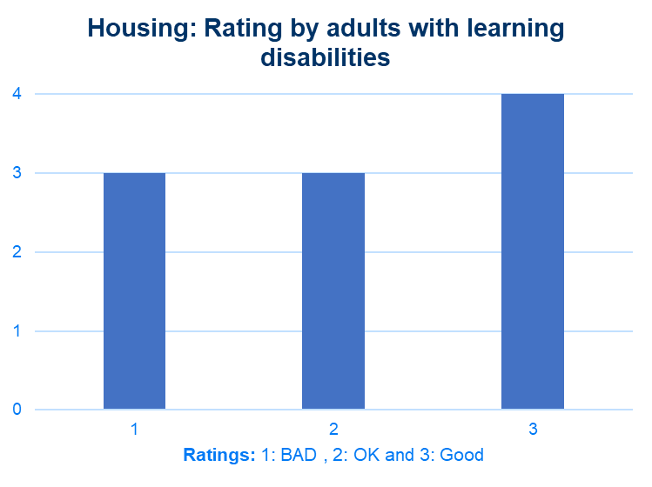
Housing accessibility
In a questionnaire/interview taken face-to-face with adults with learning disabilities, it was found
Housing
  They want better pavements
  There's a lack Cleanliness/rubbish of neighbours, laziness, lack of respect
  Pollution is bad in TH
  You have to do it yourself (repairs etc).
  Flat needs upgrades/repairs.
  Lifts constantly breaking down (wheelchair users)
  Quality and preferences- living with the carpet but having asthma.
  Living with family can be challenging, with no privacy and getting along.
  Repairs cannot always get through online.
  Space not suitable for a wheelchair
  Not always communicated.
  Noise outside, shouting at night when trying to sleep
Overall, Adults with LD would rate their housing Good

Slide 139
Carers suggest housing not suitable for adults with LD
A focus group with carers held in a carers centre revealed:
Supported living located in unsafe locations, eg, busy roads etc
Limited spacing in residential homes
Overcrowding in residential homes
Lack of support for adults with LD
Inability to adapt homes to current needs
Difficulty in getting adaptations done
Inaccessible housing with broken facilities, lifts etc
Financial mismanagement
Wasteful removal of adaptive equipment

Slide 140
Carers suggest better
Carers suggested:
More adapted housing for LD adults
Improved housing disclosure
Flexibility in home adaptations
Holistic support approach
Regular safety inspections
Prevention of overcrowding
Focus on LD-specific needs
Inclusive decision-making processes
Support from rent officers
Case Example:11-year wait for suitable housing, multiple relocations without LD consideration intervention for appropriate housing, had to go court for action to get a suitable home.

