Slide 1
Sexual & Reproductive Health JSNA Factsheet July 2024

Slide 2
Summary
Sexual and reproductive health outcomes are important for public health in Tower Hamlets because:
We have a young, diverse and sexually active population. Sexually transmitted infections (STIs) and need for reproductive health support (including contraception and terminations) are rising overall.
Sexual and reproductive health is crucial for people’s mental health and wellbeing, physical health and relationships, and use of services.
There are significant and persisting inequalities in sexual and reproductive health. Young people, BAME groups and LGBT groups have greater need which can be exacerbated by barriers to accessing care and preventative services.
Stigma associated with sexual and reproductive health is a concern across communities and can be a barrier to residents accessing services .
About this JSNA fact sheet:
This factsheet provides a summary of the sexual and reproductive health needs in Tower Hamlets, as well as what provisions are in place to meet those needs. It compares sexual and reproductive health outcomes for Tower Hamlets vs elsewhere and compares outcomes for key population groups within Tower Hamlets.
A combination of published data, local performance data and census data for demographic information (2021) have been used. The data analysis methods used in the fact sheet are described in the appendix section of this report.
The key areas covered in this fact sheet are:
Policy context
Understanding the population’s needs and service use
Current provision available to residents, compared against best practice
Insights from residents about service need and issues about access
Analysis of the gaps and recommendations.
The fact sheet acknowledges the need for further review and insights particularly around how sexual and reproductive health needs of underserved communities like homeless, sex workers, immigrant population and other GBMSM groups.
The North East London Sexual and reproductive health strategy sets out a shared strategic vision and goals for sexual and reproductive health across the system which is underpinned by a set of actions for effective collaborative working between providers and commissioners to improve sexual and reproductive health outcomes in Tower Hamlets.

Slide 3
Outcomes and Summary of recommendations
# | Outcome | Summary of recommendations
1 | Increase knowledge and information on sexual health and promote safe sexual behaviour | Work with partners to improve the delivery of SRH messaging – around safe sexual behaviour and frequent STI testing Promote PrEP awareness in the community- especially targeting high risk groups Deliver targeted STI /HIV prevention and health promotion for GBMSM
2 | Improve rates of STI/HIV & Testing | Increase STI testing in specific groups and locations: Males aged 45-64 GBMSM groups in general and GBMSM aged 35-44 & Heterosexual groups Poplar and Limehouse towards the SE of the borough and St Dunstan’s Chlamydia testing in young people Enable high-risk groups (e.g. GBMSM for Gonorrhoea and Syphilis) to test regularly as per national guidelines.
3 | Improve access to contraception | Improve availability of LARC and ensure that a full range of contraceptives are proactively offered by healthcare professionals. Work with communities and services to ensure good insight into the barriers Targeted work with service providers and communities in Mile End West & Canary Wharf
4 | Sexual and reproductive health service health service | Ensure robust Partner Notification (PN) remains a key part of sexual health service provision Further increase the number of people accessing PrEP Regular monitoring of service users being offered HIV tests Improve accessibility of SRH service Understand better the decline in HIV screening and identifying interventions to address this.
5 | SRH is accessible to young people | Ensure effective Relationship and Sex Education is offered in all Tower Hamlets schools Increase condom use Increase HPV vaccination uptake by increasing community awareness.
6 | SRH needs of underserved communities are met | Gaining an in-depth understanding of how to make service accessible for the most vulnerable groups within Tower Hamlets is required.

Slide 4
Contents
1. Introduction
Aims and objectives of the SRH Factsheet
Why is sexual and reproductive health (SRH) important
2. National policy, strategy and guidance, Framework for good SRH, regional and sub regional policy.
3. Population Overview
4. STI diagnosis
STI diagnosis – overall trends
STI diagnosis demographic profile and focus on GBMSM
STI Type and STI reinfections
5. STI testing
STI testing and positivity demographic profile & focus on GBMSM
Online compared to in clinic testing trends & focus on GBMSM
6. HIV diagnosis, testing & treatment
HIV new diagnosis & late diagnosis
testing
7. Reproductive health
Abortion
LARC and oral contraception
Emergency contraception
8. HPV Vaccine
9. Local Action
North East London sexual and reproductive health strategy
Effective interventions: what do we have in place for Tower Hamlets residents & gaps
Service activity
10. Resident feedback on SRH
11. Knowledge gap & Recommendations
12. Appendix
Data analysis methodology
Data sources and Abbreviations

Slide 5
1. Introduction

Slide 6
Introduction: Purpose of the Sexual and reproductive JSNA fact sheet
Aim:
This needs assessment aims to inform sexual and reproductive health strategy and commissioning, by providing an evidence base on the sexual and reproductive health needs of the Tower Hamlets population and the extent to which current provision meets these needs.
Objectives:
This sexual and reproductive health needs assessment factsheet objectives are to:
Build a profile of the sexual and reproductive health needs of people in Tower Hamlets and identify the needs of different groups,
Understand the current use of sexual health provision and services, and identify gaps between sexual and reproductive health needs and service provision
To provide an evidence base to inform
the re-commissioning and delivery of sexual health services
high priority actions in Tower Hamlets that can be delivered in support of the implementation of the NEL sexual and reproductive health strategy.

Slide 7
Why is sexual and reproductive health important to health and wellbeing?
Sexual and reproductive health is a key Public Health priority area due to the significant impact it can have on our population, our communities, and individuals within our borough often with a range of complexities associated with sexual health.
Sexual and reproductive health needs
Sexual and reproductive health needs vary according to factors such as age, gender, sexual orientation and ethnicity. However, there are certain core needs common to everyone, including:
high-quality information and education- enabling people to make informed responsible decisions
access to high-quality services, treatment and interventions.
The consequences of poor sexual health include:
unplanned pregnancies and abortions
psychological consequences, including from sexual coercion and abuse
poor educational, social and economic opportunities for teenage mothers, young fathers and their children
HIV transmission
cervical and other genital cancers
hepatitis, chronic liver disease and liver cancer
recurrent genital herpes
recurrent genital warts
pelvic inflammatory disease, which can cause ectopic pregnancies and infertility
poorer maternity outcomes for mother and baby.
The World Health Organisation (WHO) defines sexual health as a ‘state of physical, mental and social well-being in relation to sexuality. It requires a positive and respectful approach to sexuality and sexual relationships, as well as the aspiration of having pleasurable and safe sexual experiences, free of coercion, discrimination and violence’.
The World Health Organisation defines reproductive health as a state of complete physical, mental and social well-being and not merely the absence of disease or infirmity, in all matters relating to the reproductive system and to its functions and processes. Reproductive health therefore implies that people can have a satisfying and safe sex life and that they have the capability to reproduce and the freedom to decide if, when and how often to do so.

Slide 8
Groups mostly impacted by poor sexual and reproductive health.
Groups most impacted
The impact of STIs remains greatest in:
Young people aged 15 to 24 years. In general, young people experience the highest diagnosis rates of the most common STIs likely due to higher rates of partner change among this age group.
Ethnic minority groups
Gay, bisexual and other men who have sex with men (GBMSM).
People experiencing poverty or social exclusion
HIV continues to be concentrated among GBMSM, black African men and women, and people experiencing poverty or social exclusion.
Poor reproductive health outcomes are more likely in women who may already be experiencing disadvantage; for example, women from black and minority ethnic (BAME) groups, younger women from higher levels of deprivation, lesbian, gay, bisexual and transgender (LGBT) women, and women with a body mass index (BMI) above 30.
Other risk factors for poor sexual and reproductive health outcomes include:
People with learning disabilities - Evidence suggests that young people with a mild to moderate learning disability are more likely to practice unsafe sex and more likely to have been pregnant when compared to young people from the general population.
Substance misuse - The use of drugs can lead to a loss of inhibition resulting in unplanned sexual activities, this is more likely to have a negative impact such as increasing the likelihood of contracting a STI or an unwanted pregnancy.
Sex workers - Sex workers are at an increased risk of poor physical and mental health. Many work in unsafe environments and the stigma associated with this work means they are marginalised and socially excluded.

Slide 9
2. National policy, strategy and guidance

Slide 10
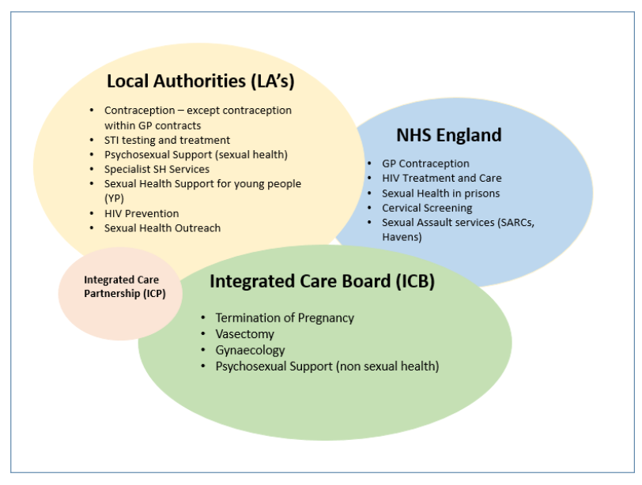
National legislation on commissioning responsibilities for sexual and reproductive health services
In 2013, the Department of Health published the Framework for Sexual Health Improvement following the changes to the health landscape brought about by the Health and Social Care Act 2012.
The new legislation outlined that councils would be responsible for commissioning most sexual health services (from April 2013), with additional roles for ICBs and NHS England (see diagram)
The Framework aimed to:
provide the information, evidence base and support tools to enable those involved in sexual health improvement to work together effectively
ensure that accessible high-quality services and support are available to everyone.
Figure 1: Commissioning responsibilities of sexual and reproductive health

Slide 11
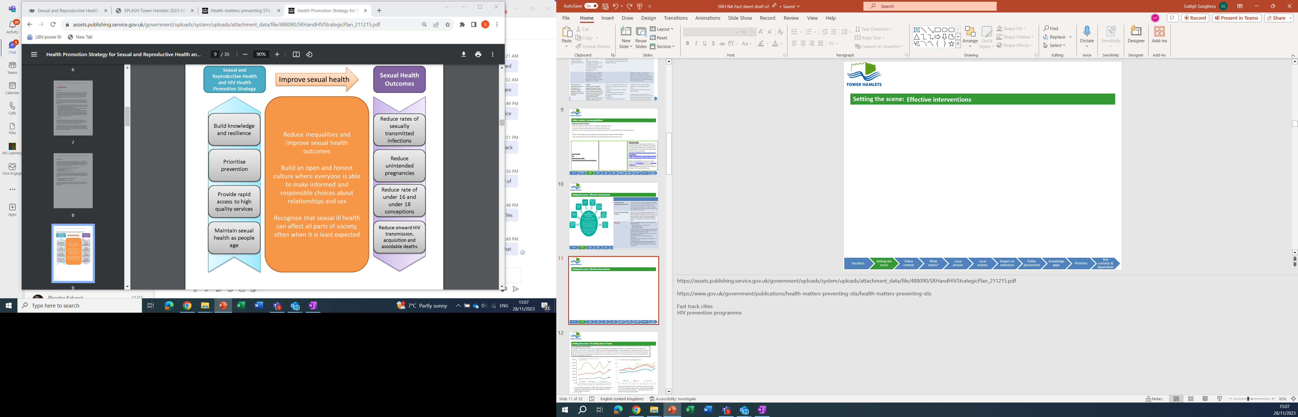
A national framework for improving Sexual and reproductive health outcomes
The Department of Health in ‘A Framework for Sexual Health Improvement in England’ (2013) sets out steps towards achieving a reduction in sexual and reproductive health inequalities, building an open and honest culture around sex and relationships and recognising that sexual and reproductive ill health can affect all ages and parts of society.
Four priorities for sexual health improvement are identified in the
framework:
onward HIV transmission, acquisition and avoidable deaths
sexually transmitted infections (STIs)
unplanned pregnancies
teenage conceptions (under 16 and under 18).
Figure 2: PHE A framework for sexual and reproductive health and HIV: strategic action plan, 2016 to 2019

Slide 12
Sexual and reproductive health national policy context
Department of Health: A framework for sexual health improvement in England 2013.
The Framework outlines the government’s ambition and objectives for good sexual health for the whole population as well as providing some key principles of best practice in sexual health commissioning to support councils, ICBs and NHS England.
These include:
prioritising the prevention of poor sexual health, strong leadership and joined-up working,
focusing on outcomes, addressing the wider determinants of sexual health
commissioning high-quality services, with clarity about accountability
meeting the needs of more vulnerable groups and good-quality intelligence about services and outcomes for monitoring purposes.
Relationship Education (Primary) and Relationship and sex education (RSE) (Secondary) September 2021
From 2020, primary schools have been required to teach relationships education when RSE became mandatory in schools.
The statutory guidance for schools, published by the Department for Education (DfE) in June 2019, requires that students at secondary level learn about:
RSE curriculums have become more inclusive of LGBTQ+ young people.
The prevalence of some STIs and the impact they can have on those who acquire them
how the different STIs, including HIV and AIDs, are transmitted
how risk can be reduced through safer sex (including through condom use)
the importance of and facts about testing and treatment
how to get further advice, including how and where to access confidential sexual and reproductive health advice and treatment
Fast-Track Cities is an international initiative to end new cases of HIV by 2030 Global movement to end HIV transmission by 2030.
Towards Zero: An action plan towards ending HIV transmission and HIV related deaths in England 2022-2025 sets out how an 80% reduction in new HIV infections will be achieved by 2030 with a focus on four key themes – prevent, test, treat and retain. The overarching ambition is to achieve zero new infections, AIDS and HIV-related deaths in England by 2030. The plan provides a framework for how this will be achieved via the following objectives:
1. Ensure equitable access and uptake of HIV prevention programmes. 2. Scale up HIV testing in line with national guidelines. 3. Optimise rapid access to treatment and retention in care. 4. Improve quality of life for people living with HIV and addressing stigma.
National Chlamydia Screening Programme (NCSP)
In June 2021, changes were made to the NCSP to focus on opportunistic screening of young women to reduce the reproductive harm of untreated infection. This means that in community settings, screening is now only proactively offered to young women. This should be combined with reducing time for results and treatment, more effective partner notification and re-testing following treatment.
Men are still offered testing where there is a specific indication such as symptoms or a partner with chlamydia. These changes are to allow the programme to maximise health benefits by focusing on the population where there is most harm from untreated infection.

Slide 13
Sexual and reproductive health national policy context & guidance
Syphilis Action Plan 2019
The Public Health England (PHE) action plan published in June 2019 focuses on the main affected populations in recognition that there is a need to strengthen public health measures to reduce transmission of syphilis. It focusses on 4 prevention pillars fundamental to syphilis control and prevention. These are:
Increase testing frequency of high-risk men who have sex with men (MSM) and retesting of syphilis cases after treatment.
Deliver partner notification to British Association for Sexual Health and HIV (BASHH) standards.
Maintain high antenatal screening coverage and vigilance for syphilis throughout antenatal care.
Sustain targeted health promotion.
Women's Health Strategy for England 2022 strategy outlines a six-point long-term plan for transformational change by 1. Ensuring women’s voices are heard 2. Improving access to services 3. Addressing disparities in outcomes amongst women 4. Better information and education 5. Greater understanding of how women’s health affects their experience
In the workplace 6. More research, improving the evidence base and better data
The strategy focuses on are menstrual health and gynecological conditions; fertility, pregnancy, pregnancy loss and post-natal support; menopause; mental health and wellbeing; cancers; the health impacts of violence against women and girls; and healthy ageing and long-term conditions.
NICE Guidance
New NICE guidance ‘Reducing sexually transmitted infections’ was published in June 2022. The guideline includes recommendations on:
Reducing the risk of people getting and transmitting STIs
Improving uptake and increasing the frequency of STI testing
Partner notification
HPV and hepatitis A and B vaccination in gay, bisexual, and other men who have sex with men.
Pre-exposure prophylaxis for HIV
NICE Guidance
Further guidelines give specific advice for particular interventions or population groups:
NICE guidance on Long-acting reversible contraception provides best-practice advice on the provision of information and care for women considering or using LARC.
Guidance on condom distribution schemes specifically details best-practice to deliver these schemes, including targeting services to meet the needs of local populations.

Slide 14
Sexual and reproductive health regional and sub regional policy context
Regional Policy (London)
London Sexual Health Partnership (LSHP) is a London wide partnership of 31 local authorities that collaborate on the planning of sexual health services across London . This partnership has lead to the development of a London Integrated Sexual Health Tariff (LISHT) which applies standardized tariff prices for a range of clinical sexual and reproductive health interventions and pathways and a Pan-London commissioning approach.
London HIV prevention Programme (LHPP) is aimed at Londoners at risk of HIV infection. This includes the two key groups: gay, bisexual and other men who have sex with men (GBMSM) and black heritage Communities, who have a disproportionately high burden of infection. The programme has developed Campaigns/communications under the Do It London brand across London and includes a London wide condom distribution scheme and targeted outreach and testing for GBMSM populations .
Sub regional – North East London collaboration
On a sub region levels we have a NEL collaboration where each borough (Newham, Waltham Forest, Tower Hamlets and Redbridge) commission the Integrated sexual health services as a collective, with one joint contract in place from 2017 to 2025, with one integrated sexual health service. This enables consistency of local services across neighbouring boroughs as well as driving a more efficient provision across the sub region.

Slide 15
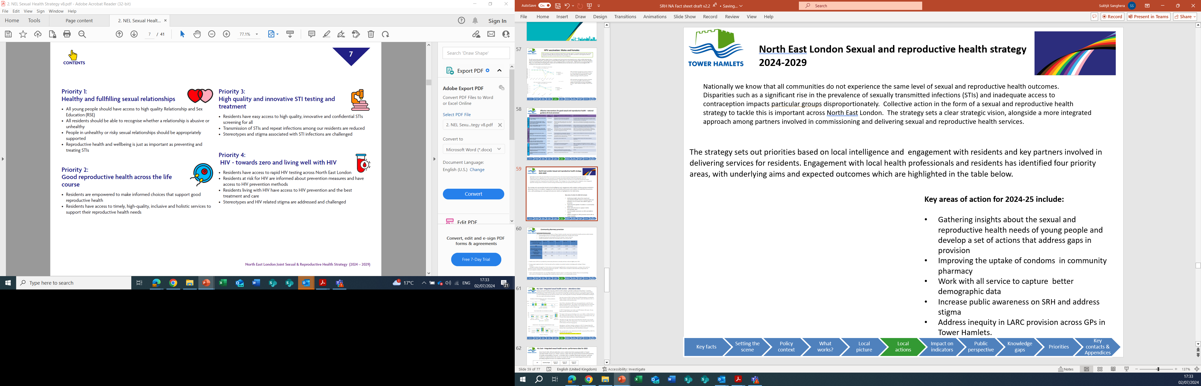
Local policy context
North East London Sexual and Reproductive Health Strategy 2024-2029
Nationally we know that all communities do not experience the same level of sexual and reproductive health outcomes. Disparities such as a significant rise in the prevalence of sexually transmitted infections (STIs) and inadequate access to contraception impacts particular groups disproportionately. Collective action in the form of a sexual and reproductive health strategy to tackle this is important across North East London. The strategy sets a clear strategic vision, alongside a more integrated approach among partners involved in commissioning and delivering sexual and reproductive health services. Strategy priority areas The strategy sets out priorities based on local intelligence and engagement with residents and key partners involved in delivering services for residents. Engagement with local health professionals and residents has identified four priority areas, with underlying aims and expected outcomes which are highlighted in the table below.

Slide 16
3. Population overview

Slide 17
Tower Hamlets has diverse population characteristics (1)
The size of our young diverse population including our large GBMSM population contributes to a high level of need for sexual and reproductive health in Tower Hamlets.
Population structure & growth
​Around 310,000 people live in Tower Hamlets (Census 2021)​
Around half (47.4%) of the Tower Hamlets population are aged between 20-39 years and with a median age of 30. Tower Hamlets is one of the youngest boroughs in the country​.
By 2040, those aged 15-44 projected to contribute more than 55.9% (207,200 people) of the Tower Hamlets population (LGA 2021-based projections).
Deprivation
Tower Hamlets experiences a high level of inequality.
Of the 144 neighborhoods in Tower Hamlets, 74 were among the bottom fifth most income-deprived, whilst 6 were among the top fifth least income-deprived in England.
Sexual orientation​
In Tower Hamlets, 7.2% of the population identify as either lesbian, gay, bisexual or other which is higher than London (4.3%) and England (3.2%)​
Out of all local authorities in the country, Tower Hamlets has the 9th largest proportion of people who identify as gay or lesbian (4%), bisexual (2.5%) or other sexual orientation (0.7%), which is a similar distribution to other London boroughs, such as Lambeth, Southwark, Hackney, Islington and Camden. These boroughs also all have median ages under the London average of 35.
Out of all London boroughs Tower Hamlets has the third largest proportion and number of men who identify as gay , bisexual or other (4.8%:11,000 men), behind Lambeth (5.9%: 14,400 men), and Southwark (5.3%: 12,400 men).​
Notes:
Data sources
Population trend – Census 21
Projection data is using ONS 2018 based projections – provided by age
Population age – Census 21
Deprivation data is 2019 IMD

Slide 18
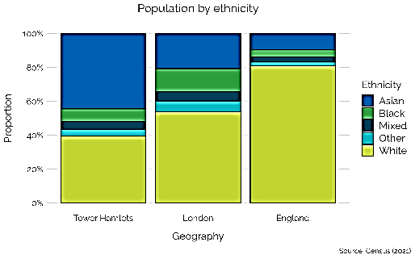
Tower Hamlets population has diverse characteristics (2)
Understanding the ethnic make-up of Tower Hamlets is important for ensuring interventions are tailored for different ethnicities.
Ethnicity
Tower Hamlets is ethnically diverse, with 44.4% identifying as Asian which is higher than both London (20.7%) and England (9.6%).
More detailed ethnicity data reveal those who identify as Bangladeshi (34.6%) form the majority ethnicity in Tower Hamlets, followed by White British (22.9%), Other White (14.6%), African (5.0%) & Chinese (3.3%).​
A variety of ethnicities contributes to Tower Hamlets being highly multilingual, 30.4% of residents have a main language other than English, compared to 23.8% in London and 9.9% in England, this in turn could impact on accessibility and use of services.
Deprivation​
There is a high level of area-based inequality in Tower Hamlets​
Of the 144 neighborhoods in Tower Hamlets, 74 (51%) were among the bottom fifth most income-deprived, whilst only 6 (4%) in top fifth least deprived in England (IMD 2019).
Notes:
.

Slide 19
4. STI diagnosis

Slide 20
STI diagnosis: Tower Hamlets profile summary
General trends
Rising rates of new STI diagnosis in Tower Hamlets are a consequence of both Tower Hamlets young and sexually diverse population, with particularly higher number GBMSM ( gay bisexual men who have sex with men).
Higher rates of STI diagnosis are in males aged 25-34, the most common STI being gonorrhoea and chlamydia.
In females the highest rates of STIs are in 15- 24 age group. Chlamydia is the most common STI in females.
Gonorrhoea and syphilis increased since pre-pandemic, with the majority of new cases of gonorrhoea in GBMSM groups. This indicates high rates of transmission through unsafe sex practice. The highest increase compared to London and 3x higher than the NEL average. Twice as high rates of syphilis in Tower Hamlets compared to NEL average.
There is a small rise in diagnosis rates in heterosexual populations, however it appears that rates are not at pre-pandemic levels​.
STI reinfection is particularly prevalent in GBMSM (5x higher than the general population) in Tower Hamlets; this inequality is similar to London.
Inequalities:
Ethnicity:
New STI diagnosis are the highest in White and Mixed groups.
The largest increase in STI diagnosis rates in recent years has been observed in Mixed and Asian populations
The Black population experience disproportionately higher than expected cases (around 2.5 times higher) after adjusting for sexuality when compared to London​, particularly aged 35-64.
Deprivation:
There is no clear association between STI diagnosis and IMD deprivation however there appears to be a potential deprivation gradient for chlamydia and gonorrhoea.

Slide 21
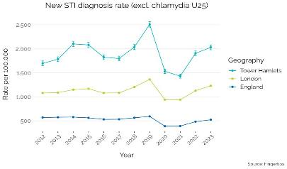
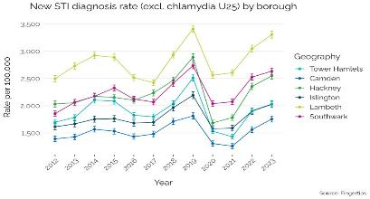
STI diagnosis
STIs have been rising recently in Tower Hamlets. These increases are concentrated among Tower Hamlets’ large GBMSM population, as is the case elsewhere.
Nationally there has been an increase in new STIs and since 2018 gonorrhoea and syphilis have re-emerged as major public health concerns, especially among GBMSM.
STI diagnoses rate is nearly twice as high in Tower Hamlets compared to London and England, in 2023 the rate of STIs was 2,030 per 100,000 compared to 1,229 per 100,000 in London and 520 per 100,000 in England​. Tower Hamlets has the 7th Highest rates out of all England boroughs.
The high rate of STI diagnosis is a consequence of both Tower Hamlets’ young and sexually diverse population. ​
When comparing London boroughs with both a similar GBMSM and age profile Tower Hamlets has similar levels of STIs:
STI diagnosis rates range from 3303.8 per 100,000 in Lambeth to 1754.8 per 100,000 in Camden​. Tower Hamlets is within a similar range.
Behavioural changes such as more condomless sex with new or casual partners are likely to be contribute to the increasing trends.

Slide 22
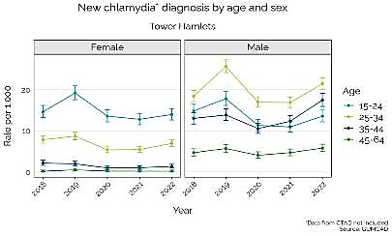
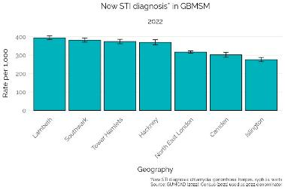
New STIs diagnoses by Key demographics: age, sex and sexuality
There are clear differences in STIs between groups with nearly four times higher rates in males aged 25-34, which is driven by GBMSM population.
New STI diagnosis are more common in males compared to females in Tower Hamlets, with diagnosis rates 3.8 times higher in men (35.7 per 1,000) compared to women (9.4 per 1,000)​. New STIs are the highest in females aged 15-24 and for males it’s in the 25-34 age group.
STI diagnosis rates in males in Tower Hamlets are largely in the GBMSM group with rates rising from 252.3 per 1,000 in 2020 to 374.0 per 1,000 in 2022 which is higher than NEL (316.7 per 1,000).​
9.6% relative increase in the number of cases for GBMSM in 2022 compared to pre-pandemic (2019) in Tower Hamlets, slightly higher than Hackney (7.6%), indicating rates are rising beyond pre-pandemic levels and to a greater extent than comparable neighbours and other London boroughs with similar GBMSM profile.
There have also been small but significant rises in diagnosis rates for heterosexual populations​
In females the STI diagnosis rate changed from 8.6 per 1,000 in 2020 to 10.1 per 1,000 in 2022, which is higher than NEL (8.9 per 1,000)​
In males the STI diagnosis rate changed from 6.3 per 1,000 in 2020 to 7.9 per 1,000 in 2022 which is similar to NEL​
For both females and males, absolute number of cases is less in 2022 compared to 2019 indicating rates have not returned to pre-pandemic levels yet.

Slide 23
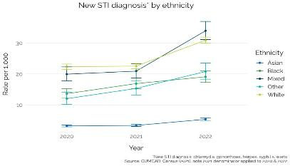
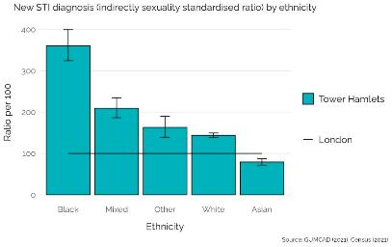
STI diagnosis by ethnicity
The largest increase in STI diagnosis has been in Mixed and Asian groups. After accounting for sexuality, people who identify as Black experience a higher rate of new STIs.
There is variation in STI diagnosis by ethnicity, with diagnosis rates ranging from 5.4 per 1,000 in Asian to around 30 per 1,000 in Mixed and White groups (2022).​
All ethnicities displayed an increased in diagnosis rates since 2020, with the largest increases observed in Other (73.1%), Mixed (70.3%) and Asian (67.1%) groups.
When comparing STI diagnosis between ethnicities, indirect sexuality-standardised ratios were calculated (to adjust for the strong influence of sexual orientation).
Data in the chart below represents a percentage difference from the number of expected cases in the “London reference population”.
After standardising for sexuality, all ethnicities (except Asian) in Tower Hamlets have higher rates of new STIs, but the Black population are disproportionately more affected with 2.5 times more cases than expected when compared to the London standard.
(see Appendix 3 for more information about the standard ratio calculation).

Slide 24
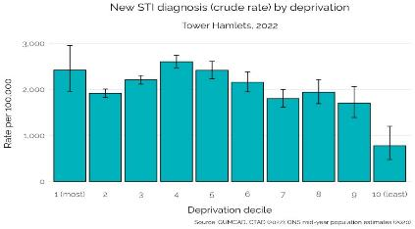
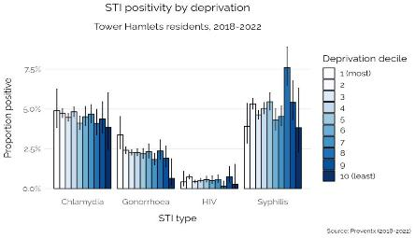
STI diagnosis by deprivation
STIs including gonorrhoea and chlamydia are more common in more deprived groups.
​There is no linear relationship between STI diagnosis and deprivation in Tower Hamlets STI diagnosis is higher in the most deprived decile (2420.0 per 100,000) compared to least deprived (777.6 per 1,000). Decile 4 has the highest New STI diagnosis (2601.4 per 100,000). STI testing online data from Preventx indicates that there could be a positive relationship with deprivation for both chlamydia and gonorrhoea diagnosis: Chlamydia: 4.9% in most deprived compared to 3.9% in the least deprived Gonorrhoea: 3.6% in the most deprived compared to 0.6% in the least deprived.

Slide 25
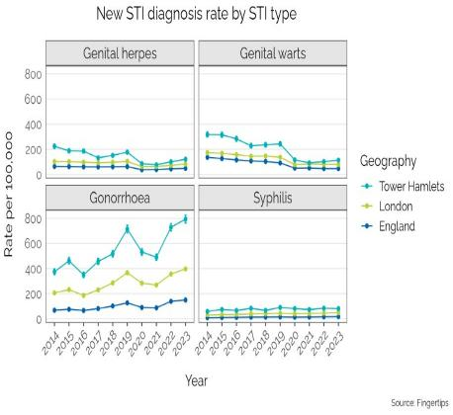
STI diagnosis by STI type: trend
Higher rates of the most common STIs, gonorrhoea has increased by almost 60% in the last three years.
Tower Hamlets continues to follow a similar trend in rates for the most common STIs and Tower Hamlets rates continue to be higher compared to the London and England average.
Diagnosis rates for genital herpes and genital warts declined by 32.1% and 53.4% since 2019, respectively, and have remained stable and not gone back to pre-pandemic levels:​
Genital warts rate: 113.0 per 100,000 (2023)​
Genital herpes rate: 119.7 per 100,000 (2023)​
Gonorrhoea diagnosis rates have reached 793.7 per 100,000 and more than doubled in the last decade, with rates above pre-pandemic levels (2023).​
Whilst diagnosis rates are comparably low for syphilis (80.4 per 100,000), they have remained stable over the last decade and show no signs of declining​.
It has long been recognised that gonorrhoea and, more recently, mycoplasma genitalium are at risk of becoming untreatable diseases due to the ongoing threat of antimicrobial resistance.

Slide 26
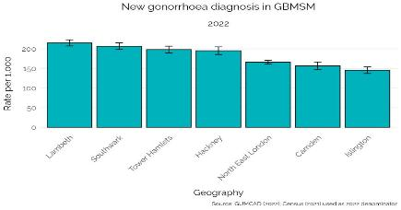
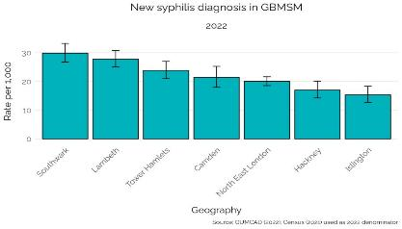
Rates of gonorrhoea and syphilis in GBMSM groups
Gonorrhoea is more common in GBMSM groups but has also risen in heterosexuals.
If high rates of gonorrhoea and syphilis are observed in a population, this suggests unsafe sex practice and ongoing transmission of infection is occurring, so prevention intervention like regular testing and improved partner notification is needed.
The new diagnoses of gonorrhoea and syphilis is most common in men aged 25-34-years, accounting for 46.6% and 37.4% of all new cases in Tower Hamlets, respectively (2018-2022)​.
The majority of new cases of gonorrhoea and syphilis were diagnosed within GBMSM, accounting for 80.0% and 87.6% of all new cases in Tower Hamlets, respectively (2020-2022).​ A similar rate to other borough with similar GBMSM profiles.
Diagnosis rates for gonorrhoea in those who identify as gay or bisexual for both sexes reveal large relative increases​:
In GBMSM groups gonorrhoea rates increased from 127.0 per 1,000 in 2020 to 198.3 per 1,000 in 2022, which is higher than NEL for 2022 (166.4 per 1,000).
In females gonorrhoea rates increased from 2.8 per 1,000 in 2020 to 6.9 per 1,000 in 2022, which is similar to NEL for 2022​
Gonorrhoea diagnosis rates for heterosexual males and females in Tower Hamlets reveal a small but significant rise since 2020 to reach around 1 per 1,000 in 2022 which is similar to NEL.​
Syphilis diagnosis rates have remained stable over the last three years in GBMSM in Tower Hamlets, with rates currently 23.8 per 1,000 in 2022 which is similar to NEL​. Syphilis diagnosis rates have remained at less than 1 per 1,000 for other sex and sexual identities in Tower Hamlets and NEL (2020-2022).

Slide 27
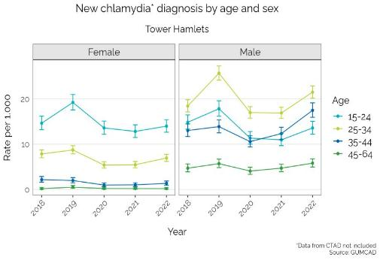
Chlamydia diagnosis rates​
In Tower Hamlets in 2022, 3,154 per 100,000 people were diagnosed with chlamydia, these rates have remained stable over the last 5 years but are consistently above the London and England averages​
For females, chlamydia diagnosis rates are most common 15-24-year-olds in 2022, that will be influenced largely by the national chlamydia screening programme for females aged between 15-24.​
For males, chlamydia diagnosis is most common in 25-34-year-olds, followed by 35-44-year-olds and 15-24-year-olds in 2022. ​
Chlamydia diagnosis rates for men who identify as GBMSM was 333 per 1,000 males, compared to 4 per 1,000 males who identify as heterosexual in 2022, indicating that the GBMSM population are driving higher rates of chlamydia diagnosis in men over 25.

Slide 28
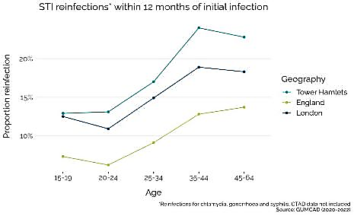
STI diagnosis reinfections by sex, age and sexuality
GBMSM groups aged 35-44 are likely to have the highest rates of STI reinfection within 12 months, which increases the likelihood of onward transmission.
STI reinfections at 12 months increase by age and are the highest in 35-44-year-olds (24.0%) in Tower Hamlets and are higher than London and England across all age bands.
STI reinfections within 12 months are higher in males (20.6%) compared to females (8.2%) in Tower Hamlets (2020-2022).
The sex difference is driven by GBMSM who account for over 95% of reinfections in men, where sexuality is known​.
STI reinfections within 12 months in GBMSM are 25.5% to 5.3% for heterosexual men​.
The proportion of reinfections in GBMSM is similar to London (25.0%) but higher than England (19.4%)
STI reinfections within 12 months in GBMSM are similar to London for gonorrhoea and chlamydia but higher than England which reflects the higher rates of STI reinfections in GBMSM groups in London.
​ | ​ STI Type​ | Tower Hamlets​ (%)​ | ​ London (%)​ | ​ England (%)​
GBMSM​ | Gonorrhoea​ | 21.7​ | 21.2​ | 16.8​
 | Chlamydia​ | 18.4​ | 17.5​ | 13.4​
 | Syphilis​ | 4.0​ | 4.7​ | 4.2​

Slide 29
5. STI testing

Slide 30
STI testing: Tower Hamlets profile summary
Testing access trend
TH has high testing rates overall, driven to a large extent by large populations of young people and GBMSM in the borough​
The high and increasing testing rate, combined with high but stable positivity, indicates good testing practices in GBMSM population.​
Testing rates in heterosexual populations are lower in comparison to other similar London boroughs. ​
Age and Ethnicity:
Very low testing rates in Asian ethnic group which have remained stable, are accompanied with a rise in STI diagnosis rates in the last year and an increase in positivity, particularly for older Asian (35-64 years) in the last 5 years​. Suggests a need to increase access to testing for Asian ethnicity.
Performance for chlamydia screening has declined in Tower Hamlets, as well as across the country​
Both chlamydia detection and (female) screening are below London and England averages, indicating a need to improve control of disease activity.
Testing in clinic
Barts and Chelsea and Westminster Trusts together account for almost three quarters of in-clinic testing for Tower Hamlets residents​
Male residents are more likely to use in person clinics (particularly Chelsea and Westminster service) for testing compared to females. ​
Online testing
Online testing service use has increased substantially since 2020 when the pandemic started​
Similar increase in use for both sexes​
20-34 year olds by far most common users of online STI testing​
An increase was observed for all ethnicities, however Asian are by far the lowest users​
Higher rate of gonorrhoea being diagnosed in 45- 64 age group.
Online testing across the borough
Clustering of lowest (online) testing rates in Poplar, Limehouse and St Dunstan’s​
Limehouse has the largest proportion (82.5%) that are aged 15-64 in the borough​
St Dunstan’s and Poplar have the second and third largest Asian populations, which is the ethnicity associated with low testing rates.

Slide 31
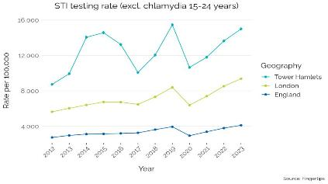
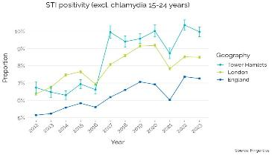
STI testing trends
Approximately 66% higher STI positivity rate compared to London, indicating that the right people are being tested.
The importance of STI testing
Sexually transmitted infections (STIs) can be passed through oral, vaginal or anal sex, often people with STIs will get no symptoms at all. STIs can have serious long-term impact (causing infertility or ectopic pregnancy ) without knowing it. The only way to know you have an infection is to get an STI test. Control of STIs relies on; consistent and correct condom use, behaviour change to decrease overlapping and multiple partners, ensuring prompt access to testing and treatment, and ensuring partners of cases are notified and tested.
Tower Hamlets continually has a higher than London and England STI testing rate with some fluctuation in recent years and are around pre-pandemic levels at 14,993 per 100,000 people, compared to 9,369 and 3,856 per 100,000 people in London & England, respectively. 7th highest testing rate in London (Newham 15th & Hackney 2nd highest in London ) in 2023.
STI positivity rates in Tower Hamlets show a general increase over the last decade with a higher proportion of STI test that are positive (Out of the populations tested for STIs 10.0% tested positive, higher than London (8.5%) and England (7.3%).
This indicates that we are relatively testing the right people (positivity between 5-12% indicates that the testing is generally accessible, while being effective at identifying and treating infection) as well as having a high burden of disease in Tower Hamlets and positivity rates in are high in Tower Hamlets, which is largely explained by our young population and high prevalence of GBMSM population.​
Note: unless otherwise stated, testing data in this section accounts for both in clinic and online testing.
Notes:
Tower Hamlets STI positivity trends are similar to other London boroughs, more recently more similar to Southwark and Lambeth. The charts below shows comparison with London borough that have a similar non-heterosexual demographic profile. Move this further down – for where the chart is placed

Slide 32
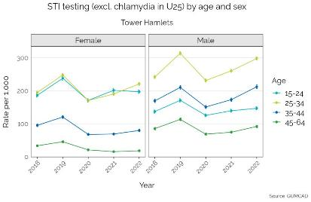
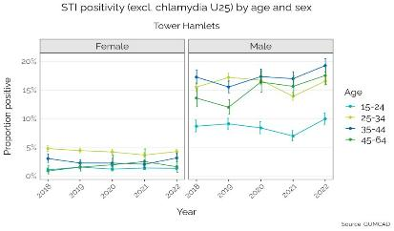
Trends in STI testing by sex and age
Under testing in men aged over 45, who have a high level of positivity but lower level of testing.
In Tower Hamlets, both testing rates and subsequent positivity are consistently higher in males compared to females. Testing rates for males were 189.9 per 1,000 compared to 134.7 per 1,000 for females, whilst positivity for males was 16.1% compared to just 3.1% for females in Tower Hamlets (2022)​.
Over time higher rate of males are testing for STIs compared to females, with the highest age group in males testing in the aged 25 -34 followed by 35 - 44 age group and the highest positivity rate in males in these age groups (highest positivity in 34 – 44 and then 45-64 age groups). There is a lower rate of STI testing in men 45-64 but higher positivity compared to the 25-34 age group. This suggested that increased testing in males over 45 should be encouraged further as a high proportion are testing positives.
Continued low positivity rates for STI testing in females but the highest rate of testing in the 15-34 age groups, over twice as high compared to testing in 35-64 age groups. Females of all ages have a relatively lower positive rate (less than 5%).
*Data includes in clinic and online testing

Slide 33
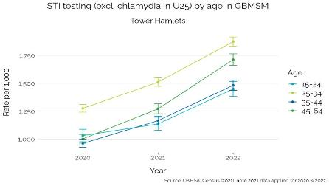
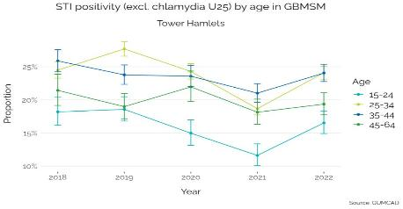
STI testing by age & sexuality (1) ​
Good levels of testing in younger GBMSM groups however under testing in GBMSM population aged 35-44.
In Tower Hamlets the GBMSM population the testing rate was 1489.4 per 1,000 and positivity rate was 22.5% compared to a testing rate of 94.3 per 1,000 and a positivity rate 4.9% in heterosexual males (2022). ​
Whilst testing is high and increasing across all ages for the GBMSM population since the pandemic started in 2020, positivity has consistently been high which indicates further testing should be encouraged generally.
In the GBMSM population the proportion that test positive for STIs is the highest in the 25 - 44 age groups yet the rates of STI testing is lower for the 35 – 44 age group, which suggests that GBMSM population in this age group need to be encouraged to be tested.
*Data includes in clinic and online testing

Slide 34
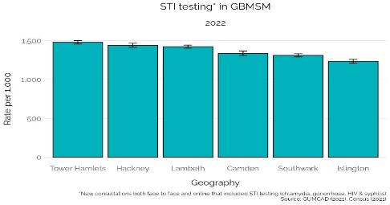
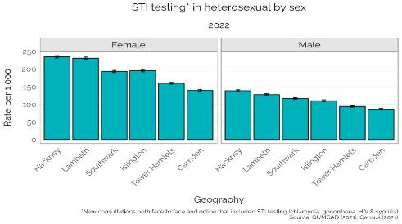
STI testing by sexuality (2)
Highest rate of STI testing compared to other London boroughs that have a similar GBMSM profile. However Tower Hamlets has lower levels of testing in heterosexual groups.
The 2021 Census was used to identify other London boroughs with a similar GBMSM profile and compared testing behaviour between these boroughs​.
Looking specifically at testing rates in GBMSM across these boroughs, Tower Hamlets has the highest testing rate (1479.0 per 1,000) along with Hackney (1439.6 per 1,000) and Lambeth (1422.5 per 1,000), whilst Camden, Southwark and Islington rates are slightly lower (around 1200-1300 per 1,000) (2022).
Testing rates in heterosexual populations in Tower Hamlets are lower compared to other London boroughs with similar population profile, indicating low level of need or under testing. ​
For female Tower Hamlets residents testing rates were 159.7 per 1,000 compared to 234.7 per 1,000 in Hackney.
For male Tower Hamlets residents testing rates were 94.0 per 1,000 compared to 138.6 per 1,000 in Hackney.
*Data includes in clinic and online testing

Slide 35
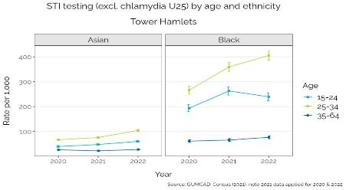
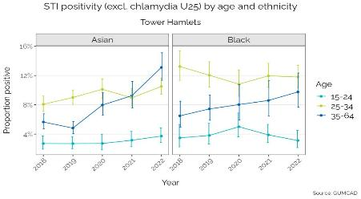
STI testing by ethnicity & age
Under testing in the Asian and Black population in Tower Hamlets, particularly in the 35-64 ages groups
Testing behaviour varies significantly between ethnic groups, ranging from 58.4 per 1,000 in Asian to 335.2 per 1,000 in Mixed (2022). Although there has been an increase in testing rates for the main ethnicities over last 3 years, testing rates are the highest in mixed groups, followed by other White and White British and the testing rate for Asians is the lowest.
Following Asian, the next lowest testing rates are observed in Other (160.4 per 1,000) and Black (201.9 tests per 1,000; 2022)​.
Data by ethnicity and age indicate that there may be under testing in the Asian population in Tower Hamlets, particularly in the 35-64-year-olds who have the stable testing rates and rising positivity. ​
A similar picture is observed for the 35-64-year-old Black population that display low and stable testing rates but an indication of an increasing trend for positivity, suggesting possible undertesting in this age and ethnic group.
*Data includes in clinic and online provision

Slide 36
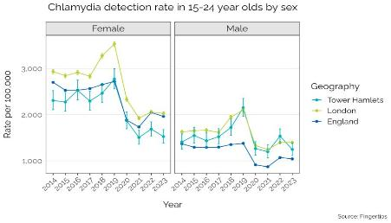
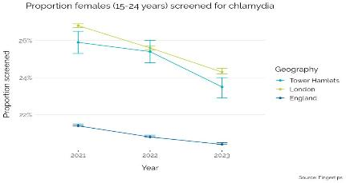
Chlamydia detection and screening in 15-24 year olds
Chlamydia detection rate for females aged 15-24 is low because there is low chlamydia testing in this age group.
Chlamydia detection and screening rates have declined for both sexes in Tower Hamlets, falling below the national 3,250 target, which indicates poor control of disease activity.
Chlamydia detection peaked in 2019 at 2489.7 per 100,000, but declined steeply during the pandemic and has remained low since.
In 2023 Chlamydia detection rates was 1412.2 per 100,000 which is below London (1739.1 per 100,000) and England (1545.9 per 100,000)​.
For females, detection rates have declined by 33% in the last decade, currently at 1,526 per 100,000 which is below London (2027.8 per 100,000) and England (1961.7 per 100,000) (2023).​
For males, detection rates have remained stable in the last decade, currently at 1,247 per 100,000 which is similar to London but higher than England (1041.6 per 100,000).​
There have been a general decline in the proportion of females screened across the country, in Tower Hamlets there has been a 2 percentage-point decrease which reflects the low detection rate observed in females. The low detection rate suggests poor awareness of, access to and/or uptake of screening.

Slide 37
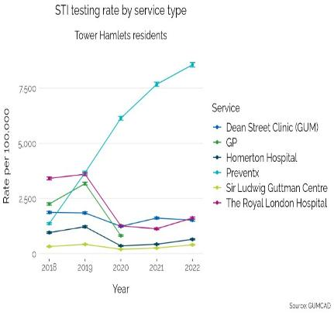
STI testing by service type
Low STI positivity for online testing compared to in clinic. This indicates that as intended, the online service is being used for asymptomatic, precautionary and low-risk testing, while testing in clinics focuses on symptomatic and complex cases.
Use of online testing service (Preventx) has seen a 6-fold increase over the last five years, from 1364.7 per 100,000 in 2018 to 8552.5 per 100,000 in 2022.
The largest decrease in testing for residents was at the Royal London Clinic, from 3411.4 per 100,000 in 2018 to 1618.2 per 100,0000 in 2022
Other sexual health clinics have generally seen similar activity or a slight decline in activity over the last 5 years
After 2020 the majority of clinic testing for Tower Hamlets residents outside of Tower Hamlets reduced but not significantly in other London sexual health services.
The proportion of TH residents using clinic services within Tower Hamlets dropped significantly from 45% (37,864 tests) to 11% (8,892 tests) in 2021-22.
Trend in GP testing has been higher than out of borough testing however since the reporting of this is no longer required in GUMCAD further data is not collected.
For Tower Hamlets residents, the positivity rate for online testing has increased marginally from 4.4% in 2018 to 6.3% in 2022, whilst the in-clinic positivity rate has increased from 12.4% to 18.2% in the same time period.
Notes:
Need to review data from Aneta -

Slide 38
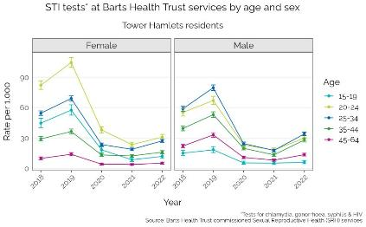
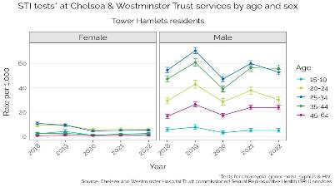
In clinic STI testing service use - comparison with main services used by Tower Hamlets residents
Men aged 25-44 are most likely to use other in-clinic London sexual health services rather than the borough local sexual health service.
Despite the declining trend of in clinic testing due to the online testing, males in Tower Hamlets are consistently more likely than females to be tested in clinic ​ The testing rate for males was 110.1 per 1,000 in 2018 and 88.5 per 1,000 in 2022. The testing rate for females was 71.0 per 1,000 in 2018 and 38.5 per 1,000 in 2022.​
72.5% of all in clinic tests were provided by Barts Health Trust (42.1%) and Chelsea & Westminster Trust (30.4%) between 2018-2022 for Tower Hamlets residents​.
The general trend in use of Barts Trust services is similar between sexes, although there is a difference in use by age​. Apart from ages 15-19 and 20-24, males have higher rate of testing than females for each other age group​.
Males in Tower Hamlets aged 25-44 are more likely to use Chelsea & Westminster Trust services than women.

Slide 39
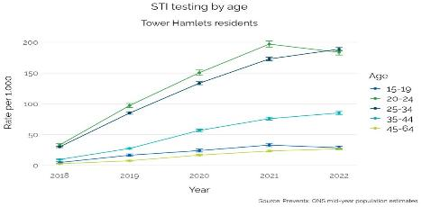
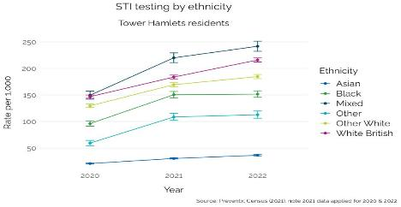
On-line STI testing by demographics
Less on-line STI testing in 15-19 and 45-64 age groups, and Asian groups.
Tower Hamlets residents aged 16 and over can access London wide online STI testing for Chlamydia, Gonorrhoea, Hepatitis B, Hepatitis C and HIV via the Sexual Health London website
In Tower Hamlets, a similar increase was observed in online testing for both sexes in recent years, rising from 17.2 per 1,000 in 2018 to 104.4 per 1,000 2022 for females and from 17.6 per 1,000 to 116.8 per 1,000 for males in the same period. ​
The increase in online testing is driven by 20-34 age group, whilst 15-19 and 45-64 age groups were least likely to use online services.​
There has been a general increase in online testing for all ethnicities, except for Asian which remains low compared to other ethnicities.

Slide 40
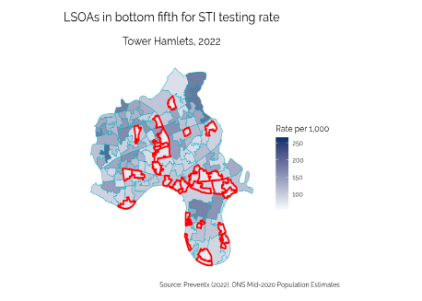
Online STI service use: Lower layer super output areas (LSOA)
More online testing required in Poplar, Limehouse and St Dunstan’s, given that there are high rates of STI diagnosis in all Tower Hamlets wards.
There is large variation in online STI testing rates by LSOA in Tower Hamlets, ranging from 55.0 tests per 1,000 people to 265.9 tests per 1,000 people.
There are lower testing rates cluster around areas of Poplar and Limehouse towards the South East of the borough and St Dunstan’s in the centre of the borough, however this does not translate to lower diagnosis rates
Low testing rates in these areas could be a related to age and ethnicity distribution: ​
The proportion of people aged 15-64 across wards in Tower Hamlets is high (70%+), with the highest proportion live in Limehouse (82.5%), dropping to 73.4% in St Dunstan’s and 71.9% in Poplar.
Asian groups display by far the lowest testing rates in the borough, St Dunstan’s and Poplar have the second (59.0%) and third (58.1%) largest Asian communities, respectively, in the borough​.

Slide 41
6. HIV diagnosis, testing and treatment

Slide 42
HIV diagnosis and testing: Tower Hamlets profile Summary
New HIV diagnosis
New HIV diagnosis rate has been declining in Tower Hamlet in line with national trends and now trends at a similar rate to London and 11th Highest in London
New HIV case have mostly been in people aged 25-34 and GBMSM being the most common route of transmission.
Heterosexual route of transmission has been increasing in the last two years in Tower Hamlets.
Late diagnosis of HIV
Cases of late diagnosis of HIV are more common in GBMSM, there is an indication of a rising trend in GBMSM, similarly to London and England
HIV treatment
The proportion of people newly diagnosed with HIV accessing antiretroviral therapy (ART) within 3 months is lower in Tower Hamlets compared to London and England which could be related to underserved groups being diagnosed that are not accessing treatment. This needs further investigation.
HIV testing
HIV testing in clinic has been declining overall and remains higher in males compared to females.
There has been an increase in online HIV testing across both sexes and all ages, particularly high in 20-34 year olds.
Repeat HIV testing among GBMSM groups in Tower Hamlets has been declining and access to PrEP could play a part in this decline among GBMSM groups.
PrEP treatment
About a quarter of those with PrEP need are accessing PrEP, which is the 5th highest local authority in the country and similar to Lambeth and Camden​
Data is needed to understand who those are who are eligible but not accessing PrEP
Almost all people using PrEP in Tower Hamlets are men.​
The rate of PrEP in 20-24-year-old men is much lower than comparable age groups (e.g. 25-44 year olds), presenting a possible age group to increase access in.

Slide 43
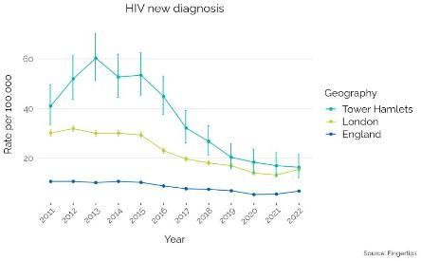
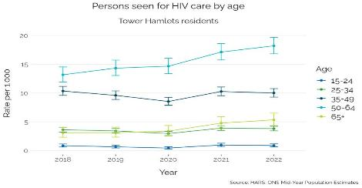
HIV diagnosis & living with HIV
Cases of new HIV are mostly in males aged 25-34 with sex between men being the route of transmission. Recently transmission via heterosexual route has been increasing.
In Tower Hamlets, new HIV diagnosis has declined from 60.3 per 100,000 in 2013 to 16.3 per 100,000 in 2022 which is similar to London (15.5 per 100,000) but higher than England (6.7 per 100,000) (OHID):
90% of new HIV diagnoses were in men, with 25-34 age group being the most common age group (46.2%) and White the most common ethnicity (55.8%) (HARS; 2018-2022)
Sex between men is the most probable exposure category in Tower Hamlets, but rates have decreased from 6.2 per 1,000 2018 to 1.8 per 1,000 in 2022 (HARS)
Transmission via heterosexual route has been increasing in the last two years which could be related to people’s belief that they are not at risk of HIV and consequently lack of HIV testing.
Previously high rates of new HIV diagnosis have contributed to Tower Hamlets having an ‘extremely high’ prevalence of people aged 15-59 living with HIV (6.9 per 1,000), which is similar to London (5.3 per 1,000) but higher than England (2.3 per 1,000) (OHID; 2022)
Around 1,800 people were seen for HIV care in Tower Hamlets, 82.3% are men and 73.3% are aged 35-64
Almost three quarters (73.2%) are living in the most deprived neighbourhoods.

Slide 44
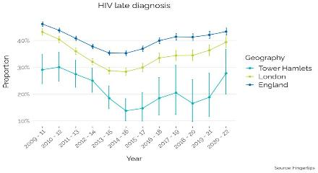
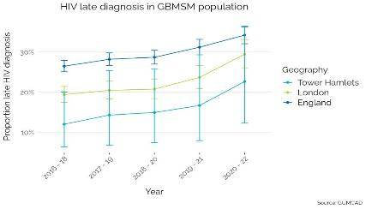
HIV late diagnosis
HIV late diagnosis in Tower Hamlets is low but has increased in recent years. The majority of HIV late diagnosis are in GBMSM populations and have been rising but the numbers are low.
Late diagnosis, classed as a person diagnosed with a CD4 count under 350 within 3 months, is the most important predictor of morbidity and increases the risk of dying by eight times.
The proportion of newly late diagnosed with HIV in Tower Hamlets has increased from 18.8% in 2020-2021 to 27.7% in 2020-22 but remains lower than London 39.4% and England 43.4%. In 2020-22, 33 people in Tower Hamlets had a late diagnosis of HIV compared to 19 in 2019-21.
Whilst the number of late diagnosis cases is low in Tower Hamlets (33), the majority of late diagnosis cases are in GBMSM and data are indicating a rising trend:
from 12% late diagnosis in 2016-18 to 22.6% in 2020-22, however this rise is not significant and does not significantly differ from London or England​
Due to low numbers, trends for other sex/sexual orientations are not provided​.
The proportion of late diagnosis in Non-White groups is 34.5% compared to 20.8% for White groups , however this is not a significant difference (2018-2022).
Notes:
Check with Nick about the first slide its no longer in the data pack

Slide 45
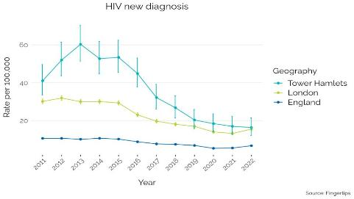
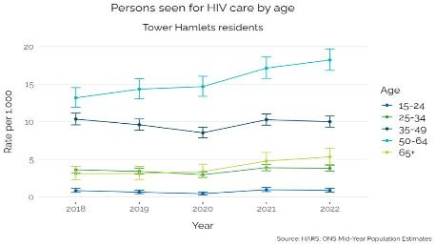
HIV testing
Online HIV testing is particularly high in people aged 20-34 and this reflects where there are higher numbers of HIV are diagnosed.
HIV testing coverage reflects the number of eligible people who accept a test for HIV within specialist sexual health services.
In Tower Hamlets, total HIV testing coverage (in clinic) has declined by 15.8%, from 63.2% in 2018 to 53.2% in 2022, which is similar to London (54.0%) and England (48.2%)​:
Testing coverage for women has declined by 31.5%, from 52.0% in 2018 to 35.6% in 2022, which is below London (42.4%) and England (38.5%)​
Testing coverage for GBMSM has declined by 14.8%, from 86.3% in 2018 to 73.6% in 2022, which is similar to London (73.3%), England (74.1%) and other boroughs with a similar GBMSM profile​.
Repeat HIV testing in clinic among GBMSM has remained stable in the last 5 years in Tower Hamlets and is currently 50.1% which is similar to London (49.3%) and other boroughs with a similar GBMSM profile, but above England (47.3%) (2022).
The decline in HIV coverage (in clinic testing) is due to the increase in online testing. The online HIV testing data shows:
For females, HIV testing increased from 12.9 per 1,000 in 2018 to 77.9 per 1,000 in 2022​
For males, HIV testing increased from 14.2 per 1,000 in 2018 to 91.7 per 1,000 in 2022​.
A significant increase in testing significantly in the 20-34 age group.

Slide 46
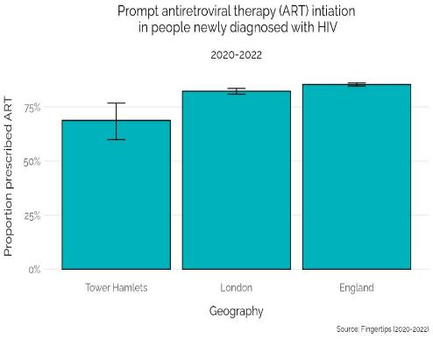
HIV treatment and care: Antiretroviral Therapy (ART)
There are low levels of people with HIV accessing antiviral therapy which could be related to high levels of migration, or to stigma and discrimination that are barriers to accessing services
Free and effective antiretroviral therapy (ART) in the UK has transformed HIV from a fatal infection into a chronic but manageable condition. People living with HIV in the UK can now expect to have a near normal life expectancy if diagnosed promptly and they adhere to treatment.
In addition, people with HIV on treatment have a consistently undetectable HIV viral load, meaning that the virus cannot pass on HIV, even if having unprotected sex (undetectable=untransmissible [U=U]).
The proportion of people newly diagnosed with HIV accessing antiretroviral therapy (ART) is lower in Tower Hamlets (68.8%) compared to London (82.3%) and England (85.4%):
Note that this measure includes people who could have been diagnosed abroad, not just the UK.
There is however good ART coverage of people living with HIV and accessing HIV care which is contributing to high virological success in Tower Hamlets:
96.3% of those accessing HIV care were prescribed ART, which is above the official target of 95% (2022)
97.6% of those accessing HIV care had an undetectable viral load (2022).
Notes:
Needs better labelling

Slide 47
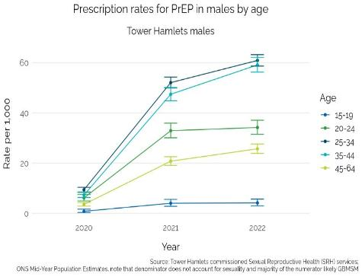
HIV treatment and care: Pre-Exposure (PrEP)
Mostly men aged 25-44 are on PrEP medication which is likely to be due to a high proportion of GBMSM population in Tower Hamlets. There remains lower access to PrEP in non-GBMSM populations (as elsewhere)
PrEP need estimates the proportion of HIV negative individuals accessing specialist sexual health services who are at substantial risk of HIV​.
24.6% of those with PrEP need are accessing PrEP in Tower Hamlets, which is the 5th highest proportion in London and similar to Lambeth, Camden & Southwark (OHID; 2022)​
Around 5,870 people are using PrEP in Tower Hamlets (SHS services; 2022)​. Almost all of them (98.3%) are men. This has increased by 25.2% (1,180 people) compared to 2021.​
The highest rate of use is in men aged 25-34 (60.9 per 1,000) and 35-44 (59.1 per 1,000), followed by 20-24 (34.2 per 1,000)​ age group.
Around 1,400 (24.0%) people started using PrEP, which is slightly less than 2021 (1,500 people). ​
Around 4,460 people (76.0%) continued using PrEP, which is slightly higher than 2021 (3,180 people).

Slide 48
7. Reproductive health

Slide 49
Reproductive Health: Tower Hamlets Profile Summary
Abortion trends
Total abortion rates have declined in Tower Hamlets, most noticeably in U18s which is supported by a large decline in conception rates​
Contraception use by age and ethnicity
Prescription of short-acting contraception is much more common across women of all ages, particularly those aged 25-29​
Data from SRH services indicate prescription of LARC is increasing across women of all ages and at a faster rate than London and England​
There is variation in contraception prescription by ethnicity​:
Asian and Black ethnic groups have the lowest short acting contraception prescription rates​
White Other and Asian ethnic groups have the lowest LARC prescription rates
The rate of LARC is higher in sexual health service compared to in GPs. GP LARC rate has been consistently lower than London and England average.
GP LARC in Tower Hamlets is similar to but lower than the London rate. The provision in GPs is not equitable across the borough and further work needs to be done to ensure that LARC is accessible for females across Tower Hamlets.
In the specialist sexual health service there has been good recovery since the impact of COVID and rate of LARC is similar to London and higher than England and increasing across all ages and at a faster rate than London and England.
Borough differences: Lowest overall contraception use situated in Mile End West and Canary Wharf, even though there is a high proportion of women aged 15-44 years (>65%) who live in these areas.
Oral contraception
There is a higher rate of oral contraception provision in GPs compared to sexual health services but rates are below London and England average. Higher use in younger age groups, particularly 25-29 age groups.
Emergency contraception
Of those accessing EHC, almost a third had accessed once in the 6 months prior​
Women aged 15-24 consistently display highest rate of EHC use​:
Asian women have the highest use of EHC (22%)​
Black women aged 25-34 have the highest use of EHC use compared to other ethnic groups of the same age​
Women aged 20-24 account for the highest rate of repeat use​
Black women account for the highest rate of repeat use

Slide 50
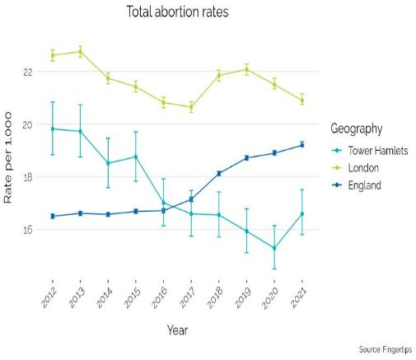
Abortion trends
Repeat abortions in under 25s have increased slightly suggesting a lack of access contraception services and advice for younger people.
The total abortion rate, under 25 years repeat abortion rate, under 25 years abortions after a birth, and over 25 years abortion rates may be indicators of lack of access to good quality contraception services and advice, as well as problems with individual use of contraceptive method.
Total abortion rates in Tower Hamlets are generally lower than London and England and have declined by 16% over the last decade​.
In the under 18s, abortion rates have decreased from 18.4 per 1,000 in 2014 to 6.0 per 1,000 in 2021, which is similar to London and England (2021).​
In over 25s, abortion rates have remained stable since 2014 and are at 15.6 per 1,000 in 2021, which is similar to London and England (2021)​.
In Under 18s conceptions, 66.7% lead to abortions which is similar to London and England (2021), however both the total number of abortions and conceptions have declined in the last decade leading to an inflated percentage of abortions.
Repeat abortions in under 25s have indicated a small but insignificant rise in the last 5 years, from 24.2% in 2017 to 31.8% in 2021 and is similar to London and England (2021).
​

Slide 51
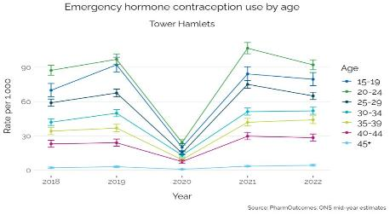
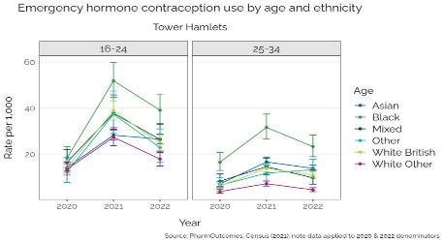
Emergency Hormonal contraception provision in community pharmacy
High rate of emergency contraception use in the 20-24 age group, followed by the 15-19 age group. Generally higher use of EHC in Asians and Black groups aged 25-34.
EHC use varies by age and ethnicity in Tower Hamlets​
There were around 16,300 provisions of EHC use between 2020-2022 in Tower Hamlets community pharmacies​.
32.9% reported accessing once in the prior 6 months​
4.6% reported accessing twice or more in the prior 6 months​
38.8% of records are missing for this variable, therefore the percent of repeat use could be higher.
Rates of EHC use in women aged 15-44 in Tower Hamlets have increased from 54.2 per 1,000 in 2018 to 61.4 per 1,000 in 2022​
Women aged 20-24, followed by those aged 15-19 & 25-29 are consistently more likely to access EHC​
15-19-year-olds have shown the largest relative increase (13.8%) compared to 2018, which could be contributing to decline in abortion rates for under 18s.+ ​
Where ethnicity is known :​
Asian account for 22% (3,500 Provision), followed by 10% for White British (1650 provisions) and 5.6% for White Other (900 provision) (2020-2022)​.
Black women account for 5.1% provisions but have a higher rate of EHC use compared to other ethnicities, particularly those aged 16-34.​
42.7% of ethnicity data missing for EHC records
The highest rate of repeat use in prior 6 months was in Black women (11.6 per 1,000), followed by Asian (8.0 per 1,000) and Mixed (7.7 per 1,000)​.
Further work is required with community pharmacies to improve data recording of ethnicity.
A system wide approach that supports females to access reliable forms will need to be considered.
Notes:
NB – improve data recording around ethnicity & EHC access in prior 6 months
Source: PharmOutcomes

Slide 52
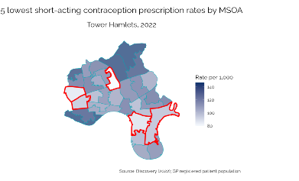
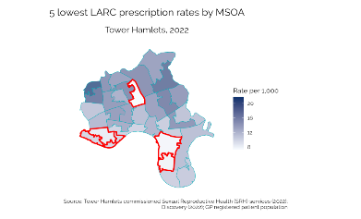
Contraception use across Tower Hamlets ​
Mile End West & Canary Wharf have the lowest rate of contraception use across Tower Hamlets yet over 65% of the population are of reproductive age.
Over half (56.4%) of women are aged 15-44 in the borough, ranging from 53.2% to 77.4% across MSOAs​
An estimated 15.4% of women aged 15-44 were prescribed or fitted with contraception (short acting or Long Acting Reversible Contraception [LARC]) in Tower Hamlets (SRH service data, Discovery; 2022)​
There is a higher rate of prescription for short acting contraception (124.0 per 1,000) compared to LARC (29.9 per 1,000) in Tower Hamlets (2022)​
Mile End West & Canary Wharf feature in the lowest rate of contraception prescription for both short acting contraception and LARC, and both of these areas have over 65% of the population aged 15-44.
5 lowest for short acting
Mile End West
Spitalfields
Canary Wharf
Aldgate
Blackwall & Leamouth
5 lowest for LARC
Millwall North
Canary Wharf
Mile End West
St George in the East & Wapping North
Tower Hill
Wapping South

Slide 53
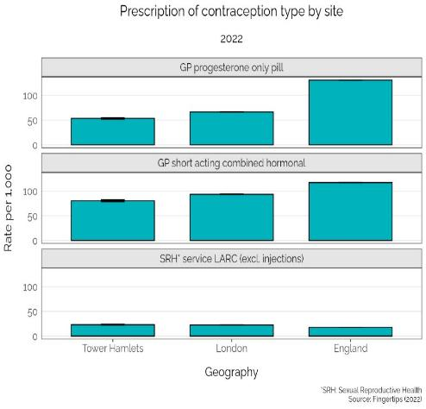
Contraception provision by site
Short acting contraception: progesterone only pill or combined pill are more common provisions by GPs and LARC is more commonly provided by sexual and reproductive health services.
In Tower Hamlets, the GP progesterone only pill prescription rate is 52.4 per 1,000, which is 8 times higher than SRH prescription rate (5.5 per 1,000) (2022)​.
GP progesterone only pill prescription rate has reduced by 18% since 2018 in Tower Hamlets and is lower than London (66.4 per 1,000) and England (130.8 per 1,000) in 2022​
In Tower Hamlets, the GP combined hormonal prescription rate is 80.3 per 1,000 which is 8 times higher than SRH prescription rate (10.2 per 1,000) (2022)​
GP combined hormonal prescription rate has reduced by 37.8% since 2018 in Tower Hamlets and is lower than London (93.3 per 1,000) and England (117.0 per 1,000) in 2022​
In Tower Hamlets, the SRH service LARC prescription rate is 23.1 per 1,000 which is 2.8 times higher than the GP prescription rate (8.5 per 1,000) (2022)​
Total LARC prescription rates have remained stable since 2018, currently at 31.7 per 1,000 for 2022 which is similar to London (33,2 per 1,000) but lower than England (44.1 per 1,000).

Slide 54
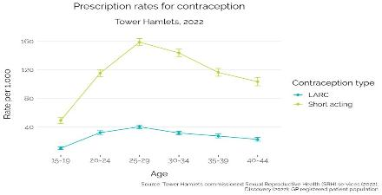

Contraception provision by age
Highest use of contraception in 25-29 age groups for LARC and short acting contraception and the SRH service provision of LARC has increased significantly in all ages.
Prescription of short acting contraception is more common than LARC across all ages (SRH service data, Discovery; 2022)​.
A similar pattern in contraception use is observed for both contraception types across age groups, with contraception provision being the highest in the 25-29 age group, followed by a gradual decline contraception use in females aged 30 and over (2022).
Trend data indicates that for those who are in contact with SRH services, use of LARC is increasing for all ages (OHID)​.
For women aged under 25, 28.4% were prescribed LARC in 2018 which has risen to 46.8% in 2022, and is higher than London (34.6%) and England (36.2%)​
For women aged over 25, 14.1% were prescribed LARC in 2018 which has risen to 59.2% in 2022, which is higher than London (51.4%) and England (53.2%).

Slide 55


Contraception use by ethnicity
Lower provision of LARC in Asian groups in SRH service and GP services.
LARC prescription at SRH services indicated some variation between ethnicities (SRH service data; 2022-23):​
LARC prescription rate is highest in Mixed (24.1 per 1,000) and White British (20.3 per 1,000) ​
LARC prescription rate is lowest in White Other (11.7 per 1,000) and Asian (8.6 per 1,000)​
25.7% of ethnicity data unknown​
LARC provision in GP services was lowest in Asian groups (6.5 per 1,000), with Black, Mixed and White displaying a similar prescription rate (around 10 per 1,000) (Discovery; 2022).
Short acting contraception prescription rate at GP services is most common in White (154.4 per 1,000) and Mixed groups (128.7 per 1,000) and similar for Asian, Other and Black groups (around 90 per 1,000) (Discovery; 2022)​.

Slide 56
8. HPV vaccination

Slide 57


HPV vaccination coverage for males and females​
HPV vaccination coverage has declined in children aged 12-13 which demonstrates the need for promotion and education with families about the important of the vaccination. This fall in vaccinations could negatively influence genital warts (as well as cervical cancer) rates in coming years.
The HPV vaccine helps protect against a range of cancers, including cervical, head and neck, anal and genital cancers, which can affect both males and females and lead to genital warts. The national HPV vaccine programme was introduced in 2008 for children aged 12 to 13 years old. Other groups that are recommended to receive the HPV vaccination include people at higher risk from HPV: GBMSM groups up to and including 45 years of age, trans women and trans men who have sex with men.
Most people will have HPV in their lifetime, 40% of women are infected within two years of becoming sexually active. Most infections do not require intervention, but the infection can persist, and symptoms potentially recur. Prevention is therefore critical, through barrier contraception and vaccination.
HPV vaccination coverage for one dose in females aged 12 to 13 was 59% in 2022-23 which shows a declining trend (71% in 2021-22) and is similar to London (59%) and lower than England (71.3%). Ranked in the bottom fifth (121 out of 149) of all local authorities in the country ​
HPV vaccination coverage for one does in Males aged 12 to 13 is 48.3% in 2022-23 which shows a declining trend (60.2% in 2021-22) and is lower than London (55%) and England (65.2%). Ranked in the bottom fifth (126 out of 149) of all local authorities in the country​ .

Slide 58
9. Local Action

Slide 59
Local provision mapped against effective interventions for good sexual and reproductive health
Source: Key targeted and universal interventions guidance on approaches - Sexual and reproductive health and HIV
Effective interventions – national guidance | Target Population | What we have in place for residents in Tower Hamlets | Gaps, challenges and next steps in Tower Hamlets
Promote age appropriate SRE in all schools and in a range of settings | Young people | Primary & secondary schools have variable SRE programmes as part of their PSHE programme. | It is unclear which schools have a SRE offer and the quality and what is provided. We need to identify what support is required in schools and identify SRE needs of young people.
Promote an open and honest culture around sexual health & reproductive health , to reduce stigma and discrimination | All Residents & target groups | SRH local service All East deliver open access services & dedicated clinics for specific groups i.e. trans and non binary clinic. | Need to have a strategy about reducing stigma and an ensure that health care staff are confident in promoting good SRH with residents.
Promote understanding of contraception options, testing , including effective LARC | Females | SRH providers: ALL East , GPs community pharmacies and women’s health hub promote the use of LARC and provide LARC. | Continue existing work to promote LARC through community engagement, and services. Focus on specific wards in the borough and particular groups: Black and Asian women.
Promote understanding of how to reduce STI & HIV risk, and how to access testing, PrEP and care. | Universal/ targeted in high risk groups | SRH providers: ALL East , GPs community pharmacies and Positive East (community HIV prevention service), SHL (online testing) promote STI testing. | Continue to ensure prevention messages meet need among specific groups with high rates of STIs (GBMSM) and with low levels of STI testing (Black, Asian and specific wards in the borough).
Establish and maintain appropriate condom distribution | Young people | Community pharmacy, young people’s service and youth settings are outlets for condom distribution. | Work with pharmacies and sexual health providers to increase condom distribution which has decreased over the last 3 years.
Routine offer of chlamydia tests for young people | Young people | Young people service: Safe East, ALL East , Community pharmacy and GP offer chlamydia testing. | Chlamydia detection rate is below national target.
Routine offer of HIV test in hospital and GPs and HIV self- sampling | All residents | HIV testing is offered in E&D and GPs . | Ensure continued funding for HIV testing in emergency departments. Pilot HIV testing in other settings.
Provide contraception advice in abortion, pregnancy loss and in maternity services | Females | Contraception is provided in TOPs and maternity services. | Maintain existing strong links between SRH and TOPS and maternity services.
Ensure access to emergency contraception and subsequent contraception | Females | Community Pharmacies provide emergency contraception and oral contraception. | High use of emergency contraception in some areas – need for system wide approaches to support the use of more suitable forms of contraception.
Increase accessibility of HIV and STI services for key risk groups | High risk groups | Positive East and All East provide community outreach on HIV and STI testing to high-risk groups. | Demand on more frequent outreach in hostels and hotel venues to support migrant populations. Need to understand the needs in migrant and asylum population.
Increase access to PrEP | High risk groups/females | All East services offers PrEP and Positive East deliver a Women 4 Women programme encouraging women from BAME groups to access PrEP. | Need to understand access or Prep by demographics. Explore options to increase PrEP via outreach clinics in primary care, and e-service.
Rapid referral into care after HIV or STI diagnosis, management of partners | Universal | All East and Grahame Hayton co-location and joint working. ALL East service manage partner notification. Positive East provide wider support | Ensure co-location of Positive East support workers into GHU.
Treatment and retention in care of people living with HIV | Targeted/ Universal | Positive East work with Graham Hayton unit. | Lower than London and England use of antiretroviral therapy. Need to understand the demographic variation in access.
Education
Prevention
Services

Slide 60
Sexual and reproductive health strategy A summary of the Tower Hamlets action plan for 2024-25
Priority 1: Health fulfilling relationships
Conduct a sexual and reproductive health needs survey with young people
Map relationship, sex and health education delivered in secondary schools
Young people's stakeholder event
Frontline staff working with young people receive training/ refresher training on sexual violence and abuse
Priority 2: Good reproductive health across the life course
Engagement /co-production community on contraception options
Increased GP LARC provision
Increasing awareness about contraception methods among BAME communities
Training community champions
Evaluation of Tower Hamlets women’s health hub service
Priority 3: high quality and innovative STI testing & treatment
Communications messaging is developed that targets population with high burden of STIs
Resident engagement plan is developed with outreach partners and delivered to support high risk resents that don’t engage with services
Increase PrEP use in high-risk groups
The Tower Hamlets action plan has been developed by the Sexual and reproductive health Tower Hamlets Partnership Group, made up of key partners:
CVS and other charity organisations that work with local communities
Health Lives Team
Public health
Sexual health service & young people’s service
Youth service
VAWG
Learning disabilities service
Community pharmacy representative
GP representatives
The partnership group will oversee the implementation of the local action plan on a quarterly basis.
Resident engagement took place through focus groups to check whether these were the right actions for 2024-2025.
Priority 4: HIV towards zero transmission & living well with HIV
Increase PrEP use in high-risk groups
HIV training sessions delivered for GPs and other primary care staff.
Continuation of HIV testing service in emergency departments
Develop a plan for implementing the new HIV Confident Charter to tackle stigma
Cross cutting priorities:
Sexual and reproductive health needs assessment to review local and make recommendations for action
Review the SRH support needs of underserved communities ( GBMSM groups, asylum seeks, people living in hostels & sex workers)
Reducing sexual and reproductive health stigma events
Annual resident feedback on accessibility of the sexual health service

Slide 61
Tower Hamlets Sexual and reproductive health services
Sexual and reproductive services that support residents in Tower Hamlets
Tower Hamlets residents have access to a wide range of services for sexual health, including:
Online STI testing services: Sexual Health London (PreventX)
All East: Specialist sexual health service
Primary care: GP practices provide Long-Acting Reversible Contraception (LARC), STI and HIV testing
Safe East: Specialist Sexual health service for young people
Community pharmacies (Emergency Hormonal Contraception (EHC), condoms, Chlamydia screening and treatment)
Positive East community HIV prevention and wellbeing service
Open Doors (supporting street sex workers through outreach, offering holistic support)
Women’s Health Hub pilot, Tower Hamlets service at Mile End Hospital in 2023.
The following slides set out some more detail on the provision from these services

Slide 62
Community pharmacy provision
Community Pharmacy service
26 Community pharmacies in Tower Hamlets provide sexual and reproductive health provisions which include:
Chlamydia/gonorrhoea screening & chlamydia treatment for sexually active people
Emergency hormonal contraception (EHC) for females 13 years and over
Condom distribution scheme for all sexually active 13 to 24-year-olds
Community Pharmacy provision type | 2018-19 | 2019-20 | 2020-21 | 2021-22 | 2022-23
EHC | 6,508 | 6,013 | 5,347 | 6,619 | 6,269
Chlamydia/gonorrhoea testing | 1,899 | 1,474 | 1,420 | 1,820 | 2,222
Treatment for chlamydia | 29 | 15 | 2 | 3 | 9
Condom distribution | 608 | 564 | 7 | 66 | 15
Similar levels of EHC are provided by community pharmacies annually and have reduced slightly since 2021.
Young people registered with a C-Card can pick up free condoms at provider locations including youth settings and community pharmacies in Tower Hamlets. The provision of condoms through the C-Card scheme, has decreased significantly in community pharmacies , posing a risk to safe sex practices in terms of preventing unwanted pregnancies and STIs. Further work is needed to understand why condom access in community pharmacies has decreased.
Fewer community pharmacies are providing chlamydia treatment and it is currently unclear whether they are actively promoting this service or if residents are choosing to be treated else where (in GPs or in sexual and reproductive health service).

Slide 63
ALL East– Integrated sexual health service – attendance data
All East is the sexual health service for residents in Tower Hamlets, It provides a range of services (level 1- 3 services, ranging from basic to advanced/complex level services) including: STI testing and treatment, HIV testing, contraception and medication: PEPSE, PrEP (to reduce risk of HIV) HIV testing, BBV testing and treatment, psychological support relating to sexual wellbeing and special clinics for women, men, trans and gender non-binary individuals and individuals working in the sex or adult entertainment industry.
Over the course of 2022-23 there were 26,790 attendances recorded for Tower Hamlets residents (this data includes repeat attendances), this is a similar number to the previous year.
Out of these attendances 59% were new appointments, and 41% were follow up appointments. The number of new appointment has increased from the previous year indicating that a new episode of care or a new person accessing the service is improving.
In 2022-23 attendance was made up of 47% female, 43% male, 1% non-binary and 9% not known or not stated.
The largest ethnic group attending services were White or White British at 44%, followed by Not known at 20%, then Asian or Asian British 17%, and 7% were from mixed and Black or Black British groups.
Attendance by age shows that nearly half of the attendees were people aged between 25 and 34, followed by 21.1% of people aged 16 to 24 and 20.3% between 35 and 44 age group.
Attendances by Tower Hamlets residents in 2022-23 showed that 62% identified as heterosexual, 26% identified as homosexual, over 7% did not disclose their sexual identity and 3.8% identified as bisexual.
The sexual health service administered 31,542 screens for STIs in 2022-23, of which 6% were positive.

Slide 64
ALL East– Integrated sexual health service performance data for 2023
Since March 2020, all local authorities across London have been paying providers of sexual specialist health services on a ‘block’ contract, rather than the usual activity-based tariff payments, to enable sustainability of services. In October 2022 a modified ‘block plus incentives’ payment model was implemented in the service to ensure the service was improving performance and providing targeted services for residents based on need.
KPI | Quarterly Target | Quarterly Target | Actuals Q1 2023-24 | Actuals Q1 2023-24 | Actuals Q2 2023-24 | Actuals Q2 2023-24 | Actuals Q3 2023-24 | Actuals Q3 2023-24
Hepatitis vaccine first dose | Hep A | Hep B | Hep A | Hep B | Hep A | Hep B | Hep A | Hep B
 | 24 | 52 | 54 | 58 | 51 | 45 | 61 | 57
Hepatitis vaccine recall (full course of 3)(%) | 55% | 55% | 33% | 102% | 39% | 110% | 33% | 76%
STI recall and re-test: invite | 97% | 97% | 100% | 100% | 100% | 100% | 100% | 100%
STI recall and re-test: uptake | 35% | 35% | 34% | 34% | 34% | 34% | 25% | 25%
LARC - Increase overall uptake | 440 | 440 | 420 | 420 | 410 | 410 | 434 | 434
PrEP - New starters | 142 | 142 | 138 | 138 | 120 | 120 | 138 | 138
There is good performance for Hepatitis A and B first doses and second doses
Hepatitis A recall is below target.
Data shows good performance for STI recalls for patients that are invited and re-tested.
LARC activity and PrEP provisions are below target but not significantly below target.
Transport For London strikes and doctor’s strikes have impacted the service delivery in 2023 but generally there is good performance on targets across a number of key provisions.

Slide 65
Young people’s service sexual and reproductive health provision
Safe East is the integrated health and wellbeing service for young people in Tower Hamlets, the service provides advice, support and treatment relating to drugs and alcohol smoking and sexual health including STI testing and treatment, condom provision and contraception for people aged under 19 and 25 for people in the care system or have special educational needs. Service provides clinical support and outreach in schools and youth settings.
Over 300 young people using the Safe East service.
In 2024 a total of STI testes were completed and 3,635 condoms were distributed to young people.

Slide 66
HIV prevention and wellbeing service – Positive East
The HIV prevention and wellbeing service supports adult residents newly diagnosed with HIV and residents living with HIV. The service also provides targeted HIV prevention, working with groups at risk of HIV to promote safe sex behaviours including encouraging HIV testing.
The service offers:
Psychosocial support
HIV Prevention, Sexual Health Promotion and Outreach
Training, System Leadership and Peer Support.
In total 5243 people were seen by the service in 2022-23 , 95% of those seen were people closely affected by HIV, 5% were HIV positive. Where there was data recorded on service use over half were non-heterosexual men and just under 30% identified as heterosexual.
For people living with HIV seen by the service, 35–44-year-olds accounted for the largest proportion. There are also high number of older groups (45 -65: 40%) accessing the service.
The service is seeing a number of people Living with HIV who have multiple health and social care needs (welfare benefits and other non-HIV age-related health conditions such as cardiovascular conditions and diabetes).

Slide 67
10. Resident feedback on SRH

Slide 68

What do residents say about sexual and reproductive health services?
Tower Hamlets resident feedback on sexual and reproductive health service 2022- 2023
Communication: I felt that the doctor had all the answers and didn't give me many options. I felt dismissed with language such as “at your age” I felt discrimination because of my age and because I did already have a child.
I have had bad experiences of taking contraception and the doctor did not explain about any related side effects or even the different types of contraception available.
Sexual health service was easy to access and I found it to be clean. I found the waiting room to be a good size and staff were welcoming and discreet.
Doctor was very thorough and covered all the bases.
Going one step further to offer me contraception and STI test even though I just a called
for PrEP.
Everything was very professional in the sexual health service, and I felt comfortable with all the staff. I was able to ask questions, and the doctor was very friendly and was able to give me answers.
Language barriers often make an already sensitive area extra difficult to talk about.
Residents should have easy but also TIMELY access to sexual health services. I have had to go to other boroughs to get an STI test promptly.
Please consider doing more for gay Muslims, especially outreach work, helping those who are not happy with speaking out.

Slide 69
11. Knowledge gaps & Recommendations

Slide 70
Knowledge gaps (1)
Sexual health service data quality
There are a number of concerns regarding data quality which has limited our full understanding of local sexual health needs in the borough. The following recommendations should be actioned :
Service data should include numbers of unique attendees, episodes of care, methods of consultation, types of appointments, repeat attendees.
Demographic data recording: should be routinely available for all performance reporting, including ethnicity and sexual orientation. This is vital to understand need and address inequalities.
Partner notification: is crucial to help contain the spread of STIs, particularly with the rising rates of gonorrhoea and is an integral role of sexual health services, but identifying and treating anonymous partners remains a challenge. Opportunities and innovations to increase partner notification within our local sexual health service needs to be fully explored.
Access to PrEP: The number of people accessing PrEP through SHS has increased, we need further data to understand if there is equitable access between different groups (women and BAME) who would benefit from PrEP.
With increasing rates of late HIV diagnosis there should be consideration about the expectation of levels of HIV testing for those attending sexual health clinics.
Chemsex: It is important that people engaging in chemsex are able to access the right support to minimise risk. Local intelligence around the use of Chemsex is limited; further insight and intelligence is needed to inform future service provision for both sexual and reproductive health and substance misuse services.
Notes:
Young people service data
Number of new presentations/attendances
22/23 - 2474
21/22 - 2475
20/21 – 2095
Total number of young people receiving interventions
22/23 - 3262
21/22 - 3300
20/21 – 3048

Slide 71
Recommendations (1)
# | Outcome |  | Recommendation | From summary slide | From gap analysis
1 | Increase knowledge and information on sexual health and promote safe sexual behaviour | 1.1 | Work with partners to improve the delivery of SRH messaging – around safe sexual behaviour and frequent STI testing - targeting specific groups and addressing stigma in the groups identified as under testing.. | X | X
 |  | 1.2 | Promote PrEP awareness in the community especially targeting groups that are not accessing but are high risk (migrant population, older GBMSM, BAME groups). | X | X
 |  | 1.3 | Deliver targeted STI /HIV prevention and health promotion for GBMSM, particularly focused on increase in gonorrhoea and syphilis. This should focus on importance of condoms, regular testing, and partner notification. | X
2 | Improve rates of STI/HIV & Testing | 2.1 | Increase STI testing in specific groups and locations : Males aged 45-64 GBMSM groups in general and GBMSM aged 35-44 & Heterosexual groups , particularly HIV testing Asian and Black groups generally and those aged 35-64 Poplar and Limehouse towards the south east of the borough and St Dunstan’s, where there is low on-line testing Chlamydia testing in young people | X
 |  | 2.2 | Enable high-risk groups (e.g. GBMSM for Gonorrhoea and Syphilis) to test regularly as per national guidelines. |  | X
3 | Improve access to contraception | 3.1 | Continue to improve availability of LARC (the most effective and cost-effective form of contraception), and to ensure that a full range of contraceptives are proactively offered by healthcare professionals. | X | X
 |  | 3.2 | Work with communities and services to ensure good insight into the barriers, understanding cultural influences on contraception choice and increase to tailor services effectively. |  | X
 |  | 3.4 | Targeted work with service providers and communities in Mile End West & Canary Wharf area where there is lowest contraception provision. | X

Slide 72
Recommendations (2)
# | Outcome |  | Recommendation | From summary slides | From gap analysis
4 | Sexual and reproductive health service health service | 4.1 | Ensure robust Partner Notification (PN) remains a key part of sexual health service provision and should be effectively delivered as per guidelines. Consider alternative methods of PN including both digital and non-digital approaches. |  | X
 |  | 4.2 | Further increase the number of people accessing PrEP and ensure demographic data is collected and reviewed on a frequent basis against PrEP need. |  | X
 |  | 4.3 | Regular monitoring of service users being offered HIV tests .The HIV Action Plan supports the introduction of 90% of new sexual health service attendees testing for HIV, as standard and NICE guidelines advise to offer and recommend an HIV test to everyone who attends for testing or treatment. |  | X
 |  | 4.4 | Improve accessibility of SRH service – reviewing targets around waiting times and reviewing service user feedback on accessibility of the service. |  | X
 |  | 4.5 | Understand better the decline in HIV screening and identifying interventions to address this. | X
5 | SRH is accessible to young people | 5.1 | Ensure effective Relationship and Sex Education offer in all Tower Hamlets schools (as per national curriculum) and ensure training is available for school staff. |  | X
 |  | 5.2 | Increase condom use: understanding and addressing barriers; promote condom use; ensure availability in settings across Tower Hamlets. |  | X
 |  | 5.3 | Increase HPV vaccination uptake by increasing community awareness. | X
6 | SRH needs of underserved communities are met | 6.1 | There is limited data that tells us how sexual and reproductive health service needs of underserved communities are being met. Gaining an in-depth understanding of how to make service accessible for the most vulnerable groups within Tower Hamlets is required. |  | X

Slide 73
12. Appendix Method of analysis and data sources.

Slide 74
Appendix 1 - Methods
All data in the data pack have been analysed in R with the PHE indicator methods package, predominantly using phe_rate, phe_proportion and calculate IS Rate functions
Unless specified, all rates are crude
Rates by sexuality
Denominator using Census (2021) data, based on identified sexuality which may not reflect sexual behaviour (e.g. heterosexual man who has sex with men)
In some instances a time trend has been created using 2021 data for other years (e.g. 2020, 2022)
Sexual identity was not a mandatory question, as such 26.4% of entries are missing for Tower Hamlets which could lead to inflated rates for certain sexualities
Ethnicity rates
Denominator using Census (2021) data
In some instances a time trend has been created using 2021 data for other years (e.g. 2020, 2022).
Notes:
Census definitions = Gay/Lesbian, Bisexual, Heterosexual
GUMCAD definitions = Gay/Lesbian, Bisexual, Heterosexual
We have used the term GBMSM throughout the fact sheet, however the data we have access to relates to peoples’ sexual behaviour and not necessarily about their sexual identity (for example GBMSM;some of whom may identify as heterosexual).
Data on sexuality rates (denominator) has been calculated using Census (2021) data with the following caveats:
Identified sexuality which may not reflect sexual behaviour (e.g. heterosexual man who has sex with men)
In some instances a time trend has been created using 2021 data for 2020 & 2022
Sexual identity was not a mandatory question, as such 26.4% of entries are missing for Tower Hamlets which could mean that there is a under reporting of data that relates to GBMSM data in the fact sheet inflated rates for certain sexualities

Slide 75
Appendix 2 - Data sources
Data not publicly available
Genitourinary Medicine Clinic Activity Dataset (GUMCAD)
PreventX Sexual Health London (SHL) online services
HIV and AIDS Reporting System (HARS)
HIV and AIDS New Diagnoses Database (HANDD)
General Practice Discovery Data Service (DDS)
Sexual Reproductive Health (SRH) services commissioned by Tower Hamlets
Pharmoutcomes
Please note in some instances data completeness was poor (e.g. ethnicity), therefore some findings may differ to what was presented. We have provided data and attempted to quantify what is missing for transparency.
Publicly available data
Sexual and Reproductive Health Profiles: Fingertips, Health Office for Health Improvement and Disparities (OHID) Fingertips

Slide 76
Appendix 3 - Indirect sexuality standardised diagnosis ratios
Choose “reference” or “standard” population (e.g. London)
Calculate sexuality-specific rates in the reference population by taking the number of counts (e.g. diagnoses) for each sexuality (gay/lesbian, bisexual & heterosexual) and dividing by their respective population counts
e.g. the number of STI counts in heterosexual people and apply to the population of heterosexual people
Apply sexuality-specific rates from the reference population to counts observed in population of interest (e.g. Tower Hamlets) to calculate the number of expected cases
Divide the number of observed counts for the population of interest by the number of expected cases to calculate the ratio
A ratio that is higher than the reference population indicates there are a higher number of cases than expected, whereas a ratio that is lower indicates there are fewer cases than expected
Note that this approach assumes that the distribution of cases across sexual orientation groups is the same across variable of interest (e.g. ethnicity)

Slide 77
Abbreviations
Abbreviation | Definitions
Antiretroviral therapy | Antiretroviral therapy
BASHH | British Association Sexual Health and HIV
C- Card | Condom distribution scheme
EHC | Emergency hormonal contraception
FSRH | Faculty of Sexual and Reproduction Health
GBMSM | Gay, bisexual and other men who have sex with men
GUMCAD | Genitourinary Medicine Clinical Activity Dataset
HIV | Human immunodeficiency virus
HPV | Human Papillomavirus
ICB | Integrated Commissioning Board
NEL | North East London
JSNA | Joint Strategic Needs Assessment
LARC | Long Acting Reversible Contraception​
ONS | Office of National Statistics
PHE/OHID | Public Health England (now replaced by Office of Health Improvement and Disparities)
PHOF | Public Health Outcomes Framework
PrEP | Pre- Exposure Prophylaxis
NICE | National Institute for Health and Care Excellence
Short acting hormonal contraception | Includes combined hormonal contraception and progesterone only pill​​
SRH | Sexual reproductive health
SRHS | Sexual Reproductive Health services
ToPs | Termination of Pregnancy Services

