Slide 1
Tower Hamlets Voluntary and Community Sector Strategy 2020-2024

Slide 2
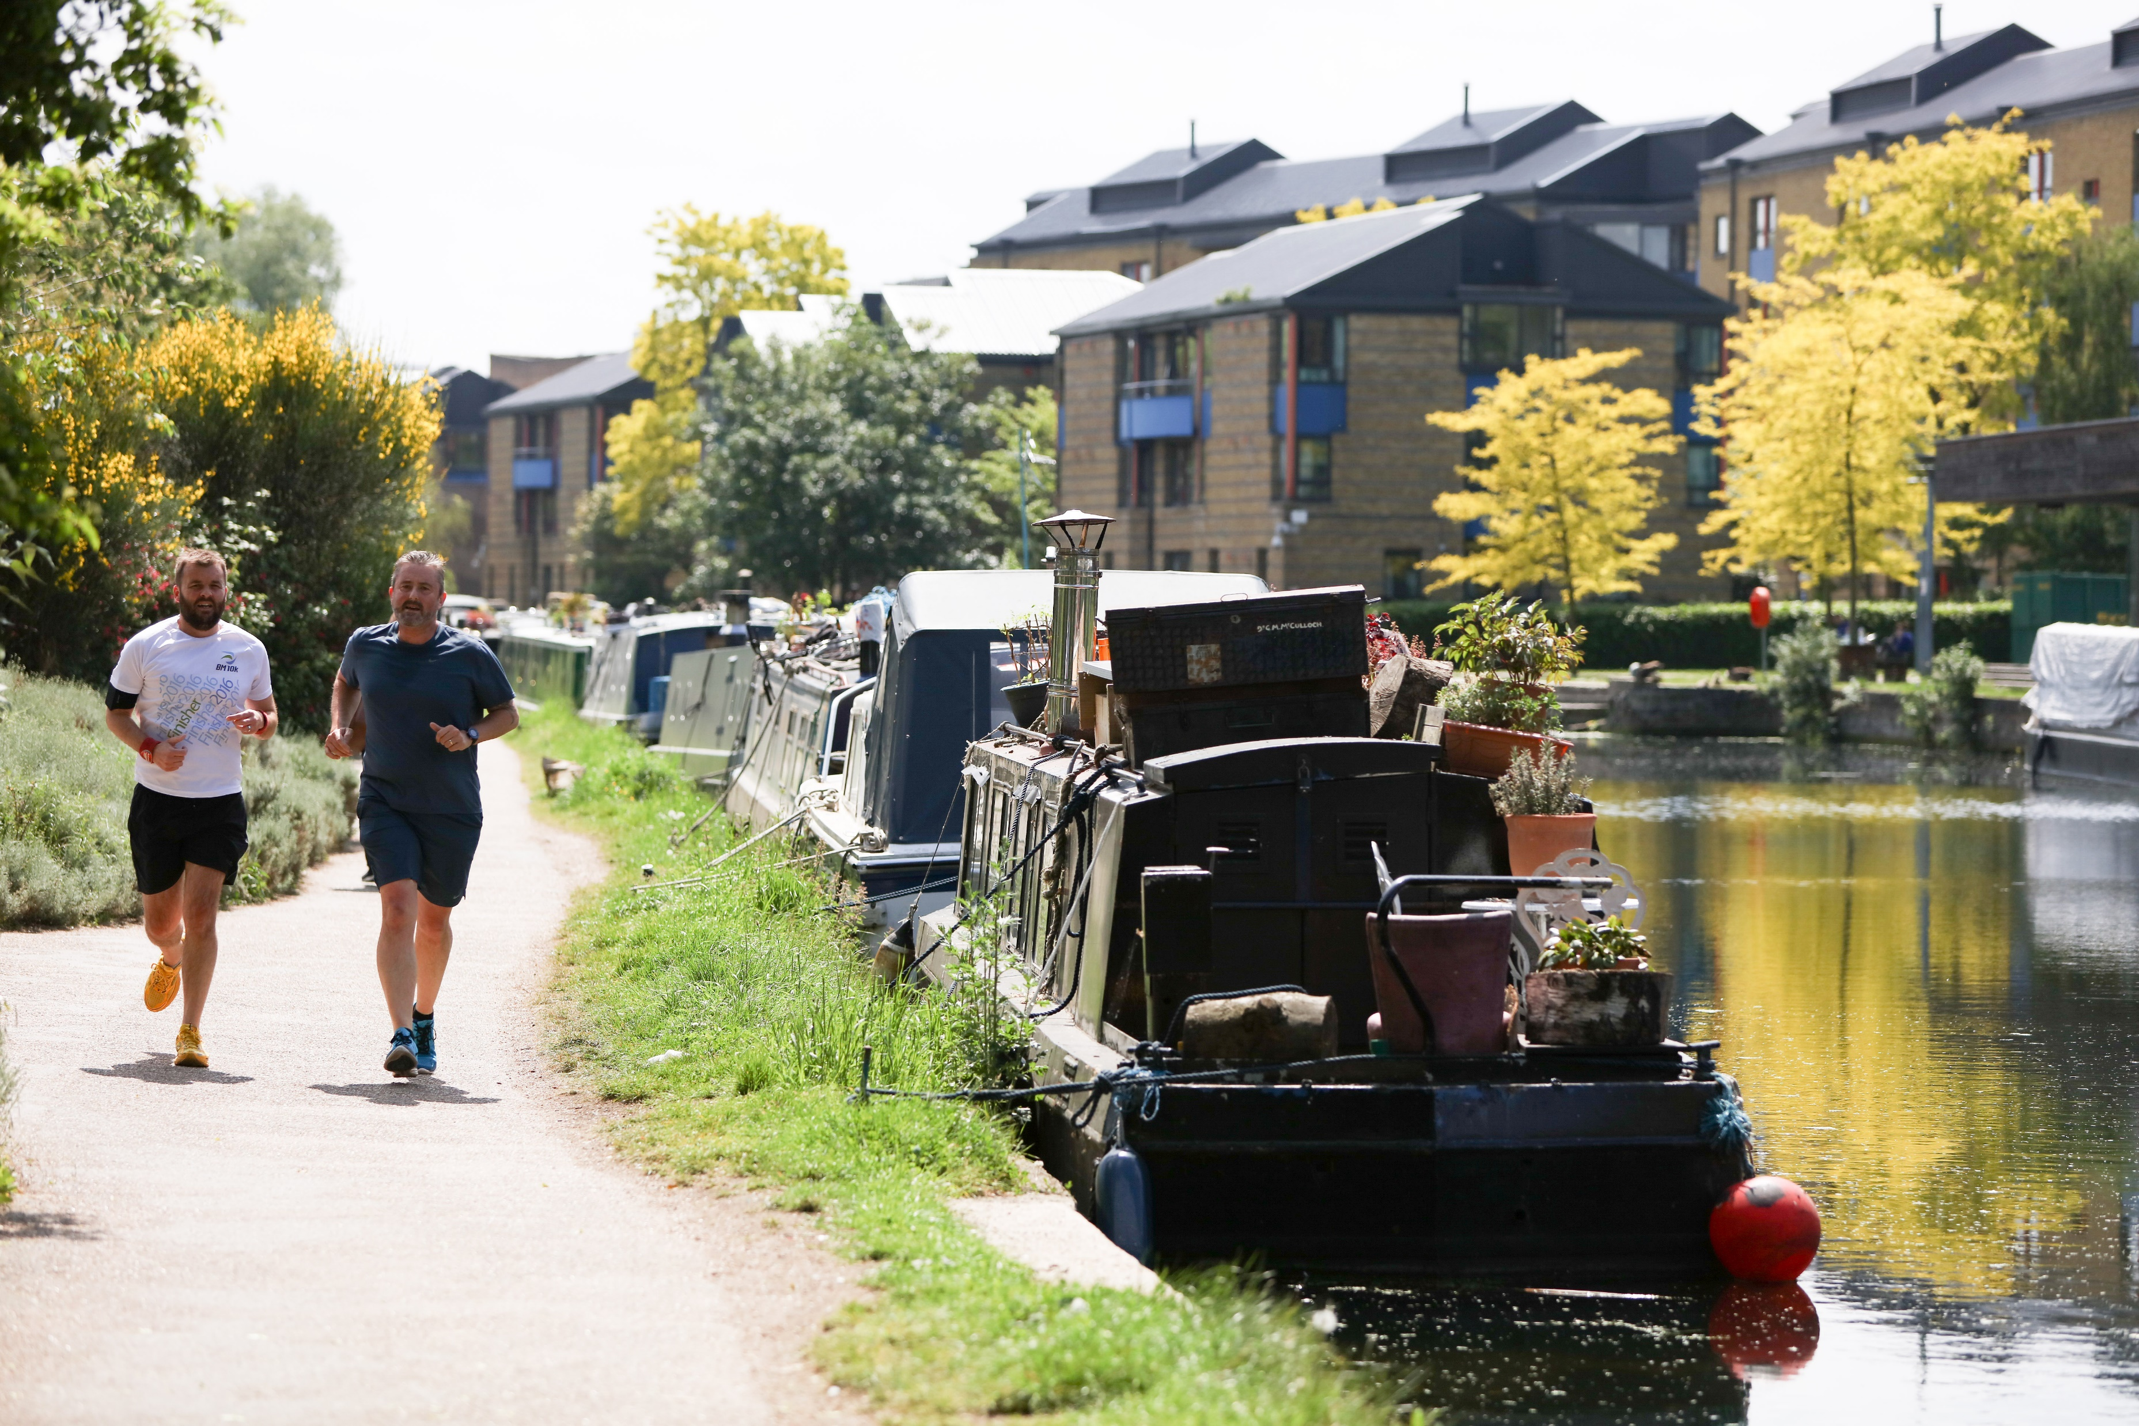
Voluntary and Community Sector Strategy 2020-2024
The Voluntary and Community Sector working with residents and partners to build stronger neighbourhoods
Contents
Foreword 3
Introduction – The Voluntary and Community Sector in Tower Hamlets 4 – 8
Profile of the Voluntary and Community Sector in Tower Hamlets 9 - 17
How Did We Develop This Strategy? 18 - 19
Priority 1 20 – 24
Priority 2 25 – 37
Priority 3 38 – 44
Next Steps 45 - 46
Making It Happen 47
How to Get Involved 48

Slide 3
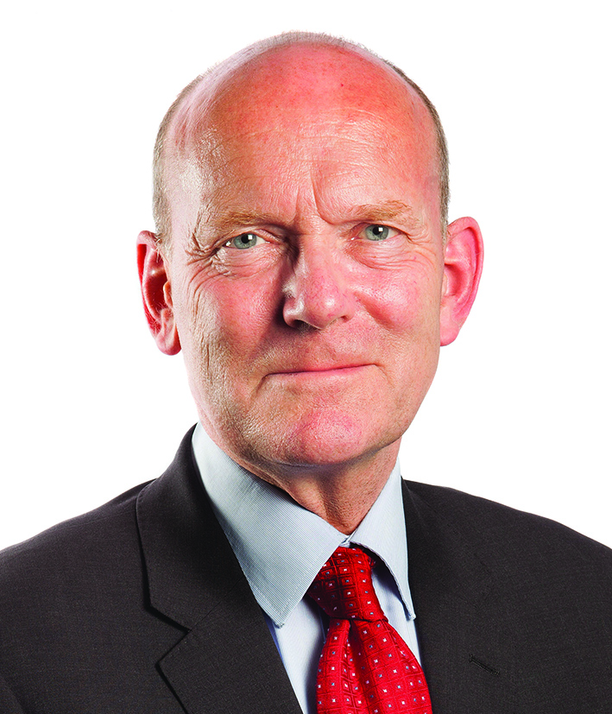
Foreword
Voluntary and Community Sector Strategy 2020-2024
The importance of the voluntary and community sector (VCS) to Tower Hamlets has been highlighted this year by the key role it has played in response to COVID-19. The VCS successfully delivered services across the borough including to our most vulnerable and socially excluded residents. At the same it has shown real innovation and flexibility in responding to the challenges of working virtually during lockdown and developing new initiatives such as the Volunteer Hub and the Emergency Food Hub as well as working with mutual aid groups and faith groups.
Our VCS organisations played a key role in responding to the pandemic in Tower Hamlets and we look forward to their equally vital contribution to the recovery process, and what happens next. We all face many significant challenges but can build upon the areas of good practice around volunteering, partnership working and digitally-based services. The way in which the sector is able to provide imaginative and high quality services for our residents is recognised as important.
The VCS Strategy has been developed working with all our partners. It highlights examples of good practice, priority areas for the sector and actions. To deliver for our community we’ll have to continue partnership working, we must all work together to reimagine what our post COVID-19 world looks like so it works for our residents.
The focus of the Strategy is how the VCS, with support from its partners, can be enabled to play a key role in the recovery of the borough and to continue to deliver for local residents. It’s about keeping our borough creative, vibrant and maintaining our sense of community.
Mayor John Biggs Mayor of Tower Hamlets | Cllr Candida Ronald Cabinet Member for Resources and the Voluntary Sector

Slide 4
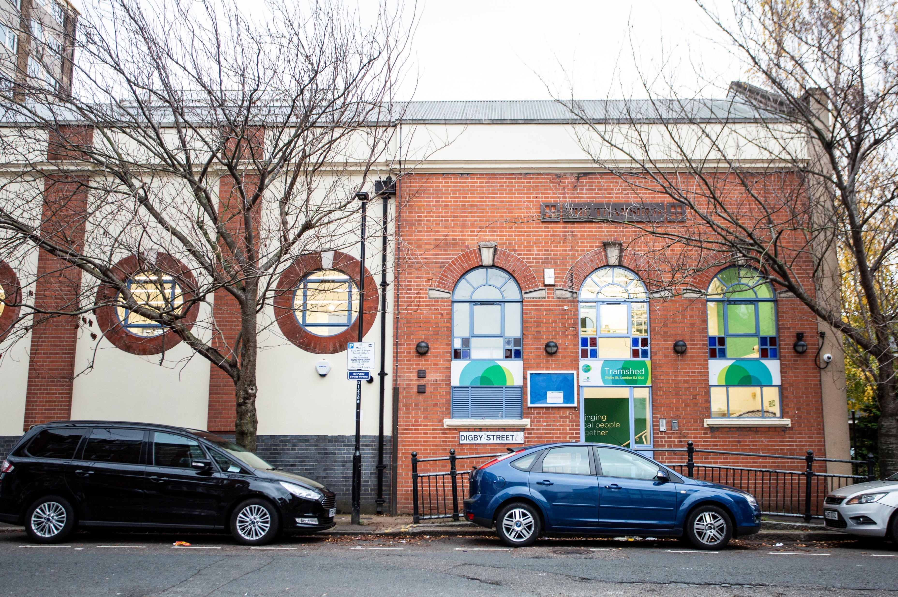
Voluntary and Community Sector Strategy 2020-2024
Introduction – the Voluntary and Community Sector in Tower Hamlets
The Tower Hamlets Voluntary and Community Sector Strategy for 2020-2024 is a partnership strategy between voluntary and community sector (VCS) organisations in the borough, the London Borough of Tower Hamlets (LBTH) and its partners, in both the public and private sector. Its focus is on achieving positive outcomes for the residents of the borough. This will include enabling the borough to recover from the COVID-19 Pandemic and move to a post-pandemic world.
The VCS Strategy has a vision of a diverse and thriving VCS, working alongside residents, the council and partner organisations to achieve better outcomes for residents. The Strategy is about the VCS in its broadest sense, but the ultimate measure of its success will be the impact for residents of Tower Hamlets.
The VCS is core to the existence of Tower Hamlets, contributing to the wider social fabric of the borough in so many ways. It offers opportunities for local residents to come together, across different communities, and work alongside each other to enrich the life of Tower Hamlets. Local residents, in large numbers, have shown their commitment to their local communities by serving as volunteers. This commitment has enabled VCS organisations to develop, flourish and provide networks of friendship and support for local residents.
The strength of the sector is not only in the services that it provides, vital though they are for many vulnerable residents, but also in the relationships that it develops between people and communities. It provides opportunities for people to cultivate their imagination and interests, allowing them to flourish as human beings.
New focus of the strategy
The strategy marks a clear break from previous VCS strategies in that its focus will be on how the council and partner organisations will work in partnership with the VCS. This will allow the VCS to thrive and prosper, rather than being dependent on the statutory sector for its development. The organisations who have worked together to develop this strategy, and who will own it as their own organisational strategy, are LBTH, Tower Hamlets Council for Voluntary Service (THCVS); Tower Hamlets Clinical Commissioning Group (THCCG), who will help to secure Tower Hamlets Together’s engagement with the Strategy, and Tower Hamlets Homes (THH), who will help to secure Tower Hamlets Housing Forum’s (THHF) engagement with the Strategy.

Slide 5
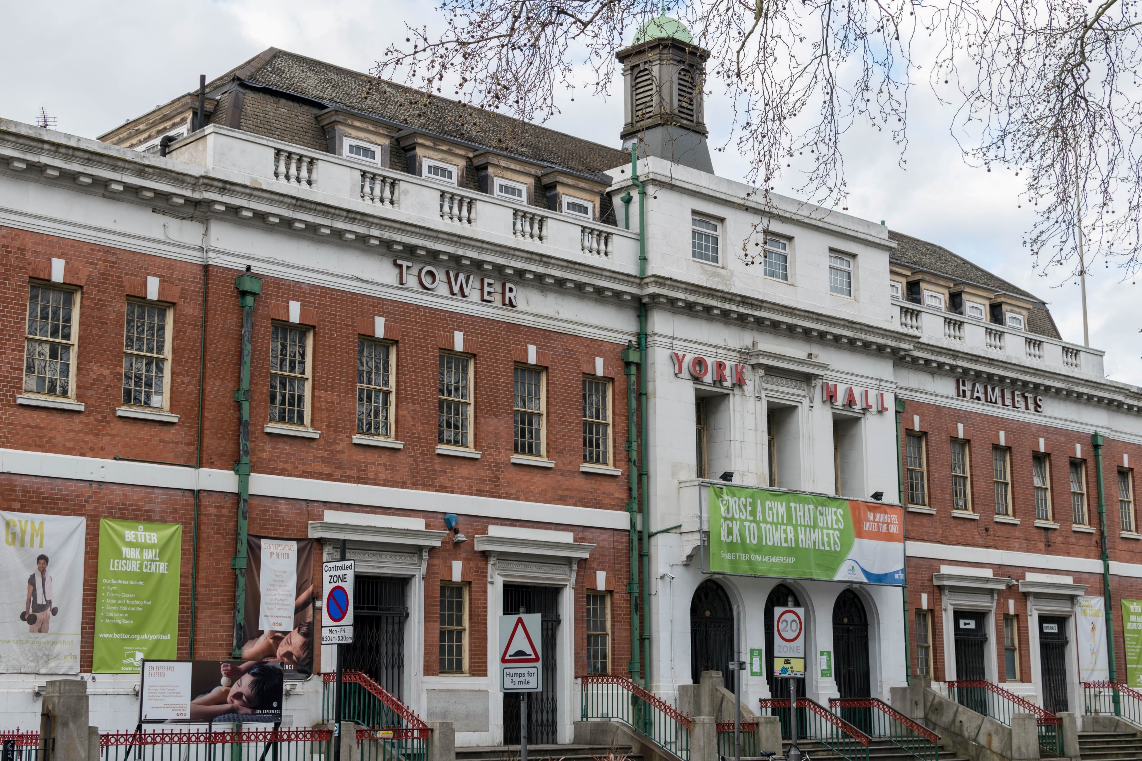
Voluntary and Community Sector Strategy 2020-2024
Introduction – the Voluntary and Community Sector in Tower Hamlets
These organisations have coproduced this strategy with the VCS. There is a wider range of partner organisations however who want to go on this journey with us. They will enable us to make the Strategy happen in the borough. This strategy sets out a framework for action and a commitment for partners to work with the VCS and to build collaboration across the sector.
This strategy will be delivered in collaboration with anchor organisations in Tower Hamlets, those whose purpose and mission are intrinsically connected to the borough. These organisations have the potential to support the development of the local VCS through increased procurement of their services, joint working on areas such as volunteering and sharing of information, expertise and resources. One example of how anchor organisations can support the sector is the council’s Social Value process. This involves the council using its procurement process to get contractors to contribute management expertise and resources, such as computers, to smaller VCS organisations in the borough.
The Strategy will also have a focus on the ambition for the VCS to develop sustainable relationships, not just with the council, but with other anchor and public sector organisations, to enable it to promote its services and offer. For example, the Strategy proposes that the VCS, due partly to its significant role in responding to the pandemic, promotes itself as a career of choice to young people, and other job seekers. This would involve engagement work by the VCS with local schools, colleges, universities and employment services.
The Strategy will focus on how partner organisations can work with the VCS to facilitate it to be more economically self-sufficient by enabling the sector to widen its funding base. This could possibly include statutory sector organisations opening up commissioning opportunities, within their procurement processes, to the VCS.

Slide 6
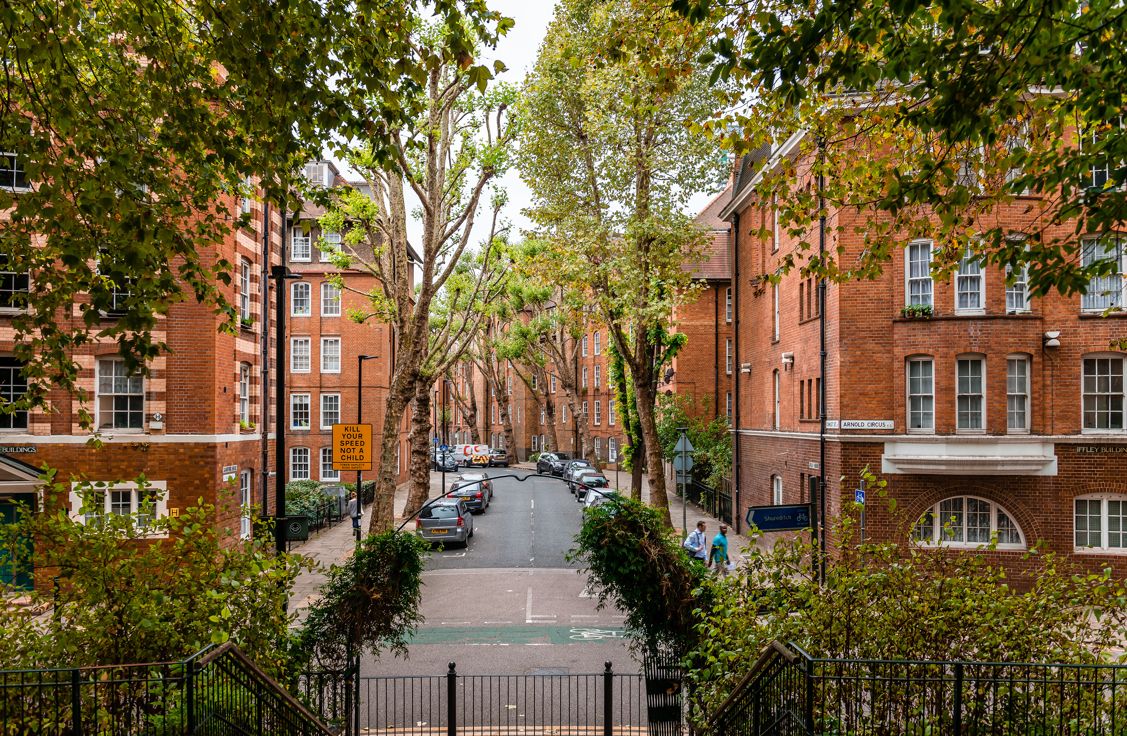
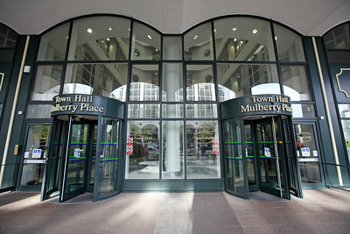
Voluntary and Community Sector Strategy 2020-2024
Introduction – the Voluntary and Community Sector in Tower Hamlets
The VCS has demonstrated significant success in obtaining new resources for the borough in order to respond to the needs of the pandemic, through successful applications for external funding opportunities. There is a need for the Strategy to build upon that success throughout the life of this strategy.
The VCS can thrive when it is financially independent and responsible for its own resources. VCS success in securing funding from statutory sector and other anchor organisations will require it to offer services which fully meet commissioning organisations’ expectations and demanding quality standards. It is because of the strength and quality of the VCS service offer that the statutory sector commissions the VCS. A key focus of the VCS Strategy will be the development of that offer.
The Strategy also contains a focus on the VCS working in partnership with the private sector, with links to that sector facilitated by partner organisations. This will include engagement with local business networks, such as East London Business Alliance, and promoting information sharing and awareness about business opportunities that would be of benefit to the local VCS
VCS
The Strategy establishes a partnership framework for the VCS, the council and partner organisations to identify future priorities and actions for joint work to respond to needs in the community. It will operate in the wider context of the borough, including the challenges and increased demands for services presented by the COVID-19 Pandemic and recovery from it.
The Strategy also recognises the need to be flexible to changing demands, and through a delivery plan and governance structure led by Cooperate, it will respond to issues as they emerge, as informed by the sector and partners.

Slide 7
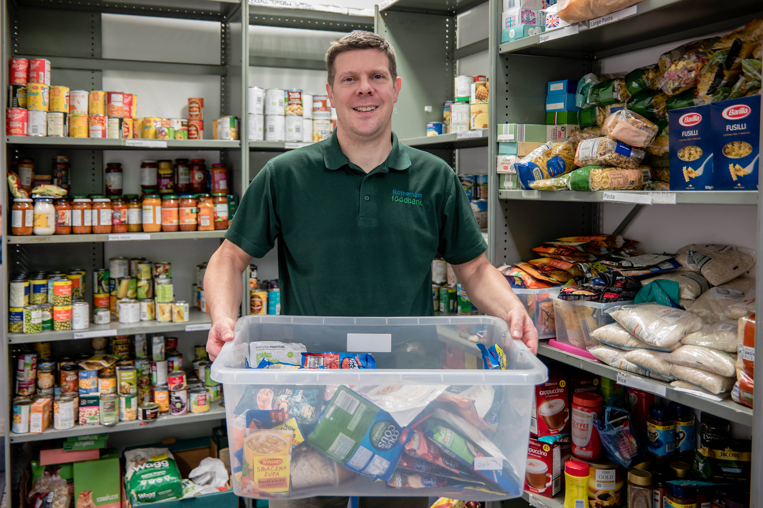
Voluntary and Community Sector Strategy 2020-2024
Introduction – the Voluntary and Community Sector in Tower Hamlets
The sector’s key role in responding to the demand of the COVID-19 Pandemic in the borough is just one way in which it has demonstrated its vital importance. Its achievements have included:
adopting new ways of working, including the delivery of digital and virtually based services, in order to continue to support local residents during COVID-19 Pandemic lockdown
71 VCS organisations in Tower Hamlets reported to the council that they provided support to local residents during the pandemic, in a wide range of areas, including telephone befriending, advice and information and social support services. It is believed that many more VCS organisations were also a part of this effort.
the COVID-19 Volunteering Hub, commissioned by the council to Volunteer Centre Tower Hamlets (VCTH), recruited and deployed local residents as volunteers in local VCS organisations and the council. Vulnerable local residents were supported through a range of volunteer roles, including food distribution, shopping and telephone befriending.
an Emergency Food Hub run by council staff, together with 27 VCS organisations, including Bow Food Bank and First Love Foundation, to help supply and deliver food to people who cannot get out, either because they are self-isolating or are considered at high risk of coronavirus
establishment of mutual aid groups in the borough, who have provided support in a range of areas. According to the Directory of East London Coronavirus Mutual Aid Groups there were 13 such groups in Tower Hamlets in March 2020, which was significantly higher than the totals for neighbouring boroughs.
securing external funding to support organisations’ continuation and delivery of services in response to the pandemic.

Slide 8
Voluntary and Community Sector Strategy 2020-2024
Introduction – the Voluntary and Community Sector in Tower Hamlets
The sector will aim to build upon the examples of good practice and new skills highlighted during the COVID-19 Pandemic, particularly in regard to volunteering, providing digitally based services, partnership working and securing external funding. The VCS Strategy will work to embed these successes into the longer-term VCS offer.
The success of the VCS in responding to the pandemic reflects the underlying strength of the sector in Tower Hamlets. It builds on its track record in delivering responsive and effective services, particularly to marginalised communities. The role of the VCS in the borough goes beyond delivering services. It brings communities together, develops relationships between people and makes Tower Hamlets a place that people are proud to live in.
The sector, especially elements such as faith groups, have played a particularly important role in in the pandemic in the borough by representing and delivering services to population groups that have been disproportionately affected by the impact of coronavirus. These groups have included: Black, Asian and Minority Ethnic (BAME) communities, disabled people, people with mental health support needs, people with learning difficulties and elderly people.
The VCS will play a key role as the restrictions of lockdown are eased and we move to a post-pandemic world. It will face the challenge of responding to the "new normal", including adapting to emerging needs in areas which may not have been fully addressed during the pandemic, such as mental health.
There will ultimately be the challenge of how to meet changing and increasing demand. Nevertheless, the strength and adaptability of the VCS witnessed during the pandemic will enable the sector to continue to deliver responsive services that meet the needs of all sections of the local community going forward. The VCS Strategy will support the sector on this journey.
Our vision is of a local VCS that has a positive impact on the lives of residents and is a celebrated asset of the borough as a whole. It sees the sector playing a key role in Tower Hamlets’ recovery from the pandemic, developing its own resources and skills to tackle inequalities in the community.

Slide 9
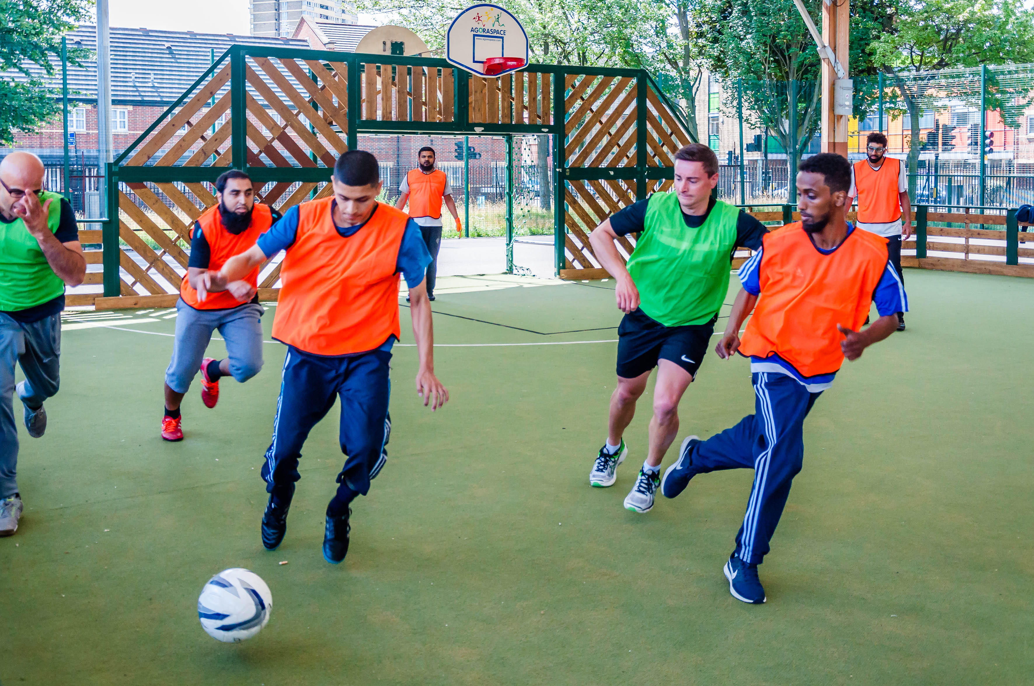
Voluntary and Community Sector Strategy 2020-2024
Profile of the Voluntary and Community Sector in Tower Hamlets
The voluntary sector in Tower Hamlets comprises a wide range of organisations, approximately 1,300 in total, offering a range of services, including:
registered charities
faith groups
unregistered and informal community groups, including mutual aid groups
social enterprises
tenants and residents’ associations
co-operatives
community interest companies with charitable elements.
Organisations undertake activity in a range of areas including:
social care
health
information, advice and advocacy
education
training and access to employment
children
culture and the arts
housing
sport
community safety
environmental projects, including three city farms.

Slide 10
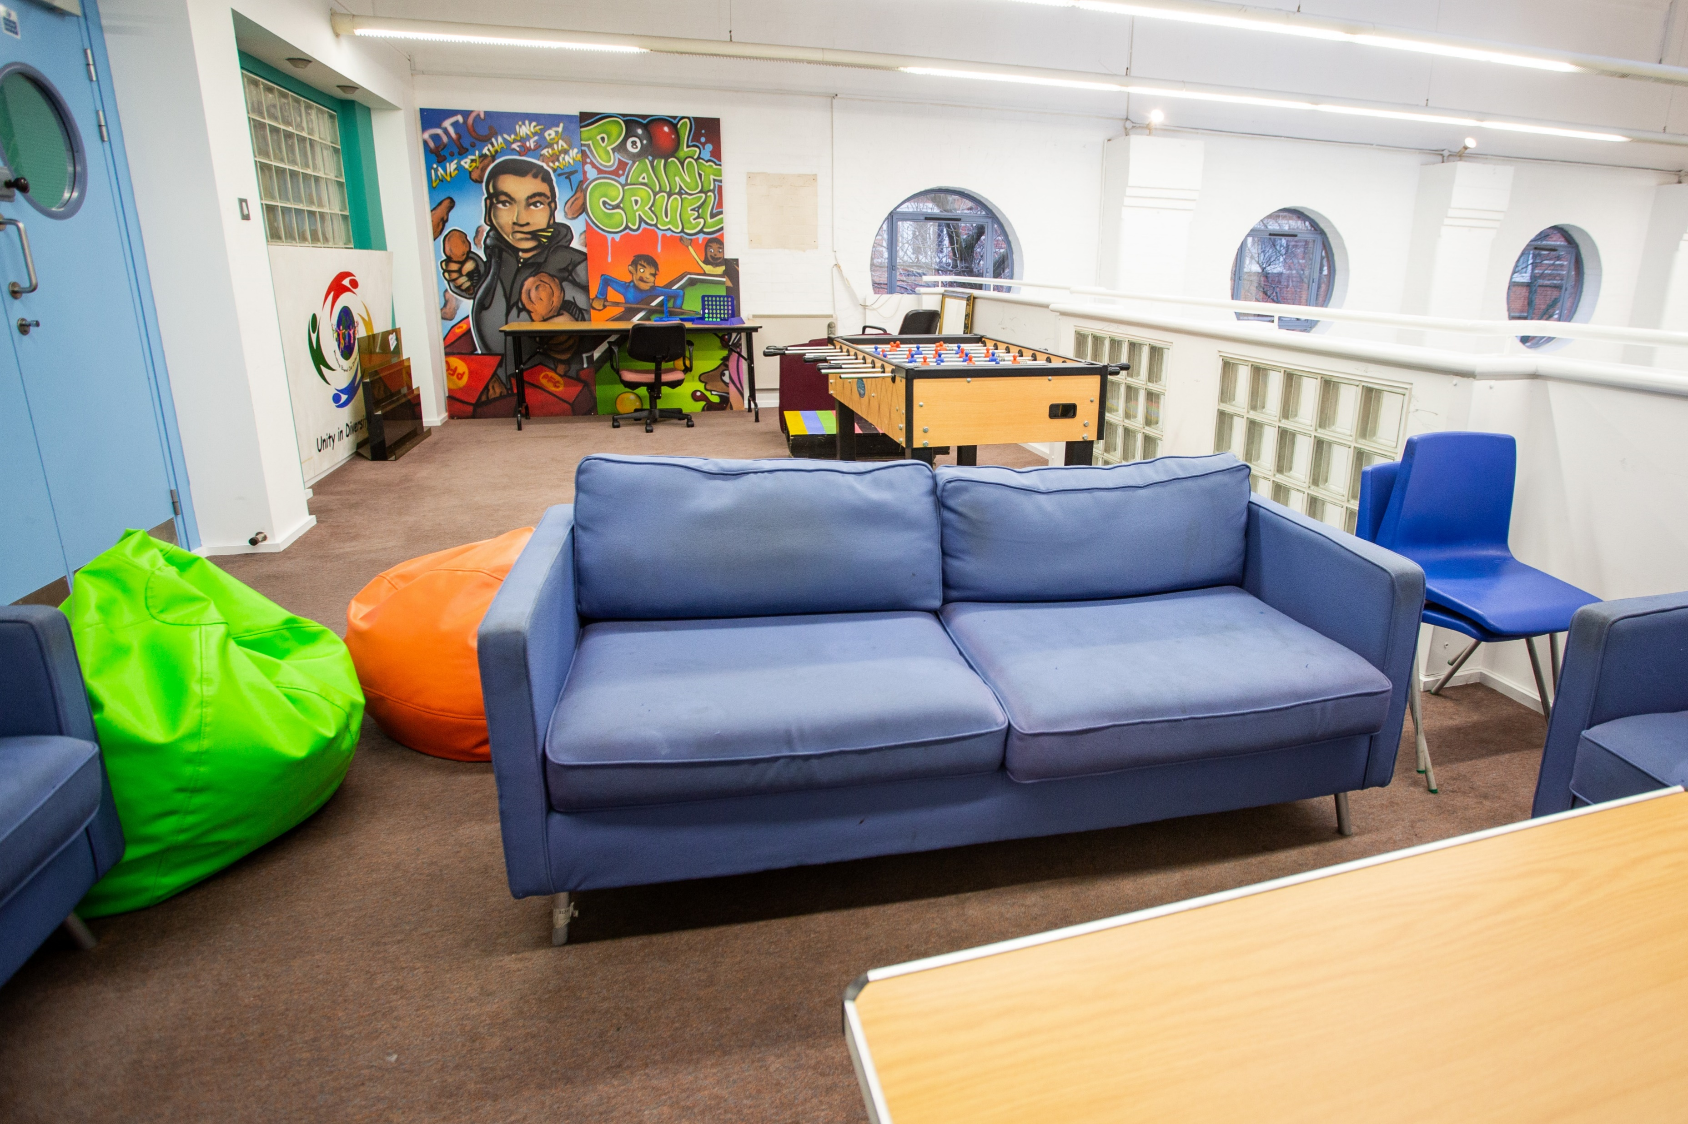
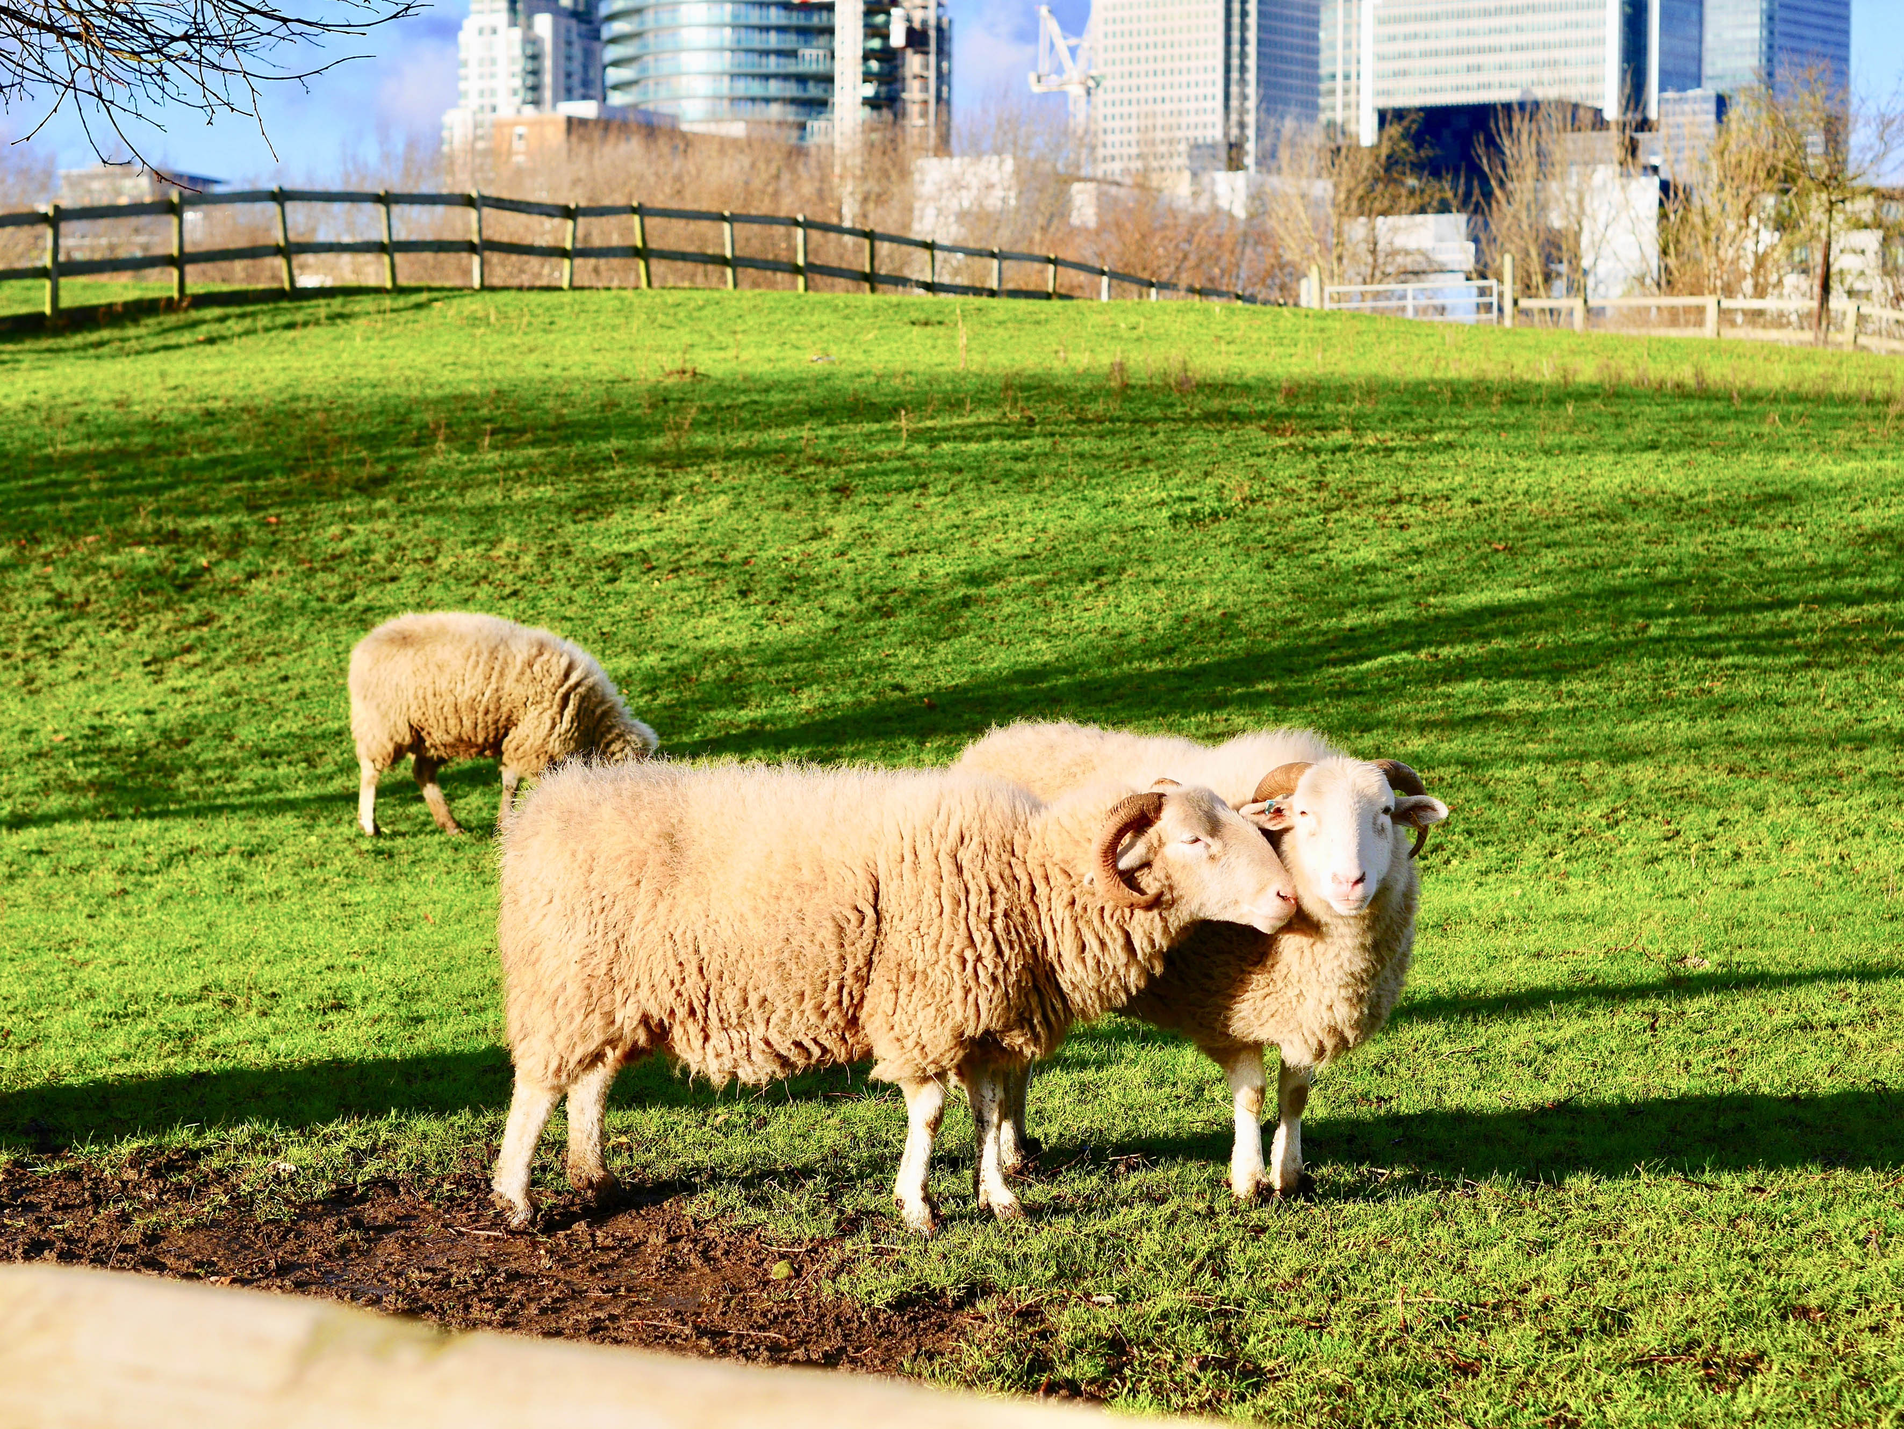
Voluntary and Community Sector Strategy 2020-2024
Profile of the Voluntary and Community Sector in Tower Hamlets
Statutory sector investment in the voluntary sector
The local statutory sector recognises the key role of the voluntary sector in the borough by funding it to deliver a range of services to Tower Hamlets residents. This includes:
the council's Local Community Fund programme, £9.3 million funding 50 projects between 2019-2023
a number of other council grants – Infrastructure and Capacity Building Programme, Small Grants Programme, Innovation Fund, Contingency Fund
council contracts with VCS organisations totalling around £25 million (2019-2020 total)
significant sums of investment from Tower Hamlets Housing Forum (THHF) members, as well as usage by VCS organisations of their assets. (THHF is a partnership between housing associations (registered providers) and LBTH).
Tower Hamlets Clinical Commissioning Group (THCCG) spends over £1m each year on VCS organisations in Tower Hamlets. In many instances, the THCCG and council commission services jointly to ensure a more joined up approach. The THCCG-commissioned services include Social Prescribing and disease specific support such as self-management for Cardiovascular Disease (CVD), Chronic Kidney Disease (CKD) Hypertension and Diabetes.
Council and other statutory sector funding for VCS organisations in Tower Hamlets is a key element of the local voluntary and community sector’s funding base. It also assists VCS organisations to obtain funding from external sources, such as charitable trusts and the National Lottery, by demonstrating the strength and credibility of the funded organisations and supporting their management and infrastructure.

Slide 11
Voluntary and Community Sector Strategy 2020-2024
Profile of the Voluntary and Community Sector in Tower Hamlets
The nature and breadth of VCS activity in Tower Hamlets
The VCS enables local people to live life to the full, to cultivate their imagination, enhance their spirits and develop as human beings. Its way of working and its openness, innovation and inclusivity are as important as any of the services that it delivers.
The vibrancy of the VCS in Tower Hamlets can be seen in the wide range of areas of life that it contributes to. Three city farms allow residents of the borough to get in touch with nature, providing a haven from the pressures of city life. Sports clubs provide enjoyment, the opportunity to stay fit and make new friends. Tenants and residents’ associations give people a say in how the local areas they live in are run. Community education providers allow people to broaden their minds and fulfil their potential.
A range of arts organisations provide local people with the opportunity to participate in or watch performances of dance, drama and music. Employment brokerage and skills training providers enable socially excluded people to get on the first rung of the career ladder or obtain access to education. Information, advice and advocacy organisations allow local residents to access the support that they are entitled to and have a say in determining the services that they receive. The VCS is at the heart of community life in Tower Hamlets in many different guises.
The current flagship funding programme for the VCS in Tower Hamlets is the council’s Local Community Fund programme. It involves the following themes and examples of innovative projects, which engage with local residents, support the development of people’s potential and bring communities together:
Inclusion, health and wellbeing
Residents benefit from a range of projects that promote their wider health and social inclusion. This includes projects that support participation in physical exercise, empowerment projects for young women and befriending and advocacy support for isolated older people.
For example, The Yard Theatre’s Teenage Teens project enables young people, particularly young women, to increase their access to youth services and improve their health and well-being. It provides them with the opportunity to design, produce and participate in innovative theatre-based programmes, building community cohesion through celebrating local life and talent.

Slide 12
Voluntary and Community Sector Strategy 2020-2024
Profile of the Voluntary and Community Sector in Tower Hamlets
Digital inclusion and awareness
Training is provided in digital technology for groups who traditionally have less experience in using IT – for example, older people – and awareness training is provided on on-line safety issues to local families and young people.
A key project for this Theme is SocietyLinks’ E-Safety Champions project which trains local women to become champions for e-safety in the community. The project’s trained champions go into local schools and community groups to spread their knowledge of the importance for families of online safety to young people, parents and carers.
Advice and information
This theme involves provision of advice services on a range of issues and capacity building support for the borough’s advice services.
Island Advice Centre’s Tower Hamlets Advice Training and Capacity Building Project recruits local people for voluntary placements in local advice centres, thus supporting centres to respond to local people’s needs. It trains volunteers to be advice workers, on issues such as benefits, housing and debt, thus improving their chances of obtaining employment.
Employment and skills
Training and mentoring support is provided to communities who are disadvantaged in the labour market – e.g. young people not in education, employment or training, BAME women – to enable them to obtain employment and access to education opportunities, particularly in areas from which they have been traditionally excluded, such as the creative sector.
Magic Me’s Artworks project provides traineeships to talented local residents from BAME and working class backgrounds to enable them to gain the knowledge, skills and confidence to access careers in community arts co-ordination and production. Beneficiaries participate in paid placements which give them first-hand experience of the challenges of delivering arts projects in community settings such as care homes, school and art venues across London.

Slide 13
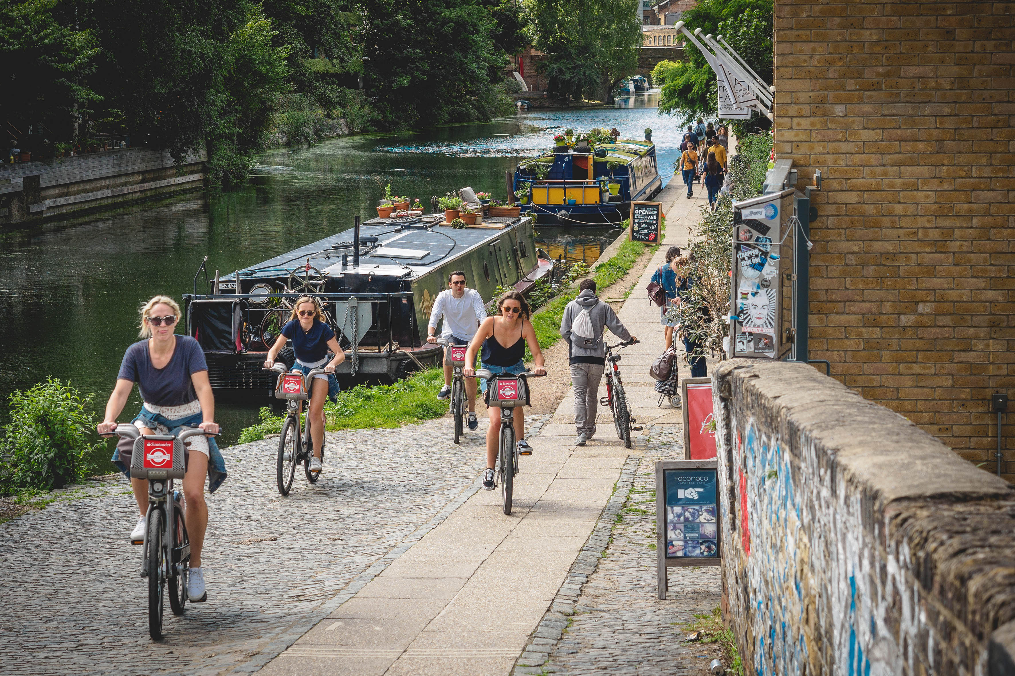
Voluntary and Community Sector Strategy 2020-2024
Profile of the Voluntary and Community Sector in Tower Hamlets
Community safety
Support is provided to develop young people’s skills and confidence to improve their community safety and prevent them engaging in criminal activity.
Four Corners’ Into Focus Photography Project is an inter-generational photography initiative involving groups of young people and people over 50 working together to produce photographic exhibitions at Four Corners’ Gallery. Exhibitions will focus on social perceptions and misperceptions between older and younger people to promote positive attitudes and increase mutual understanding.
Employment and volunteering
The voluntary sector is a significant employer and business presence in the borough. In 2016 the London Voluntary Service Council estimated that the sector employed 5,219 people, 1.9% of the workforce in Tower Hamlets, and generated a combined income of £352.4 million.
The borough has a track record of local residents serving as volunteers. Tower Hamlets Annual Residents’ Survey 2019 found that 21% of residents had been involved in some volunteering work over the previous year.
The importance of volunteering in Tower Hamlets has been highlighted by the COVID-19 Volunteering Hub which, as at mid-October 2020, matched a volunteer candidate to a volunteer role 2,924 times. These volunteers have served in a variety of roles to help vulnerable and socially isolated people during the pandemic and support the wider community.

Slide 14
Voluntary and Community Sector Strategy 2020-2024
Profile of the Voluntary and Community Sector in Tower Hamlets
Challenges
The voluntary sector in Tower Hamlets, and nationally, is faced with a number of serious challenges, many of which are directly or indirectly related to the COVID-19 Pandemic. These include:
the possibility of an upsurge in the pandemic
the pandemic’s long-term negative health and social care impact on local residents
challenges in resuming organisations’ services with the easing of lockdown restrictions
the financial challenges to the voluntary sector, with a number of organisations losing hall rental income or retail income and a reduction in donations
the difficulties that a number of VCS organisations and their beneficiaries face in making use of digital services due to income disparities and low levels of IT experience and skills
beneficiaries of employment and training services provided by VCS organisations will face more intensive competition for employment in the context of an economic downturn.
The sector also faces a number of challenges in the borough that pre-date the pandemic and have been exacerbated by it, including:
rising need in the community, including child poverty, youth unemployment, mental health and anti-social behaviour
Brexit, with the loss of European funding and potential source of staff and volunteers, plus negative impacts on the economy and social cohesion
ongoing wider policy context of reduced resources, which traditionally has an above average negative impact on the sector.

Slide 15
Voluntary and Community Sector Strategy 2020-2024
Profile of the Voluntary and Community Sector in Tower Hamlets
Responding to the challenges
The above challenges highlight the need for partnership working between VCS organisations in Tower Hamlets, with the support of the local statutory and private sectors, to respond to the unique challenges that our borough faces. The vibrancy of the VCS in Tower Hamlets has been witnessed over a number of years and is evident in the range of successful and diverse organisations that make up the sector in the borough. The VCS can build upon its strengths and successes to face the challenges of the future.
The central role of the VCS in response to the pandemic confirms its vitality, which will be essential in the recovery process and in the post-pandemic world. The Strategy aims to build upon the above successes and provide the platform for the VCS to continue to flourish.
The achievements of the VCS in Tower Hamlets, and the continued buoyancy of so many VCS organisations in the borough, is a source of confidence for the VCS and its partners as it responds to current and future challenges. There is an urgent need to endeavour to ensure the survival of VCS organisations that are essential to the recovery process and life in Tower Hamlets post-recovery. This will require the VCS to make the most of the adaptability and imagination that it has previously demonstrated. It will also require the statutory sector working with the VCS on a partnership basis that recognises and acknowledges the strengths of the VCS and identifies areas for joint work to ensure the continued role of the VCS.
The strength and longevity of so many VCS organisations in the borough highlight their accomplishments in securing external resources. This has been highlighted by the success of many VCS organisations in Tower Hamlets in securing external funding to respond to the demands of the pandemic. The ongoing success of the VCS in securing external funding can be enhanced by partnership work between VCS organisations, with support from the local statutory sector.

Slide 16
Voluntary and Community Sector Strategy 2020-2024
Profile of the Voluntary and Community Sector in Tower Hamlets
Tower Hamlets has a proud track record of volunteering, with local residents being prepared to give up their time, on a regular basis, to support their community. The existing strength of volunteering culture in the borough has enabled statutory and VCS organisations in Tower Hamlets to provide support to vulnerable residents before and during the pandemic.
The strategy will build upon this community mobilisation effort to support a more sustainable volunteering picture with both VCS and partner organisations in the borough.
The success of many VCS organisations in using digital technology during the lockdown period, to offer virtually-based services to beneficiaries in their own homes, is an example of the imagination and adaptability of the VCS. Many of these practices have the potential to be integrated into organisations’ long-term service offer, going forward. The experience of the pandemic has highlighted more than ever the need to develop the digital skills and capacity of VCS organisations who often have limited digital resources and experience. This could include complementary work to develop the digital skills of these organisations’ beneficiaries, who may have limited or no experience of using digital technology. There is potential for peer to peer VCS organisational support in this area and wider partnership work, including bringing in statutory and private sector partner assistance.

Slide 17
Voluntary and Community Sector Strategy 2020-2024
Case study:
Leaders in Community’s (LiC) Mind the Gap project
Mind the Gap (formerly known as Project Connect) is an intergenerational project, delivered by Leaders in Community and funded by LBTH through the Local Community Fund. It builds relationships between young adults and those over 50 in the borough, aiming to break down barriers and combat pre-conceived notions each group may have of one another. The project came about because research found older residents felt unsafe around young people.
Through a partnership with Tower Hamlets Friends & Neighbours and Over 50s Consortium, young people collaborate with older people living in Poplar and Mile End in designing activities to develop long-term social connections. This involves co-designing community events and exploring the perception of young people in the community from both perspectives.
The project’s outcomes are shared with the community through events and publicity to counter stereotypes of both young and old. The project aims to engage 100 younger people and 50 older people each year, with the focus for the younger people being predominantly on those from traditionally disengaged groups – e.g. BAME young people and those not in education, employment or training.
The project has been progressing well, despite the COVID-19 Pandemic. Its steering group discusses ideas to connect with the older people that it supports.
The biggest challenge was getting the older people connected online. Through a crowdfunding campaign, via Spacehive, it secured £1,895, matched with £984 from the council’s Innovation Fund, to buy the older people tablets to connect with others. Tutorials on how to use the tablets were also created.
The project’s steering group continues with its work. It has so far produced:
20 videos focusing on connecting with older people
videos relating to members’ different cultures to share with older people
The steering group has provided young people with the opportunity to assume positions of responsibility and develop their self-confidence and leadership skills. They have led in producing social media content to enable the group to communicate with the older members, including:
Meet the Team blog in which each member described themselves
Members recorded videos of themselves responding to the questions: “How would you describe your younger self?” and “What made you the person you are today?”
The project will continue to work towards its goals of building common ground between younger and older people, through asking questions and sharing stories.

Slide 18
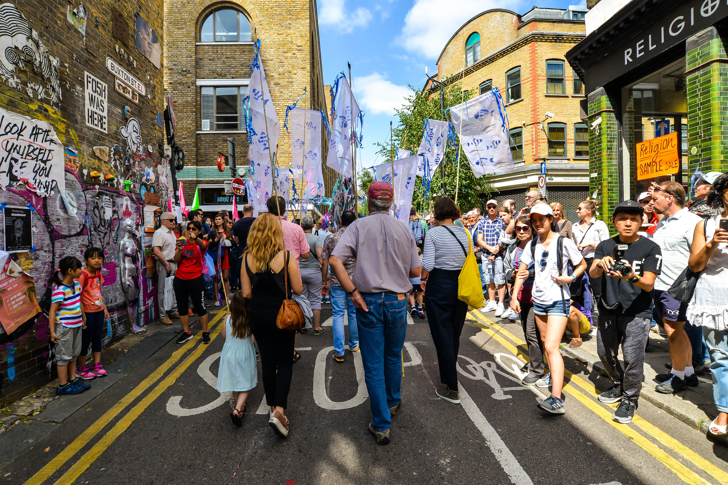
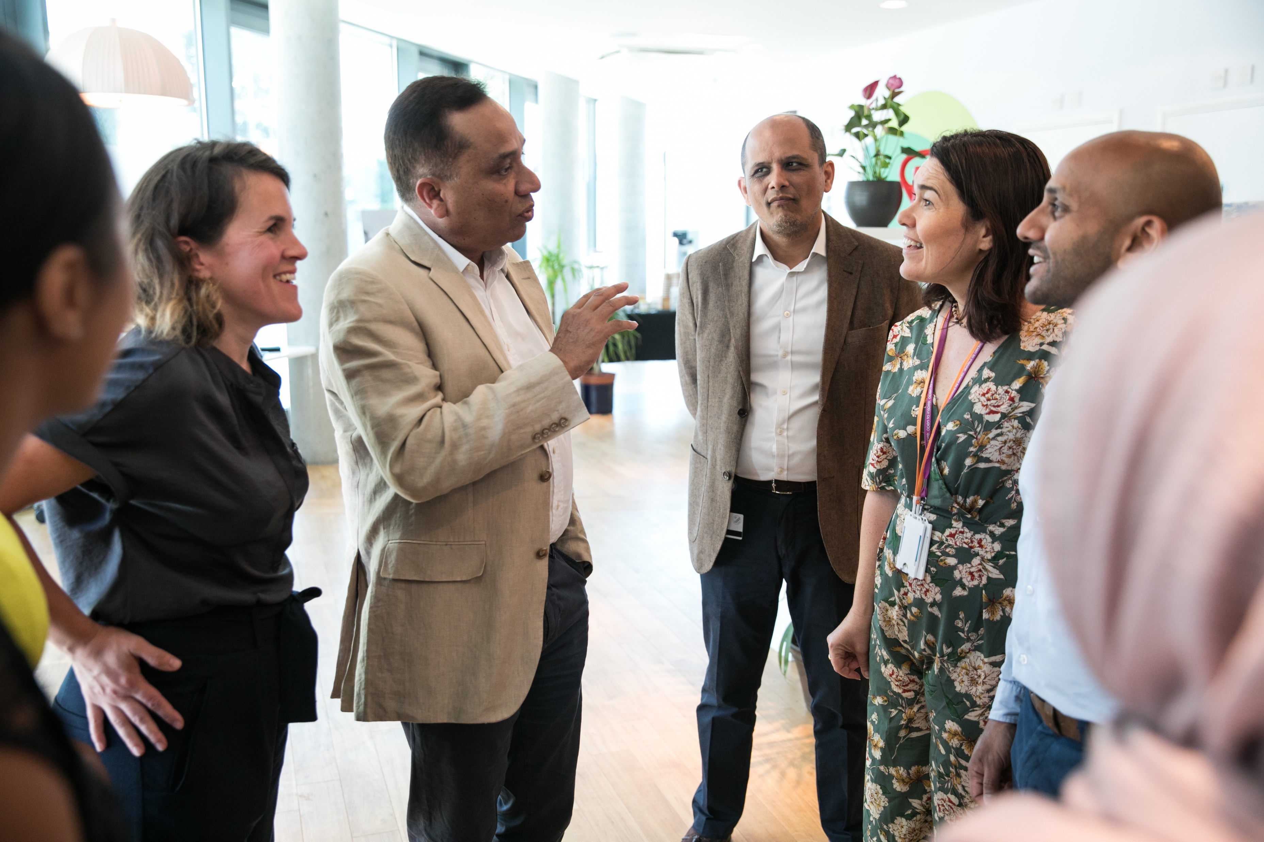
Voluntary and Community Sector Strategy 2020-2024
How did we develop this strategy?
The development of the Voluntary and Community Sector (VCS) Strategy has been supported by a number of consultation events with VCS and partner organisations. This has included consultation through a number of key voluntary sector forums, including:
Cooperate
Health and Wellbeing Forum
Premises Forum
Somali Community Working Group
Tower Hamlets Co-production Network
Tower Hamlets Partnership Executive Group
Tower Hamlets Registered Providers (Housing) Community Involvement Network
Training Enterprise & Employment Forum workshop
Voluntary Sector Children and Youth Forum meeting
The development of the Strategy has also been influenced and supported by:
a survey with VCS organisations, conducted by the council and THCVS in April 2020
regular teleconferences that have been taking place since May 2020, between the Mayor, LBTH officers and representatives of VCS organisations in the borough. There was a presentation on the VCS Strategy at the Teleconference meeting of 28th September 2020.

Slide 19
Voluntary and Community Sector Strategy 2020-2024
Case study:
ICM Foundation CIC’s CORE Projects Get Active newspaper
CORE Projects Get Active Newspaper is a project delivered by ICM Foundation and funded by LBTH through the Local Community Fund. It builds relationships between adults with learning difficulties and disabilities in the borough, supporting them to build their confidence and independence and increase levels of physical and mental wellbeing. Its work is centred on a group of adults with learning difficulties and disabilities who design and deliver accessible newspapers, on the theme of health and wellbeing, to communities that reflect the borough's diversity.
The newspaper focuses on improved lifestyle choices, through increased use of inclusive services. The team plans content, writes articles, carries out research, and interviews people. They decide on job roles, with role tasks allocated according to participants’ strengths and interests. These include meaningful activities that help them to get active, learn skills and make friends and connections. The newspaper reflects the experiences of its creators and readers who access community activities that support healthy lifestyle choices and social inclusion.
The project has been delivered in a person centred, user-led way, where project trainees in the newspaper team decide on what articles to write and research where to go. They travel in the community to take part in a range of activities and review their experience with these activities. For example, the newspaper team researched healthy eating choices that were affordable and reviewed a lunch option. It also discovered a free skating activity and went along to review it. The team conducted interviews and shared information for disabled people.
The project held a launch event in February 2020, to which they invited other groups to attend and review the printed newspaper, giving the team ideas and feedback on what was good, what needed to be different and what articles to write in the future.
The project trainees have also run workshops for adults with learning difficulties and disabilities to give them a voice on the issues that they face. The trainees supported participants and responded to questions that they raised.
The project has continued to operate during the COVID-19 Pandemic, now with a digital newspaper. The articles have included features on how to exercise and cook at home, plus interviews and artwork. This digital newspaper was shared with ICM Foundation’s network in the borough.
ICM Foundation has also been able to offer wider support to all of its beneficiaries during the pandemic, including videos that promote safety. It has supported accessible exercise at home - such as chair-based exercises – and facilitated arts and craft activities.

Slide 20
Priority 1
Better partnership working within the VCS

Slide 21
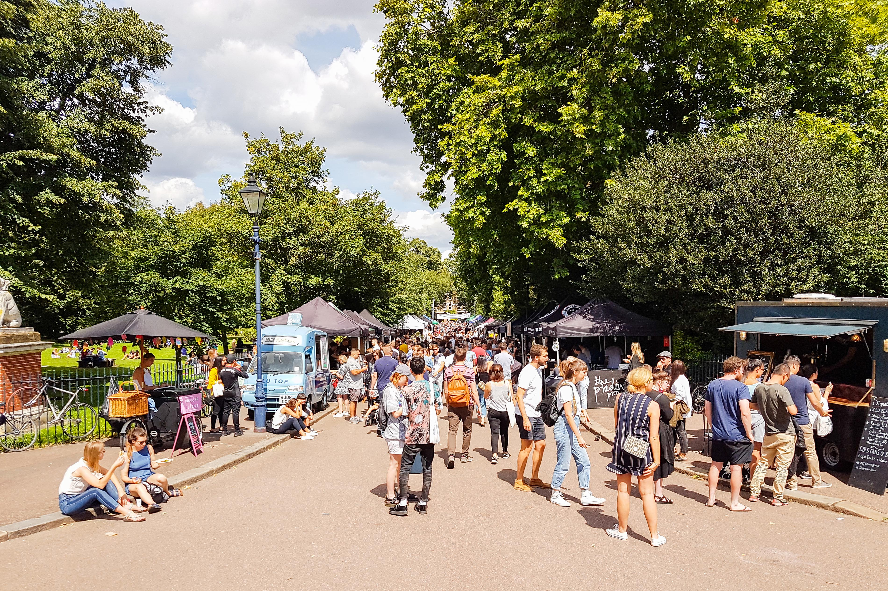
Voluntary and Community Sector Strategy 2020-2024
Priority 1: Better partnership working within the VCS
Why is this priority important?
During the consultation process to develop the Strategy, VCS organisations identified a number of barriers to joint working with each other and potential options to improve partnership working between each other:
organisations are often geographically close, but do not work together to maximise outcomes for local residents
the council should use its strategic role to encourage partnerships and promote partnerships in the allocation of funds
partnerships between smaller VCS organisations are particularly needed
there is a lack of clarity about the voluntary sector offer and a need for a joint directory of VCS organisations, people and projects.
Effective partnership working, both between different VCS organisations, and between VCS organisations and the statutory sector, has many benefits:
supports the focus on the holistic needs of people supported by partners - focus is on people, not organisations
enables organisations to fully identify the needs of the people that they support, thus providing more effectively targeted services. VCS organisations’ community focus and links are particularly helpful, as has been witnessed during the pandemic
the sharing of expertise and knowledge ensures that residents receive quality services and supports organisational development
maximises resources by enabling partners to focus on key areas of need for the target group and supporting bids for external funding.
The value of partnership working in Tower Hamlets has been demonstrated recently by initiatives to respond to the COVID-19 Pandemic in the borough, including the COVID-19 Volunteering Hub and the Emergency Food Hub.

Slide 22
Voluntary and Community Sector Strategy 2020-2024
Priority 1: Better partnership working within the VCS
What actions will we take?
Significantly raise the profile of the VCS via enhanced digital presence
Map VCS organisations and services in the borough and create an on-line directory
Promote VCS as career of choice for young people and jobseekers
Use digital technology to support referrals between VCS services
Set up local VCS partnerships to deliver targeted services.
Raising the profile of VCS activity
There is a need to increase the profile of the VCS across the borough, so that residents have better access to information and services and organisations are able to work together more effectively.
Establishing a stronger digital presence for the VCS in the borough. This should include examining the potential for overhaul of information about VCS services on LBTH and partner organisation web sites. More interactive web material and VCS case studies should be included in the above revised web site information.
An online directory of VCS organisations and services in the borough, supported by a VCS mapping exercise conducted by THCVS, the council and partners. The on-line directory could provide local residents with details of how, where and when to access local VCS services. It should be hosted on partner organisations’ web sites.
Using the higher profile of the VCS during the pandemic to establish it as a career of choice for local residents. Local VCS organisations have the opportunity to work with local employment and careers services to promote the sector with young people. This would involve direct work in schools, colleges and universities, and with older job seekers, including people considering a career change, via placements at VCS organisations.
Highlighting the value of the sector to the local community, including setting up a high profile VCS showcase event, with presentations of awards for projects, organisations and people.

Slide 23
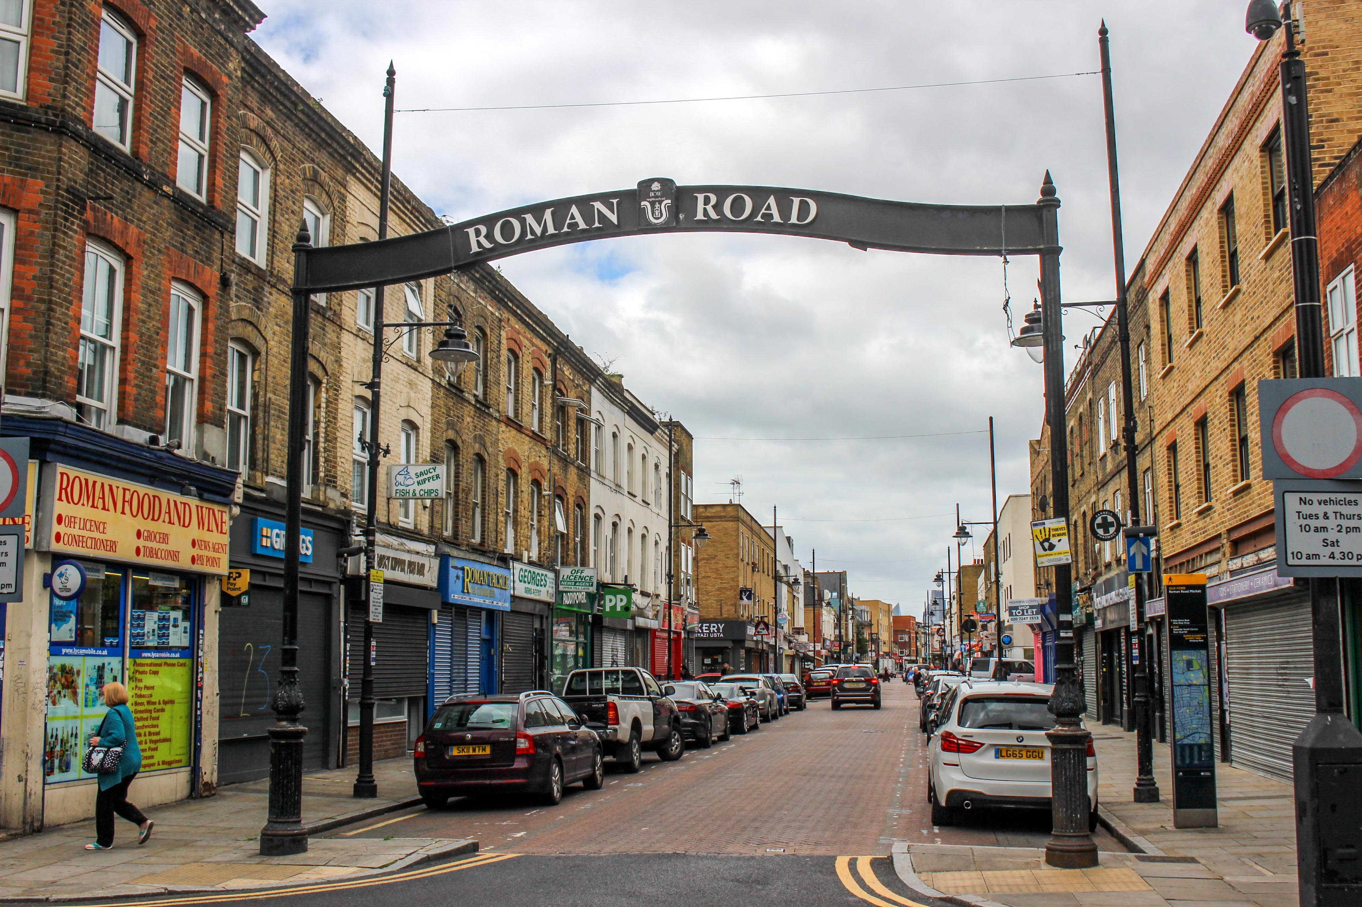
Voluntary and Community Sector Strategy 2020-2024
Priority 1 – Outcomes to be achieved by 2024
Enhanced communications and joint working between VCS organisations
Ensuring that VCS organisations’ beneficiaries receive services that fully address their needs by developing and trialling digital tools and using them to support better referrals between VCS services
Developing local VCS leadership to help lead the recovery process in the borough. Systems should be set up to increase opportunities for VCS managers and staff to network with each other and share expertise.
Establishment of local VCS services on a sub-borough basis
Establishment of the 15 minute Neighbourhoods/ward-based model, to promote and develop localised, targeted and multi-purpose services to meet needs in the community and revive local neighbourhoods
Piloting of ward-based meetings with local VCS organisations and residents to identify organisations and projects for potential new sub-borough partnerships.

Slide 24
Voluntary and Community Sector Strategy 2020-2024
Case study of VCS partnership working in practice:
COVID-19 Volunteering Hub
Volunteer Centre Tower Hamlets (VCTH) is an independent registered charity and a key partner. As the local volunteering infrastructure agency, its mission is to improve volunteering in the borough. It has an established track record of supporting 450+ local VCS organisations, helping them to recruit and manage volunteers.
In March 2020, with the coronavirus pandemic escalating, it was recognised that VCS organisations would be instrumental in supporting residents, and that volunteers would play a critical role. VCTH was commissioned by LBTH to manage the new Tower Hamlets COVID-19 Volunteering Hub. Within just a few days, over 1,000 local people had registered to become volunteers. Roles were promoted and volunteers rapidly mobilised to help the most vulnerable residents.
During the height of the pandemic, the Hub matched volunteers to more than 60 VCS organisations, ranging from new community groups to well-established charities. The Hub also supplied volunteers to council services. Volunteers deliver food parcels, PPE and toy bags, prepare hot meals, collect shopping and medication, provide befriending and mentoring, patrol parks, manage communications, and support ESOL provision. Volunteers from the Hub also supported organisations to deliver the Holiday Hunger programme, ensuring children accessed healthy lunches and fun activities during the school holidays. By the end of August, over 2,300 volunteers had registered with the Hub, and more than 2,700 matches had been made to over 150 different roles.
Staff at VCTH also supported workers in VCS organisations to develop meaningful volunteer roles. Free training and peer support for volunteer managers was provided to help organisations.
The Volunteering Hub is an example of a responsive and effective resource for VCS organisations, enabling them to provide even greater support to Tower Hamlets residents during an exceptionally difficult time.
One of the VCS organisations that benefitted from the Volunteering Hub was the Women’s Inclusive Team. Its Chief Executive Officer, Safia Jama, has stated:
We want to thank VCTH for the invaluable support they have provided in recruiting volunteers for our projects at Women’s Inclusive Team. The team provided amazing help and dealt with our last-minute requests efficiently. They went above and beyond to send us really high-quality volunteers to support our COVID-19 response. We simply wouldn’t have been able to get through the past few months without their help, and we look forward to continuing this fantastic relationship. WIT has grown so much, due to the support of VCTH.

Slide 25
Priority 2
A more resilient and sustainable VCS

Slide 26
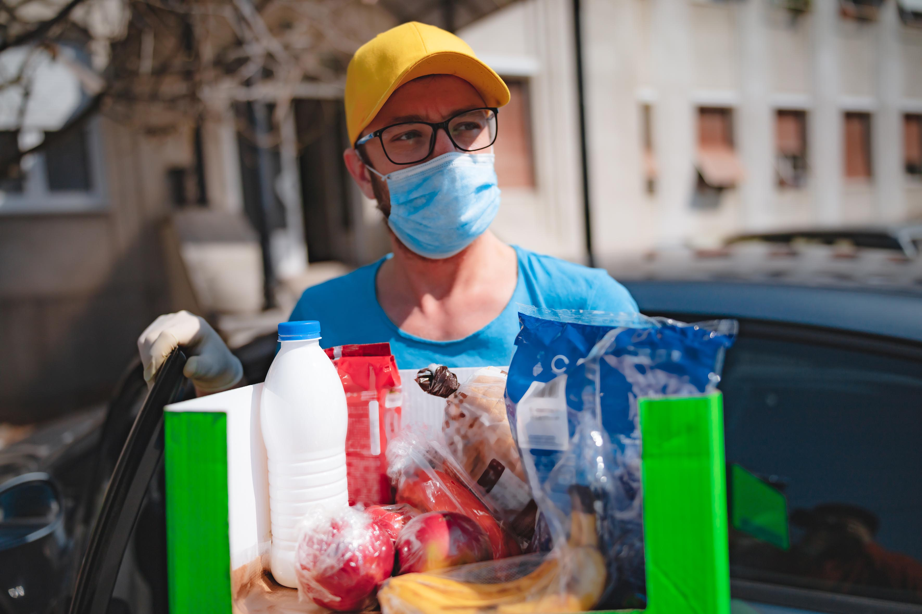
Voluntary and Community Sector Strategy 2020-2024
Priority 2: A more resilient and sustainable VCS
Why is this priority important?
VCS organisations raised a number of concerns about resources in the Strategy consultation process, including the need:
to promote and support employee volunteering, giving it more respect and making use of the untapped potential in this area
to support, promote and give advice on volunteer management, plus specific support and development for trusteeship
for affordable premises and flexible premises options, such as co-working/shared office spaces
for more transparency in decision-making processes on grant and contract awards
to minimise digital exclusion, with all groups supported to access digital resources, both in terms of organisations and the people that they support.
A focal point for the VCS Strategy will be how the VCS can work in partnership with the local statutory sector and local businesses to become more self-reliant and sustainable. In a time of financial constraint, which has been heightened by the challenges of the pandemic, the VCS and its partners will need to focus on working holistically to maximise resources.
Volunteering
Volunteering has been of ongoing importance to Tower Hamlets. This has been highlighted by the success of the COVID-19 Volunteering Hub. Follow-up partnership work is required to ensure sustainable volunteering engagement with both VCS and partner organisations.
Many of the volunteers engaged during the pandemic have the commitment, skills and expertise to offer long-term commitments to local VCS organisations, including as trustees. Employee volunteering needs to be developed and encouraged to link private and public sector employee expertise to the local VCS.
The volunteering pool can be further widened by support for remote and informal volunteering. Mutual aid groups have played an important role in the response to the pandemic in Tower Hamlets, engaging with people who would not have had previous experience of voluntary work. These groups should be supported to continue and develop.

Slide 27
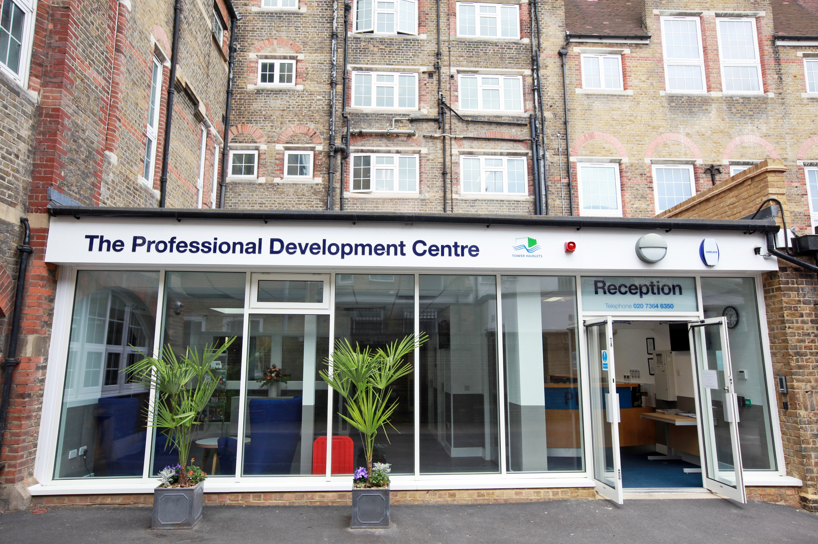
Voluntary and Community Sector Strategy 2020-2024
Priority 2: A more resilient and sustainable VCS
Premises
Access to affordable premises that meet the needs of VCS organisations and their service users is a key issue for the VCS in Tower Hamlets. There is a need for imaginative responses from the local statutory sector, rather than adherence to traditional notions of premises ownership or renting. It needs to be innovative in its planning for provision for VCS premises, including taking the sector’s needs into account at the planning stage for new physical development in the borough. Funding for the VCS from the statutory sector must take premises costs fully into consideration.
The local statutory sector must work in an imaginative and flexible manner with the VCS to publicise and maximise the diverse range of premises options for the sector. This should involve the use of on-line technology to publicise all premises options, including buildings available to lease or purchase.
Statutory sector funding
A key priority for the Strategy will be supporting the statutory sector to set long-term priorities for VCS grant funding and enabling the VCS to compete effectively for its contract opportunities. The local VCS needs to be able to widen its funding base beyond statutory sector grant funding.
Statutory sector partners should explore how they could possibly prioritise the VCS in their commissioning processes and review how they commission services. This could include examining the potential for longer lead-in times for their commissioning processes, in order to provide smaller VCS organisations with greater opportunities to produce tender submissions. They should also consider introducing promotion and support packages to link VCS organisations, particularly smaller organisations, to their contract opportunities.
Social value
Increased support from the local statutory sector to the VCS through its commissioning activity can also be delivered by the Social Value process. LBTH is embedding the Social Value process into its procurement of contracted services to ensure that private sector contractors will be expected to provide support to local VCS organisations, particularly smaller organisations. This will include contractors donating equipment, such as computers, and management time for mentoring support on areas such as bidding for external funding, project management and marketing.

Slide 28
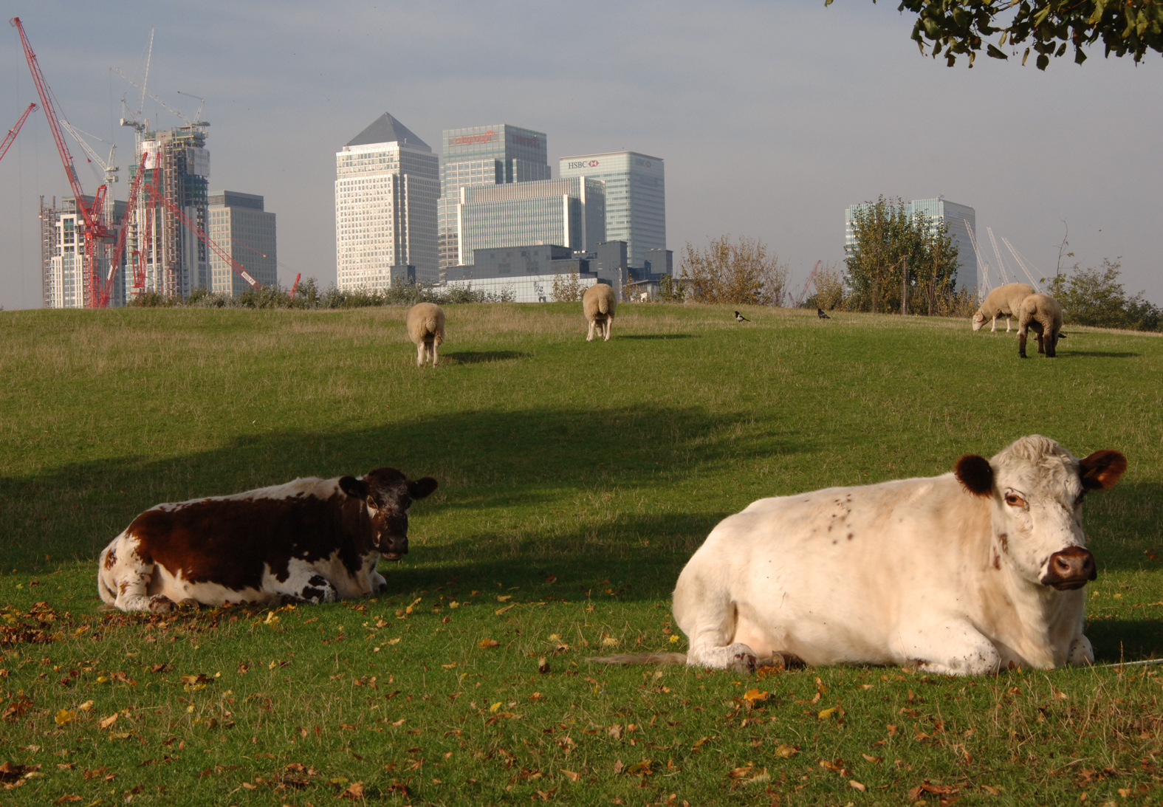
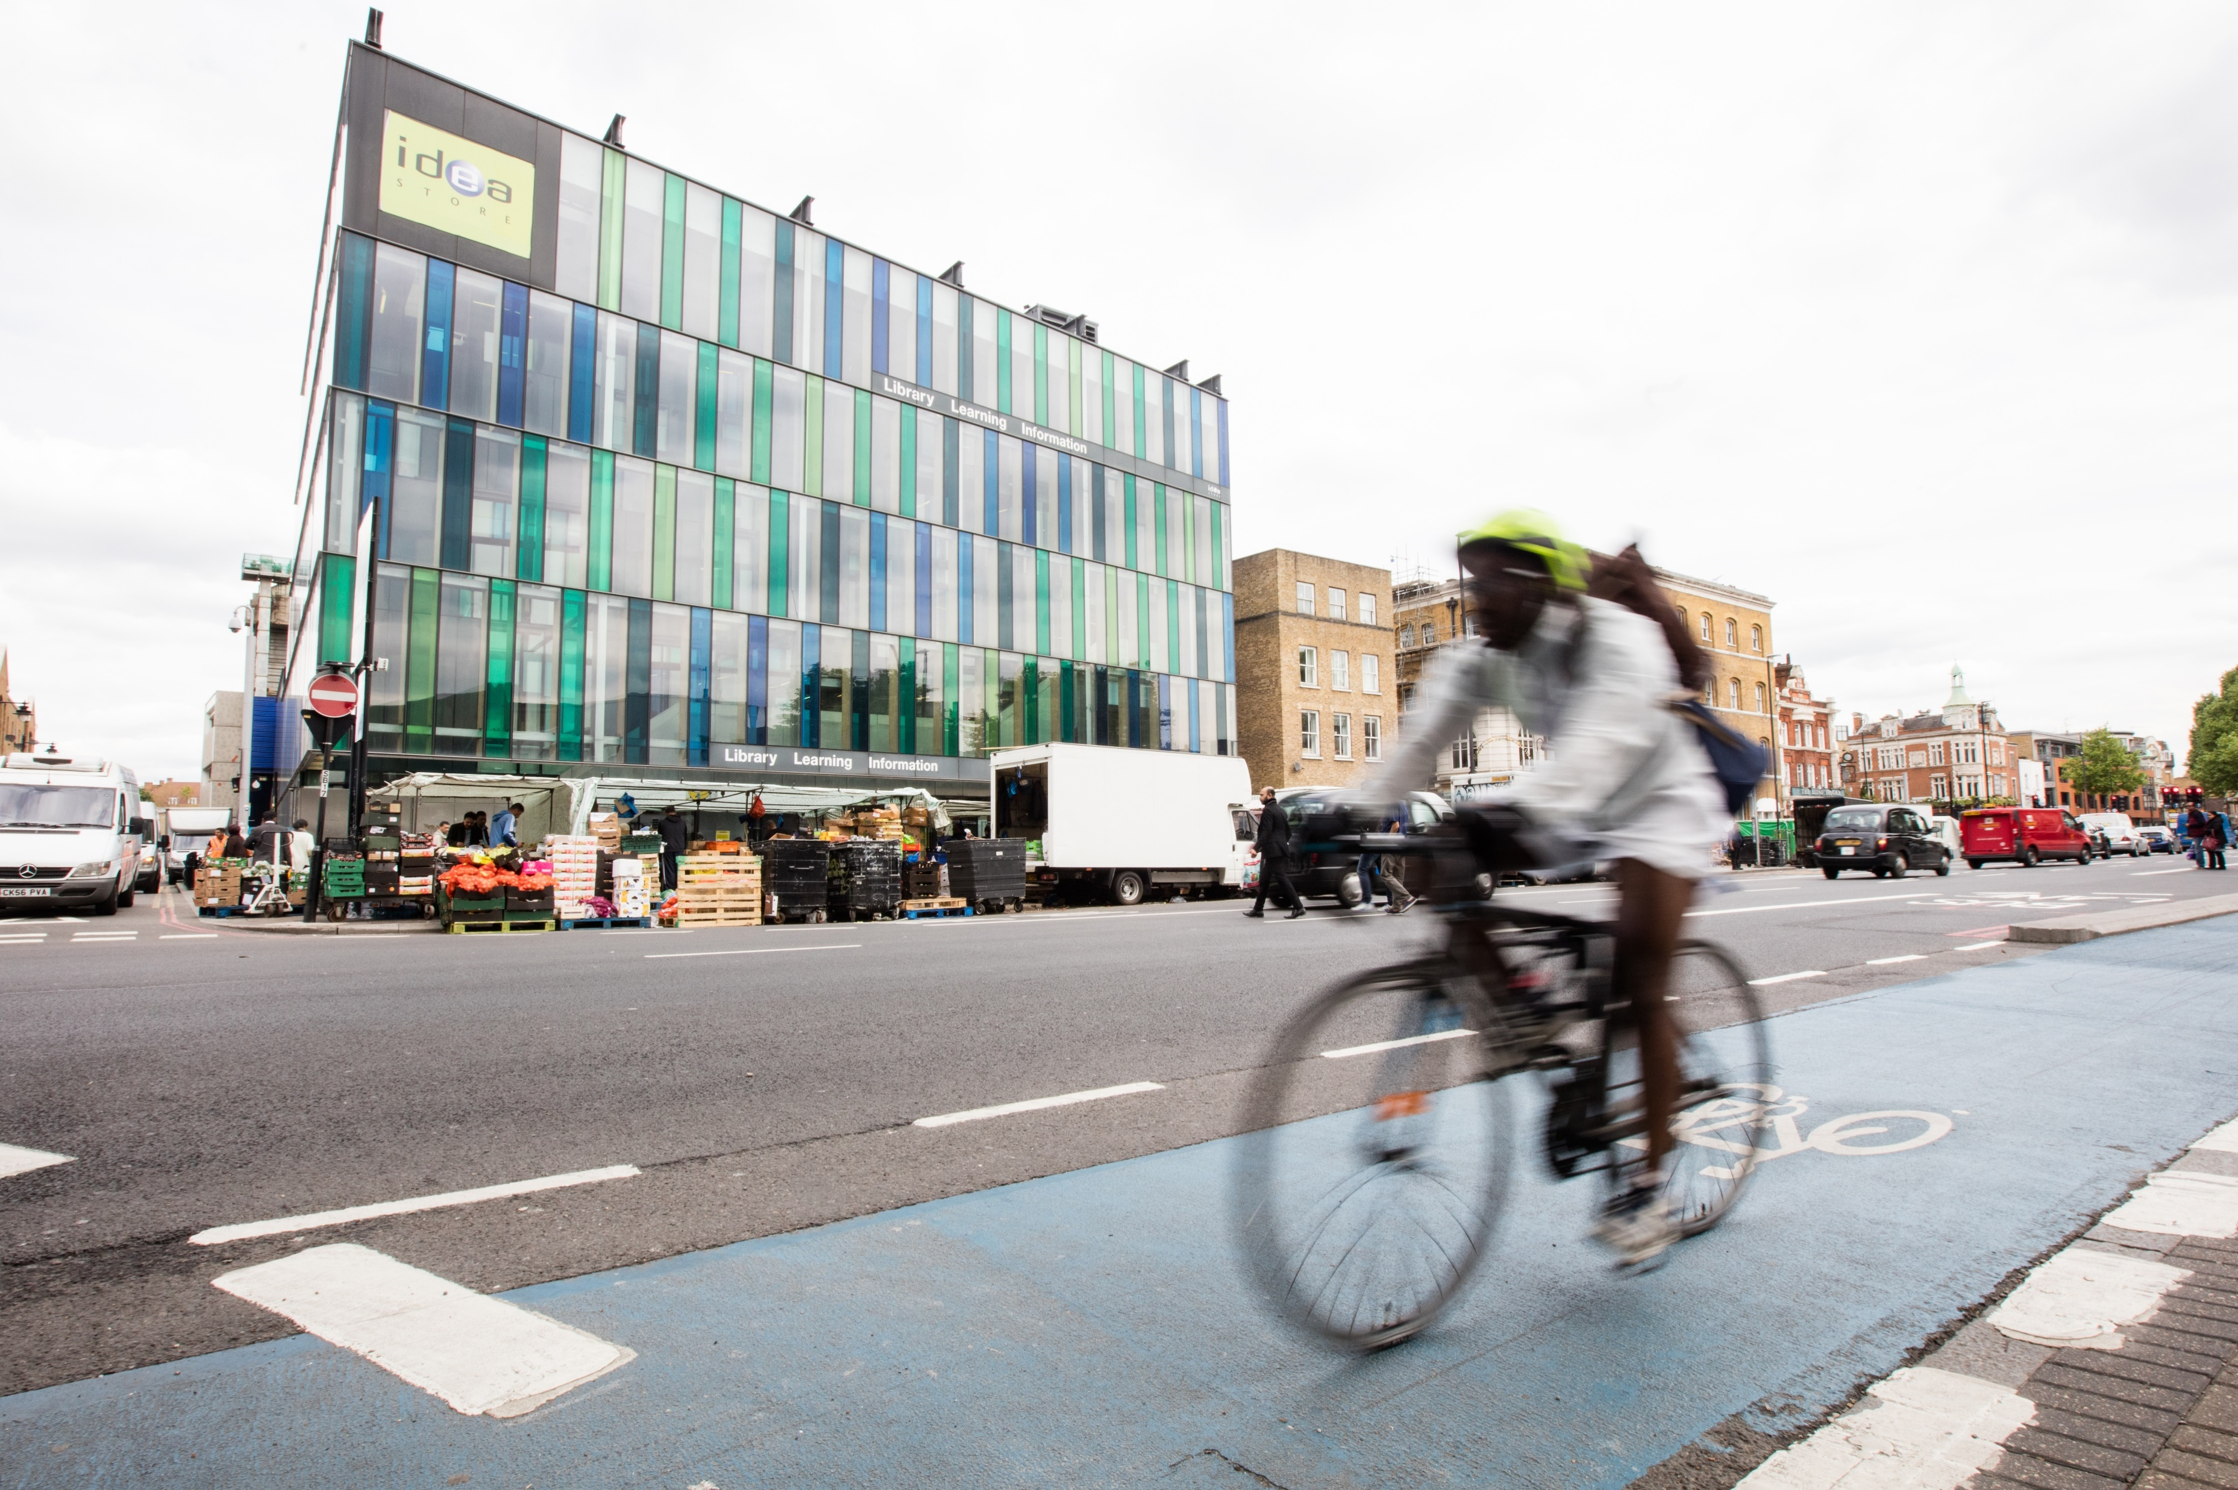
Voluntary and Community Sector Strategy 2020-2024
Priority 2: A more resilient and sustainable VCS
Lessons gained can be shared with other local statutory sector organisations to encourage them to consider adopting Social Value in their procurement processes to support the VCS.
External funding
The VCS in Tower Hamlets has demonstrated success in obtaining external funding during the pandemic. The emergency has provided an incentive for VCS organisations to look beyond the council to seek external funding. The 360Giving web site has reported that VCS organisations in Tower Hamlets have secured £5.9 million in external funding to respond to the pandemic. This is the sixth highest total funding secured by the VCS in a borough in the UK.
The VCS in Tower Hamlets needs to be supported to build upon these successes. This should involve development support to enhance the quality of organisations’ applications for funding, particularly from smaller organisations, including those representing and supporting BAME communities. There is also a need for improved information sources on external funding opportunities for the sector.
There is a need to develop partnerships between VCS organisations to support applications for external funding. Partnerships for large-scale external funding bids - between the VCS, the statutory sector and local business networks - should also be supported, with VCS organisations being the budget holder for successful funding applications. This partnership working should also support the creation of a VCS funding strategy for Tower Hamlets.
BAME-led voluntary sector
COVID-19 has had a disproportionate impact on BAME communities in Tower Hamlets. BAME-led VCS organisations have played a vital role in service provision to the above communities during the pandemic.

Slide 29
Voluntary and Community Sector Strategy 2020-2024
Priority 2: A more resilient and sustainable VCS
The importance of BAME-led organisations in the recovery process in the borough highlights the opportunity to strengthen their power and influence. VCS groups run for and led by smaller BAME communities should be provided with capacity building support. This should including development support for their managers and leaders. There should be joint work between the voluntary, public and private sectors to assist this process. This development support needs to establish links with the work of LBTH’s BAME Commission and its work to develop local community leadership.
Digital resources
Many VCS organisations in Tower Hamlets have used digital resources in innovative ways during the pandemic to deliver services differently. This demonstrates expertise which can be embedded in the longer-term service offer of the VCS.
The above successes highlight the importance of increasing the digital capabilities and resources of those VCS organisations and residents in the borough whose access to and experience with IT is more limited. This exclusion or lack of experience with IT can be due to a range of factors, including economic exclusion or traditional digital technology formats being unsuitable for disabled people and people with sensory impairments.
Developing the VCS contribution to greening
VCS organisations, with their well-established community roots, are in prime position to engage and lead on green issues, including through partnership work between organisations.
This should involve VCS organisations developing green action plans to review their organisations’ carbon footprint in a range of areas and identifying actions to ensure that they operate in an environmentally friendly manner. VCS organisations also have the potential to offer community leadership on environmental issues, engaging local residents on the green agenda.

Slide 30
Voluntary and Community Sector Strategy 2020-2024
Priority 2: A more resilient and sustainable VCS
What actions will we take?
Establish volunteering at the heart of the borough by building on the successful track record of volunteering in Tower Hamlets, including during the pandemic, to establish sustainable and varied volunteering resources for local VCS and partner organisations.
Enable the VCS to have improved access to community buildings and other available premises by developing innovative approaches to ownership and renting and publicising available premises resources effectively to the VCS
Ensure that the VCS is seen as a priority in the commissioning processes of local statutory sector organisations and that its access to commissioning opportunities is supported by promotion and support packages
Promote the Social Value process in public sector procurement to ensure that local VCS organisations secure additional resources from contractors commissioned to deliver public services
Widen the resource pool for local VCS organisations by enhancing their capacity to make successful funding applications, making them aware of external funding opportunities and supporting the development of partnership bids
Deliver capacity building support for VCS groups run for and led by smaller BAME communities, including development support for organisations’ leaders
Increase access for VCS organisations and their beneficiaries to digital resources, including devices and shared network connections, plus training of sector staff, volunteers and beneficiaries on IT skills
Support VCS organisations to develop and implement green action plans to ensure that they operate in an environmentally friendly manner and offer community leadership on green issues

Slide 31
Voluntary and Community Sector Strategy 2020-2024
Priority 2 – Outcomes to be achieved by 2024
Volunteering
Development of a borough volunteering plan to build upon the track record of volunteering in Tower Hamlets, including the success of volunteering in the pandemic, and putting volunteering at the heart of the borough and its recovery process. This will involve establishing a sustainable pool of volunteers to support VCS and partner organisations to deliver their services to local residents.
Promoting volunteering to young people, in schools, colleges and youth hubs, linking volunteering experiences to accreditation and access to education and employment
Establishment of permanent systems to publicise volunteering roles in the borough, linking volunteers to local VCS and partner organisations
Increased support for employee volunteering, particularly in large public and private sector organisations, with volunteering opportunities identified through the revised borough partnership structure, outlined in Priority 3
Ensuring quality management of local volunteering, including by developing shared volunteer management procedures and resources, to support informal and remote volunteering, including mutual aid groups. This should include agreed procedures on DBS checks for volunteers and safeguarding. Partner organisations and the THCVS should examine the possibility of providing capacity building, training and information resources to support the development of mutual aid groups – e.g. with crowdfunding - whilst respecting their independence and local roots.
Supporting VCS organisations to benefit from volunteers’ professional expertise by creating pathways to link volunteers to trusteeship roles with VCS organisations.

Slide 32
Voluntary and Community Sector Strategy 2020-2024
Priority 2 – Outcomes to be achieved by 2024
Improving access to statutory sector buildings for VCS
This will involve:
creation of a vision and strategies for community hubs and buildings that enable VCS organisations to lead in managing them, support affordable access to these premises by the VCS and recognise the value that these premises bring to residents and VCS organisations alike
the statutory sector determining how it can widen VCS organisations’ access to its buildings, in ways which respect social distancing, to support delivery of services and assist the recovery process in the borough
development and piloting of ways of working that consider spaces and buildings in the broadest sense and that involve VCS organisations in positive ways at the earliest stage of new capital developments – e.g. streetscapes and public realm, planning for new buildings, redevelopment of high streets
enabling VCS organisations to find out about available premises in the borough. This could involve the establishment of a directory of community buildings on local statutory sector and community web sites to publicise information about available buildings, including their location and how they can be accessed by VCS organisations.
the council working with partners to provide capacity building to VCS organisations on matters relating to facilities management of premises
Statutory sector funding
Local statutory sector organisations should explore the potential to:
prioritise the VCS in their commissioning processes, including reviewing how they commission services. This could include the introduction of longer-lead in times for commissioning. They should consider introducing promotion and support packages to link VCS organisations, particularly smaller organisations, to their contract opportunities.
publicise and promote their grant and contract opportunities more widely with the VCS, making use of on-line publicity formats
examine their funding processes and feedback from previous local grant and contract rounds to inform development of priorities and procedures for future grants and contracts to ensure that they fully address local priorities. Any local statutory sector organisation grant programmes for the VCS will be aligned with responsible organisations’ budget processes to ensure that funding is available.

Slide 33
Voluntary and Community Sector Strategy 2020-2024
Priority 2 – Outcomes to be achieved by 2024
Social value
The council and partner organisations should explore the possibility of using Social Value in their procurement processes to require their largest contractors to pledge resources - including computers, other digital equipment and executive management time - to local VCS organisations, particularly smaller organisations.
External funding
The local VCS can be supported in a number of ways to enhance its potential to secure external funding:
The local statutory sector, voluntary sector infrastructure organisations and businesses should explore the potential of the private sector and social value processes to support smaller VCS organisations, including those representing and supporting BAME communities, to be better positioned to obtain external funding. Support could include provision of targeted training and mentoring support on how to make high-quality funding applications and linking smaller VCS organisations to partnerships with larger VCS organisations. Support from the local statutory sector and VCS infrastructure organisations could also involve supporting smaller VCS organisations to improve their overall quality standards, which could be formally accredited to support their case with external funders.
LBTH and THCVS must build upon their work in publicising external funding opportunities relating to the COVID-19 Pandemic to VCS organisations on their websites, providing similar information on external funding opportunities, post-pandemic.

Slide 34
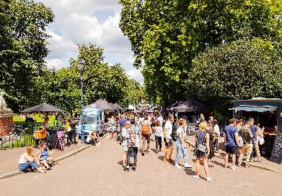
Voluntary and Community Sector Strategy 2020-2024
Priority 2 – Outcomes to be achieved by 2024
VCS forums, such as the new Community Sector Forum and the Health & Wellbeing Forum, should be supported to identify areas of high level need and broker VCS partnerships to produce sector focused applications for funding
Links should be developed between VCS networks in Tower Hamlets and similar networks in neighbouring boroughs to establish partnerships and funding applications for cross-borough projects on priority areas
Protocols between the voluntary and local statutory sectors should be established to support applications from both sectors for external funding for new services in the borough, with support from the private sector. The protocols should stipulate how each sector can cooperate with each other in terms of development of funding applications, including consulting on these applications, and delivering the services they fund. There is the possibility of joint work on large scale funding bids – e.g. to the National Lottery – for new projects for which VCS organisations would have the responsibility of managing any secured funds. The local statutory sector has the potential to fundraise for money and in-kind support from third parties to support VCS projects in Tower Hamlets – e.g. the council in crowdfunding to respond to the COVID-19 Pandemic.
The above cross-partnership working should also be used to set up an external funding strategy for the VCS in Tower Hamlets, through a revived Funders Forum. A key objective for the Forum should be developing links between external funders, including regional funders, and the VCS in the borough.
BAME-led VCS organisations
The local statutory sector, in partnership with VCS and business infrastructure organisations, needs to support community leadership, to aid the borough’s recovery process, by providing training and development support to:
VCS groups run for and led by smaller BAME communities
BAME leaders in the local VCS.

Slide 35
Voluntary and Community Sector Strategy 2020-2024
Priority 2 – Outcomes to be achieved by 2024
Digital resources
Local VCS organisations and their beneficiaries who have limited digital resources must be supported to fully benefit from the possibilities of digital technology. This will enable them to fully participate in the post-pandemic world, when digitally-based services will be more prevalent.
This process requires support from local statutory sector organisation social value processes, volunteer resources, including employee volunteering, the development of links with local digital technology businesses and corporate donations of staff time and equipment. It could involve:
distribution of IT equipment to VCS organisations, including corporate recycling of equipment and partnership bids for funding new equipment
establishment of models for digital skills training for VCS organisations and beneficiaries, via corporate and health sector volunteers. This should involve local business networks developing links with local digital technology businesses to secure their training and mentoring support for smaller VCS organisations and their beneficiaries.
VCS organisations being supported to obtain access to good broadband connections through local business hubs, including access to flexible workspaces with broadband links.
The above work should link in with partner organisations’ work to promote digitalisation in the borough, including the council’s Digital Inclusion strategy.

Slide 36
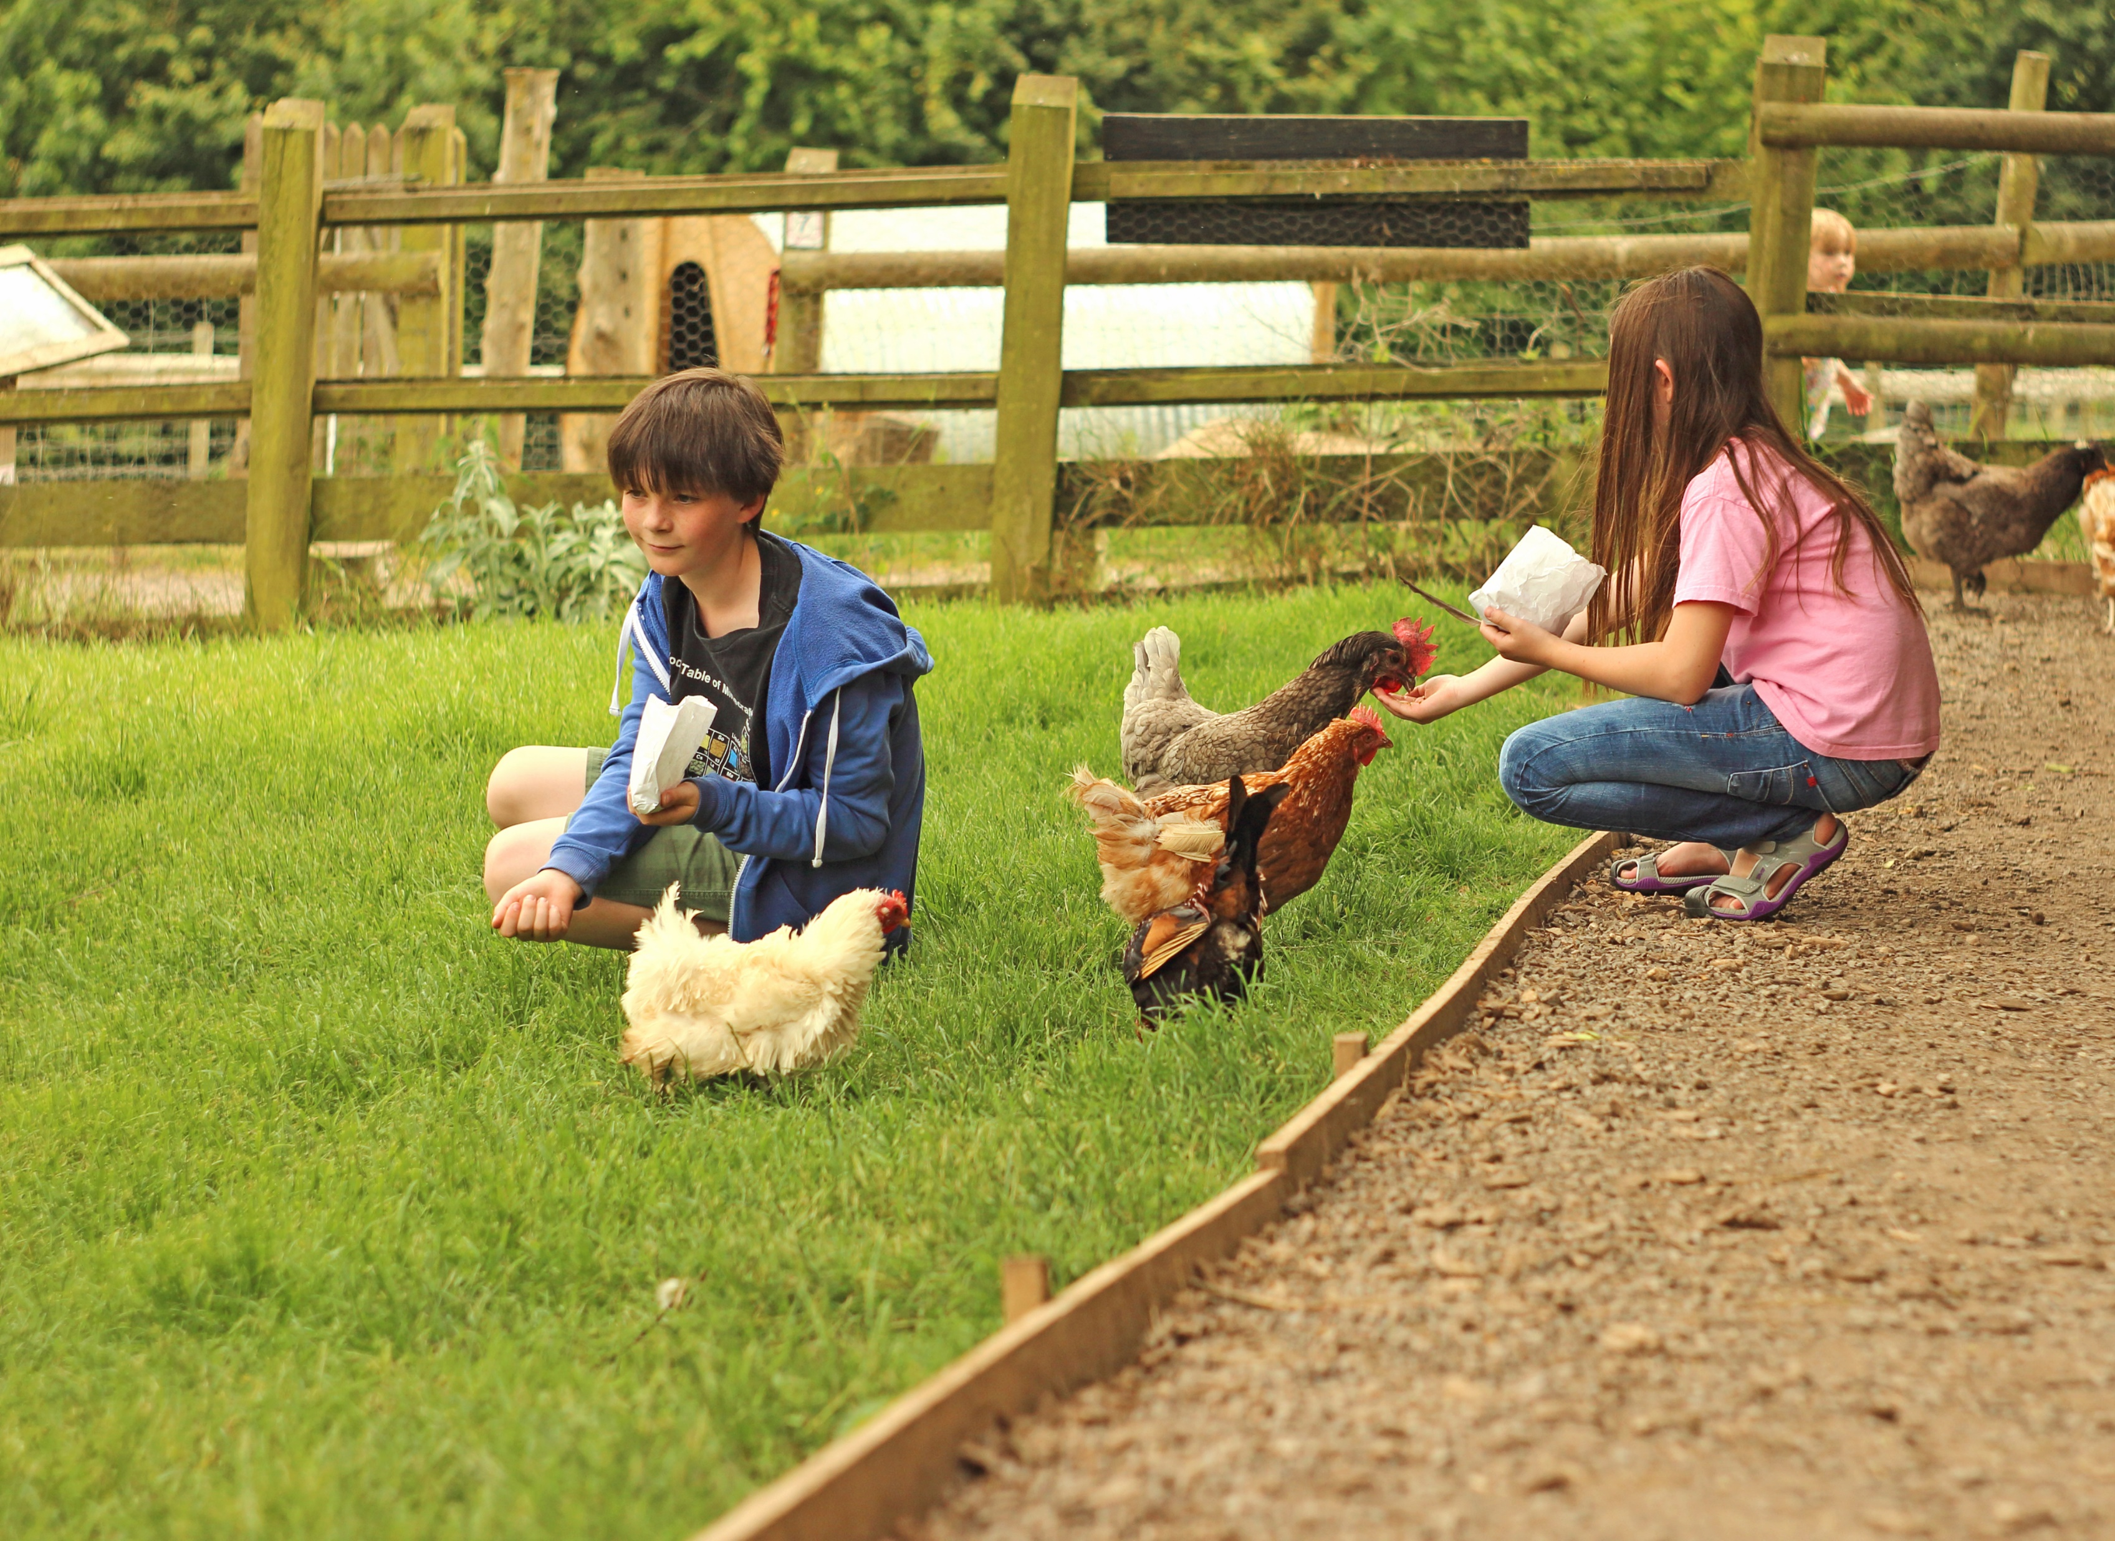
Voluntary and Community Sector Strategy 2020-2024
Priority 2 – Outcomes to be achieved by 2024
Developing the VCS contribution to greening
VCS organisations, with their strong community roots, are well positioned to offer community leadership on green issues. This should involve:
VCS organisations working in partnership to develop green action plans, which will review their carbon footprint in a range of areas. These will include use of renewable energy, transport, recycling, waste disposal, environmentally preferable purchasing, paperless systems and digital meetings. These action plans can identify measures for organisations to implement to ensure that they operate in the most environmentally friendly manner.
Local VCS organisations setting up a Green Forum to:
support VCS organisations to develop their green action plans and best practice on environmental issues. This could include joint work on areas like recycling or premises sharing.
provide community leadership on green issues, linking in with the development of 15-minute Neighbourhoods, as proposed in Priority 1
Partner organisations should support local VCS organisations to be more sustainable, examining the potential to link them to sustainability initiatives that they are involved with. They should examine the potential to purchase services from local green social enterprises.

Slide 37
Voluntary and Community Sector Strategy 2020-2024
Case study of VCS external funding in practice:
East End Citizens Advice Bureau
The key funding stream in London to assist the VCS to respond to the COVID-19 pandemic has been the London Community Response Fund (LCRF). Over £22 million was distributed through this Fund, which involved 60 funders across different sectors.
Organisations operating in Tower Hamlets have had significant success in securing LCRF monies, with £2.3 million being awarded to projects that work solely in Tower Hamlets, or for multi-borough projects that cover Tower Hamlets. East End Citizens Advice Bureau (CAB) obtained £55,000 to support it to deliver its work in Tower Hamlets and neighbouring boroughs.
This LCRF allocation has enabled East End CAB to fund additional, trained benefit advisers to deal with increased demands on the organisation’s service following the pandemic and lockdown. It has also supported East End CAB to purchase additional equipment to respond to the remote calls on its service.
With the closure of East End CAB’s offices, client queries are being made via telephone, e-mail and SMS. It has been receiving on a daily basis, during the pandemic, 450 to 500 requests for support, compared to pre-pandemic demands of 20 to 30 cases each day, which were handled on a face-to-face-basis.
The additional advisers have manned the new advice lines to respond to the pandemic, including a telephone triage system which enables beneficiaries’ queries to be directed to the most appropriate adviser. This system enables appointments to be arranged between beneficiaries and advisers, with East End CAB staff contacting beneficiaries to set up these appointments. Staff also responded to beneficiaries’ queries directly, via e-mail and SMS. The new system has supported queries to be dealt with in appropriate response times.
The main area of the additional queries from beneficiaries during the pandemic have concerned Universal Credit, including from people who had been made redundant or put on furlough, because of lockdown. There have also been additional queries about housing, such as rent and council tax arrears.
East End CAB is exploring how it can incorporate its partners into the new telephone advice services that it has set up to respond to the pandemic.
Ali Halil, Manager at East End CAB, believes that the funding from LCRF has helped his organisation to provide a high quality service during the pandemic. It has enabled East End CAB to hire additional staff and purchase new equipment to address the high level of additional client demand that it has faced. LCRF funds has supported East End CAB to use technology in the most resourceful way to address beneficiaries’ needs. The triage telephone system has saved money and time on beneficiaries’ behalf.

Slide 38
Priority 3
Improved partnership arrangements across sectors

Slide 39
Voluntary and Community Sector Strategy 2020-2024
Priority 3: Improved partnership arrangements across sectors
Why is this priority important?
The VCS Strategy’s consultation process identified a number of ways for the sector to work with partners to improve local residents’ lives, including the need for:
a new forum representing smaller VCS organisations to influence policy and decision making
better two-way communication between the council and the VCS
VCS organisations to ensure that local residents have an effective voice in local consultation
strengthened collaboration and referral pathways between organisations.
The VCS has played a key role in responding to COVID-19 in the borough, successfully delivering new services to vulnerable residents and adapting existing services during lockdown. It will be vitally important in both the recovery process in the borough and the post-pandemic world.
There is an opportunity to improve the statutory-voluntary sector joint working structure in order to support the implementation of the VCS Strategy, the recovery from the pandemic and the journey to a post-pandemic world. This improved structure should promote a more open dialogue and improved information sharing between partners.
VCS participation in policy making in Tower Hamlets has often been piecemeal, with engagement taking place quite late in the process. The role of the VCS in consulting with local residents needs to be developed to be at the forefront of consultation.
There is a need to develop better working links between VCS organisations, the local statutory sector and local businesses. Each sector can benefit from the expertise sharing and interaction with each other.
The VCS can engage in the economic recovery process in the borough by increased participation in local opportunities for growth. Partner organisations should examine their potential to commission more services from local VCS organisations.

Slide 40
Voluntary and Community Sector Strategy 2020-2024
Priority 3: Improved partnership arrangements across sectors
The COVID-19 Pandemic has highlighted the importance of organisations working together to respond to emergency situations. It has raised the need for the VCS to engage at a strategic level with local statutory sector organisations in relation to resilience planning for Tower Hamlets, to assist the borough to respond effectively to future emergencies.
COVID-19’s disproportionate effect on local BAME communities and the Black Lives Matter movement have raised the importance of ensuring that all public and community services adhere to equality principles in their service delivery. There is a need for joint work between the local voluntary, public and private sectors to ensure that all residents of the borough receive effective and responsive services that fully meet their needs.
What actions will we take?
Place the VCS at the forefront of consultation processes in the borough in order to ensure that all of Tower Hamlets residents are able to have a say in the development of local strategy and policy making
Establish a more central role for the VCS in the borough’s joint decision-making process, particularly in relation to the recovery process from the pandemic
Develop protocols for sharing and use of evidence and data across VCS organisations, and between VCS organisations and the statutory sector, to inform policy development
Develop links between VCS organisations, the statutory sector and local businesses in order that each sector can benefit from newly established working links. This should include promoting the potential for VCS organisations to access local business opportunities.
Local statutory sector organisations should work in partnership with local VCS infrastructure organisations to develop strategic relationships in regard to resilience planning. This strategic engagement should also support VCS organisations’ operational responses to emergency situations.
Joint work between the local voluntary, statutory and private sectors is required in order to embed equality principles in the delivery of services to local residents and promote equality within the borough.

Slide 41
Voluntary and Community Sector Strategy 2020-2024
Priority 3 – Outcomes to be achieved by 2024
Increasing VCS role in consultation and engagement
VCS organisations’ strong roots with local communities can help to amplify residents’ voices, including with the local statutory sector. The community intelligence from the VCS must be at the heart of consultation and engagement in the borough. Effective use of this intelligence will support the development of new local policies and strategies. This will involve the local statutory and voluntary sectors developing processes for deciding how and when to make use of co-production and consultation as part of the policy formation process, including the establishment of clearer “policy pipelines”.
Strategic decisions are influenced by VCS at a community level
This will be achieved through improved communications and engagement on policy development between the VCS and local statutory sector organisations.
Joint working between the local voluntary and statutory sectors needs to result in a meaningful impact on policy development. The contribution of the VCS must be fully reflected in resulting policies and strategies.
This will involve:
establishing a revised Tower Hamlets Cooperate-Voluntary Community Sector Partnership structure, with Cooperate having a more pro-active role in securing local partners’ direct involvement in policy development
Setting up Tower Hamlets Community Sector Forum to enable a wider range of people and organisations from the VCS, particularly from smaller and more informal groups, to fully influence the development of local policy and strategy
VCS Forums leading implementation of VCS Strategy and recovery work.

Slide 42
Voluntary and Community Sector Strategy 2020-2024
Priority 3 – Outcomes to be achieved by 2024
Establishing information sharing protocols
There is a need to improve the sharing of information and data between the local voluntary and statutory sectors. Agreed protocols in this area can inform policy development and decision making and support applications for external funding for new services.
This will involve developing:
a system where the sharing of lessons and evidence from VCS projects can be recorded to feed into the policy and decision-making process
increased joint working between statutory sector data and intelligence teams and VCS organisations – e.g. on Joint Strategic Needs Assessments.
Developing closer working relationships between VCS and local statutory and private sectors
This needs to involve:
partner organisations examining their potential to purchase more services from local VCS organisations. This would help to revive the local economy and support the economic development of local neighbourhoods in the borough.
setting up network meetings and a business forum between VCS organisations, local businesses, including SMEs, and East London Business Alliance to broker business opportunities between each sector. Any plans to promote engagement with local businesses will need to be mindful of the challenges that they are facing due to the economic dislocation caused by the pandemic. However, the above networking could also help to promote opportunities for local businesses who are currently under threat. Furthermore, each sector could gain from the other’s expertise and insights into the local economy and community needs.
As outlined in Priority 2, the local statutory sector needs to use the Social Value process to enable businesses to donate management expertise, computers and other equipment to VCS organisations, particularly smaller organisations.

Slide 43
Voluntary and Community Sector Strategy 2020-2024
Priority 3 – Outcomes to be achieved by 2024
Resilience planning
The VCS needs to be a full partner with local statutory sector organisations in regard to resilience planning for any future emergency situations in the borough. Local statutory sector organisations should work with local VCS infrastructure organisations, such as THCVS and VCTH, and with VCS networks, such as the Inter-Faith Forum, to develop strategic relationships in regard to resilience planning. This strategic engagement should also support VCS organisations’ operational responses to emergency situations.
Joint working to promote equality
The local VCS, statutory sector organisations and business networks must work together to promote equality principles in regard to delivery of services to Tower Hamlets residents. BAME-led VCS organisations should be central to this process, as should faith groups which represent BAME communities, particularly those providing services to local residents.
LBTH has set up a BAME Inequality Commission to focus on the promotion of equalities in the areas of health, community leadership and employment. The work of this Commission can support the promotion of more responsive VCS services to local BAME residents, particularly in the areas of health and social care, which is even more important than ever due to the disproportionate impact of COVID-19 on BAME communities. We will work to make VCS management committees and trustee boards more representative of the diversity of the borough, with more equal representation of BAME people and women, for example, on VCS Boards.
This process can also be supported by strengthening the involvement of the range of faith communities across Tower Hamlets. This will build on the role of the Interfaith
Forum in linking faith communities to wider community support. Faith groups played a vital role in responding to community needs during the pandemic, particularly amongst local BAME communities. There is a need to ensure that faith communities’ role continues to be central to our approach.

Slide 44
Voluntary and Community Sector Strategy 2020-2024
Case study of partnership working between sectors in practice:
Emergency Food Hub
LBTH worked with the VCS to establish a Food Hub in April 2020, a collective partnership to provide assistance to vulnerable residents during the COVID-19 Pandemic. The Hub is run by council staff, working with VCTH and food banks, with 27 VCS organisations helping to supply and deliver food to high risk or self-isolating residents.
The Hub has been feeding 5,000 people a week, via food parcels, offering Halal, vegan and fresh food options where required. Where possible, food has been sourced from local retailers. This ensures that allocated food parcels, which also involve food delivered to the Hub by the government, are sufficiently nutritious for vulnerable residents. There has also been support from private sector companies in relation to packaging and distribution of the food.
The Emergency Food Hub has worked with the Somali Senior Citizens Club (SSSC). This work has enabled hot, Halal meals to be delivered on a daily basis to 30 SSCC members. Jama Omar from SSSC reports that the Food Hub is vital for his organisation’s beneficiaries as it provides the security of knowing that they will receive food every day. The support from the Food Hub and SSSC provides beneficiaries with someone to talk to and makes them feel part of the community. SSCC has also been able to support these beneficiaries through shopping, evening befriending sessions and getting their laundry washed.
The Women’s Inclusive Team (WIT) has also worked with the Food Hub. 90 of WIT’s beneficiaries, who are predominantly Somali, have been able to benefit on a weekly basis from the Food Bank. The Bank has provided them with vegetarian ready meals, fresh food and vegetables, plus ambient foods which can be stored for long periods. All food provided meets beneficiaries’ dietary requirements. Local residents have also benefitted from WIT’s community kitchen, which was feeding 150 people a week, seven days a week, during the height of the pandemic.
Jennifer Sutcliffe, Community Centre Manager at WIT, believes that the importance of the Food Hub and WIT’s community kitchen is that these services are feeding people who would not otherwise be fed. They remove feelings of isolation that might otherwise result from WIT’s luncheon club being closed. WIT has been providing beneficiaries with daily telephone befriending calls. Many of the beneficiaries do not have family or friends, or cannot cook, as they are living in temporary accommodation. A number have lost their jobs and income overnight and thus cannot buy food. Jennifer believes that both the Emergency Food Hub and WIT benefit from working with each other, each complementing the other’s services.

Slide 45
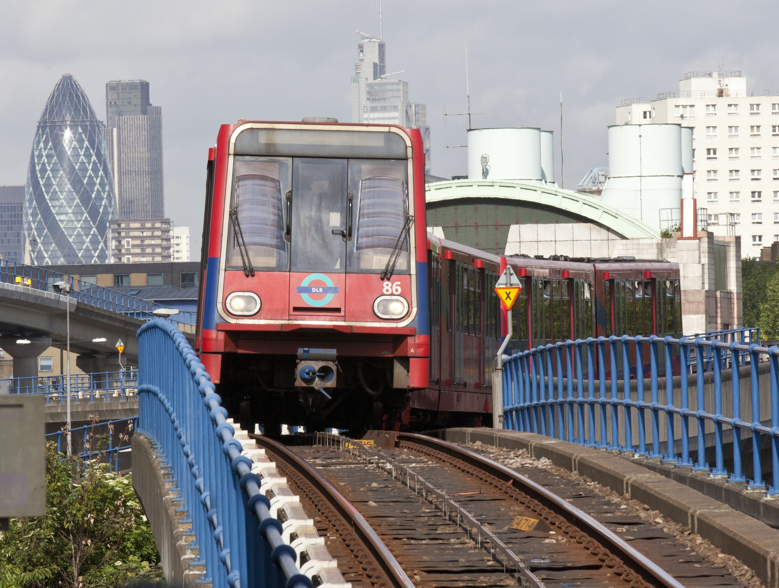
Voluntary and Community Sector Strategy 2020-2024
Next Steps
The VCS Strategy sets out a framework for action and will be implemented via a delivery plan approach developed by strategy partners. These partners include the VCS, led by THCVS, and statutory and private sector partners. This approach will translate the words of the strategy into action.
The work will be supported by a revised Cooperate-VCS Partnership structure. Cooperate is the key VCS partnership body in the borough. In the new structure, it will be co-chaired by the council’s Cabinet Member for Resources and the Voluntary Sector and the Chief Executive Officer of THCVS.
Meetings of Cooperate will bring together relevant partners and representatives of the wider VCS to take the strategic lead on delivering against VCS Strategy priorities, with task and finish groups taking the lead on who does what and when. A number of VCS forums will report to Cooperate under the new structure, including the new Tower Hamlets Community Sector Forum. These Forums will take specific VCS Strategy priorities and identify actions and solutions to address them.
The VCS Forums will seek to engage in this work key anchor organisations in the borough including the council, the NHS, registered providers of social housing, New City College, and the police, as well as the private sector, through organisations such as East London Business Alliance. This approach will ensure that the VCS and partners have ownership of the VCS Strategy and resulting actions, with the oversight of Cooperate. Cooperate will also engage with Tower Hamlets Partnership Executive Group (THPEG), which involves senior management from key stakeholder organisations in the borough, to ensure full engagement of the VCS Strategy with the Tower Hamlets Plan.

Slide 46
Voluntary and Community Sector Strategy 2020-2024
Next Steps
The VCS Strategy’s key priorities in its first year will be:
mapping VCS organisations and services in the borough to support the establishment of an on-line directory of VCS services and organisations. This directory should be hosted on local partner organisations’ web sites.
development of a borough volunteering plan
establishing an external funding strategy for the VCS
enabling VCS organisations with low levels of digital resources and skills to access digital training and equipment
increasing the VCS role in consultation and engagement, using its community roots to amplify residents’ voices
improved communications and engagement on policy development between the VCS and local statutory organisations. This should ensure that strategic decisions are influenced by the VCS at a community level.
The priorities for delivery in future years will be determined by Cooperate, working with the VCS Forums, and focusing on priority areas that have been highlighted in this strategy.

Slide 47
Voluntary and Community Sector Strategy 2020-2024
Making It Happen
Illustration of Cooperate-VCS partnership governance structure
Tower Hamlets Community Sector Forum (new)
Cooperate
Tower Hamlets Community Advice Network
Tower Hamlets Inter-Faith Forum
VCS Health and Wellbeing Forum
Voluntary Sector Children and Youth Forum
Tower Hamlets Partnership Executive Group (PEG)
Tower Hamlets Plan
2018-23
Tower Hamlets Voluntary
and Community Sector
Strategy 2020-24
Task and Finish Groups as required

Slide 48
Voluntary and Community Sector Strategy 2020-2024
How to Get Involved
Tower Hamlets Voluntary and Community Sector (VCS) Strategy has a vision of a diverse and thriving VCS working alongside residents, the council and partner organisations to achieve better outcomes for residents. If you would like to know more about the VCS Strategy for Tower Hamlets, or would like to become involved with the voluntary sector in Tower Hamlets, then please contact the London Borough of Hamlets or Tower Hamlets Council for Voluntary Service:
https://www.towerhamlets.gov.uk/lgnl/community_and_living/community_and_living.aspx
https://thcvs.org.uk/
vcs@towerhamlets.gov.uk
info@thcvs.org.uk

