Slide 1

Women’s Commission
Employment Evidence Pack

Slide 2
The Women’s Commission
The Women’s Commission was established by the Council in 2024 to investigate and address inequalities affecting women across the borough. It responds to the fact that outcomes for women fall behind men:
Gender Inequalities in Tower Hamlets
Women tend to spend fewer years in good health than men
Women’s employment rate is significantly lower, with Black, Asian and Multi-Ethnic women experiencing the greatest disadvantage.
Nearly double the percentage of women are in insecure jobs
Only 40 per cent of councillors are women.
Seventy-five per cent of domestic abuse survivors are women.
Ninety-five per cent of perpetrators of domestic violence are men.

Slide 3
Purpose and Scope of The Women’s Commission
The Women’s Commission represents a borough-wide commitment to addressing inequalities for women and ensuring all women can lead safe, healthy, and fulfilling lives.
A workshop was held with residents in June 2024 to identify four key priority areas:
Leadership
Safety
Health
Employment
Enabling and supporting women to take up decision making roles.
Gender inclusive design and feeling of safety in public spaces
Improving physical health, healthy eating, and pathways to health services
Removing barriers to secure and flourish within well-paid and fulfilling work

Slide 4
Engagement Approach – Let’s Talk Tower Hamlets Survey (1)
To explore the lived experience of women in leadership, the Commission conducted extensive consultation with residents across the borough:
Idea Store Whitechapel
Let’s Talk Tower Hamlets Survey
Supplementary Community Workshops
Themed Community Workshops
TH Town Hall x 2
The survey was hosted on Let’s Talk Tower Hamlets and was open for eight weeks.
Accessible survey: offered online, in print, in a simplified format, and translated into Bengali, with support
Promoted: council communication channels and community organisations
Monitoring: weekly, engagement strategies adapted for representation
Outreach: 7 stalls in 8 weeks, improving access for all women.
TH Women’s Awards
Muslim Women’s Health Fair
Overland Family Hub
Idea Store Chrisp Street

Slide 5
Engagement Approach – Community Workshops
To gain deeper insight into the lived experiences of women, the Commission convened community workshops.
From July to September 2025: two per theme delivered with local partners.
Participation: 118 women participated in community workshops overall with 21 attending Employment specific workshops delivered in partnership with Limehouse Project and East London Advanced Technology Training (ELATT).
Safe spaces: trusted venues, women-only, officer support.
Accessibility: inclusive venues, translators, participation packs.
Recognition: participants renumerated for time and contribution.
"I have found focus group as a safe zone for sharing some problems I am facing as a working woman"
Participant from ELATT
“…this session was quite an eye opener … I honestly enjoyed this session”.
Participant from Limehouse Project Workshop

Slide 6
Engagement Approach – Supplementary Workshops
The Commission delivered a series of supplementary workshops to ensure that women had the opportunity to share their lived experiences and to address lower engagement among specific groups.
Themes: health, employment, safety and community leadership.
Target groups: young women, digitally excluded, Asian (non-Bangladeshi) and Black women, women with disabilities, and LGBTQ+.
Delivered with partners: in safe, trusted spaces
Accessibility: inclusive venues, translation, participation packs.
Vietnamese, and Chinese women
Community of Refugees from Vietnam
Women with disabilities
Apasen and Look Ahead
Women of Black heritage
Bow Roman Catholic Church
Digitally Excluded women
St. Hildas and AgeUK
LGBTQ+ women
ELOP
Young women and girls
Youth Council and NumbiArts

Slide 7
Engagement Approach – Respondents Information (1)
In total, 303 women shared their lived experience with the Commission, 111 from the survey, 118 from community workshops and 74 from supplementary workshops.
Of the 303 women who engaged with the Commission, 257 shared information about their protected characteristics.
Engagement reflected a broad cross-section of women, with some overrepresentation in the 35–64 age group and underrepresentation for young girls aged 0-15 years.
Strong representation included:
33% identifying as disabled
14% aged 65 or older
* Percentages may not add up to 100% due to the ‘prefer not to say’ category.

Slide 8
Engagement Approach – Respondents Information (2)
Of the 303 women we spoke to, 136 (45%) spoke about employment. Seventy women engaged with us through the Survey, 21 from community workshops and 45 from supplementary workshops.
Women were from a range of backgrounds and largely followed the same pattern of representation as the Commissions overall respondent information.
* Percentages may not add up to 100% due to the ‘prefer not to say’ category.

Slide 9

Our Mission for Employment
The Commission seeks to help more women access employment and tackle gendered inequality across the sector. Presently, we know that women and young girls have unequal outcomes when compared to men and young boys:
Women’s employment rate (59.7%) is 25.8 percentage points lower than men’s. Black, Asian, and Multi-Ethnic women have an employment rate of 46.8%.
Two-thirds of men (66%) report working full time, compared to only 45% of women in Tower Hamlets.
Women earn around 29% less than men.
Creating lasting change means dismantling barriers to access, tackling structural discrimination, and ensuring equality across every sector.
To accomplish this, we have listened to women and their experiences to understand the barriers they face, the support they need, and the opportunities that must be created to ensure the borough is safe for all women.

Slide 10
Barriers to Job Opportunities
Seventy-one per cent of women who sought work in the past year reported negative experiences of finding a job in the borough, facing wide-ranging and often overlapping challenges:
Fragmented job searches: women had to search across multiple websites making it difficult to find job opportunities.
Job Advertisements: women reported rigid requirements and gendered working which discouraged them from applying, particularly among women who already face disadvantage (e.g. LGBT+ women)
Application process: unclear and complex processes left applicants uncertain about how to present their skills when they did not meet every listed requirement.
Limited flexibility: women noted a decline in available flexible work opportunities, including part-time, term-time, hybrid, remote or job-sharing roles, especially in sectors such as adult social care.
“I do believe that the concept of flexible working is slowly starting dropping from job descriptions…which is not feasible for mothers”
‘Be aware of the multiple responsibilities of women as carers, especially women of colour, Muslim and or Bengali woman who are looking after children, parents and in laws.”

Slide 11
Women Returning to Work
Women returning to work after career breaks, including mothers, carers and pensioners, reported that existing provision did not adequately meet their needs.
Existing provision: women noted that existing provision, such as training programmes or apprenticeships are often tailored for younger people.
Skills gaps: women highlighted the need for practical, accessible training tailored to adults re-entering the workforce, such as digital skills (i.e. Microsoft Excel, Outlook and Teams).
Lack of flexible options: The absence of short, flexible courses created barriers, particularly for women balancing caring responsibilities alongside the need to retrain and upskill.
‘Being a relatively new mother - I feel the having to report the gap in my employment (for maternity leave) is an instant negative to employers.
“Opportunities such as apprenticeships for mature individuals as most are aimed towards youngsters. This would be very helpful e.g. for women who have had career breaks”

Slide 12
Volunteering as a Pathway to Employment
Women viewed volunteering as a key stepping stone into paid work, helping them to gain experience, transferable skills and also confidence. However, they noted several barriers that limit the uptake of volunteering opportunities:
Limited opportunities: women noted a shortage of meaningful placements across the borough.
Barriers in access: lengthy or complex application processes were noted as creating additional challenges, as well as a lack of referral support.
Universal Credit constraints: Requirements for job applications limited time for volunteering, and volunteering experiences were not recognised as relevant work experience.
Women called for more accessible, flexible and skill-focused volunteering opportunities to make it a genuine route into employment.
”There’s not enough hands on experience for customer service or admin—it’s only possible through voluntary, so it’s unpaid, and you need to go through interviews, and there’s a lack of opportunities”
“Organisations ask for a lot of questions before applying, this makes it hard to have the time to apply—this is for both voluntary and paid positions. Not many organisations provide a reference, or certificate, or signpost to available jobs to volunteers”

Slide 13
Discrimination
Many women reported facing discrimination throughout the job application process, which affected both their ability to secure employment and progress within their roles.
Recruitment barriers: Women reported discrimination affecting hiring and promotion, including bias against those with childcare responsibilities and older women.
Workplace culture: sexual harassment and a biased, hostile working environment impacted the women we spoke to.
Intersectional challenges: discrimination often intersected with other protected characteristics such as race and religion.
“Employers do not need to know if women have children at home. It doesn’t make women less employable…”
‘As a women who wears Islamic clothing hijab and abaya, I fear not being able to get a job because of this.’

Slide 14
The Gender Pay Gap
Many women reported disparities in pay within organisations, with women often earning less than men for similar roles and responsibilities.
Pay disparities: women often earn less than men for similar roles, influenced by bias, part-time work and career breaks for caring responsibilities.
Impact on progression: reduced earnings were seen to limit opportunities for promotions, savings and economic independence.
Reinforcing inequality: women felt that unequal pay contributes to systemic disadvantage and persistent gender inequality in the workplace and wider life.
“My gender has stopped me from being promoted to senior leadership roles”
“For certain level of employment which includes senior positions and team leader roles it has been noted that more and more males are selected as opposed to women”

Slide 15
Creating an Inclusive Employment Sector
Women highlighted the need for an inclusive employment sector across the borough to tackle intersecting barriers and ensure women can participate fully in the job market.
Gender-related health support: lack of awareness and accommodations for women who struggle with menstrual conditions or menopause.
Barriers from workplace norms: prioritising uninterrupted careers, younger people, or full-time availability created challenges for women looking to re-enter into the workforce or those requiring flexible working arrangements.
Childcare support: Women shared that a lack of childcare support forces women into unemployment. Women noted that creche services are not enough.
To foster inclusivity, women noted that organisations should offer flexible career pathways, implement supportive policies and value all contributions regardless of background or identity.
Improved pathways to employment
Tackling Sexism
Menopause
Flexible Working
Progression Opportunities
Menstruation
Gender inclusive language
Supportive policies
Training opportunities
Addressing Bias
No Gender Pay Gap
Tackling Sexual Harassment

Slide 16
Summary (1)
Barriers to Job Opportunities Fragmented job listing pages, discoursing language in adverts, unclear application processes, and limited flexible opportunities.
Recommendations from women
One central job listing site advertising all opportunities in the borough.
Gender inclusive language on job descriptions.
Publicly available referral systems and mentorship opportunities.
Supporting Women Returning to Work Existing training and apprenticeship programmes often target younger people, leaving gaps for those seeking to retrain, refresh skills or re-enter the workforce.
Recommendations from women
Improved opportunities for women re-entering the workforce.
Relevant training programmes to upskill women.

Slide 17
Summary (2)
Volunteering as a Pathway to Employment Volunteering was viewed as an important stepping stone into employment, but women faced barriers such as limited placements, lengthy application processes and constraints by Universal Credit.
Recommendations from women
Simplify the application process for volunteering roles.
Centralised site with volunteering opportunities across the borough.
Publicly available referral systems and mentorship opportunities.
Workplace Discrimination Discrimination during recruitment processes and in the workplace, including sexual harassment and biases about hiring or promoting women, particularly those with childcare responsibilities or older workers.
Recommendations from women
Call for employers to recognise and address their bias in recruiting women from all backgrounds.
Organisations, their leaders and men holding themselves accountable for discriminatory workplace culture.

Slide 18
Summary (3)
The Gender Pay Gap Women reported earning less than men, often due to part-time work, career breaks or caregiving.
Recommendations from women
> Understand and tackle disparities in pay and progression between men and women.
Creating an Inclusive Workplace culture Inclusive workplace cultures are often lacking, with current practices failing to support diverse needs, including gender-related health issues like menopause and menstrual conditions.
Recommendations from women
Commitment and action to tackling discrimination and bias within the workplace and job market more generally.
Flexible working opportunities and childcare support for women seeking to progress whilst having additional responsibilities such as caring duties.
Acknowledging and making accommodations for women related health issues within the workplace.

Slide 19
Sources
Department of Health and Social Care (2021). Health Profile for England: Chapter 1 – Life expectancy and healthy life expectancy. London: UK Government. Available at: https://www.gov.uk/government/publications/health-profile-for-england/chapter-1-life-expectancy-and-healthy-life-expectancy
Women’s Budget Group (2023). Women and the Labour Market. London: WBG. Available at: https://www.wbg.org.uk/publication/women-and-the-labour-market
UK Government (2023). Employment by Ethnicity. Ethnicity Facts and Figures Service. Available at: https://www.ethnicity-facts-figures.service.gov.uk/work-pay-and-benefits/employment/employment/latest
Lancaster University (2023). New study shows working women at sharp end of cost-of-living crisis, with 26% trapped in severely insecure work. Lancaster: The Work Foundation. Available at: https://www.lancaster.ac.uk/news/new-study-shows-working-women-at-sharp-end-of-cost-of-living-crisis-with-26-trapped-in-severely-insecure-work
Office for National Statistics (2024). Domestic abuse victim characteristics, England and Wales: year ending March 2024. London: ONS. Available at: https://www.ons.gov.uk/peoplepopulationandcommunity/crimeandjustice/articles/domesticabusevictimcharacteristicsenglandandwales/yearendingmarch2024
Women’s Aid (2023). Domestic abuse is a gendered crime. London: Women’s Aid Federation of England. Available at: https://www.womensaid.org.uk/information-support/what-is-domestic-abuse/domestic-abuse-is-a-gendered-crime
Tower Hamlets (2024). Tower Hamlets’ Borough Equality Assessment 2024-2026. Available at: https://share.google/SUdzfKcRHixfZ5fZI
Sports England (2022). Active Lives Children and Young People Survey Academic Year 22/23. Available at: www.activelives.sportengland.org
Office for National Statistics (2021). Census 2021. Available at: https://www.ons.gov.uk/census
Office for National Statistics (2021). Census 2021. Available at: https://www.ons.gov.uk/census
Tower Hamlets (2024). Tower Hamlets’ Borough Equality Assessment 2024-2026. Available at: https://share.google/SUdzfKcRHixfZ5fZI
Tower Hamlets Equality Policy 2023-2027. Available at: https://www.towerhamlets.gov.uk/lgnl/community_and_living/Equalities_in_Tower_Hamlets/Tower-Hamlets-Equality-policy.aspx (Accessed: 27 October 2025).

Slide 20


Supporting Women in Employment – The Limehouse Project’s Experience
Tower Hamlets Women’s Commission
Farida Yesmin

Slide 21
Introduction
At Limehouse Project, we believe every woman deserves the chance to thrive — in her home, community, and career.
Our work supports women to gain confidence, develop skills, and access real employment opportunities.
This presentation shares our journey: what we’ve done, what we’ve learned, and how we can work together to make Tower Hamlets a place where women’s ambitions are realised.

Slide 22
What We Do – Empowering Women to Move Forward
Many women come to us unsure where to begin — limited English, little or no recent work experience, and low confidence.
We offer a safe, supportive environment where they can rebuild confidence, learn new skills, and explore opportunities.
Through holistic IAG, confidence building, skill development, and tailored employment pathways so the women progress from isolation to independence
Every woman receives individual guidance to match her aspirations and overcome personal and structural barriers.

Slide 23
The TIDE Model – Supporting Women into Employment
Tackling Barriers
One-to-one support to overcome personal, skills, and confidence challenges.
Identifying Needs
Assess strengths, goals, and training needs.
Create personalised SMART action plans to track progress.
Developing Skills
Build confidence through employability and business workshops.
Connect women to external partners like WorkPath for job brokerage and other employment opportunities
Provide post-employment support to sustain progress.
Enabling Opportunities
Support with CVs, interviews, and job matching.
Encourage networking and peer learning to build confidence.
Our belief: Every woman can reach her potential with the right, tailored support.

Slide 24
Barriers – What Women Tell Us
“I want to work, but I have no childcare and don’t know where to start.”
Many women face language barriers, low confidence, and isolation after years outside the workforce.
Digital skills gaps and lack of local opportunities limit progress.
Cultural pressures and fear of discrimination affect women’s career choices.
Learning: Trust, empathy, and safe, women-only spaces are key to engagement and long-term success.
Health and Wellbeing Factors, Physical or mental health challenges linked to poverty, isolation, or caring stress

Slide 25
Impact and Achievements in 2024-2025
441 learners supported through Education, Training & Employment programmes.
161 completed training on E-Commerce & Employability Workshops
390 learners completed basic skills training
206 gaining qualifications
92% of participants reported improved confidence and motivation.
88% progressed into further training, volunteering, or employment.

Slide 26
Example of a Successful Project – Childcare Plus (CC+)
Supported 500+ unemployed women, mainly of Bangladeshi and Somali origin.
Targeted women furthest from employment — with low skills and cultural barriers to work.
Delivered an integrated programme of personal development, employability, and childcare vocational training.
Helped participants gain qualifications and move into jobs in nurseries and schools.
Key Outcomes:
501 women supported, 85% aged 26–45.
50 women gained sustainable employment.
101 women engaged in volunteering (68% above target).
90% completed non-accredited training; 86% gained accredited qualifications.
Winner of Women in Housing Award for “Improving the Lives of Women or Communities.”

Slide 27
Example of a Successful Project – New Horizon
Designed for women balancing heavy caring and domestic responsibilities who can’t access traditional 9–5 roles.
Responded to growing interest in home-based work and online entrepreneurship.
Funded by Santander Foundation (3 years).
Programme Highlights:
Provided entrepreneurial and financial skills training for women to monetise existing talents — sewing, cooking, beauty, crafts, and online retail.
Built digital literacy, business confidence, and financial awareness.
Empowered women to explore flexible, self-employed opportunities compatible with family life.
Created pathways to economic independence and empowerment for women previously excluded from the labour market.

Slide 28
Recommendations
Invest in
Invest in affordable, flexible childcare linked to training and employment.
Invest in
Invest in ESOL, digital and other sector-specific training that offer shorter pathways to employment
Promote
Promote women's entrepreneurship and flexible working models.
Sustain
Sustain funding for trusted community-led programmes.
Recognise
Recognise community organisations as key partners in women's empowerment.
Establish
Establish a Tower Hamlets Women's Employment Network to share best practices and learning.

Slide 29
Tower Hamlets Women’s Commission November 17th 2025 Cllr. Musthak Ahmed Cabinet Member for Growth, Skills & Employment

Slide 30
Women’s Commission: Employment
Employment gap, pay gap, lack of flexibility remain key challenges.
Cultural expectations & invisible labour
Health and employment are linked (menstrual health, menopause, mental wellbeing)
Extremist ideologies threaten equality

Slide 31
Key Recommendations
Improve access to employment information: Centralise job listings and volunteering opportunities. Use gender-inclusive language and simplify application processes.
Support women returning to work: Expand flexible, adult-focused training. Co-design digital skills and modular learning with providers.
Tackle workplace discrimination and bias: Audit recruitment and pay practices. Promote inclusive policies around health, caregiving, and progression.

Slide 32
Build on What Works
Listening → Leading → Action
Growth Spurt & Career Returner’s Toolkit
Skills and Adult Learning Services: digital & vocational training
Bespoke support and employer engagement

Slide 33
How We Support Women
Tailored Programmes: Local Supported Employment, Individual Placement & Support in Primary Care, Connect to Work
Flexible learning for caregivers
Health & wellbeing & personal development integrated into service delivery
Employer engagement including pledges for inclusivity and flexibiity
Tailored ESOL & digital skills

Slide 34
Outcomes & Impact
Training type | No. of women completed
Employability | 273
Sector Specific | 18
BKSB | 7
Mental Health & Wellbeing | 2
Digital Skills | 2
Functional Skills | 2
Total | 304
42% of all clients currently supported by Workpath are women.
55% of clients that have completed a training programme since April 2025 have been women.
Of these, 32% have completed their training courses. Averaging better than our male clients who have achieved a 27% completion rate.
45% of women clients into work
Need to better measure “distance travelled” outcomes.

Slide 35
Case Study 1 - Laura
In the past I have worked as an English tutor, babysitter, carer and cleaner for a few months.
I was looking for an entry level office job. Some of the obstacles I faced in securing employment included childcare and mental health problems such as anxiety and depression.
Women In Prison UK as an employer were willing to use alternative recruitment methods such as a task-based interview rather than traditional methods to assess a client's capabilities. This was an ideal opportunity for clients to showcase their skills where they would otherwise be overlooked.

Slide 36
Case Study 2 - Nasrat
Nasrat enjoyed an unpaid nursery placement during college but left after completing required hours. She struggled with lack of purpose and depression. She worked briefly in a café, then faced a year-long cycle of unemployment due to childcare qualifications barrier. Nasrat met a Supported Employment Officer at a Youth Fair in Feb 2024; gained reassurance and trust through flexible, client-led approach. Support included confidence building, maintaining control, and tailored guidance toward employment goals.
I was assisted with: Requesting my National Insurance number again, CV support, Advised of more training (Phlebotomy, Confidence boosting workshops), Job search, - Interviews, - And so much more …
…I have had my confidence boosted so much that I’ve been able to regain my life again and am now employed as Nursery Practitioner through sourcing my own work. This has all happened due to IPSPC supporting me in ways that are unique to my needs.

Slide 37
Learning from Others
Hopscotch Women’s Centre
Culturally aware
QED Foundation’s Job Steps
Locally embedded
Hopscotch Women’s Centre
Strong employer links

Slide 38
Three Areas for Impact and How We Make it Happen
Three Areas for Impact
Flexible, inclusive employment pathways Jobs designed to fit women’s lives—recognising caring responsibilities and health needs.
Workplace culture & employer engagement Go beyond recruitment reform—embed flexibility, progression, and inclusion as the norm.
Health & wellbeing in employment Make health equity central: menstrual health, menopause, mental wellbeing, and caregiving.
How We Make It Happen
Lead by example: Inclusive recruitment, progressive training, and workplace culture.
Collaborate with employers: Co-design practical, real-world solutions.
Provide tools: Toolkits, training modules, and policy templates for measurable change.
Secure commitment: Shared vision backed by clear actions and transparent reporting.
Keep listening: Lived experience shapes strategy and delivery.

Slide 39
Next Steps
Refine strategy
Develop action plan
Engage employers
Monitor progress

Slide 40

Barts Health NHS Trust
NHS Trust operating 5 hospitals across the City of London
and East London – largest single employer in the area with 18,000 staff
Prioritising hires from local talent pools in disadvantaged communities
Premise is to maximise role as a large/anchor employer to raise employment rates in areas local to our 5 hospitals - local populations can supply labour for lower banded roles (Admin, HCA/Support, MLA etc.)
Drivers include a workforce that reflects the community – a culturally, linguistically and faith sensitive workforce aids service improvement and provides health benefits for both candidates and patients. Local candidates live closer to work and are more likely to live in affordable housing which supports job retention
Work to maximise community benefits from procurement/social value including capital programmes such as the Whipps Cross redevelopment and Life Science
11 women from Tower Hamlets secured work in the past 12 months
7 women were employed at the Royal London Hospital
B2-3s roles are ring fenced for a week. Include clinical and corporate admin and support roles
Candidates are strengthened prior to hiring via pre-employment training and placements
A pool of local people is created through partnerships with local authorities, RSLs, JCP, FE colleges
New Project Search cohort at RLH site for Tower Hamlets residents
84
Job outcomes in the 2024-25 programme evaluation
Majority of outcomes are from BAME backgrounds (63%)
10% offered jobs have declared disabilities

Slide 41
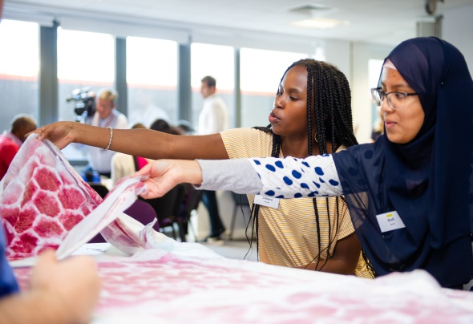
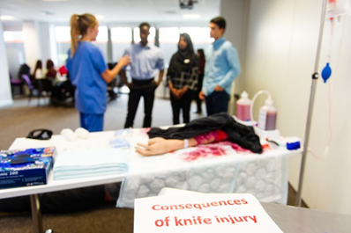
Healthcare Horizons programme
Healthcare Horizons
Linking with local schools and colleges in East London providing careers and employment programme for local young people
Our key aim is to promote health careers among local communities, and help young people embark on their career journey but also to:
Increase awareness of NHS careers and career pathways
Raise career aspirations among local communities
Promote the Trust as a local employer of choice
Improve careers advice and guidance provided to young people in relation to health careers
Improve life chances for young people from deprived and excluded backgrounds
Increase employment opportunities for local young people via bespoke pre-employment programmes

Slide 42
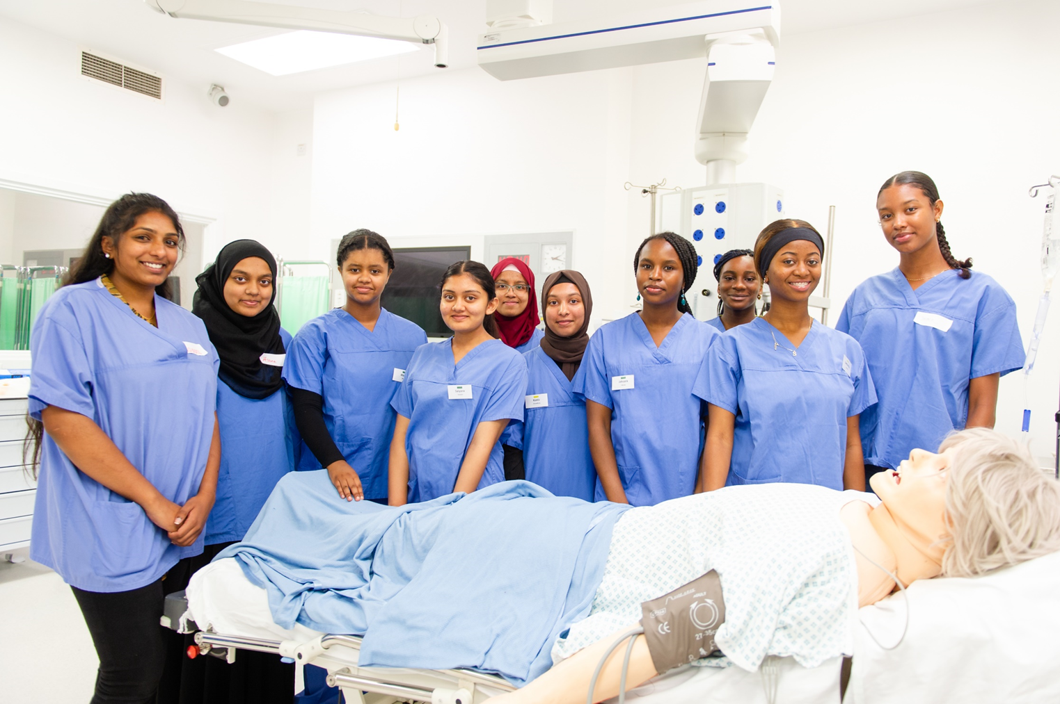
Healthcare Horizons (1)
Linking with local schools and colleges in East London providing careers and employment programme for local young people
Healthcare Horizons programme
Our offer:
Years 10-13 (14-19 year olds) | Career events (Trust, schools, virtual) Barts Health summer school Face to face work experience Parents’ evenings to increase awareness of existing career pathways Virtual work experience platform Online mentoring programme
17-30 year olds | New2Admin pathway (pre-employment training programme with focus on entry level admin positions at the Trust)
18-30 year olds | New2Care pathway (HCA recruitment of young people with no previous care experience)

Slide 43

Healthcare Horizons programme
Linking with local schools and colleges in East London and with young people not in education, employment or training (NEETs)
Bespoke Tower Hamlets programme (Extended placement scheme):
The pathway supported young people into jobs within the NHS and Primary Care via offering paid placements of up to 3 months.
The opportunities were open to 18-30 year olds living in TH particularly within the following underrepresented groups:
Experiencing poverty and deprivation
From BAME with particular focus on Somali and Bangladeshi women
Unemployed, NEETs or in insecure employment
The scheme increased candidates’ chances of securing work which ultimately altered their benefit status and raised their socio-economic status.
The scheme offered wider benefits related to financial autonomy, confidence, skills and empowerment gained through the exposure of working in a professional environment.
Majority of participants from BAME and not having connections with health professionals
90 girls from TH schools attended face to face work experience since Apr’24
Barts Health NHS Trust
27 women from TH supported into employment since Apr’24
14 Tower Hamlets schools/ colleges enrolled
Extended placement scheme offered paid opportunities to 38 participants
25 participants secured employment after placement completion

Slide 44

Case study- Sophie
Background and decision to start the programme
Sophie had gaps in her employment and had been unemployed for around 6 months prior to applying to the programme. She had never really known much about jobs in health care, neither was interested in health-related jobs when she was at school. She has no relatives working in the sector but seeing her mum’s caring nature towards her terminally ill grandfather was a true inspiration for her. This made Sophie interested in a nursing career. She was referred to the programme by her job coach.
“As soon as I found out about the training, I was very eager to begin, I was unemployed, and I wasn't studying so I really wanted to start straight away.”
Impact of the programme
Once she had completed the New2Care training, Sophie was successful at securing a Healthcare Support Worker at Barts Health NHS Trust. She absolutely loves her current role and the way she is treated by her co-workers and patients. She feels appreciated for what she does but also notices changes on a personal level:
“I think my favourite thing that has changed for me is my confidence. I used to be shy, and I was quite introverted (…) this job has really forced me to come out of my shell. I am so thankful for it”.
Sophie states that if it wasn’t for the training, she would have probably been working in retail, but she has never had any regrets about embarking on this journey and starting her new career pathway. She is constantly developing, learning new skills and feels that there are always new opportunities to progress her knowledge and career further. She feels very happy and fulfilled in her job.
She speaks very highly of the New2Care programme and the Healthcare Horizons team
“I would 100 percent recommend the New2Care program as I think it is really amazing and helpful. I was constantly learning and improving (…) if it wasn't for this program and the people working behind the scenes to make everything happen; myself and so many others that they have worked with would be out of work and wouldn't be where we want to be in life right now. I can't say how pleased I am with the help provided by the staff”.

Slide 45

Q+A
Barts Health NHS Trust

Slide 46
Tower Hamlets Women’s Commission 17th November 2025

Slide 47
Agenda
Key facts about Vistry:
At Vistry, we’re building more than homes — we’re building communities, opportunities, and a more inclusive construction sector.”
Leading UK housebuilder, multi-tenure model ￼
Strong track record in partnerships and social value.
Meet the Leaders
Farrah Hussain
Caroline Richardson
How Vistry Supports Women in Construction
Key Support Areas
Impact Achievements and Metrics
Gender Pay Gap
Skills Academy Success
Sustained Partnerships
Recognition
Community Engagement
Development Overview Harriot, Aspley and Pattison (HAP) Development

Slide 48
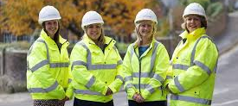
Key Facts Vistry

Slide 49
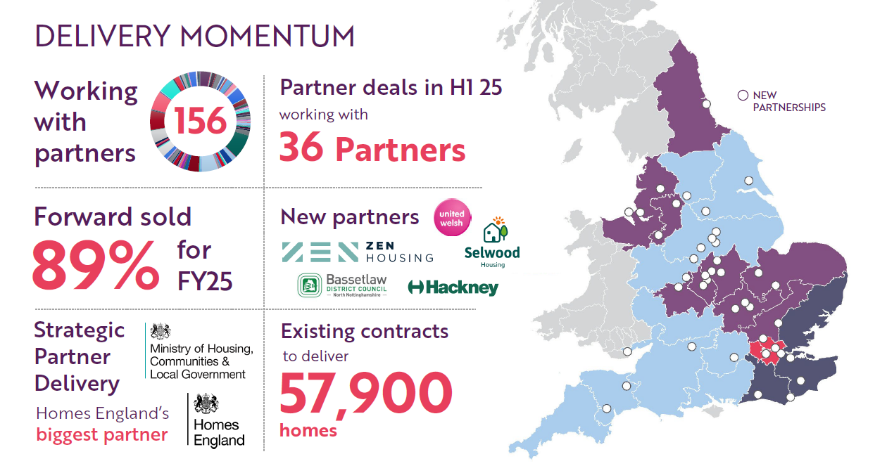
Vistry Group Update

Slide 50
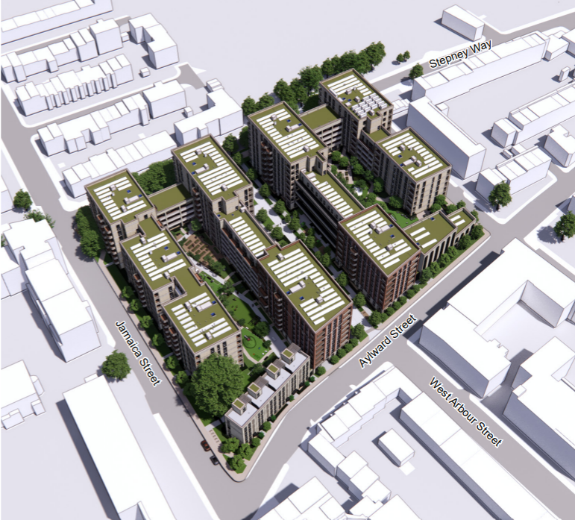
Development Overview
Full planning application approved
407 new homes, 43% affordable.
Blocks range from 6 to 8 storeys in height
New Redcoat Community Centre & Mosque
Block B2
Block B1
Block B3
Block A1
Block A2
Block B6
Block A3
RCCM
Block A7
Block B5
Phase 1:
64 replacement homes for LBTH
45 additional affordable homes for LBTH
Block A4
Block A6
Block A5
Phase 2:
66 additional affordable homes for LBTH
232 open market / BtR homes

Slide 51
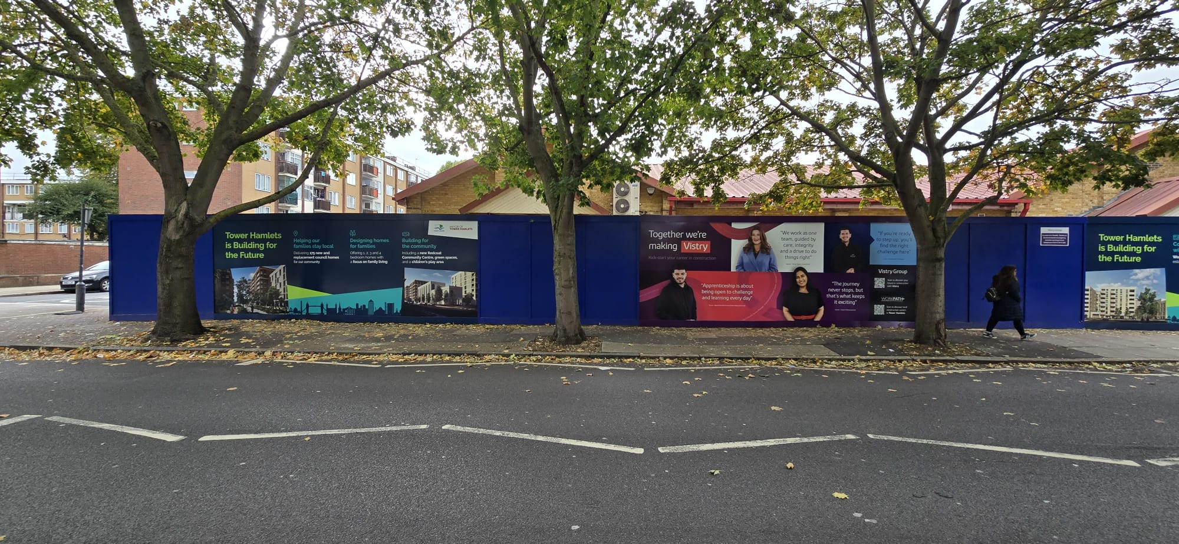
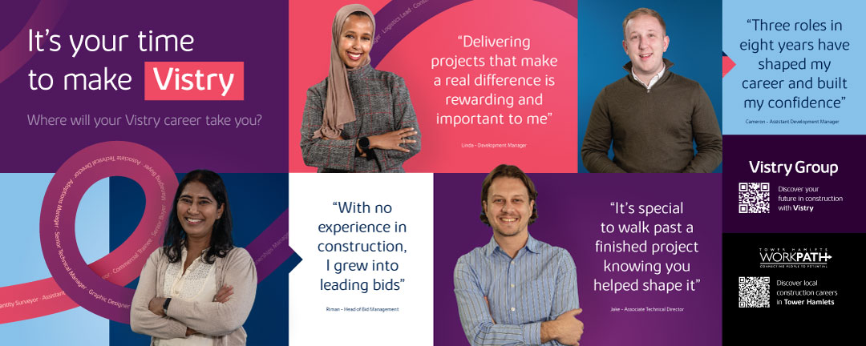
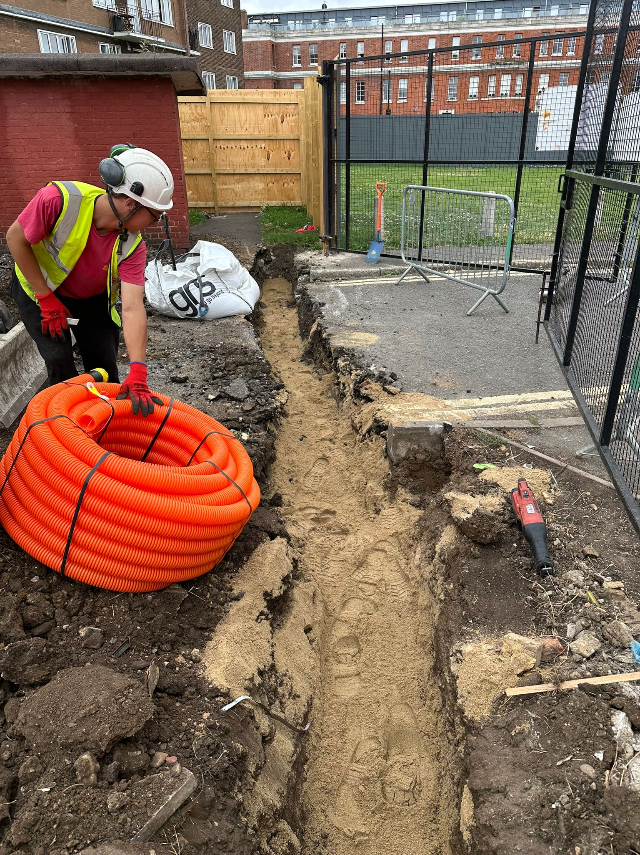
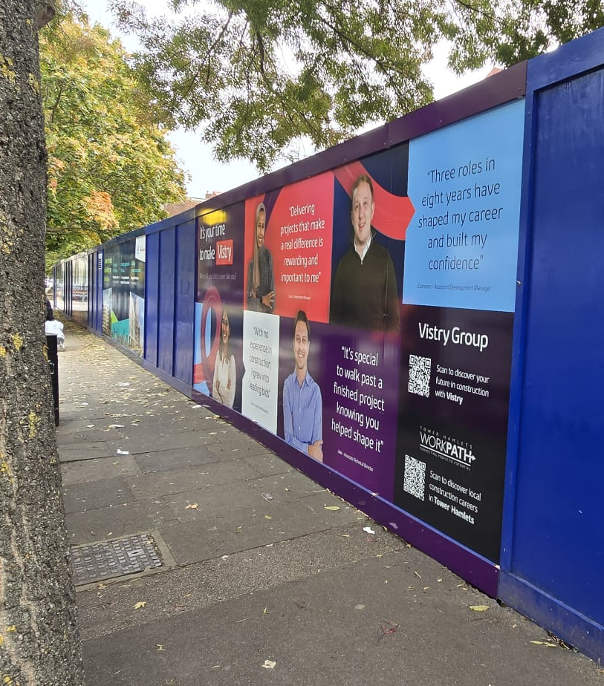
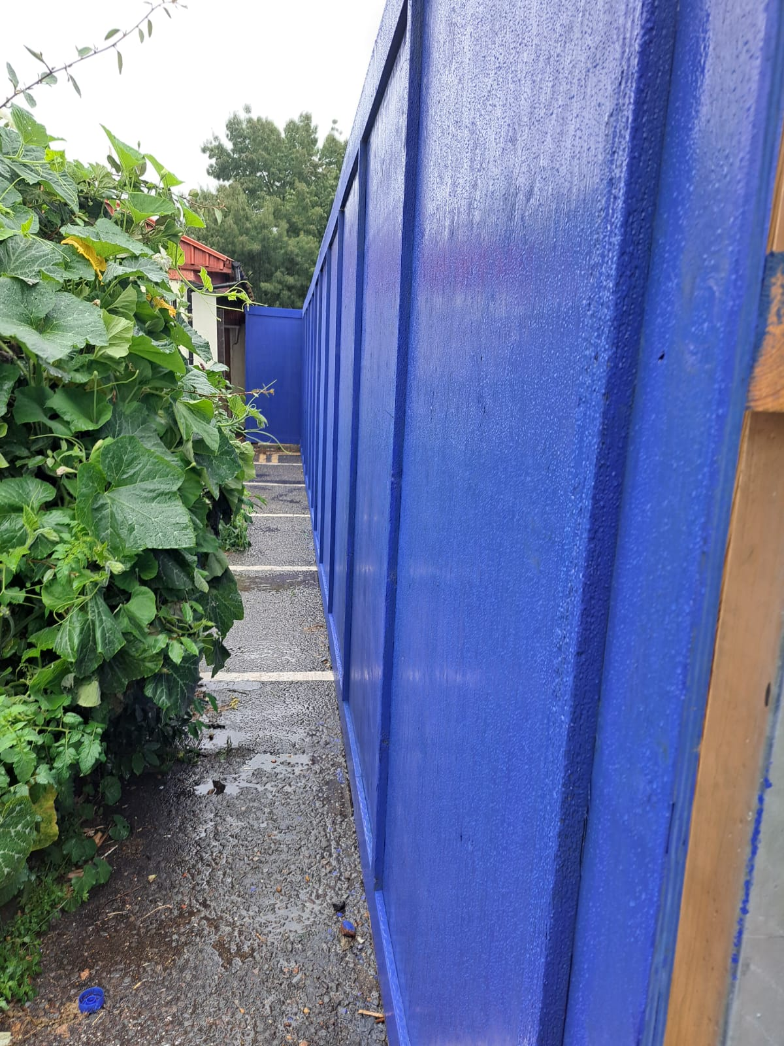
Representation on site

Slide 52
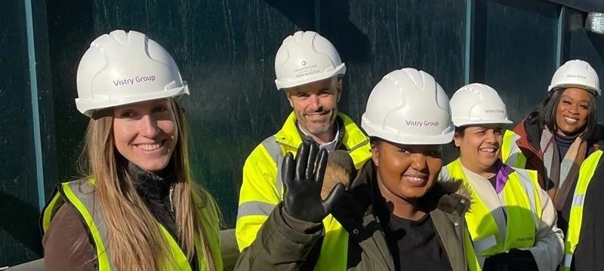
Meet the Leaders

Slide 53

Farrah Hussain
Role: Head of Development, Countryside Partnerships (part of Vistry Group) ￼
Bio:
Farrah holds a Master’s in Urban Planning & Development Management and has built a strong career in regeneration and strategic housing development. She joined Countryside Partnerships (Vistry) in a senior development role and now is a Heads of Development East London / Partnerships division. ￼
She has played a key role in flagship sites, such as Beam Park, one of Vistry’s major developments. ￼
Farrah’s leadership and impact in the sector have been recognised via her shortlisting for major industry awards (e.g., Housebuilder Star Award).

Slide 54
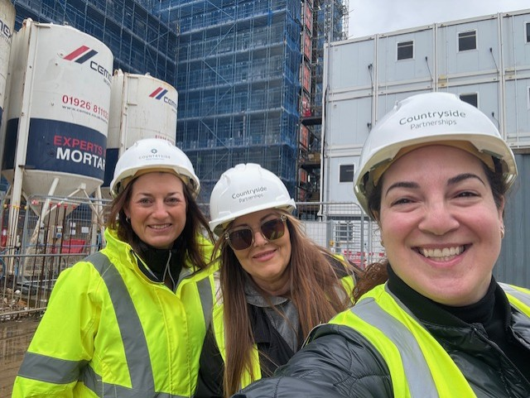
Caroline Richardson
Role: Divisional Head of Social Value, Vistry Group
Bio:
Caroline is leading strategies that deliver lasting benefits to communities through education, employment, sustainability, and stakeholder engagement.
She is champion for diversity and inclusion, driving initiatives like career fairs, volunteering programs, and partnerships with schools to inspire future talent and create opportunities.
Industry advocate for culture change, sharing insights on social value and inclusive development through forums and podcasts, promoting responsible growth and environmental stewardship.

Slide 55
How Vistry Supports Women into Construction

Slide 56
Overall
Women-Only Skills Pathway: Vistry (via Countryside Partnerships) runs a women-only “Pathway to Site” in partnership with training provider Train 4 All. ￼
Partnership with Women into Construction: Vistry supports placements, site visits, and mentorship in collaboration with Women into Construction.
Industry-Wide Engagement: Works with the Home Builders Federation’s “Women into Home Building” cohorts to open doors into site management and construction roles.
Apprenticeships & Training: Promotes degree apprenticeships and practical site-based training for female colleagues and new entrants.
Diversity Embedded in Policy: Strong inclusion goals in Vistry’s people strategy; people development is a core part of Vistry’s culture.

Slide 57
Key Support Areas for Women
Diversity & Inclusion Culture
Formal D&I policy covering the whole organisation
Active Women’s Network offering community, events, mentoring and peer support
Leadership & Career Progression
Women in Leadership development programmes (multiple cohorts)
Mentoring programmes focused on supporting senior women
Career pathways supported through apprenticeships, traineeships and graduate schemes
Inclusive Recruitment
Diverse interview panels
Unconscious bias training for managers
Reviewed and improved job adverts to encourage more women applicants
Flexible & Family-Friendly Working
Agile working options (part-time, job share, flexible patterns)
Enhanced maternity support
Menopause guidance and wellbeing resources
Support for returners after maternity or long-term absence
Monitoring & Accountability
Annual gender pay gap reporting and action plans
Monitoring diversity of applicants, promotions and employee experience
Visibility & Role Models
Promoting stories of women in non-traditional and senior roles
Showcasing women’s achievements to inspire internal and external audiences

Slide 58
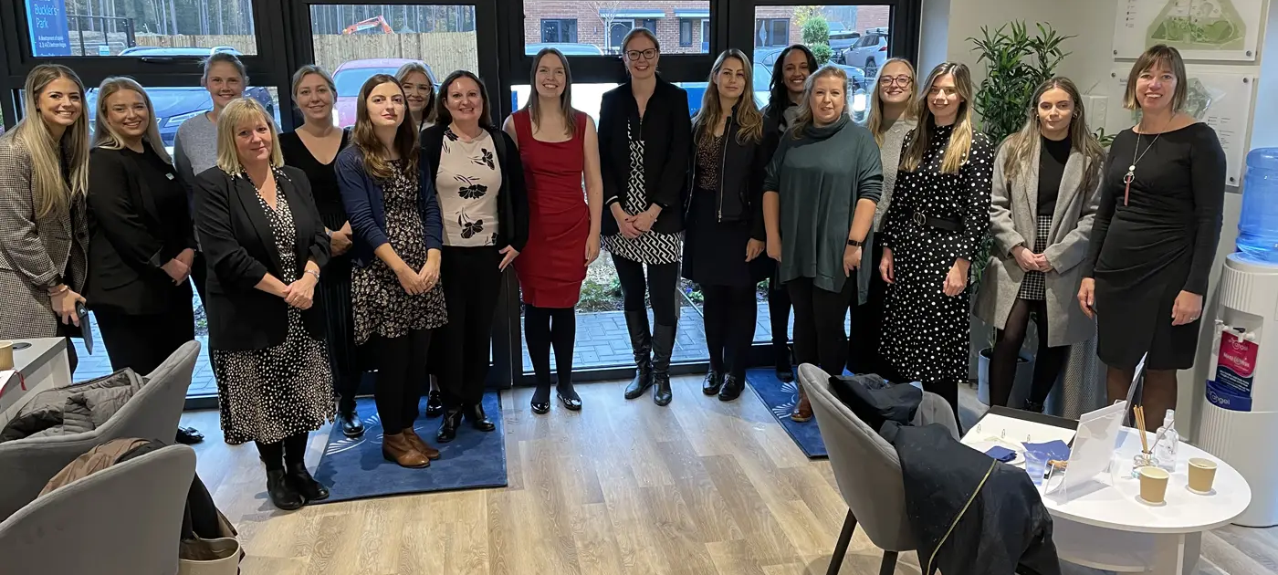
Impact: Achievements & Metrics

Slide 59
Impact: Achievements & Metrics (1)
Gender Pay Gap (2024): Vistry reports a mean gap of 16.3% and a median of 19.9%.
Vistry Group has 34% female employees, significantly higher than the industry average of 15%.
Skills Academy Success: Women-only pathway delivered via Vistry’s Skills Academy (Train 4 All) offering hands-on training and route into site roles.
Sustained Partnerships: Multi-year commitment with Women into Construction to support ongoing cohort placement and career development.
Recognition: Farrah Hussain shortlisted / recognised in industry awards (Housebuilder Star) for her development leadership. ￼
Community Engagement: Under James Colwell, Vistry has participated in initiatives like workplace visits, training outreach, and employment events (e.g., Barking Riverside).

