Slide 1

Tower Hamlets Women’s Commission
Health Formal Public Review
Thursday 23rd October 2025

Slide 2

Women’s Commission
Health Findings
For further information, please contact:
Claire Christopher, Senior Strategy and Policy Officer
Claire.Christopher@towerhamlets.gov.uk

Slide 3
The Women’s Commission
The Women’s Commission was established by the Council in 2024 to investigate and address inequalities affecting women across the borough. It responds to the fact that the outcomes for women fall behind their male counterparts:
Gender Inequalities in Tower Hamlets
Women tend to spend fewer years in good health than men
Women’s employment rate is significantly lower, with Black, Asian and Multi-Ethnic women experiencing the greatest disadvantage.
Nearly double the percentage of women are in insecure jobs
Only 40 per cent of councillors are women.
Seventy-five per cent of domestic abuse survivors are female
Ninety-five per cent of perpetrators of domestic violence are male.

Slide 4

Purpose and Scope of The Women’s Commission
The Women’s Commission represents a borough-wide commitment to addressing inequalities for women and ensuring all women can lead safe, healthy, and fulfilling lives.
A workshop was held with residents in June 2024 to identify four key priority areas:
Leadership
Safety
Health
Employment
Enabling and supporting women to take up decision making roles.
Gender inclusive design and feeling of safety in public spaces
Improving physical health, healthy eating, and pathways to health services
Removing barriers to secure and flourish within well-paid and fulfilling work

Slide 5
Engagement Approach – Let’s Talk Tower Hamlets Survey
To explore the lived experience of women in leadership, the Commission conducted extensive consultation with residents across the borough:
Idea Store Whitechapel
Let’s Talk Tower Hamlets Survey
Supplementary Community Workshops
Themed Community Workshops
TH Town Hall x 2
The survey was hosted on Let’s Talk Tower Hamlets and was open for eight weeks.
Accessible survey: offered online, in print, in a simplified format, and translated into Bengali, with support
Promoted: council communication channels and community organisations
Monitoring: weekly, engagement strategies adapted for representation
Outreach: 7 stalls in 8 weeks, improving access for all women.
TH Women’s Awards
Muslim Women’s Health Fair
Overland Family Hub
Idea Store Chrisp Street

Slide 6
Engagement Approach – Community Workshops
To gain deeper insight into the lived experiences of women, the Commission convened community workshops.
From July to September 2025: two per theme delivered with local partners.
Participation: 118 women participated in community workshops overall, with 35 attending Health specific workshops delivered in partnership with SocietyLinks and Sister Circle.
Safe spaces: trusted venues, women-only, officer support.
Accessibility: inclusive venues, translators, participation packs.
Recognition: participants renumerated for time and contribution.
"The discussion that were held amongst everyone was enlightening. We felt that we were being listened to and all feedback was being taken on board"
Participant from Sister Circle workshop
“We definitely felt heard. Everyone was very vocal and did not hold back. Friendly people running and delivering the event”.
Participant from SocietyLinks workshop

Slide 7
Engagement Approach – Supplementary Workshops
The Commission delivered a series of supplementary workshops to ensure that women had the opportunity to share their lived experiences and to address lower engagement among specific groups.
Themes: health, employment, safety and community leadership.
Target groups: young women, digitally excluded, Asian (non-Bangladeshi) and Black women, women with disabilities, and LGBTQ+.
Delivered with partners: in safe, trusted spaces
Accessibility: inclusive venues, translation, participation packs.
Vietnamese and Chinese women
Community of Refugees from Vietnam
Women with disabilities
Apasen and Look Ahead
Women of Black heritage
Bow Roman Catholic Church
Digitally Excluded women
St. Hildas and AgeUK
LGBTQ+ women
ELOP
Young women and girls
Youth Council and NumbiArts

Slide 8
Engagement Approach – Respondents Information
In total, 303 women shared their lived experience with the Commission, 111 from the survey, 118 from community workshops and 74 from supplementary workshops.
Of the 303 women who engaged with the Commission, 257 shared information about their protected characteristics.
Engagement reflected a broad cross-section of women, with some overrepresentation in the 35–64 age group and underrepresentation for young girls aged 0-15 years.
Strong representation included:
33% identifying as disabled
14% aged 65 or older
* Percentages may not add up to 100% due to the ‘prefer not to say’ category.

Slide 9
Engagement Approach – Health Respondents Information
Of the 303 women we spoke to, 198 (65.3%) spoke about Health. Eighty-nine women engaged with us through the Survey, 35 from community workshops and 74 from supplementary workshops.
Women were from a range of backgrounds and largely followed the same pattern of representation as the Commissions overall respondent information, but with a higher proportion of carers.
**Percentages may not add up to 100% due to the ‘prefer not to say’ category.

Slide 10

Our Mission for Health
The Commission seeks to support and enable more women to access a healthy lifestyle across the borough. Presently, we know that women and young girls have unequal outcomes with regard to health when compared to men:
Only 6% of young girls in the borough achieve the recommended 60 minutes of physical activity a day, compared to 32.4% of boys in Tower Hamlets.
Women live fewer years in good health (57.8 years) in Tower Hamlets compared to men in the borough (65.3 years).
To help tackle this, we have listened to women and their experiences to understand the barriers they face, the support they need, and the opportunities that must be created to make accessing a healthy lifestyle accessible across Tower Hamlets.

Slide 11
Healthy lifestyles
Women in Tower Hamlets described a healthy lifestyle as more than physical wellbeing but including:
Happiness
Quality of life
Strong social connections.
Living conditions
Overall, a healthy lifestyle was strongly connected to physical and mental wellbeing, a good quality of life, social connection and living conditions.
Healthy Relationships
Physical Activity
Quality of Life
Period Equity
Social Connection
Family Connections
Wellbeing
Living Conditions
Good Food
Independence
Basic Living Essentials
Housing Quality
Mental Health
Happiness
Green Spaces

Slide 12
Being heard and taken seriously
“I’ve had to be really persistent just to have my health concerns taken seriously. It makes me wonder—would I have to fight this hard if I weren’t a woman?”
Being Heard and Taken Seriously
Dismissal by GPs/health professionals.
Delayed diagnoses.
Reactive care
Reproductive and sexual health
Lack of appropriate information.
Inadequate support and limited services.
Poor pain management
“... I had been struggling with bad Premenstrual Dysmorphic Disorder and…the doctor wasn’t great. She didn’t seem to care about my symptoms or offer any explanation”

Slide 13
Barriers to Health Information
Women noted barriers to accessing clear, appropriate and accessible forms of health information.
English as a second language
Digitally excluded women
“If it (health information) came through my door, I don’t think I’ll even look at it. It’s litter.”
Communication challenges with GPs and healthcare professionals were also common.
Limited time in appointments
Lack of follow-up
Questions often dismissed.
Older women reported ageism, with staff minimising their need for information.
“So much information is now online! [but] ow about all those residents for whom English is not their first language? And older people who are not tech savvy?”

Slide 14
Accessing Healthy Food
Women described healthy eating as central to a healthy lifestyle, linking it to fresh, organic, chemical-free food, balanced nutrition and home-cooked meals.
Barriers limited women's ability to access healthy food:
High cost of fresh and organic produce
Unequal access to fresh produce across neighbourhoods
Frequent trips to the supermarket
Barriers meant that many women turned to more convenient but less nutritious food options. Women emphasised the importance of supporting residents to grow their own produce through allotments and partnering with schools and food banks.
“I’m pre-diabetic [and] fairly well informed, I’m part of forums, [but I] can’t afford range of food: seeds, nuts”
“I have to get the bus to a market with fresh produce – it is difficult with children as you have to find the bus fair for them too”
“Residents should be empowered to grow their own food and this needs to be supported by housing associations”

Slide 15
Physical Activity (1)
Many women face barriers in accessing suitable facilities that meet their needs, particularly women-only spaces and community-based classes.
Experiences of existing provision:
Women-only spaces
Mixed-gender facilities often feel unsafe or unwelcoming
Existing provision is in high demand and often only available outside the borough.
Language, caring responsibilities and work schedules affect access
Older women and those with mobility or cognitive challenges often feel overlooked.
Underused local centres exist despite high demand for women-focused services.

Slide 16
Physical Activity (2)
Practical barriers
Scheduling conflicts with work/childcare
Costs of memberships and classes.
Limited access to information, especially for women not digitally active.
Summary
Women linked physical activity to physical health, mental health, social connection and inclusion.
Community-based activities were seen as especially valuable for older women and those with disabilities, who are often excluded from mainstream provision and face a greater risk of social isolation.
“I work and some of the services I’m interested in like walking exercises are all during the day which I cannot access”
“Women [are] not excited by the 1 hour slots for women at gyms – by the time you get there, get changed, it’s not long enough. We need more support in this area”
“There are no women only gyms, if there are then it’s expensive, not enough mindful activities”

Slide 17
Summary (1)
Healthy Lifestyle
Women defined a healthy lifestyle holistically, including physical health, mental wellbeing, happiness, family and community connections.
Recommendations from women
A holistic approach to health that recognises the importance of social connection and mental wellbeing.
Being Heard and Taken Seriously
Many women report their health concerns are dismissed by GP’s or healthcare professionals, leading to reactive, rather than preventative care.
Recommendations from women
Culturally sensitive clinics specialising in women's health, staffed by diverse women
Robust referral systems that foster preventative care for women

Slide 18
Summary (2)
Barriers to Health Information
Health information is not always accessible, particularly for women with English as a second language or those who are digitally excluded.
Recommendations from women
Improved ways of distributing health information
More relevant and appropriate information from healthcare professionals on women’s health
Accessing Healthy Food
Cultural foods should be recognised in guidance, high cost of groceries, limited access to fresh produce, frequent shopping trips and time pressures make healthy earing difficult.
Recommendations from women
More affordable and accessible healthy food options, including support such as food vouchers
Improved access to growing spaces and community kitchens

Slide 19
Summary (3)
Being Physically Active
Women-only spaces and community-based leisure is limited and barriers to activity include cost, timing and safety concerns.
Recommendations from women
More women staff and provision for women only
Group activities that foster social connection, particularly aimed at those most at risk of isolation and loneliness
Provision that is accessible to all women, with inclusive booking systems
“…We need more women staff… we need more support like yoga, social activities, ESOL classes. we need healthy life, more park and activity centres. There is not enough activities, yoga social groups etc. not any activities we are unhealthy”

Slide 20
Sources
Department of Health and Social Care (2021). Health Profile for England: Chapter 1 – Life expectancy and healthy life expectancy. London: UK Government. Available at: https://www.gov.uk/government/publications/health-profile-for-england/chapter-1-life-expectancy-and-healthy-life-expectancy
Women’s Budget Group (2023). Women and the Labour Market. London: WBG. Available at: https://www.wbg.org.uk/publication/women-and-the-labour-market
UK Government (2023). Employment by Ethnicity. Ethnicity Facts and Figures Service. Available at: https://www.ethnicity-facts-figures.service.gov.uk/work-pay-and-benefits/employment/employment/latest
Lancaster University (2023). New study shows working women at sharp end of cost-of-living crisis, with 26% trapped in severely insecure work. Lancaster: The Work Foundation. Available at: https://www.lancaster.ac.uk/news/new-study-shows-working-women-at-sharp-end-of-cost-of-living-crisis-with-26-trapped-in-severely-insecure-work
Office for National Statistics (2024). Domestic abuse victim characteristics, England and Wales: year ending March 2024. London: ONS. Available at: https://www.ons.gov.uk/peoplepopulationandcommunity/crimeandjustice/articles/domesticabusevictimcharacteristicsenglandandwales/yearendingmarch2024
Women’s Aid (2023). Domestic abuse is a gendered crime. London: Women’s Aid Federation of England. Available at: https://www.womensaid.org.uk/information-support/what-is-domestic-abuse/domestic-abuse-is-a-gendered-crime
Tower Hamlets (2024). Tower Hamlets’ Borough Equality Assessment 2024-2026. Available at: https://share.google/SUdzfKcRHixfZ5fZI
Sports England (2022). Active Lives Children and Young People Survey Academic Year 22/23. Available at: www.activelives.sportengland.org
Office for National Statistics (2021). Census 2021. Available at: https://www.ons.gov.uk/census

Slide 21
Women’s Health Hub update
Ishi Bains – GP, Primary care lead for Gynaecology for London, Clinical Lead TH WHH
Rehan Khan – Consultant Gynaecologist , London Clinical Director for Gynaecology, Clinical Lead TH WHH
Cate Onanda – Women’s Health Programme Manager

Slide 22
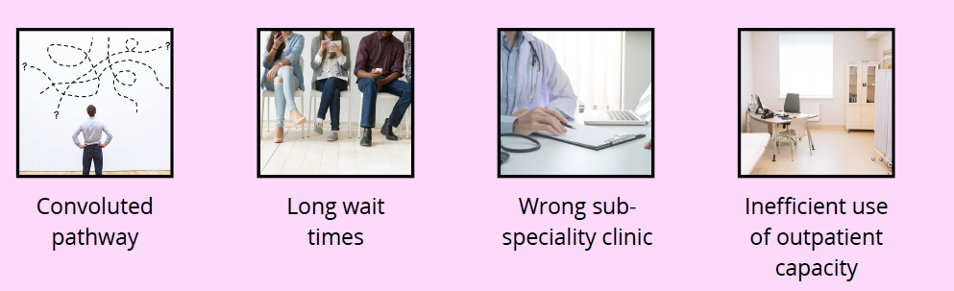
Where it started
Outpatient transformation project.
Existing Women’s Health clinical pathway challenges impacting patient experience.
Patient insights groups, GP feedback, Consultant feedback and A&R audit during pandemic.

Slide 23
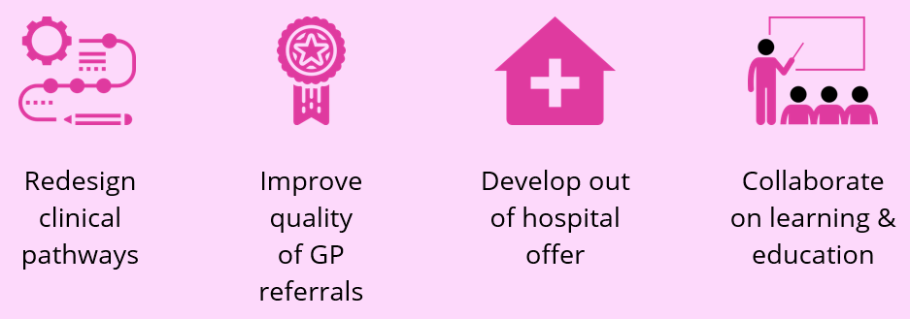
Project aims
The planned care team commissioner led
Co-development and collaboration through a series of workshops to bring clinicians and SME to an agreement on clinical pathways, development of a specification for the SPA and WHH.
Co-developed key metrics to measure impact.
Developed now a blueprint that links to the 10 year plan- left shift and that can be used across other HVLC specialties.

Slide 24
Women’s health hubs
A place where women can be referred to for a range of conditions in an integrated way which avoids being referred to multiple teams.
Model of care- 10-year plan (workforce model and neighbourhood hub) / WH Strategy
Address fragmentation
Overcomes barriers to partnership working across traditional ‘lines’
Delivers care across a ‘lifecourse’
Intermediate care between primary care and secondary care
Digital offer through virtual engagement and group consultations
They are showing that they meet system priorities:
delivering care closer to home
improving patient experience
tackling health inequalities
reducing pressure on secondary care and waiting lists

Slide 25
Management pathways and templates
Common gynaecology conditions pathways
Abnormal Menstrual Bleeding
PCOS
Menopause
Urogynae
Postnatal care beyond the 6 weeks
Vulval Pain
Vaginal Discharge
Premenstrual Disorder
Chronic Pelvic Pain
Developed collaboratively between Barts health and Primary care leads for gynaecology
Gynae network sign off
Nationally approved guidelines
Reviewed periodically when new RCOG (Royal College of Obstetrics and Gynaecology) guidance
Medicines Optimisation Board – TNW
Accessible within a 10-minute consultation

Slide 26
How the hub operates
MDT Team
All referrals excluding 2ww, emergency and maternity
Mon-Fri 9am-5pm
Triage session for all GP referrals will be required 5 days a week
Staffing
Sexual Health consultant / Registrar
Gynae consultant
Nurse
HCA
GPSI
Receptionist/ Admin
Blended workforce model on site and working remotely
SRH Consultant
Gynae Consultant
Specialist Nurse
Physiotherapist
GPSI
Social Prescriber

Slide 27
Impact
60%
reduction in secondary care referrals
30% reduction in waiting lists
Before the hub launched, 85% of gynaecology referrals were seen in secondary care gynaecology and 15% were supported via advice and guidance to their GP. The results show the outcomes after 12 months of the service being in operation and 3515 referrals
Patient feedback:
“I am very pleased to know that such a place exists as a woman and we are able to have a detailed conversation with a doctor who is able to explain everything in detail. Please keep this available for women.”
37%
of referrals managed in primary care
35% of women treated in Tower Hamlets Women’s Health Hub

Slide 28
Success to date - focus on Royal London Hospital
Left shift

Slide 29
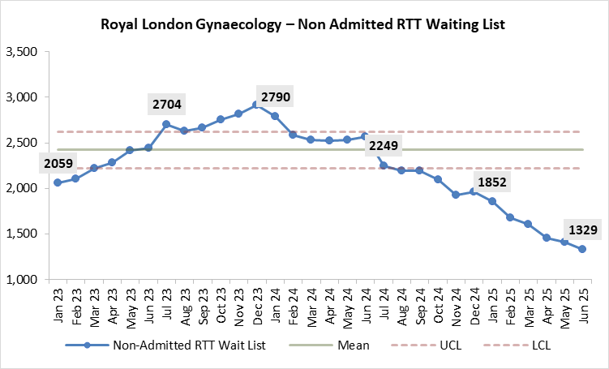
Royal London gynaecology – Non admitted RTT waiting list
The trend indicates that RLH has managed to reduce backlog pressures, particularly in Outpatient Gynaecology services, likely with the help of the Women's Health Hub as well as the various Demand and Capacity work the service has undertook.

Slide 30
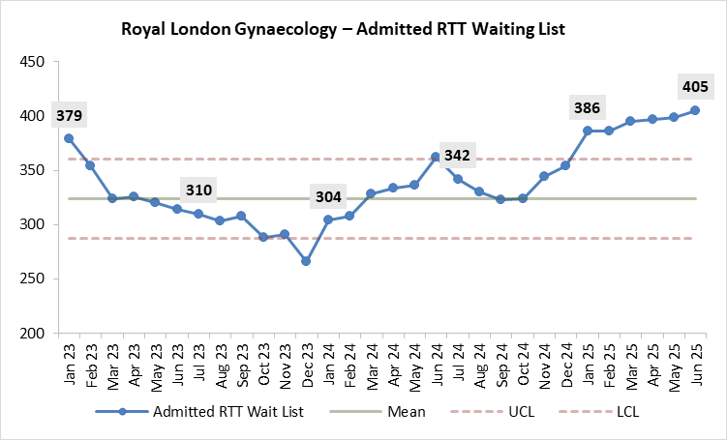
Royal London gynaecology – Admitted RTT waiting list
We can see an improved conversion from outpatient to surgery with more patients being added to the admitted surgical pathways.
This upward trend suggests ongoing challenges with Admitted pathways which may require and benefit from a resources shift.

Slide 31
Patient feedback
"I have found this service incredibly helpful in supporting my post partum recovery. The staff are very friendly and professional“.
“I am very pleased to know that such a place exists as a woman and we can have a detailed conversation with a doctor who is able to explain everything in detail. Please keep this available for women.”
“I loved that I could have a scan and biopsy all on the same day and come back to speak to someone about my results.”

Slide 32
How will we ensure the hubs are sustainable?
Work with NHS England in developing best practice tariff for key pathways
Phased approach to test best funding model
In tandem review the left shift of activity, i.e. how/who and where is the activity moving to and how is it funded
Partnership and collaboration arrangements

Slide 33
The Future
Satellite hubs
Hot line
Training
Self referral
Virtual Consultations
More teaching and educational events
Collaboration collaboration and more collaboration (primary secondary community and PATIENTS!)
Digital offer
Comms projects
MODEL NOT UNIQUE TO WOMEN’S HEALTH

Slide 34

Thank you

Slide 35
Women’s Health Inequalities
Presentation to Women’s Commission
Georgia Chimbani, Corporate Director Health and Adult Social Care
Somen Banerjee, Director of Public Health
23rd October, 2025

Slide 36
Overview
Insights from engagement
Recommendations from women (from evidence pack)
A holistic approach to health that recognises the important of social connection and mental wellbeing
Improved ways of distribution of health information that ensures access for all women
More affordable and accessible healthy food options
Improved access to growing spaces and community kitchens
More women staff and provision for women only activities
Group activities that foster social connection

Slide 37
Insights from engagement with women

Slide 38

Muslim Women’s Health initiative
Two-year programme to tackle long term health conditions which drive health inequalities faced by Muslim women
104 Muslim women in Tower Hamlets engaged in focus groups and interviews
Engagement in trusted community spaces

Slide 39
Findings on challenges facing women align with Women’s Commission
Women’s Commission
Being heard and taken seriously
Barriers to health information
Muslim Women’s Health Initiative
Cost of living leading to skipped meals and reliance on food banks
Barriers to accessing healthy food
Barriers to physical activity and access to suitable facilities
Limited women-only spaces
Trust issues with health and care services
Communication gaps, lack of interpreters, judgements
Cultural sensitivity missing in service delivery

Slide 40


Coproducing health and wellbeing

Slide 41
Recommendations of women and stories from the community…..

Slide 42

A holistic approach to health that recognises the importance of social connection and mental wellbeing..

Slide 43
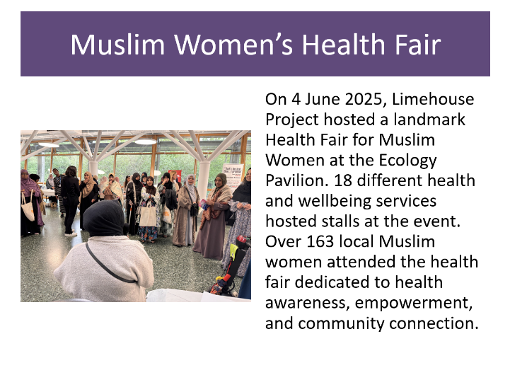
Improved ways of distribution of health information that ensures access for all women

Slide 44
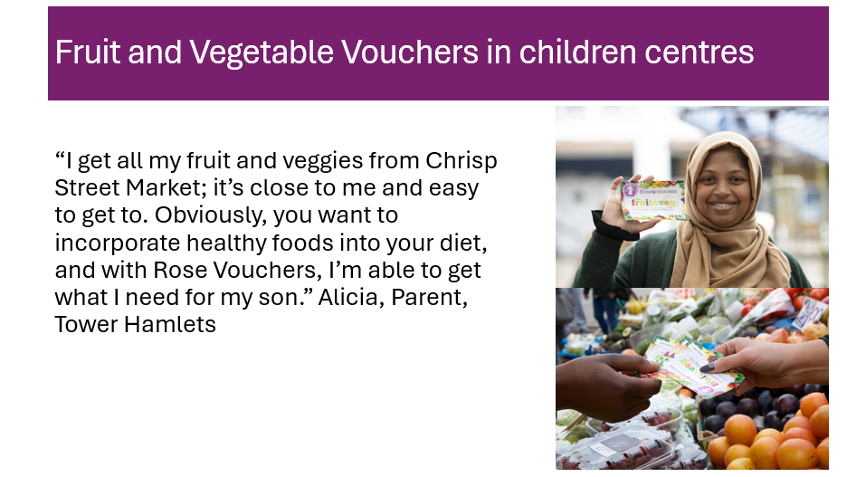
More affordable and accessible healthy food options

Slide 45

Group activities that foster social connection

Slide 46
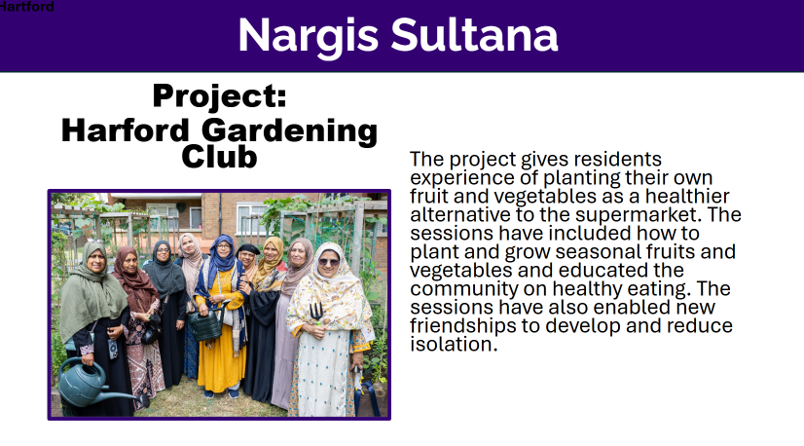
Improved access to growing spaces and community kitchens

Slide 47
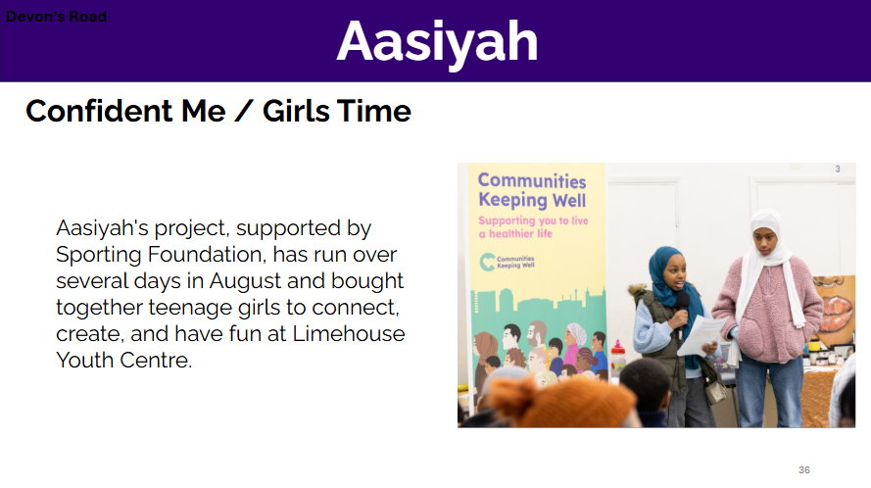
More women staff and provision for women only activities

Slide 48
Video snapshot of Communities Keeping Well women’s projects
CKW women commission on Vimeo

Slide 49
Thank you!

Slide 50
Be Well
Supporting Women’s Health & Wellbeing
Simon Jones, Head of Leisure Operations

Slide 51
Background & Achievements
Action plan submitted: 9th May 2024
Focus: Supporting women & girls in sport and physical activity
1200+ engaged during International Women Week
428 attended OurPark women-only sessions
54% of Urban Adventure Base participants are girls
“Find Your…” campaign launched
New activities: Badminton, Cricket, Box Fit, Self Defence, Running

Slide 52
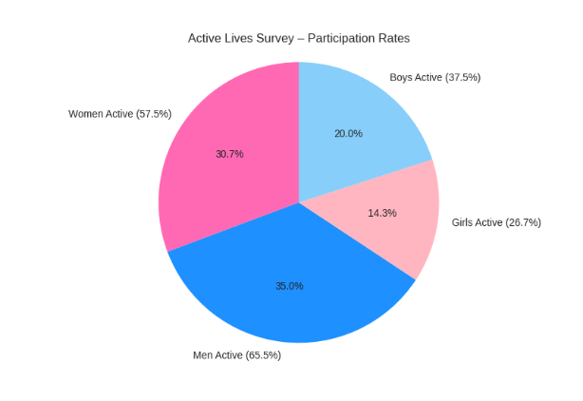
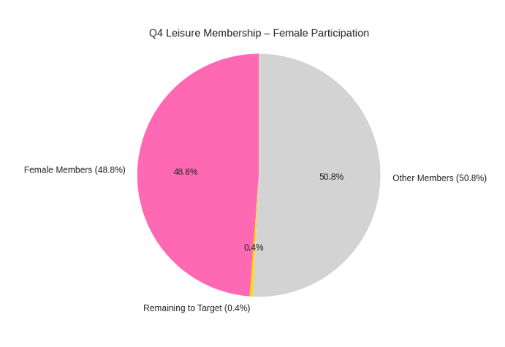
Survey Insights

Slide 53
Breaking Down Barriers
✅ Free swimming for women & girls (16+)
✅ Expanded women-only sessions
✅ Targeted campaigns launched
✅ Lifeguard & fitness instructor training offered
✅ Community engagement via events & social prescribing
✅ Partnership with Women Inclusive Team (e.g. creche)
✅ Hosted pan-London networking with London Sport

Slide 54
What the Numbers Tell Us
📊 1200+ new members registered
🧾 LMS captures gender, age, postcode, activity, and centre usage
📅 Quarterly dashboard reporting started (from Sept 2024)
📍 Data used to measure social return on investment

Slide 55

Current Offerings for Women
We recognise that spaces for women and girls are limited.
That’s why we have a dedicated women and girls programme of activities.
Activities: Women-only fitness classes, walking groups, wellness workshop.
Free Swimming: Dedicated women’s swim sessions at selected sites.
EmpowerHER: A targeted programme supporting women’s physical and mental wellbeing through peer-led activities and mentoring.
Our ‘Find your…’ campaign is all about empowering women and girls to find their place, their community, their friends and their fun to improve their physical and mental wellbeing.

Slide 56


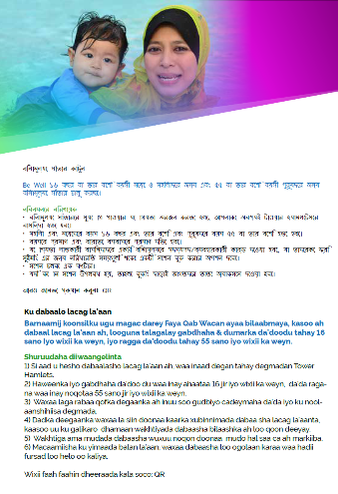

Free swimming programme

Slide 57

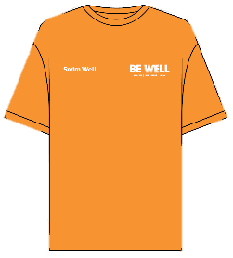

Free swimming buddies and lessons

Slide 58
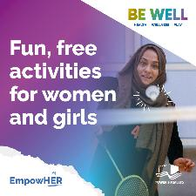
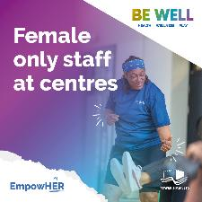


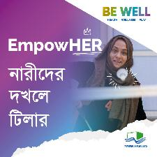

EmpowHER Event

Slide 59





Barriers to Participation - Challenges Faced by Women
Lack of accessible crèche facilities for mothers
Language barriers limiting engagement and understanding of services
Limited availability of female lifeguards, affecting comfort and cultural inclusion
General lack of awareness or confidence in accessing leisure spaces

Slide 60
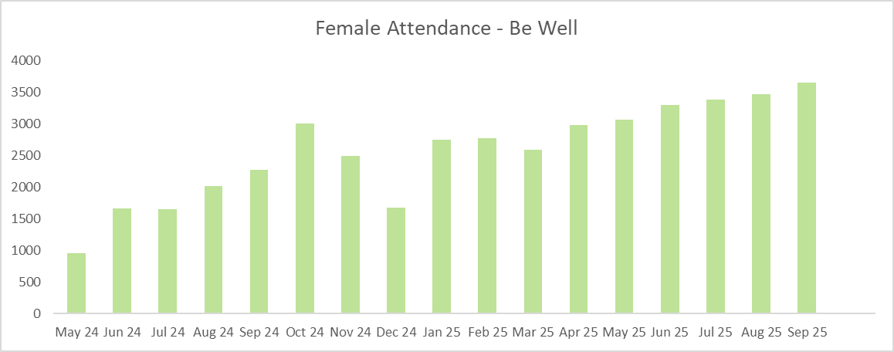
Data & Insights
Understanding Participation – 4Global Data
Usage trends by gender, age, and location
Drop-off rates and peak engagement times
Identified gaps in participation among women from ethnic minority backgrounds
Data used to inform programme design and resource allocation

Slide 61


Marketing & Outreach
How We’re Communicating
Social media campaigns tailored to women’s wellbeing
Posters and flyers in community hubs, GP surgeries, and schools
Outreach through local women’s groups and cultural organisations
Feedback shows need for more inclusive and multilingual materials

Slide 62



Upcoming Actions Based on Group Feedback
Interest in more women-only gym hours
Requests for female-led workshops on mental health and nutrition
Desire for community-led events and peer support networks
Need for flexible scheduling to accommodate work and family commitments
Women only gym new Poplar opening this year and extension to the gym Mile End.
Women only lifeguard training courses

Slide 63

Next Steps & Feedback
Expand EmpowerHER and free swim sessions across more sites
Explore partnerships for crèche support and multilingual outreach
Recruit and train more female lifeguards and instructors
Women only gym new Poplar opening this year and extension to the gym Mile End.
Continue gathering feedback through focus groups and surveys
Invite Commission members to support pilot programmes and advocacy

Slide 64
Appendixes
Be Well Leisure

Slide 65
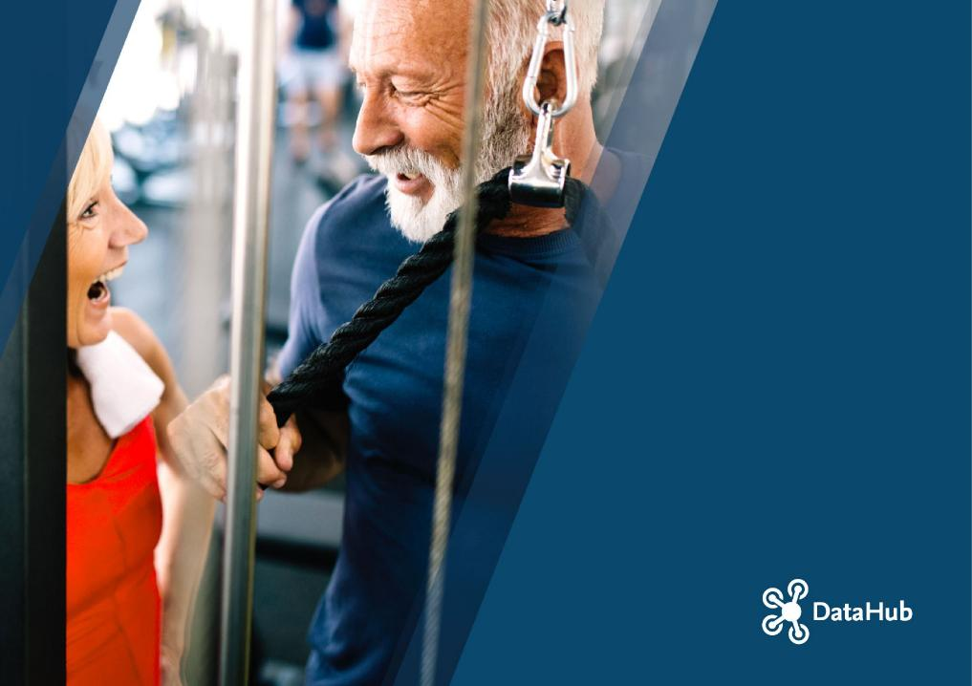
SOCIAL VALUE CALCULATOR REPORT
OPERATOR NAME :
TOWER HAMLETS COUNCIL
REPORT DATE:
21.10.2025

Slide 66
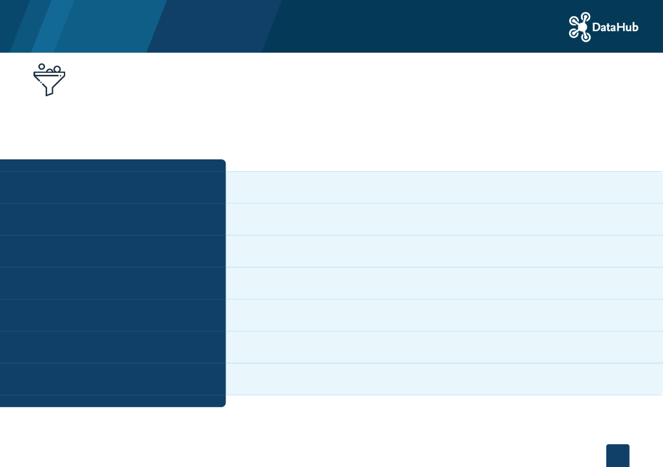
1 - FILTERS
4GLOBAL Social Value Calculator uses filtering based on date, location, demographics, membership and activity type. The following filters have been selected to generate this Social Value report.
DATE
Rolling Months
BENCHMARK PERIOD
Same period last year
LOCATION
TOWER HAMLETS COUNCIL
DEMOGRAPHICS
Gender: All Age: All
CASUAL / MEMBER
Member
MEMBERSHIP TYPE
-
ACTIVITY TYPE
Health and Wellbeing

Slide 67

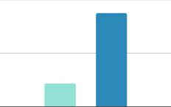
2 - SOCIAL VALUE DASHBOARD
The dashboard displays the main Social Value KPIs based on selected lters: 1-Total social value generated, 2-Total number of participants generating social value 3-Average social value per person, 4-Average social value per site. The total social value is then broken down by month within the selected time period and benchmarked against the same time period from the previous year.
TOTAL SOCIAL VALUE TOTAL SV PARTICIPANTS
£87,938 1,033
SOCIAL VALUE PER PERSON
SOCIAL VALUE PER SITE
£85
£87,938
TOTAL SV Oct-23 Sep-24 vs Oct-24 Sep-25 100k £87,938 50k £21,831 0 Oct-Sep Previous Year Filter Period | 15k |  | 6K 0 Nov | 5K 0 Dec | TOTAL SV PER MONTH Oct-23 Sep-24 vs Oct-24 Sep-25 8K ^{8K} 7K 7K 5K 2K 0 0 0 0 Jan Feb Mar Apr May Previous Year Filter Period
 |  |  |  |  |  |  |  |  | 12K
 |  |  |  |  |  | 10K
 | 10k
 |  |  |  |  |  |  | 7K | 8K
 | 5k | 5K |  |  |  | 4K | 4K | 6K | 6K
 |  | 0
 | 0
 |  | Oct |  |  |  | Jun | Jul | Aug | Sep
 |  | Oct
YOY (Oct-23 Sep-24 vs Oct-24 Sep-25) +302.82% |  |  | MONTH ON MONTH CHANGE (Sep-24 vs Sep-25) |  |  | +115.52%
£
£

Slide 68

INDICATORS
PHYSICAL & MENTAL HEALTH
SUBJECTIVE WELLBEING
INDIVIDUAL DEVELOPMENT
SOCIAL & COMM. DEV.
£15,043
£49,778
£404
£22,706
HEALTH INDICATORS
Oct-24 | Sep-25
10k
£6,060
£4,347
5k
£1,865
£2,217
£
£145
£256
£163
£633
£699
£1,024
0
-5k
£-2,366
CHD Stroke
Breast Cancer
Colon Cancer
Type 2 Diabetes
Dementia
Depression
Hip Fractures
Back Pain
Reduced GP Visits
Reduced
Psychother…
Injuries
Filter Period
HEALTH INDICATORS
The Social Value for Physical and Mental Health is calculated based on the health care cost savings for eight health outcomes based on the reduced risk and prevented cases combined with the reduced GP visits & psychotherapy usage for physically active people.
The Subjective Wellbeing outcome refers to the increase in life satisfaction. It is calculated by multiplying the value of increased wellbeing derived from a participant’s engagement in sport by the number of unique people taking part.
Individual Development refers to the improvement in educational attainment and higher starting salaries gained through participating in sport at university.
Social and Community Development outcome represents the reduction in crime rates for young males and the social capital based on improved networks, trust and reciprocity.

Slide 69


3 - BENCHMARKING
This section provides comparisons for the selected KPIs (social value per site, social value per person and social value growth) against the sector benchmarks. For each KPI, you can see the Actual Value, the Index Score and the Sector Graph, which groups all individual sites from the sector into four quartiles based on their performance in the selected KPI.
SOCIAL VALUE PER SITE (SECTOR GRAPH)
Filter: £87,938
ACTUAL VALUE
SV INDEX SCORE
£87,938
£2K
£720K
88
0
100k
200k
300k
400k
£
500k
600k
700k
800k
Bottom quartile
Second quartile
Third quartile
Top quartile
SOCIAL VALUE PER SITE
The average social value generated by each site within the selected time period is calculated by the division of the total social value generated by the operator by the number of sites included in the
lter. This value is then benchmarked with all sites the sector on the quartile graph.
Actual Value: The actual social value delivered by the operator (or the selected sites) within the selected time period.
Index Score: The percentage score (1 to 100) given to the operator (or the site) based on their performance against the rest of the sector – a higher score represents better performance (i.e. 100 is the best performing site/ operator).
Sector Graph: The graph with all sites from the sector matching the selected lters grouped into four quartiles based on their performance – i.e. Top Quartile includes the best performing 25% of the sites in the sector and Bottom Quartile included the worst performing 25% of the sites in the sector for the selected KPI.

Slide 70



SOCIAL VALUE PER PERSON
ACTUAL VALUE
SV INDEX SCORE
SOCIAL VALUE PER PERSON (SECTOR GRAPH)
Filter: £85
£85
£64
£33
85
£11
£467
0
50
100
150
200
250
£
300
350
400
450
500
Bottom quartile
Second quartile
Third quartile
Top quartile
Average social value generated by each person within the selected time period. This value is calculated by the division of the total social value by the number of participants that generated social value.
ACTUAL VALUE
SV INDEX SCORE
SOCIAL VALUE CHANGE (%) YoY (SECTOR GRAPH)
302.82%
100
%-26.09
%-98.90
%27.13
%275.28
%
Bottom quartile
Second quartile
Third quartile
Top quartile
SOCIAL VALUE CHANGE (%) - YOY
This value represents the change in social value generated by the selected operator/site compared to the same time period in the benchmark year.

Slide 71

4 - PEOPLE OUTCOMES
This section focuses on the activity levels of individuals required to generate social value following the WHO guidelines for physical activity. Social value is generated for ‘active’ participants at the physical activity threshold of 150+ minutes per week of moderate activity. In addition, for health outcomes, social value is also generated for ‘fairly active’ participants (30-149 minutes) based on the reduced risk of developing various health conditions.
SOCIAL VALUE PARTICIPANTS
PERSON TYPE BREAKDOWN
ACTIVITY LEVEL BREAKDOWN
SOCIAL VALUE PER PERSON
1,033
1,033
MEMBER
0
CASUAL
655
ACTIVE
378
FAIRLY ACTIVE
£132
ACTIVE
£1.92
FAIRLY ACTIVE
NOTES
In addition to the activity level classi cation based on the activity duration within the month, each member is assigned to a demographic segment based on their age and gender and to a Mosaic segment based on their postcode information. These three indicators (activity level, demographic and Mosaic segmentation) combined are used to determine the risk reduction rates for health outcomes and impact the social value generated.
Social Value Participants: The total number of unique individuals (member and casual users) that generated social value within the selected time period.
Person Type Breakdown: Members are de ned as facility users with an active subscription (paid or unpaid) to use the facility. Casuals are all facility users without an active subscription using the facility to do physical activity occasionally or regularly.
Participant Breakdown: The total number of Active (150+ minutes per week) and Fairly Activity (30-149 minutes per week) participants averaged across a month, including members and casual users.
Social Value Per Person: Average social value generated by each Active (150+ minutes per week) and Fairly Active (30-149 min per week) person within the selected time period

Slide 72






TOTAL ACTIVE PEOPLE
TOTAL ACTIVE PEOPLE (%)
Oct-23 Sep-24 vs Oct-24 Sep-25
ACTIVE PEOPLE (%) PER MONTH
Oct-23 Sep-24 vs Oct-24 Sep-25
75
63%
75
65%
58%
59%
58%
57%
60%
53%
61%
62%
Active People (%)
Active People (%)
49%
53%
48%
50
50
45%
43%
40%
33%
25
25
0
0
0%
0%
0%
0%
0%
0%
0%
Oct-Sep
Oct
Nov
Dec
Jan
Feb Mar
Previous Year
Apr May
Filter Period
Jun
Jul
Aug
Sep
Previous Year
Filter Period
In the above graph, the percentage of active people (150+ minutes per week) over total number of leisure centre users for each month within the selected time period is compared with the same time period in the benchmark year.
PHYSICAL & MENTAL HEALTH
SUBJECTIVE WELLBEING
INDIVIDUAL DEVELOPMENT
SOCIAL & COMM. DEV.
548
1,033
Total number of unique individuals (members and casual users) that generated social value in four outcome areas - physical and mental health, subjective wellbeing, individual development and social and community development are displayed above.
548
222
SV PARTICIPANTS PER OUTCOME

Slide 73
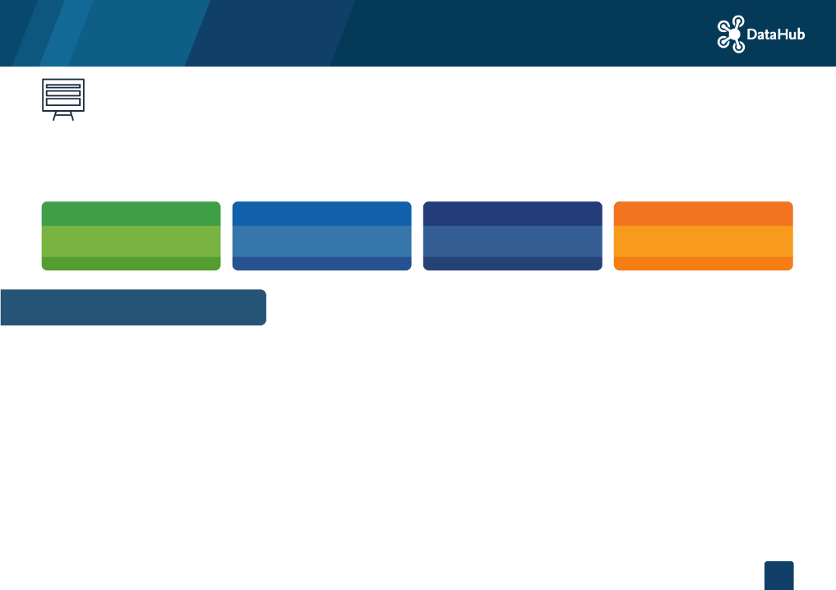
5 - LEAGUE TABLE
The data tables in this section display the main social value KPIs for the top ve regions, contract and sites of the operator based on selected
lters with comparisons against the same period in the previous year. The full tables are available in SVC3 and can be exported in excel, csv and pdf format.
HIGHEST SV (REGION) | HIGHEST SV (CONTRACT) | HIGHEST SV (SITE) | HIGHEST SV GROWTH (SITE)
£87,938 UNKNOWN REGION | £87,938 UNKNOWN CONTRACT | £87,938 MILE END PARK LEISURE CENTRE | 0%
SOCIAL VALUE LEADERBOARD
The region, contract and leisure centre of the operator generating the highest total social value within the selected time period are displayed in the above KPI boxes. In addition, the leisure centre with the highest growth in social value generation is presented with its year-on-year growth rate.
LEAGUE TABLE - REGION (TOP 5)
REGION □□ | SOCIAL VALUE (FILTER PERIOD) □□ | SV YOY % CHANGE □□ | PEOPLE COUNT (FILTER PERIOD) □□ | AVG VALUE PER PERSON (FILTER PERIOD) □□ | AVG SV YOY % CHANGE □□
UNKNOWN REGION | £87,938 | - | 1,033 | £85 | +135.14%

Slide 74

LEAGUE TABLE - SITE (TOP 5)
LEAGUE TABLE - CONTRACT (TOP 5)
CONTRACT □□ | REGION □□ | SOCIAL VALUE (FILTER PERIOD) □□ | SV YOY % CHANGE □□ | PEOPLE COUNT (FILTER PERIOD) □□ | AVG VALUE PER PERSON (FILTER PERIOD) □□ | AVG SV YOY % CHANGE □□
UNKNOWN CONTRACT | UNKNOWN REGION | £87,938 | - | 1,033 | £85 | +135.14%
SITE □□ | CONTRACT □□ | REGION □□ | SOCIAL VALUE (FILTER PERIOD) □□ | SV YOY % CHANGE □□ | PEOPLE COUNT (FILTER PERIOD) □□ | AVG VALUE PER PERSON (FILTER PERIOD) □□ | AVG SV YOY % CHANGE □□
MILE END PARK LEISURE CENTRE AND STADIUM | UNKNOWN CONTRACT | UNKNOWN REGION | £87,938 | - | 1,033 | £85 | +135.14%

Slide 75





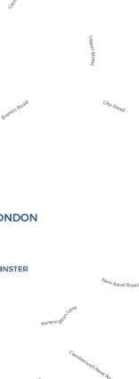




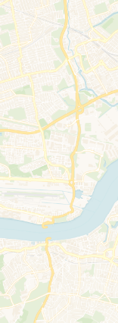






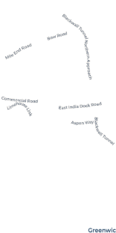

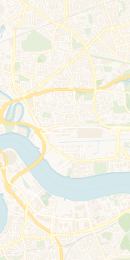


6 - MAP
The heat map displays the social value generated by the selected sites on a map view using the same lters from the dashboards.
+ –
Leaflet | © OpenStreetMap contributors, © CARTO

Slide 76
SOCIAL VALUE CALCULATOR REPORT (2)
OPERATOR NAME :
TOWER HAMLETS COUNCIL
REPORT DATE:
21.10.2025

Slide 77
FILTERS
4GLOBAL Social Value Calculator uses filtering based on date, location, demographics, membership and activity type. The following filters have been selected to generate this Social Value report.
DATE
Rolling Months
BENCHMARK PERIOD
Same period last year
LOCATION
TOWER HAMLETS COUNCIL
DEMOGRAPHICS
Gender: All Age: All
CASUAL / MEMBER
Member
MEMBERSHIP TYPE
-
ACTIVITY TYPE
Health and Wellbeing

Slide 78
SOCIAL VALUE DASHBOARD
The dashboard displays the main Social Value KPIs based on selected lters: 1-Attributable social value generated, 2-Total number of participants generating social value 3-Average social value per person, 4-Leisure centre users full social value per site. The attributable social value is then broken down by month within the selected time period and benchmarked against the same time period from the previous year.
ATTRIBUTABLE SOCIAL VALUE
TOTAL SV PARTICIPANTS
SOCIAL VALUE PER PERSON
LC USERS FULL SV
£141,646
1,033
£137
£410,661
150k 100k 50k 0 | TOTAL SV Oct-23 Sep-24 vs Oct-24 Sep-25 £141,646 £43,102 Oct-Sep Previous Year Filter Period | 20k |  | 0 Nov | 10K 0 Dec | TOTAL SV PER MONTH Oct-23 Sep-24 vs Oct-24 Sep-25 8K 6K 0 0 0 0 Jan Feb Mar Apr May Previous Year Filter Period
 |  |  |  |  |  |  |  |  |  | 16K
 |  | 15k |  |  |  |  | 13K
 |  | 10k | 11K |  |  |  | 9K | 11K 9K | 12K 9K | 10K
 |  | 5k
 |  |  | 0
 |  | 0
 |  |  | Oct |  |  |  | Jun | Jul | Aug | Sep
YOY (Oct-23 Sep-24 vs Oct-24 Sep-25) +228.63% |  |  |  | MONTH ON MONTH CHANGE (Sep-24 vs Sep-25) |  |  | +61.27%
£
£

Slide 79
INDICATORS (1)
INDIVIDUAL WELLBEING
TOTAL SV £ (IND W.)
£0.0 £120,298.0
PHYSICAL & MENTAL HEALTH
TOTAL SV £ (P&MH)
£18,796.5 £2,550.5
£120,299
£21,347
HEALTH INDICATORS
Oct-24 | Sep-25
10k
£6,091
5k
£5,660
£
£1,780
£1,731
£698
£540
£1,250
£1,401
£1,985
£550
0
£-339
-5k
CHD
Stroke
Type 2 Diabetes
Dementia
Depression
Hip Fractures
Back Pain Reduced GP
Visits
Reduced Psychologi… Distress
Injuries
Cancer
Filter Period
14 health outcomes (reduced risk of various health conditions) are valued by estimating the number of reduced cases resulting from participation in sport and physical activity multiplied by the associated average annual direct (healthcare) and indirect (social and informal care) cost per case for each health outcome.
PHYSICAL AND MENTAL HEALTH
INDIVIDUAL WELLBEING: This outcome is calculated by multiplying the value of the increase in life satisfaction associated with sport and physical activity participation (using the guidance on wellbeing valuation approach) by the number of adults (aged 16+) and children (aged 11-16) meeting a speci c threshold of participation.
The wellbeing valuation approach uses large scale survey data to estimate the e ect of di erent physical activity thresholds on people’s self reported life satisfaction, which is then converted to a monetary value of enhanced wellbeing using guidance issued by HM Treasury.

Slide 80

BENCHMARKING
This section provides comparisons for the selected KPIs (social value per site, social value per person and social value growth) against the sector benchmarks. For each KPI, you can see the Actual Value, the Index Score and the Sector Graph, which groups all individual sites from the sector into four quartiles based on their performance in the selected KPI.
SOCIAL VALUE PER SITE (SECTOR GRAPH)
Filter: £141,646
ACTUAL VALUE
SV INDEX SCORE
£141,646
92
0
50k 100k 150k 200k 250k
300k
£
350k 400k 450k 500k 550k 6…
Bottom quartile
Second quartile
Third quartile
Top quartile
SOCIAL VALUE PER SITE
The average social value generated by each site within the selected time period is calculated by the division of the total social value generated by the operator by the number of sites in the lter. This value is then benchmarked with all sites across the sector.
Actual Value: The actual social value delivered by the operator (or the selected sites) within the selected time period.
Index Score: The percentage score (1 to 100) given to the operator (or the site) based on their performance against the rest of the sector – a higher score represents better performance (i.e. 100 is the best performing site/ operator).
Sector Graph: The graph with all sites from the sector matching the selected lters grouped into four quartiles based on their performance – i.e. Top Quartile includes the best performing 25% of the sites in the sector and Bottom Quartile included the worst performing 25% of the sites in the sector for the selected KPI

Slide 81


SOCIAL VALUE PER PERSON (1)
ACTUAL VALUE
SV INDEX SCORE
SOCIAL VALUE PER PERSON (SECTOR GRAPH)
Filter: £137
£137
80
0
50
100
150
200
250 300
£
350
400
450 500
550
Bottom quartile
Second quartile
Third quartile
Top quartile
Average social value generated by each person within the selected time period. This value is calculated by the division of the total social value by the number of participants that generated social value.
ACTUAL VALUE
SV INDEX SCORE
SOCIAL VALUE CHANGE (%) YoY (SECTOR GRAPH)
Filter: 228.63%
228.63%
98
-150
-100 -50
0
50
100
%
150
200
250 300
350
Bottom quartile
Second quartile
Third quartile
Top quartile
SOCIAL VALUE CHANGE (%) - YOY
This value represents the change in social value generated by the selected operator/site compared to the same time period in the benchmark year.

Slide 82
PEOPLE OUTCOMES
This section focuses on the activity levels of individuals required to generate social value following the CMO guidelines for physical activity. Social value is generated for ‘active’ participants at the physical activity threshold (150+ minutes per week) and for ‘fairly active’ participants (30-149 minutes) of moderate activity based on the reduced risk of developing various health conditions and increased wellbeing bene ts.
1,033
MEMBER
0
CASUAL
748
ACTIVE
630
FAIRLY ACTIVE
£107
ACTIVE
£98
FAIRLY ACTIVE
1,033
In addition to the activity level classi cation based on the activity duration within the month, each member is assigned to a demographic segment based on their age and gender. These indicators (activity level and demographic segmentation) combined are used to determine the risk reduction rates for health outcomes and impact the social value generated.
Social Value Participants: Total number of unique individuals that generated social value within the selected time period.
Person Type Breakdown: The breakdown of social value participants into members and casuals. Members are de ned as facility users with an active subscription (paid or unpaid) to use the facility. Casuals are all facility users without an active subscription using the facility to do physical activity occasionally or regularly.
Participant Breakdown: The total number of Active and Fairly Active participants averaged across a month, including members and casual users. The sum of the active and fairly active participants are higher than the total SV participants because a person can be active in certain months and fairly active in other months, which would add to the count of active and fairly active users in the dashboard.
The classi cation is based on physical activity thresholds de ned by the Chief Medical O cer (CMO) guidelines that are adapted by applying the assumptions from the Active Lives Survey and the DataHub.
Social Value Per Person: Average social value generated by each Active and Fairly Active person within the selected time period.

Slide 83







TOTAL ACTIVE PEOPLE (1)
TOTAL ACTIVE PEOPLE (%)
Oct-23 Sep-24 vs Oct-24 Sep-25
ACTIVE PEOPLE (%) PER MONTH
Oct-23 Sep-24 vs Oct-24 Sep-25
75
64%
100
Active People (%)
68%
Active People (%)
75
68%
69%
70%
68%
77%
70%
70%
74%
50
58%
59%
58%
67%
58%
60%
50
25
25
0
0
0%
0%
0%
0%
0%
0%
0%
Oct-Sep
Oct
Nov
Dec
Jan Feb Mar
Previous Year
Apr May
Filter Period
Jun
Jul
Aug
Sep
Previous Year
Filter Period
In the above graph, the percentage of active people (150+ minutes per week adjusted for in-centre thresholds) over total number of leisure centre users for each month within the selected time period is compared with the same time period in the benchmark year.
INDIVIDUAL WELLBEING
PEOPLE NUMBERS (IND W.)
PHYSICAL & MENTAL HEALTH
PEOPLE NUMBERS (P&MH)
28,730
PRIMARY VALUE
28,332
SECONDARY VALUE
348
11-15 YEARS OLD
28.381
16+ YEARS OLD
26,313
16-64 YEARS OLD
2,018
65+ YEARS OLD
Total number of unique individuals (members and casual users) that generated social value in two outcome areas - individual wellbeing and physical and mental health are displayed above. The gures are further broken down into age groups for each outcome area.
SV PARTICIPANTS PER OUTCOME

Slide 84
LEAGUE TABLE
The data tables in this section display the main social value KPIs for the top ve regions, contract and sites of the operator based on selected filters with comparisons against the same period in the previous year. The full tables are available in SVC4 and can be exported in excel, csv and pdf format.
HIGHEST SV (REGION) | HIGHEST SV (CONTRACT) | HIGHEST SV (SITE) | HIGHEST SV GROWTH (SITE)
£141,646 | £141,646 | £141,646 | 229%
UNKNOWN REGION | UNKNOWN CONTRACT | MILE END PARK LEISURE CENTRE | MILE END PARK LEISURE CENTRE
SOCIAL VALUE LEADERBOARD
The region, contract and leisure centre of the operator generating the highest total social value within the selected time period are displayed in the above KPI boxes. In addition, the leisure centre with the highest growth in social value generation is presented with its year-on-year growth rate.
LEAGUE TABLE - REGION (TOP 5)
REGION | SOCIAL VALUE (FILTER PERIOD) | SV YOY % CHANGE | PEOPLE COUNT (FILTER PERIOD) | AVG VALUE PER PERSON (FILTER PERIOD) | AVG SV YOY % CHANGE
UNKNOWN REGION | £141,646 | +228.63% | 1,033 | £137 | +91.83%

Slide 85
LEAGUE TABLE (1) - SITE (TOP 5)
LEAGUE TABLE - CONTRACT (TOP 5)
CONTRACT | REGION | SOCIAL VALUE (FILTER PERIOD) | SV YOY % CHANGE | PEOPLE COUNT (FILTER PERIOD) | AVG VALUE PER PERSON (FILTER PERIOD) | AVG SV YOY % CHANGE
UNKNOWN CONTRACT | UNKNOWN REGION | £141,646 | +228.63% | 1,033 | £137 | +91.83%
SITE | CONTRACT | REGION | SOCIAL VALUE (FILTER PERIOD) | SV YOY % CHANGE | PEOPLE COUNT (FILTER PERIOD) | AVG VALUE PER PERSON (FILTER PERIOD) | AVG SV YOY % CHANGE
MILE END PARK LEISURE CENTRE AND STADIUM | UNKNOWN CONTRACT | UNKNOWN REGION | £141,646 | +228.63% | 1,033 | £137 | +91.83%

Slide 86
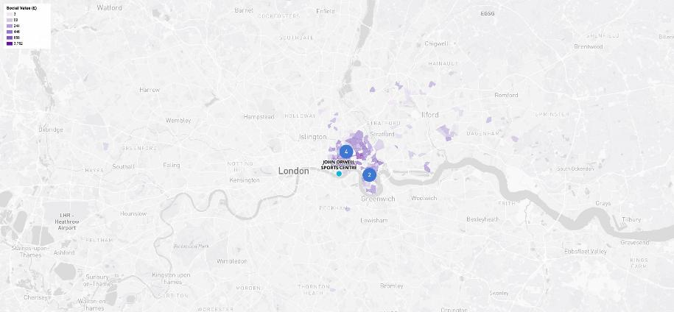
MAP
The heat map displays the social value generated by the selected sites on a map view using the same filters from the dashboards.

Slide 87

DataHub Credits
datahubclub.com
Building 7,
Chiswick Business Park 566 Chiswick High Road London W4 5YG, UK
Phone : + 44 (0) 208 123 4693

Slide 88

Supporting women's health in Tower Hamlets
Beth Brown
Director of Patient Experience and Community Engagement

Slide 89
Spotlight on... equity programme
Healthy Life Expectancy
Life expectancy in Tower Hamlets between the richest and poorest women is 6.3 years
Healthy Life Expectancy has improved for males, but for females remains much below regional averages
Females live 7.5 years less, on average than males.
The sex differential in Healthy Life Expectancy is larger in Asian and Mixed ethnic groups. It is driven primarily by larger numbers of long-term unemployed females in Tower Hamlets than elsewhere.
Waiting times and patient experience
Nationally, men reported a better experience on every question in the last CQC adult inpatient experience survey
In Tower Hamlets, women and specifically those waiting for gynaecology services, tend to experience longer waits
We have collaborated with local partners to open a Women’s Hub in Tower Hamlets to help address this disparity
The Hub brings together a range of professionals, including sexual and reproductive health doctors, GPs, a women’s health physiotherapist, a nursing associate, and others, to provide more holistic and coordinated care.
Maternal and neonatal outcomes
Black, Asian and Minority Ethnic (BAME) women tend to have poorer maternal and neonatal outcomes
The reasons are complex and multifactorial, but we are working with the National Race and Health Observatory on a series of interventions to help address these inequalities, including an intervention to address high rates of post-partum haemorrhage in South Asian communities.

Slide 90
Spotlight on... community engagement
Maternity engagement drop-in sessions
Building trust in safe, familiar spaces for women to seek information, share experiences and connect with clinical teams -working with community partners such as Women’s Inclusive Team, Praxis and Limehouse Project, Flourishing Communities partnership.
“This pregnancy and labour was extremely traumatic for me that I buried it deep down. When I heard about the drop-in sessions at WIT and Limehouse Project, I had an internal struggle. Part of me just wanted to forget about it all and move on, but another part of me knew I couldn’t without talking to someone and getting some answers.”
“I felt listened to for the first time… a real blessing from God is walking down the road and having direct access to a midwife you can ask questions to and learn from, with a cup of tea.”
Breast cancer screening and awareness champions
One woman shared that a close relative had fled back to Somalia after receiving a breast cancer diagnosis, too frightened to seek treatment here. She attended our sessions because she wanted to empower and educate her community, and herself. Although she admitted she was still scared of the word 'cancer', she explained that understanding the signs, symptoms and the importance of early diagnosis helped her realise that awareness and education are the best forms of prevention.

Slide 91
Spotlight on... public health team
68-year-old female admitted for Respiratory problems
Patient screened and opt-out automatic referral sent to the Tobacco Dependence Inpatient Service
Patient visited to explore current smoking patterns, triggers, readiness to stop smoking
Supported with nicotine patches and prescribed a supply for after discharge
Patient has stayed tobacco free and enjoying food more!
Tobacco dependence service
Last year the inpatient service supported over 100 women to successfully give up smoking, and many others reduce the amount they smoke.
43% of women referred accepted support to quit, and of these 33% had still quit four weeks after discharge.
"Enjoying food more"

Slide 92
Spotlight on Healthcare Horizons
Online mentoring, career events, work experience and virtual work experience platform for
14 secondary schools in Tower Hamlets.
Women in Tower Hamlets | 2024/25 | 2025 - present
Supported into employment | 19 | 8
Attended work experience | 41 | 49
38 placements
25 secured employment
Royal London Hospital or Tower Hamlets GP services
Two extended placement schemes support 18–30-year-olds in Tower Hamlets into NHS and Primary care jobs​
Paid placements for up to three months in Royal London Hospital or Tower Hamlets GP services.​
Focus on under-represented groups​:​
Experiencing poverty and deprivation​
From global majority, with particular focus on Somali and Bangladeshi women​
Unemployed, NEETs (Not in Education, Employment or Training) or in insecure employment​

Slide 93
Key considerations
Understanding intersectionality, wider determinants of health, and the multiple roles women hold, particularly in Tower Hamlets, cannot be underestimated
Working in partnership with VCFSE (voluntary, community, faith, social enterprise) sector organisations is vital
User-led and co-produced solutions are essential.
Our HEAL principles:
Start with relationships, not services | Train and empower local leaders | Co-production leads to stronger outcomes | Embed equity at every level | Partnership is power
Real change begins with listening to communities, understanding their lived experiences, and valuing their voices as equal partners in shaping healthcare solutions. | Investing in community leadership creates a sustainable foundation for long-term engagement, advocacy, and cultural change. | Designing solutions with communities rather than for them results in more relevant, equitable, and effective services. | Addressing health inequalities is not just a project goal, it must be a guiding value, influencing how resources are allocated, decisions are made, and success is measured. | Collaboration and respect between the NHS and VCFSE organisations creates the conditions for systemic change

Slide 94

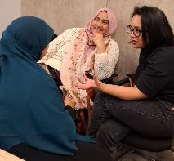


Spotlight on... HEAL (Health Equity Action Leadership)
TELCO x Barts Health partnership aimed to:
Build stronger relationships with our communities
Redefine how the public is supported to influence and shape healthcare, through developing local leadership capacity and community ownership of health outcomes.
What we did
Began with structured community listening process – residents and staff
Disconnect emerged between support available to access services and public awareness
Steering Committee co-produced the HEAL Champions pilot programme
Champions trained in health literacy (Barts Health) and community organising (TELCO)
HEAL Champion institutions host ‘Health Banks’, help their members navigate services, and feed insight back to inform areas for improvement and campaigns
HEAL Champions are equipped to support their communities to navigate healthcare as service users but also as transformation partners.
Before HEAL Champions training: 87% felt not at all confident giving feedback or finding information about healthcare services. After: 100% reported being very confident in both areas.

Slide 95
Presentation to Women’s Commission - Health
www.sistercircle.org.uk

Slide 96

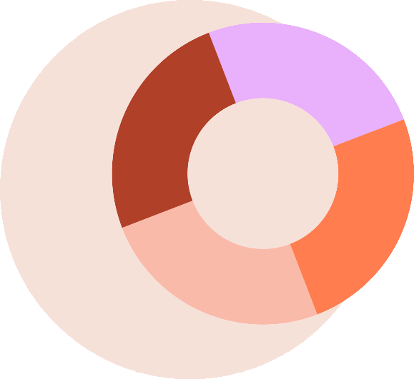



Sister Circle: walking alongside women during pregnancy, sexual and reproductive health and mental health journeys.
~
B
i
r
t
t
r
h
o
S
p
u
p
p
u
p
l
S
o
Pregnancy, birth and postnatal support.
a
r
c
t
~
i
t
c
W
a
r
o
d
P
m
n
e
a
n
M
'
l
a
s
a
t
H
n
e
o
r
e
i
n
a
t
l
o
i
t
m
M
t
h
E
a
y
~
h
t
S
~
t
e
u
e
l
s
p
r
a
p
a
o
C
e
r
l
t
Trauma Counselling, Pregnancy loss, baby loss.
a
i
c
v
i
H
e
g
~
o
r
l
M
o
e
g
a
c
t
e
n
e
a
H
r
n
i
n
y
r
al
G
e
H
~
Putting women's health first
e
h
e
a
t
l
Supporting local women to walk alongside other
women, providing practical and emotional support.
l
t
a
t
h
e
n
~
H
A
l
u
a
n
t
C
l
t
n
o
e
e
o
H
n
M
V
a
n
e
t
~
a
v
a
l
e
l
~
i
r
e
n
a
r
g
C
C
s
n
o
l
a
n
a
t
f
i
s
i
t
o
d
a
e
n
n
e
c
r
e
P
~
h
V
~
Supporting survivors of Female Genital Cutting.
t
i
l
t
a
a
e
l
H
e
P
~
v
o
i
s
t
t
c
n
u
a
d
t
o
a
r
l
p
~
e
R

Slide 97



Her Health Programme
Her Health provides holistic support for women experiencing health complications as a result of cutting and other form of gender-based violence and trauma: one-to-one advocacy, education and knowledge.
Sister Circle are part of the Violence Against Women and Girls (VAWG) Network, committed to campaigning against all forms of gender-based violence and providing vital support services for survivors.
Her Health delivers education and awareness sessions on Female Gential Mutilation/Cutting (FGC) to healthcare professionals and schools across Tower Hamlets, focusing on legal frameworks and access to support services.
Her Health programme provides advocacy and support at specialist FGC clinics in Tower Hamlets. A women’s Conversation Cafe, safe space for growth and tranformation.
Influencing system change a) moving FGC out of safeguarding and into women’s health. Holistic care (NHSE). b) campaigning for FGC awareness to be included in all health professionals formal education pathways (NHSE/Women’s Health Strategy). c) Reducing barriers.
Equality Data insights ......a sample
Nigeria 6%
18-24
17%
Arabic 17%
94% of attendees to the clinic reported they received the support and care they needed 70% of participants of the cafe report feeling more confident discussing their health.
40% attended screenings or clinics they had previously avoided.
Gambia 6%
35-40
39%
Eritrea 10%
English 11%
25-30
22%
Ethopia 6%
Tigrinya 6%
Somali 66%
Somali 66%
30-35
22%

Slide 98
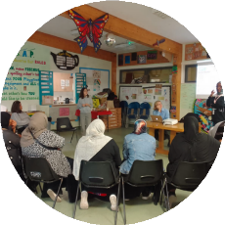
A Bridge to Equity — Women’s Conversation Café
It turns lived experience into learning, insight, and community leadership.
Pathway to Peer Leadership
Women progress from
participants to co-deliverers and advocates, becoming health
champions in their communities.
This peer-led model activates
sustainable change and reduces long-term reliance on services.
Listening as a tool for Insight
Every session captures real-time insights into women’s lived
experiences, highlighting what’s
working and where gaps exist. This shifts community engagement from just activity delivery to a vital
listening and intelligence function.
Safe Space, Barriers removed
A non-clinical, welcoming environment where women feel safe to discuss taboo or stigmatised topics, often for the first time.
Complementing Clinical Pathways
Builds trust and emotional readiness women need to engage meaningfully with statutory services.
It’s not a referral , women choose to show up, invited by warmth and connection, often having conversations they didn’t know they were allowed to have
Building Health Literacy & Confidence
Through gentle facilitation and peer sharing, women learn about their rights, services, and health choices. This boosts confidence to ask questions, attend appointments, and support
others, reflecting the empowerment model at the heart of community development.

Slide 99

Conversation Cafe: Topics covered (Apr-July) What women had to say.
The importance of Routine Gynaecological Exams
Thursday is my Sister Circle day, seeing the other women and listening to the speaker. They are like my sisters
The childcare really helps me to come here as I can listen and know he is ok, he will be starting pre school soon.
Perinatal depression and mental health awareness
One week, a lady shared about her diabetes as we spoke on insulin, another women was shocked that she was not clear on how to manage it and was still using so much sugar in her tea, she stated she has not been able to get any more information and not sure how. The other lady said, not to worry, I am here for you sister, diabetes is serious I will come with you. We can call them together.
The Impact of Nutrition on Reproductive Health
Session really open my eyes and having the chance to speak to the speaker helps me to understand. We all learning.
The importance of looking after both physical and mental health
Women share how when they listen to the session they go back home and share with their family and friends what they have learnt. They have gone on to attend health checks and regularly do checks using the machines in the library together, they encourage one another.
Menstrual Health: (Part Two)
Managing periods, understanding menstrual disorders, and dispelling myths.

Slide 100

Her Struggle
Barriers To Proper Healthcare
The Gatekeeper
(Limited Healthcare Access)
Blocks herpath to carethrough longwait times, inaccessible facilities, lack of interpreters, and confusing healthcare processes, making it difficult for her to receive timely support
LimitedHealthcare Access
Fatima’s Frustration
Fatima, who lives in a rural area, struggles to find an accessible clinic and faces long wait times for specialist care.
The Misinformer (Misinformation
or Lack of Knowledge)
Spreads myths,cultural taboos, and incorrect health information, causing fear, confusion, and hesitation in seeking care.
Prevents her from making informed health
choices
Misinformationor LackofKnowledge
Yasmin’s Confusion
Yasmin, a recent immigrant, has never been told about the importance of cervical screenings and fears they are dangerous.
The Shamer (Stigma and Shame) Usescultural taboos, social pressure,and judgment to make her feel embarrassed or unworthy of seeking healthcare.
Discourages open discussions, making her hesitant to access support.
Stigma and Shame
Hawa’s Silence
Hawa, from a conservative background, feels unable to discuss reproductive health with her family or doctor.
The Neglecter (Reactive Health
Approach)
Ignores her symptoms, downplaysher
concerns, or fails to provide necessary care. Leads to misdiagnosis, untreated conditions, and worsening health outcomes.
Reactive Health Approach
Elena’s Delay
Elena only seeks medical attention when her symptoms become unbearable, missing opportunities for early intervention.
The Dismissor (Disrespect and Bias) Ignoresherconcerns,minimizes herpain, and reinforces systemic biases in healthcare.
Disrespect and Bias
Naomi’s Dismissal
Naomi, a Black woman, feels her pain is not taken seriously by healthcare providers, leading to a misdiagnosis.
The Isolator (Lack of Social
Support)
Sheis cutofffromnetworks thatcould provide guidance, advocacy, or emotional
support.
Isolationand Lackof Social Support
Dalia’s Disconnection
Dalia, an asylum seeker, has no family nearby and struggles to navigate healthcare without a support system
The Barrier Builder (Economic and Financial Constraints)
Blocks herfromaccessinghealthcare due to immigration status, financial hardship, or lack of advocacy.
Economic andFinancial Constraints
Tanya’s Struggle
Tanya, a single mother, relies on the NHS but faces long wait times for specialist care. She struggles with the cost of prescriptions, transportation to appointments, and taking time off work for medical needs.
The Shadow Caster (Trauma and Mental Health Barriers)
Ensures past trauma, displacement, or discrimination prevents her from engaging
with healthcare services.
Trauma and Mental Health Barriers
Samira’s Shadows
Samira, a refugee who has faced trauma, avoids healthcare settings due to anxiety and past discrimination.

Slide 101

Her Health Programme (1)
Awareness, Advocacy & Action
A 12 Week Programme Empowerment journey for women to break barriers and confidently access the care they deserve.
Unlocked
Developed
In partnership with local women, health advocates and community voices
Unlocking women’s health, voice & power, to access equitable healthcare, self advocate, and navigate health services.

Slide 102
Q&A

Slide 103

Flourishing communities’ the legacy.
Community centered approach
Coproduced with the communities
Community engagement through community conversations

Slide 104

What we achieved!
Built confidence of the women involved.
Built trust and confidence in services.
Built health literacy
Supported identifying and addressing inequalities

Slide 105
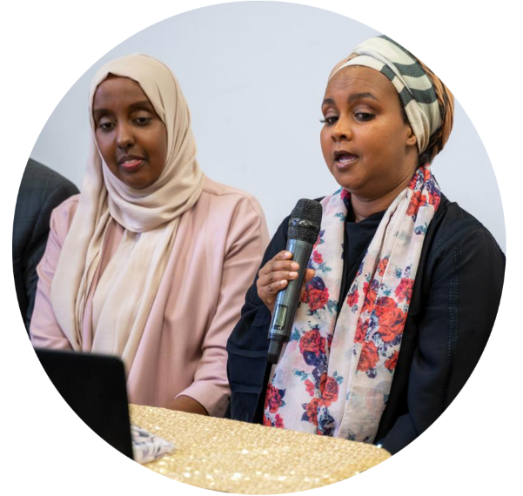
Coproduction with the partners
Recruiting and supporting women to be on the steering group.
Hosting meetings for the groups.
Recruiting, training and supporting champions.
Working with the women at cervical screening events and holding community conversations.
Working with health partners in the learning events.
Qi Project to support women into employment,
Attending events to promote the project.

Slide 106

Community engagement with the Champions
Training on women’s health issues
Sessions that are culturally sensitive in the community.
Opportunities to influence change through working with staff.

Slide 107
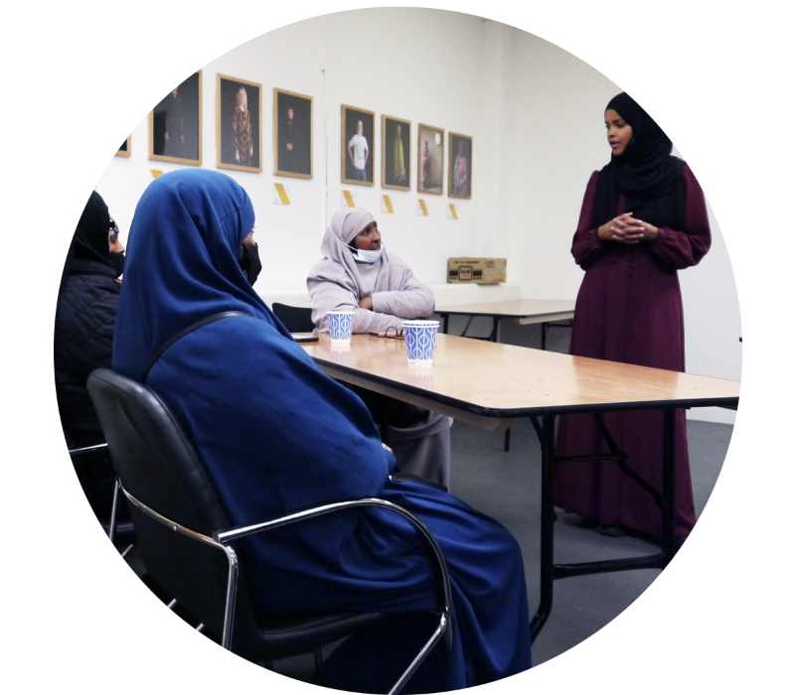
Working with
health services
Public health.
CEPN
GP care group.
Women’s health hub
Maternity services.
Sexual health services.
Other VCS partners delivering health interventions with women.

Slide 108
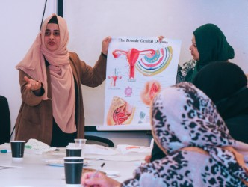
Culturally sensitive approaches to cervical screening
Information sessions in community settings.
Lack of awareness and trust in the communities of women’s health issues.
Cultural barriers due to embarrassment about talking about ‘private parts’
Lack of understanding of HPV and FGM and services.

Slide 109
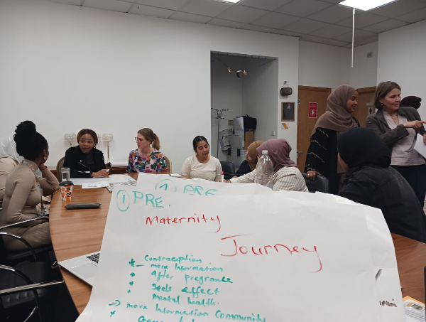
Maternity drop in – in community settings.
Monthly maternity drop ins in community settings.
Involving diverse groups of women to give a voice to their concerns.
Discuss embarrassing issues in a culturally safe space for the women and staff.
Addressing gestational diabetes and supporting women in a culturally sensitive way.

Slide 110

Impact across the system
Supporting staff awareness and training
Health literacy with women – developing consistent approach
Collaborating to identify inequalities and address access to services
Services in the community targeting vulnerable women
Collaborations to support representation and access to employment.
Mapping the health eco system and persona development. .

Slide 111
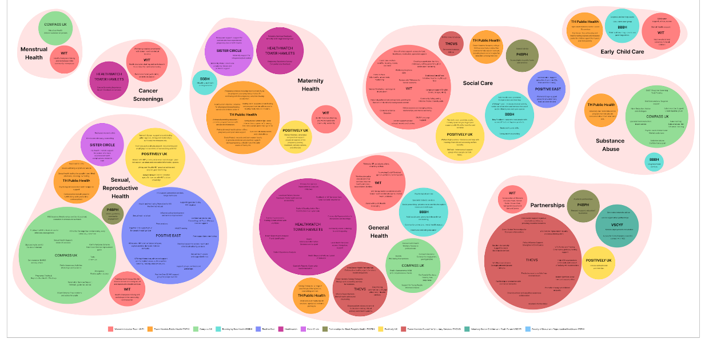
Tower Hamlets sexual and reproductive health services working map by THCVS and MA Service Design (London College of Communication)

Slide 112
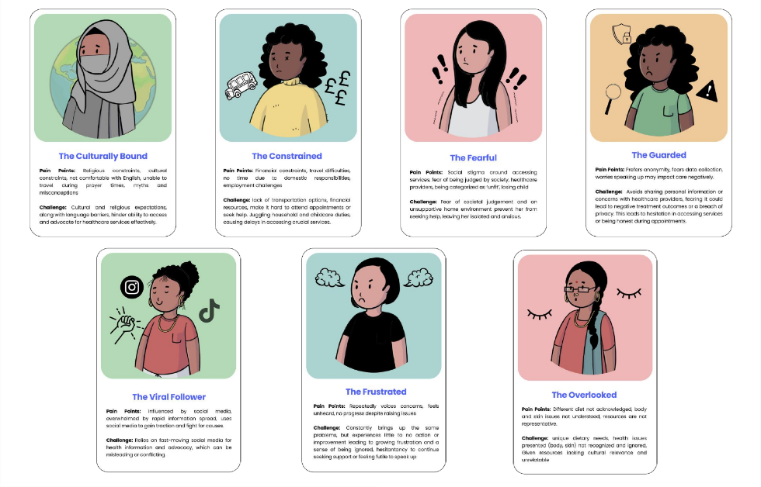
Tower Hamlets Personas: Women receiving inadequate healthcare

Slide 113
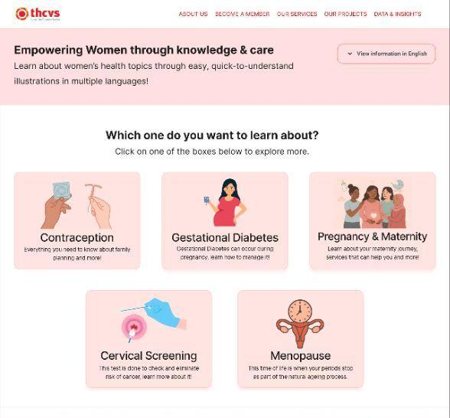
Health Literacy Online Resource
Link to early prototype

Slide 114
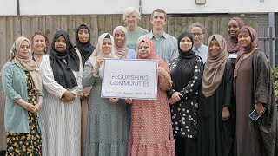
Photo of flourishing communities

Slide 115



Muslim Women’s Health Initiative
Addressing long-term health conditions & inequalities
Phase 1: Voices of 104 Muslim women gathered (focus groups & interviews)
Findings shared with Tower Hamlets Public Health to shape policy
25 Community Champions recruited to co-design health activities
Embedding women’s voices in health literacy programmes

Slide 116

Our ask of the board. What will you do to ?
This programme has been a success in building trust for communities, so, trust is not lost, how will you support embedding the legacy from the project across services ?
Not loose women’s voice and take a risk in continuing to use coproduction and community engagement ?
Support organisations working in women’s health to collaboration?

Slide 117
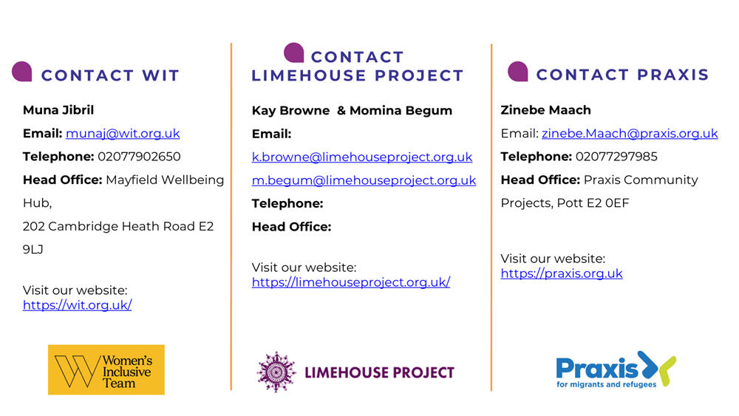
Contact

Slide 118
Thank you for your time
Contact
fc@limehouseproject.org.uk
Alison.Robert@thcvs.org.uk

