Slide 1

Women’s Commission
Safety Evidence Pack For further information, please contact:
Claire Christopher, Senior Strategy and Policy Officer
Claire.Christopher@towerhamlets.gov.uk

Slide 2
The Women’s Commission
The Women’s Commission was established by the Council in 2024 to investigate and address inequalities affecting women across the borough. It responds to the fact that outcomes for women fall behind men:
Gender Inequalities in Tower Hamlets
Women tend to spend fewer years in good health than men
Women’s employment rate is significantly lower, with Black, Asian and Multi-Ethnic women experiencing the greatest disadvantage.
Nearly double the percentage of women are in insecure jobs
Only 40 per cent of councillors are women.
Seventy-five per cent of domestic abuse survivors are women.
Ninety-five per cent of perpetrators of domestic violence are men.

Slide 3
Purpose and Scope of The Women’s Commission
The Women’s Commission represents a borough-wide commitment to addressing inequalities for women and ensuring all women can lead safe, healthy, and fulfilling lives. To achieve this, the Commission will:
Examine the barriers, disadvantages, and risks faced by women in Tower Hamlets.
Identify practical, evidence-based measures to close the gender gap.
Propose a clear and actionable Women’s Strategy that the Council, partners, and the wider community can adopt to drive long-term change.
To shape the scope of the Commission, a workshop with residents was held in June 2024 to identify the key priorities. These were then formalised during a work-planning session with Commissioners in March 2025, alongside the use of local evidence. From this work, four focus areas emerged:
Leadership
Safety
Health
Employment
Enabling and supporting women to take up decision making roles.
Gender inclusive design and feeling of safety in public spaces
Improving physical health, healthy eating, and pathways to health services.
Removing barriers to secure employment and helping women flourish within well-paid and fulfilling work.

Slide 4
Engagement Approach – Let’s Talk Tower Hamlets Survey
To explore the lived experience of women in health, the Commission conducted extensive consultation with residents across the borough:
Idea Store Whitechapel
Let’s Talk Tower Hamlets Survey
Themed Community Workshops
Supplementary Community Workshops
TH Town Hall x 2
The survey was hosted on Let’s Talk Tower Hamlets and was open for eight weeks.
Accessible Survey: the survey was offered online, in print, in a simplified format, and translated into Bengali, with support available for completion.
Promotion: through council communication channels (Twitter, Facebook, LinkedIn) and shared with community organisations to reach diverse groups.
Monitoring: weekly, with communication and outreach strategies adjusted to ensure broad representation.
Outreach: hosted seven stalls over eight weeks, improving access for women with disabilities, language barriers or digital exclusion.
TH Women’s Awards
Muslim Women’s Health Fair
Overland Family Hub
Idea Store Chrisp Street

Slide 5
Engagement Approach – Community Workshops
To gain deeper insight into the lived experiences of women, the Commission convened two community workshops for each theme, delivered in partnership with local organisations across the borough.
From July to September 2025, workshops built on survey findings and enabled women to share experiences in greater depth.
Participation: 118 women participated in community workshops overall with 21 attending safety specific workshops delivered in partnership with Women's Inclusive Team and Solace Women's Aid.
Safe Spaces: held in trusted, familiar settings to ensure women felt safe and comfortable to speak openly. Spaces were women-only, with officers providing support and signposting to services.
Accessibility: prioritised throughout, ensuring fully accessible venues, translators, and advance participation packs.
Recognition: participants were renumerated in recognition of their time and contribution.

Slide 6
Engagement Approach – Supplementary Workshops
The Commission delivered a series of supplementary workshops to ensure that women had the opportunity to share their lived experiences and to address lower engagement among specific groups.
Discussions focused on the four key themes: health, employment, safety and community leadership.
Workshops were run in partnership with local organisations, ensuring trusted and safe spaces for participants.
Targeted groups included women and girls who were young, digitally excluded, Asian (other than Bangladeshi), disabled and LGBTQ+.
Accessibility measures included accessible venues, translation support, and participation packs.
Vietnamese, and Chinese women
Community of Refugees from Vietnam
Women with disabilities
Apasen and Look Ahead
Women of Black heritage
Bow Roman Catholic Church
Digitally Excluded women
St. Hildas and AgeUK
LGBTQ+ women
ELOP
Young women and girls
Youth Council and NumbiArts

Slide 7
Engagement Approach – Respondents Information (1)
In total, 303 women shared their lived experience with the Commission, 111 from the survey, 118 from community workshops and 74 from supplementary workshops.
Of the 303 women who engaged with the Commission, 257 shared information about their protected characteristics.
Engagement reflected a broad cross-section of women, with some overrepresentation in the 35–64 age group and underrepresentation for young girls aged 0-15 years.
Strong representation included:
33% identifying as disabled
14% aged 65 or older
* Percentages may not add up to 100% due to the ‘prefer not to say’ category.

Slide 8
Engagement Approach – Respondents Information
Of the 303 women we spoke to, 175 (58%) spoke about safety. Eighty women engaged with us through the Survey, 21 from community workshops, and 74 from supplementary workshops.
Women were from a range of backgrounds and largely followed the same pattern of representation as the Commissions overall respondent information, but with a higher proportion of carers.
* Percentages may not add up to 100% due to the ‘prefer not to say’ category.

Slide 9

Our Mission for Safety
The Commission seeks to improve the safety of women and girls in Tower Hamlets and ensure everyone feels safe in all parts of their daily lives, from travelling on public transport to walking in the borough. Presently, we know that women and young girls have unequal outcomes with regard to safety when compared to men:
In 2023, 83% of female respondents experienced behaviours in the borough that made them feel unsafe, such as catcalling
Seventy-five per cent of domestic abuse survivors are female
Ninety-five per cent domestic violence perpetrators are male.
Creating lasting change means addressing factors that allow women to feel unsafe and ensuring their safety is embedded across the borough.
To address this, we have listened to women and their experiences to understand the barriers they face, the support they need, and the opportunities that must be created to ensure the borough is safe for all women.

Slide 10
Safety in Public Spaces (1)
“I don’t leave the house when it’s dark”
Eight in ten women who took part in the survey (82.5%) felt unsafe in public spaces across Tower Hamlets. Many described anxiety when alone, leading them to avoid certain routes, public transport or areas perceived as high-risk.
Poor street lighting and poorly maintained public spaces intensified these feelings, limiting women’s freedom of movement and ability to travel safely for work, education and social activities.
Several factors contributed to women’s sense of unsafety:
Anti-social behaviour: around three quarters of respondents identified this a major concern
Harassment and intimidation: from road users, encounters with theft or aggressive behaviour and intimidation linked to drug-related activity
Reckless driving: speeding cars and e-bikes were often perceived as gendered attempts to intimidate women
“Walking home across mile end park, [there is] not enough lighting and at the end of roads groups of men can be scary, especially at night”
“The prevalence of illegal E-bikes and scooters on the streets and pavements… the drug dealers and boy-racers in big fast cars racing up and down the streets all make me feel very unsafe”

Slide 11
Safety in Public Spaces (2)
Among the women who reported feeling safe in the borough, many adopted strategies to manage risk, which included:
Relying on a strong sense of community.
Avoiding dark or isolated areas.
Using spaces with CCTV surveillance.
Despite these precautions, fear and harassment were often seen as a normal part of everyday life for women.
While men generally navigate these spaces without restriction, women frequently felt unable to access them fully or safely. As a result, many described the borough as feeling significantly smaller for them compared to men.
I feel safe when many people are outside when I am outside. I can ask for help if needed instead of having a problem when no one is outside.”
“If I have to go out [at night] I will only go by private hire car as the long intervals between what used to be a frequent bus service mean long waits in dark areas”.

Slide 12
Gender-Based Harassment
Women reported fear and harassment in public spaces, particularly around men in large groups. Many described harassment and sexism as routine, shaping the precautions they take to stay safe. This included:
Avoiding certain areas such as bus stops, canals and parks
Modifying behaviour e.g. avoiding eye contact with men when alone
Keeping a safe distance from men
Travelling in well-lit busy places
Harassment was described as intersecting with other aspects of identity, including religion, race, age and disability. Disabled women reported feeling more vulnerable because of their disability, restricting movement to familiar, well-populated spaces; while queer women described modifying their gender expression to avoid harassment, with concerns heightened by the 2025 Supreme Court ruling.
These experiences were noted to limit women’s freedom of movement and access to public spaces.

Slide 13
Surveillance and Police Presence
Nearly two-thirds of women in Tower Hamlets said they rarely saw police in their neighbourhoods and wanted more visible, local patrolling.
Increased presence of officers, enforcement teams, or community champions was seen as a way to reduce anti-social behaviour, ease anxiety, and provide guidance on where to turn to for help. Without it, women often felt that they must manage their safety on their own.
Visibility, however, was deemed by women as not enough, officers must be approachable, responsive and supportive. Many described previous interactions with officers as cold, unhelpful or biased due to age, race, or sexual orientation.
Women highlighted a need for:
Clear guidance on where to go to report instances of harassment
Being taken seriously and believed by authorities
Sensitive, trauma-informed responses and support
“A man launched into verbal abuse, threatened me with violence, people laughed, everyone else looked the other way. If I went to the police, what would they do? [I] fear that the police would downplay, ‘what do you want us to do’.

Slide 14
Shaping Safer Spaces
Women want to play an active role in designing safer public spaces and services, ensuring that policies and community initiatives reflect their lived experiences and address daily safety challenges.
A need for greater representation of women in leadership and decision-making roles was highlighted, alongside mechanisms for meaningful input into policies that affect their safety.
Community-centred outreach was also emphasised as essential to creating safer environments. Key suggestions included:
Women-only spaces
Family-friendly provisions
Self-defence classes
Overall, women called for sustainable and collaborative approaches to decision-making that place their safety central to local planning and service provision.
Women’s Voices at the heart
Renumeration
Consulting Women
Resident Working Groups
Women in Leadership
Better Representation
Codesign

Slide 15
Summary (1)
Experiences of safety in public spaces
Women feel unsafe particularly at night, avoiding certain routes and areas due to harassment, poor lighting, anti-social behaviour and reckless driving, with impacts on freedom of movement and daily activities.
Recommendations from women
> Improve and increase lighting across public spaces in the borough
Gender-Based Harassment
Women experience harassment and fear, particularly form men, and adjust their behaviour or limit mobility accordingly. Harassment often intersects with religion, race, disability and gender expression.
Recommendations from women
> Improved police presence and tackling of male violence and harassment against women
“Better lighting, especially at bus stops where you feel especially vulnerable when alone with little routes of escape…”
“More well lit streets, more police presence around, reduction in anti social behaviour.”

Slide 16
Summary (2)
Surveillance and Police Presence
Women report a lack of police presence, calling for increased, responsive and supportive officer presence, clear guidance, and trauma informed support to feel safer reporting incidents.
Recommendations from women
> Targeted training on responding to women’s safety concerns sensitively and in a trauma-informed way
> Increase in police presence, i.e. increased neighbourhood patrolling
Shaping Safer Spaces
Women want to be actively involved in designing safer public spaces. Recommendations from women
> Resident working groups that foster co-design and make women’s voices central.
> Increase representation of women in decision making spaces and leadership roles.
“It would also help for police and community leaders to be trained well in how to deal with scary and delicate issues women may face”
“Having regular community outreach set up can make women feel safe. Also making women aware of organizations that are in place to help when in need”

Slide 17
Sources
Department of Health and Social Care (2021). Health Profile for England: Chapter 1 – Life expectancy and healthy life expectancy. London: UK Government. Available at: https://www.gov.uk/government/publications/health-profile-for-england/chapter-1-life-expectancy-and-healthy-life-expectancy
Women’s Budget Group (2023). Women and the Labour Market. London: WBG. Available at: https://www.wbg.org.uk/publication/women-and-the-labour-market
UK Government (2023). Employment by Ethnicity. Ethnicity Facts and Figures Service. Available at: https://www.ethnicity-facts-figures.service.gov.uk/work-pay-and-benefits/employment/employment/latest
Lancaster University (2023). New study shows working women at sharp end of cost-of-living crisis, with 26% trapped in severely insecure work. Lancaster: The Work Foundation. Available at: https://www.lancaster.ac.uk/news/new-study-shows-working-women-at-sharp-end-of-cost-of-living-crisis-with-26-trapped-in-severely-insecure-work
Office for National Statistics (2024). Domestic abuse victim characteristics, England and Wales: year ending March 2024. London: ONS. Available at: https://www.ons.gov.uk/peoplepopulationandcommunity/crimeandjustice/articles/domesticabusevictimcharacteristicsenglandandwales/yearendingmarch2024
Women’s Aid (2023). Domestic abuse is a gendered crime. London: Women’s Aid Federation of England. Available at: https://www.womensaid.org.uk/information-support/what-is-domestic-abuse/domestic-abuse-is-a-gendered-crime
Tower Hamlets (2024). Tower Hamlets’ Borough Equality Assessment 2024-2026. Available at: https://share.google/SUdzfKcRHixfZ5fZI
Sports England (2022). Active Lives Children and Young People Survey Academic Year 22/23. Available at: www.activelives.sportengland.org
Office for National Statistics (2021). Census 2021. Available at: https://www.ons.gov.uk/census

Slide 18
Women’s Safety In Public Spaces Women’s Commission Menara Ahmed December 2025
3M

Slide 19
National Landscape
Women’s safety in UK public spaces remains a pressing concern in 2025, with national strategies evolving but facing gaps in implementation, funding, and measurable outcomes.
Current national context:
-National Action Plan on Women, Peace & Security (2023–2027)
-The UK government’s fifth National Action Plan (NAP) focuses on women’s safety, particularly in conflict-affected and marginalized communities.

Slide 20
TH Strategic Overview
Theme 6 in Serious Violence Strategy:
-Prioritising women safety in public spaces
-Carrying out community prevention and awareness to tackle misogyny
Extensive VAWG Needs Assessment 2024
Tower Hamlets 4th Violence Against Women and Girls Strategy October 2024 – first 2012. Link
Sets out role we can all play in tackling VAWG through a coordinated community response.
Now includes women safety in public spaces
Development and implementation of annual Action Plan
CSP commitment – 10% increase in women who report feeling safe in public spaces at night.
Three overarching priorities:
Preventing harm and promoting safety
Supporting victims and survivors
Responding to perpetrators

Slide 21
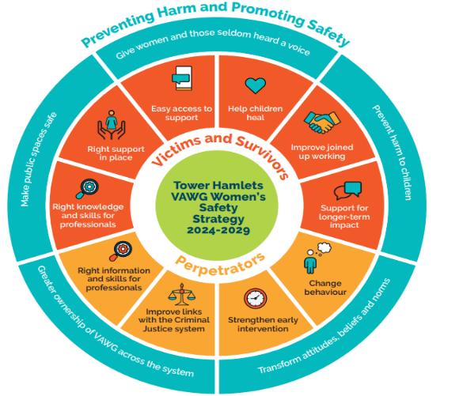
What are we doing to tackle VAWG and women’s safety in public spaces?
Notes:
Model we base our work around – the overarching theme of preventing harm and promoting safety.
Action plan sets out our clear actions, with associated, measurable, outputs and outcomes.

Slide 22
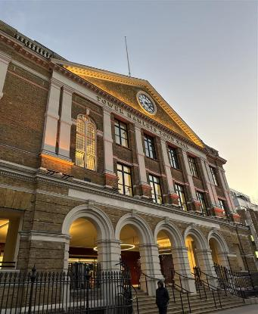
VAWG, DA & Women’s Safety Team (1)
Development and implementation of VAWG Strategy ensuring new focus of women safety in public spaces is embedded as a priority across the Partnership, not just VAWG Team
Continued awareness raising and promotion of VAWG/women safety offer
Collaboration with Tower Hamlets Inter-faith Forum (THIFF) and Council of Mosques.
Increasing engagement with Muslim women – intersectionality
Incorporating women safety/VAWG in Friday sermons

Slide 23
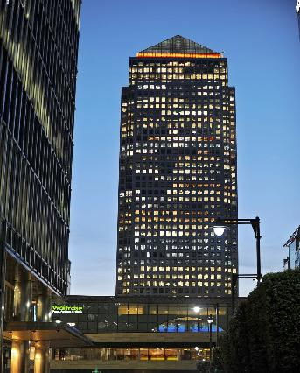
VAWG, DA and Women’s Safety Team (2)
Weekly Domestic Abuse One Stop Shop
Marginalised Migrant Women - Collaborate with Praxis and join the VAWG/Asylum GLA London Council Group to actively contribute to ways to address the significant barriers asylum seekers face when reporting incidents of VAWG
Gender based abuse Campaigns (16 Days Activism)
Promote VAWG Service Directory with all victim services promotion including help with perpetrator behaviour
Promote Report it to Stop it campaign (TFLs sexual harassment campaign)

Slide 24
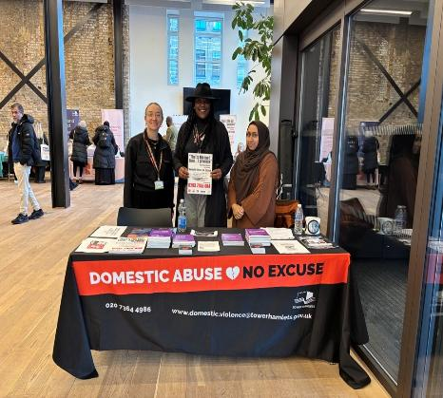
VAWG, DA & Women’s Safety Team (3)
Misogyny training
Male Allyship Project
Extensive VAWG training offer (VAWG Champions Project – Community and Professionals including neighbourhood and customer contact teams)
Targeted training and awareness ensuring all communities reached across protected characteristics/intersectionality
LBTH Policies (Sexual Harassment, Domestic Abuse Guidance)
Partnership working with London Legacy Development Cooperation with Hackney and Newham in working around women safety across shared spaces (canals, parks)

Slide 25
Broader VAWG & Women’s Safety Plan Activities
Continue commissioning hostel provision for single women with multiple complex needs ensuring they receive comprehensive, psychologically informed wrap around support that is gender informed.
Women’s Resource Centre (Nari) – dedicated safe space for women
Family Hubs – safe space for women
SHEWISE deliver holistic, trauma-informed, culturally responsive support services and programmes for marginalised ethnic minority women and girls, particularly from South Asian and Middle Eastern backgrounds.
Comply and develop a policy to fully respond to the new Work Protection Act duty for employers to prevent sexual harassment (SH) in the workplace.
PSHE Programme of work includes tackling misogyny
Prevent training includes extreme misogyny in Counter Terrorism Local Profiles
-VAWG services and signposting included in training
-Sporting Foundation Project (last year) to recognise young girls/women were vulnerable to being drawn into being radicalised

Slide 26
Broader VAWG and Women’s Safety Plan Activities
Door of Hope, (commissioned to Beyond the Streets) delivers support service in the borough for women who sell survival sex.
Outreach sessions per week in high risk areas on-street sex industry.
Volunteers offer sexual health packs, hot food and drinks and information on safety and support services.
In 2024/25 DoH delivered 109 outreach sessions and supported 56 unique women.
MPS monthly patrols and arrests of men who loiter for the purpose of buying sex
You Choose Programme - awareness course with Streetlight UK.
95% participants not reoffending, thus contributing to safer streets in Tower Hamlets.
Dedicated Womens Criminal Justice Pathways Coordinator – creating and maintaining pathways for women out of Criminal Justice system
Partnership and collaboration within Criminal Justice System partners (LJA, LCJB)

Slide 27
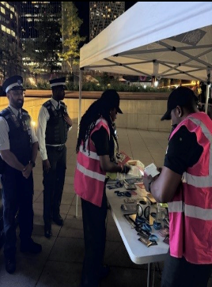
Integrated Enforcement Service (1)
THEOs and CCTV supporting Live Facial Recognition Ops in the borough – positive results in identifying registered sexual offenders
Don’t Cross the Line campaign event in Canary Wharf (Aug25) – multi-agency engagement night with THEOs, Canary Wharf Group, Trading Standards, Licensing Police/SNT to raise awareness on VAWG linked to the Night-Time Economy (spiking and night-time safety).
Dedicated Town Centre Police Team Whitechapel working closely with Integrated enforcement resources – hotspot for sexual offences crimes
New Business Crime Reduction Initiative launched in Whitechapel to tackle business crimes

Slide 28
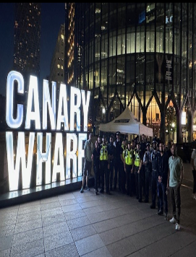
Integrated Enforcement Service (2)
New Met Engage Initiative – council partner – gives women the opportunity to shape policing
CCTV Transformation Programme: 350+ cameras upgraded, and a new CCTV control room launched in the Phase 1 of the Programme (3M investment). 3.7M have been allocated to Phase 2 which will see the expansion of CCTV onto council estates and blocks. Crucial intervention to increase women’s perception of safety and women’s safety in their local area.
All CCTV operators trained in women safety
New ASB Response line launched and manage by CCTV – women will be able to raise their ASB issue when they are occurring and have an immediate response from THEOs

Slide 29
Integrated Enforcement Service (3)
Expansion of THEOs service completed (64 officers).
Increased resources allows more night-time shift patterns
Increased community visibility including VAWG hotspots
Drug Squad launched to tackle 50 most prolific street-based drug-related ASB perpetrators, often prolific acquisitive crimes perpetrators too.
Initiative aims to support people into treatment, safeguarding women at risk of exploitation to feed their addiction.
Reducing visible drug use/dealing
Women THEOs – the proportion of female THEOs have risen from 7% to 35%
Joint patrols and operations between council, police and other partners to tackle areas known for exploitation of women selling survival sex
Exploring feasibility of Public Spaces Protection Orders for sexual harassment
Personal alarms and anti-spiking gadgets distributed to women
Notes:
Drug Squad launched in the summer to tackle the 50 most prolific street-based drug-related ASB perpetrators, often prolific acquisitive crimes perpetrators too. The aim of this initiative is to support people into treatment, safeguarding women at risk of exploitation to feed their addiction. By reducing visible drug use/dealing, the initiative is also expected to increase women’s safety in public spaces and places – reducing for example the repeat victimisation rate of women working in retails

Slide 30
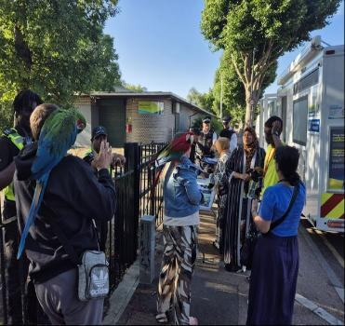
ASB Team (1)
Officers trained as VAWG Champions
Specialist Training on harassment, gender-based safety concerns to ensure informed and sensitive responses
Trained to undertake Environmental Visual Audits (EVA)
Recommendations made for environmental changes (e.g., lighting, CCTV, layout) to improve safety.
For complex cases, the DOCO Crime Prevention Manager conducts a formal EVA and produces a detailed report.

Slide 31
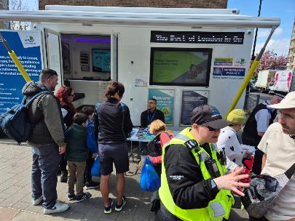
ASB Team (2)
Regular Community Engagement events to educate residents on reporting ASB, crime, and women’s safety concerns. Distribution of literature, panic alarms, and safety resources at events, ward panels, and resident meetings.
Collaboration with Safer Neighbourhood Teams (SNT) for initiatives like phone and bike marking events, enhancing overall community safety.
Safe Reporting Channels
Clear, confidential routes for women to report concerns, with signposting to specialist support services.
Awareness & Prevention
Public campaigns and direct engagement to challenge harmful behaviours and promote respect in shared spaces.

Slide 32
Parks & Open Spaces (1)
Installation of 10+ outdoor gym zones to help promote women usage in parks, and also exercise / healthy living
Improve lighting across park routes, entrances, and parking areas to extend safe evening use for women
Use diverse, low-maintenance planting (e.g., spring bulbs, native trees, pollinator beds) to create welcoming, colourful spaces for locals to enjoy
Upgrading of numerous playgrounds with accessible and inclusive equipment, shaded seating, and parent-friendly layouts for mothers with children
Increase presence of THEOs and regular patrols, especially around peak use times
Support friends groups for litter picking, park maintenance, and seasonal beautification projects with women participants

Slide 33
Parks & Open Spaces (2)
Scheduled regular holiday-term activities in larger parks for families, which attracts mothers and women (arts, crafts, fitness, parent-child programs)
Delivery of nature walks and ecological learning programs, encouraging residents to learn more local nature, in particular women and children
Facilitate collaborative community events by local groups
Improve accessible paths and stroller friendly routes with smooth surfaces, gradual slopes, and rest stops
Introduce regular maintenance schedules and rapid-response teams for trip hazards, broken equipment, and graffiti in women-heavy areas
Promote women-led volunteering and leadership opportunities within park stewardship programs
Management of horticulture, by way of reducing dense vegetation to open up sight lines / visibility, to help women and children navigate the parks, but to also deter ASB, rough sleeping etc
Working on partnership with the local Police, Councils rough sleeping team and THEO’s to help address ASB and crime in parks

Slide 34
Young People
Youth Champions Project (including some members of Youth Council)
The VAWG Whole School Approach - training for staff and parents (including Queen Mary’s University)
Anti-VAWG School Pledge
Weekly young women's sessions Haileybury Youth Centre for sports, drop-in, crafts
Future sessions to have VAWG projects.
Youth Charity Women Event – Women Safety workshops planned by young people.
The group also held a fundraising bake sale for safe spaces for women
VAWG Stall held at the education awards
Youth Council VAWG project – survey of young people’s experiences, teen relationship/issues findings to be presented in January

Slide 35
London Fire Brigade
Various projects ensuring youth engagement, confidence building and crime awareness raising
Driven and Taken Away
Junior Citizens Scheme – TFL/LFB partnership – 2400 engaged on how to be safe, aimed at Year 6
Cadets - safe space for 13-17 year olds including girls, awareness around safety, encouraged to address any concerns
Outcomes include increased confidence building of young girls

Slide 36
TH Women’s Network
Provides platform for advocacy and addressing barriers for female employees
Key priorities include health and safety
Support Groups
Awareness Campaigns
Training and Policy influence – Sexual Harassment Survey
Contribution at Corporate Equalities Board, VAWG and Women Safety Board
Events and learning

Slide 37
Highways
10500 street lights now LED and set above British Standards for lighting the public highway
Wide footways
Introduced a central management system (CMS) which monitors any outages in real time avoiding delays in maintenance contractor resolving issues
Removal of flags on highways without lawful authority
Not allowing street furniture, such as the new BT Hubs, which allow someone to hide behind and removal of unnecessary clutter such as euro bins on the highway.
CCTV in hotspots.
Design out crime principles for new developments to enhance natural surveillance.
Safety improvements at public transport hubs – buses, rail and at crossing points.

Slide 38
Key Challenges
Limited domestic implementation due to resourcing.
Ensuring intersectional approaches—marginalised groups often remain underserved.
Slow rollout of national frameworks at the local level and inconsistent resources
Ensuring tackling women safety is everyone’s business and embedding across services and organisations
Difficulties in obtaining measurable outcomes
Increasing trust and confidence of women (i.e. with Police)
TH densely populated yet (8 sq miles) ensuring safety is key thought in design
One of most deprived boroughs in London
Lack of control around national media and cases and impact locally in women feeling unsafe
Global challenges around misogyny and education
Tackling barriers to participation
Take up of misogyny awareness from all (not mandatory)
Criminal Justice System (prosecution rates etc)
Take up from Schools to receive and deliver more awareness around misogyny/safety

Slide 39
What more can we do?
Allocate resource for this new priority to mitigate against limitations of implementation
Exploration of Public Spaces Protection Orders
Community leaders/Cllrs/Womens Commission to become VAWG Champions/male allies/attend training
All to challenge Misogyny within communities
Support training, outreach and awareness campaigns
Procurement contracts to include women’s safety proposals i.e. x% of staff trained on misogyny, organisation has a domestic abuse policy, sexual harassment policy etc

Slide 40
Women’s Commission
Regulatory Services

Slide 41
Regulatory Services
Improvement to public spaces
In 2022 as statutory review of the borough’s Statement of Licensing Policy was carried out. The reviewed policy came into force on 1st November 2023. The changes included additional sections on tackling sexual harassment in the Night Time Economy :
encourage licence holders to sign up to Women's Night Safety Charter,.
placed and expectation on licence holders to take a zero tolerance in regard to sexual harassment and refuse entry/service in the event of an act of misogyny,
encourage applicants to discuss applications with the Councils VAWGs Team,
encouraged licence holder and their staff to attend Welfare and Vulnerability Training (WAVE). This training also incorporates “Ask for Angela.

Slide 42

Regulatory Services
Improvement to public spaces
Late Night Levy funded actions:
Pre 2024 -
Patrol:
Street pastors
Police
Medics
Joint work with LB Hackney, City of London and LB Tower Hamlets to launch #dontcrosstheline
Additional CCTV Cameras in Hackney Wick
Improvement to public spaces
Late Night Levy funded actions:
Post 2024 -
Patrol:
Police
Police VAWG Cars
Promotion of #dontcrosstheline
Anti-Drink Spiking Awareness Activation
Purchase of #dontcrosstheline bracelets

Slide 43
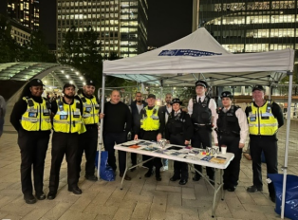
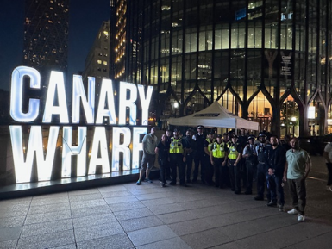
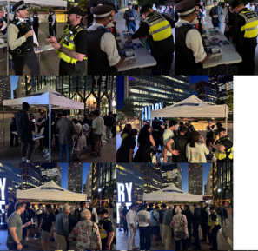
Regulatory Services
Improvement to public spaces
Anti-Drink Spiking Awareness Activation - Photos
20 September 2024 Canary Wharf –
Joint operation with Licensing Officers. Police, THEOs, and Canary Wharf Management
8 August 2025 Canary Wharf
Joint operation with Licensing Officers, Police, including VAWG Officers, THEOs.

Slide 44
Regulatory Services
Improvement to public spaces
Planned work:
Relaunch of #dontcrosstheline:
Working with Police to arrange more activations in different locations in the borough,
Letters to all licence Bars, Pubs, Clubs, Restaurants, and Hotels (circa 750 premises)
Other measure:
Attendance a pub watches (4 in the borough – Hackney Wick, Canary Wharf, Brick Lane and Bethnal Green),
Best Bar None, best practice scheme that aims to improve safety, and promote responsible licensing.
Targeted operations to Massage Parlours to ensure services of a sexual nature are not being offered.

Slide 45
Regulatory Services
Training
From October 2023 to May 2025:
Self-defence Boxfit classes for the female employers, employees and local community organisation representatives delivered between October 2023 to May 2025.
This has resulted in Council’s Leisure Services implementing an improved offer of boxfit classes for women.
Leisure Services (part of the Communities Directorate Culture Division) have agreed to offer the Wednesday classes free of charge for council staff.

Slide 46
Women’s Commission Presentation
9th December 2025
Sripriya Sudhakar
Director, Planning and Building Control

Slide 47
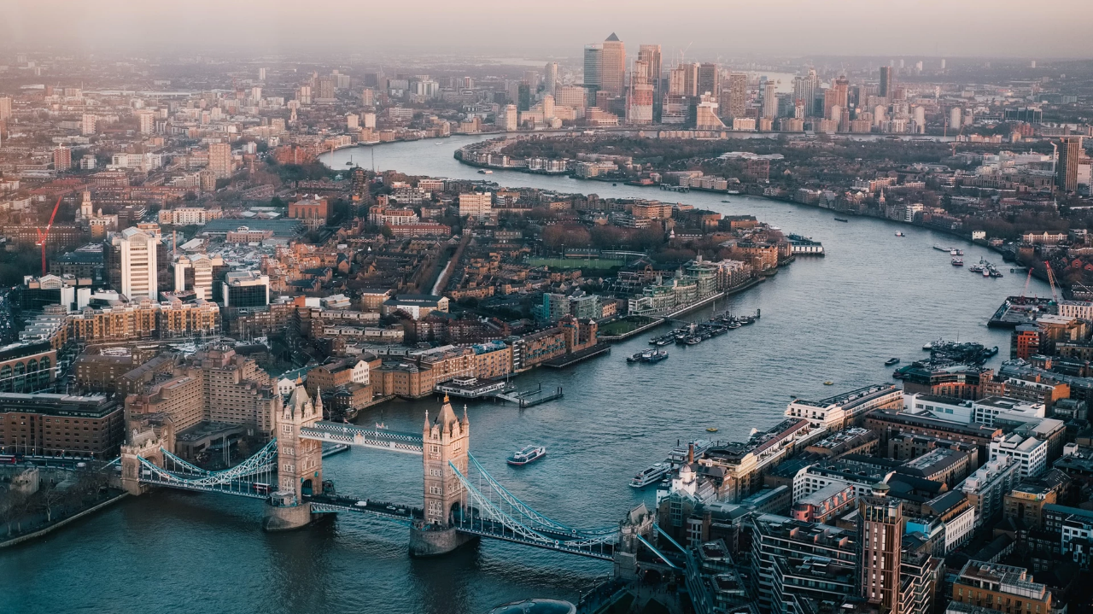
The Commission seeks to improve the safety of women and girls in Tower Hamlets and ensure everyone feels safe in all parts of their daily lives, from travelling on public transport to walking in the borough.

Slide 48
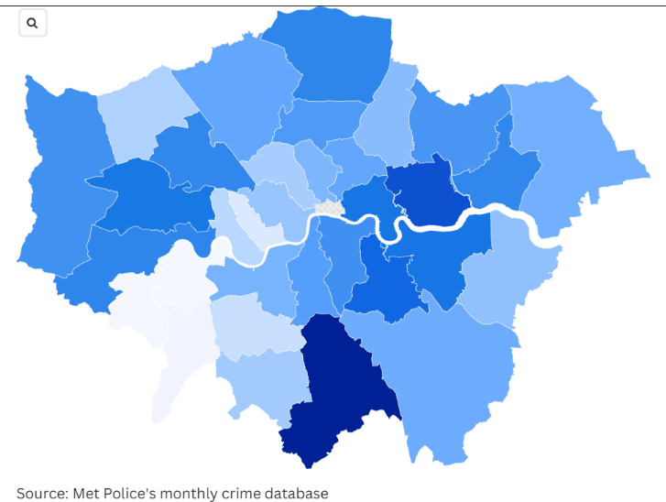

When accounting for population per 1,000 residents, Barking and Dagenham (2,879) had the highest number, followed by Tower Hamlets (3,605), Greenwich (3,117), Lewisham (3,266), Hounslow (2,911), Croydon (4,018), Newham (3,516), Haringey (2,602), Islington (2,168) and Hillingdon (2,739).

Slide 49
Safety in Public Spaces
Home - place of safety, security, known, familiar,
Outside – Unknown, unfamiliar, fear, strangers
Estate /Block
Street
Neighbourhood
Borough
City
Country

Slide 50
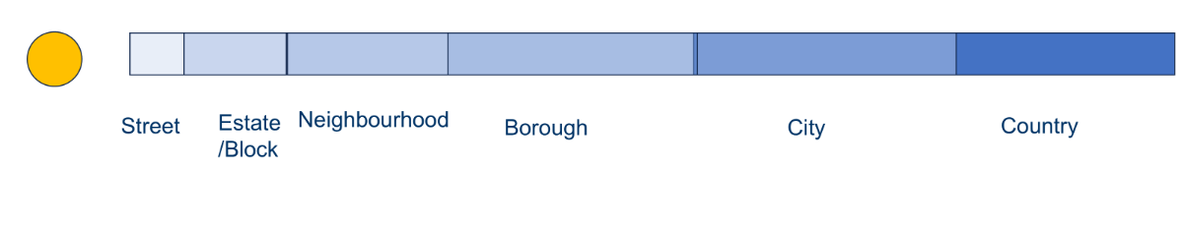
Safety in Public Spaces
Experiences of women in cities has not always been positive.
Inequality women experience in homes and public spaces are all too common as identified in the women's commission work and interviews.
Domestic violence and threat experiences by women in their own homes is all too common. And we need to get our homes safe for women to feel safe in the first place. And good work is being done by everyone in this room.

Slide 51
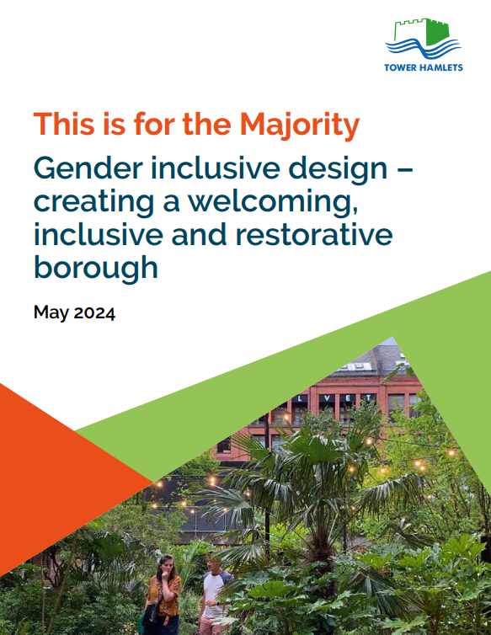
Women in Public Spaces - Policy
Gender inclusive design is an approach to development that learns from the experiences of women and girls in order to build inclusive, healthy, child friendly, climate resilient places that are socially and economically prosperous.
This report was prepared to inform planning policy in London Borough of Tower Hamlets. It is an evidence base for the new Local Plan and has been through public consultation.
The findings of this research have been aggregated throughout the new Local Plan draft with input into each policy and this document will be circulated across the council and further afield, in order to encourage shared approaches and collaborative strategies that embed equity in the built environment.

Slide 52
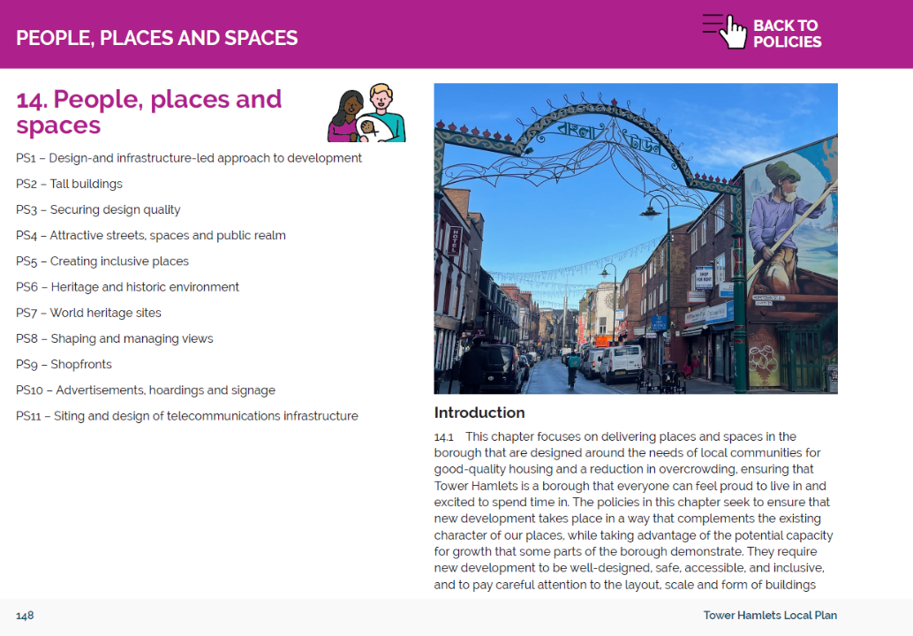
Local Plan Policies

Slide 53
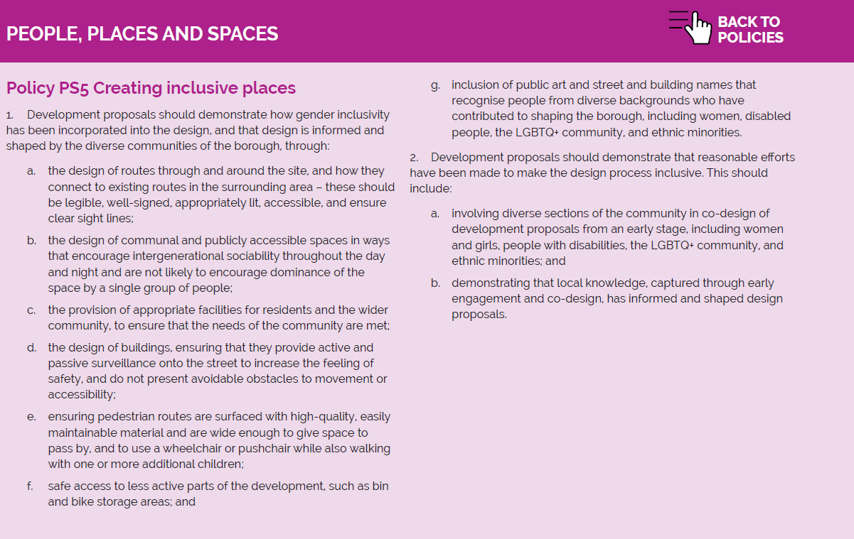

Slide 54
Women in Public Spaces - Practice
Enabling and supporting women to take up decision making roles.
Planning practice
Gathering Intelligence
Visits
Democratic Processes
Practitioners
Lived Experience
Knowing the borough
Leadership
Gender inclusive design and feeling of safety in public spaces
Safety
Improving physical health, healthy eating, and pathways to health services.
Health
Removing barriers to secure employment and helping women flourish within well-paid and fulfilling work.
Employment

Slide 55
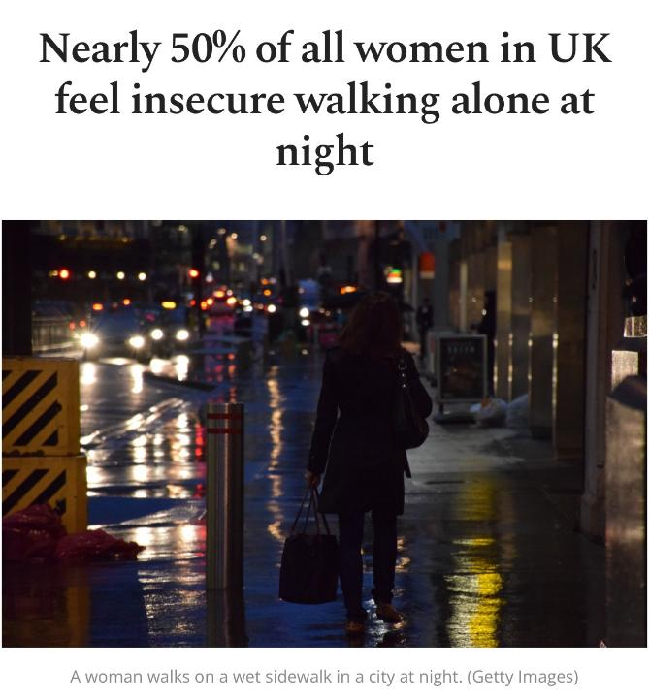
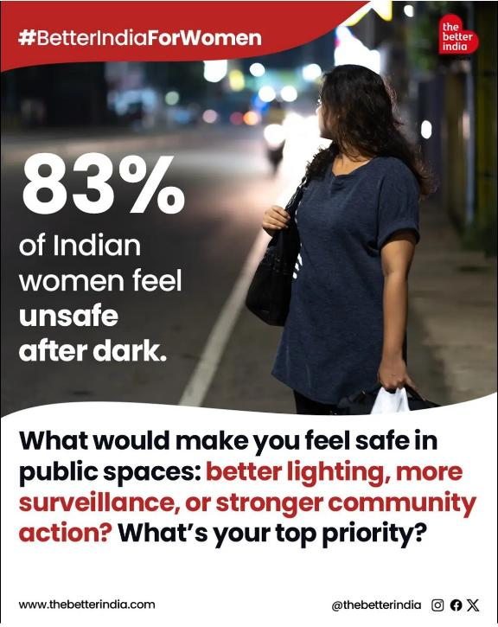

Slide 56
Yasmin Lalani
Detective Chief Inspector
Metropolitan Police

Slide 57
Presented by: DCI Yasmin Lalani
Tower Hamlets Women’s Commission: Formal Public Review on Women’s Safety in Public Spaces.
Introduction
Purpose: Review current efforts, challenges, and opportunities to improve women’s safety in Tower Hamlets.
Focus: Metropolitan Police initiatives, barriers, recommendations
•16 days of action 25th November to 10th December 2025:
•Women’s Safety Community Stall – Whitechapel Town Hall
•Green Space Patrols – Bethnal Green Gardens / Weavers Field
•St Agnes Green Walk Talk and DO, 1200-1300hrs, Mile End Ward Walk and Talk to be held in Mill wall Park, E14 to raise awareness about Violence Against Women and Girls (VAWG)
•Street Briefing
•Green Space Patrols – Bethnal Green Gardens / Weavers Field
•Safety Surgery near Chrisp Street Market E14, this would be held to raise awareness about VAWG and also focusing on retail premises that have the highest amount of business crimes and also female employees
•Bike and Phone marking Walk, Talk and Do Event – Whitechapel Road
•Hostel visits, speaking with females and young families Male Allies C Women’s Safety Talk – Whitechapel Town Hall
•East London Mosque – Jummah (Prayer) Input
•X2 Welfare vehicle covering Hackney and Tower Hamlets VAWG hotspots
•Event with THEO’s at transport hubs Walk and Talk held near Tesco, Poplar High Street, E14 to raise awareness about VAWG
•VAWG Safety Surgery @ Mile end Uni with Safer Communities.
•High Vis Patrols markets and shopping areas
•Roman Road Market, Walk Talk Walk, Talk and Do Event – Spitalfields market, Shadwell area, Bow,
•Ask for Angela training at licensed premises

Slide 58
Metropolitan Police Initiatives
Key Actions in Tower Hamlets:
•Project Vigilant C Verona: Targeting predatory behaviour in night-time economy. Walk and Talks: Officers Walk with women to identify unsafe areas.
•Street Safe App: Anonymous reporting of unsafe locations.
Barriers to Women's Safety
•Underreporting of Violence
•Intersectional Vulnerabilities
•Urban Regeneration Impacts
•Cultural and Systemic Barriers
Learnings from Engagement
•Importance of trauma-informed approaches.
•Need for co-production with women’s groups.
•Value of real-time feedback via safety walks and apps.
Recommendations for the Borough s Partners
•Champion male allyship and leadership.
•Expand community engagement and co-design.
•Improve lighting, visibility, and surveillance.
•Invest in holistic support services.
•Promote education and early intervention.
Conclusion
•Progress made, but challenges remain.
•Collective action needed across police, council, and community.
•Let’s build a safer, more inclusive Tower Hamlets for all women.

Slide 59


Enhancing Women’s and Girls’ Safety in Public Spaces
Insights & Recommendations
Minara Uddin-Meghna
Notes:
Welcome everyone to the Tower Hamlets Women’s Commission Public Review Meeting.

Slide 60


Introduction
WE WANT TO LIVE DAY TO DAY FREE OF FEAR IN PUBLIC SPACES
Street Harassment undermines women’s/girl’s safety, restricts our freedom and feels intimidating
Once upon a time fear free routes felt safe, now feels unsafe while jogging/running/walking such as canal side-walkways, or to enjoy nature the parks on own
Changing personal behaviours and routines to feel safer
Hate crimes that are gendered and racialised - physical violence and verbal abuse on women in public spaces
Notes:
Assalamu alaikum / Good evening, everyone. I'm Minara Uddin-Meghna, honoured to speak as an advocate for women's safety and empowerment in London.

Slide 61


Statistics discussed with groups
57% of women in London feel unsafe on streets - 68% for ages 18–24 (www.survation.com 2025).
Prevalence of Harassment: A 2021 survey by UN Women UK found that 97% of young women in the UK have experienced sexual harassment in public spaces.
The murders and attacks on women in UK public spaces are significant issues that have sparked national conversations and calls for institutional change. High-profile cases have highlighted the fear and danger many women experience when in public.
Notes:
Share these statistics to emphasize the urgency of addressing women's safety.

Slide 62


Recent High Profile Cases
Never Forgotten;
Sarah Everard – Abducted, raped and murdered as she was walking her usual route home
Sabina Nessa – Murdered while taking a short walk through a park near home on her way to meet friends
Zara Aleena – Killed while walking on a busy street ,on her way home
Bibaa Henry and Nicole Smallman - Murdered in a country park celebrating a birthday
Amie Gray – Murdered in a knife attack while sitting with a friend on a beach
Lives of women taken all in public spaces and surroundings

Slide 63
Newark Youth London Community Initiatives to promote safety and awareness; Women's walking Club: Promoting safe routes & engagement with activities Boxing sessions- Girls feel empowered attending girls only sessions build confidence and learn how to defend self, to stay alert of surroundings when on own GIA-Girls In Action project – Enable girls to have a voice, be heard and speak about concerns, be involved in social action, raise awareness and bring about change in the community and wider Blossom Project: Supporting physical health and wellbeing of women and girls – cycling, yoga, creativity, catch up chat sessions over a hot drink-talk about concerns and challenges Youth Clubs: workshops - raising awareness and challenge sexist behaviours in public spaces, educating on respectful relationships towards women/girls, create a culture of respect and safety in youth clubs and other spaces, providing information.
Notes:
Highlight your initiatives and their positive impact on the community.

Slide 64
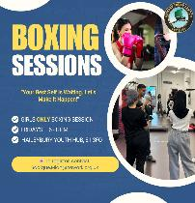

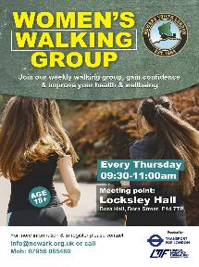


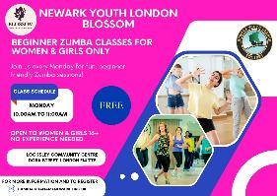

More activities and information can be found on website and social media channels

Slide 65

Outcomes from group chat and projects activities;
Barriers-Challenges
Hesitant to report in case of being victimised by perpetrator, feeling vulnerable as Black, Asian and Minority Women or just because they are a ‘Women or Girl’
Intersectional identities – Racism – Islamophobia - Xenophobia
Concerns of safe space in case of an emergency when outside
Avoid walking anywhere on own, will only use of cabs and driving even if it is a short walk
Notes:
Discuss practical steps women can take to enhance personal safety.

Slide 66
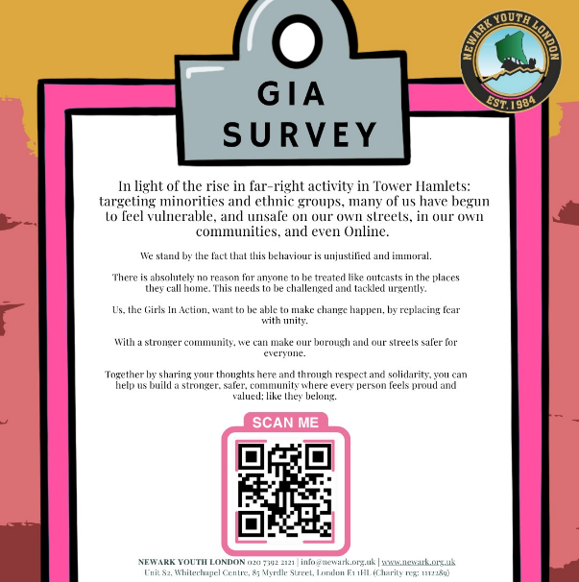
Newark GIA Survey for active community participation;
Girls In Action – Girls For Change
This survey is active for participation till the end of December 2025. Findings will be ready to share beginning of 2026.
To contribute towards Tower Hamlets public safety review.

Slide 67

Recommendations
Access streets to improve and increase street lighting & CCTV coverage in public areas to deter perpetrators.
Emergency response systems - install emergency phones or panic buttons in public spaces, parks, and public transport.
Designated safety zones across the borough community, collaborative partnerships, work with local businesses, community groups, and law enforcement.
Inclusive Design-Involve women and girls in designing public spaces to ensure they're safe and accessible for all.
Education and Awareness - Allocate funds for education, awareness, and information materials to promote a culture of respect in community, education sector and workplaces.
Funding for community projects activities and initiatives that promote women's safety and empowerment. Education and training - such as free self-defence sessions, encourage reporting without fear.
Bystander Training - Educate communities on how to intervene safely and support victims of harassment.
Develop and distribute resources and materials that raise awareness about sexual harassment and violence in public spaces and the law.
Notes:
Outline actionable recommendations for improving safety in public spaces.

Slide 68
Call to Action
Safety is a shared responsibility
Work together to create safer public spaces
We can create a culture where women and girls can thrive without fear of violence or harassment
Notes:
Encourage collaboration and participation to create safer communities.

Slide 69
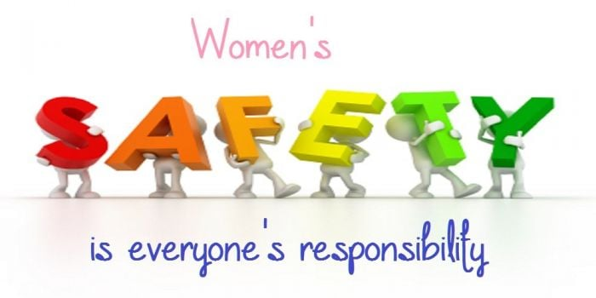


Thank you.
Notes:
Invite questions and feedback from the audience.

Slide 70
Tackling and Preventing violence
How to Protect Women & Girls in Public Spaces
A public space formal or informal should be a place where women and girls feel safe and secure at all times of the day and night. This includes people of all ages, from children to the elderly, and individuals of all abilities.
Women and girls should be safe, supported, and empowered in all public spaces physically, mentally, emotionally, socially, spiritually, environmentally, and recreationally. They should be able to build supportive networks and access essential services without risk, fear of harm, or judgment.
Human Rights • Safety • Equality • Dignity

Slide 71
Prevention Measures
Ensuring the safety of women and girls requires prevention measures, with a strong emphasis on early intervention and tackling unconscious bias, mediation and counselling.
Prevention transforms social attitudes, especially by educating ALL to respect and uphold the dignity of others.
A preventative system can save lives, reduce public spending, reduce court cases and create safer, more resilient communities.

Slide 72
Current normalised Prevention Measures
Personal Safety
Stay alert: Be aware of your surroundings. Avoid using headphones in both ears.
Identify hazards: Assess risks and take precautions.
Know what to do in a threat: Move to populated areas, make noise, or call for help.
Recognise, respond, and report concerns or incidents.
Avoid isolated spaces: Stay away from alleys, doorways, bushes, or other secluded areas where someone could hide.
Use direct, populated routes.
Plan routes ahead of time.
Leave venues with friends whenever possible.
Watch your drink: Never leave drinks unattended at parties, restaurants, or events.
However, we would like to see this changed by the Commission.

Slide 73
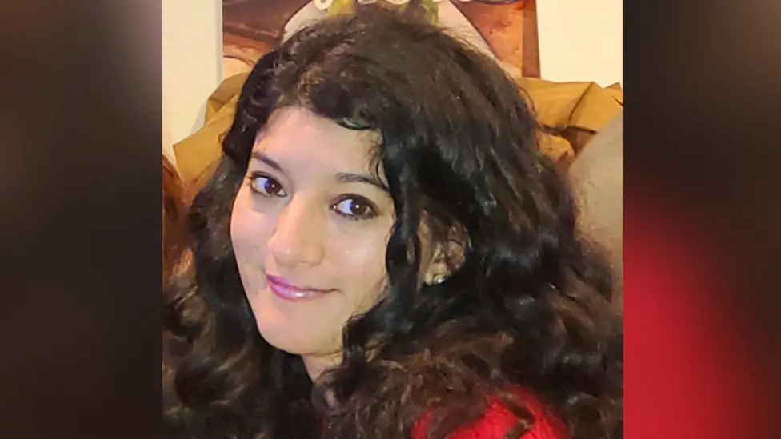
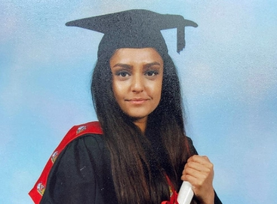
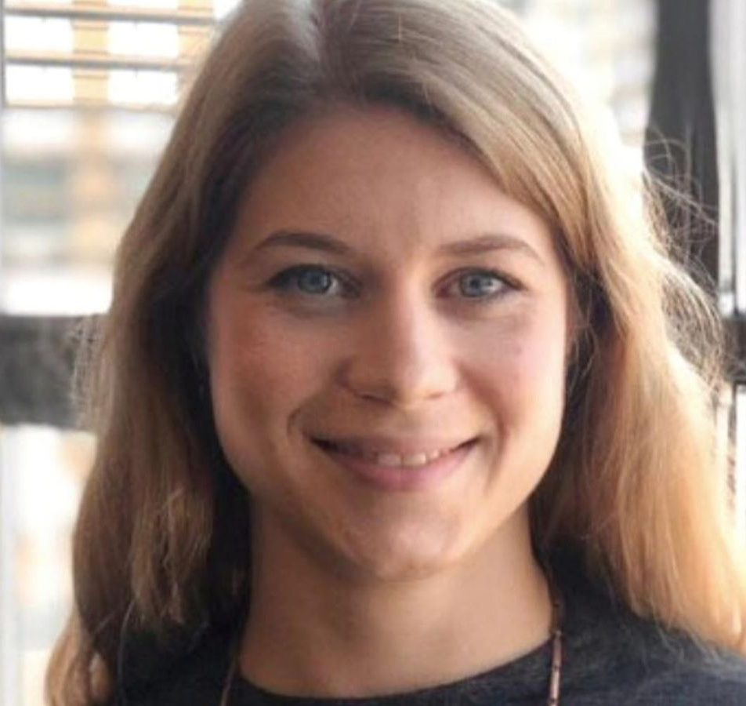
Loss of life in public space Lives cut short by unimaginable cruelty
Zara Aleena
Sarah Everard
Sabina Nessa

Slide 74
Current normalised Prevention Measures
Travel & Movement Safety
Use safe transportation: Book licensed taxis or verified ride services.
Travel with others: Walk or travel with a friend or in a group when possible.
Keep your phone charged.
Carry essentials: Power bank, safety whistle, ID, and emergency contacts.
However, we would like to see this changed by the Commission.

Slide 75
Current normalised Prevention Measures
Personal Belongings & Digital Boundaries
Keep valuables hidden: Keep phones, wallets, and other valuables out of sight.
Protect your bag: Keep it closed and in front of your body.
Set boundaries online and offline: Manage the content you consume, your interactions, and what you share.
Avoid oversharing location details on social media.
Share only necessary information privately or publicly.
However, we would like to see this changed by the Commission.

Slide 76
Current normalised Prevention Measures
Tools, Preparedness & Emergency Planning
Action planning: Know emergency numbers and establish safety words.
Personal Safety: Free tools, Safety alarms, location-sharing apps, and check-in alerts. Let someone know when you arrive home safely.
Identify safe places: Know nearby stores, banks, police stations, and other safe havens.
Self-defence: Learn basic protective skills if accessible.
However, we would like to see this changed by the Commission.

Slide 77
Recommended Prevention Measures
Physical Safety Measures (Community & Environmental)
Provide more street lighting.
Increase police patrols.
Display safety information.
Safety alarms for women.
Design inclusive, non-discriminatory public spaces.
Ensure safe commuting options, including for disabled women and girls.
Tackle drug and alcohol misuse,

Slide 78
Recommended Prevention Measures
Community Education & Social Change
Bystander intervention.
Men and boys to become allies.
Education for all. support education and local initiatives that promote safer, more inclusive environments for women and girls.
Unconscious bias: cultural and religious training to be given to all service providers where and when possible for better delivery of services towards the community

Slide 79
Recommended Prevention Measures
Zero tolerance for abuse of power by individuals in positions of public authority and by service providers
Public authorities must actively work to secure, implement, and transform public spaces for women and girls, in the Best Interest of Society.
Mandatory education and training for those in authority on anti-sexist, anti-misogynistic, and anti-racist organisational practices to address, understand and eradicate sexism, racism, and misogyny, and to promote a positive culture free from all forms of discrimination.
Unconscious bias training to address the realities of gender issues and cultural and religious practices, fostering a society that is inclusive of gender, race and ethnicity.

Slide 80
Community support
Build peer networks and mentorship opportunities.
Support girls and women with special needs or disabilities.
Engage religious and cultural leaders in promoting safety and equality.
Promote education, training, and professional development for women to equip them to face challenges, bias, and harassment.
Encourage community initiatives, advocacy, and the promotion of gender equality.

Slide 81
PROMOTE ACTIVE BYSTANDER INTERVENTION
Continuously include the direct perspectives and lived experiences of women and girls in all planning and decision-making for better understanding and implementation of better outcomes and for them to feel heard rather than telling women to protect themselves.
Ensure diverse female voices shape policies and public space design.
Facilitate access to knowledge, skills, services, and referral networks that are safe and tailored to women and girls.

Slide 82
LEGAL & INSTITUTIONAL
Zero tolerance for harassment and violence.
Trauma-informed emergency response.
Gender-responsive urban planning.
Introduce and prioritise community fund allocation to services, infrastructure, projects and needs for the most marginalised women.
Low-level public authorities should help develop best practices for conducting needs assessments and implementing reform policies and monitor, review and evaluate risk assessment to ensure all requirements are met including for those women and girls from minority backgrounds that are significantly and disproportionately at risk in public spaces.

Slide 83
conclusion
Safety is a human right. Protecting women and girls in public spaces requires public awareness campaigns, community engagement, and the creation of well-designed, well-lit, and well-monitored environments. Ultimately, the goal is to ensure that public spaces are accessible, welcoming, and safe for everyone without exception.

